Slide 1
Preparing for CS472 Labs

Slide 2


Overview
Our lab environment will be using the GNS3 Network Emulator, along with the open source FRRouting software
which we will be using to build our virtual routers and configure them using modern routing algorithms
GNS3 – Commercial Network Emulation Tooling
FRRouting/frr Open Source Implementation of Many Routing Algorithms
https://www.gns3.com/
https://frrouting.org/

Slide 3
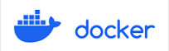
Prerequisites
GNS3 is complex to configure, there is a front-end component with implementations for linux, windows and MacOS, but GNS3 requires a backend component that is Linux only. Therefore to run GNS3 you can either run the entire stack on a linux VM (which is what we will be doing) or figure out how to deploy the backend on a Linux machine / VM and then connect the front end
FRRouting is an open source suite of routing algorithms with a router runtime. Its configuration tooling emulates Cisco tooling, however, it also can be a difficult piece of software to deploy and configure. To overcome this, we will be using a pre-built docker container to emulate a fully functioning router.

Slide 4
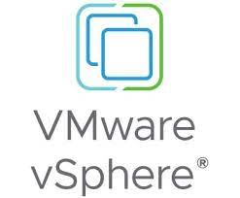

Prerequisites
To simplify the configuration process, I worked with CCI – IT to create pre-built Ubuntu based VMs that are pre-configured with all of the software that we will need. Drexel CCI uses VMWare / vCenter / vSphere software
Drexel CCIs VMWare instance is deployed in such a way that in order to access it you must either be on Drexel’s campus (aka connected to the DragonFly network),
or connected into Drexel over Drexel CCIs VPN that uses Cisco Anywhere Connect tooling.

Slide 5
Helpful Links
https://support.cci.drexel.edu/getting-connected/vpn/
This link takes you to Drexels page with information on how to download, install and configure the Anyconnect VPN tooling (if you don’t already have it installed). Again, to do this lab you will need to connect to VMWare from Drexels campus network or over the VPN if you are remote
https://support.cci.drexel.edu/cci-virtual-lab-resources/vmware-vcenter-or-vsphere/
This link takes you to information on how to access Drexel CCI VMWare resources
https://vcenter.cci.drexel.edu
This link takes you Vcenter to launch and manage your virtual machine

Slide 6
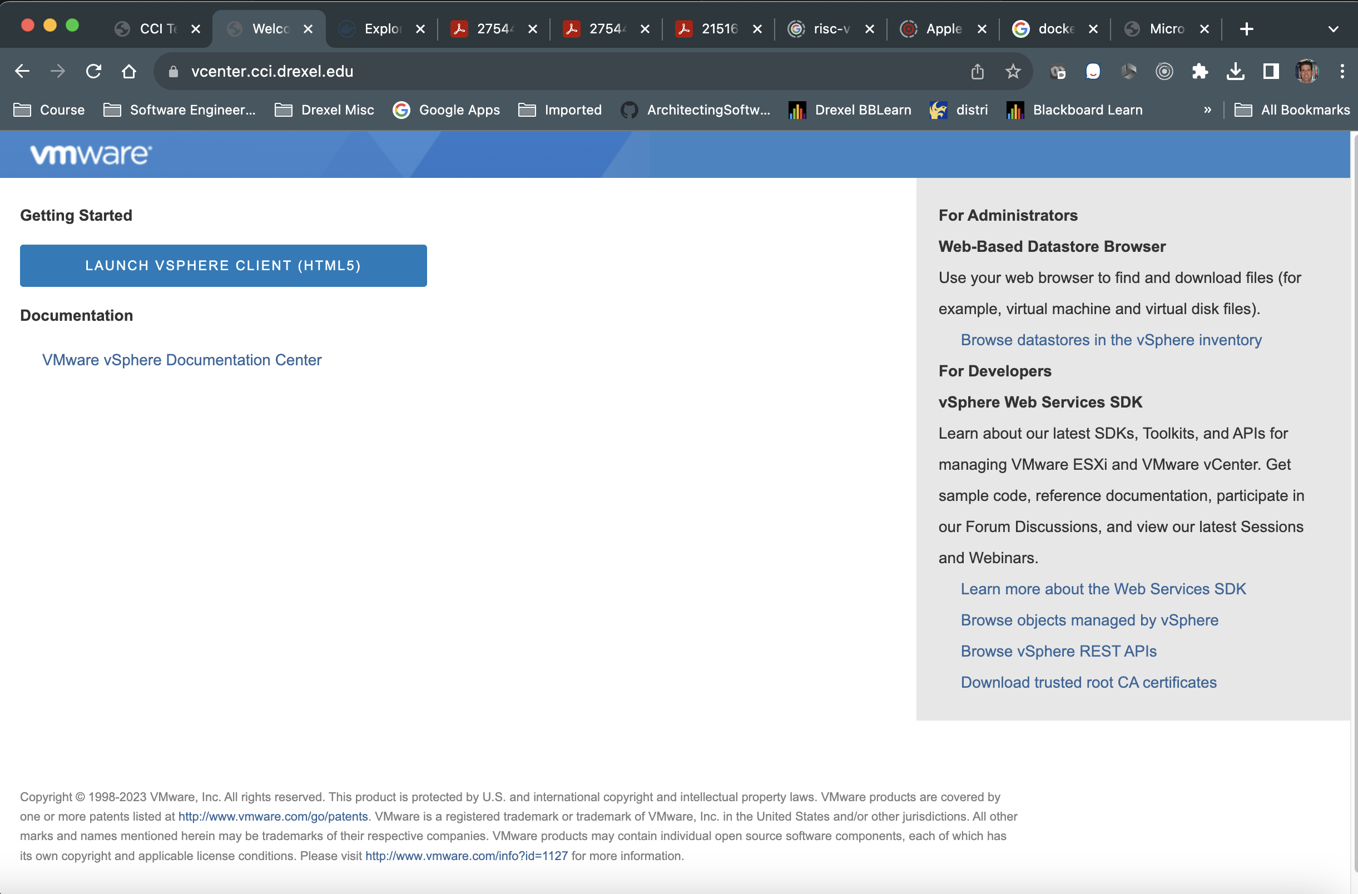
Connecting to your VM
https://vcenter.cci.drexel.edu

Slide 7
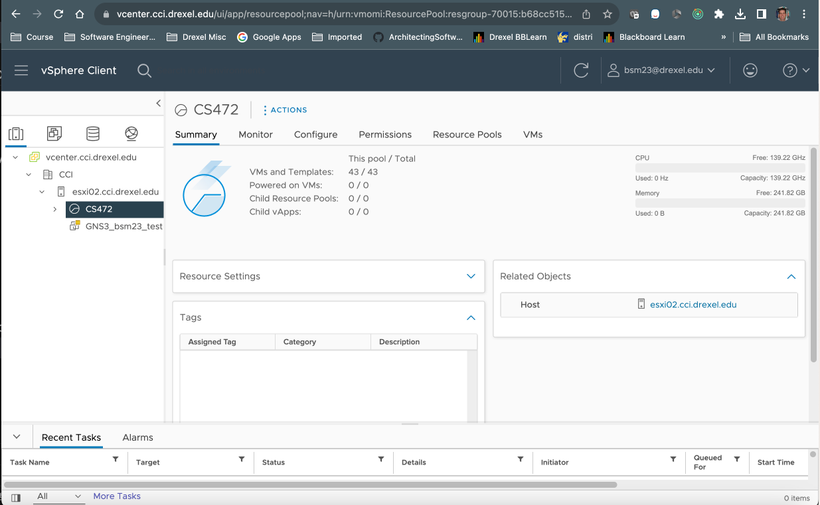
Connecting to your VM
Your VM Should Be Here (Click)

Slide 8
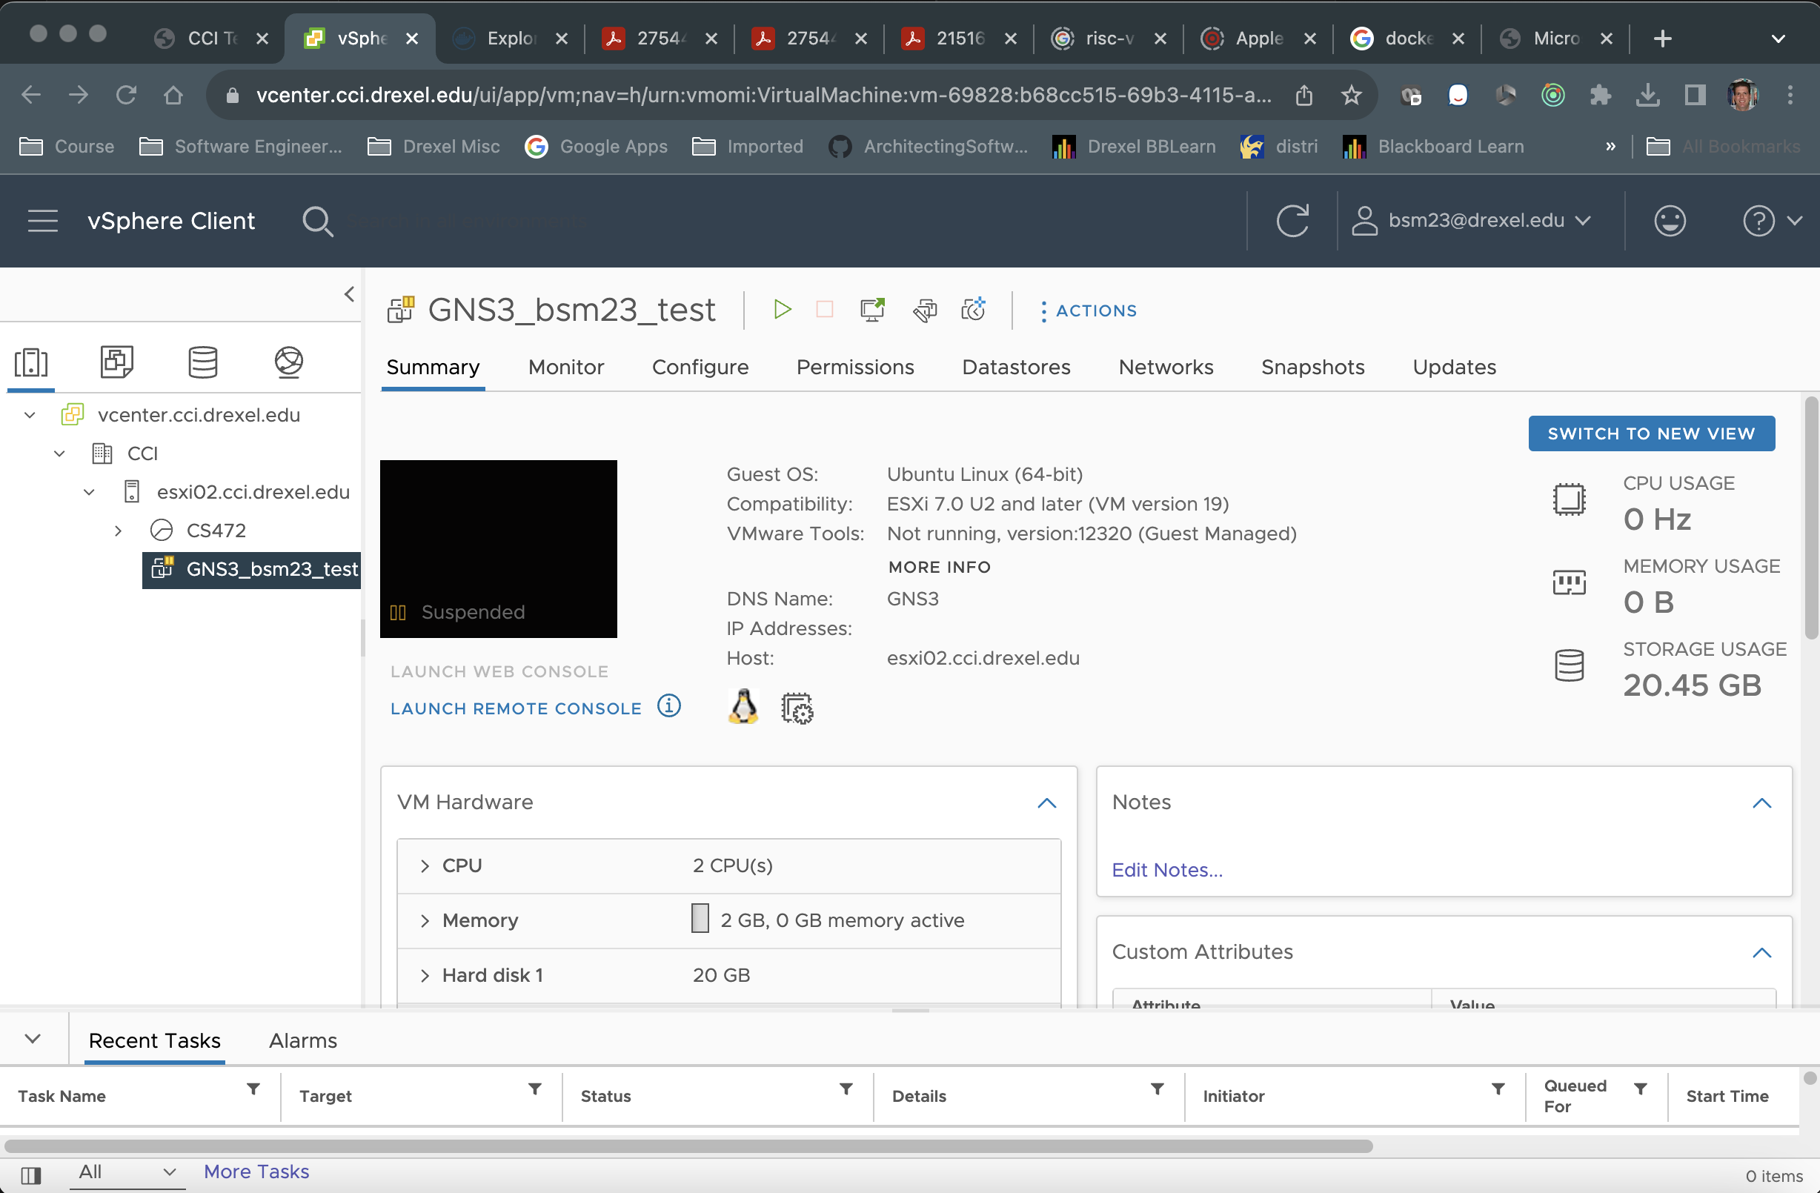
Connecting to your VM – VM Start Page
Start your VM (click)

Slide 9
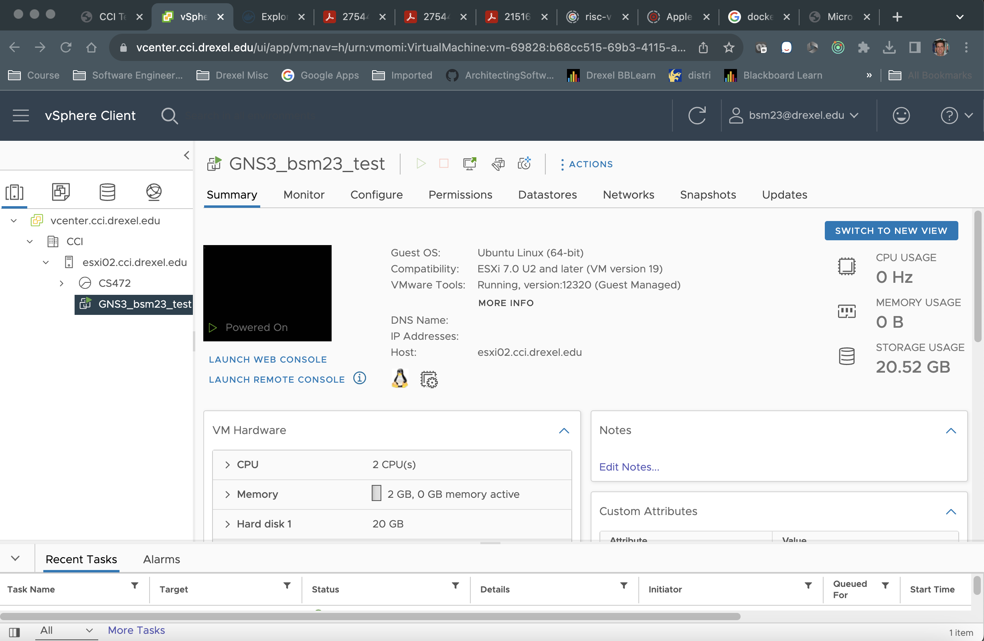
Connecting to your VM – VM Start Page
Start the console (click)

