Slide 1
CS 575: Software Design
More on Modeling
Notes:
TODO
Why search versus other techniques? Reread Bill’s ACDC and Koche’s ICSM01 papers.
Thinking Point 1: Goal is to propose an abstract representation of source code. There is no “correct” answer. Use multiple views – each view provides additional insight into the overall architecture.

Slide 2
Why is the ability to reconstruct an architecture important?
Its important to be able to reconstruct an architecture to reason about its design for a number of reasons…
Program Understanding – we need to make modifications to the system, where would the modifications go, how long would they take, how much would they cost
Explaining the operation of the system to stakeholders – how does the system work, what are its major features, why should you use this system versus a competitors solution
Providing a common document to capture the high-level design of the system that can be used to make important management and technical decisions
Measuring technical health and technical debt – how far does the “as built” system deviate from the “as designed” architecture?

Slide 3
Where to Start? Consider what needs to be modeled!
The hardest part of reconstructing an architecture is selecting what needs to be modeled …
Components – hierarchical description of the major subsystems
Connectors – connections between the components
Interfaces – the protocols governing the connectors, or the properties managed by the clients
Patterns and Styles – are there any interesting patterns or styles used in the architecture that should be documented?
Rationale – reasoning behind decisions of the aspects we chose to model – are they important to stakeholders? are they critical to the understanding of the system?
Constraints – what dependencies don’t we want to have in the solution

Slide 4
Where to Start? Consider what needs to be modeled!
Think about what is important to show to promote an understanding of the architecture…
Static aspects are things that do not change as the system runs, and
Dynamic aspects are things that do change, manage important state, or are sequence dependent
Platform aspects are things where the runtime or deployment decisions play an important part of the architecture – load balancers, proxy servers, etc.

Slide 5
Where to Start? Consider what needs to be modeled!
How do we find things that we want to model…
Look at the code
Source code analysis tools
Class/package structure
Build / configuration management information
Test cases – what is being tested – that must be important
Directory structures
Naming conventions

Slide 6
Where to Start? Consider what needs to be modeled!
How do we find things that we want to model…
What do we know about the system
What are the main features
How are they exposed to the users
Build / configuration management information
Test cases – what is being tested – that must be important
Directory structures
Naming conventions
Non-functional aspects

Slide 7
Think about what story that you want to tell
Think about how you were taught to write stories in elementary school:
Who? Who is your stakeholder or target audience
What? What is the key message you are trying to get across
Why? Why is it important
Where? Where are the most important parts – think scale, security, etc
When? When do key events happen?
How? How does it work?
How Much? How much impact does the system have on an existing landscape?

Slide 8
And the outcome you want to achieve
Why do I create a Model / View:
Drive stakeholder clarity
Making quality / informed decisions
Forcing others to make decisions
Being transparent around the solution – what it is and what it is not
Being opinionated around constraints
Show alignment, and possible misalignment with enterprise or industry standards

Slide 9
Example – What are the major pieces?

Slide 10
Example – What is impacted?

Slide 11
Example - Who needs to weigh in?

Slide 12
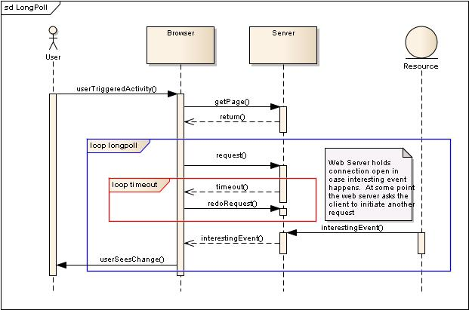
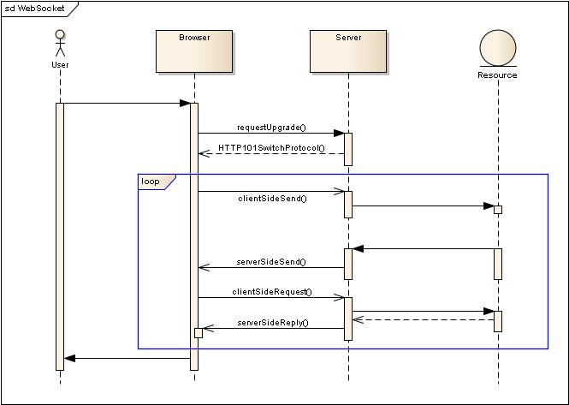
Example – How does it work?

Slide 13
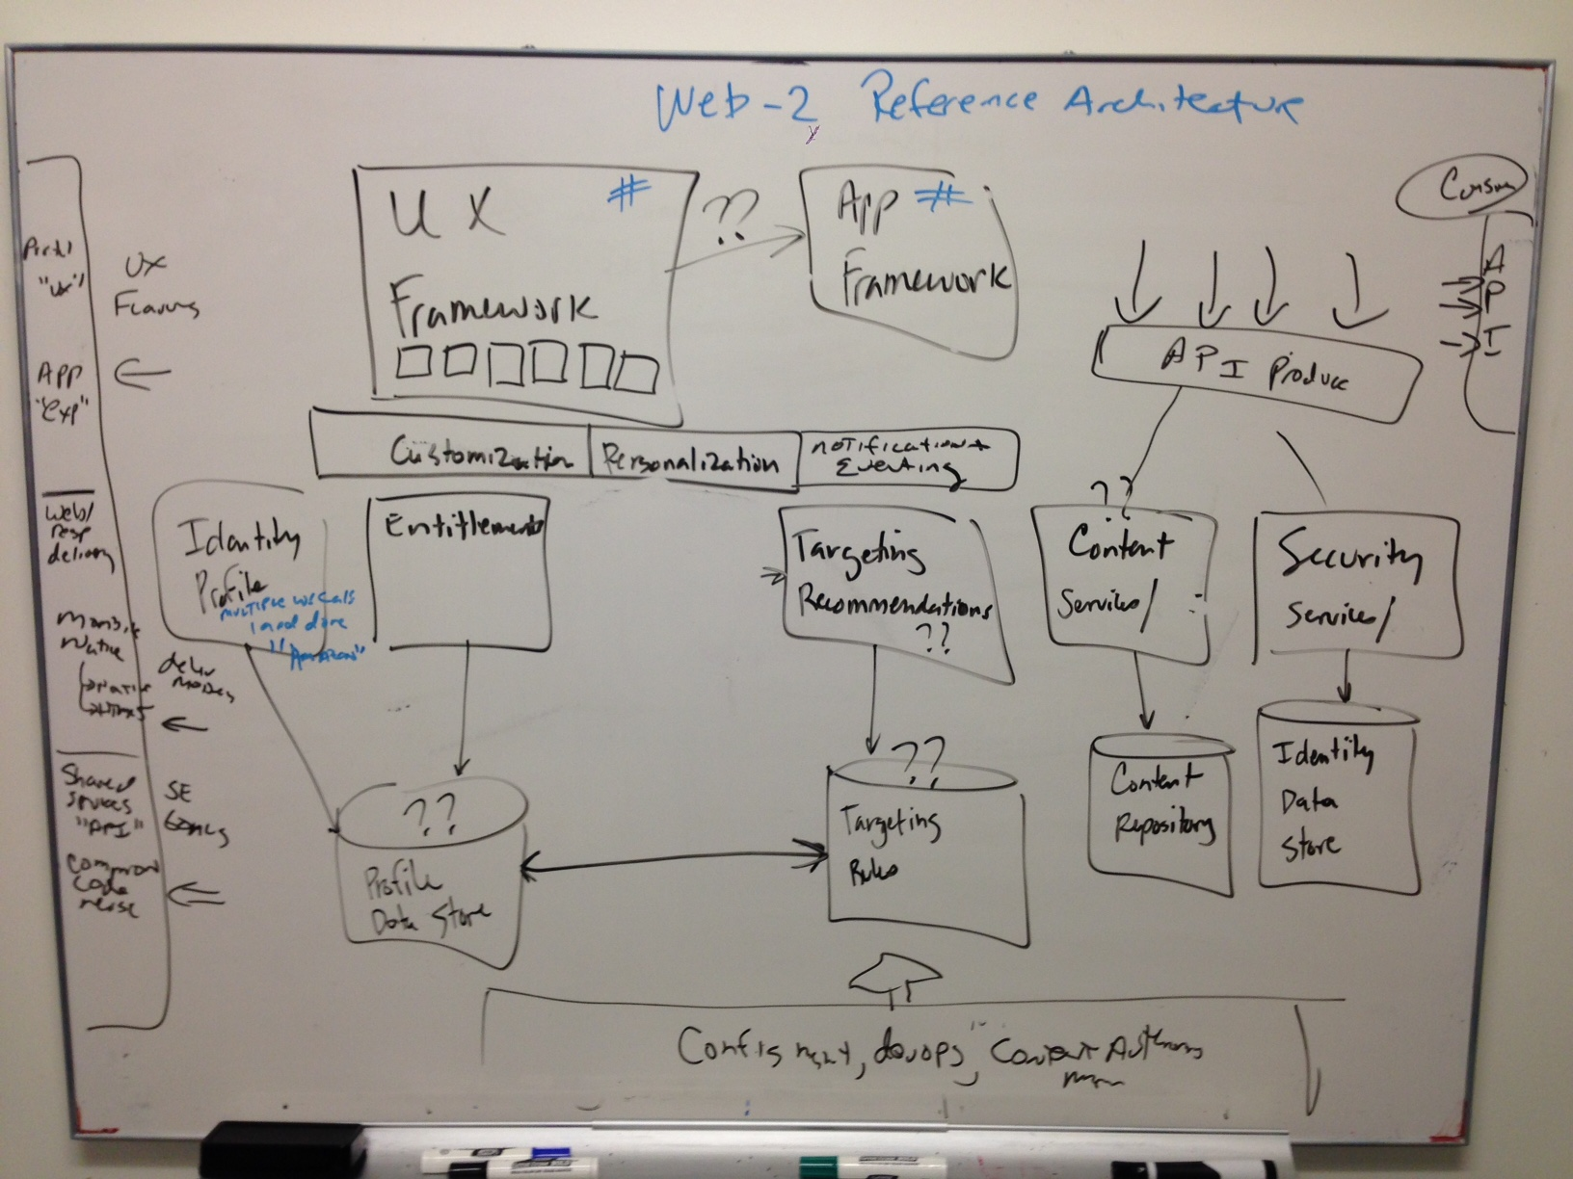
Example – How do we explain what we want to change?

Slide 14
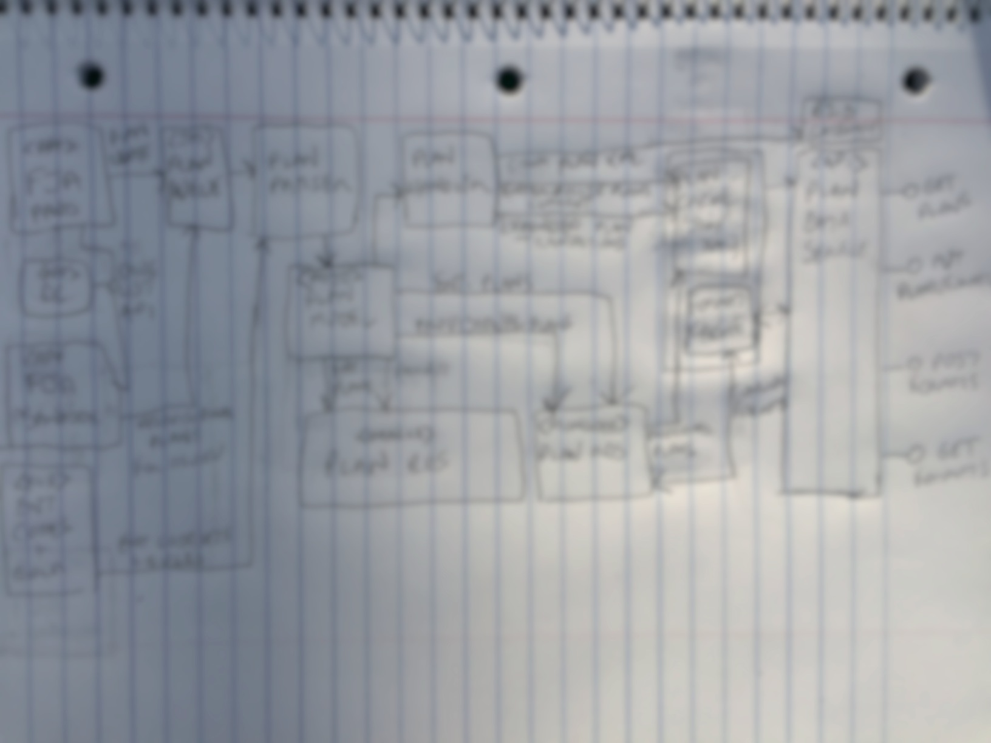
Example – Is this a feasible idea? – (Inspiration during a camping trip…. sorry, blurred on purpose)

Slide 15
Don’t worry about the notation to get started
Architecture and design models can be expressed using
Formal architecture description languages
UML or a variant of UML (Archimate, SysML, SoaML, etc)
Simple lines and boxes
Semiformal models like C4

Slide 16
A Conceptual Process to Get Started
EXPLORE
UNDERSTAND
EVALUATE
MAKE
Source: http://resources.sei.cmu.edu/library/asset-view.cfm?assetid=436496

Slide 17
A Conceptual Process to Get Started
UNDERSTAND
Actively seek information from stakeholders and work to (re)frame the problem.
Source: http://resources.sei.cmu.edu/library/asset-view.cfm?assetid=436496

Slide 18
A Conceptual Process to Get Started
EXPLORE
Use generative thinking to identify design concepts and engineering approaches.
Source: http://resources.sei.cmu.edu/library/asset-view.cfm?assetid=436496

Slide 19
A Conceptual Process to Get Started
Realize design concepts by creating them in the real world as a model, prototype, program, or other artifact.
MAKE
Source: http://resources.sei.cmu.edu/library/asset-view.cfm?assetid=436496

Slide 20
A Conceptual Process to Get Started
Determine the fitness of design decisions and decide whether to revisit other modes.
EVALUATE
Source: http://resources.sei.cmu.edu/library/asset-view.cfm?assetid=436496

Slide 21
Types of architecture models / views
Reference Architecture – Provides a view across a particular domain or problem space
Solution Architecture – Provide an understandable picture of the overall purpose of the proposed solution. Focus on the right level of abstraction
Physical Architecture – Shows physical components such as servers, firewalls, network equipment, storage engines, etc. Generally captures location and function – ie “A Web Server”

Slide 22
Some best practices for modeling architectures from Simon Brown
YouTube
https://www.youtube.com/watch?v=x2-rSnhpw0g
Companion Material
https://architectis.je/
A copy of Simon’s visualizing materials is also under the /Misc directory of the course materials on GitHub

