Slide 1
CS 575: Software Design
Introduction to Software Architecture
Notes:
TODO
Why search versus other techniques? Reread Bill’s ACDC and Koche’s ICSM01 papers.
Thinking Point 1: Goal is to propose an abstract representation of source code. There is no “correct” answer. Use multiple views – each view provides additional insight into the overall architecture.

Slide 2
Software Design
A software design is a precise description of a system, using a variety of different perspectives…
Structural
Packaging
Requirements,
Test/Validation Criteria
Behavioral
Infrastructure

Slide 3
Expressing A Software Design
Software Designs are complicated, therefore, they must be modeled…
Similar to an architects blueprint
A model is an abstraction of the underlying problem
Designs should be modeled, and expressed as a series of views
Helpful to use a modeling language such as UML

Slide 4
Modeling as a Design Technique
Designs are too complicated to develop from scratch
Good designs tend to be build using models…
1) Abstract different views of the system
2) Build models using precise notations (e.g., UML)
3) Verify that the models satisfy the requirements
4) Gradually add details to transform the models into the design

Slide 5
Modeling as a Design Technique
Lets Build this System…
Models
Incremental Refinement
Design
Lets Start Building this System…

Slide 6
Modeling as a Design Technique – Reality is we rarely start from scratch these days
Lets Build this System…
Models
Frameworks, Patterns, Templates, etc.
Incremental Refinement
Design
Lets Start Building this System…

Slide 7
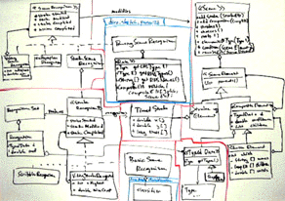
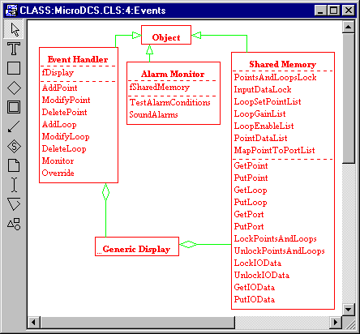


Modeling Designs…
Design
Designing With Models
Model
Repository
Very
Complicated
To Understand
Modeling Tool
Visualization

Slide 8

UML – A modeling Notation for Design
Structural
Packaging/Implementation
Class Diagrams
Package Diagrams
Component Diagrams
Requirements,
Test/Validation Criteria
Behavioral
Infrastructure/ Environment
Use Cases
Sequence Diagrams Collaboration Diagrams
Statechart Diagrams Activity Diagrams
Deployment Diagrams

Slide 9
Software Architecture
According to Shaw and Garlan… The Software Architecture of a system consists of a description of the system elements, interactions between the system elements, patterns that guide the system elements, and constraints on the relationships between system elements.
Its a more abstract view of the design
Its helpful for communication and complexity management

Slide 10
Software Architecture
SEI Definition… The software architecture of a program or computing system is the structure or structures of the system, which comprise software components, the externally visible properties of those components, and the relationships among them.
[Bass, Clements & Kazman, “Software Architecture in Practice”, 1998]
Problem: There is no standard definition – see http://www.sei.cmu.edu/architecture/definitions.html

Slide 11
The Software Architecture “Stack”
Software Architecture
Subsystem Decomposition
Subsystem Dependencies
Subsystem Interfaces
Module/Class Decompositions
Module/Class Dependencies
Module/Class Interfaces
Data Structures
Algorithms

Slide 12
The Software Architecture “Stack”
Software Architecture
High-Level (Abstract) Design
Subsystem Decomposition
Subsystem Dependencies
Subsystem Interfaces
Module/Class Decompositions
Low-Level (Detailed) Design
Module/Class Dependencies
Module/Class Interfaces
Data Structures
Algorithms

Slide 13
Why do we design…
A software design is not necessary for trivial systems, but for large systems a design is essential
Manage complexity
Validation of delivered software
Simplify future maintenance
A mechanism for communication between domain experts and technical professionals
Enables Visualization
Enables project team members to work concurrently
Partitioning the work effort with limited overlap
Example: Concurrently developing test cases while the code is being development

Slide 14
Why is design so hard…
Software design can’t be taught, but principles of good design can
There are degrees of good and bad design, but its hard to say if a design is correct or not
The underlying assumptions and requirements that support the design change
A design is like wine, it takes a long time to see if it is good or not

Slide 15
The Process of Design
Definition:
Design is a problem-solving process whose objective is to find and describe a way:
To implement the system’s functional requirements...
While respecting the constraints imposed by the quality, platform and process requirements...
including the budget
And while adhering to general principles of good quality

Slide 16
Design as a series of decisions
A designer is faced with a series of design issues
These are sub-problems of the overall design problem.
Each issue normally has several alternative solutions:
design options.
The designer makes a design decision to resolve each issue.
This process involves choosing the best option from among the alternatives.

Slide 17
Making decisions
To make each design decision, the software engineer uses:
Knowledge of
the requirements
the design as created so far
the technology available
software design principles and ‘best practices’
what has worked well in the past

Slide 18
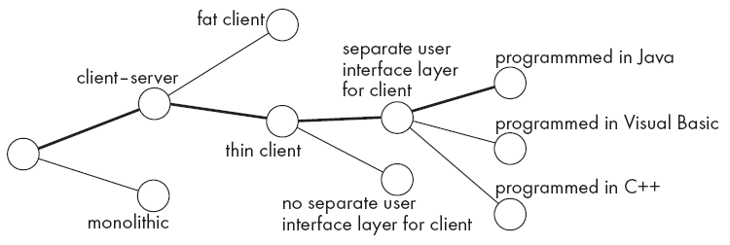
Design space
The space of possible designs that could be achieved by choosing different sets of alternatives is often called the design space
For example:

Slide 19
Component
Any piece of software or hardware that has a clear role.
A component can be isolated, allowing you to replace it with a different component that has equivalent functionality.
Many components are designed to be reusable.
Conversely, others perform special-purpose functions.

Slide 20
Module
A component that is defined at the programming language level
For example, methods, classes and packages are modules in Java.

Slide 21
System
A logical entity, having a set of definable responsibilities or objectives, and consisting of hardware, software or both.
A system can have a specification which is then implemented by a collection of components.
A system continues to exist, even if its components are changed or replaced.
The goal of requirements analysis is to determine the responsibilities of a system.
Subsystem:
A system that is part of a larger system, and which has a definite interface

Slide 22
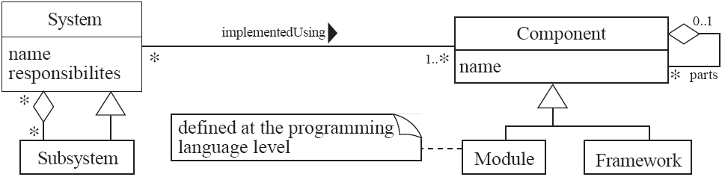
UML diagram of system parts

Slide 23
Different aspects of design
Software architecture :
The division into subsystems and components,
How these will be connected.
How they will interact.
Their interfaces.
Class design:
The various features of classes.
User interface design
Algorithm design:
The design of computational mechanisms.
Protocol design:
The design of communications protocol.

Slide 24
9.2 Principles Leading to Good Design
Overall goals of good design:
Increasing profit / reducing cost / increasing revenue
Ensuring that we actually conform with the requirements
Accelerating development
Increasing qualities such as
Usability
Efficiency
Reliability
Maintainability
Reusability

Slide 25
Design Principle 1: Divide and conquer
Trying to deal with something big all at once is normally much harder than dealing with a series of smaller things
Separate people can work on each part.
An individual software engineer can specialize.
Each individual component is smaller, and therefore easier to understand.
Parts can be replaced or changed without having to replace or extensively change other parts.

Slide 26
Ways of dividing a software system
A distributed system is divided up into clients and servers
A system is divided up into subsystems
A subsystem can be divided up into one or more packages
A package is divided up into classes
A class is divided up into methods
Try to promote hierarchies

Slide 27
Design Principle 2: Increase cohesion where possible
A subsystem or module has high cohesion if it keeps together things that are related to each other, and keeps out other things
This makes the system as a whole easier to understand and change
Type of cohesion:
Functional, Layer, Communicational, Sequential, Procedural, Temporal, Utility

Slide 28
Design Principle 2: Increase cohesion where possible
Functional | Keeps all code that computes a particular result together
Layer | Facilities for accessing related services are kept together. Hierarchical, you can access layers below but not above
Communicational | Modules that access or manipulate certain data are kept together
Sequential and Procedural | Procedures where one provides input to the next are kept together in a common module. Also procedures that are used one after the next are kept together
Temporal | Operations that are performed at the same phase of execution are kept together (e.g., Initialization)
Utility | Keep related semantic things together, e.g., java.lang.math

Slide 29
Design Principle 3: Reduce coupling where possible
Coupling occurs when there are interdependencies between one module and another
When interdependencies exist, changes in one place will require changes somewhere else.
A network of interdependencies makes it hard to see at a glance how some component works.
Type of coupling:
Content, Common, Control, Stamp, Data, Routine Call, Type use, Inclusion/Import, External

Slide 30
Design Principle 2: Reduce coupling where possible
Content | One module modifies internal data of another module
Common | Coupling based on a global variable
Control | Parameter is passed as an argument that controls the behavior of the callee, e.g, (“CustomerArrived” passed as an arg that is then processed by a switch statement
Stamp | Using custom types as arguments to a method or function. Couples class dependencies – very common in OO languages
Routine | When one method calls a method in another class or package
Type use | When one module uses a type defined in another module
Inclusion / Import | When one module imports another module
External | When a module has an external dependency on things like an operating system, shared library or hardware

Slide 31
Design Principle 4: Increase abstraction
Ensure that your designs allow you to hide or defer consideration of details, thus reducing complexity
A good abstraction is said to provide information hiding
Abstractions allow you to understand the essence of a subsystem without having to know unnecessary details
Examples of abstractions:
Classes
UML associations
Interfaces
State machines
Domain specific languages (DSLs)

Slide 32
Design Principle 5: Increase reusability where possible
Design the various aspects of your system so that they can be used again in other contexts
Generalize your design as much as possible
Follow the preceding three design principles
Design your system to contain hooks
Simplify your design as much as possible

Slide 33
Design Principle 6: Reuse where possible
Design with reuse is complementary to design for reusability
Actively reusing designs or code allows you to take advantage of the investment you or others have made in reusable components
Cloning should not be seen as a form of reuse

Slide 34
Design Principle 7: Design for flexibility
Actively anticipate changes that a design may have to undergo in the future, and prepare for them
Reduce coupling and increase cohesion
Create abstractions
Do not hard-code anything
Leave all options open
Do not restrict the options of people who have to modify the system later
Use reusable code and make code reusable

Slide 35
Design Principle 8: Anticipate obsolescence
Plan for changes in the technology or environment so the software will continue to run or can be easily changed
Avoid using early releases of technology
Avoid using software libraries that are specific to particular environments
Avoid using undocumented features or little-used features of software libraries
Avoid using software or special hardware from companies that are less likely to provide long-term support
Use standard languages and technologies that are supported by multiple vendors

Slide 36
Design Principle 9: Design for Portability
Have the software run on as many platforms as possible
Avoid the use of facilities that are specific to one particular environment
E.g. a library only available in Microsoft Windows

Slide 37
Design Principle 10: Design for Testability
Take steps to make testing easier
Design a program to automatically test the software
Discussed more in Chapter 10
Ensure that all the functionality of the code can by driven by an external program, bypassing a graphical user interface
In Java, you can create a main() method in each class in order to exercise the other methods
Use Junit or similar frameworks

Slide 38
Design Principle 11: Design defensively
Never trust how others will try to use a component you are designing
Handle all cases where other code might attempt to use your component inappropriately
Check that all of the inputs to your component are valid: the preconditions
Unfortunately, over-zealous defensive design can result in unnecessarily repetitive checking

Slide 39
Example: SOLID Design Principles
From WikiPedia - http://en.wikipedia.org/wiki/SOLID_(object-oriented_design)
Initial | Principle
S | Single responsibility principle a class should have only a single responsibility (i.e. only one potential change in the software's specification should be able to affect the specification of the class)
O | Open/closed principle “software entities … should be open for extension, but closed for modification.”
L | Liskov substitution principle “objects in a program should be replaceable with instances of their subtypes without altering the correctness of that program.” See also design by contract.
I | interface segregation principle “many client-specific interfaces are better than one general-purpose interface.”
D | Dependency inversion principle one should “Depend upon Abstractions. Do not depend upon concretions.” Dependency injection is one method of following this principle.

Slide 40
Is Software Design a Wicked Problem…
Types of Problems:
Simple problems: Both the problem and the solution are known
Complex problems: The problem is known but the solution is not.
Wicked Problem: Neither the problem or solution is known
So is software design a Wicked Problem?

Slide 41
What is a Wicked Problem?
Characteristics of Wicked Problems:
The understanding of the problem is driven by the formulation of a (proposed) solution
There is no stopping rule – you will never know when the perfect solution is defined
You can only tell that a solution “is good enough”
You can only tell that a solution is successful after it is built

Slide 42
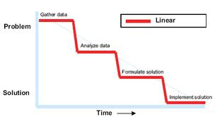
Is Software Design a Wicked Problem…
The intuitive way to solve a problem is to follow an orderly flow from problem definition to solution formulation

Slide 43
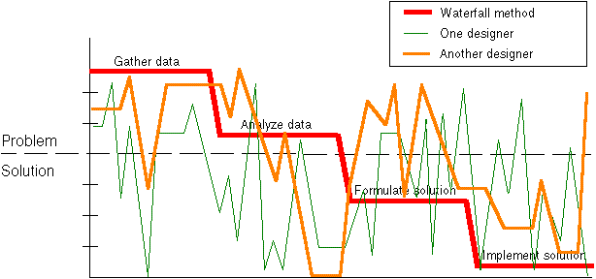
Is Software Design a Wicked Problem…
When faced with complex problems humans tend to jump from the problem to the solution space, using their intuition in the problem domain, do validation in the solution domain, that then drives further intuition…

Slide 44
Dealing with Wicked Problems
Techniques to deal with Wicked Problems:
Lock down the problem domain
Specify objective measures to measure the success of a solution
Give up on the notion that there is a “perfect” solution, and focus on what would be a “good enough solution”
Balance what is needed with what can be built given the constraints of solving the problem

Slide 45
Complex/Wicked Problems in Software Engineering
Software Development Methodologies help manage the complexity of designing and building complex systems
Brings structure to answering questions such as:
What does the software need to do
How long will the software take to construct
How much investment will constructing the software take
What are the technical constraints associated with building the software
And So On…

Slide 46
Wicked Problems and Ultra-Large Scale Systems
In 2006, SEI Introduced the term Ultra-Large Scale Systems, these systems:
Have decentralized data, development, evolution and operational control
Address inherently conflicting, unknowable, and diverse requirements
Evolve continuously while it is operating, with different capabilities being deployed and removed
Contain heterogeneous, inconsistent and changing elements
Erode the people system boundary. People will not just be users, but elements of the system and affecting its overall emergent behavior.
Encounter failure as the norm, rather than the exception, with it being extremely unlikely that all components are functioning at any one time
Require new paradigms for acquisition and policy, and new methods for control

Slide 47
Characteristics of Ultra-Large Scale Systems
A ULS System has unprecedented scale in some of these dimensions:
lines of code
amount of data stored, accessed, manipulated, and refined
number of connections and interdependencies
number of hardware elements
number of computational elements
number of system purposes and user perception of these purposes
number of routine processes, interactions, and “emergent behaviors”
number of (overlapping) policy domains and enforceable mechanisms
number of people involved in some way

Slide 48
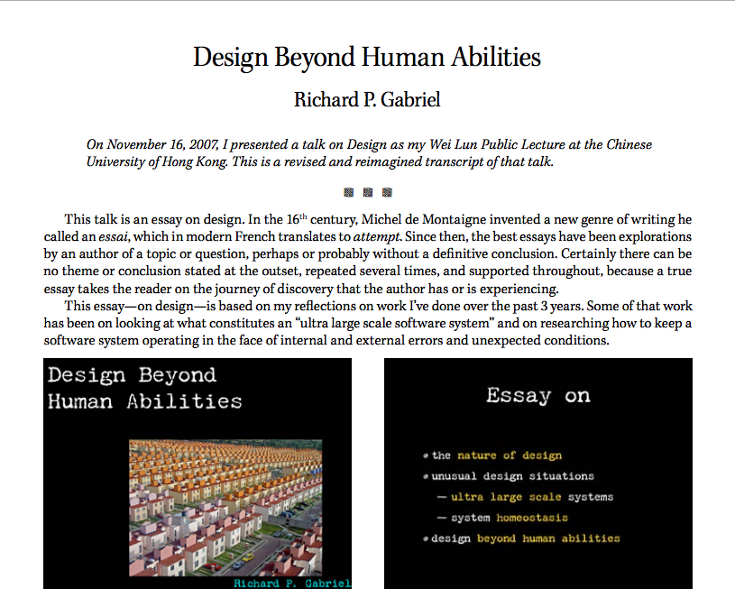
Designing beyond Human Ability
https://dreamsongs.com/Files/DesignBeyondHumanAbilitiesSimp.pdf

Slide 49
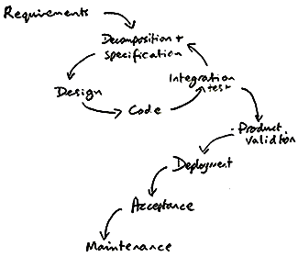
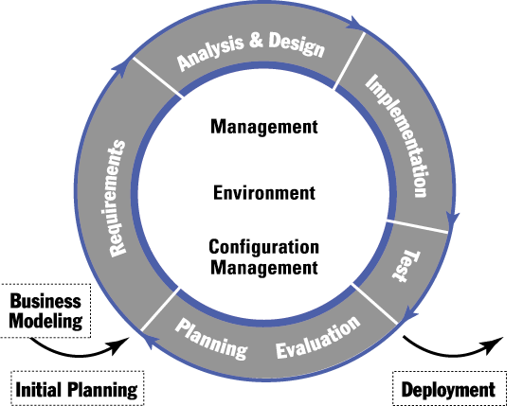
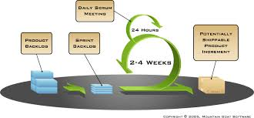
Design Methodologies- Dealing with Complexity
Waterfall
Iterative
Agile/Scrum

Slide 50
Software Development Methodology
A Methodology is:
A Process
What happens over time
Coupled to the Software Development Lifecycle (SDLC)
A Management Approach
What is needed to move from one step to another
Helps with the project management aspects of a software development project

Slide 51
Modeling Emphasis for Different Design Approaches
Data
Object Oriented
Component Oriented
Structure
Traditional/ Structured
Function

Slide 52
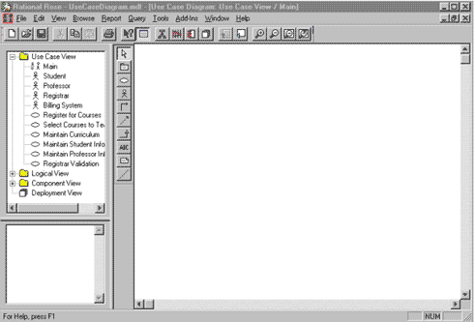
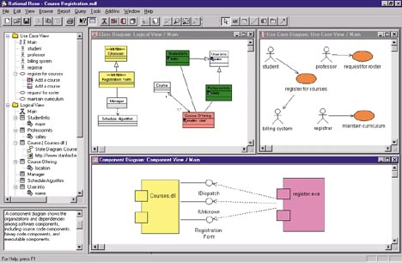
Jumpstarting Design
?
Starting from scratch “blank screen” is tough. Components of a design toolbox – Templates, Patterns, Reference Architectures, Frameworks, and so on…

Slide 53
Back to Architecture
The previous definitions presented focus on the vocabulary of architecture components
Terms used: Components, Connectors, Structures, and so on.
I like to think about architecture in terms of laying out the foundation for design
What design decisions do we need to make, and/or what structures do we need to document in order to realize all of the constraints imposed on the system
Constraints typically come from the non-functional requirements – time to market, budget, technology standards, skillsets, etc
Good architecture makes important decisions early and defers less-important decisions to later
Do we really need to pick the database technology up front?
How much should the fact that the system is web-based influence the overall design, can we abstract this for now and specify it later?

Slide 54
Architecture and Design Patterns
Architecture Style
Defines the vocabulary of the components and connectors in a software architecture and the constraints on how they can be combined.
Example: Pipe and Filter
Architecture Patterns
Focus is on the organization of the overall system
An instance of an architecture style
Design Patterns
Focus is on the organization of a block of code

Slide 55
Architecture Styles
Architecture Styles Define and Constrain the:
The components of the solution
What are the major computational units of the solution
Eg., Security, Data Access, Protocol Handling, …
The connectors of the solution
How are the interactions between the components realized
Eg., procedure calls, network calls, events, broadcasts, …
The properties of the solution
What are the quality attributes and non-functional requirements
Eg., pre/post conditions, availability specifications, interface semantics, …

Slide 56
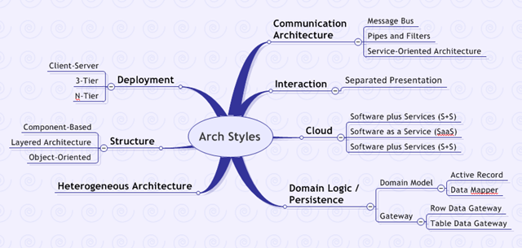
Architecture Styles are generally categorized and can be specialized

Slide 57
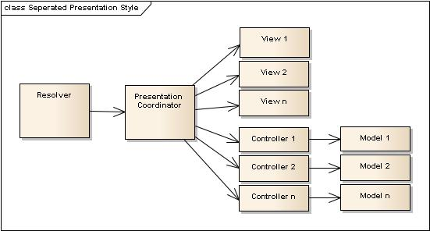
Example Architecture Style: Layered Style
Suitable for applications that involve distinct classes of services that can be organized hierarchically.
Each layer provides service to the layer above it and serves as a client to the layer below it.
Only carefully selected procedures from the inner layers are made available (exported) to their adjacent outer layer.

Slide 58
Architecture Patterns
Architecture Patterns can be thought of an instance of an architecture style that defines the specific components, connectors, and properties used to describe the overall architecture of a (sub)system
Generally architecture patterns have a generic description and one or more specializations

Slide 59
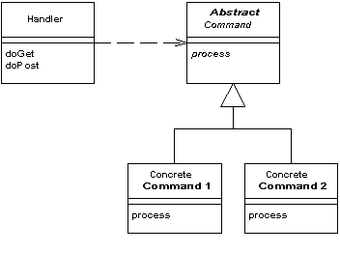
Example Architecture Pattern: Generic Front Controller Pattern
From: http://www.martinfowler.com/eaaCatalog/frontController.html
In a complex Web site there are many similar things you need to do when handling a request. These things include security, internationalization, and providing particular views for certain users. If the input controller behavior is scattered across multiple objects, much of this behavior can end up duplicated. Also, it's difficult to change behavior at runtime.
The Front Controller consolidates all request handling by channeling requests through a single handler object. This object can carry out common behavior, which can be modified at runtime with decorators. The handler then dispatches to command objects for behavior particular to a request.

Slide 60
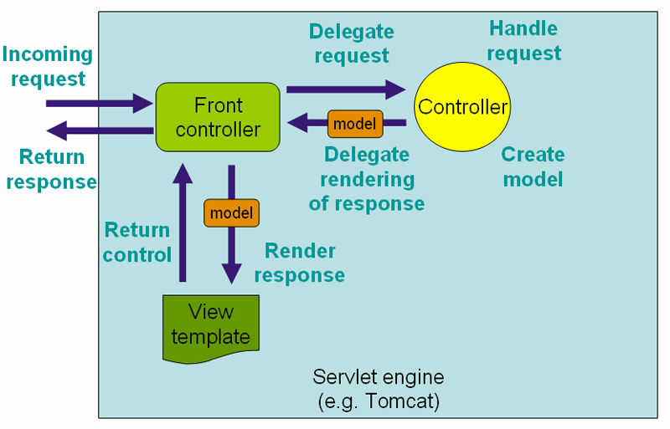
Example: Front Controller Pattern for a Web Application
Using the Front Controller Pattern to Modularize Web Applications (e.g., Spring Framework)

Slide 61
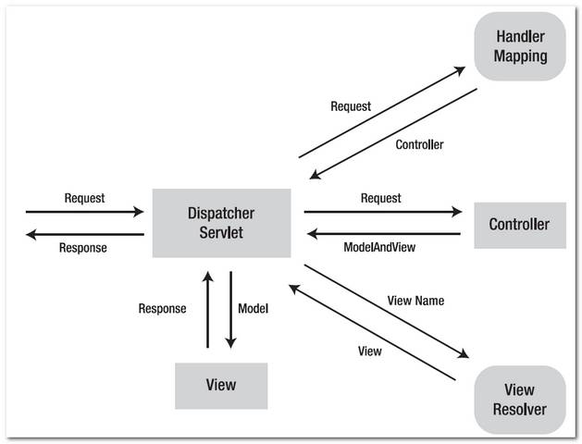
Example Front Controller: Spring MVC Framework

Slide 62
Design Patterns
Design Patterns can be thought of as building blocks of an architecture pattern that defines the specific code-level components and connectors used to implement the architecture pattern
An architecture pattern tends to be realized through one or more design patterns

Slide 63
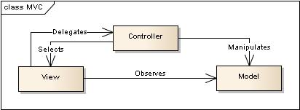
Is our MVC pattern or its specialization Front Controller a Design Pattern?
People have different opinions, but mine is NO, MVC and its derivatives are not sufficient to structure a software design

Slide 64
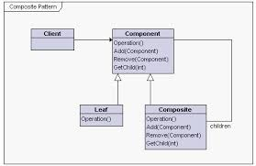
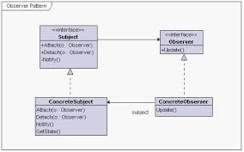
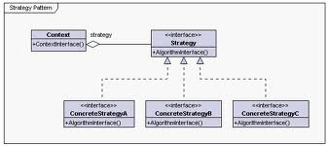
Design Patterns for MVC
MVC ?= Observer+Strategy+Composite Pattern
Observer: Have central object notify other objects of changes that they are interested in observing
Composite: Treat tree-like structures uniformly…
Strategy: Abstraction to allow behavior to be selected at runtime

Slide 65
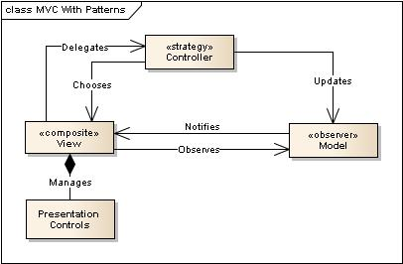
Using Design Patterns to Realize an Architecture Pattern?
Model uses an Observer pattern to notify the view of changes
Controller uses a Strategy pattern to manage which view should be rendered
View uses a Composite pattern to manage the hierarchy of presentation controls
Note that MVC can be implemented using other design patterns as well, this is just a sensible representation to show one way that this can be accomplished

Slide 66
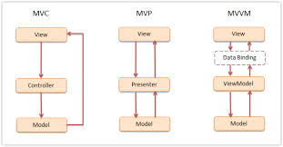
MVC Variations – Like Most Patterns MVC has Specializations
Controller facilitates
Binding the model to the view
Presenter proxies the model for the view
ViewModel binds to one or more views. Generally data binding is bi-directional

Slide 67
Patterns
Architecture styles define a vocabulary for the overall software architecture (and can be specialized)
Architecture patterns define the components and connectors used to organize the software architecture (and can be specialized)
Design patterns define the code-level assets and their associations.
Architecture Styles
Architecture Pattern
Architecture Pattern
Design Pattern
Design Pattern
Design Pattern
Design Pattern
Design Pattern

Slide 68
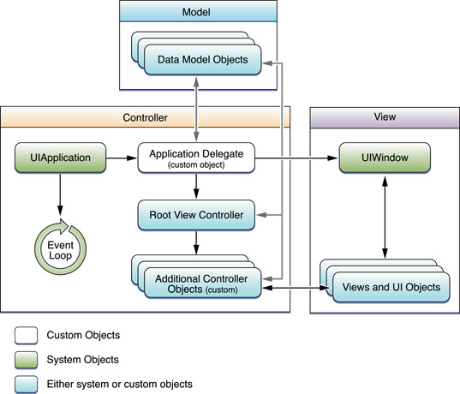
Example: IOS Cocoa Framework MVC

Slide 69
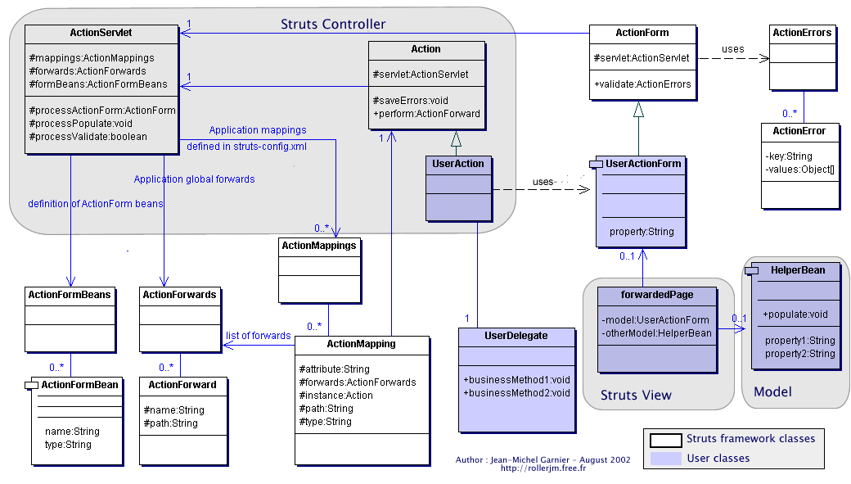
Example: Jakarta Struts Presentation Framework – A Design of an MVC

Slide 70
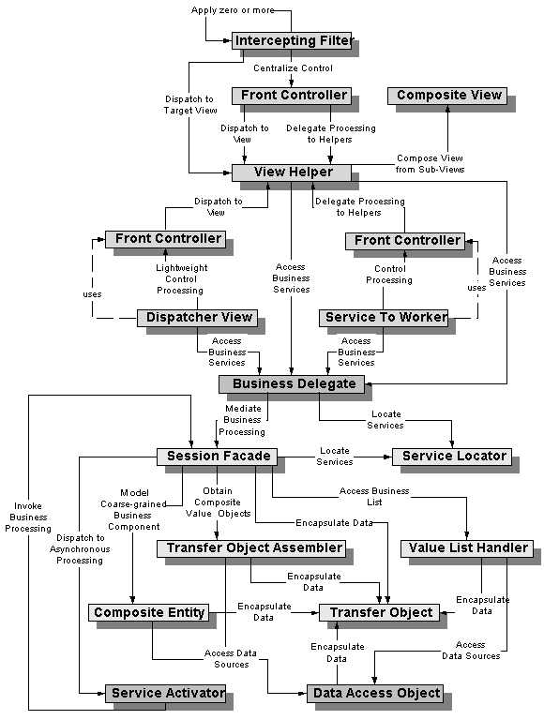
Example: J2EE Architecture Patterns
Source:
http://java.sun.com/ blueprints/ corej2eepatterns/Patterns/

Slide 71
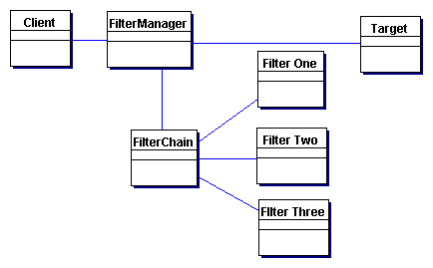
Example: Intercepting Filter Pattern Architectural Pattern
Problem: Preprocessing and post-processing of a client Web request and response are required
When a request enters a Web application, it often must pass several entrance tests prior to the main processing stage:
Has the client been authenticated?
Does the client have a valid session?
Is the client's IP address from a trusted network?
Does the request path violate any constraints?
What encoding does the client use to send the data?
Do we support the browser type of the client?
The key to solving this problem in a flexible and unobtrusive manner is to have a simple mechanism for adding and removing processing components, in which each component completes a specific filtering action.

Slide 72
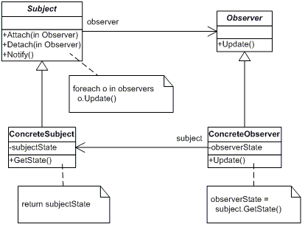
Design Patterns
Example: Observer Pattern
Define a one-to-many dependency between objects so that when one object changes state, all its dependents are notified and updated automatically
Note: Design pattern references often include sample code in a variety of languages to illustrate how to use the pattern.

Slide 73
What’s good about Patterns
They solve common problems in a “proven” way
They tend not to be implementation specific
They tend to be classified in a common way – context, forces, examples, etc
They embody good design principles
Example: Loose Coupling

Slide 74
Design Quality
Software design “quality”, as with other ideas on quality, is an elusive concept:
It depends on priorities of your company and the customers:
fastest to implement
easiest to implement
easiest to maintain, “evolve”, port
most efficient/reliable/robust end-product.

Slide 75
How to “Fix” A Software Design
Many times the source code is the only up-to-date documentation for a software system
Must be able to recover the design to some extent
Must be able to “improve” the design where appropriate

Slide 76

Improving Existing Designs - Refactoring
See Martin Fowler’s Book
What is Refactoring:
Refactoring is a technique to restructure code in a disciplined way
Used to improve a system design in any number of ways
Pattern/Template based process
Automated tools exist
Refactoring is a behavior preserving transformation of the source code…

Slide 77
Example: Refactoring – PushDown Method
Before
After
Bill
Bill
+setName() +getAddress()
…
+send()
+setName() +getAddress()
…
#send()
Note: There are many ways to do this type of refactoring – this is just one example.
EBill
MailBill
+send()
+send()

Slide 78
Anti-Patterns (plus Refactoring)
AntiPatterns are Negative Solutions that present more problems than they address
AntiPatterns are a natural extension to design patterns
AntiPatterns bridge the gap between architectural concepts and real-world implementations.
Understanding AntiPatterns provides the knowledge to prevent or recover from them
Recovery can be via Refactoring
From: www.antipatterns.com

Slide 79
Antipattern Example: Poltergeists
Proliferation of classes [Riel 96]
Spurious classes and associations
Stateless, short-lifecycle classes
Classes with few responsibilities
Transient associations
Excessive complexity
Unstable analysis and design models
Analysis paralysis
Divergent design and implementation
Poor system performance
Lack of system extensibility
From: www.antipatterns.com

Slide 80
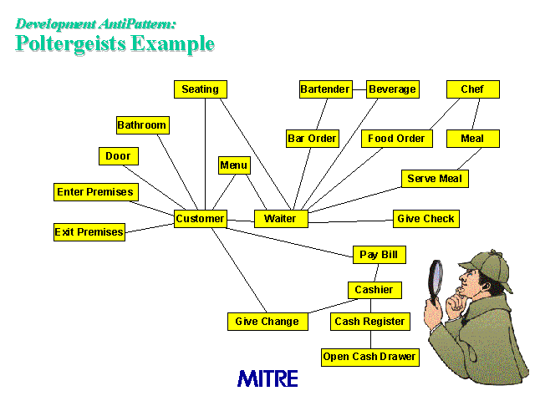
Antipattern Example: Poltergeists
From: www.antipatterns.com

Slide 81
Antipattern Example: Fixing Poltergeists
Refactor to eliminate irrelevant classes
Delete external classes (outside the system)
Delete classes with no domain relevance
Refactor to eliminate transient “data classes”
Refactor to eliminate “operation classes”
Refactor other classes with short lifecycles or few responsibilities
Move into collaborating classes
Regroup into cohesive larger classes
From: www.antipatterns.com

Slide 82
Good Design Properties
Hierarchical: A good design should be organized into a well-designed hierarchy of components.
Modular: Separate distinct concerns (dataand processing) into distinct containers (i.e.,subsystems, modules, and/or classes). Hide implementation details and provide clean, simple interfaces for each container.

Slide 83
Good Design Properties
Independent: Group similar things together; limit the amount of “special knowledge” that unrelated components may share. If you change your mind about something, the impact will be localized.

Slide 84
Good Design Properties
Simple Interfaces: Endless flexibility adds complexity. Complex interfaces mean:
hard to understand by users and developers (e.g., Unix man page syndrome)
many possible variations of use
inconvenient to change interface in order to eliminate “bad options”.
You can get away with “flexible interfaces” in a low-level localized setting, but the larger the scale, the simpler the interface should be.

Slide 85
Summary: Software Design
Good software designers are experienced software designers
Given a design, and experienced designer can tell you:
What’s good, What’s Bad, and provide suggestions for improvement
Patterns and Frameworks are very helpful to software designers
Good software designs are based on good design principles

Slide 86
References
Some materials derived from Dr. Tim Leftbridge’s Software Engineering Class Notes - http://www.site.uottawa.ca/~tcl/seg2105/ (specifically Chapter 9)

