Slide 1
Modern Web Architectures

Slide 2
The Early Web
Focus on finding and sharing static content
Mainstream application architecture was client/server – not much thought was given to moving applications to the browser
Early attempts at dynamic content were provided for limited use cases
Some browsers supported “plugging in” applications into the browser

Slide 3
Factory Method - Java
public interface Animal {}
private class Dog implements Animal {}
private class Cat implements Animal {}
public class AnimalFactory {
public static Animal createAnimal(String kind) {
if ("cat".equals(kind)) return new Cat();
if ("dog".equals(kind)) return new Dog();
throw new IllegalArgumentException();
}
}
AnimalFactory.createAnimal("dog");

Slide 4
Factory Method - Scala
trait Animal
private class Dog extends Animal
private class Cat extends Animal
object Animal {
def apply(kind: String) = kind match {
case "dog" => new Dog()
case "cat" => new Cat()
}
}
Animal("dog")

Slide 5
Lazy Initialization - Java
private volatile Component component;
public Component getComponent() {
Component result = component;
if (result == null) {
synchronized(this) {
result = component;
if (result == null) {
component = result = new Component();
}
}
}
return result;
}

Slide 6
Lazy Initialization - Scala
lazy val x = {
print("(computing x) ")
42
}
print("x = ")
println(x)
// output is: x = (computing x) 42

Slide 7
Singleton – Java (Thread Safe)
public class SingletonDemo {
private static volatile SingletonDemo instance = null;
private SingletonDemo() { }
public static SingletonDemo getInstance() {
if (instance == null) {
synchronized (SingletonDemo .class){
if (instance == null) {
instance = new SingletonDemo ();
}
}
}
return instance;
}
public void doSomething() {
//do something useful here
}
}
SingletonDemo.getInstance().doSomething(); //run it

Slide 8
Singleton – Scala (Thread Safe)
object SingletonDemo {
def doSomething() {
//do something useful here
}
}
SingletonDemo.doSomething() //run it

Slide 9
Adapter – Java
public interface Log {
void warning(String message);
void error(String message);
}
public final class Logger {
void log(Level level, String message) { /* ... */ }
}
public class LoggerToLogAdapter implements Log {
private final Logger logger;
public LoggerToLogAdapter(Logger logger) { this.logger = logger; }
public void warning(String message) {
logger.log(WARNING, message);
}
public void error(String message) {
logger.log(ERROR, message);
}
}
Log log = new LoggerToLogAdapter(new Logger());

Slide 10
Adapter – Scala
trait Log {
def warning(message: String)
def error(message: String)
}
final class Logger {
def log(level: Level, message: String) { /* ... */ }
}
implicit class LoggerToLogAdapter(logger: Logger) extends Log {
def warning(message: String) { logger.log(WARNING, message) }
def error(message: String) { logger.log(ERROR, message) }
}
val log: Log = new Logger()

Slide 11
Decorator – Java
public interface OutputStream {
void write(byte b);
void write(byte[] b);
}
public class FileOutputStream implements OutputStream { /* ... */ }
public abstract class OutputStreamDecorator implements OutputStream {
protected final OutputStream delegate;
protected OutputStreamDecorator(OutputStream delegate) {
this.delegate = delegate;
}
public void write(byte b) { delegate.write(b); }
public void write(byte[] b) { delegate.write(b); }
}
public class BufferedOutputStream extends OutputStreamDecorator {
public BufferedOutputStream(OutputStream delegate) {
super(delegate);
}
public void write(byte b) {
// ...
delegate.write(buffer)
}
}
new BufferedOutputStream(new FileOutputStream("foo.txt"))

Slide 12
Decorator – Scala
trait OutputStream {
def write(b: Byte)
def write(b: Array[Byte])
}
class FileOutputStream(path: String) extends OutputStream { /* ... */ }
trait Buffering extends OutputStream {
abstract override def write(b: Byte) {
// ...
super.write(buffer)
}
}
new FileOutputStream("foo.txt") with Buffering // with Filtering, ...

Slide 13
Value Classes – Java
public class Point {
private final int x, y;
public Point(int x, int y) { this.x = x; this.y = y; }
public int getX() { return x; }
public int getY() { return y; }
public boolean equals(Object o) {
// ...
return x == that.x && y == that.y;
}
public int hashCode() {
return 31 * x + y;
}
public String toString() {
return String.format("Point(%d, %d)", x, y);
}
}
Point point = new Point(1, 2)

Slide 14
Value Classes– Scala
In Scala Tuple classes can be used to group objects. Scala has built in Tuple classes for Tuple2 to Tuple22
val point = (1,2) //new Tuple2(1,2)
Scala also has the ability to make Type aliases:
type Point = (Int, Int)
val point: Point(1,2)
In Scala case classes are like Java beans or value objects
case class Point (x:Int, y:Int)

Slide 15
Null Object – Java
public interface Sound {
void play();
}
public class Music implements Sound {
public void play() { /* ... */ }
}
public class NullSound implements Sound {
public void play() {}
}
public class SoundSource {
public static Sound getSound() {
return available ? music : new NullSound();
}
}
SoundSource.getSound().play();

Slide 16
Null Object – Scala
trait Sound {
def play()
}
class Music extends Sound {
def play() { /* ... */ }
}
object SoundSource {
def getSound: Option[Sound] =
if (available) Some(music) else None
}
for (sound <- SoundSource.getSound) {
sound.play()
}
Scala has a predefined Option type that can take an optional value – it has a Some() part and a None part.

Slide 17
Web 1.0 Architecture
Web
Browser
Web
Server
File System

Slide 18
Web 1.0 Architecture
Advantages
Simple
Cachable
Indexable
Disadvantages
No dynamic content
No interaction with user – every request must go back to web server
Example : Netscape 1.0

Slide 19
Web 1.1 Architecture
Web
Browser
Web Server
File System
HTML
Resource Manager
stdin / stdout
CGI
Script
Database

Slide 20
Web 1.1 Architecture
Advantages
Somewhat Cachable
Some ability for Dynamic Content / Personalization
Disadvantages
High compute overhead – need to run a separate process for each request
All I/O via anonymous pipes – must parse HTML in, and generate HTML out
Although introduces dynamic content, all updates require a round-trip to the server
Example : Perl

Slide 21
Web 1.2 Architecture
Web
Browser
Web Server
File System
HTML
Resource Manager
Javascript Engine
stdin / stdout
CGI
Script
Database

Slide 22
Web 1.2 Architecture
Advantages
Improved user experience – user input can be validated client side
Some dynamic DOM manipulation to avoid round-trips to the server
Disadvantages
Same issues as architecture 1.1
Code redundancy – same code needed on client and server side
Javascript engines not very compatible
Example : Netscape, IE3

Slide 23
Web 1.5 Architecture
Web
Browser
Web Server
File System
HTML
Resource Manager
Javascript Engine
Application Server
Database
WebApp

Slide 24
Web 1.5 Architecture
Advantages
Introduction of an application server component to provide lifecycle management for web applications
Move to per-threads versus per-process for requests
Wrappers for request and response objects, simplifying the need to parse and generate HTML
Disadvantages
Still need to work on a HTTP request an HTTP response level
Common to generate
Example : Tomcat 1.0

Slide 25
Web 1.5+ Architecture
Web
Browser
Web Server
File System
HTML
Resource Manager
Javascript Engine
Application Server
Database
WebApp
MVC Web Framework

Slide 26
Web 1.5+ Architecture
Advantages
Introduces the MVC framework to modularize server code
Views can be pre-compiled to improve speed
Views can be created in markup instead of code
Disadvantages
Same as web 1.5
Introduces additional complexity due to the discipline needed to work with, and configure a MVC framework
Introduces non-standard markup to bind the view and controller
Example : Spring MVC, Struts, ASP.Net

Slide 27
The Web 2.0 Architecture
Demand for robust user experience delivered to the browser starts to emerge
Javascript becomes a platform by accident – drives explosion of Javascript frameworks.
XmlHttpRequest (XHR), which found its way into early browsers for limited use cases, is exploited by Google to create some amazing applications

Slide 28
Web 2.0 Architecture
Web
Browser
http
Web Server
File System
HTML
Resource Manager
Javascript Engine
AJAX XHR
Application Server
Database
WebApp
MVC Web Framework

Slide 29
Web 2.0 Architecture
Advantages
First time ever having desktop like experience on browser-based application – amazing experience
Can alter the UI without having to refresh the entire page
Disadvantages
Significant programming complexity
Significant testing required due to browser differences in handling Ajax/XHTR
Server-side resources must be returned from the same domain as the place that loaded the code (no cross-domain is allowed)
Javascript libraries are required to deal with complexity - jQuery
Example : Google Maps

Slide 30
Web 2.0+ Architecture
Web Browser
http
Web Server
File System
HTML
Javascript Engine
Resource Manager
Javascript Framework
AJAX XHR
Application Server
Database
WebApp
MVC Web Framework

Slide 31
Web 2.0+ Architecture
Advantages
Robust frameworks are developed to address Javascript complexity and Javascript compatibility
Application functionality and richness continues to grow
Disadvantages
Javascript codebases explode in size, programming model is based on pattern-matching and callbacks gets difficult to support
New frameworks come and go almost on a weekly basis making it difficult to gain stability in the web 2.0 space
Example : Gmail, mustache, handlebars, underscore

Slide 32
The Web 3.0 Architecture
Application moves to the browser
Leverages frameworks typically found on the server to simplify Javascript
Enables application to be delivered from a CDN
Allows for the application to run disconnected using local storage
Server primarily used to deliver data to the client
Server used to protect secrets such as API keys and manage security given that the code on the client can be viewed from any browser

Slide 33
Web 3.0 (rev 1) Architecture
Web Browser
Web Framework
http
Static Assets
Javascript MVC Framework
Embedded HTTP Server
SPA Assets
Single Page Web App (SPA)
rest
MVC / Async IO Framework
Database
Server Side Resources
Web Services
Web Services
Web Services

Slide 34
Web 3.0 (rev 1) Architecture
Advantages
Extremely robust applications are possible
Frameworks finally enable Javascript as a platform– modularization, scope management, dependency injection, promise/futures, etc
Frameworks enable full lifecycle debugging, and robust build/configuration management
Cacheable and CDN friendly – only data needs to flow back to browser app
Enables “reactive” programming model and async-IO to improve scalability
Disadvantages
Still need to master Javascript
Polyglot (is advantage and disadvantage)
Security might be challening – cant maintain secrets in client app (e.g., “View Code”)
Traditional application servers still request/reply based, limits scalability in some cases
Example : AngularJS, BackboneJS, Node.js

Slide 35
Web 3.0 (rev 2) Architecture
Web Browser
Web Framework
http
Static Assets
Javascript MVC Framework
Embedded HTTP and Web Socket Server
SPA Assets
Single Page Web App (SPA)
rest
MVC / Async IO Framework
websockets
Database
Server Side Resources
Web Services
Web Services
Web Services

Slide 36
Web 3.0 (rev 2) Architecture
Advantages
Able to support for the first time real time architectures for applications like trading, chat, gaming etc
Eliminate overhead of using the HTTP protocol
Messages can be initiated from either the client (browser) or server
Disadvantages
Only modern browsers support, although web sockets can be simulated with XHR long polling
Some proxies and HTTP infrastructure don’t know how to deal with web sockets (this will change)
Example : SockJS, socket.io, Node.js, Play!

Slide 37
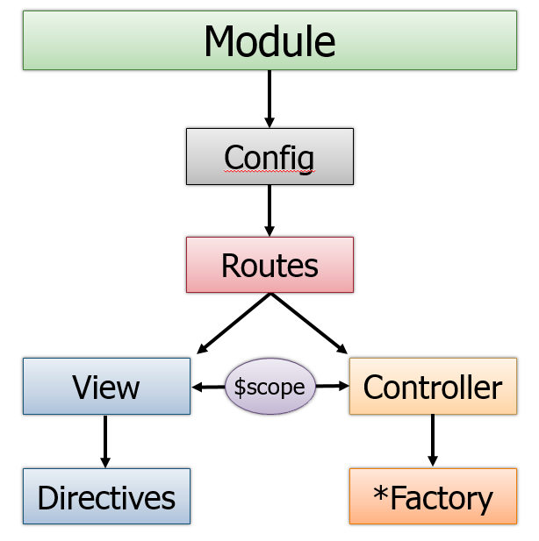
Modern Web Architectures: Front End MVC - AngularJS Example

Slide 38
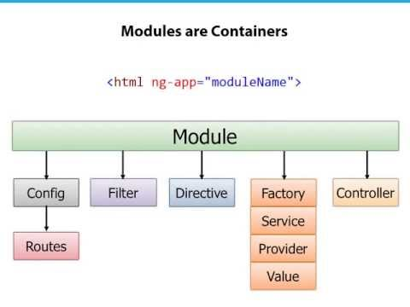
Example: AngularJS Architecture

Slide 39
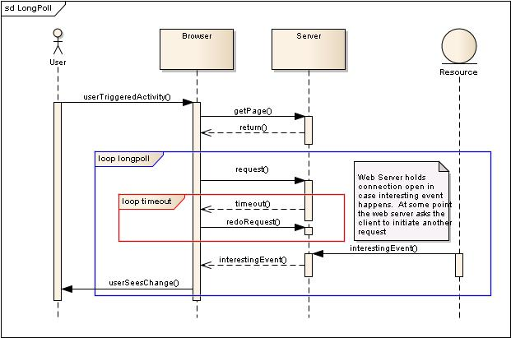
How it works: XHR Long Poll

Slide 40
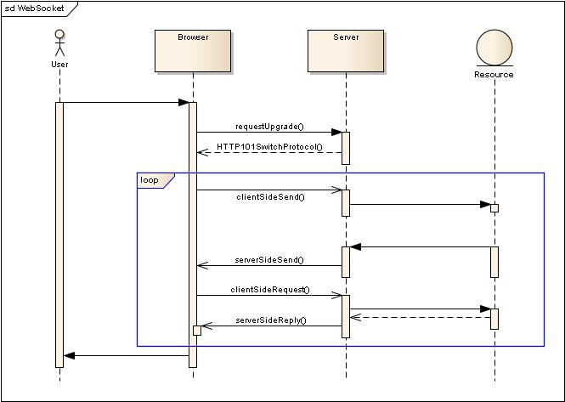
How it works: Web Sockets

Slide 41
References
Design Patterns in Scala: http://pavelfatin.com/design-patterns-in-scala/
The WebSockets protocol: http://tools.ietf.org/html/rfc6455
Node.js: http://www.nodejs.org/
Play! Framework: http://www.playframework.com/

