Slide 1
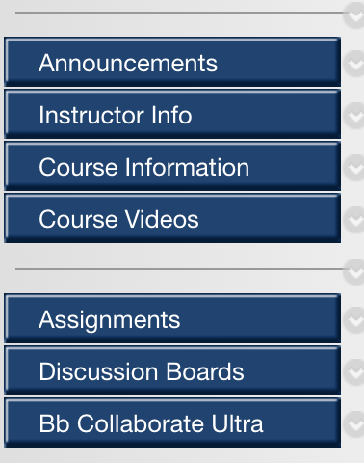
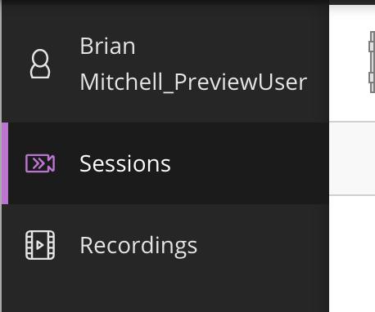
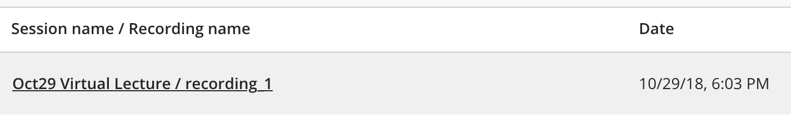
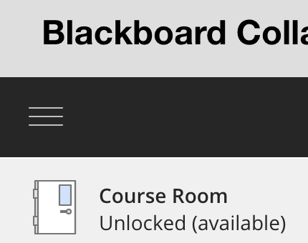
Watching a Video Recorded on Bb Collaborate Ultra
STEP1
STEP 3
Select Recordings
Select BbColloborte Ultra from menu on Blackboard
STEP 4
STEP 2
Select the recording you want to view
Select the Menu (3 lines)

