Slide 1
Modeling Software Architectures - ADLs, UML and Other Notations
Brian Mitchell

Slide 2
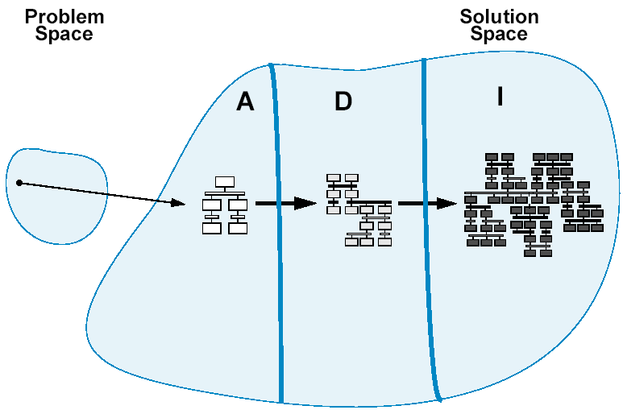
From Architecture to Design

Slide 3
The State-Of-Practice is NOT Improving for Modeling Software Design and Architecture
Researchers and practitioners have different objectives…
Academic Focus | Practitioner Focus
Focus on analytic evolution of architecture models | Focus on a wide range of development issues
Individual models | Families of models
Rigorous modeling notations | Practicality over rigor
Powerful analysis techniques | Architecture as the “Big Picture” in development
Depth over breadth | Breadth over depth
Special-Purpose solutions | General Solutions

Slide 4
Revisiting Software Architecture
The software architecture of a system defines its high-level structure, exposing its gross organization as a collection of interacting components.
Components needed to model a software architecture include:
Components, Connectors, Systems, Properties and Styles.

Slide 5
Software Architecture Concepts
Components
The computational elements and data stores of the system
May have multiple interfaces, called ports
Ports define a point of interaction between a component and its environment
Connectors
Model interactions among components
Runtime perspective: connectors mediate the communication and coordination activities between components
Connectors may have interfaces that define the roles played by the participants in the interaction

Slide 6
Software Architecture Concepts
Systems
Graphs of components and connectors
Tend to be hierarchical – components and connectors may represent subsystems that have their own internal architectures
Bindings map the interfaces of one level of a system to another
Properties
Represent the non-structural information about the parts of an architecture description
Example: a connector can be a function call, or a network interaction
Properties can be attached to any architectural element

Slide 7
Software Architecture Concepts
Style
An architectural style represents a family of related systems
Defines the design vocabulary (and constraints) for the components, connectors, ports, roles, bindings and properties.

Slide 8
So what are software architecture models?
Architecture models capture the foundational design decisions about a system.
An architecture model is an artifact that captures these decisions
These models serve as documentation that can be consumed by various stakeholders

Slide 9
Modeling choices are important!
The choice of what to model is important!
This activity takes time and costs money so picking what to model becomes a critical activity
The choice of how detailed your models are are important!
What stakeholders are you trying to influence?
How much detail is needed to describe the architecture to the stakeholders?
Does the model describe the design, or is the model intended to influence a decision?
The choice of what notation is used to document your architecture is important!
Should you use formal, or semi-formal notations

Slide 10
Modeling is about documenting design decisions!
A model is an artifact that captures a number of different design decisions used to establish the overall system architecture
This activity takes time and costs money so picking what to model becomes a critical activity
Key things to consider when modeling
What architectural decisions and concepts should be modeled,
At what level of detail, and
With how much rigor or formality
Adapted From Software Architecture, Foundations, Theory and Practice

Slide 11
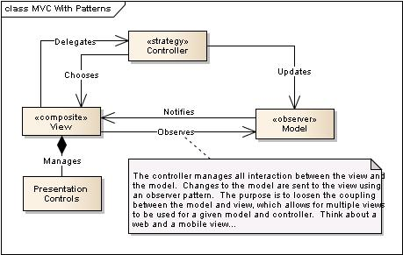
What do we document in a model?
Components
Connectors
Interfaces (including constraints)
Decisions and Rational
Structural, Runtime and Behavioral Constraints
Remind you of the definition of software architecture?

Slide 12
Thinking about models…
To experiment
To clarify
To understand
To analyze
To evaluate
Reason for Modeling
What is the purpose of the model, and who is the model for?
What to Model
How to Model
Structure
Transformations
State
Inputs and Outputs
Textual
Graphical
Formal / Mathematical
Adapted From: https://www.cl.cam.ac.uk/teaching/1112/SWDesign/softwaredesign01.pdf

Slide 13
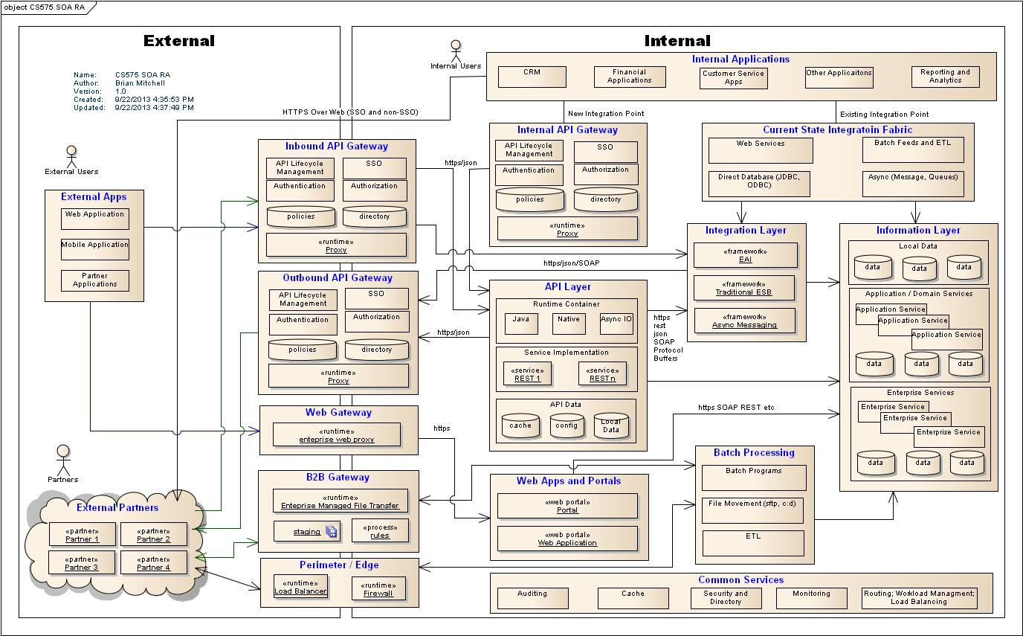
Example: What are some of the key aspects of this model?

Slide 14
Modeling the different views – Static and Dynamic
Static models describe the structure of the system
These structures generally do not change over time
Capture the topology of the system components:
can be software component relations – uses/inherits
Can be runtime component relations – sends message to over HTTP
Can be deployment component relation – this software is deployed to this server…
Dynamic models capture the behavior of the system during runtime
The important thing to capture is change is being managed over time
State of the components
Data flow over the connectors

Slide 15
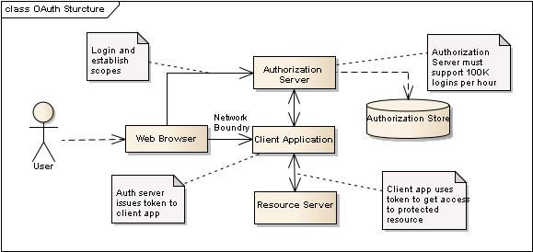
Static Model View (Example: oAuth)
Is this view useful to discuss the components associated with managing the oAuth protocol (functional and non-functional)?

Slide 16
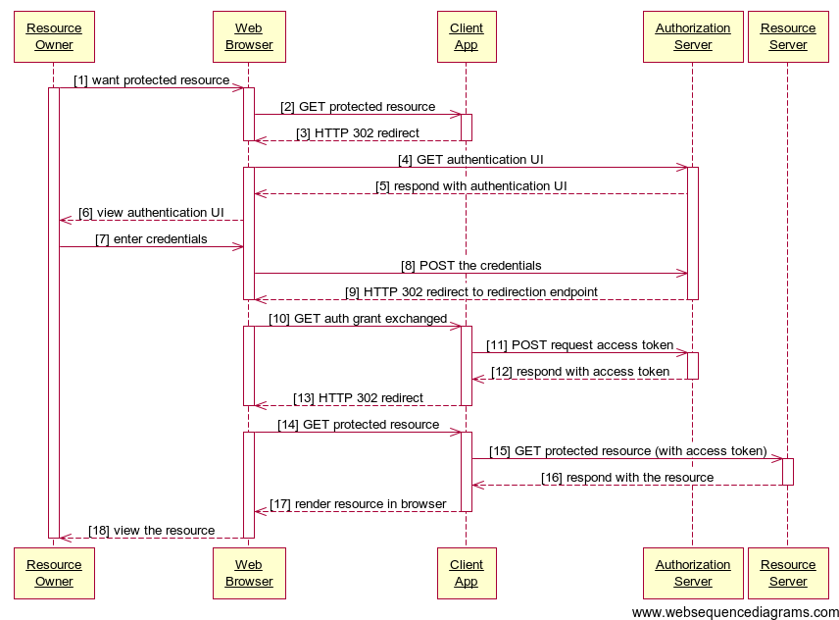
Dynamic Model View (Example: oAuth)
Is this view useful to discuss how the components implementing the oAuth protocol work together?

Slide 17
Possible problems using multiple views to model software architectures
Modeling a realistic software architecture using a single view is not practical
Too complex
Different concerns that don’t belong together – static, dynamic, deployment
Key challenge is to ensure that all of the different views are consistent
Might be hard to find these issues
Direct – one diagram states two servers, another states three servers
Indirect – one view is at a higher level than another and the refinement introduced inconsistencies
Structure vs Dynamic – structures don’t support dynamic requirements
Functional vs Non-Functional – The structure does not support the non-functional requirements

Slide 18
Describing Architectures
Formal Approaches
Architectural Description Languages
Many to date
Informal Approaches
UML Notation – Simple and known by a broader community
UML is missing architecture semantics
Lines and Boxes with natural English

Slide 19
Architecture Description Languages
Formal languages to describe architectural components, their associated runtime views and semantics
Some ADL’s have associated tooling
See David Garlan, Shang-Wen Cheng, and Andrew J. Kompanek paper for examples

Slide 20
ADL – Example Pipe and Filter – Line and Box Drawing
Style PipeFilter
Filter
Input Port
Pipe
Output Port
Binding
Simple PipeFilter System
Grep Filter
Merge and Sort
Splitter Filter
Merge
Sort

Slide 21
ADL Example – Pipe and Filter
Family PipeFilter = {
Port Type OutputPort;
Port Type InputPort;
Role Type Source;
Role Type Sink;
Component Type Filter;
Connector Type Pipe = {
Role src : Source;
Role snk : Sink;
Properties {
latency : int;
pipeProtocol: String = …;
}
};
};
System simple : PipeFilter = {
Component Splitter : Filter = {
Port pIn : InputPort = new InputPort;
Port pOut1 : OutputPort = new OutputPort;
Port pOut2 : OutputPort = new OutputPort;
Properties { … }
};
Component Grep : Filter = {
Port pIn : InputPort = new InputPort;
Port pOut : OutputPort = new OutputPort;
};
Component MergeAndSort : Filter = {
Port pIn1 : InputPort = new InputPort;
Port pIn2 : InputPort = new InputPort;
Port pOut : OutputPort = new OutputPort;
Representation {
System MergeAndSortRep : PipeFilter = {
Component Merge : Filter = { … };
Component Sort : Filter = { … };
Connector MergeStream : Pipe = new Pipe;
Attachments { … };
}; /* end sub-system */
Bindings {
pIn1 to Merge.pIn1;
pIn2 to Merge.pIn2;
pOut to Sort.pOut;
};
};
};
Connector SplitStream1 : Pipe = new Pipe;
Connector SplitStream2 : Pipe = new Pipe;
Connector GrepStream : Pipe = new Pipe;
Attachments {
Splitter.pOut1 to SplitStream1.src;
Grep.pIn to SplitStream1.snk;
Grep.pOut to GrepStream.src;
MergeAndSort.pIn1 to GrepStream.snk;
Splitter.pOut2 to SplitStream2.src;
MergeAndSort.pIn2 to SplitStream2.snk;
};
}; /* end system */

Slide 22
The Problem with ADL’s
There are many of them that have been developed by the research community
The desire for practitioners to learn another language is not there
The process of modeling the architecture prior to modeling the design is new, and not widely applied
ADL’s are formal models, practitioners are not skilled in working with formal models

Slide 23
The Case for UML to Model Architecture
UML is widely known
There is wide commercial tool support for UML
Research has shown that ADL formality can be “mapped” to UML
UML is extensible via the UML meta-meta model
Changing UML to support modeling architecture components invalidates the desirability of using UML itself – if one needed to learn new UML features might as well just learn an ADL.

Slide 24
What UML can do (Out-of-the-Box)
UML can model:
Classes and their declared attributes, operations and relationships
The possible states and behavior of the individual classes
Packages of classes and their dependencies
Example scenarios of system usage and the behavior of the overall system in the context of a usage scenario
Examples of object instances with actual attributes and relationships
The deployment and communication of software components on distributed hosts
The goal of a UML model is to have HIGH FIDELITY where fidelity is the measure of how close the model corresponds to the eventual implementation

Slide 25
Extending UML
The designers of UML realized that they couldn't create a language that effectively described the semantics of all possible situations.
UML has extensibility mechanisms that allow users to define custom extensions of the language, in order to accurately describe the semantics of specific information domains
These extensions were intended to be applied to the design problems and not architectural concerns

Slide 26
Built-In Mechanisms to Extend UML
Tagged values
Allows arbitrary information to be attached to model elements using keyword-value pairs called tags.
Stereotypes
Allows sub-classification of model elements. Stereotypes can be used to introduce additional distinctions between model elements, that are not explicitly supported by the UML meta model.
Constraints
Allows new semantic restrictions to be applied to elements. This makes it possible to linguistically specify additional constraints that should be obeyed by elements.
Profiles
Profiles are pre-defined stereotypes, tagged values, constraints and icons to support modeling in a specific domain

Slide 27
The Design of UML
UML is a semiformal graphical language
UML is specified using:
A meta-model
Informal descriptive text
Constraints
The UML metamodel is a UML model that specifies the abstract syntax of UML models
For example the UML metamodel specifies the class modeling element

Slide 28
UML: Models and Meta-Models
In meta-modeling terminology, both the model of a software system and the meta model, are layers in a meta-modeling architecture. A model of a system is considered an instance of the meta model.
The meta-modeling architecture for UML has a conceptual framework based on four meta-layers…

Slide 29
The UML Meta-Model Architectural Layers
Layer | Scope | Defines | Sample
Meta-Meta Model | general metamodeling infrastructure | Meta Model Specification Language | MetaClass, MetaOperation, MetaAttribute
Meta Model | UML Specification | Model Specification Language | Class, Component, Attribute, Operation
Model | Project Using UML | Domain Specification Language | List, Queue, Customer
User Object Data | Runtime System | Specific Domain | Customer [name=smith]

Slide 30
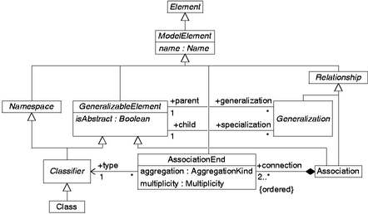
Part of the UML Meta-Model
The UML Meta-Model Describes the Semantics of UML
Models…

Slide 31
Constraining the UML meta-model
A powerful UML extension mechanism to support architectural modeling can be achieved by constraining the way the meta model is used to construct system models
For example, consider the built-in stereotype <<abstract>>, this introduces a constraint on how a class is instantiated, consider defining other custom stereotypes to constrain containment or interaction between components

Slide 32
Options for using UML as an ADL
Use UML “as is”
Constrain the UML meta-model using built in extension mechanisms
Extend the UML meta-model (using the meta-meta model) to directly support needed software architecture concepts

Slide 33
Strategy 1: Use UML “As Is”
Simple Approach: Based on existing UML notation
Architectural Models are understandable by users who already know UML
Architectural Models can be manipulated by any UML-compliant tool
The architectural concepts need to be simulated (overloaded) using existing UML notation

Slide 34
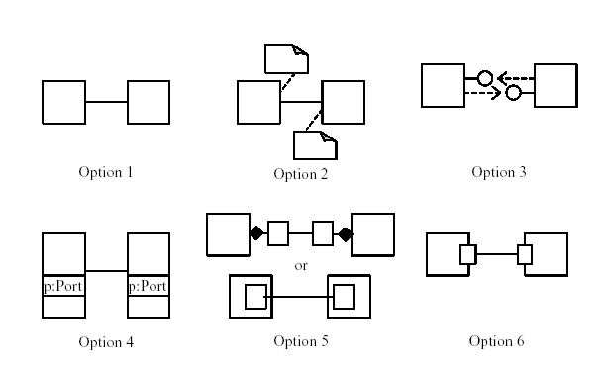
Strategy 1: Use UML “As Is”
Need to agree on notational conventions
ports as annotations
generic (line-and-box)
ports as interfaces
ports as class attributes
ports as classes
ports as classes (shown on boundary)

Slide 35
Strategy 1: Use UML “As Is”
Simultaneous consideration of architecture rules and UML notational constructs
Develop a UML domain model
Develop an (informal) architectural diagram
Map domain classes to architectural components
Design class (component) interfaces
Provide constructs for modeling connectors
Connectors add no functionality at the domain model level
Model architectural structure in class, object, and collaboration diagrams
See Garlan 2001

Slide 36
Strategy 1: Use UML “As Is”
Service Locator, Business Delegate,…

Slide 37
Strategy 2: Constrain UML to Model Architectural Artifacts
Use UML’s built-in extension mechanisms on meta-classes
Allows automated conformance checking
Select a meta-class semantically close to an ADL construct
Define a stereotype and apply it to meta-class instances
Class semantics are constrained to that of the ADL

Slide 38
Strategy 2: Constrain UML to Model Architectural Artifacts
A suggested process:
Identify UML constructs that map closest to an architectural construct:
Components, Connectors, Systems, Properties and Styles
Use stereotypes to constrain the UML entities
Describe semantics using UML statecharts and Object Constraint Language

Slide 39
OCL – What is it, Why do we need it…
Full Reference: http://umlcenter.visual-paradigm.com/umlresources/obje_11.pdf
OCL is a formal language to specify side-effect free constraints
OCL used to specify well-formedness rules of the UML metamodel
Why OCL: Graphical languages like UML cannot produce an unambiguous specification
Need to describe additional constraints about objects in the model
OCL can be used to develop architecture-appropriate constraints that can used by OCL-compliant tooling

Slide 40
Strategy 2: Constrain UML to Model Architectural Artifacts
Define Custom Stereotypes

Slide 41
Strategy 3: Extend UML
Use UML’s meta metamodel to extend UML
Introduce explicit architectural constructs and in UML
Introduce additional notations for modeling architectural semantics
Follow an approach similar to strategy #1 to model specific architectures
Follow an approach similar to strategy #2 to model specific architectural styles

Slide 42
Comparing the Approaches
“Straight” UML
understandable architectures
manipulable by standard tools
architectural constraint violations
“Constrained” UML
ensures architectural constraints
requires complete style specifications
requires OCL-compliant tools
“Extended” UML
provides “native” support for architectures
requires backward tool compatibility
may result in incompatible UML versions
must be careful not to create another “box and line” notation, invalidating the motivation to use UML in the first place

Slide 43
Example: Revisiting ADL’s for Architectural Modeling
Recall that “strategy 2” involved constraining UML to model architectural artifacts
Although useful for design, we have also demonstrated that certain types of ADL’s can be used for architectural maintenance.

Slide 44
Using informal lines and boxes to model architecture
In this approach a diagraming tool such as Microsoft Visio or Omnigraffle is used to document the architecture views
Tends to create the “best looking” views given that there is no limitation to the artwork that can be applied to the components and connectors.
Probably the most popular approach to document architectures
But there are challenges:
There is a lack of rigor over the component and connector vocabulary
They tend to be pictures, and difficult to get value over managing the views in a model repository – for example – there is limited opportunity to share metadata between diagrams
Hard to deal with versioning and change – “Is this the latest view?”
Impossible to detect inconsistencies between models

Slide 45



Example: Line and Box Drawing for SOA Architecture
API

Slide 46
Comparing the approaches
Approach | Pros | Cons
ADL | Most formal of all of the approaches Able to precisely define architecture components, connectors and constraints | Not visual Too complex for use outside of the academic community No wide standard Almost no activity in the research community these days, and not used in industry to the best of my knowledge
UML | Supports the basic constructs to support architecture concerns Can be integrated into a model repository promoting reuse Good support for maintaining relationships between models | UML is really designed for OOP where design can be mapped to code Quasi-formalism may lead to inconsistency between different designers Attempts to add architecture semantics to UML are challenging
Lines and Boxes | Just drawings – can represent any architecture concern Easiest to create models that can be digested by the widest number of stakeholders Produces the nicest looking views | Just artwork, can be interpreted differently by different people Typically just managed as files (not versioned in a repository) which can lead to version management problems. No direct support for maintaining relationships between models

Slide 47
And now a shameless plug into some interesting research on architecture recovery and architecture style repair

Slide 48
ISF: Interconnection Style Formalism
ISF is a visual language used to define Interconnection Styles
Interconnection Styles are specified in ISF using a series of rules that define structural and semantic properties of architectural relations

Slide 49
ISF Rules
ISF allows for the definition of 2 types of rules…
Permission rules, which define the set of well-formed configurations of sub-systems, modules, usage and architectural relations that adhere to a specific style.
Definition rules, which are used to define new relations based on patterns of components and relations.

Slide 50
ISF Style Examples – Export and Broad Export
Export Style
Broad Export Style

Slide 51
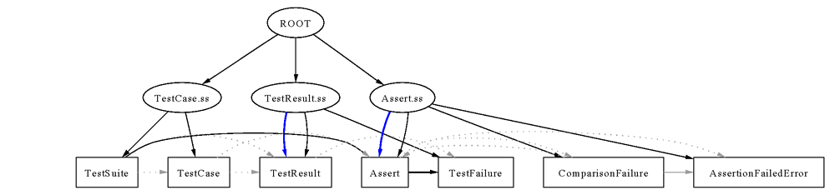
A Small Example
Relation Types
Use
Contain
Export
[from source code]
[from clustering process]
[from architectural recovery]

Slide 52
Example: Using ISF for Architectural Maintenance [from Mitchell,Mancoridis 2004]

Slide 53
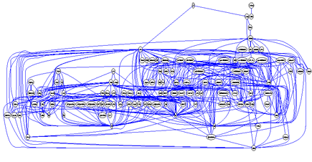
Example: Using ISF for Architectural Maintenance
Here is the dependency view of the Bunch system…

Slide 54
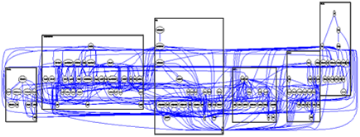
Example: Using ISF for Architectural Maintenance
Here is the automatically produced decomposition of Bunch’s structure showing 6 abstract subsystems. Each of these
Subsystems are comprised of one or more additional subsystems, resulting in a hierarchy of subsystems

Slide 55
An Example Showing A “Reengineering” opportunity
BAD
High Visibility
GOOD
High Encapsulation

Slide 56
What we can learn about the Export Style

Slide 57
Example: Export versus Modified Export Style

Slide 58
References
A framework for the UML meta model – online at: http://www.ii.uib.no/~rolfwr/thesisdoc/main1.html
Nenad Medvidovic, Class Notes: http://sunset.usc.edu/classes/cs578_2004/April6b.pdf
David Garlan, Shang-Wen Cheng, and Andrew J. Kompanek, “Reconciling the Needs of Architectural Description with Object-Modeling Notations”, Science of Computer Programming Journal, 2001.
Nenad Medvidovic, David Rosenblum, David Redmiles, Jason Robberts, “Modeling Software Architectures in the Unified Modeling Language”, ACM Transactions on Software Engineering and Methodology, Vol. 11, No. 1, Jan 2002.
Brian S. Mitchell, Spiros Mancoridis, and Martin Traverso, “Using Interconnection Style Rules to Infer Software Architecture Relations”, Proceedings of the 2004 Genetic and Evolutionary Computational Conference (GECCO), June 2004.
R. Taylor, N. Medvidovic and E. M. Dashofy, “Software Architecture: Foundations, Theory and Practice”, Wiley, January 2009.

