Slide 1
Modern Web Architectures

Slide 2
The Early Web
Focus on finding and sharing static content
Mainstream application architecture was client/server – not much thought was given to moving applications to the browser
Early attempts at dynamic content were provided for limited use cases
Some browsers supported “plugging in” applications into the browser

Slide 3
Web 1.0 Architecture
Web
Browser
Web
Server
File System

Slide 4
Web 1.0 Architecture
Advantages
Simple
Cachable
Indexable
Disadvantages
No dynamic content
No interaction with user – every request must go back to web server
Example : Netscape 1.0

Slide 5
Web 1.1 Architecture
Web
Browser
Web Server
File System
HTML
Resource Manager
stdin / stdout
CGI
Script
Database

Slide 6
Web 1.1 Architecture
Advantages
Somewhat Cachable
Some ability for Dynamic Content / Personalization
Disadvantages
High compute overhead – need to run a separate process for each request
All I/O via anonymous pipes – must parse HTML in, and generate HTML out
Although introduces dynamic content, all updates require a round-trip to the server
Example : Perl

Slide 7
Web 1.2 Architecture
Web
Browser
Web Server
File System
HTML
Resource Manager
Javascript Engine
stdin / stdout
CGI
Script
Database

Slide 8
Web 1.2 Architecture
Advantages
Improved user experience – user input can be validated client side
Some dynamic DOM manipulation to avoid round-trips to the server
Disadvantages
Same issues as architecture 1.1
Code redundancy – same code needed on client and server side
Javascript engines not very compatible
Example : Netscape, IE3

Slide 9
Web 1.5 Architecture
Web
Browser
Web Server
File System
HTML
Resource Manager
Javascript Engine
Application Server
Database
WebApp

Slide 10
Web 1.5 Architecture
Advantages
Introduction of an application server component to provide lifecycle management for web applications
Move to per-threads versus per-process for requests
Wrappers for request and response objects, simplifying the need to parse and generate HTML
Disadvantages
Still need to work on a HTTP request an HTTP response level
Common to generate
Example : Tomcat 1.0

Slide 11
Web 1.5+ Architecture
Web
Browser
Web Server
File System
HTML
Resource Manager
Javascript Engine
Application Server
Database
WebApp
MVC Web Framework

Slide 12
Web 1.5+ Architecture
Advantages
Introduces the MVC framework to modularize server code
Views can be pre-compiled to improve speed
Views can be created in markup instead of code
Disadvantages
Same as web 1.5
Introduces additional complexity due to the discipline needed to work with, and configure a MVC framework
Introduces non-standard markup to bind the view and controller
Example : Spring MVC, Struts, ASP.Net

Slide 13
The Web 2.0 Architecture
Demand for robust user experience delivered to the browser starts to emerge
Javascript becomes a platform by accident – drives explosion of Javascript frameworks.
XmlHttpRequest (XHR), which found its way into early browsers for limited use cases, is exploited by Google to create some amazing applications

Slide 14
Web 2.0 Architecture
Web
Browser
http
Web Server
File System
HTML
Resource Manager
Javascript Engine
AJAX XHR
Application Server
Database
WebApp
MVC Web Framework

Slide 15
Web 2.0 Architecture
Advantages
First time ever having desktop like experience on browser-based application – amazing experience
Can alter the UI without having to refresh the entire page
Disadvantages
Significant programming complexity
Significant testing required due to browser differences in handling Ajax/XHTR
Server-side resources must be returned from the same domain as the place that loaded the code (no cross-domain is allowed)
Javascript libraries are required to deal with complexity - jQuery
Example : Google Maps

Slide 16
Web 2.0+ Architecture
Web Browser
http
Web Server
File System
HTML
Javascript Engine
Resource Manager
Javascript Framework
AJAX XHR
Application Server
Database
WebApp
MVC Web Framework

Slide 17
Web 2.0+ Architecture
Advantages
Robust frameworks are developed to address Javascript complexity and Javascript compatibility
Application functionality and richness continues to grow
Disadvantages
Javascript codebases explode in size, programming model is based on pattern-matching and callbacks gets difficult to support
New frameworks come and go almost on a weekly basis making it difficult to gain stability in the web 2.0 space
Example : Gmail, mustache, handlebars, underscore

Slide 18
The Web 3.0 Architecture
Application moves to the browser
Leverages frameworks typically found on the server to simplify Javascript
Enables application to be delivered from a CDN
Allows for the application to run disconnected using local storage
Server primarily used to deliver data to the client
Server used to protect secrets such as API keys and manage security given that the code on the client can be viewed from any browser

Slide 19
Web 3.0 (rev 1) Architecture
Web Browser
Web Framework
http
Static Assets
Javascript MVC Framework
Embedded HTTP Server
SPA Assets
Single Page Web App (SPA)
rest
MVC / Async IO Framework
Database
Server Side Resources
Web Services
Web Services
Web Services

Slide 20
Web 3.0 (rev 1) Architecture
Advantages
Extremely robust applications are possible
Frameworks finally enable Javascript as a platform– modularization, scope management, dependency injection, promise/futures, etc
Frameworks enable full lifecycle debugging, and robust build/configuration management
Cacheable and CDN friendly – only data needs to flow back to browser app
Enables “reactive” programming model and async-IO to improve scalability
Disadvantages
Still need to master Javascript
Polyglot (is advantage and disadvantage)
Security might be challening – cant maintain secrets in client app (e.g., “View Code”)
Traditional application servers still request/reply based, limits scalability in some cases
Example : AngularJS, BackboneJS, Node.js

Slide 21
Web 3.0 (rev 2) Architecture
Web Browser
Web Framework
http
Static Assets
Javascript MVC Framework
Embedded HTTP and Web Socket Server
SPA Assets
Single Page Web App (SPA)
rest
MVC / Async IO Framework
websockets
Database
Server Side Resources
Web Services
Web Services
Web Services

Slide 22
Web 3.0 (rev 2) Architecture
Advantages
Able to support for the first time real time architectures for applications like trading, chat, gaming etc
Eliminate overhead of using the HTTP protocol
Messages can be initiated from either the client (browser) or server
Disadvantages
Only modern browsers support, although web sockets can be simulated with XHR long polling
Some proxies and HTTP infrastructure don’t know how to deal with web sockets (this will change)
Example : SockJS, socket.io, Node.js, Play!

Slide 23
Web 3.0 (rev 3) Architecture
Docker/Kubernetes
Web Browser
Web Framework
http
Static Assets
Javascript MVC Framework
Embedded HTTP and Web Socket Server
SPA Assets
Single Page Web App (SPA)
rest
MVC / Async IO Framework
websockets
Database
Server Side Resources
Web Services
Web Services
Web Services

Slide 24


So Why Are Modern Web Architectures Useful
Desktop Apps via Electron
Engaging Web Apps
Native Mobile Apps

Slide 25
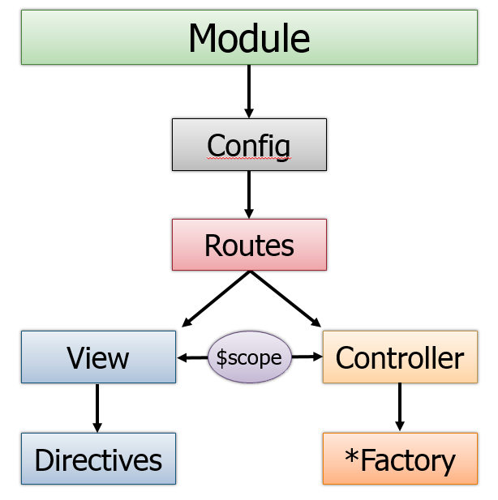
Modern Web Architectures: Front End MVC - AngularJS Example

Slide 26
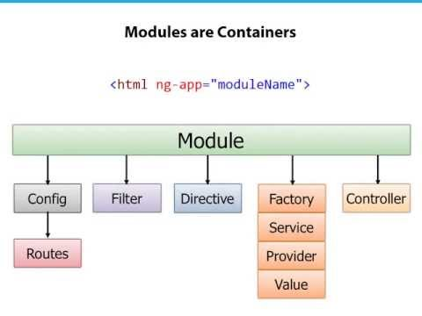
Example: AngularJS Architecture

Slide 27
Example: Lets Look at Angular via Example
We will look at some examples from here:
https://curran.github.io/screencasts/introToAngular/exampleViewer/#/

Slide 28
Angular 1.x
The good and the bad discussion, what do you think?

Slide 29
Javascript vs Typescript
JavaScript has grown up a good bit, but we will actually be using TypeScript instead because it has many advantages Lets take a look at the Typescript Playground:
https://www.typescriptlang.org/

Slide 30
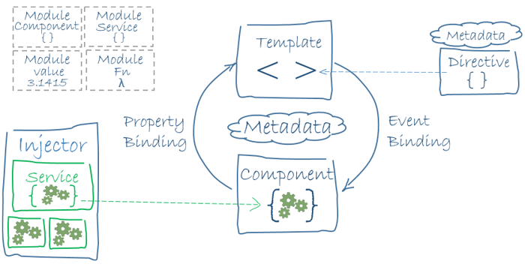
Angular.io (Angular 7 currently)
SEE: https://angular.io/guide/architecture

Slide 31
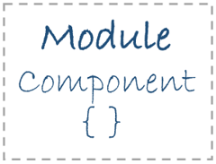
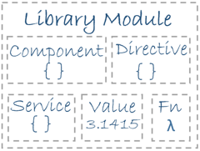
Angular.io (Angular 7 currently)
SEE: https://angular.io/guide/architecture

Slide 32
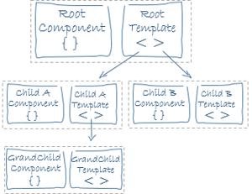
Angular.io (Angular 7 currently)
SEE: https://angular.io/guide/architecture

Slide 33

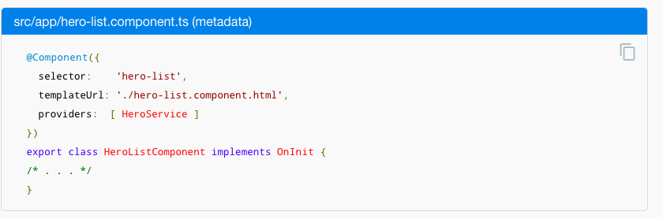
Angular.io (Angular 4 currently)
SEE: https://angular.io/guide/architecture

Slide 34

Angular.io (Angular 4 currently)
SEE: https://angular.io/guide/architecture

Slide 35
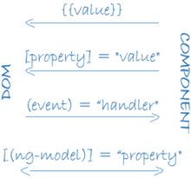
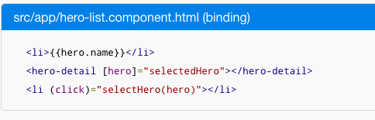
Angular.io (Angular 4 currently)
SEE: https://angular.io/guide/architecture

Slide 36
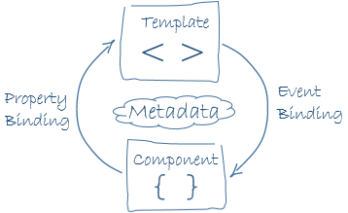
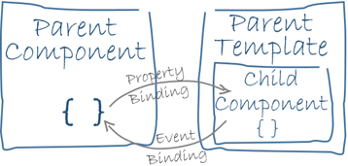
Angular.io (Angular 4 currently)
SEE: https://angular.io/guide/architecture

Slide 37

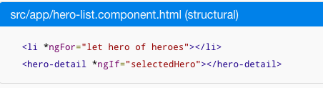
Angular.io (Angular 4 currently)
SEE: https://angular.io/guide/architecture

Slide 38
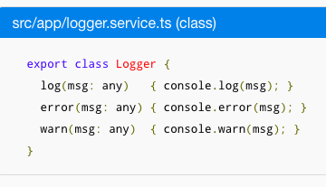

Angular.io (Angular 4 currently)
SEE: https://angular.io/guide/architecture
A service is just a class, recommend decorating with
@Injectable()

Slide 39

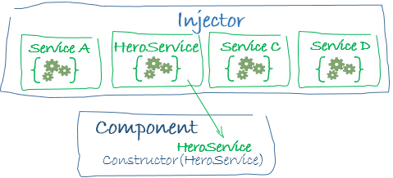
Angular.io (Angular 4 currently)
SEE: https://angular.io/guide/architecture

Slide 40
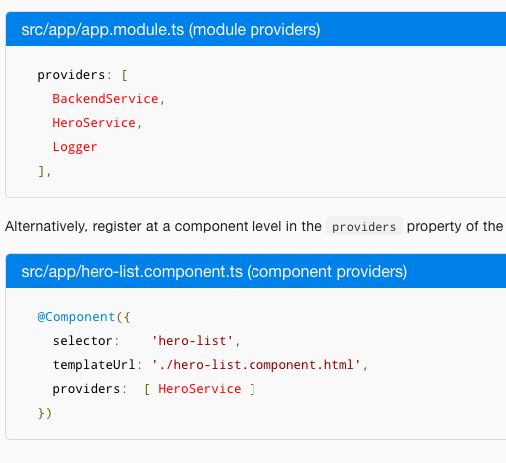
Angular.io (Angular 4 currently)
SEE: https://angular.io/guide/architecture

Slide 41
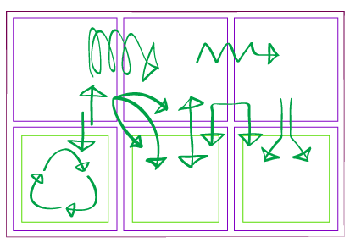
State Management
One of the main problems with web component frameworks like angular is related to managing application state

Slide 42
State Management
Commonly views cache copies of the same data, how do things stay consistant
View 1
View 2
View 3
DATA
DATA
DATA
DATA

Slide 43
State Management
To keep state manageable, a common best practice is to push state down via properties, and use events to pass state changes up

Slide 44
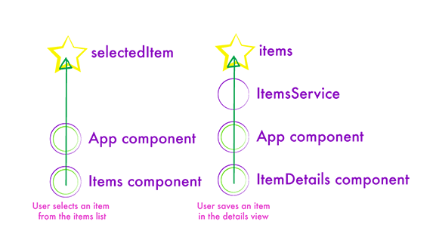
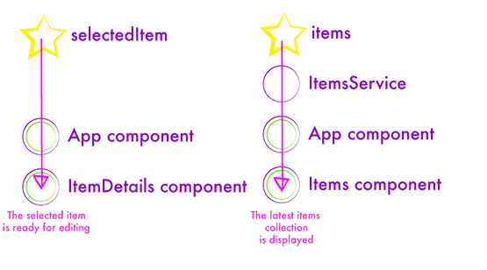
State Management
Pushing State Changes Down, and Reacting to Events Up works well if the components fall into hierarchies
State Down
Events Up

Slide 45
State Management
With more global event management, Angular supports propagating state via, services (singletons), event emitters and observables
Lets take a look at this, but it gets complex fast…

Slide 46
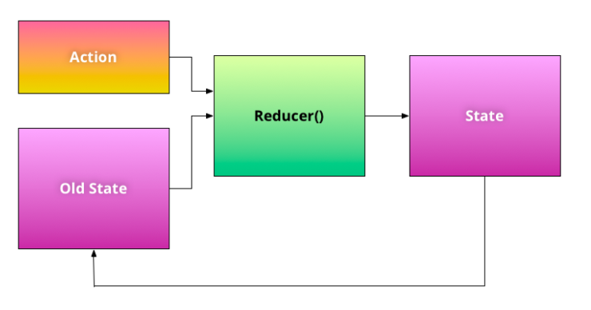
State Management – Flux / Redux
SEE: http://blog.ng-book.com/introduction-to-redux-with-typescript-and-angular-2//
Embrace immutability – functional programming techniques
(Old_State, Action) => New_State

Slide 47
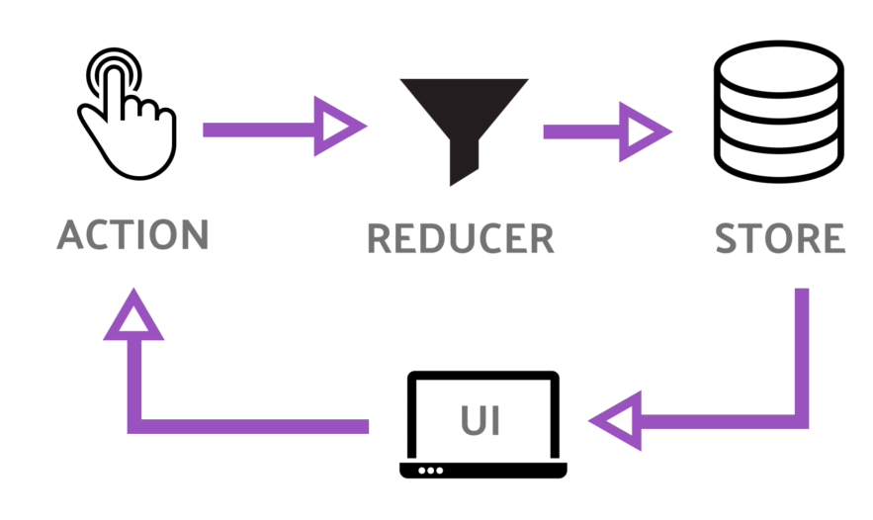
State Management – Flux / Redux
SEE: https://angularfirebase.com/lessons/angular-ngrx-redux-starter-guide/

Slide 48
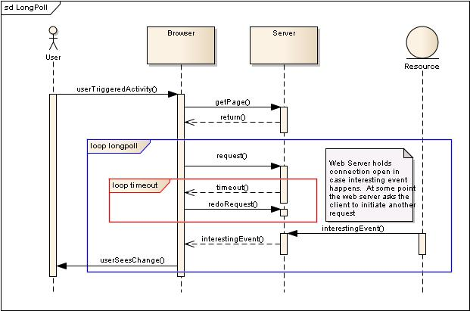
How it works: XHR Long Poll

Slide 49
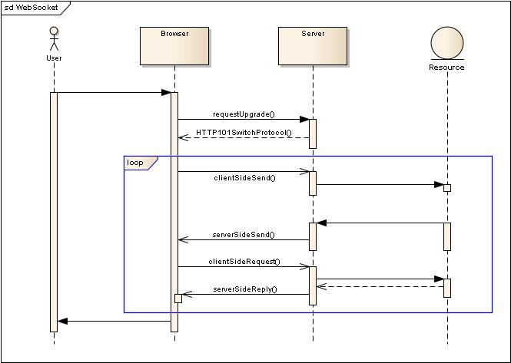
How it works: Web Sockets

Slide 50
React Architecture
APP
Virtual DOM
React Framework
Physical DOM
REACT
Component
Manipultates
Diff Algorithm
REACT
Component

Slide 51
Flux Architecture – Data Travels One Way

Slide 52
References
AngularJS: http://angularjs.org/
The WebSockets protocol: http://tools.ietf.org/html/rfc6455
Node.js: http://www.nodejs.org/
Play! Framework: http://www.playframework.com/

