Slide 1
Software Design with Functional Languages: Deep dive into software design patterns

Slide 2
The reemergence of Functional
Functional languages have been around since the 1950’s but have not found much adoption outside of academic circles or special use cases.
Difficult to reason about
Difficult syntax
Difficult to work with common idioms such as looping and dealing with state
Today newer languages have been adding functional capabilities, or in the case of Scala, a blend of functional and object oriented capabilities
Why
Functional languages are more concise (DRY)
Functional languages support immutability, which is very important in developing highly scalable applications

Slide 3
We also need to address legacy challenges such as too much Boilerplate
Consider something simple in Java:
And the equitant in Scala:
Java promotes an imperative style – “Do this, then this, then this” – but a functional style is about “transformation of values” using functions – “what do you want to do”
int [] array = {1,2,3,4,5};
int [] array2 = new int[5];
for (int i = 0; i < array.length; i++)
array2[i] = array[i] * 2;
for(int i = 0; i < array2.length; i++)
System.out.println(array2[i]);
val array = Array(1,2,3,4,5);
val array2 = array.map(_ * 2);
array2.foreach(println(_))

Slide 4
Features found in functional languages
Avoiding/minimizing side effects
Features to promote immutable development
Side-effect free functions – outputs produced only using inputs
Referential transparency – able to replace a function with its outputs without changing the programs behavior
Functions are first-class citizens
Higher order functions – functions that take or return other functions as parameters
Currying and Partial functions – defining functions out of other functions
Building abstractions via composition
Lambdas and Closures
Lazy evaluation
Recursion, especially efficient tail-recursion over looping
Functional processing of collections
Advanced type systems and type inference

Slide 5
Benefits of FP
Debugging
Development of parallel code
Modularization of code
Code reuse

Slide 6
Benefits of getting started with FP using Scala
Blend of OO and Functional
Fully integrated with Java, leverages the JVM
Pattern matching
Closures done right
DSLs
Operator Overloading
Traits
Case Classes, Companion Objects
Implicits
Currying
Robust functional collections
List comprehensions

Slide 7
One of the best ways to learn about functional programming is to study design patterns
Design patterns are reusable solutions known to have good software engineering principles. They come in families, and we will look at:
Creational: focus on object creation
Factory Method
Lazy Initialization
Singleton
Structural: focus on simplifying ways to realize relationships between objects
Adapter
Decorator
Behavioral: focus on common communication patterns between objects
Value Class
Null Object
Strategy
Command
Chain-of-Responsibility
Dependency Injection

Slide 8
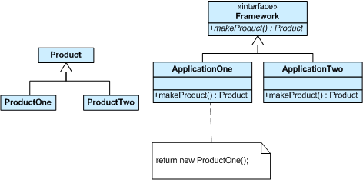
Factory Method Pattern
Type: Creational Patten
Usage: Provides an interface for creating objects
Allows the caller to specify which object to create from the “factory”
Specifies which object to create using a logical name
Hides the complexity of creating complex objects
Allows for caching objects

Slide 9
Factory Method - Java
public interface Animal {}
private class Dog implements Animal {}
private class Cat implements Animal {}
public class AnimalFactory {
public static Animal createAnimal(String kind) {
if ("cat".equals(kind)) return new Cat();
if ("dog".equals(kind)) return new Dog();
throw new IllegalArgumentException();
}
}
AnimalFactory.createAnimal("dog");

Slide 10
Factory Method - Scala
trait Animal
private class Dog extends Animal
private class Cat extends Animal
object Animal {
def apply(kind: String) = kind match {
case "dog" => new Dog()
case "cat" => new Cat()
}
}
Animal("dog")
We will see the use of object later, but its usage is to create a singleton instance, we also see scala pattern matching at work in this example

Slide 11
Lazy Initialization Pattern
Type: Creational Patten
Usage: Defers creating object until it is first referenced
Defers expensive computation until the object is actually needed
Can improve startup times for applications
May lead to reduced memory footprint as not every object is used or needed each time an application is executed

Slide 12
Lazy Initialization - Java
private volatile Component component;
public Component getComponent() {
Component result = component;
if (result == null) {
synchronized(this) {
result = component;
if (result == null) {
component = result = new Component();
}
}
}
return result;
}
With java, tag the property as volitale, and create a custom getter that defers creating the object until it is first accessed.

Slide 13
Lazy Initialization - Scala
lazy val x = {
print("(computing x) ")
42
}
print("x = ")
println(x)
// output is: x = (computing x) 42
Scala, being a functional language, supports lazy evaluation as a first-class citizen. Just decorate a val/var with “lazy”

Slide 14

Singleton Pattern
Type: Creational Patten
Usage: Restricts instance of a class to a single object
Single, global point to create instance
Limits number of object instances
Useful for libraries
Allows for lazy initialization (when values are computed at runtime)

Slide 15
Singleton – Java (Thread Safe)
public class SingletonDemo {
private static volatile SingletonDemo instance = null;
private SingletonDemo() { }
public static SingletonDemo getInstance() {
if (instance == null) {
synchronized (SingletonDemo .class){
if (instance == null) {
instance = new SingletonDemo ();
}
}
}
return instance;
}
public void doSomething() {
//do something useful here
}
}
SingletonDemo.getInstance().doSomething(); //run it

Slide 16
Singleton – Java (Simple)
public class Cat {
private static final Cat instance = new Cat();
private Cat() {}
public void doSomething() { /* do something here */}
public static Cat getInstance() {
return instance;
}
}
Cat.getInstance().doSomething();
Java uses static and final to ensure that a single instance is created

Slide 17
Singleton – Scala (Thread Safe)
object SingletonDemo {
def doSomething() {
//do something useful here
}
}
SingletonDemo.doSomething() //run it
Scala singletons are built in. The object keyword can be used by itself, or an object can be a companion of a class

Slide 18
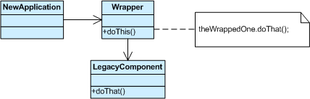
Adapter Pattern
Type: Structural Patten
Usage: Converts an interface of a class into an “expected” interface
Wraps one classes interface with an alternative that expected
Useful when you want to adapt existing components into an application, framework or library

Slide 19
Adapter – Java
public interface Log {
void warning(String message);
void error(String message);
}
public final class Logger {
void log(Level level, String message) { /* ... */ }
}
public class LoggerToLogAdapter implements Log {
private final Logger logger;
public LoggerToLogAdapter(Logger logger) { this.logger = logger; }
public void warning(String message) { //wraps encapsulated object
logger.log(WARNING, message);
}
public void error(String message) { //wraps encapsulated object
logger.log(ERROR, message);
}
}
Log log = new LoggerToLogAdapter(new Logger());

Slide 20
Adapter – Scala
trait Log {
def warning(message: String)
def error(message: String)
}
final class Logger {
def log(level: Level, message: String) { /* ... */ }
}
implicit class LoggerToLogAdapter(logger: Logger) extends Log {
def warning(message: String) { logger.log(WARNING, message) }
def error(message: String) { logger.log(ERROR, message) }
}
val log: Log = new Logger() //basically equals //val log = new LoggerToLogAdapter(new Logger())
This might take a little time to get your head around but scala has the notion of “implicit”s – with this feature the compiler can imply what to do from the code context. So, in this case an implicit class extends Log, so therefore when an object of type Log is created, scala will wrap that object with LoggerToLogAdapter ☺.

Slide 21
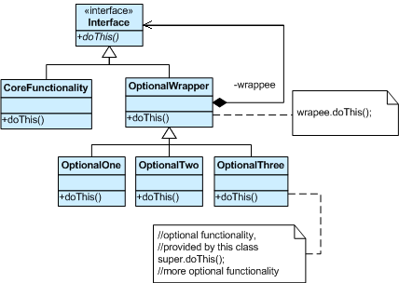
Decorator Pattern
Type: Structural Patten
Usage: The decorator pattern is used to extend the functionality of a particular object, without impacting other objects created from instances of the same class
Flexible alternative to subclassing
Useful when the goal is to combine several different ways that a base class can be extended
Useful if the extensions can be stacked/chained

Slide 22
Decorator – Java
public interface OutputStream {
void write(byte b);
void write(byte[] b);
}
public class FileOutputStream implements OutputStream { /* ... */ }
public abstract class OutputStreamDecorator implements OutputStream {
protected final OutputStream delegate;
protected OutputStreamDecorator(OutputStream delegate) {
this.delegate = delegate;
}
public void write(byte b) { delegate.write(b); }
public void write(byte[] b) { delegate.write(b); }
}
public class BufferedOutputStream extends OutputStreamDecorator {
public BufferedOutputStream(OutputStream delegate) {
super(delegate);
}
public void write(byte b) {
// ...
delegate.write(buffer)
}
}
new BufferedOutputStream(new FileOutputStream("foo.txt"))
In java, the decorator pattern is usually implemented by delegating from the extended class to the base class

Slide 23
Decorator – Scala
trait OutputStream {
def write(b: Byte)
def write(b: Array[Byte])
}
class FileOutputStream(path: String) extends OutputStream { /* ... */ }
trait Buffering extends OutputStream {
abstract override def write(b: Byte) {
// ...
super.write(buffer)
}
}
new FileOutputStream("foo.txt") with Buffering // with Filtering, ...
In scala, traits can be “mixed-in” using the with keyword, multiple mix-ins can be combined. This naturally simulates the decorator pattern with an out-of-the box scala feature. This binding is done at compile time so at run time this is very fast.

Slide 24
Value Class Pattern
Type: Behavioral Patten
Usage: A value class is an immutable object that has a set of properties
Equality is not based on the identity of the object. Value objects are equal if all of their properties are equal
Useful as data transfer objects (DTO)
Immutability is useful in multi-threaded applications

Slide 25
Value Classes – Java
public class Point {
private final int x, y;
public Point(int x, int y) { this.x = x; this.y = y; }
public int getX() { return x; }
public int getY() { return y; }
public boolean equals(Object o) {
// ...
return x == that.x && y == that.y;
}
public int hashCode() {
return 31 * x + y;
}
public String toString() {
return String.format("Point(%d, %d)", x, y);
}
}
Point point = new Point(1, 2)
In order to support the equality feature, hashCode() needs to be overridden to ensure that it is based on the values of the properties.

Slide 26
Value Classes– Scala
In Scala Tuple classes can be used to group objects. Scala has built in Tuple classes for Tuple2 to Tuple22
val point = (1,2) //new Tuple2(1,2)
Scala also has the ability to make Type aliases:
type Point = (Int, Int)
val point: Point(1,2)
In Scala case classes are like Java beans or value objects
case class Point (x:Int, y:Int)
val point = Point(1,2)

Slide 27
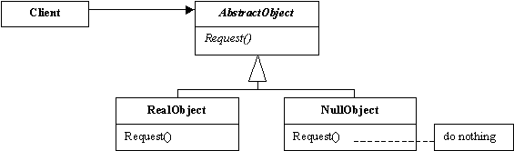
Null Object Pattern
Type: Behavioral Patten
Usage: Useful for a “do nothing” comparison – think of the absence of an instance of an object
Want to use a pattern to avoid setting instances to null and then checking for them in code with if(x == null) given that this leads to null pointer exceptions

Slide 28
Null Object – Java
public interface Sound {
void play();
}
public class Music implements Sound {
public void play() { /* ... */ }
}
public class NullSound implements Sound {
public void play() {}
}
public class SoundSource {
public static Sound getSound() {
return available ? music : new NullSound();
}
}
SoundSource.getSound().play();
A better implementation would have NullSound as a Singleton since all instances are the same
This pattern avoids code like:
if(SoundSource.getSound() != null) SoundSource.getSound().play() and ensures accidental calls to play without this check don’t generate a null pointer exception.

Slide 29
Null Object – Scala
trait Sound {
def play()
}
class Music extends Sound {
def play() { /* ... */ }
}
object SoundSource {
def getSound: Option[Sound] =
if (available) Some(music) else None
}
for (sound <- SoundSource.getSound) {
sound.play()
}
Scala has a predefined Option type that can take an optional value – it has a Some() part and a None part. In the above example sound only has a value if getSound() does not return None

Slide 30
The Null Object Pattern
In Java its common to deal with unexpected events by throwing exceptions or by checking for null:
In Scala Option is commonly used to clean up the code
if (device2 != null) then device2.start()
or
try{
device2.start();
} catch (Exception e) { /* do something */ }
Option(device2)map{_.start()}
This is another example of where Scala tries to manage down the use of exceptions, except for the case of dealing with exceptional (and/or unexpected) events.

Slide 31
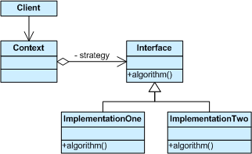
Strategy Pattern
Type: Behavioral Patten
Usage: Defines a family of encapsulated algorithms and lets the algorithm vary from the clients that use it.
Helpful when we need to select an algorithm at runtime – example perform validation based on the type of data
Avoid clients coupling themselves to a particular interface when the number of options is likely to change over time.

Slide 32
Strategy – Java
public interface Strategy {
int compute(int a, int b);
}
public class Add implements Strategy {
public int compute(int a, int b) { return a + b; }
}
public class Multiply implements Strategy {
public int compute(int a, int b) { return a * b; }
}
public class Context {
private final Strategy strategy;
public Context(Strategy strategy) { this.strategy = strategy; }
public void use(int a, int b) { strategy.compute(a, b); }
}
new Context(new Multiply()).use(2, 3);

Slide 33
Strategy – Scala
type Strategy = (Int, Int) => Int
class Context(stratImpl: Strategy) {
def use(a: Int, b: Int) = { stratImpl(a, b) }
}
val add: Strategy = _ + _
val multiply: Strategy = _ * _
new Context(multiply).use(2, 3)
Because scala supports passing functions as parameters an implementation of the strategy can be passed as an argument.

Slide 34
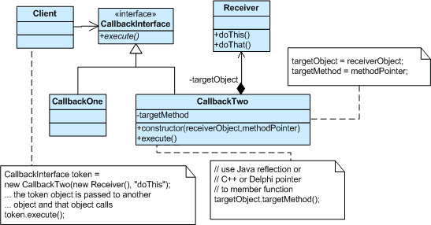
Command Pattern
Type: Behavioral Patten
Usage: This pattern is useful when we want to encapsulate the information needed to call a method at a later time
Useful to delay, sequence or log method calls
Need to issue a request to an object without knowing anything about the operation being requested or the receiver of the request

Slide 35
Command – Java
public class PrintCommand implements Runnable {
private final String s;
PrintCommand(String s) { this.s = s; }
public void run() {
System.out.println(s);
}
}
public class Invoker {
private final List<Runnable> history = new ArrayList<>();
void invoke(Runnable command) {
command.run();
history.add(command);
}
}
Invoker invoker = new Invoker();
invoker.invoke(new PrintCommand("foo"));
invoker.invoke(new PrintCommand("bar"));
In this example the history list is the receiver. Thus this list can be used to playback or redo commands that were executed via the invoker

Slide 36
Command – Scala
object Invoker {
private var history: Seq[() => Unit] = Seq.empty
def invoke(command: => Unit) { /* pass function by namex:=> Unit syntax */
command
history :+= command _ /* this is a shortcut for history :+= (() => command) */
}
}
Invoker.invoke(println("foo"))
Invoker.invoke {
println("bar 1")
println("bar 2")
}
Because scala supports passing functions as parameters, in this case command is passed as a function by-name, thus the command can be invoked and saved. The alternative by-value would invoke the function before the function is invoked. Note the unusual syntax “command _”, which means don’t execute the command, but save the command function in the history list. This could be replaced by (() => command), which may or may not be more readable.

Slide 37
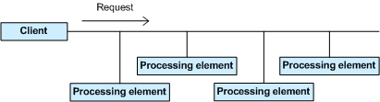
Chain of Responsibility Pattern
Type: Behavioral Patten
Usage: Useful when we want to avoid coupling the sender of a request to its receiver by giving more than one object the chance to handle the request.
One or more receivers may handle the request, which are processed sequentially.
Useful for “fire and forget” use cases

Slide 38
Chain of Responsibility – Java
public abstract class EventHandler {
private EventHandler next;
void setNext(EventHandler handler) { next = handler; }
public void handle(Event event) {
if (canHandle(event)) doHandle(event);
else if (next != null) next.handle(event);
}
abstract protected boolean canHandle(Event event);
abstract protected void doHandle(Event event);
}
public class KeyboardHandler extends EventHandler { // MouseHandler...
protected boolean canHandle(Event event) {
return "keyboard".equals(event.getSource());
}
protected void doHandle(Event event) { /* ... */ }
}
KeyboardHandler handler = new KeyboardHandler();
handler.setNext(new MouseHandler());
In Java this pattern is often handled by building a linked list within the object graph itself. A method decides if it can handle the event and if it wants to pass control onto the “next event in the list.

Slide 39
Chain of Responsibility – Scala
case class Event(source: String)
type EventHandler = PartialFunction[Event, Unit]
val defaultHandler: EventHandler = PartialFunction(_ => ())
val keyboardHandler: EventHandler = {
case Event("keyboard") => /* ... */
}
def mouseHandler(delay: Int): EventHandler = {
case Event("mouse") => /* ... */
}
keyboardHandler.orElse(mouseHandler(100)).orElse(defaultHandler)
In scala a PartialFunction[A,B] is defined as a function that is defined for a subset of values that type A can take on. For example the following function root is only defined for positive values.
val root: PartialFunction[Double,Double] = {
case d if (d >= 0) => math.sqrt(d)
}
Scala supports the orElse methods in partial functions to support chaining.

Slide 40
Dependency Injection Pattern
Type: Behavioral Patten
Usage: Avoids the use of hard-coded dependencies
Can be resolved at compile or runtime
Can be used to determine proper instance from multiple choices
Can be used to inject a mock instance for testing

Slide 41
Dependency Injection – Java
public interface Repository {
void save(User user);
}
public class DatabaseRepository implements Repository { /* ... */ }
public class UserService {
private final Repository repository;
UserService(Repository repository) {
this.repository = repository;
}
void create(User user) {
// ...
repository.save(user);
}
}
new UserService(new DatabaseRepository());
In Java this pattern is often used with a DI framework such as Spring – without such a framework needed dependencies are passed in as instances via the constructor

Slide 42
Dependency Injection – Scala
trait Repository {
def save(user: User)
}
trait DatabaseRepository extends Repository { /* ... */ }
trait UserService { self: Repository => // requires Repository
def create(user: User) {
// ...
save(user)
}
}
new UserService with DatabaseRepository
Scala supports a “requires-a” relationship between objects that is not not bound by an inheritance hierarchy. Notice that the UserService trait “injects” self: Repository. To implement this it mixes-in an instance using the with keyword.

Slide 43
References
Design Patterns in Scala: The WebSockets protocol: http://tools.ietf.org/html/rfc6455
Node.js: http://www.nodejs.org/
Play! Framework: http://www.playframework.com/

