Slide 1
SE 577 Software Architecture SPA, API, Linux, Docker & Kubernetes (k8s) Architecture Primer

Slide 2
Single Page Application Architecture - SPA
Web
Browser
Web Page
Web Component
Networking
Page Component
Component Template
Security
Children
Children
Component Styling
Layout Engine
Child
Child
Child
Child
Child
Component Behavior
Styling Engine
Component Events
C
C
C
C
C
C
C
C
C
Local Storage
Kind of Trivial but Web Pages can be thought of as a hierarchy of components, where components nest, the leafs of the webpage are native controls such as entry fields, static text, buttons, etc
Web Components in an SPA consist of a template for layout, styling for look/feel, Javascript/Typescript code to manage behavior, and an eventing framework to communicate with other web components
Javascript Engine
Google Maps
GMail

Slide 3
SPA Frameworks
Building SPAs by hand can be very complicated, over the years multiple frameworks and libraries have been introduced to make this easier. Top frameworks are React, Vue, Angular, and most recently Svelte.
SPA Architecture
Web Component
Web Component
Manager
SPA Framework
SPA Tooling
SPA Community
Component Template
Routing
Command Line Tools
Libraries
Create
Component Styling
Utilities
Destroy
State Management
Compiler Optimizer
Component Behavior
Lifecycle Events
Plugins
Rendering Optimizer
Packaging
Testing
Component Events
Component Events
Libraries
Event Manager
Prebuilt Components
Deployment
Google Maps
GMail

Slide 4
SPA Frameworks
SPA Components are event-driven, almost all interesting interactions happen over sending and reacting to asynchronous events.
SPA architectures often have abstractions for the network interfaces that treat ingress and egress network interactions as events
State management for SPAs (discussed soon) is often facilitated via variations to the flux pattern. This pattern features state being managed in an immutable store, and uses events to query, mutate or react to changes in the store
User interface updates are handled entirely locally, they can be full page swaps, which are driven by the router, or they can be incremental page updates based on reacting to user behavior (clicking a button, pressing a key, etc) SPA Web Components, via an interaction manager, can communicate with each other via sending events, and reacting to callbacks.
SPA Architecture
Router
SPA Rendering Controller
SPA WEB COMPONENTS
SPA Component Interaction Manager
Network
Events
State Management
Google Maps
GMail

Slide 5
SPA Component Interaction Best Practices
SPA Architecture
Remember, SPAs create hierarchies of components
There are strict parent/child relationships
Best practice, when a parent creates a child, it passes all properties that that child needs. These take the form of:
SPA Parent Component
callBackFunction(Parameters, …) {
…
} <CHILD prop= [p1,p2, pn], callback = [f1(), f2(), fn()] />
Properties, or props – think of these as a web component constructor, the parent passes data to the child for initialization
Callback functions – as the child component runs, sometimes it needs to notify the parent about interesting things, such as state changes or anything else of interest. The parent passes a callback function to the child, that the chid can use to interact with the parent
PROPERTIES AND CALLBACK FUNCTION REFERENCES
Callback Notifications
SPA Child Component
Setup(properties, …) callBackFunction(Parameters, …);
SPAs are very strict on flow of direction, properties flow down, callbacks / events flow up

Slide 6
Reference Architecture for REST
Availability Zone
Resource Manager
Security Identity Provider
API Gateway
REST Server
REST Server
REST Server
REST Server
REST Server
REST Server
Control Plane
Web Appliction FIREWALL (WAF)
REST Client
Layer 7 Load Balancer
FIREWALL
HTTP Interface
Availability Zone
Resource Manager
API Gateway
REST Server
REST Server
REST Server
REST Server
REST Server
REST Server
DNS (Lookup)
Control Plane

Slide 7
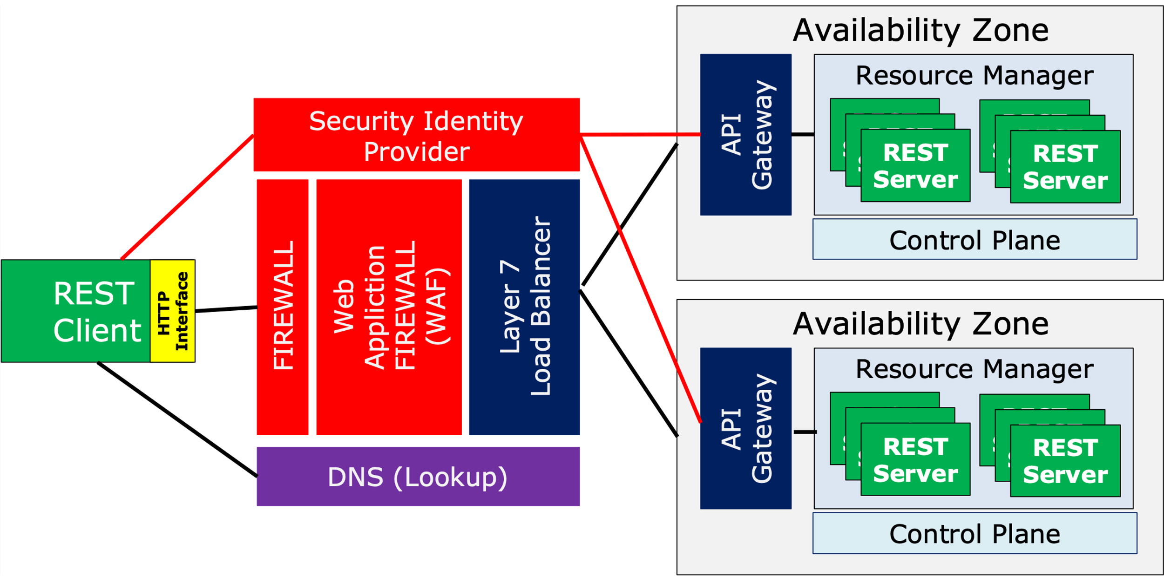
REST Architecture Components
Component | Description
REST Client | Component that makes API calls and receives responses from the REST Server
Firewall | Layer 2/3 firewall that deals with IP addressing, IP Routing and Port Filtering
WAF | Layer 7 (e.g, HTTP aware) firewall that supports protecting against HTTP attacks – SQL Injection, Bots, etc
L7 Load Balancer | Load balancer that distributes load and ensures health of downstream components – eg., the API Gateway. It works at Layer 7 so its optimized for HTTP protocol
Identity Provider (IdP) | A RESTFul security endpoint that handles authentication and authorization requests. Typically they issue tokens that can be used to assert trust
DNS | Location services for REST
API Gateway | An intelligent proxy that can load balance REST services, act as a security enforcement point, apply policies around traffic management and shaping, etc
Resource Manager/ Control Plane | An intelligent runtime that supervises running services. It can react to traffic congestion, errors, etc and can scale up/down running instances as needed
REST Server | Component that receives and processes REST Client calls

Slide 8
API Architecture
HTTP
Plugins e.g. CORS
API Framework
Plugins e.g. CORS
Plugins e.g. CORS
Plugins e.g. CORS
HTTP Library
Router
Request Middleware Pipeline
Response Middleware Pipeline
HTTP Library
Plugins e.g. CORS
API Library
Plugins e.g. CORS
API Router
Plugins e.g. CORS
Middleware e.g. oAuth
Middleware Pipeline Builder
YOUR CODE input (req) returns resp
Most API Frameworks/Libraries Use a Repository Style Architecture
API Library Utilities
We have used several in this course Koa, Fastify, GoLang Gin, Ktor, etc

Slide 9
How you should think about this lecture and the remainder of the lectures in this class
We will be looking at real world things that have very interesting architectures
You might be thinking as I introduce and walk through some of the material – “Isn't this an architecture class?” – It is, but to get to some of the interesting aspects of the architecture, tradeoffs, constraints, etc – we need to have a fundamental understanding of the technology itself

Slide 10
Linux Architecture
Linux is a layered architecture, the kernel sits close to the hardware and even has some hardwre specific code (e.g., x-64 vs ARM).
The code we run, tools, custom code, etc sits at the top layer
User code leverages the system call interface to bridge between user space and kernel space
When you pick a Linux distribution, they basically provide the stuff in the blue boxes
OS Tools bash, ls, chmod, …
Your Code and
Applicaitons (node, chrome, etc)
User Space
System Call Interface Library (glibc, musl)
Linux Kernel
System Call Interface
Linux Kernel
Kernel Space
Hardware Architecture Specific Kernel Code
Hardware Specific Device Drivers
Note the actual linux architecture is significantly more complex, but this should suffice for our needs

Slide 11
Linux Namespaces
When linux boots, it synthesizes process Id (pid) 1 - its called the init process, often implemented by the systemd process. This process is used to spawn all other processes in the system.
One way linux can create a child process is via the clone syscall. By default the new child process runs in the same execution context as the parent. Processes in the same execution context share a common linux namespace.
The clone system call also provides options to allow the child to be put in separate namespaces.
Linux currently supports 7 different namespaces – CGroup, IPC, Network, Mount (filesystem), PID, Time, User (user permissions and groups), UTS
Process
Clone systcall
New Process
Processes that have attributes that run in a common namespace are not isolated, processes with different namespaces are

Slide 12
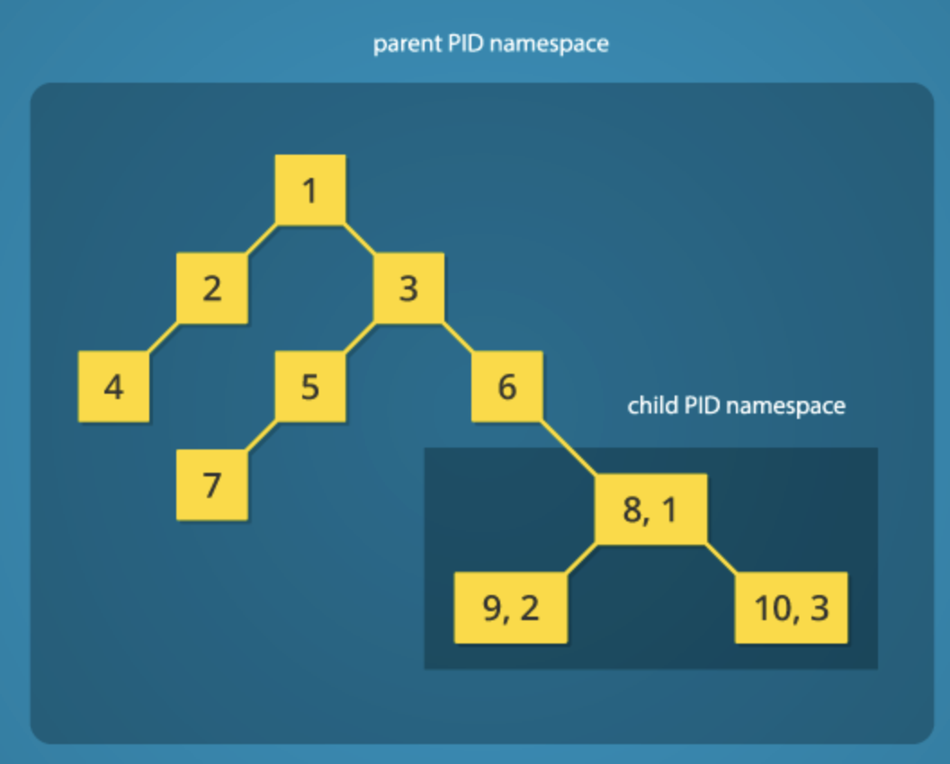
Linux Namespaces – Example, cloning a child process into a new process/pid name space
Ultimately every process is given a unique id in the guest operating system. Thus if you listed all processes in the system you would see PID 1-10.
However look at pid 6 it cloned PID8, and PID8 cloned both PID9 and PID10
The cool thing is that if you asked PID 8 what its process ID is it would come back as 1; Same for pid9 and 10, they would come back as 2 and 3.
Thus everything in the child namespace can see each other, but it cannot see anything in the partent namespace.

Slide 13
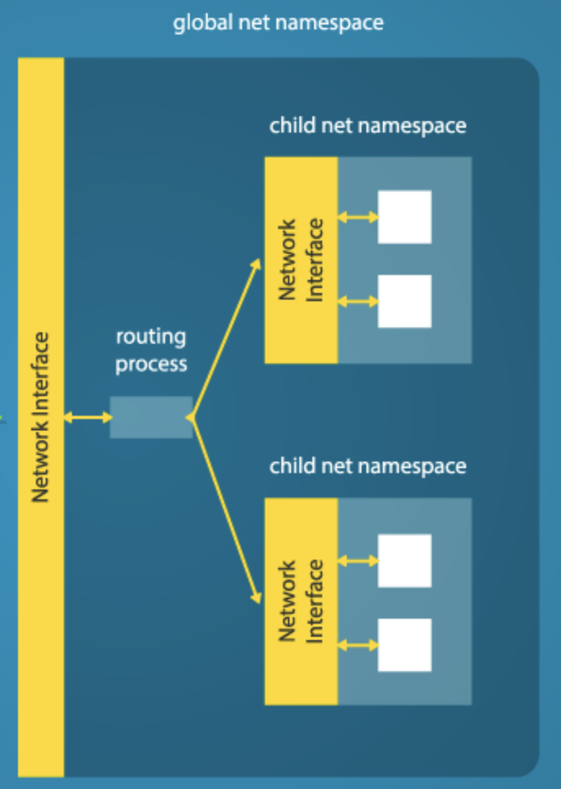
Linux Namespaces – Example, cloning a child process into a new network namespace
Ultimately every process is given a unique id in the guest operating system. Thus if you listed all processes in the system you would see PID 1-10.
However look at pid 6 it cloned PID8, and PID8 cloned both PID9 and PID10
The cool thing is that if you asked PID 8 what its process ID is it would come back as 1; Same for pid9 and 10, they would come back as 2 and 3.
Thus everything in the child namespace can see each other, but it cannot see anything in the partent namespace.

Slide 14
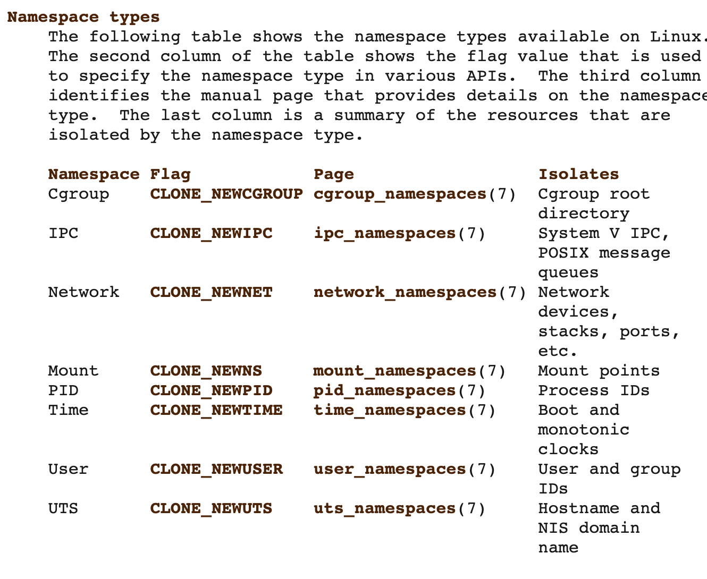
Linux Namespaces – allow for logical isolation in linux
If you clone a child process into a new namespace for all namespace types, it will for all practical purposes be fully isolated from the parent.
Also, if the isolated process creates new processes it will inherit by default the same namespace as the parent thus allowing process groups to be isolated

Slide 15
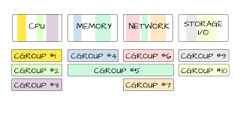
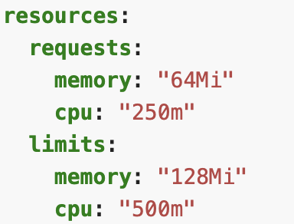
Linux Cgroups – managing resource limits on collections of processes - /sys/fs/cgroup/…
Cgroups allow resource limits to be attached to a collection of processes.
For example you might want to restrict how much network and file I/O can be used and also cap CPU at ½ of a core
In this example we are requesting an initial allocation of 64Mb of memory and 250 millicores (1/4 of a physical core), and allowing it to burst up to the limit of 128Mb of memory and 500 millicores (1/2 of a physical core

Slide 16
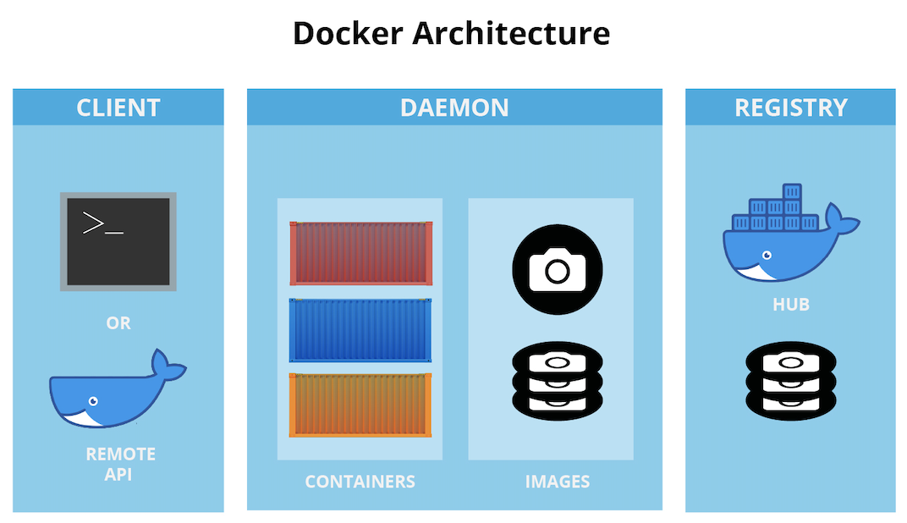
Docker
Now that we know how linux can isolate process groups (namespaces) and resources (cgroups) we can better understand the docker architecture
Managing Docker
Running Containers
Getting Containers

Slide 17




Docker Daemon and Linux
On windows and Mac the docker daemon is required and runs a customized, container optimized version of linux in a hypervisor. On linux machines the daemon does not use a hypervisor because it has access to the linux kernel
General Purpose Linux Distributions
Container Optimized Linux Distributions

Slide 18
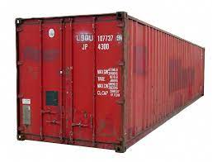
The docker container
The docker container is a portable package containing everything needed to run your workload. It adheres to the open container initiative specification https://opencontainers.org/
Linux Process in Separate Namespace/CGroup
EXPOSED PORT
Docker Container
Your Code & Dependencies
Isolated Filesystem
CMD or EXEC
Attached Storage
Base Image Tooling
Base Image System Call Interface Lib
The shipping container transformed logistics
System Call Interface
Linux Kernel

Slide 19
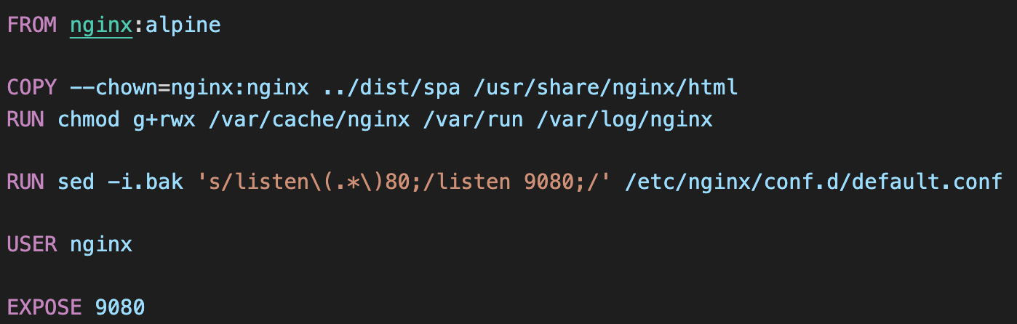
Building Docker Containers
Docker Container
Create Ephemeral Writable Layer
Expose port 9080
Set the user to nginx
Run script to set default port for nginx to 9080
Copy SPA code into /usr/share/nginx/html + change owner to nginx
Alpine-Based OS and Tools with Nginx Installed

Slide 20
Building Docker Containers
docker build -t architecting-software/se577-demo-app -f Dockerfile .
Docker Container
Create Ephemeral Writable Layer
Expose port 9080
Set the user to nginx
Run script to set default port for nginx to 9080
Copy SPA code into /usr/share/nginx/html + change owner to nginx
Alpine-Based OS and Tools with Nginx Installed
docker build –squash –t architecting-software/se577-demo-app -f Dockerfile .
Docker Container
Create Ephemeral Writable Layer
Have nginx running running and exposing port 9080, with our code in the /usr/share/nginx/html directory with file ownership of nginx

Slide 21
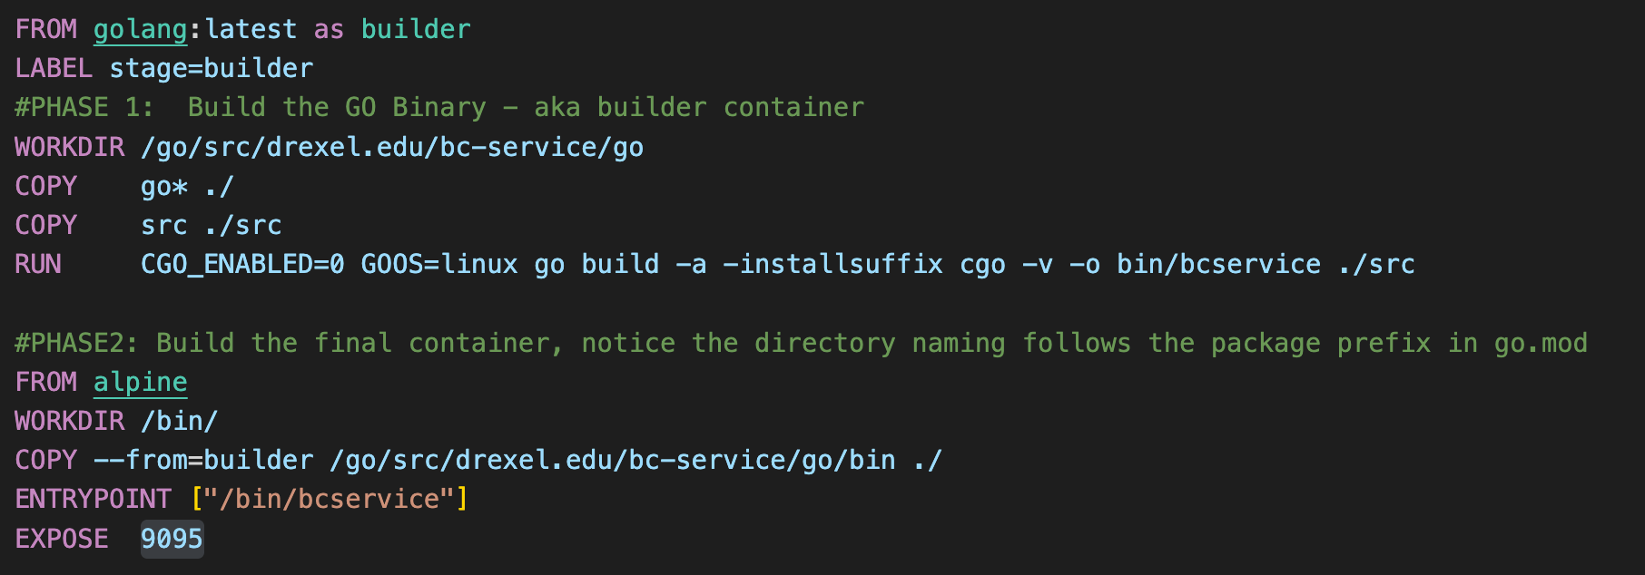
Building Docker Containers
Its not uncommon to create a build process where you create a build container first and then use the output of that build container to create your final container
Build Container
Run Container

Slide 22
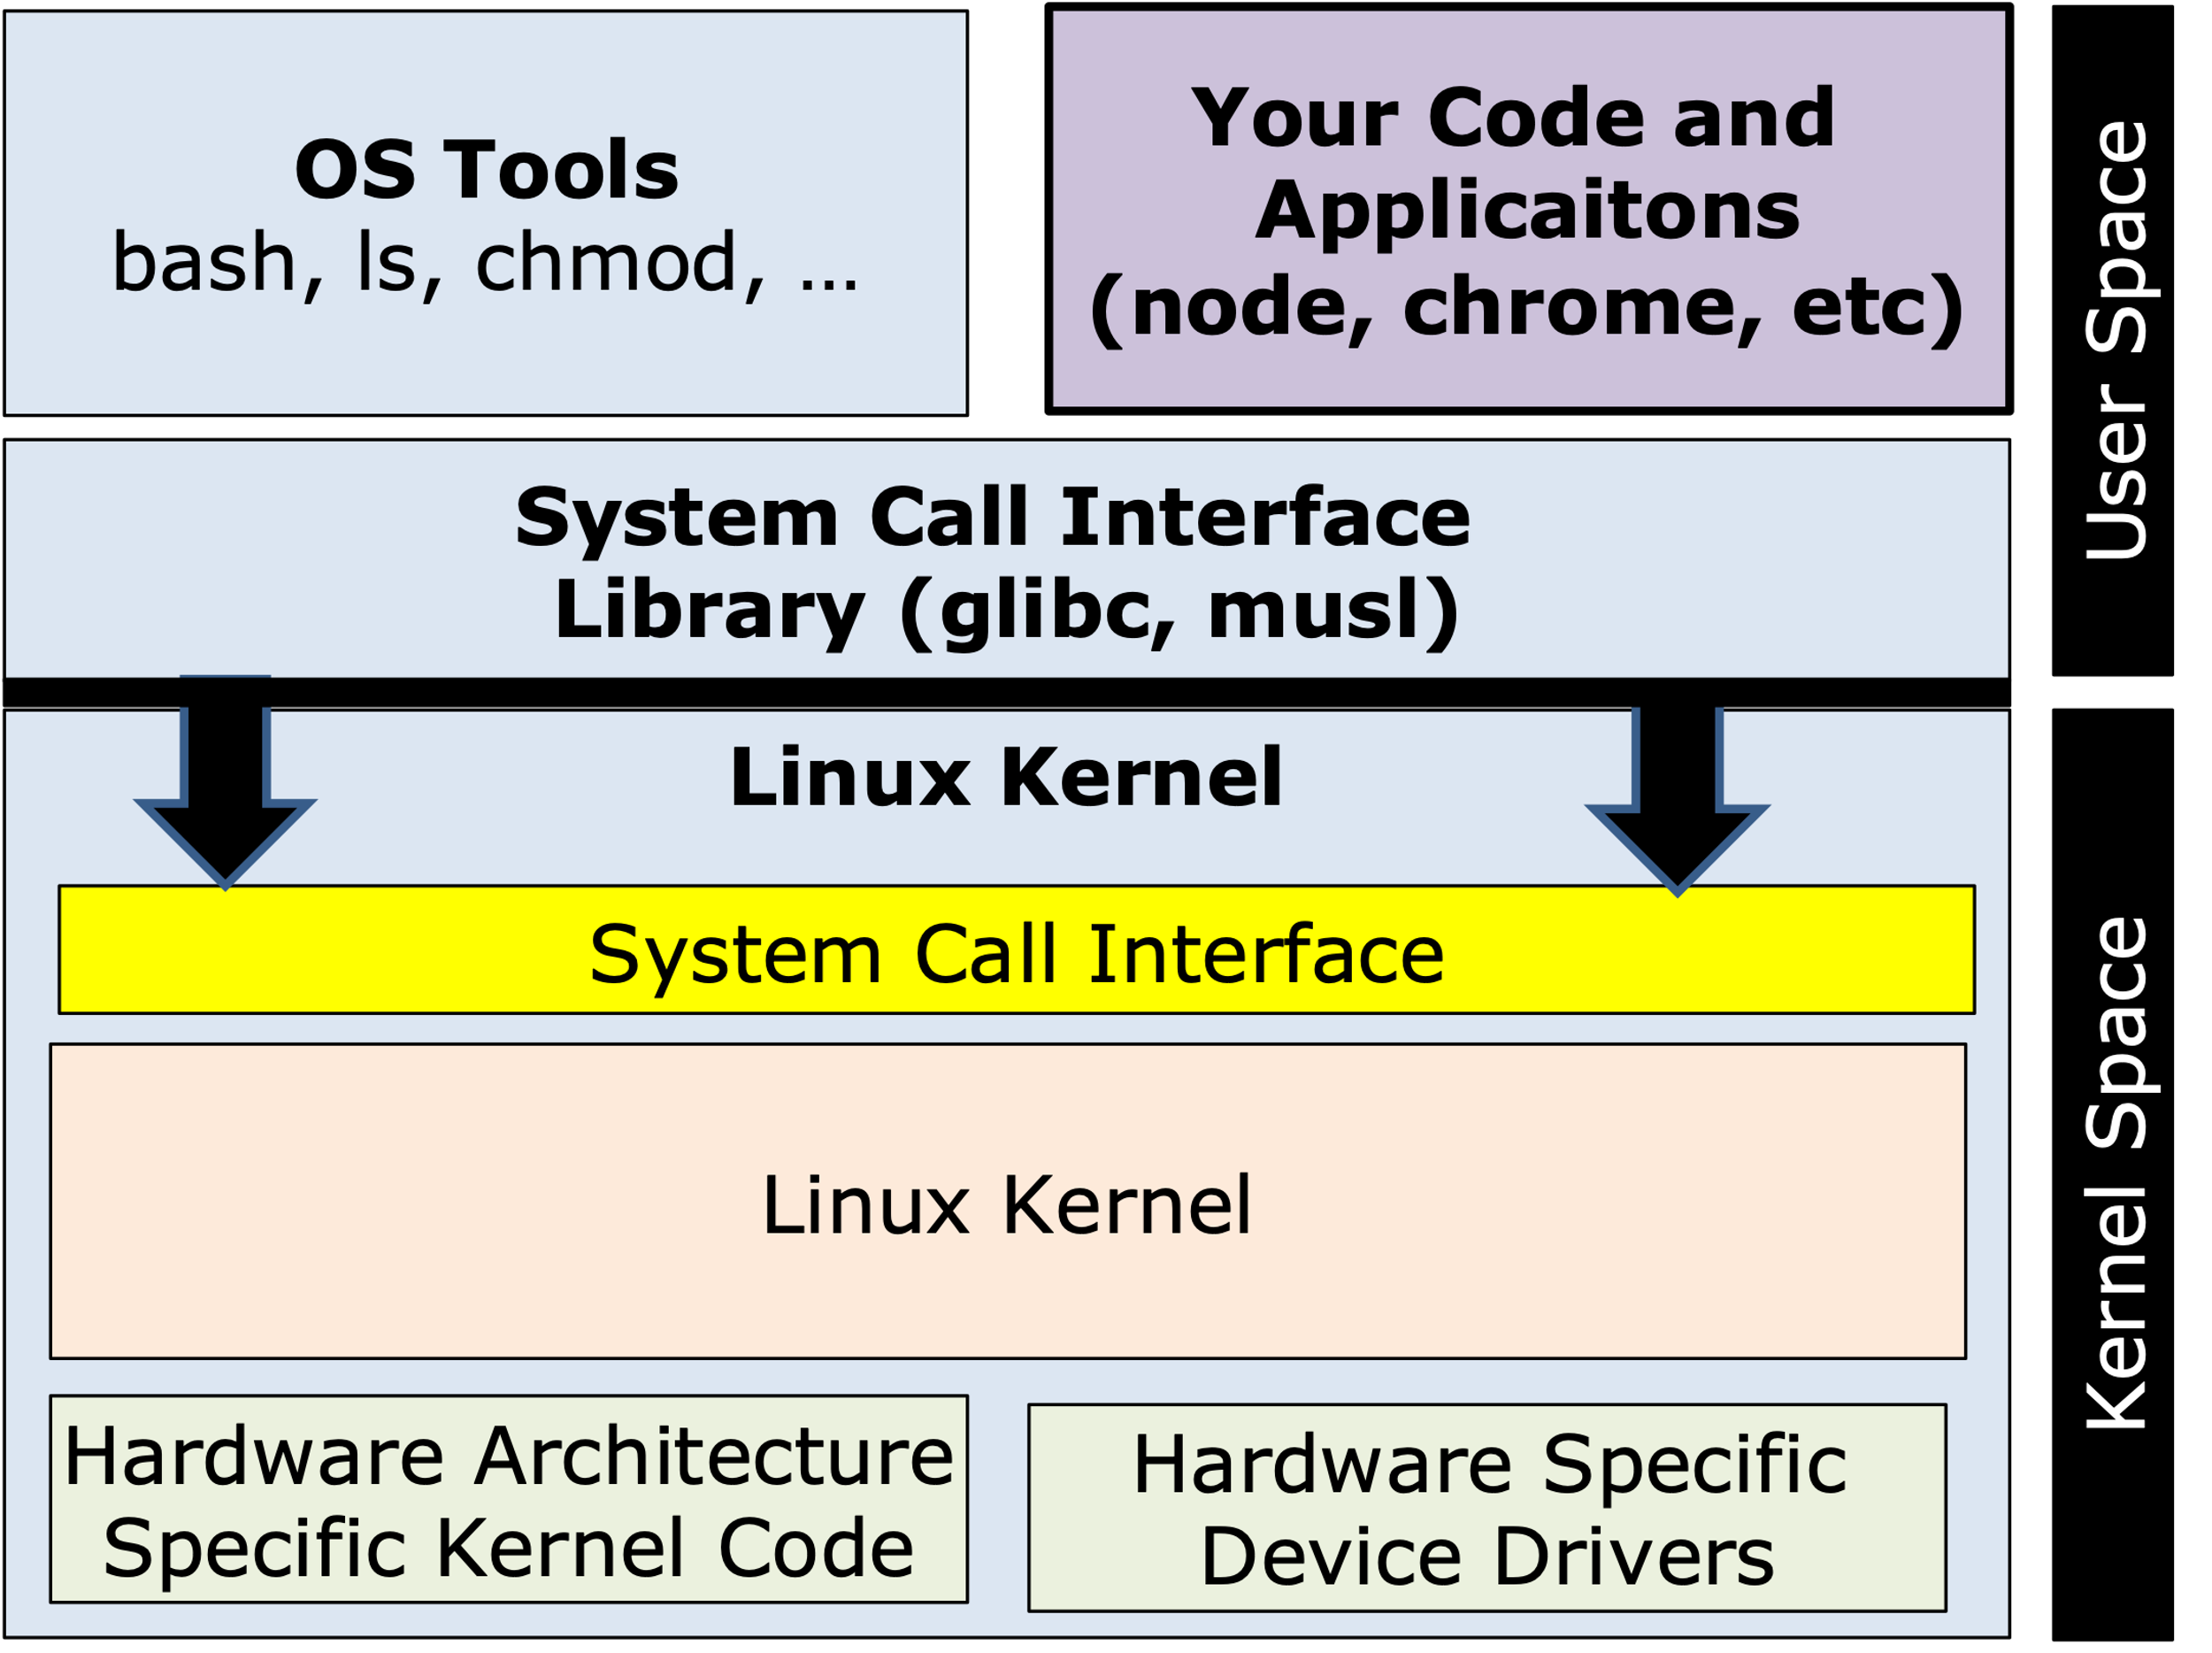
What OS Kernel does a container use?
Note the base container is created from an OS image in this example
FROM alpine
OS Tools bash, ls, chmod, ps, etc
System Call Interface Library (glibc, musl)
Host Machines Kernel

Slide 23
Architecting for containers
Generally containers run one process, and are expected to do one thing. Thus we need a way for containers to work together to build useful architectures
Node Blockchain API (container)
Browser Running Vue SPA
Vue demo application (container)
Go Blockchain API (container)
GitHub API (external)

Slide 24
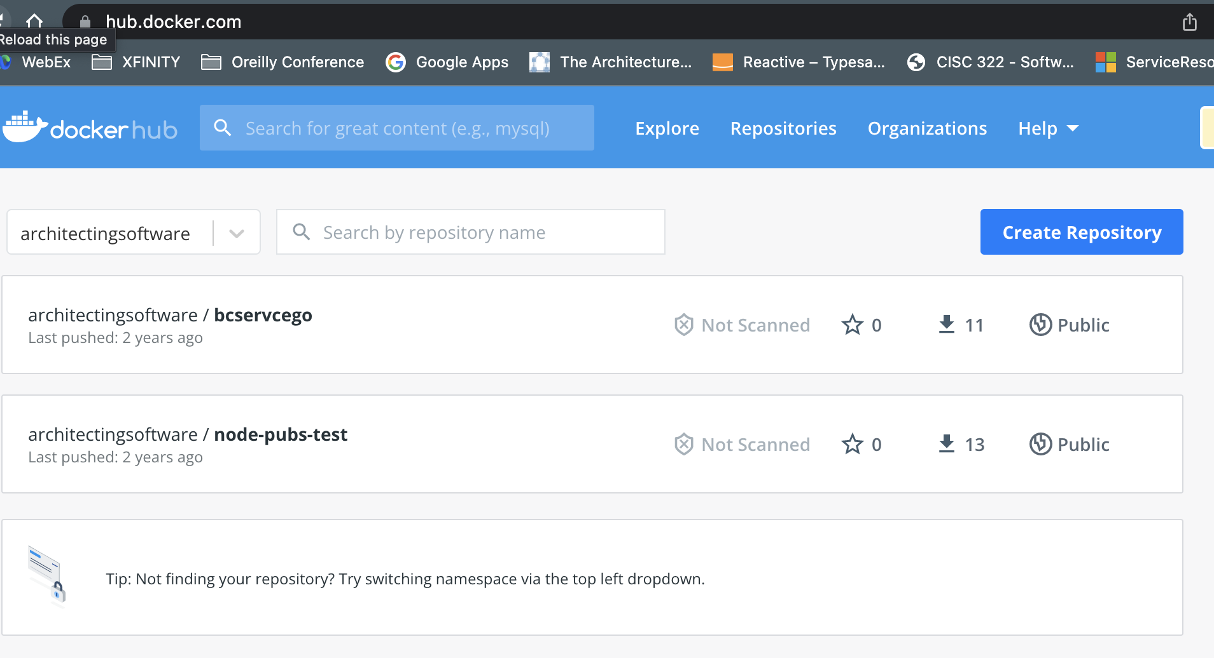
Container Repositories
After containers are created, they are generally pushed to a container repository. These could be public or private
Manage Container Versions
Push Containers on Build
Pull Containers When Needed

Slide 25
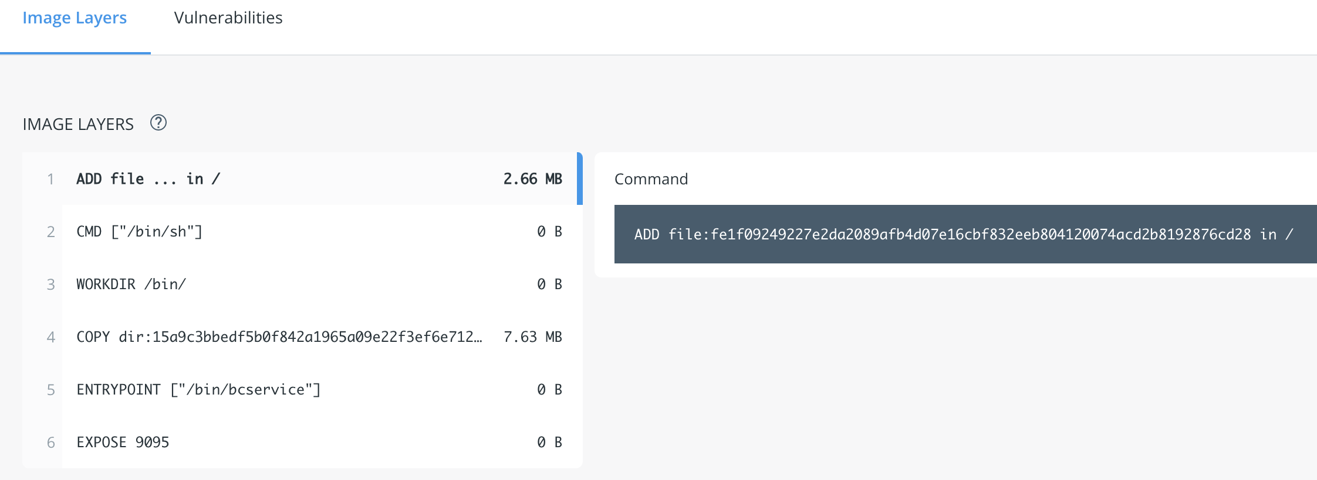
Container Repositories
Container repositories also keep track of the container layers and can do other things like scan for security vulnerabilities

Slide 26
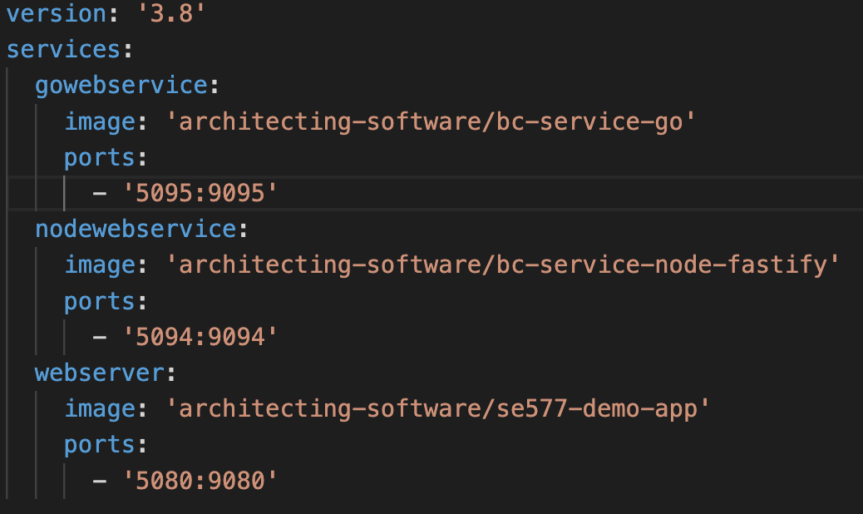
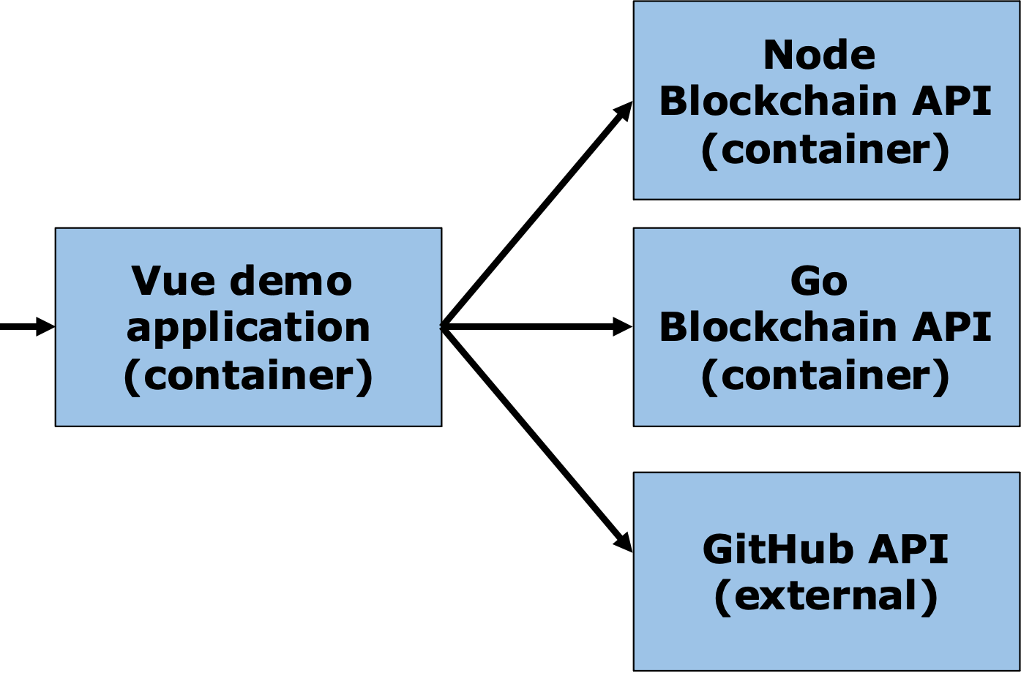
Using Docker-Compose
Generally containers run one process, and are expected to do one thing. Thus we need a way for containers to work together to build useful architectures
Port 5094
Port 5080
:9095
External Port 443 https
Docker compose allows us to bring up collections of containers via docker-compose up, and docker-compose down

Slide 27
Architectural Issues with Docker-Compose
Docker compose does not supervise the running environment
What happens if the process in this container crashes?
Port 5094
Port 5080
What happens if this container is getting slammed with traffic?
Port 5095
External Port 443 https

Slide 28
Running Containers at Scale In Production
Containers are ephemeral – this is a big deal – every time its run it has the same starting state
Containers can be distributed via container repositories and inherit other benefits like ensuring the proper containers are used, they are secure, etc
But containers alone are not enough:
They need to be “supervised” – are they healthy, have they crashed, do they need to be restarted?
They need to be distributed to prevent against issues when their runtime crashes
They need to be aware of load so they can autoscale up, and autoscale down
They need to be isolated, so only container workloads that interact with each other can interact with each other

Slide 29
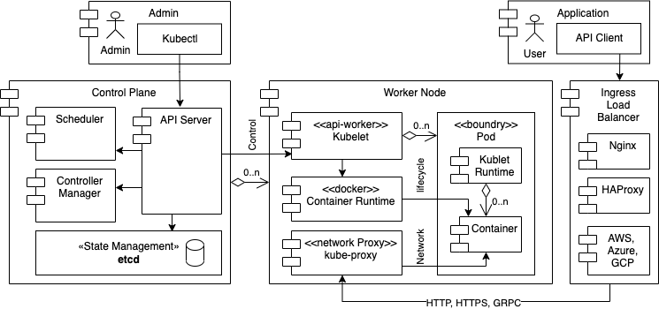
Running Containers at Scale In Production – Kubernetes or k8s

Slide 30
Running Containers at Scale In Production – Kubernetes or k8s
Everything managed via APIs
Control & Data Plane are High Availability
Container Work is Supervised
Target Configuration is Persisted, Tracked and kept up to date
Container Work & Network is Isolated

Slide 31
Running Containers at Scale In Production – Kubernetes or k8s - Pods
Most of the time pods run one container, the kubelet manages the pod runtime
Kubernetes Pod
Namespaces are used to govern what is shared between containers in the “pod” such as IPC, and things across the Kubernetes cluster such as network
Kubernetes Pod
Ip: w.x.y.z
Each k8s pod is given a routable
IP address
Each container in the pod can be reached via a port on that IP address
Kublet Runtime
Kublet Runtime
Container
Container
Container
Container
Container
Container
Container
Container
Container
Container port: xx

Slide 32
Running Containers at Scale In Production – Kubernetes or k8s – Core K8s Objects
Managing Kubernetes can be complex, but you can get by with just a few of the k8s objects
Kubernetes Deployment
Kubernetes Service
Kubernetes Ingress
Kubernetes Replica Set
type ClusterIP
Inbound Ingress Rules
Kubernetes Pod
type NodePort
Routing Rules
Kubernetes Pod
Kubernetes Pod
Kubernetes Pod
type LoadBalancer
Firewall/Security Rules

