Slide 1
SE 577 Software Architecture Intro to Software Architecture

Slide 2
What is Software Architecture?
The fundamental organization of a system, embodied in its components, their relationships to each other and the environment, and the principles governing its design and evolution.
ANSI/IEEE Std 1471-2000, Recommended Practice for Architectural Description of Software-Intensive Systems.

Slide 3
What is Software Architecture? (cont’d)
A software system architecture comprises:
A collection of software and system components, connections, and constraints.
A collection of system stakeholders' need statements.
A rationale which demonstrates that the components, connections, and constraints define a system that, if implemented, would satisfy the collection of system stakeholders' need statements.
Boehm, et al., 1995

Slide 4
What is Software Architecture? (cont’d)
An architecture is the set of significant decisions about the organization of a software system, the selection of the structural elements and their interfaces by which the system is composed, together with their behavior as specified in the collaborations among those elements, the composition of these structural and behavioral elements into progressively larger subsystems, and the architectural style that guides this organization---these elements and their interfaces, their collaborations, and their composition
P. Kruchten: The Rational Unified Process.

Slide 5
What is Software Architecture? (cont’d)
As the size and complexity of software systems increases, the design problem goes beyond the algorithms and data structures of the computation: designing and specifying the overall system structure emerges as a new kind of problem. Structural issues include gross organization and global control structure; protocols for communication, synchronization, and data access; assignment of functionality to design elements; physical distribution; composition of design elements; scaling and performance; and selection among design alternatives. This is the software architecture level of design.
Garlan and Shaw, 1999

Slide 6
Every system has an architecture, regardless if it was planned or not planned
Every system comprises elements and relations among them to support some type of reasoning.
But the architecture may not be known to anyone.
Perhaps all of the people who designed the system are long gone
Perhaps the documentation has vanished (or was never produced)
Perhaps the source code has been lost (or was never delivered)
An architecture can exist independently of its description or specification.
Documentation is critical.

Slide 7
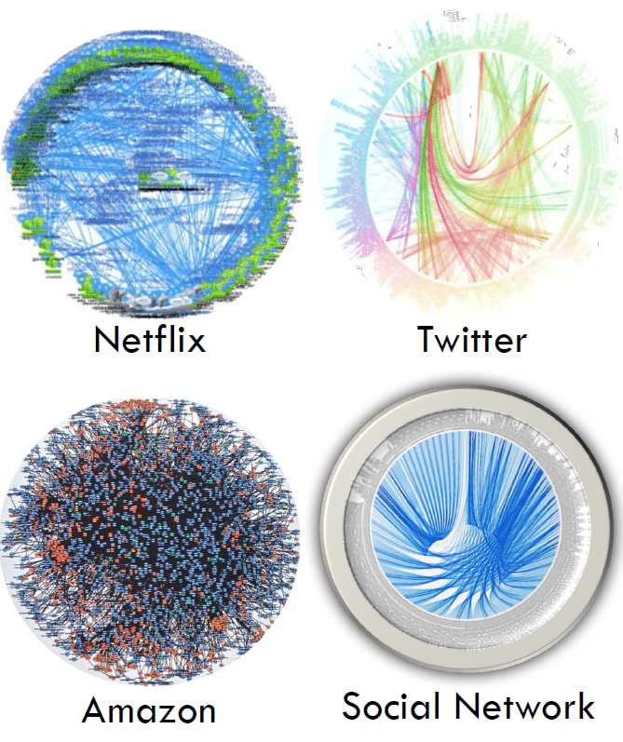
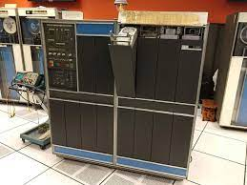
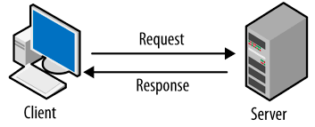
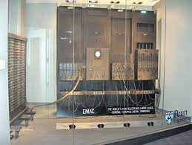
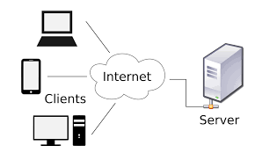
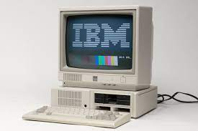
But why do we need architecture?
Massively Scaled Cloud Architectures
Batch Business Processing on Mainframes
Basic Client/Server
monolythic applications on a desktop computer
Basic Web Applications
Purpose Built Computers
1940s
1960s
1980s
1990s
2000s
2010s
2020s

Slide 8
But why do we need architecture?
Massively Scaled Cloud Architectures
Batch Business Processing on Mainframes
Basic Client/Server
Complex, Highly Integrated and Distributed Systems built by very large teams
Able to build things with relatively small isolated teams
Monocytic applications on a desktop computer
Basic Web Applications
PRE-NEED FOR SOFTWARE ARCHITECTURE
NEED FOR SOFTWARE ARCHITECTURE
Purpose Built Computers
1940s
1960s
1980s
1990s
2000s
2010s
2020s
Growth of number of Components in System

Slide 9
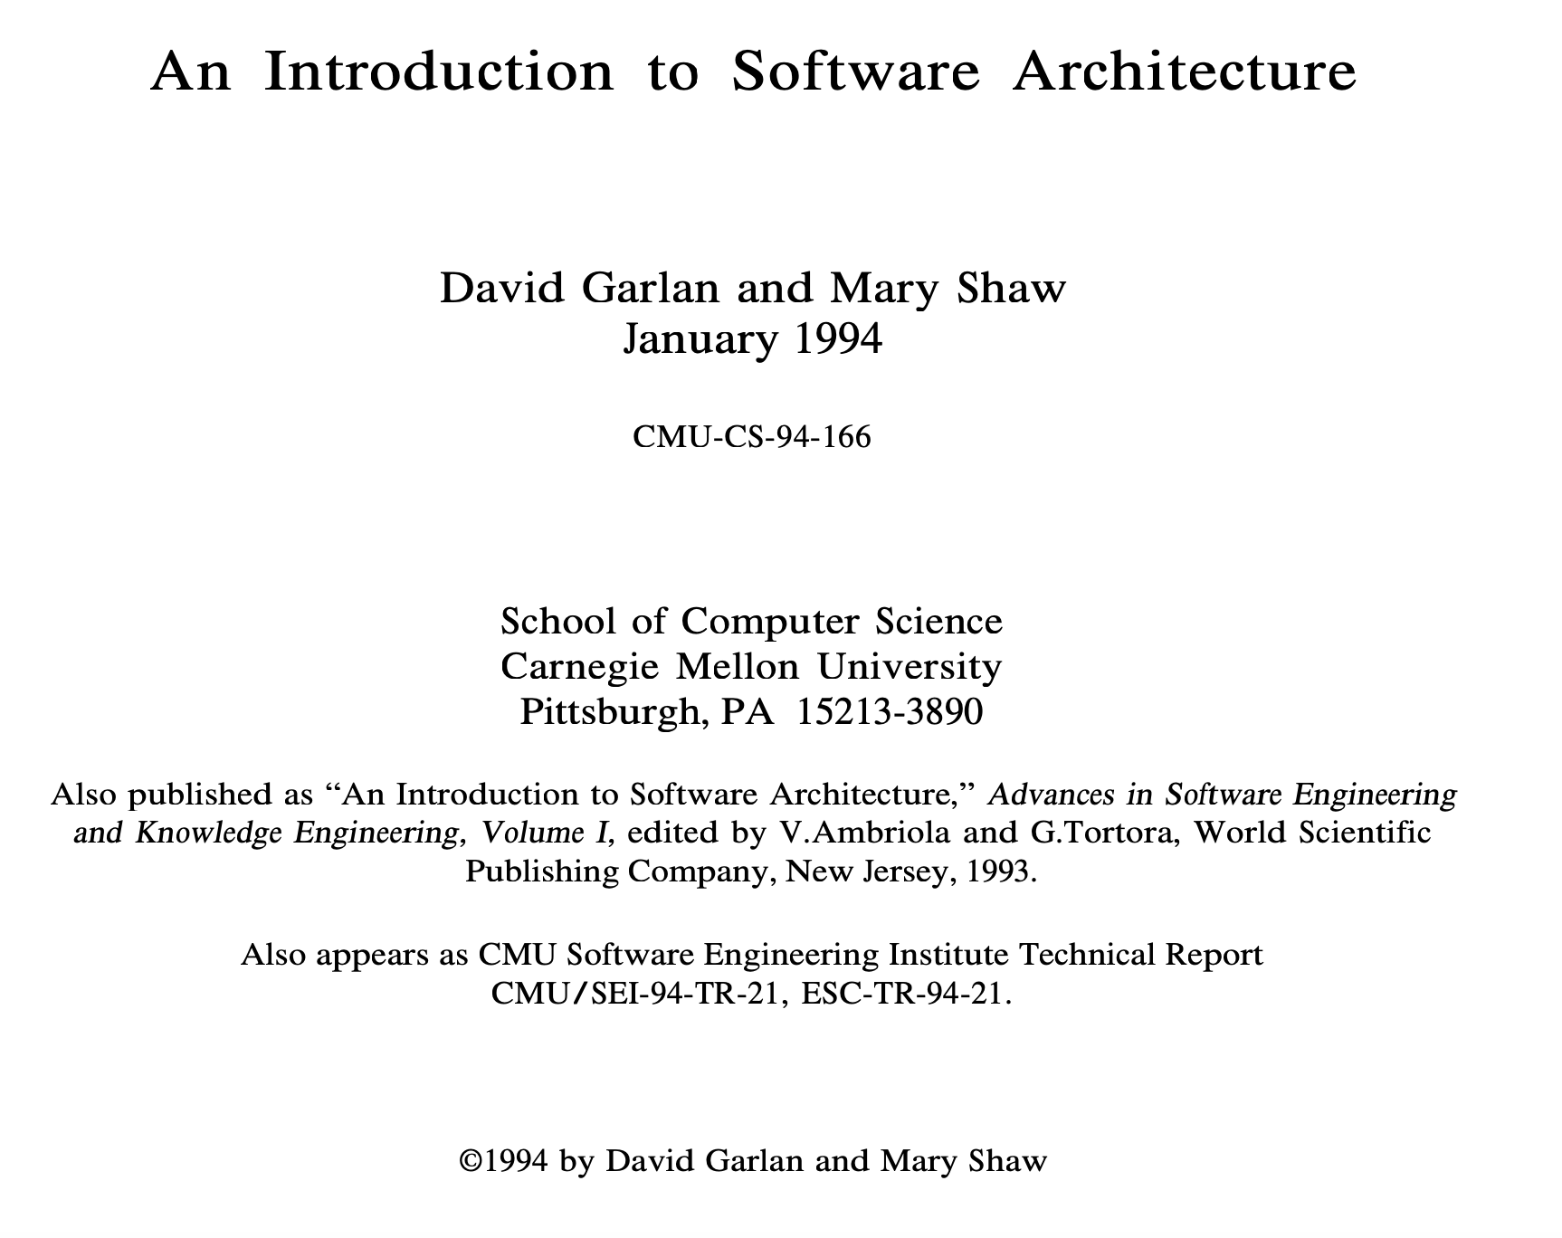
But why do we need architecture?
The Seminal Paper Describing the Need for Software Architecture

Slide 10
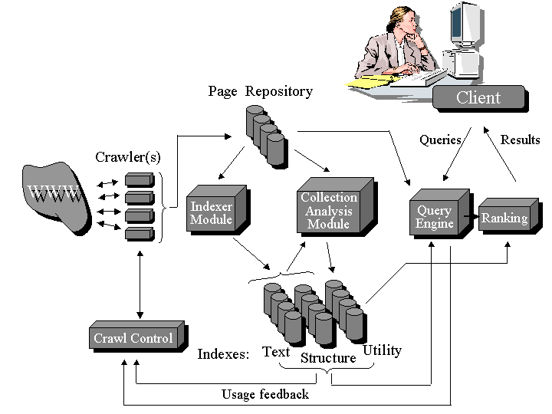
General Search Engine Architecture (Arvind)

Slide 11
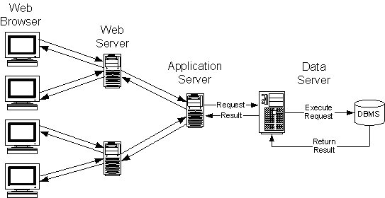
Multi-tier Architecture

Slide 12
Software Architecture as a Design Activity
It’s about software design
All architecture is software design, but not all design is software architecture
Part of the design process
Simply, architecture focuses on issues that will be difficult/impossible to change once the system is built
Quality attributes like security, performance
Non-functional requirements like cost, deployment hardware
More on these later in this course
Generally architecture is about the effective management of constraints on the to be built system

Slide 13
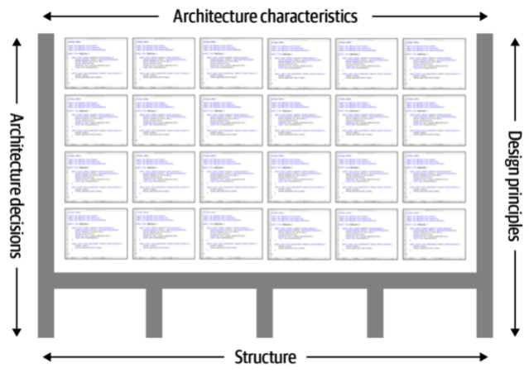
Software Architecture in the Context of Design
The design and code stuff is in here
Architecture is key to constraining and structuring the design of systems
Ref: Fundamentals of Software Architecture – N. Ford & M. Richards

Slide 14
Architecture is Expressed using Models
Software architecture emerged when it was becoming obvious that designs are too complicated to develop from scratch (circa early 1990s)
Good designs tend to be build using models…
1) Abstract different views of the system
2) Build models using precise notations (e.g., UML)
3) Verify that the models satisfy the requirements
4) Gradually add details to transform the models into the design
And such models can be derived from proven/established architecture patterns – more on this later

Slide 15
Architecture Abstractions
There are different techniques to perform software architecture analysis…
Reference Architecture – focus is on the broad domain
Solution Architecture – focus on the solution space
Software Architecture – focus on the key technical abstractions
As well as a diversity of use cases where this information can be useful…
New product definition
Monitoring design quality (trends)
Redocumenting and/or extending the lifespan of existing systems
The “art” of architecture is to pick the correct abstractions based on the desired objectives or outcomes

Slide 16
Architecture Framing
When thinking about a reference-, solution-, or software architecture focus on:
Who is the constituent – aka, who am I trying to talk to or influence
What do I want them to understand – aka, why am I talking about architecture
What are the benefits, constraints, or tradeoffs associated with the architecture I am describing
If you cant answer any/all of the above questions the impact of your architectural work will likely be sub-optimal
We will look at documentation approaches later, but I’m not necessarily a big fan of standard notations – more on that later.

Slide 17
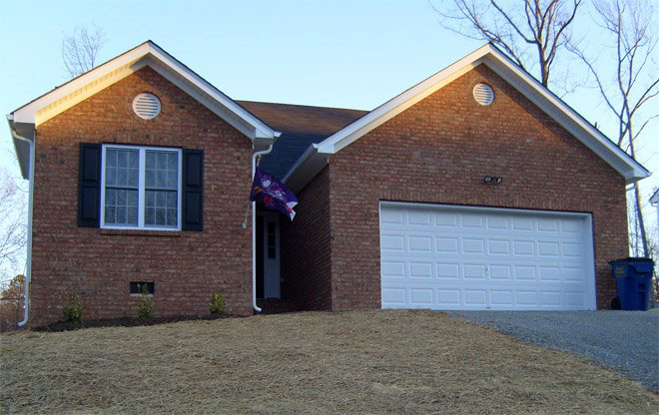
Architecture Done Poorly …

Slide 18
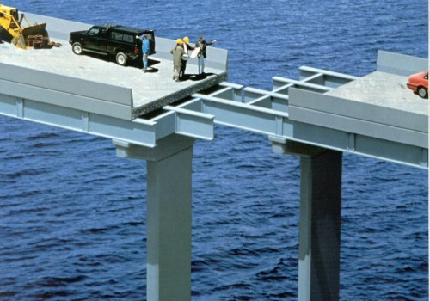
Get it Right the First Time !

Slide 19
Why Study Architecture?
It is an integral aspect of structuring software so that it can be built, understood and maintained:
Client / Server
Layered systems
Cloud based systems
etc
Architectural choices are critical in determining SW quality:
Performance
Scalability
Reuse
… and other non-functional properties

Slide 20
Why Study Architecture? (cont’d)
As a architect, you need to:
Effectively manage complex tradeoffs to meet stakeholder objectives
Layout, socialize and influence your decisions.
Communicate with your team and convince your customer / boss of their merit.
Reason about the properties of the overall system in an abstract and convenient way.

Slide 21
Why Study Architecture? (cont’d)
Certain “canonical” architectural designs provide valid blueprints for a lot of systems.
Architectural styles
Learn to recognize applicability and characteristics of styles.
Learn to use technologies that induce and support those styles.

Slide 22
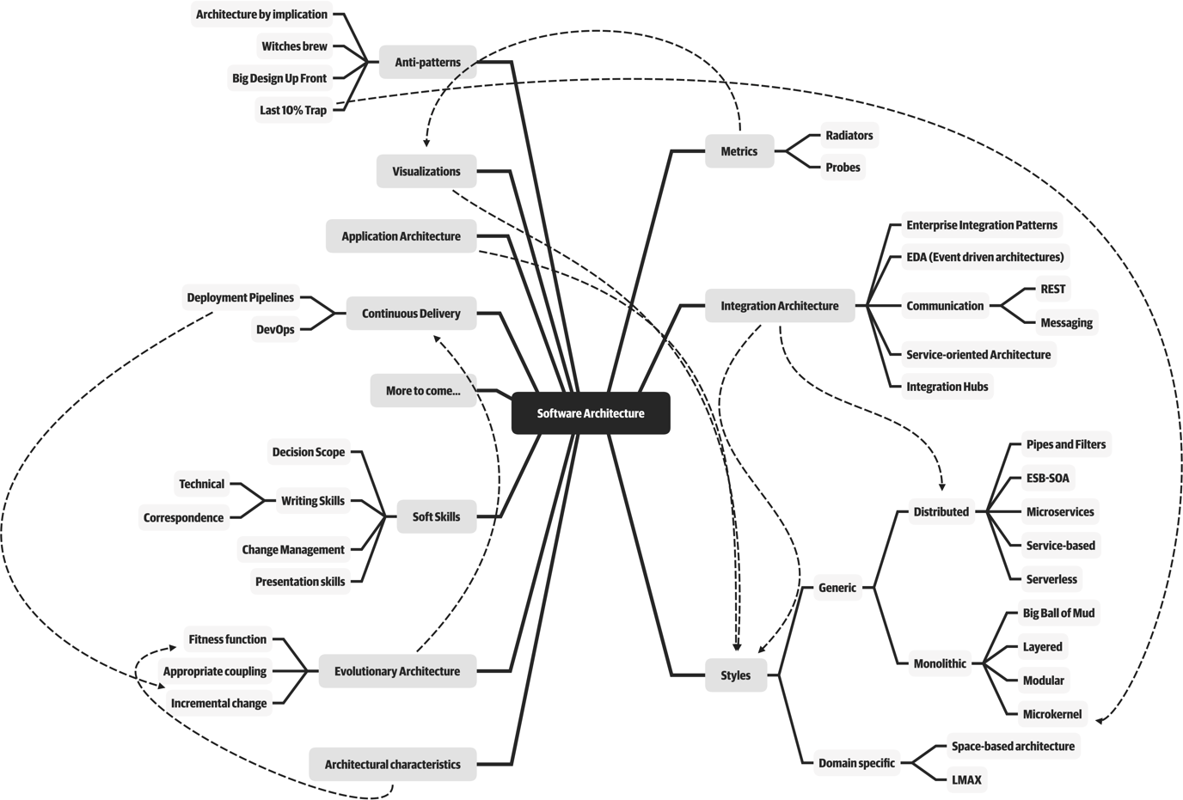
Software Architects need to cover a lot of ground

Slide 23
What does a Software Architect do?
Interact with stakeholders to make sure their needs are being met.
Craft the right architecture to solve the problem at hand.
Make sure the right modeling is being done, to know that qualities like performance are going to be met.
Make sure that the architecture is not only the right one for operations, but also for deployment and sustainment.
Document, influence, and communicate it.
Give input as needed to issues like tool and environment selection.
Manage risk identification and risk mitigation strategies associated with the architecture, and architecture decisions.
Work closely with engineering teams, ensuring architecture guidance is relevant, is followed, and is adding value.

Slide 24
Expectations of a software architect
Be able to create abstractions and models that capture key constraints and tradeoff decisions
Continually analyze and update architecture as new things are learned
Keep current with the latest trends
Ensure compliance with decisions
Have diverse exposure and experience
Have business domain knowledge
Possess interpersonal skills (required for influencing)
Understand and navigate politics
Effectively demonstrate credibility to diverse audiences

Slide 25
SE 577 Software Architecture Basic SW Architectural Concepts

Slide 26
Acknowledgement
Material from several sources including:
Ian Gorton. Essential Software Architecture (2nd Edition), Springer-Verlag.
R.N. Taylor, N. Medvidovic, and E.M. Dashofy. Software Architecture: Foundations, Theory and Practice, Wiley.
Neil Ford & Mark Richards Software Architecture Fundamentals

Slide 27
Architecture in a Traditional Project Life Cycle
Business Case
Planning and Architecture Phase
Requirements
Carries through the life of the project
Architecture
High Level Design
Detailed Design
This ”waterfall” approach represents the historic approach to doing architecture. Its now considered an anti-pattern – “Big Architecture Up Front”

Slide 28
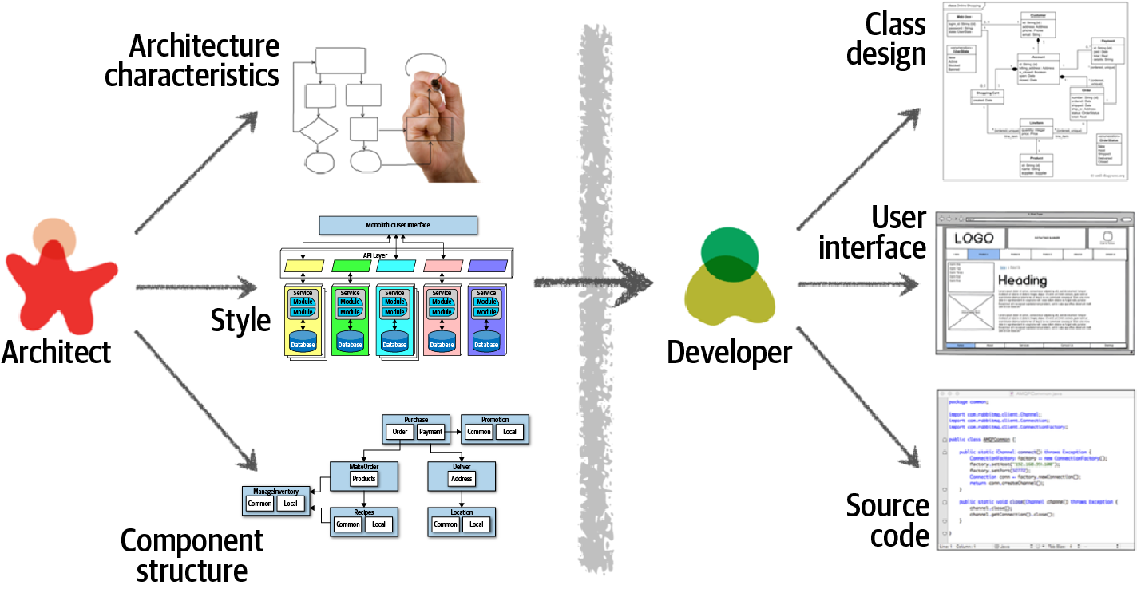
Major Areas of Concern for Architectural Design

Slide 29
Architecture in an Agile Project Life Cycle
Create Reference Architecture – “how the proposed solution fits into the big picture”
Iterate
Create Solution Architecture for a Program Increment (approx. 5 Sprints)
Update Existing Architecture Decisions Define new architecture decisions that need to be made
Create Technical Architecture Guidance to Guide Engineering, Delivery and Testing
Monitor Engineering, ensuring architecture guidance is followed or creating a backlog for adjusting architecture
Perform Architecture Retrospective
Monitor overall architecture against agreed objectives
Consistently support activities needed in support of quality attributes – e.g., security, compliance, etc
Negotiate and Influence on behalf of architecture and engineering ongoing progress and required changes

Slide 30
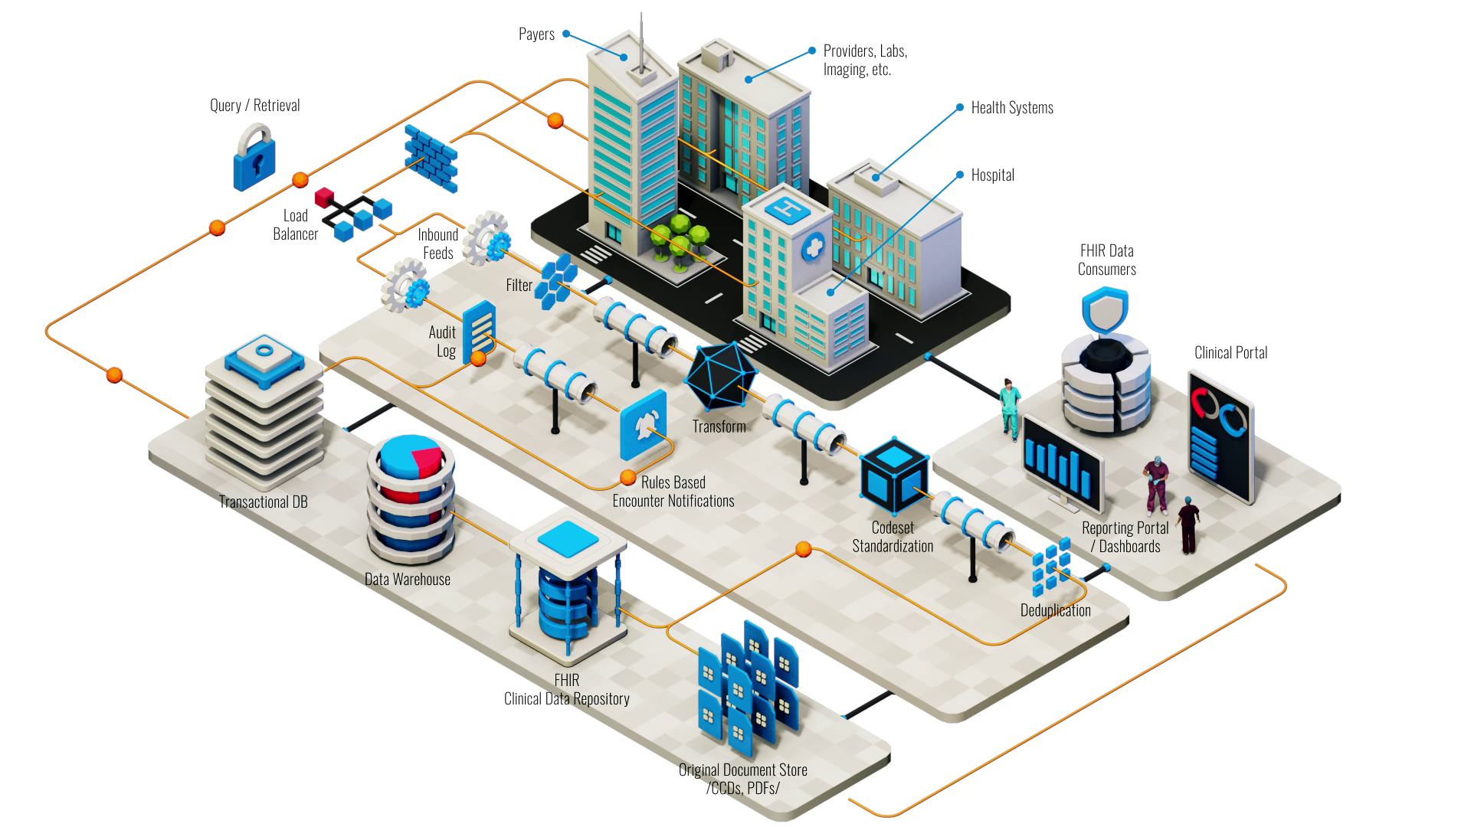
Example of Reference Architecture
Create Reference Architecture – “how the proposed solution fits into the big picture”
OBJECTIVE Improve timeliness of insights from healthcare delivery system to improve the patient experience and outcomes

Slide 31
Example: Architecture Kickoff
Create Reference Architecture – “how the proposed solution fits into the big picture”
OBJECTIVE Improve timeliness of insights from healthcare delivery system to improve the patient experience and outcomes
KEY ARCHITECTURE NEEDS
Pick a healthcare interoperability partner – partner must support real-time FHIR events
Identify key systems that must be adjusted to react to real time patient data Build new data insights engine to process events real time and to build actionable insights Modernize legacy systems to react in real time to key events of interest
Build analytics solution to measure effectiveness and patient outcomes

Slide 32
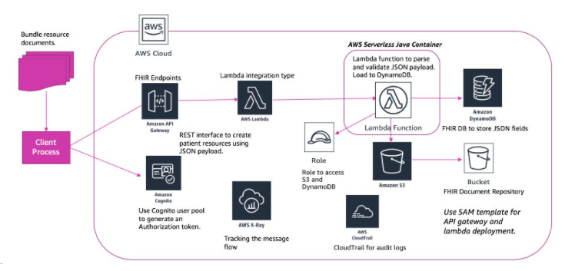
Example: Establish baseline solution architecture next
Create Solution Architecture – “how the proposed solution will be structured”
OBJECTIVE Employ cloud native architecture patterns to ensure resiliency, scale, and flexibility to ingest real-time clinical events
KEY ARCHITECTURE DECISIONS and GUIDENCE
Ensure that HIPAA privacy and security requirements are enforced in every component of the solution
Favor managed cloud services to support dynamic scalability and resiliency Ensure audit and control policies are supported by the solution via CloudFront
Ensure data is flexibly stored to support FHIR resource standards

Slide 33
Major Areas of Concern for Architectural Design
Requirements
Both functional and non-functional
Operational excellence
Error recovery: How does the system handle rainy day scenarios?
Building resiliency and scale into the solution from the get go

Slide 34
Requirements
Traditional SE suggests requirements analysis should remain unsullied by any consideration for a design.
However, without reference to existing architectures it becomes difficult to assess practicality, schedules, or costs.
Requirements analysis and consideration of design must be pursued at the same time.
Think about it, building a prototype app to get angel funding for a startup is a lot different than building a safety critical system

Slide 35
Non-Functional Requirements
Non-Functional Requirements (NFRs) define “how” a system achieves its functional requirements.
NFRs include:
Quality attributes
Application performance must provide sub-four second response times for 90% of requests.
Technical constraints
The system must be written in Java so that we can use existing development staff.
Business constraints
“We want to work closely with and get more development funding from MegaHugeTech Corp, so we need to use their technology in our application.”

Slide 36
Non-Functional Requirements (cont’d)
NFRs rarely captured in functional requirements
They are also known as “architecture requirements”
Must be elicited by architect
Specification of NFR might require an architectural framework to even enable their statement.
An architectural framework will be required for assessment of whether the properties are achievable.
This is the key place where an architect plays – Driving transparency around constraints and tradeoffs

Slide 37
System Quality Attributes
Ref: https://en.wikipedia.org/wiki/List_of_system_quality_attributes
Although there are many quality attributes, certain ones tend to appear again and again that impact the design and architecture of systems
Modularity
Maintainability
Testability
Availability
Deployability
Reliability
Scalability
Evolvability
Affordability
++ FEASIBILITY ++

Slide 38
Error Recovery
The system has to be designed from the standpoint of errors.
The sunny day paths are easy; the error handling is what complicates the system.
Must have a consistent approach for handling errors.
Error recovery (like OA&M) is often overlooked in the system architecture.

Slide 39
Error Recovery: Kinds Of Errors
Communication
Intermittent / interrupted communication
Unexpected / incorrect network changes
Process
Abnormal termination
Asleep waiting (patiently) for an event (which may never occur, or that has been missed).
Resource leaks
Coordination
Someone forgot to tell the up/downstream systems about the new data format.
Other systems in the network do not react kindly to a system going down due to a failure or for a scheduled upgrade

Slide 40
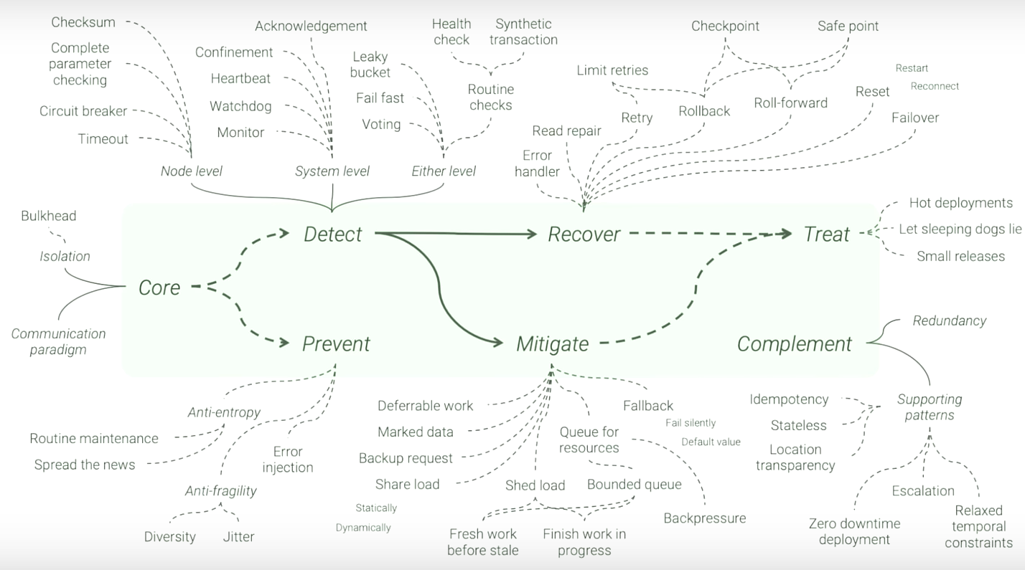
There is a whole body of work on architecture resiliency patterns
Ref: Uwe Fridrichsen – he has a lot of good YouTube talks on the subject

Slide 41
Software Architecture’s Elements
A software system’s architecture should be a composition and interplay of different elements
Processing
Data, also referred as information or state
Interaction
These are generally referred to as:
Components
Connectors
& Patterns and Constraints that govern how they can be connected to each other.

Slide 42
Components
Elements that encapsulate processing and data in a system’s architecture are referred to as software components
A software component is an architectural entity that:
Encapsulates a subset of the system’s functionality and/or data.
Restricts access to that subset via an explicitly defined interface.
Has explicitly defined dependencies on its required execution context.
Components typically provide application-specific services.

Slide 43
Connectors
A software connector is an architectural building block tasked with effecting and regulating interactions among components.
In complex systems interaction may become more important and challenging than the functionality of the individual components.
In many software systems connectors are usually simple procedure calls or shared data accesses.
Much more sophisticated and complex connectors are possible!
Connectors typically provide application-independent interaction facilities.

Slide 44

Examples of Connectors
Procedure call connectors
Shared memory connectors
Message passing connectors
Streaming connectors
The Netflix Microservice Architecture

Slide 45
Architecture Defines Structure
Decomposition of system into components/modules/subsystems
Architecture defines:
Component responsibilities
Precisely what a component will do when you ask it
Component interfaces
What a component can do
Component communications and dependencies
How components communicate

Slide 46
Architecture Specifies Component Communication
Communication involves:
Data passing mechanisms
Remote method invocation
Asynchronous message
Streaming and eventing
Control flow
Sequential
Concurrent/parallel

Slide 47
An Important Concern: Structure and Dependencies
Excessive component dependencies are bad!
Key architecture issue
Identifying components that may change
Reduce direct dependencies on these components
Creates more modifiable systems
C1
C2
C3
C4
C1
C2
C3
C4
AL
Third Party
Component
Third Party
Component
Four components are directly dependent on a third party component. If the third party component is replaced with a new component with a different interface, changes to each component are likely.
Only the AL (abstraction layer) component is directly dependent on the third party component. If the third party component is replaced, changes are restricted to the AL component only
C
Diagram Key
Component
Dependency
Coupling & Cohesion

Slide 48
An Important Concern: Almost every modern systems is a distributed system
Components may be owned by different entitles
Interactions happen at massive scale across machine and network boundaries
They are asynchronous by design
They require automation just to manage them

Slide 49
Configurations
Components and connectors are composed in a specific way in a given system’s architecture to accomplish that system’s objective
An architectural configuration, or topology, is a set of specific associations between the components and connectors of a software system’s architecture.

Slide 50
Architecture Styles/Patterns
Patterns catalogue successfully used structures that facilitate certain kinds of component communication
Client-server
Message broker
Pipe-and-filter
Patterns have well-known characteristics appropriate for particular types of requirements
Patterns are very useful…
Reusable architectural blueprints
Help efficiently communicate a design
Large systems comprise a number of individual patterns
“Patterns and Styles are the same thing – the patterns people won” [anonymous SEI member]

Slide 51
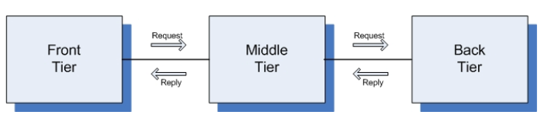
Three-Tiered Pattern
Front Tier
Contains the user interface functionality to access the system’s services
Middle Tier
Contains the application’s major functionality
Back Tier
Contains the application’s data access and storage functionality

Slide 52
Architectural Models, Views, and Visualizations
Architecture Model
An artifact documenting some or all of the architectural design decisions about a system
Architecture View
A subset of related architectural design decisions
Architecture Visualization
A way of depicting some or all of the architectural design decisions about a system to a stakeholder

Slide 53
Architecture Views
A software architecture represents a complex design artifact
Many possible ‘views’ of the architecture
Cf. with buildings – floor plan, external, electrical, plumbing, air-conditioning

Slide 54
Architecture Views (cont’d)
Logical view: describes architecturally significant elements of the architecture and the relationships between them.
Process view: describes the concurrency and communications elements of an architecture.
Physical view: depicts how the major processes and components are mapped on to the applications hardware.
Development view: captures the internal organization of the software components as held in e.g. a configuration management tool.

Slide 55
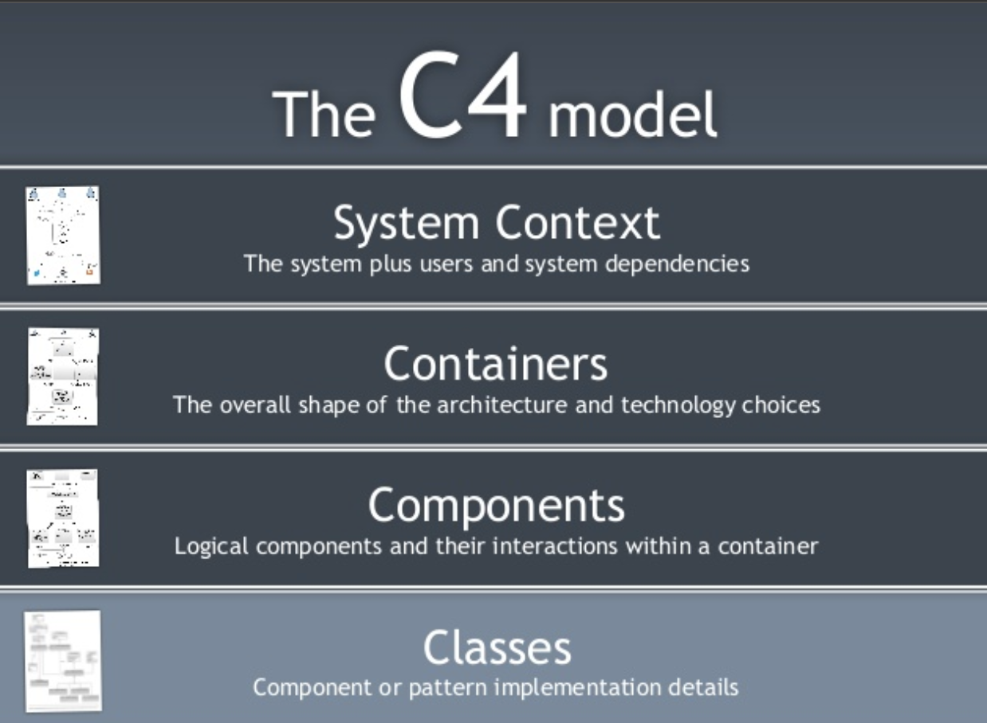
Architecture Views (cont’d)

Slide 56
Prescriptive vs. Descriptive Architecture
A system’s prescriptive architecture captures the design decisions made prior to the system’s construction
It is the as-conceived or as-intended architecture
A system’s descriptive architecture describes how the system has been built
It is the as-implemented or as-realized architecture

Slide 57
Temporal Aspect
Architecture has a temporal aspect
Design decisions are made over a system’s lifetime
A system’s architecture will change over time
At any given point in time the system has only one architecture

Slide 58
As-Designed vs. As-Implemented Architecture
Which architecture is “correct”?
Intent vs. added experience of implementation
Are the two architectures consistent with one another?
Architectural inconsistencies can be much more complex and/or insidious.
What criteria are used to establish the consistency between the two architectures?
Sophisticated techniques might be needed
On what information is the answer to the preceding questions based?
Diagrams may not contain adequate information

Slide 59
Architectural Evolution
When a system evolves, ideally its prescriptive (as-designed) architecture is modified first.
In practice, the system – and thus its descriptive (as-implemented) architecture – is often directly modified.
This happens because of:
Developer sloppiness
Perception of short deadlines which prevent thinking through and documenting
Lack of documented prescriptive architecture
Need or desire for code optimizations
Inadequate techniques or tool support

Slide 60
Architectural Degradation
Two related concepts
Architectural drift
Architectural erosion
Architectural drift is introduction of principal design decisions into a system’s descriptive architecture that
Are not included in, encompassed by, or implied by the prescriptive architecture
But which do not violate any of the prescriptive architecture’s design decisions
Architectural erosion is the introduction of architectural design decisions into a system’s descriptive architecture that violate its prescriptive architecture

Slide 61
Architectural Recovery
If architectural degradation is allowed to occur, one will be forced to recover the system’s architecture sooner or later
Architectural recovery is the process of determining a software system’s architecture from its implementation-level artifacts
Implementation-level artifacts can be
Source code
Executable files
Java .class files

