Slide 1
SE 577 Software Architecture Architectural Design

Slide 2
Acknowledgement
Material from several sources including:
D. Garlan and M. Shaw, “An Introduction to Software Architecture”, CMU-CS-94-166
R.N. Taylor, N. Medvidovic, and E.M. Dashofy. Software Architecture: Foundations, Theory and Practice, Wiley.
Farshidi, Jansen, and van der Wolf. Capturing software architecture knowledge for pattern-driven design. Journal of Systems and Software, 2020
Erder, Pureur, and Woods. Continuous Architecture in Practice
Richards and Ford. Fundamentals of Software Architecture
Carvantes and Kazman. Designing Software Arhitectures

Slide 3
Why do we design…
A software design is not necessary for trivial systems, but for large systems a design is essential
Manage complexity
Validation of delivered software
Simplify future maintenance
A mechanism for communication between domain experts and technical professionals
Enables Visualization
Enables project team members to work concurrently
Partitioning the work effort with limited overlap
Example: Concurrently developing test cases while the code is being development

Slide 4
Why is design so hard…
Software design can’t be taught, but principles of good design can
There are degrees of good and bad design, but its hard to say if a design is correct or not
The underlying assumptions and requirements that support the design change
A design is like wine, it takes a long time to see if it is good or not

Slide 5
The Process of Design
Definition:
Design is a problem-solving process whose objective is to find and describe a way:
To implement the system’s functional requirements...
While respecting the constraints imposed by the quality, platform and process requirements...
including the budget
And while adhering to general principles of good quality

Slide 6
Design as a series of decisions
A designer is faced with a series of design issues
These are sub-problems of the overall design problem.
Each issue normally has several alternative solutions:
design options.
The designer makes a design decision to resolve each issue.
This process involves choosing the best option from among the alternatives.

Slide 7
Making decisions
To make each design decision, the software engineer uses:
Knowledge of
the requirements
the design as created so far
the technology available
software design principles and ‘best practices’
what has worked well in the past

Slide 8
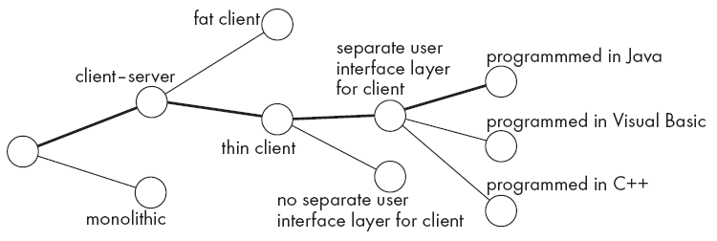
Design space
The space of possible designs that could be achieved by choosing different sets of alternatives is often called the design space
For example:

Slide 9
Component
Any piece of software or hardware that has a clear role.
A component can be isolated, allowing you to replace it with a different component that has equivalent functionality.
Many components are designed to be reusable.
Conversely, others perform special-purpose functions.

Slide 10
Module
A component that is defined at the programming language level
For example, methods, classes and packages are modules in Java.

Slide 11
System
A logical entity, having a set of definable responsibilities or objectives, and consisting of hardware, software or both.
A system can have a specification which is then implemented by a collection of components.
A system continues to exist, even if its components are changed or replaced.
The goal of requirements analysis is to determine the responsibilities of a system.
Subsystem:
A system that is part of a larger system, and which has a definite interface

Slide 12
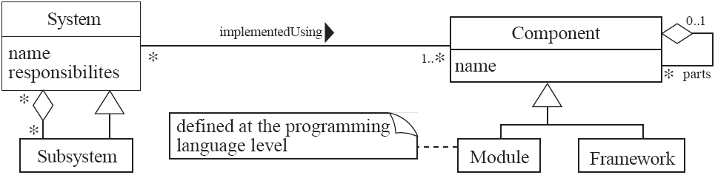
UML diagram of system parts

Slide 13
Different aspects of design
Software architecture :
The division into subsystems and components,
How these will be connected.
How they will interact.
Their interfaces.
Constraints on allowed dependencies
Module/Class design:
The various features of modules/classes.
User interface design
Algorithm design:
The design of computational mechanisms.
Protocol design:
The design of communications protocol.

Slide 14
9.2 Principles Leading to Good Design
Overall goals of good design:
Increasing profit / reducing cost / increasing revenue / learning opportunity (e.g., open source)
Ensuring that we actually conform with the requirements
Accelerating development
Increasing qualities such as
Usability
Efficiency
Reliability
Maintainability
Reusability

Slide 15
Design Principle 1: Divide and conquer
Trying to deal with something big all at once is normally much harder than dealing with a series of smaller things
Separate people can work on each part.
An individual software engineer can specialize.
Each individual component is smaller, and therefore easier to understand.
Parts can be replaced or changed without having to replace or extensively change other parts.

Slide 16
Ways of dividing a software system
A distributed system is divided up into clients and servers
A system is divided up into subsystems
A subsystem can be divided up into one or more packages
A package is divided up into classes
A class is divided up into methods
Try to promote hierarchies

Slide 17
Design Principle 2: Increase cohesion where possible
A subsystem or module has high cohesion if it keeps together things that are related to each other, and keeps out other things
This makes the system as a whole easier to understand and change
Type of cohesion:
Functional, Layer, Communicational, Sequential, Procedural, Temporal, Utility

Slide 18
Design Principle 2: Increase cohesion where possible
Functional | Keeps all code that computes a particular result together
Layer | Facilities for accessing related services are kept together. Hierarchical, you can access layers below but not above
Communicational | Modules that access or manipulate certain data are kept together
Sequential and Procedural | Procedures where one provides input to the next are kept together in a common module. Also procedures that are used one after the next are kept together
Temporal | Operations that are performed at the same phase of execution are kept together (e.g., Initialization)
Utility | Keep related semantic things together, e.g., java.lang.math

Slide 19
Design Principle 3: Reduce coupling where possible
Coupling occurs when there are interdependencies between one module and another
When interdependencies exist, changes in one place will require changes somewhere else.
A network of interdependencies makes it hard to see at a glance how some component works.
Type of coupling:
Content, Common, Control, Stamp, Data, Routine Call, Type use, Inclusion/Import, External

Slide 20
Design Principle 2: Reduce coupling where possible – Code Level Things
Content | One module modifies internal data of another module
Common | Coupling based on a global variable
Control | Parameter is passed as an argument that controls the behavior of the callee, e.g, (“CustomerArrived” passed as an arg that is then processed by a switch statement
Stamp | Using custom types as arguments to a method or function. Couples class dependencies – very common in OO languages
Routine | When one method calls a method in another class or package
Type use | When one module uses a type defined in another module
Inclusion / Import | When one module imports another module
External | When a module has an external dependency on things like an operating system, shared library or hardware

Slide 21
Design Principle 2: Reduce coupling where possible – Architecture Things
Efferent
component b
component e
component c
component a
component f
component h
component d
component g
sync
Afferent
Temporal
Afferent | How multiple other components depend on a target component
Efferent | How dependent a component is on other components
Temporal | Coupling introduced by non-static timing dependencies

Slide 22
Design Principle 2: Reduce coupling where possible – Architecture Things
Efferent
component b
component e
component c
component a
component f
component h
component d
component g
sync
Afferent
Temporal
Pathologic | One component depends on the inner workings of another
External | Multiple components share an externally imposed protocol or data format
Control | One component passes information on another component on what to do
Data | Components are bound to the same data context

Slide 23
Design Principle 4: Increase abstraction
Ensure that your designs allow you to hide or defer consideration of details, thus reducing complexity
A good abstraction is said to provide information hiding
Abstractions allow you to understand the essence of a subsystem without having to know unnecessary details
Examples of abstractions:
Classes
UML associations
Interfaces
State machines
Domain specific languages (DSLs)

Slide 24
Design Principle 5: Increase reusability where possible
Design the various aspects of your system so that they can be used again in other contexts
Generalize your design as much as possible
Follow the preceding three design principles
Design your system to contain hooks
Simplify your design as much as possible

Slide 25
Design Principle 6: Reuse where possible
Design with reuse is complementary to design for reusability
Actively reusing designs or code allows you to take advantage of the investment you or others have made in reusable components
Cloning should not be seen as a form of reuse

Slide 26
Design Principle 7: Design for flexibility
Actively anticipate changes that a design may have to undergo in the future, and prepare for them
Reduce coupling and increase cohesion
Create abstractions
Do not hard-code anything
Leave all options open
Do not restrict the options of people who have to modify the system later
Use reusable code and make code reusable

Slide 27
Design Principle 8: Anticipate obsolescence
Plan for changes in the technology or environment so the software will continue to run or can be easily changed
Avoid using early releases of technology
Avoid using software libraries that are specific to particular environments
Avoid using undocumented features or little-used features of software libraries
Avoid using software or special hardware from companies that are less likely to provide long-term support
Use standard languages and technologies that are supported by multiple vendors

Slide 28
Design Principle 9: Design for Portability
Have the software run on as many platforms as possible
Avoid the use of facilities that are specific to one particular environment
E.g. a library only available in Microsoft Windows

Slide 29
Design Principle 10: Design for Testability
Take steps to make testing easier
Design a program to automatically test the software
Use approaches like TDD
Ensure that all the functionality of the code can by driven by an external program, bypassing a graphical user interface
In Java, you can create a main() method in each class in order to exercise the other methods
Use Junit or similar frameworks

Slide 30
Design Principle 11: Design defensively
Never trust how others will try to use a component you are designing
Handle all cases where other code might attempt to use your component inappropriately
Check that all of the inputs to your component are valid: the preconditions
Unfortunately, over-zealous defensive design can result in unnecessarily repetitive checking

