Slide 1
SE 577 Software Architecture Web Architecture also Includes Blockchain Architectures which are a part of Web 3.0

Slide 2
The Architecture of the Web – How to think about this material
While the first part of this lecture may appear pretty basic from looking at the slides, its important to understand the “why” we are covering it
The evolution of web is one of the best examples of architecture done right
While the web itself is credited to being invented in the early 1990s, the web itself rides on inventions going back to the 1960s with TCP/IP
Its remarkable about how the web we know today largely evolved from pioneering work that started in the 1960s
We will examine the Web Architecture across 3 generations – Web1, Web2, and the emerging Web3

Slide 3

The “Father” of the internet – Vint Cerf
In September 2021 I had the unbelievable privilege to talk with Vint Cerf for an hour
Vint is recognized as one of the fathers of the internet for co-inventing TCP/IP and a lot of the foundational technologies that enabled the web going back to the early 1960s
For those who don’t know the Vint story, he always wears three-piece suits ☺
My conversation with Vint Cerf over Zoom in Sept 2021

Slide 4
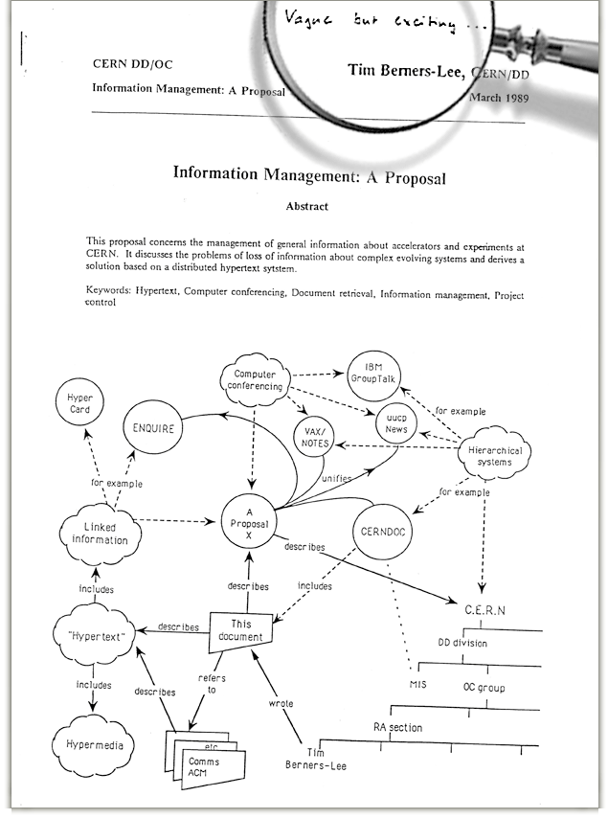
History of the Web – circa 1989/1990
In March 1989, Tim Berners-Lee wrote a proposal that outlined the architecture of the web
Initial proposal was considered vague and not well received, it was revised and eventually accepted in October 1990
Introduced the concepts we know today:
HTML: Formatting/Markup
URI: Addressing approach (now generally called URL)
HTTP: The protocol for encoding and transmitting information over the web

Slide 5
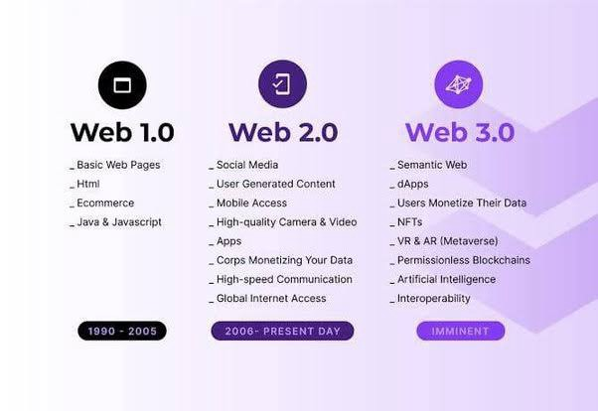
Web 1.0, 2.0, and perhaps soon 3.0

Slide 6
Web 1.0 – The “Read Only Web” Architecture
Web
Browser
Web
Server
File System
HTTP
ReadFile
Files Stored in HTML
Advantages
Simple
Cachable
Indexable
Disadvantages
No dynamic content
No interaction with user
All requests must go back to server

Slide 7
Web 1.0.1 – The Common Gateway Interface (CGI) Circa 1993
Architecture Changes
Web server acts as router
.html files returned from filesystem
.cgi extension resulted in web server executing a new process that piped information via stdin and stdout
CGI programs generated HTML directly
Enabled the web to start to support transactional personalized experiences
Since CGIs are just programs, they were often developed in languages like C and/or Perl
Architectural challenges
Scale – all CGI ran as a process
Interactivity, all actions from the browser had to travel over the network to the server
Web
Browser
Web Server
File System
HTML
Resource Manager
stdin / stdout
CGI
Script
Database

Slide 8
Web 1.0.2 – Javascript Circa 1995
Architecture Changes
Web
Browser
Web Server
Web Browser gets Smarter
HTML can now embed or link to javascript that can be executed on the browser
Code running directly in browser improves user experience
Enabled some user behavior to be processed in browser avoiding trips back to the server
Architectural challenges
Same as 1.0.1, plus,
Code redundancy, often checks had to be made both in the client (javascript) and the server (CGI)
Javascript was developed in 10 days and has always been regarded as a poor language
Javascript compatibility was very poor for the first 20 years of its existence leading to workaround solutions like jQuery becoming popular
File System
HTML
Resource Manager
Javascript Engine
stdin / stdout
CGI
Script
Database

Slide 9

Web 1.0.3 – The Application Server - Circa 1999
Architecture Changes
The CGI handler was replaced with a totally new architecture
CGIs were processed based
CGIs had to communicate via stdin and stdout to a local file system
Application servers replaced CGI with interfaces that streamed HTTP over a network protocol (could be localhost, but could also be anywhere)
Application Server managed the lifecyle of applications – called webapps
Webapps could be run in threads instead of processes
Libraries were created that abstracted HTTP and HTML from developers
Web
Browser
Web Server
File System
HTML
Resource Manager
Javascript Engine
http
Application Server
Database
WebApp
Apache Tomcat 1.0

Slide 10


Web 1.0.4 – The Application Framework - Circa 2000-2003
Architecture Changes
Previous generation provided code libraries to help translate code data structures to HTML
Improvements with MVC
Server side code could be much better modularized, which supported creating larger applications
HTML rendering code replaced with markup files for the view that can be translated into code and pre-compiled for speed
Behavior can be altered via configuration
Challenges
Configuration files that controlled code execution became complex and difficult to maintain (not to mention debug)
Web
Browser
Web Server
File System
HTML
Resource Manager
Javascript Engine
http
Application Server
Database
WebApp
MVC Framework
Spring MVC (2003)
Apache Struts (2000)

Slide 11
Web 1.0 Summary (from an architecture perspective)
Web 1.0 existed for about 15 years between 1990 and 2005
It started out supporting read-only content
It evolved to supporting reasonable applications, that could run at reasonable scale over the basic web architecture
The underlying architecture changed very little over this period, mainly supporting enhancements that allowed content-rich applications to be developed using oriented technologies
Introduced the MVC pattern as a best practice for developing web-centric applications

Slide 12
Web 2.0 – Circa 2005/2006
Web
Browser
Web
Server
Web
Application
TCP
Web Data
WEB 1.0
HTTP
HTTP
Browser/ Mobile / IOT
Web Services (APIs)
TCP
Web Data
HTTP w/JSON/XML Payload
WEB 2.0
“Web”
Application
The primary architecture shift in web 2.0 is that the application itself moves to running on the client and the client types expand from just a browser to mobile and IoT

Slide 13
Web 2.0 starts by exploiting a little known feature called XHTR (XML Http Request)
In 1998, Microsoft developed the concept behind XHTR to support a web-based mail program which was first shipped with IE5 in 1999
This “feature” was inconsistently implemented in a variety or browsers over the early years
In 2004, Google saw the promise of XHTR and creaed a browser compatible javascript library that they needed to support a new generation of applications they were creating – Gmail in 2004, and Google Maps in 2005
In 2006, XHTR was released as a standard by the W3C - https://www.w3.org/TR/2006/WD-XMLHttpRequest-20060405/
Like most interesting things, the enabler for web 2.0 was introduced for a totally different purpose and then later exploited to enable things we use today

Slide 14
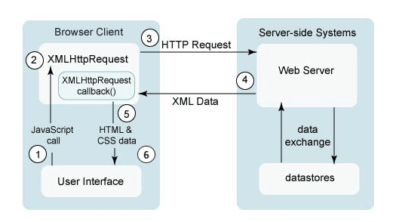
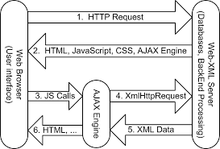
What does XHTR (and AJAX) enable along with its architecture?
Terminology, XHTR is often talked about with something else called AJAX – Ajax stands for asynchronous javascript and XML
AJAX is the API component that the browser uses, XHTR is the structure of the object that interacts with servers over HTTP

Slide 15
Capabilities enabled by the Web 2.0 Architecture
Web 1.0 was about the evolution from static content to dynamic content
Web 2.0 is about running fully featured applications over the web protocols
Multi-Client – not just web browsers but mobile and IoT devices
Web 2.0 also brought with it extensions to the underlying HTTP protocol
HTTP/2.0 – Switch from non-persistent to persistent connections; Switch from text to binary payloads
MQTT – A queue based lightweight, low-energy protocol suitable to support fleets of IoT devices running embedded web 2.0 applications
Most basically stated – Web 2.0 is about being able to do useful things over the Web

Slide 16


Web 2.0 – Circa 2005
Architecture Changes
Content Provider
Cloud CDN
Javascript Bundle
Introduction of multiple new components
Content provider: Browser downloads application code either via a web server or a content delivery network
Once application is downloaded, it is bootstrapped and executed 100% in browser
Application makes requests over HTTP to APIs using Ajax
To manage scale and security, purpose built proxies are deployed; a WAF for security, and an API gateway to manage the APIs
Challenges
Javascript is complex to create and maintain these types of applications
Download
Cloud
Web
Browser
Web Server
File System
Javascript Bundle
Javascript Engine
Javascript Application Ajax()
API Runtime (K8s, VM, Serverless)
API Gateway
Web Application Firewall
API
API
API
XHTR (XML/JSON)
API
API
API
API
API
API
Google Maps
GMail

Slide 17





Web 2.x – Circa 2008-today
Web
Browser
Content Provider
Cloud CDN
Javascript Bundle
Architecture Changes
Cloud
Introduction of multiple new components
Single Page Application (SPA) Frameworks mature to make developing modern web applications significantly easier
Mobile Apps arise with nice SDKs that reuse the web platform for data exchange
IoT devices become very popular – IoT devices have varying capabilities and power thus multiple integration paths are supported – direct HTTP/JSON, MQTT over TCP, or specialized low power protocols such as Z-Wave, ZigBee, Bluetooth, etc
Javascript Engine
Web Server
SPA Framework
File System
Javascript Bundle
SPA Application
Mobile
API Runtime (K8s, VM, Serverless)
Mobile App
Web Application Firewall
API Gateway
API
API
API
IoT Device
IoT App
API
API
API
MQTT Gateway
Low Power
API
API
API
IoT Gateway
Google Maps
GMail

Slide 18
Web 2.x Summary
Web
Browser
Content Provider
Cloud CDN
Javascript Bundle
For all practical purposes this is the current state of the web
Web 1.0 was about delivering rich content
Web 2.0 is about using the web architecture to do useful things
Architecture Pivots
Application code delivered to client remotely – benefits, easy patching and updates
Application runs locally on client – provides limitless scale
Data and remote functions provided by APIs – numerous architectural innovations here as well (more to come on this topic)
Cloud
Javascript Engine
Web Server
SPA Framework
File System
Javascript Bundle
SPA Application
Mobile
API Runtime (K8s, VM, Serverless)
Mobile App
Web Application Firewall
API Gateway
API
API
API
IoT Device
IoT App
API
API
API
MQTT Gateway
Low Power
API
API
API
IoT Gateway
Google Maps
GMail

Slide 19
Single Page Application Architecture - SPA
Web
Browser
Web Page
Web Component
Networking
Page Component
Component Template
Security
Children
Children
Component Styling
Layout Engine
Child
Child
Child
Child
Child
Component Behavior
Styling Engine
Component Events
C
C
C
C
C
C
C
C
C
Local Storage
Kind of Trivial but Web Pages can be thought of as a hierarchy of components, where components nest, the leafs of the webpage are native controls such as entry fields, static text, buttons, etc
Web Components in an SPA consist of a template for layout, styling for look/feel, Javascript/Typescript code to manage behavior, and an eventing framework to communicate with other web components
Javascript Engine
Google Maps
GMail

Slide 20
SPA Frameworks
Building SPAs by hand can be very complicated, over the years multiple frameworks and libraries have been introduced to make this easier. Top frameworks are React, Vue, Angular, and most recently Svelte.
SPA Architecture
Web Component
Web Component
Manager
SPA Framework
SPA Tooling
SPA Community
Component Template
Routing
Command Line Tools
Libraries
Create
Component Styling
Utilities
Destroy
State Management
Compiler Optimizer
Component Behavior
Lifecycle Events
Plugins
Rendering Optimizer
Packaging
Testing
Component Events
Component Events
Libraries
Event Manager
Prebuilt Components
Deployment
Google Maps
GMail

Slide 21
SPA Frameworks
SPA Components are event-driven, almost all interesting interactions happen over sending and reacting to asynchronous events.
SPA architectures often have abstractions for the network interfaces that treat ingress and egress network interactions as events
State management for SPAs (discussed soon) is often facilitated via variations to the flux pattern. This pattern features state being managed in an immutable store, and uses events to query, mutate or react to changes in the store
User interface updates are handled entirely locally, they can be full page swaps, which are driven by the router, or they can be incremental page updates based on reacting to user behavior (clicking a button, pressing a key, etc) SPA Web Components, via an interaction manager, can communicate with each other via sending events, and reacting to callbacks.
SPA Architecture
Router
SPA Rendering Controller
SPA WEB COMPONENTS
SPA Component Interaction Manager
Network
Events
State Management
Google Maps
GMail

Slide 22
SPA Component Interaction Best Practices
SPA Architecture
Remember, SPAs create hierarchies of components
There are strict parent/child relationships
Best practice, when a parent creates a child, it passes all properties that that child needs. These take the form of:
SPA Parent Component
callBackFunction(Parameters, …) {
…
} <CHILD prop= [p1,p2, pn], callback = [f1(), f2(), fn()] />
Properties, or props – think of these as a web component constructor, the parent passes data to the child for initialization
Callback functions – as the child component runs, sometimes it needs to notify the parent about interesting things, such as state changes or anything else of interest. The parent passes a callback function to the child, that the chid can use to interact with the parent
PROPERTIES AND CALLBACK FUNCTION REFERENCES
Callback Notifications
SPA Child Component
Setup(properties, …) callBackFunction(Parameters, …);
SPAs are very strict on flow of direction, properties flow down, callbacks / events flow up

Slide 23
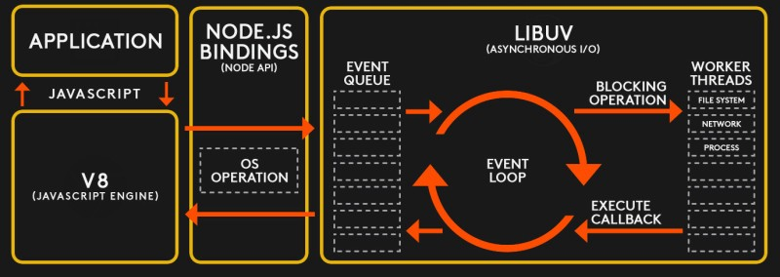
The architecture of Javascript, and more importantly its runtime
The javascript runtime is single threaded with an event loop at the center, effective use of asychonous programming techniques is essential to making these applications perform well.
Because most web architectures are I/O bound this model works well, but specific strategies are required for compute bound workloads in order to ensure that work is processed efficiently.

Slide 24
The architecture of Javascript, and more importantly its runtime
The javascript programming model provides multiple models for doing async programming
function after(args) {
//post processing here
}
function do_something(args, cb{
//do some work cb(args)
}
function client() {
do_something(”hello”, after) }
var promise = new Promise(function(resolve, reject) {
// do a thing, possibly async, then…
if (/* everything turned out fine */) {
resolve("Stuff worked!");
}
else {
reject(Error("It broke"));
}
});
//calling it promise.then(function(result) {
console.log(result); // "Stuff worked!"
}, function(err) {
console.log(err); // Error: "It broke"
});
Callback example – do some work let me know when you are done
Async with Promises

Slide 25
The architecture of Javascript, and more importantly its runtime
The javascript programming model provides multiple models for doing async programming
async function worker() {
data = await call_database(); status = await web_service_call()
return status
}
//calling it let s = worker()
console.log(s);
async function f() {
return 1;
} //async functions return promises
f().then((v) => console.log(v)
Async functions return promises so you can just code them as such
async function f() {
return 1;
} let v = await f()
console.log(v)
Using async/await together, notice how this async code looks sync
Note that javascfipt also has a future called a generator that is used to break up compute intensive work, if you have interest in this please ask a question.
You can use await to make async code look synchronous

Slide 26
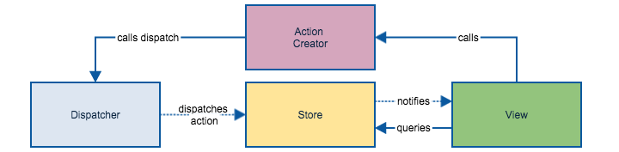
Now we know enough to look at how state management is handled in SPAs
The best architecture pattern for handling state is called flux https://facebook.github.io/flux/
The key to this pattern is that all information flows in one direction and all interactions between the components are carried over events
Note that flux is a pattern and there are various implementations of this pattern that have been encapsulated in libraries – Redux, Vuex, Pinia

Slide 27
Pinia state management example
import { defineStore } from 'pinia’
export const useCounterStore = defineStore({
id: 'counter’,
state: () => ({ counter: 0 }),
getters: { doubleCount: (state) => state.counter * 2 },
actions: {
increment() { this.counter++ } ,
async callWebService() { http.get(…)}
}
})
//using in your components
const counterStore = useCounterStore()
counterStore.inrement() counterStore.callWebService() console.log(counterStore.counter)
Console.log(counterStore.doubleCount)
let {counter} = storeToRefs(counterStore) //reactive counters reacts to changes
Store setup, define the state properties and initial values
Calculated properties State not mutated
Action that mutates state – notice this keyword
Action can be async as well

Slide 28
Wrapping up Web2 – Overall Reference Architecture
Cloud or On Premise Compute
Network/Subnet Management
Identity Provider IdP
Control Plane
API Data
API Documentation Server
Kubernetes
API
API Data
API Gateway
API Runtime/Supervision
Client Browser, Mobile App, IoT
API Routing
API Data
Third Party Security Services
API
Data Leak Protection(DLP)
Ingress Firewall
API Data
Bot Detection
Application Execution Context
Web Application Firewall
API Traffic Management
PROXY
Server;ess
API Data
API Security
API
API
API Data
API Analytics
End-to-End Config/Misconfiguration Management
Google Maps
GMail

Slide 29
Wrapping up Web2 – Overall Reference Architecture – Component Description
Component | Description
Application Execution (context) | Web 2.0 applications generally execute directly on the client. The client can be a web browser, a mobile device, or an IoT device. The most popular approach is to use single page web application (SPA) technology frameworks such as Angular, React, Vue or Svilte on the client. Emerging technology is web assembly
Data Leak Protection | Often offered by a third party that runs as a hosted service. This component observes all ingress and egress traffic looking for suspicious traffic being sent to destination locations. The objective is to prevent data from leaking.
Bot Detection | With the dark web, and the tendency to reuse passwords, Bots hit various websites using known credentials to try to break into other sites. This is known as credential stuffing. Bot detection solutions apply AI techniques to determine if security/login endpoints are being interacted with by a human or a BOT. Captua technology is a common defense. Shape security is an example provider of such services.
Ingress Firewall | The ingress firewall manages network connections at the edge. They do a varity of things including blocking unwanted TCP/IP ports. Its common for these firewalls to block anything outside of port 443 (HTTPS)
Google Maps
GMail

Slide 30
Wrapping up Web2 – Overall Reference Architecture – Component Description
Component | Description
Web Application Gateway (WAF) | The WAF is aware of L7 protocols such as HTTPS and can apply rules to block certain types of attacks. Attacks addressed by WAFs include SQL Injection, Cross Site Scripting, Ddos, Cookie based attacks, etc. Examples: AWS WAF, F5
Data Leak Protection | Often offered by a third party that runs as a hosted service. This component observes all ingress and egress traffic looking for suspicious traffic being sent to destination locations. The objective is to prevent data from leaking.
Identity Provider (IdP) | The identity provider is a security component that handles authentication and authorization services. It can act as a reverse proxy ensuring clients are using secure sessions, or support protocols such as oAuth and issue and validate tokens either in a proxy mode or by providing security signing services to validate tokens. Examples: Okta
Network Subnet Management | These services can be offered via physical network design, or logical network design in the cloud. They can be facilitated by switches, firewalls or cloud based network access controls. The purpose of this component is to ensure that different services are isolated into different subnets and that clear rules are executed that specify what traffic can cross subnet boundaries.
Google Maps
GMail

Slide 31
Wrapping up Web2 – Overall Reference Architecture – Component Description
Component | Description
End to End Configuration Management | Ofen deployed in the cloud, these services constantly watch infrastructure and ensure that the deployed configuration manages the desired configuration. This includes what components are running along with their configuration. Example: Cloud Custodian
API Gateway | The API gateway is a critical piece of infrastructure to manage, as it name states, APIs. API gateways include services to manage APIs, to manage access to APIs, to document API interfaces and to manage traffic policies for APIs (e.g., rate limiting, circuit breakers, etc). Examples: Gloo Edge, Envoy, Kong
API Runtime Supervision / API Control Plane | As APIs execute, they benefit by being supervised by a component that manages their availability and scalability – being able to scale up, scale down, detect and restart ill behaving API runtime containers. Examples: Kubernetes, AWS Lambda.
API Data | This layer of the architecture is responsible for providing data to the APIs. Often time it is delivered via special purpose NoSQL databases that are designed for horizontal scale. Examples: MongoDB, DynamoDB, CosmosDB, DocumentDB, etc.
Google Maps
GMail

Slide 32
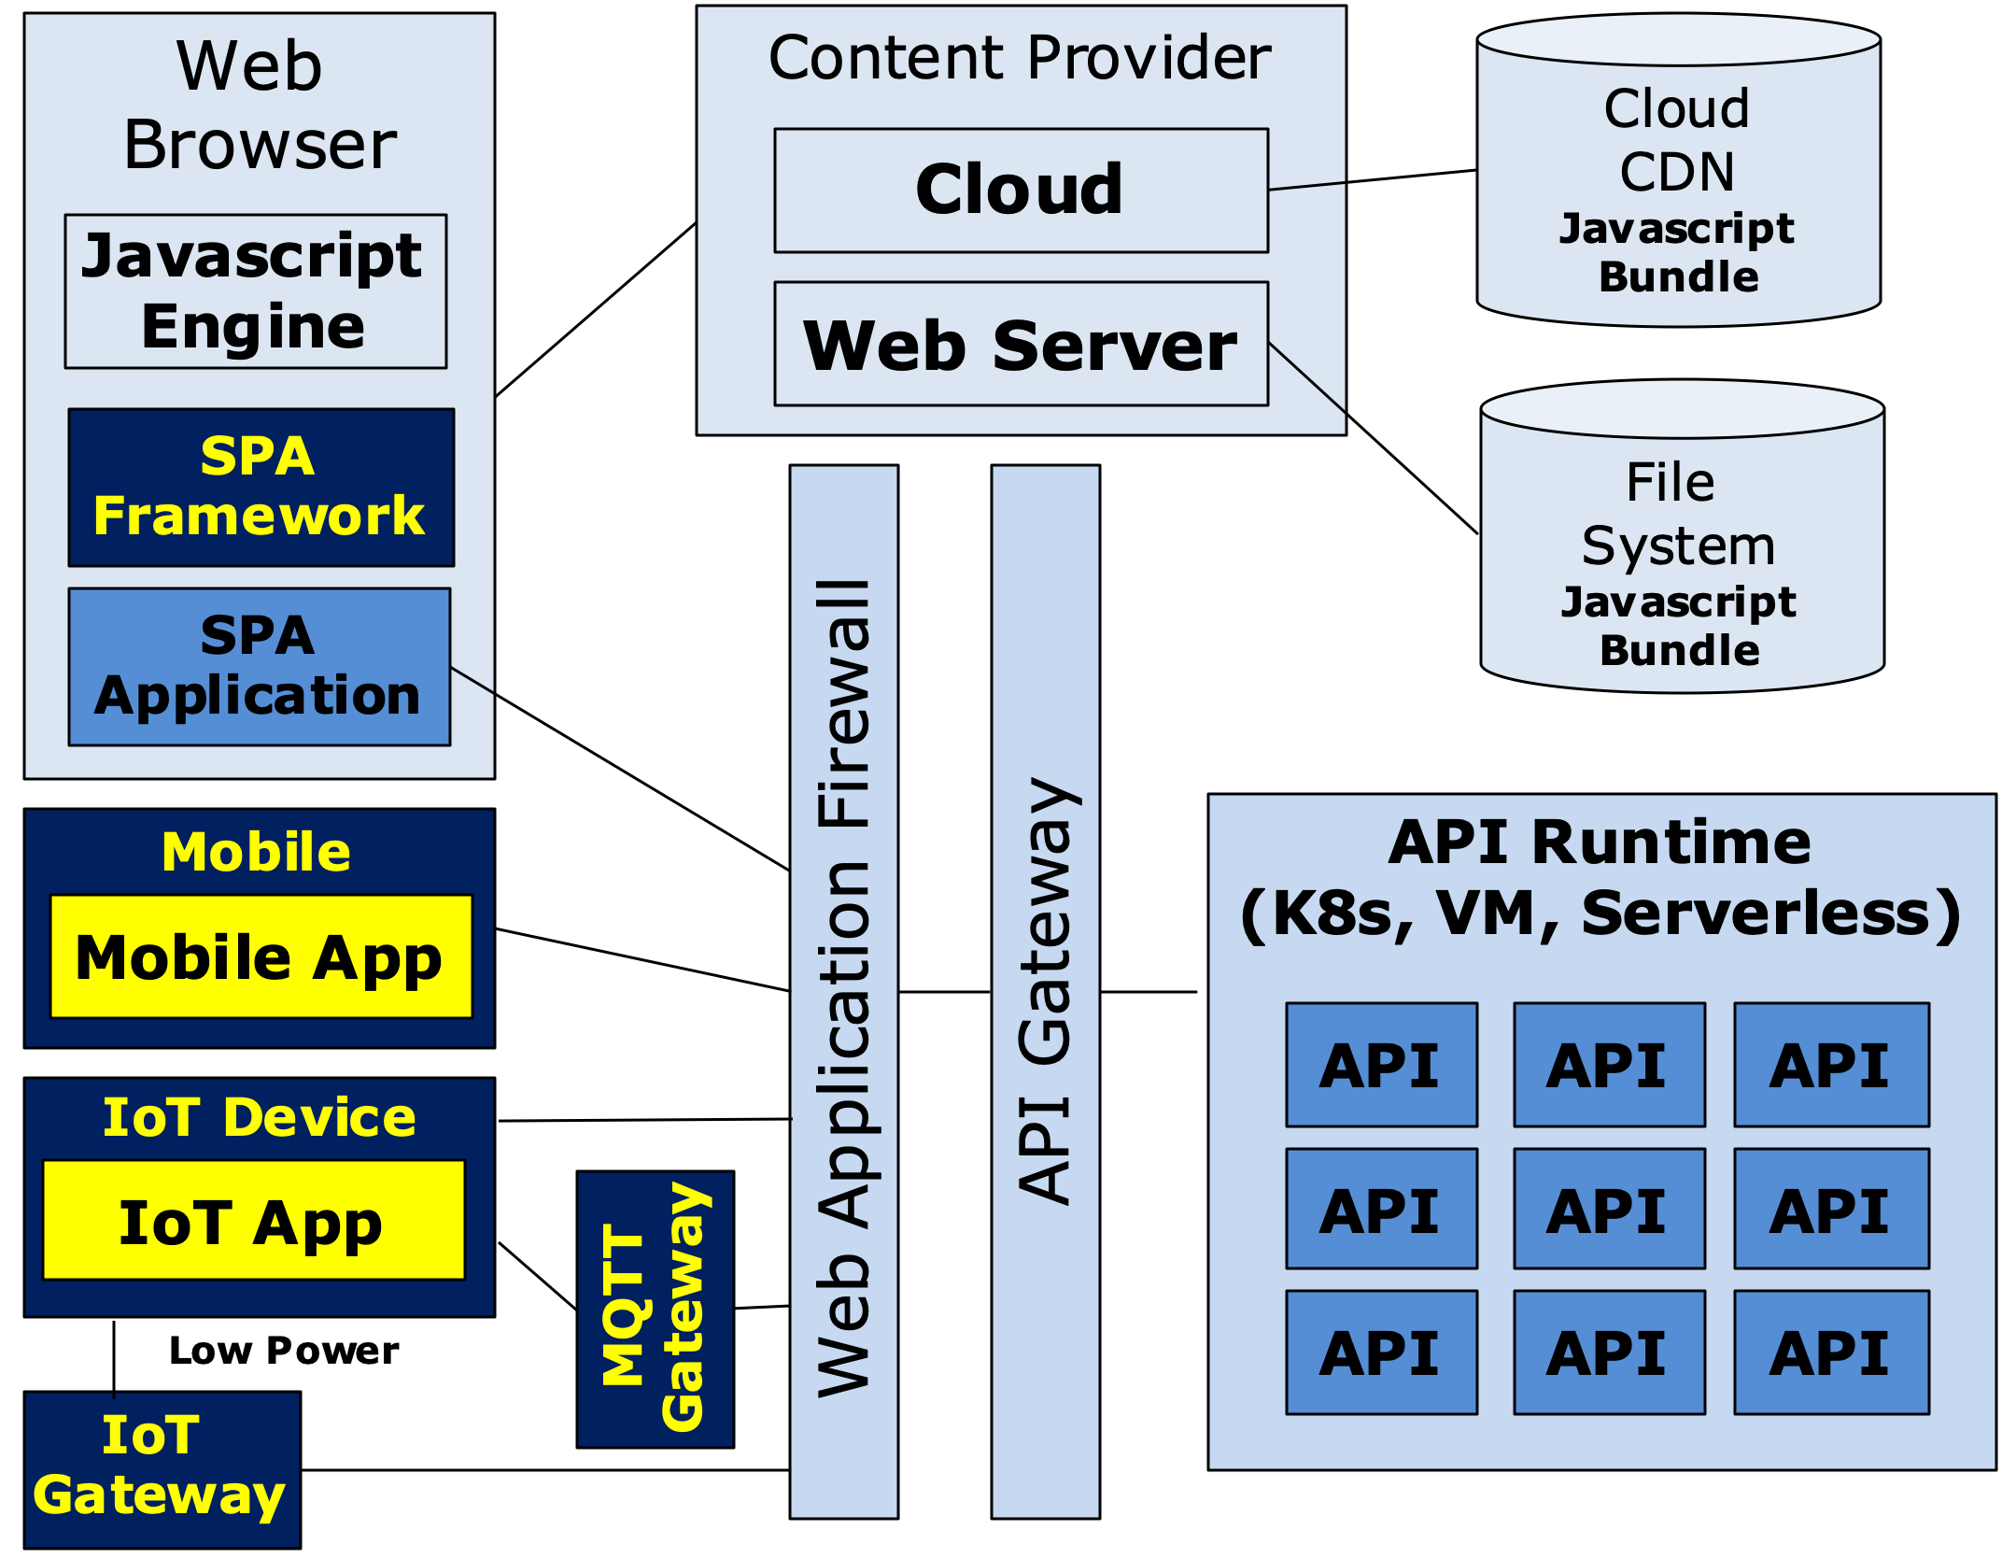
Web 2.x Architecture Summary
The Web 2.0 architecture has served us very well, but there are some challenges that are calling for an architecture pivot
Although the architecture of the web is highly scalable and distributed, much of the internet is controlled by central parties
Google (search), Facebook, Netflix, Amazon, etc
Platforms: Amazon AWS/ Microsoft Azure, Google GCP
Many of the backend services provided by APIs are owned by entities that require knowing who you are
Banks, Insurance Companies, Entertainment Providers, Ecommerce Suppliers, etc
Think about the number of accounts and passwords you have, each is for a different entity
While its still too early to see where this is going architecturally, we are starting to hear about Web 3.0
Google Maps
GMail

Slide 33
Web 2.x Security Architecture – Session Based
Credentials Store (e.g, LDAP)
Security Proxy
Web Services
--→ Login UserId/Password in POST header
Client
Authentication endpoint
Secure Web API
Browser
←-- Login Response Session ID via secure session cookie if OK HTTP/200 OK; 401 Not OK
Session Cache
Mobile
--→ API Call Proxy Request if Session OK
--→ API Call Session Cookie Passed in Header
Secure endpoint
Public endpoints
Public Web API
--→ Public API Call
Pass through
Google Maps
GMail

Slide 34
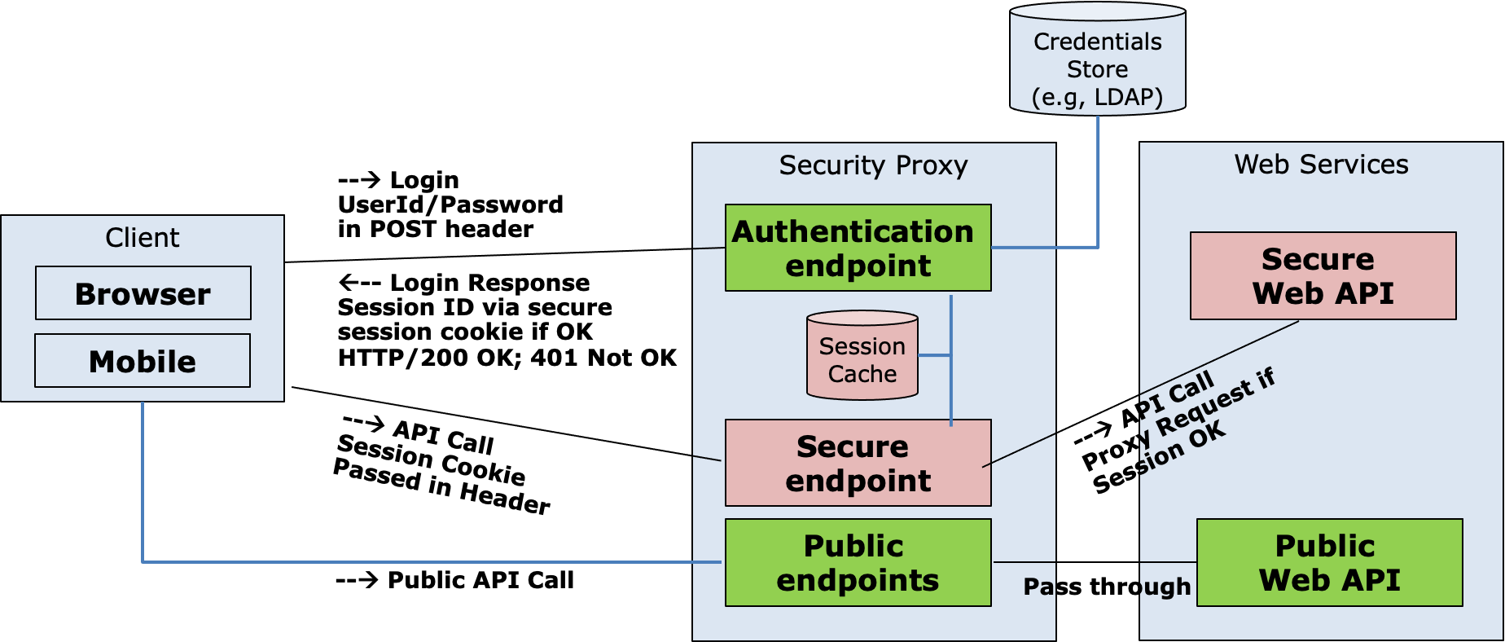
Web 2.x Security Architecture – Session Based Architecture Strengths and Weakness
Works well, time tested
Very secure assuming payloads, and therefore headers are encrypted over HTTPS
Issue: Many single points of failure – Proxy, LDAP
Issue: Very difficult to cluster given session cache has to be distributed, or sticky sessions are required to “stick” a client application to an instance of a proxy
Issue: Very difficult to federate, for example you want to use a third party to authenticate a user –e.g., Microsoft, google, amazon, twitter
Issue: Works well for web browsers because cookies are a natural part of the ecosystem, but need to be supported by the client directly for other clients such as mobile applications
Google Maps
GMail

Slide 35
Using oAuth for security
Most modern security approaches are based on oAuth 2.0
oAuth uses tokens to ensure security
Tokens can be opaque or packaged as JWTs
Opaque Tokens Carry No Meaningful Information Normally a Random Value or a UUID
Example: 123e4567-e89b-12d3-a456-556642440000
JWTs carry useful information in JSON format and are tamper proof via digital signatures
Example: See JWT.io
Significant Optimizations can be made to the oAuth protocol using JWTs

Slide 36
Web 2.x Security Architecture – oAuth opaque Token Based
Identity Provider (IdP)
3 --→ Login Request – Credentials & Agree to claims
Authentication Endpoint
4 ←-- Redirect w/ Short Lived Authorization Token
Credentials Store
Claims
Store
6 --→ Auth Token
API Gateway
Client
1 --→ Login Request
7 --→ Access Token
Token Validation
2 ←-- Login Response Redirect
Login Endpoint
Public Signer Keys
Browser
5 --→ Auth Token
Mobile
8 ←-- Access Token
10 --→ Verify Token
9 --→ API Call w/ Access Token
Secure Proxy
Web Services
12 ←-- API Response
Secure Web API
Public Key Cache
11 --→ API Call
Public Web API
--→ Public API Call

Slide 37
Web 2.x Security Architecture – oAuth JWT Token Based
Identity Provider (IdP)
3 --→ Login Request – Credentials & Agree to claims
Authentication Endpoint
4 ←-- Redirect w/ Short Lived Authorization Token
Credentials Store
Claims
Store
6 --→ Auth Token
API Gateway
Client
1 --→ Login Request
7 --→ Access Token
Token Validation
2 ←-- Login Response Redirect
Login Endpoint
Public Signer Keys
Browser
5 --→ Auth Token
Mobile
8 ←-- Access JWT Token
Public Key Cache
<<async>> Cache Keys
Web Services
10 ←-> Verify Signature
9 --→ API Call w/ Access Token
Secure Proxy
Secure Web API
12 ←-- API Response
11 --→ API Call
Public Web API
--→ Public API Call
Can you spot the optimization?

Slide 38
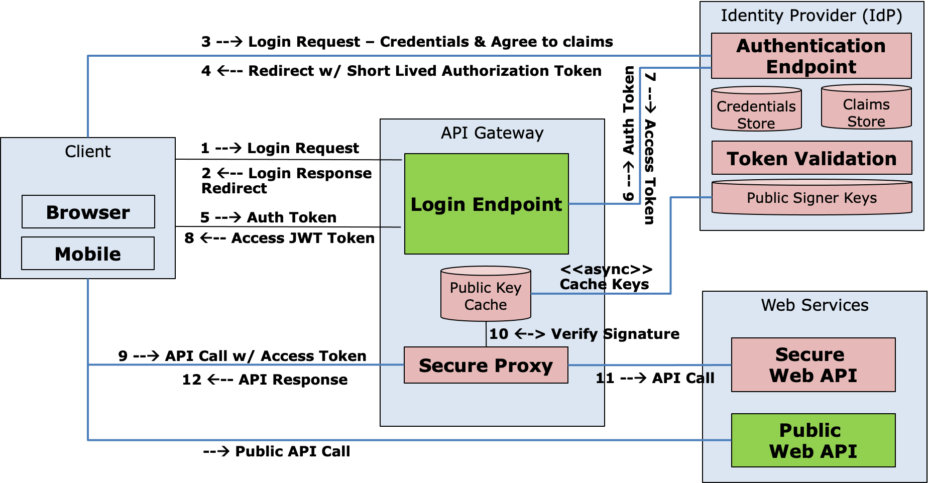
Web 2.x Security Architecture – oAuth Based Security
Works well, time tested
Very secure and flexible
Works with a variety of different client devices, not just browsers
Intrinsically supports federation given the IdP can be internally owned or external
Has other features that were not covered such as referesh tokens that allow for long lived “remember me” scenarios
Google Maps
GMail

Slide 39
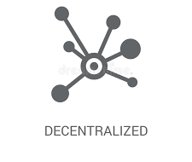


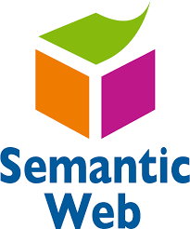
Web 3.0 Objectives – Possibly what’s next
Web 3.0 Objectives Will Require Significant Architecture Changes to the Web
Decentralized Computing: Edge computing becomes the primary model – in Web 2.0 most transactions happen via APIs owned by centralized parties; Web 3.0 the endpoints directly sell, exchange or barter their data without loosing ownership control. The middleman goes away
Open, Trustless & Permissionless: Open in applications built from open source software; trustless in that the network itself allows participants to interact publicly or privately without a trusted third party; permissionless in that anyone, both users and suppliers can participate without authorization from a governing body
Connectivity and Ubiquity: We are starting to see this emerge in web 2.0; but web 3.0 is assuming that the web will be everywhere – connecting everything without any hardware or software limitations
Semantic Web: AI and ML will replace web 2.0s “query based” model to find information with deep personalization and relevance to the user and their current context
https://www.monocubed.com/blog/what-is-web-3-0/
Google Maps
GMail

Slide 40
Web 3.0 Also Introduces New Capabilities that Impact the Architecture
Web 3.0 Objectives Will Require Significant Architecture Changes to the Web
Reimagining Security: Identity moved to edge owned by individual users vs centralized identity providers making large breaches difficult, also the model moves to zero trust where secure connections are setup for every network interaction
Monetization of Users Attention vs Data: Web 2.0 largely monetizes its “free” services via targeted ads, however targeted adds require massive data collection and data processing leading to privacy issues. Web 3.0 focus shifts away from pushing ads to enabling companies to compete for your attention in the open using things like nonfungible tokens (NFTs)
Digital Products and exchange: With web 3.0 tangible digital assets can be created and exchanged using technologies such as blockchain. Examples, digital currency, selling digital content, music, movies, etc. NFTs can also be used to represent and exchange physical assets without intermediary third parties – art, real estate, event tickets, etc.
Google Maps
GMail

Slide 41
Before we get into the architecture of Web3, an example is required to understand it.
Scenario: You work for a large company that provides you healthcare coverage, you injure your knee, go to the doctor, the doctor orders an MRI. Possible outcomes:
You get the MRI, and then a week later an email pointing you to an explanation of benefits showing that the service was fully covered, your cost is $0, and you are happy
You are told by the doctor that you need an MRI, but your insurance requires a pre-authorization approval, and it might take up to a week. The MRI is approved, you get the MRI and then a week later a bill shows up for $50.
Same as above, but you get a bill for $750 (or any other amount that is calculated)
Same as above, but you call the insurance company, file an appeal, and then two weeks later a decision is made. The result could be your bill is adjusted to a much smaller amount, even $0, or your appeal can be denied, making you responsible for the full amount
Your doctor wants you to get an MRI, tells you that a prior authorization is required, but the prior authorization is denied. If you want the MRI you have to pay the full cost, which could be several thousand dollars
How can the same scenario lead to such a diversity of outcomes that impact cost and customer satisfaction?
Google Maps
GMail

Slide 42
What is a prior authorization, and why are these things even necessary
The cost of healthcare in the US in 2019 has been reported as $3.8T, which is by far the largest category of spending in the US – about 18% of the total economy and approximately $11.5K for every person in the US
Most people don’t understand healthcare, and fully place trust in doctors. Thus, people think if a doctor says you need something, it must be necessary. However, doctors can be inconsistent, thus there is a need to improve consistency to manage overall healthcare costs
Doctors are inconsistent, some are very conservative and order tests – “just in case”, and some doctors are even fraudulent, for example, they may own a stake in an imaging lab, or get referral fees.
We see imaging labs all over the place, they are out for profit, and the equipment that they use is expensive. Thus, the cost for the same procedure can vary widely from one imaging center to another
Most people view processes like prior authorizations as a scheme by healthcare providers to deny coverage, and thus stuff their pockets with more profits. Many don’t know that many commercial plans have the employer pay all medical costs, and healthcare companies get paid fees to leverage their networks and expertise. Thus, if a prior authorization is approved or denied, in many cases it does not impact in any way the amount of money a healthcare company spends or profits that they make.
At the end of the day, nobody likes this process, but many agree its necessary
Google Maps
GMail

Slide 43
But how can the outcomes for the same use case differ?
Healthcare is provided to employers, with the terms and conditions outlined in a legal contract. The systems that healthcare companies use to process claims are based on algorithms. Thus interpretation is sometimes needed between a legal contract and an algorithmic decision.
Healthcare companies deploy multiple strategies to lower the cost of making pre-authorization decisions, many of these things are not visible to patients consuming healthcare services
From a scale perspective, healthcare companies negotiate preferred rates with certain imaging providers to drive more volume to their services. What's good about this? There is transparency in terms that clinical best practices are followed – if they are not followed, the lab will not get paid. Patients and employers benefits from lower contracted rates
From a customer satisfaction perspective, healthcare companies offer incentives to providers to follow their prior-authorization best practices. Once a provider gets onto this list, they no longer have to get a pre-authorization as its expected that the provider applied best practices and are steering customers to the lowest cost, and highest quality imaging labs.
Why should you care? Would you be willing to drive 2 additional miles to go to an alternative imaging lab that saves you or your employer several hundred dollars?
Google Maps
GMail

Slide 44
How doe healthcare companies monetize prior authorization services?
All healthcare companies deploy prior authorization as a best practice, how do healthcare companies monetize this service?
In many cases healthcare companies cant and do not charge for prior authorization services. The costs to support this process is baked into healthcare premiums. That said, many healthcare companies use either third party experts, or third party software to make prior authorization decisions. Thus prior authorization is an expense and not a profit item.
Healthcare companies that do prior authorization well, use this as a competitive advantage when selling their overall services to clients, thus doing this well can increase overall sales and profits
Healthcare companies realize that prior authorization is accepted as necessary by providers and clients, but nobody really likes it because of issues like patient satisfaction, and occasional delays medical services.
Business Objective: Healthcare companies that can apply algorithmic decisions to making prior authorization decisions have a massive opportunity to lower costs, improve clinical quality, and improve patient satisifaction
Google Maps
GMail

Slide 45


Architecture for Prior-Authorization in Web2
Prior Auth Request API
Healthcare Backend Systems
Prior Auth Requests
Prior Auth Software
Doctors
Prior Auth Decision
API
Healthcare Network Contracts
Manual Reviewers
Prior Auth Decision
Claim Submission API
Labs
Customer Healthcare Service Contract
Claims Engine
Bill $$$$$
Patient
Google Maps
GMail

Slide 46
Architecture for Prior-Authorization in Web2
Prior Auth Request API
Healthcare Backend Systems
Doctors
Prior Auth Decision
API
The healthcare provider must be considered a centralized trusted entity
They own the overall decisions yet how these decisions are made are not transparent to Patients
Claim Submission API
Labs
Bill $$$$$
Patient
Google Maps
GMail

Slide 47

Architecture for Prior-Authorization in Web3
Prior Auth Request API
Decentralized and permissionless Blockchain
Prior Auth Smart Contracts
Doctors
Prior Auth Decision
API
Claim Processing Smart Contracts
Claim Submission API
Blockchain Ledger
Labs
Bill $$$$$
Decisions typically based on trust from a central entity are now transparent over a decentralized network
Patient
Google Maps
GMail

Slide 48
API in Web 2 vs Smart Contracts in Web3 from an Architecture Perspective
Centralized Entity, e.g., A company
API Call
API Interface
Application
API
API Data
API Interface Documentation
JSON over HTTP
APIs exposed over public internet
APIs (usually) provide documentation over interfaces, actions they perform, outcomes and errors
Entities who provide the API are trusted to fulfil the responsibility of the API
Examples: Send a venmo transaction for $25 to a friend, order a teeshirt over amazon, etc
Examples: Trust must be provided to the entity supplying the API given they do not make available their databases, logs, or API algorithm implementations for reviews. Appeals when there is disagreement or dissatisfaction is not easy – e.g., ”I want a refund, I never received my package”
Google Maps
GMail

Slide 49
Blockchain Architecture – The blockchain
Blockchain
Pending Transactions
Block 1
Block 2
Block …
Block N
x x x
Block N+1
Pending Transactions
Pending Transactions
Pending Transactions
A blockchain is a linked list of blocks, each block containing a validated collection of transactions
A blockchain is distributed and replicated, all parties can view the same thing
Blockchain miners perform a complex process to mint new blocks from pending transactions, but once minted, the correctness of the block is easily verified by all parties
Blockchain miners compete for awards via fees and tips to mint new blocks
Blockchain Miner(s)
Blockchain
Pending Transactions
Block 1
Block 2
Block …
Block N
Block N+1
Pending Transactions
Pending Transactions
Pending Transactions
Google Maps
GMail

Slide 50
Blockchain Architecture – The smart contract
coin
cost – total-money
coin
State Machine Code
Initial state
Accumulate Money
Dispense Product
Refund Overpayment
State Change Trigger
Send Refund
State Change Trigger
Product Selection
total-money > cost
Refund Overpayment
State Change Trigger
Transaction-finished
A “smart contract” is basically a state machine. The logic for the state machine is recorded on the blockchain itself
Since on the blockchain, its behavior is open to all to review, is immutable, and cant be changed (but it can be evolved)
All state changes are recorded on the blockchain open to be validated to all – If I paid a coin, all would see it and a merchant could not claim that I did not
Changes in state happen automatically once all of the preconditions are satisfied
Google Maps
GMail

Slide 51
Returning to the Pre-Auth example via smart contract
denied
yes
approved
Service provided
Patient selection
Initial state
Preauth Required
Preauth Rules
Imaging Center Selection & Costs
Imaging Center Services
Patient Billing Calculation
Doctor Requests Imaging
approved
preauth approval
Patient Payment
Provider preferred – auto-approved
The previous pre-auth experience was not fully transparent to all participants – lends itself to suprises and dissatisfaction
The smart contract makes concepts such as preferred providers, the rules around if a pre-auth is required, how are they approved or denied, cost transparency around location selection and how payment is made transparent to all parties.
There are no secrets, nor the ability to alter how this works
Identities and patient information is protected via private keys, just like in other blockchains
Google Maps
GMail

Slide 52
Fungible Tokens
A fungible token is divisible, interchangeable and non-unique. Crypto-currency is an example. For example, 10 individual bitcoin transactions in a wallet is equivalent to one transaction containing 10 bitcoins. Fungible tokens are often divided when exchanged.
Example, I have a transaction on the blockchain indicating my ownership of 10BTC, and want to send you 6 BTC
TransactionID: 123 $10BTC Owner: abcd
Transaction SPEND: TX-123 Send: $5BTC, To: wxyz Send: $4.95 BTC, To: abcd
TX-456 $5BTC Owner: wxyz
TX-789 $5BTC Owner: abcd
Transactions are immutable, to exchange a fungible token, a new transaction is created that “spends” the old one and divides it into multiple parts. One part to new party, the other is change. The reminder is a fee/tip to the miner to incent them to put on a block.
Google Maps
GMail

Slide 53
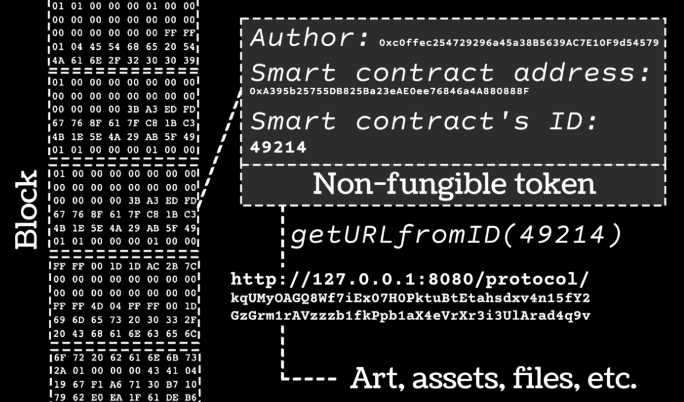
Non Fungible Tokens
The other interesting thing about Web3 is the ability to create and own digital assets
The obvious example is crypto-currency where crypto currency can be used directly in commerce or also be exchanged for fiat money such as US Dollars.
A NFT is just a digitally signed token that is stored on the blockchain – they can be owned or exchanged just like any other crypto-token
Examples:
Car and home titles
Insurance contracts
Birth/Marriage/Death certificates
Electronic art
Intellectual property
Google Maps
GMail

Slide 54
Non-Fungible Tokens
(google ERC-721 for the definition of the standard for NFTs, note the below is simplified to demonstrate the concepts in the architecture)
A non-fungible token is used to assert ownership of an asset.
Example, I mint a NFT asserting my ownership of a car, then I gift it to my son. In this example, my wallet id is “abc”, and my son’s wallet id is “xyz”
1
2
3
TransactionID: 123 MINT-NFT NFT-ID: 12-34-56
NFT-CREATOR: abc
NFT-OWNER: abc
Data: {type: auto-title,…}
TX-456 Send-NFT NFT-ID: 12-34-56
From: abc
To: xyz Dig-Sign(Priv-Key(abc), Hash(NFT-ID,From,To))
TX-789
NFT-ID: 12-34-56 NFT-OWNER: xyz
A NFT can be created by anybody via self minting. Notice when an NFT is created its given a unique ID and has other attributes such as metadata about the NFT itself
When an NFT is going to be exchanged, a new transaction/smart contract is executed, showing ownership transfer using “to” and “from”. Notice the private key of the current owner is used to digitally sign the transactions to prove that they are transitioning ownership. The signature can be easiely verified via the public key
Once ownership is transferred, notice the NFT-ID does not change, it never will change. This shows linage back to the original creator of the NFT.
Google Maps
GMail

Slide 55
Semi-Fungible Tokens
(google ERC-1155 for the definition of the standard for SFTs, note the below is simplified to demonstrate the concepts in the architecture)
A semi-fungible token is basically the same thing as a NFT, with one minor difference
NFTs are unique, and when they are minted are tied to exactly one asset
Semi-Fungible tokens (SFT) can be minted with a quantity. For example mint a “lot” of NFTs. When an SFT is minted, its quantity is fixed and can not be altered up or down.
Example, I can issue 100 SFTs for a piece of artwork, either digital or physical. Thus each SFT represents 1/100 ownership of the physical asset. You can of course, own more than one SFT for an asset thus increasing your ownership stake
If you mint a SFT with quantity 1, then its basically a NFT.
Google Maps
GMail

Slide 56
Selling Non- or Semi-Fungible Tokens
We just covered how to exchange a NFT and SFT, hopefully you can see how we can not only exchange but sell the transfer of rights with a SFT via smart contracts
Contract 1 – Sell NFT 123
Contract 1 – Buy NFT 123
Advertise for sale
Pay
Mint NFT 123
Sell NFT for 100 coins
Buy NFT 123
Send 100 coins from wallet xyz
coins received
NFT Received
Received
100 coins from wallet xyz
Transfer NFT 123 to wallet xyz
Receive token of ownership for NFT 123
Payment received
Conceptually a buyer creates a contract offering to sell an NFT, and a buyer creates a contract to buy an NFT. Note that state changes happen automatically when events are triggered via the contract
Google Maps
GMail

Slide 57
API in Web 2 vs Smart Contracts in Web3 from an Architecture Perspective
Centralized Entity, e.g., A company
API Call
API Interface
Application
API
API Data
API Interface Documentation
JSON over HTTP
Decentralized Entity
API Call
API Interface
Smart Contracts
Application
Blockchain
JSON over HTTP
Architecturally, the concepts make sense, but the current-state-of-the-art blockchain technology is hard to scale and introduces other challenges that need to be overcome for this to be a practical solution
Google Maps
GMail

Slide 58
Web 3.0 Important Architecture Pivot
This is one of the most significant architecture differences…
Web1 & Web 2
Web3
Web
Browser
Server
Client
Server
Database
API / Web Service
Browser
Javascript Engine
Mobile
Custom App
Blockchain Hold Both Data and Code via Smart Contracts
With web1 and web2 we brought data to our code;
With web3 we bring code to our data!
Google Maps
GMail

Slide 59
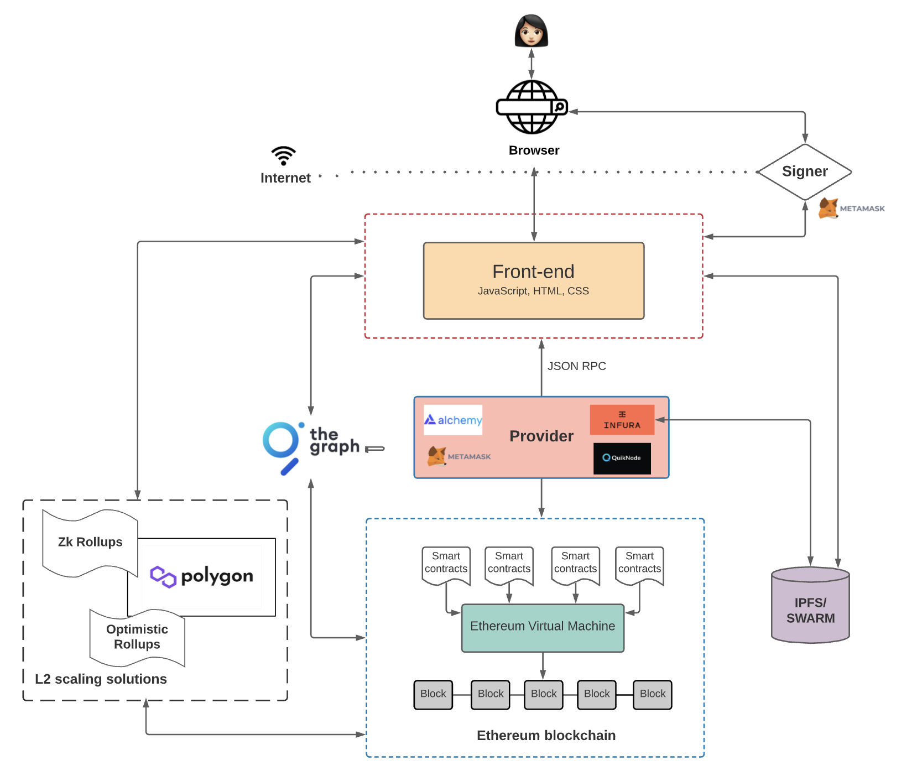
Web3 – More Realistic Architecture
User interface code similar to Web2 solutions
Assists with signing and private keys for security and privacy
Optimized service for querying the blockchain
Intermediary between your app and the blockchain, not needed if you want to run your own blockchain nodes
Scaling solution for executing transactions off chain and then periodically merging
Cost effective off chain storage for intermediate state changes
Smart Contracts persisted in the blockchain
https://www.preethikasireddy.com/post/the-architecture-of-a-web-3-0-application
Google Maps
GMail

Slide 60
Web 3.0 Summary
Significant Technical Challenges exist for Web3 to overtake Web2, Time will Tell
The more likely outcome is that Web3 will coexist and complement Web2 for some time into the future
Google Maps
GMail

