Slide 1
SE 577 Software Architecture Architectural Modeling

Slide 2
Modeling is a technique used to tame complexity
Models are used to capture abstractions of complex systems to make them easier to reason about.
What are the key questions that you need to be able to answer
Identify the optimal level of abstraction at which to model
Identify what “objects” will be modeled and the types of interactions you will model
Identify the possible states of the system including both system states and the state of their runtime environment
Identify how interactions will change (if at all) over time

Slide 3
So what are software architecture models?
Architecture models capture the foundational design decisions about a system.
An architecture model is an artifact that captures these decisions
These models serve as documentation that can be consumed by various stakeholders

Slide 4
Why is the ability to document architecture important?
Its important to be able to document an architecture to reason about its design for a number of reasons…
Program Understanding – we need to make modifications to the system, where would the modifications go, how long would they take, how much would they cost
Explaining the operation of the system to stakeholders – how does the system work, what are its major features, why should you use this system versus a competitors solution
Providing a common document to capture the high-level design of the system that can be used to make important management and technical decisions
Measuring technical health and technical debt – how far does the “as built” system deviate from the “as designed” architecture?

Slide 5
Modeling choices are important!
The choice of what to model is important!
This activity takes time and costs money so picking what to model becomes a critical activity
The choice of how detailed your models are are important!
What stakeholders are you trying to influence?
How much detail is needed to describe the architecture to the stakeholders?
Does the model describe the design, or is the model intended to influence a decision?
The choice of what notation is used to document your architecture is important!
Should you use formal, or semi-formal notations

Slide 6
Modeling is about documenting key architecture and design decisions!
A model is an artifact that captures a number of different design decisions used to establish the overall system architecture
This activity takes time and costs money so picking what to model becomes a critical activity
Key things to consider when modeling
What architectural decisions and concepts should be modeled,
At what level of detail, and
With how much rigor or formality
Adapted From Software Architecture, Foundations, Theory and Practice

Slide 7
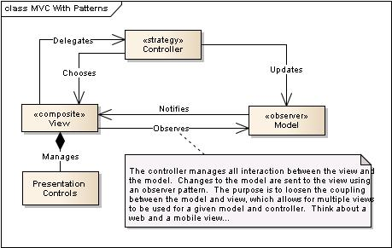
What do we document in a model?
Components
Connectors
Interfaces (including constraints)
Decisions and Rational
Structural, Runtime and Behavioral Constraints
Remind you of the definition of software architecture?

Slide 8
Thinking about models…
To experiment
To clarify
To understand
To analyze
To evaluate
Reason for Modeling
What is the purpose of the model, and who is the model for?
What to Model
How to Model
Structure
Transformations
State
Inputs and Outputs
Textual
Graphical
Formal / Mathematical
Adapted From: https://www.cl.cam.ac.uk/teaching/1112/SWDesign/softwaredesign01.pdf

Slide 9
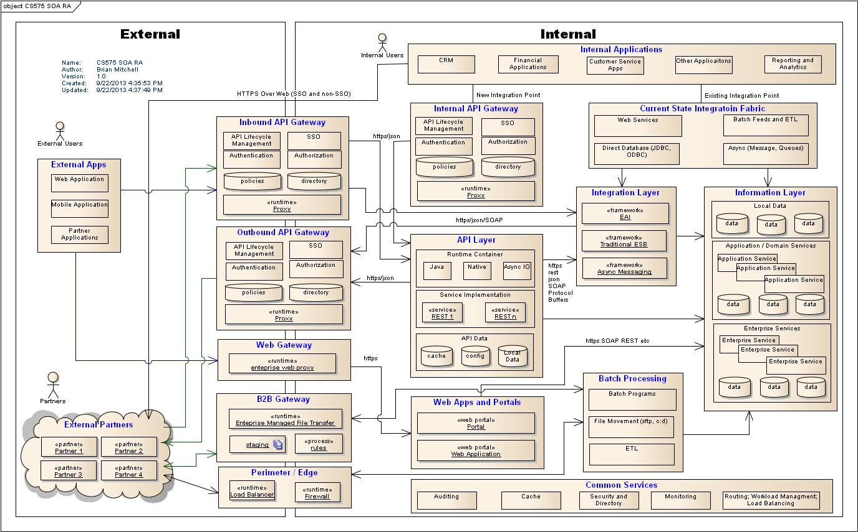
Example: What are some of the key aspects of this model?

Slide 10
Modeling the different views – Static and Dynamic
Static models describe the structure of the system
These structures generally do not change over time
Capture the topology of the system components:
can be software component relations – uses/inherits
Can be runtime component relations – sends message to over HTTP
Can be deployment component relation – this software is deployed to this server…
Dynamic models capture the behavior of the system during runtime
The important thing to capture is change is being managed over time
State of the components
Data flow over the connectors

Slide 11
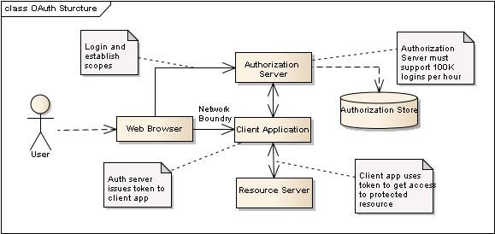
Static Model View (Example: oAuth)
Is this view useful to discuss the components associated with managing the oAuth protocol (functional and non-functional)?

Slide 12
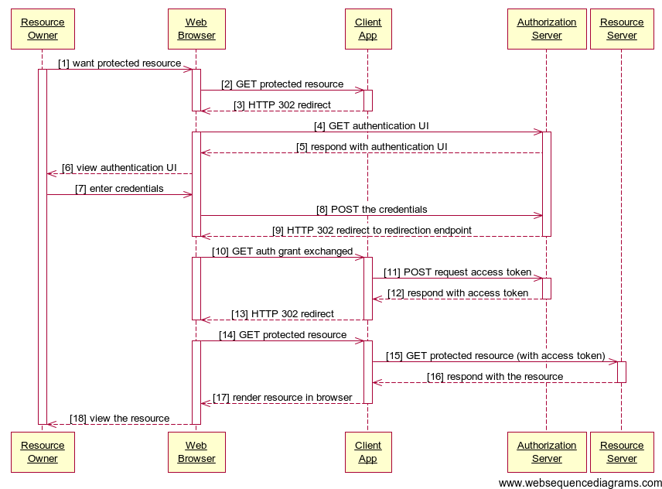
Dynamic Model View (Example: oAuth)
Is this view useful to discuss how the components implementing the oAuth protocol work together?

Slide 13
Possible problems using multiple views to model software architectures
Modeling a realistic software architecture using a single view is not practical
Too complex
Different concerns that don’t belong together – static, dynamic, deployment
Key challenge is to ensure that all of the different views are consistent
Might be hard to find these issues
Direct – one diagram states two servers, another states three servers
Indirect – one view is at a higher level than another and the refinement introduced inconsistencies
Structure vs Dynamic – structures don’t support dynamic requirements
Functional vs Non-Functional – The structure does not support the non-functional requirements

Slide 14
Modeling (Documentation) Objectives
Useful now, represents the best knowledge of key architecture and design decisions
Is contextual to the key problems or design decisions that need to be made
Is appropriate to a targeted stakeholder
As little as possible, documentation requires maintenance

Slide 15
Where to Start? Consider what needs to be modeled!
The hardest part of reconstructing an architecture is selecting what needs to be modeled …
Components – hierarchical description of the major subsystems
Connectors – connections between the components
Interfaces – the protocols governing the connectors, or the properties managed by the clients
Patterns and Styles – are there any interesting patterns or styles used in the architecture that should be documented?
Rationale – reasoning behind decisions of the aspects we chose to model – are they important to stakeholders? are they critical to the understanding of the system?
Constraints – what dependencies don’t we want to have in the solution

Slide 16
Where to Start? Consider what needs to be modeled!
Think about what is important to show to promote an understanding of the architecture…
Static aspects are things that do not change as the system runs, and
Dynamic aspects are things that do change, manage important state, or are sequence dependent
Platform aspects are things where the runtime or deployment decisions play an important part of the architecture – load balancers, proxy servers, etc.

Slide 17
Where to Start? Consider what needs to be modeled!
How do we find things that we want to model…
Look at the code
Source code analysis tools
Class/package structure
Build / configuration management information
Test cases – what is being tested – that must be important
Directory structures
Naming conventions

Slide 18
Where to Start? Consider what needs to be modeled!
How do we find things that we want to model…
What do we know about the system
What are the main features
How are they exposed to the users
Build / configuration management information
Test cases – what is being tested – that must be important
Directory structures
Naming conventions
Non-functional aspects

Slide 19
Think about what story that you want to tell to identify important things that need to be modeled
Think about how you were taught to write stories in elementary school:
Who? Who is your stakeholder or target audience
What? What is the key message you are trying to get across
Why? Why is it important
Where? Where are the most important parts – think scale, security, etc
When? When do key events happen?
How? How does it work?
How Much? How much impact does the system have on an existing landscape?

Slide 20
And the outcome you want to achieve
Why do I create a Model / View:
Drive stakeholder clarity
Making quality / informed decisions
Forcing others to make decisions
Being transparent around the solution – what it is and what it is not
Being opinionated around constraints
Show alignment, and possible misalignment with enterprise or industry standards

Slide 21
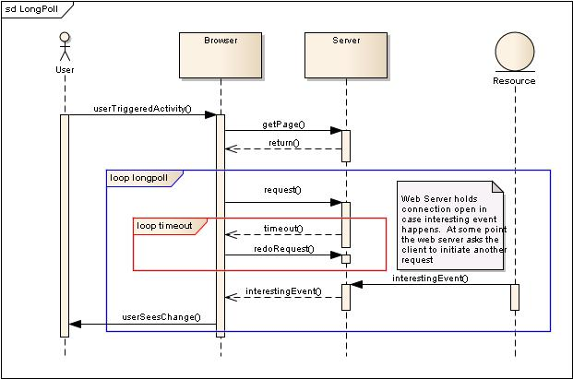
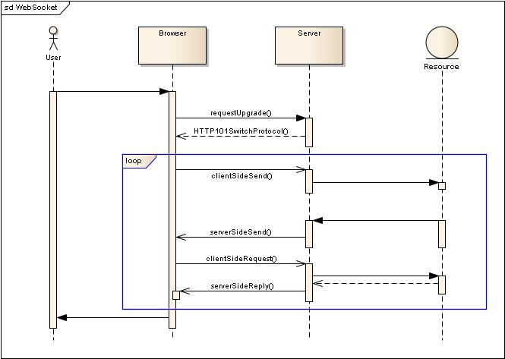
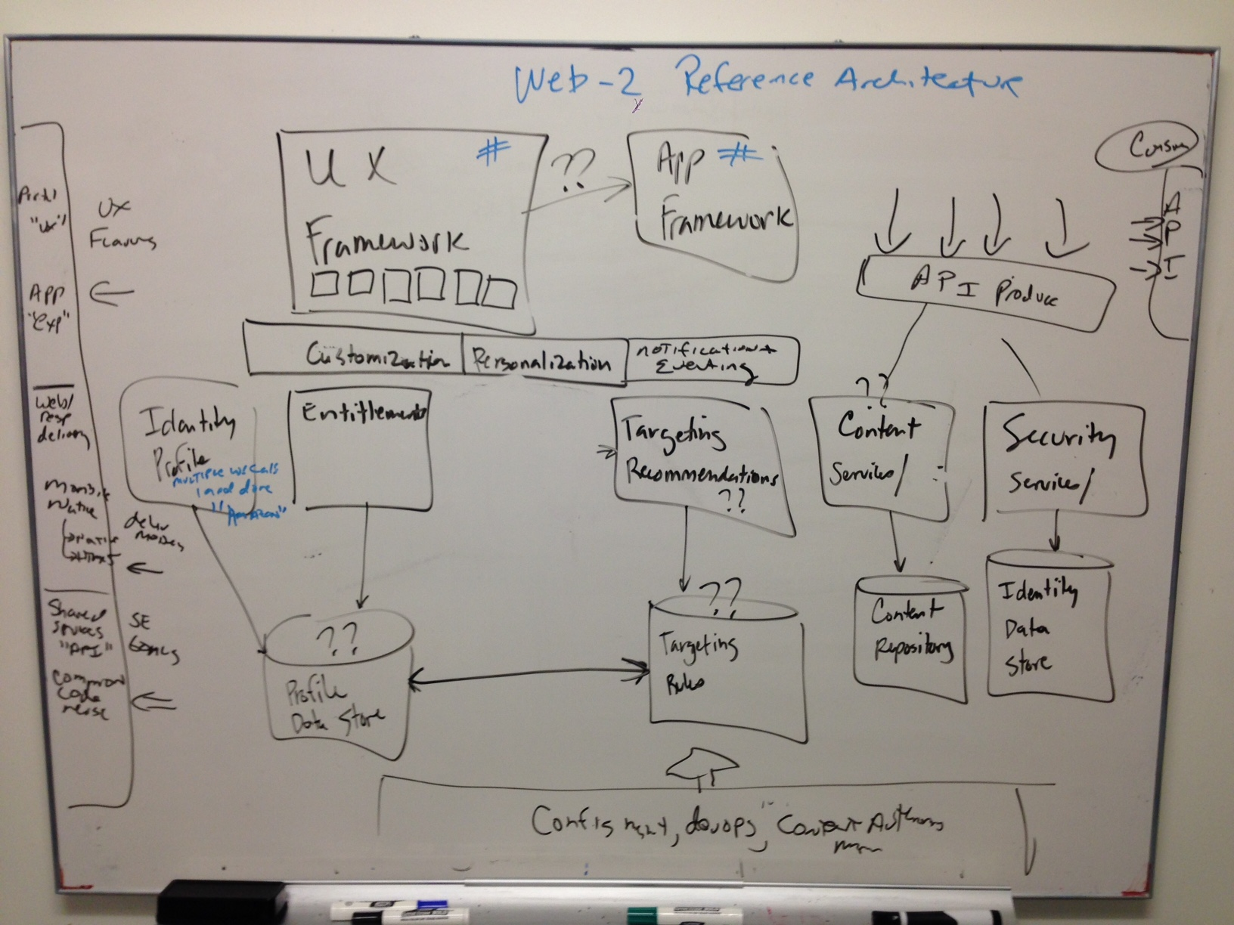
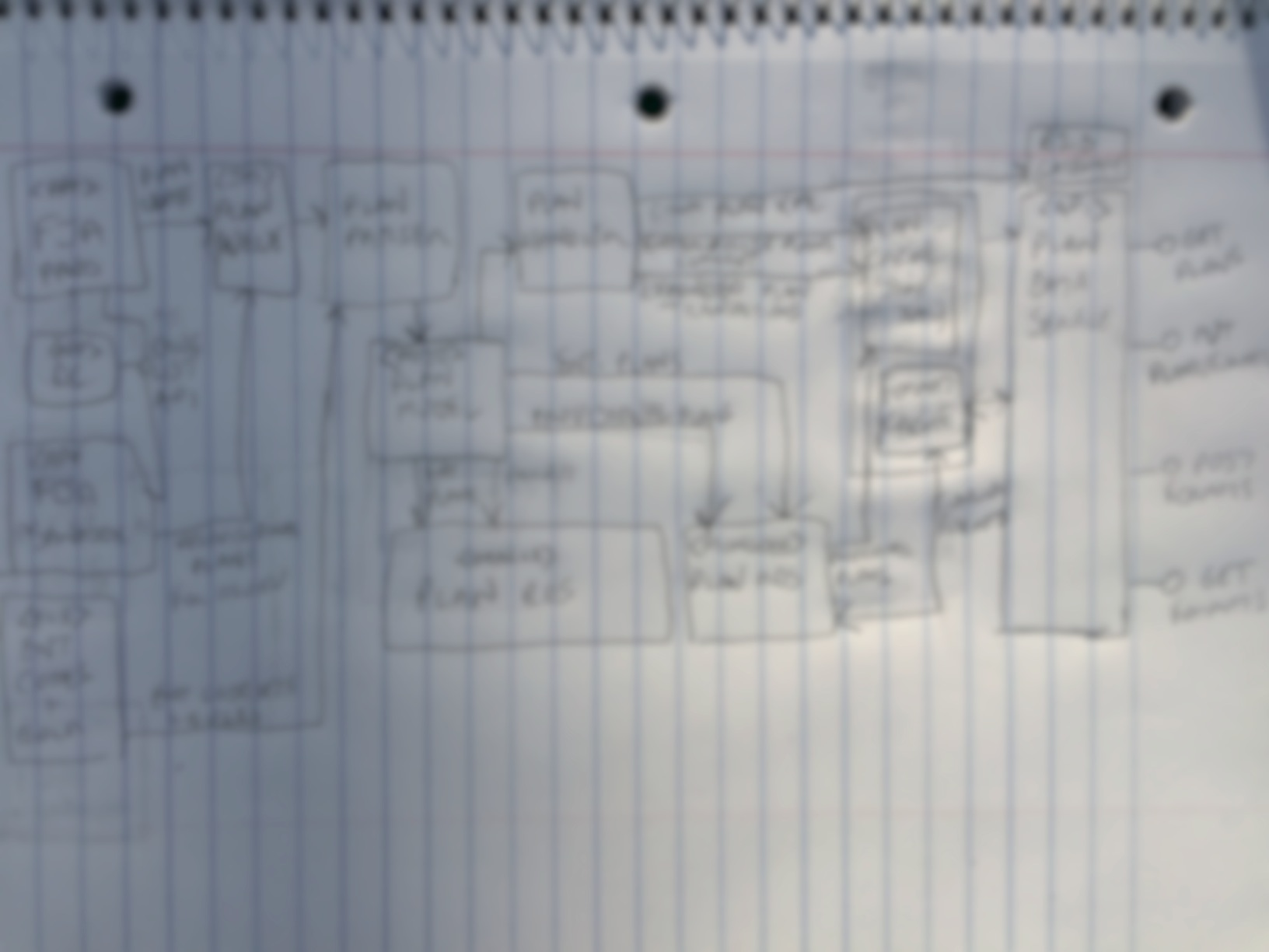
Be clear on the outcome you are trying to accomplish
What are the major Components?
What is being impacted?
Who are the important stakeholders?
How does this complex behavior work?
How do we message what needs to change?
Is this even feasible?

Slide 22
MOST IMPORTANT CONCEPT IN THIS LECTURE
At the end of the day, a model is a quasi-useless artifact unless:
It helps you as the architect, or your architectecture team decompose the complexity of the problem domain, or
Its purposefully targeted at one or more key stakeholders to facilitate alignment on:
Decision that have, or will need to be made on the solution to meet its functional or non-functional requirements
Aspects around tradeoffs driven by constraint balancing that require agreement
Agreement related to technical debt that require socialization
Agreement around technical stack or deployment options that impact engineering
Alignment around which decisions need to be made when, even if those decisions have not been made yet.

Slide 23
Describing Architectures
Formal Approaches
Architectural Description Languages
Many to date
Informal Approaches
UML Notation – Simple and known by a broader community
UML is missing architecture semantics
Lines and Boxes with natural English
Other Notations – C4

Slide 24
Method 1 – Formal Architecture Description Languages
Family PipeFilter = {
Port Type OutputPort;
Port Type InputPort;
Role Type Source;
Role Type Sink;
Component Type Filter;
Connector Type Pipe = {
Role src : Source;
Role snk : Sink;
Properties {
latency : int;
pipeProtocol: String = …;
}
};
};
System simple : PipeFilter = {
Component Splitter : Filter = {
Port pIn : InputPort = new InputPort;
Port pOut1 : OutputPort = new OutputPort;
Port pOut2 : OutputPort = new OutputPort;
Properties { … }
};
Component Grep : Filter = {
Port pIn : InputPort = new InputPort;
Port pOut : OutputPort = new OutputPort;
};
Component MergeAndSort : Filter = {
Port pIn1 : InputPort = new InputPort;
Port pIn2 : InputPort = new InputPort;
Port pOut : OutputPort = new OutputPort;
Representation {
System MergeAndSortRep : PipeFilter = {
Component Merge : Filter = { … };
Component Sort : Filter = { … };
Connector MergeStream : Pipe = new Pipe;
Attachments { … };
}; /* end sub-system */
Bindings {
pIn1 to Merge.pIn1;
pIn2 to Merge.pIn2;
pOut to Sort.pOut;
};
};
};
Connector SplitStream1 : Pipe = new Pipe;
Connector SplitStream2 : Pipe = new Pipe;
Connector GrepStream : Pipe = new Pipe;
Attachments {
Splitter.pOut1 to SplitStream1.src;
Grep.pIn to SplitStream1.snk;
Grep.pOut to GrepStream.src;
MergeAndSort.pIn1 to GrepStream.snk;
Splitter.pOut2 to SplitStream2.src;
MergeAndSort.pIn2 to SplitStream2.snk;
};
}; /* end system */
OK, I mentioned them

Slide 25
UML as a Modeling Language for Architecture
The Good
UML is somewhat-widely known
There is commercial tool support for UML
UML is extensible
The Not-So Good
UML is a language of design, and not architecture
Many of UML abstractions are really constructs that you see in object oriented programming languages
UML has many options to do basically the same thing, how to you get consistency?

Slide 26
Example: UML to model a banking service
UML Basic Component Diagram with Stereotypes

Slide 27
Another UML Example
Adding Custom Stereotypes – Service, Service Connector, Service Interface

Slide 28
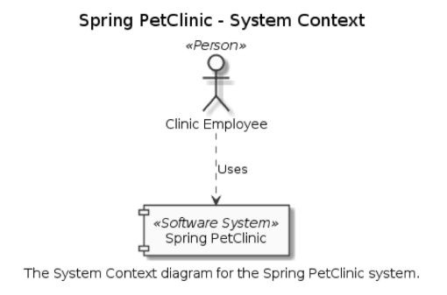
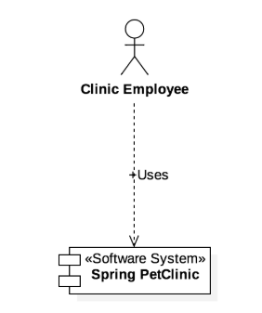
Strategy 2: Constrain UML to Model Architectural Artifacts – C4 Example
C4 Context Diagrams in UML
Ref: https://c4model.com/

Slide 29
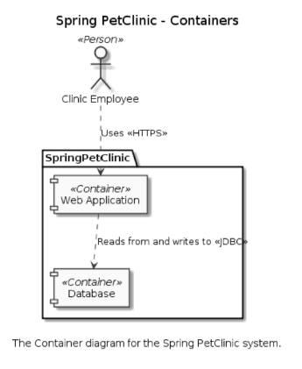
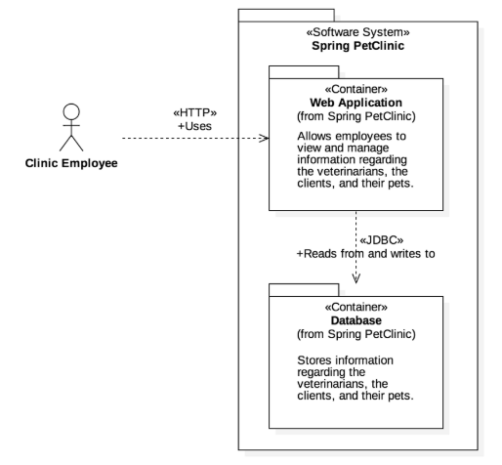
Strategy 2: Constrain UML to Model Architectural Artifacts – C4 Example
C4 Container Diagrams in UML
Ref: https://c4model.com/

Slide 30
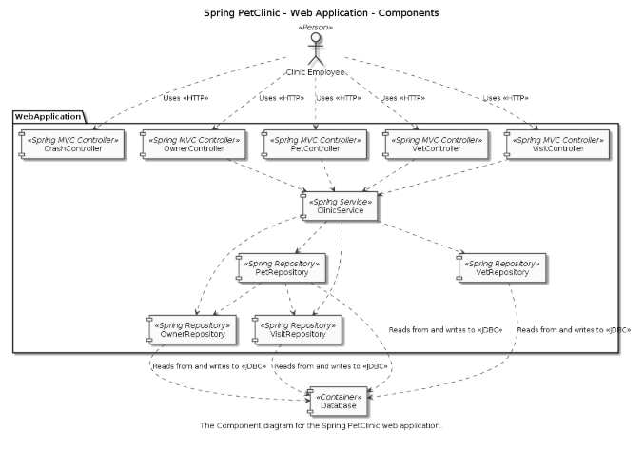
Strategy 2: Constrain UML to Model Architectural Artifacts – C4 Example
C4 Component Diagrams in UML
Ref: https://c4model.com/

Slide 31
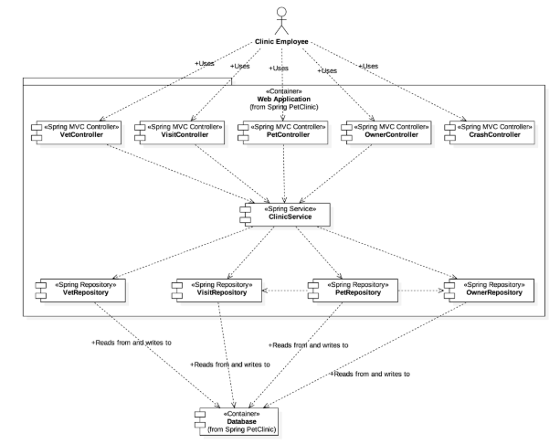
Strategy 2: Constrain UML to Model Architectural Artifacts – C4 Example
C4 Component Diagrams in UML
Ref: https://c4model.com/

Slide 32
Strategy 3: Extend UML
Use UML’s meta metamodel to extend UML
Introduce explicit architectural constructs and in UML
Introduce additional notations for modeling architectural semantics
Follow an approach similar to strategy #1 to model specific architectures
Follow an approach similar to strategy #2 to model specific architectural styles

Slide 33
Comparing the Approaches
“Straight” UML
understandable architectures
manipulable by standard tools
architectural constraint violations
“Constrained” UML
ensures architectural constraints
requires complete style specifications
requires OCL-compliant tools
“Extended” UML
provides “native” support for architectures
requires backward tool compatibility
may result in incompatible UML versions
must be careful not to create another “box and line” notation, invalidating the motivation to use UML in the first place

Slide 34
Using informal lines and boxes to model architecture
In this approach a diagraming tool such as Microsoft Visio or Omnigraffle is used to document the architecture views
Tends to create the “best looking” views given that there is no limitation to the artwork that can be applied to the components and connectors.
Probably the most popular approach to document architectures
But there are challenges:
There is a lack of rigor over the component and connector vocabulary
They tend to be pictures, and difficult to get value over managing the views in a model repository – for example – there is limited opportunity to share metadata between diagrams
Hard to deal with versioning and change – “Is this the latest view?”
Impossible to detect inconsistencies between models

