Slide 1
SE 577 Software Architecture Linux, Docker & Kubernetes (k8s) Architecture

Slide 2
API Architecture
HTTP
Plugins e.g. CORS
API Framework
Plugins e.g. CORS
Plugins e.g. CORS
Plugins e.g. CORS
HTTP Library
Router
Request Middleware Pipeline
Response Middleware Pipeline
HTTP Library
Plugins e.g. CORS
API Library
Plugins e.g. CORS
API Router
Plugins e.g. CORS
Middleware e.g. oAuth
Middleware Pipeline Builder
YOUR CODE input (req) returns resp
Most API Frameworks/Libraries Use a Repository Style Architecture
API Library Utilities
We have used several in this course Koa, Fastify, GoLang Gin, Ktor, etc

Slide 3
How you should think about this lecture and the remainder of the lectures in this class
We will be looking at real world things that have very interesting architectures
You might be thinking as I introduce and walk through some of the material – “Isn't this an architecture class?” – It is, but to get to some of the interesting aspects of the architecture, tradeoffs, constraints, etc – we need to have a fundamental understanding of the technology itself

Slide 4
Linux Architecture
Linux is a layered architecture, the kernel sits close to the hardware and even has some hardwre specific code (e.g., x-64 vs ARM).
The code we run, tools, custom code, etc sits at the top layer
User code leverages the system call interface to bridge between user space and kernel space
When you pick a Linux distribution, they basically provide the stuff in the blue boxes
OS Tools bash, ls, chmod, …
Your Code and
Applicaitons (node, chrome, etc)
User Space
System Call Interface Library (glibc, musl)
Linux Kernel
System Call Interface
Linux Kernel
Kernel Space
Hardware Architecture Specific Kernel Code
Hardware Specific Device Drivers
Note the actual linux architecture is significantly more complex, but this should suffice for our needs

Slide 5
Linux Namespaces
When linux boots, it synthesizes process Id (pid) 1 - its called the init process, often implemented by the systemd process. This process is used to spawn all other processes in the system.
One way linux can create a child process is via the clone syscall. By default the new child process runs in the same execution context as the parent. Processes in the same execution context share a common linux namespace.
The clone system call also provides options to allow the child to be put in separate namespaces.
Linux currently supports 7 different namespaces – CGroup, IPC, Network, Mount (filesystem), PID, Time, User (user permissions and groups), UTS
Process
Clone systcall
New Process
Processes that have attributes that run in a common namespace are not isolated, processes with different namespaces are

Slide 6
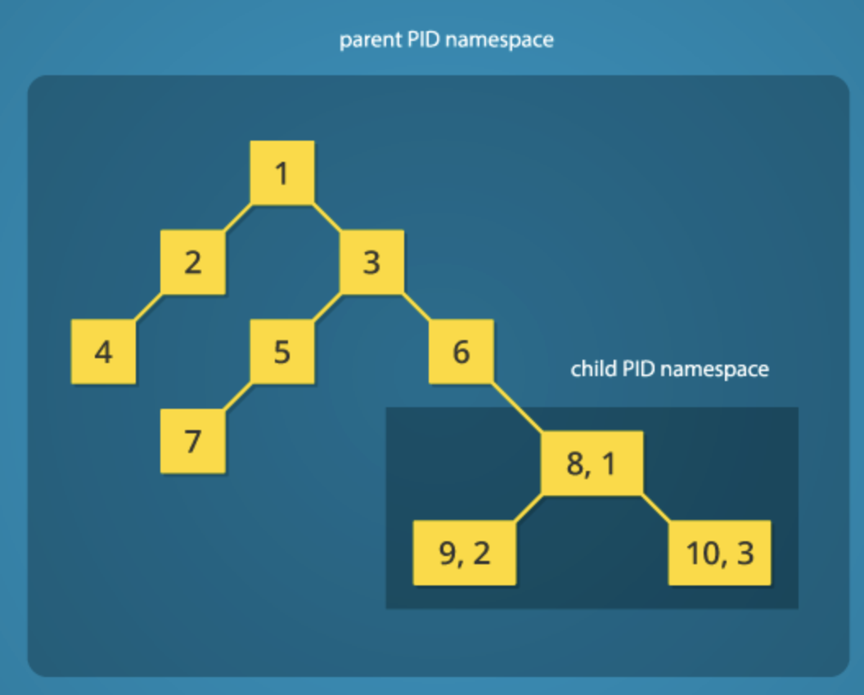
Linux Namespaces – Example, cloning a child process into a new process/pid name space
Ultimately every process is given a unique id in the guest operating system. Thus if you listed all processes in the system you would see PID 1-10.
However look at pid 6 it cloned PID8, and PID8 cloned both PID9 and PID10
The cool thing is that if you asked PID 8 what its process ID is it would come back as 1; Same for pid9 and 10, they would come back as 2 and 3.
Thus everything in the child namespace can see each other, but it cannot see anything in the partent namespace.

Slide 7
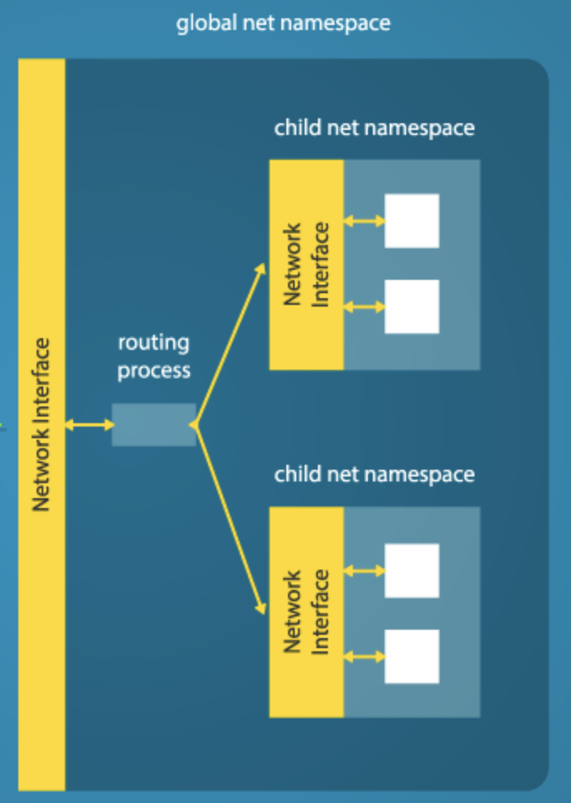
Linux Namespaces – Example, cloning a child process into a new network namespace
Ultimately every process is given a unique id in the guest operating system. Thus if you listed all processes in the system you would see PID 1-10.
However look at pid 6 it cloned PID8, and PID8 cloned both PID9 and PID10
The cool thing is that if you asked PID 8 what its process ID is it would come back as 1; Same for pid9 and 10, they would come back as 2 and 3.
Thus everything in the child namespace can see each other, but it cannot see anything in the partent namespace.

Slide 8
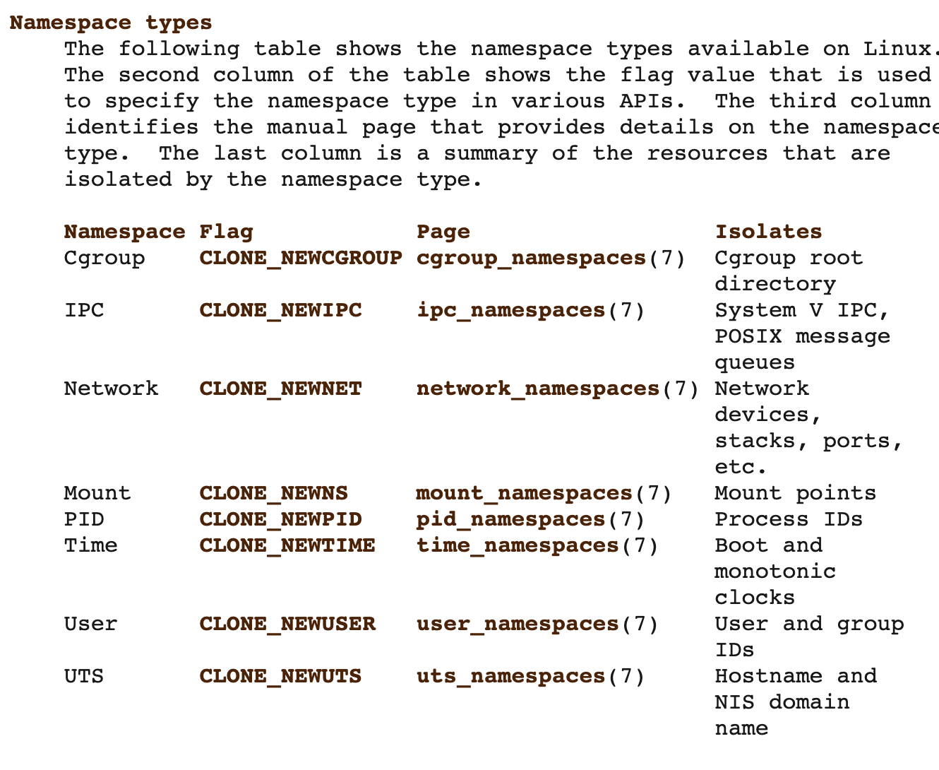
Linux Namespaces – allow for logical isolation in linux
If you clone a child process into a new namespace for all namespace types, it will for all practical purposes be fully isolated from the parent.
Also, if the isolated process creates new processes it will inherit by default the same namespace as the parent thus allowing process groups to be isolated

Slide 9
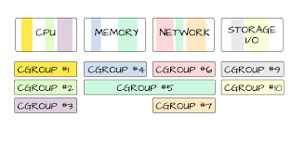
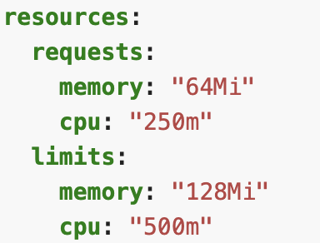
Linux Cgroups – managing resource limits on collections of processes - /sys/fs/cgroup/…
Cgroups allow resource limits to be attached to a collection of processes.
For example you might want to restrict how much network and file I/O can be used and also cap CPU at ½ of a core
In this example we are requesting an initial allocation of 64Mb of memory and 250 millicores (1/4 of a physical core), and allowing it to burst up to the limit of 128Mb of memory and 500 millicores (1/2 of a physical core

Slide 10
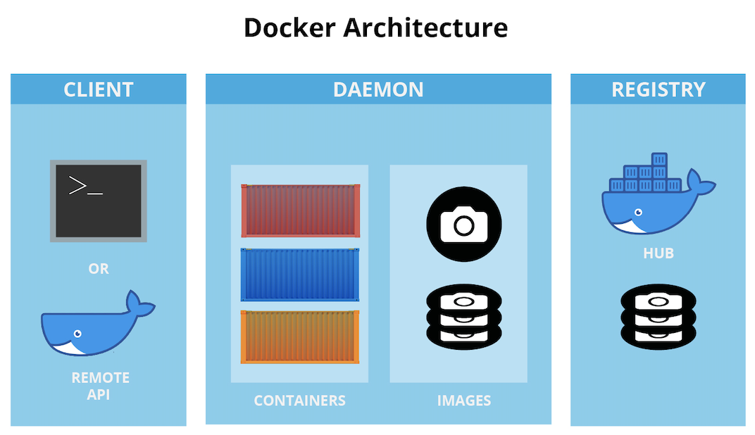
Docker
Now that we know how linux can isolate process groups (namespaces) and resources (cgroups) we can better understand the docker architecture
Managing Docker
Running Containers
Getting Containers

Slide 11




Docker Daemon and Linux
On windows and Mac the docker daemon is required and runs a customized, container optimized version of linux in a hypervisor. On linux machines the daemon does not use a hypervisor because it has access to the linux kernel
General Purpose Linux Distributions
Container Optimized Linux Distributions

Slide 12
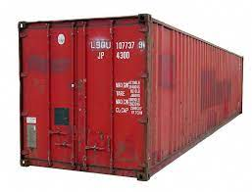
The docker container
The docker container is a portable package containing everything needed to run your workload. It adheres to the open container initiative specification https://opencontainers.org/
Linux Process in Separate Namespace/CGroup
EXPOSED PORT
Docker Container
Your Code & Dependencies
Isolated Filesystem
CMD or EXEC
Attached Storage
Base Image Tooling
Base Image System Call Interface Lib
The shipping container transformed logistics
System Call Interface
Linux Kernel

Slide 13
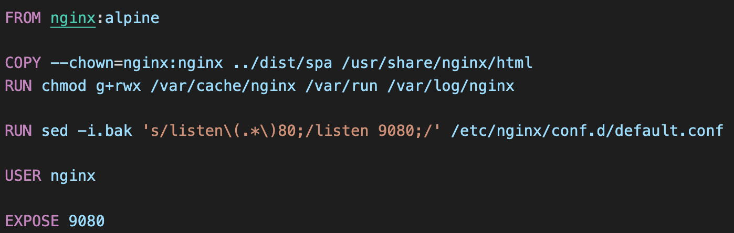
Building Docker Containers
Docker Container
Create Ephemeral Writable Layer
Expose port 9080
Set the user to nginx
Run script to set default port for nginx to 9080
Copy SPA code into /usr/share/nginx/html + change owner to nginx
Alpine-Based OS and Tools with Nginx Installed

Slide 14
Building Docker Containers
docker build -t architecting-software/se577-demo-app -f Dockerfile .
Docker Container
Create Ephemeral Writable Layer
Expose port 9080
Set the user to nginx
Run script to set default port for nginx to 9080
Copy SPA code into /usr/share/nginx/html + change owner to nginx
Alpine-Based OS and Tools with Nginx Installed
docker build –squash –t architecting-software/se577-demo-app -f Dockerfile .
Docker Container
Create Ephemeral Writable Layer
Have nginx running running and exposing port 9080, with our code in the /usr/share/nginx/html directory with file ownership of nginx

Slide 15
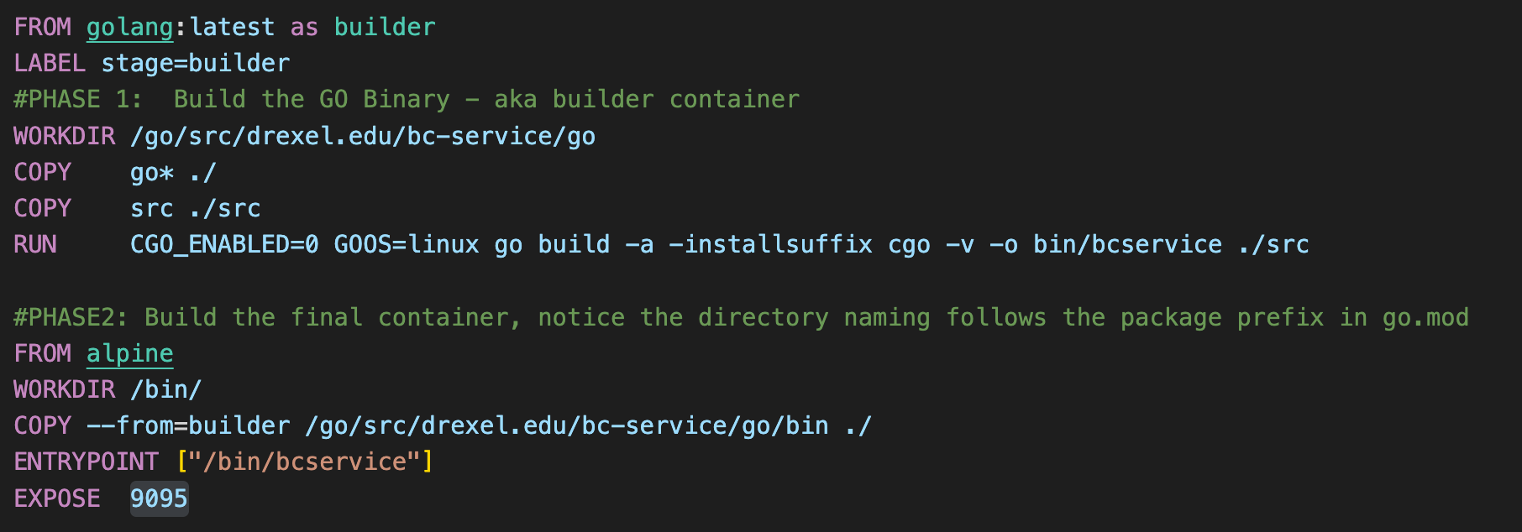
Building Docker Containers
Its not uncommon to create a build process where you create a build container first and then use the output of that build container to create your final container
Build Container
Run Container

Slide 16
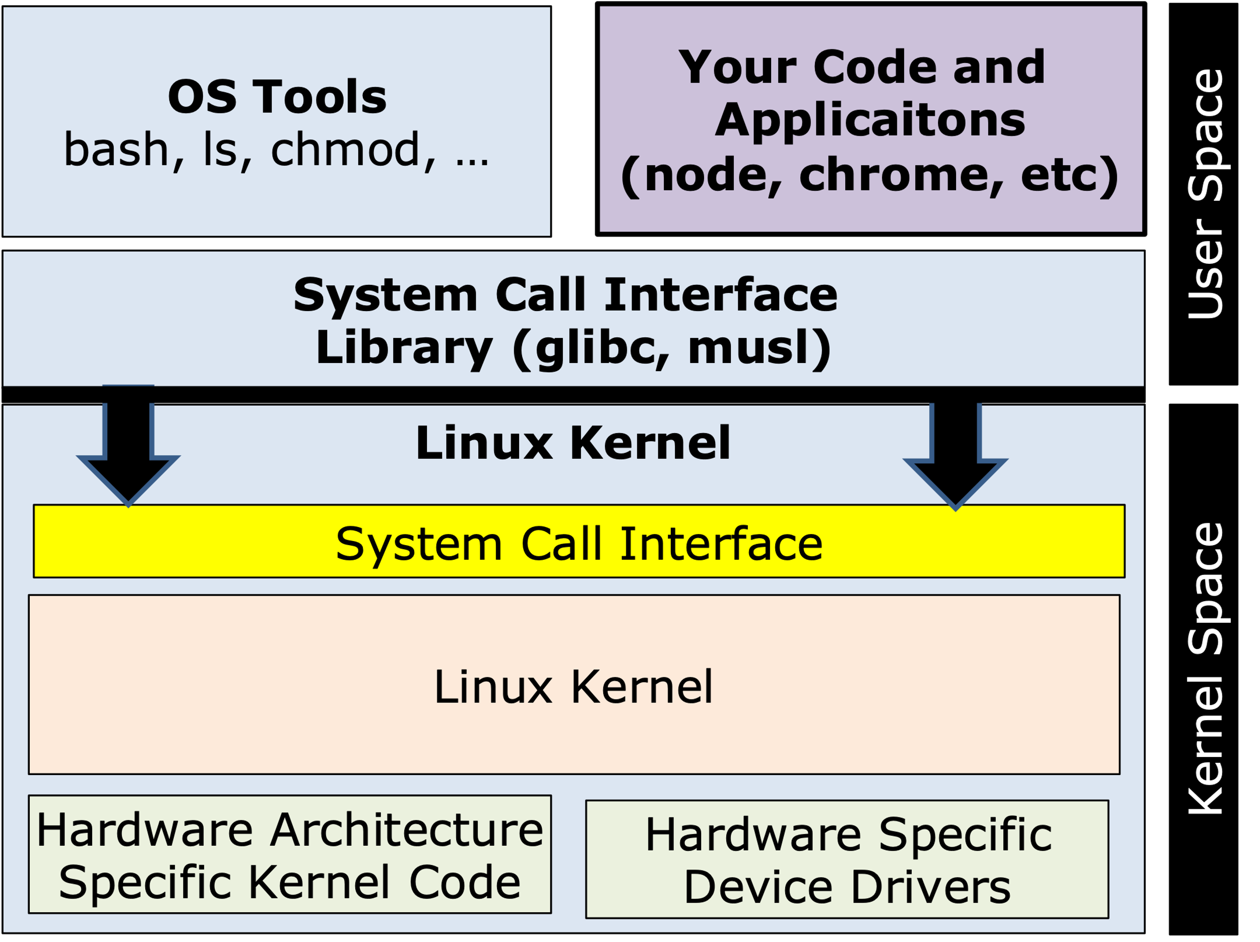
What OS Kernel does a container use?
Note the base container is created from an OS image in this example
FROM alpine
OS Tools bash, ls, chmod, ps, etc
System Call Interface Library (glibc, musl)
Host Machines Kernel

Slide 17
Architecting for containers
Generally containers run one process, and are expected to do one thing. Thus we need a way for containers to work together to build useful architectures
Node Blockchain API (container)
Browser Running Vue SPA
Vue demo application (container)
Go Blockchain API (container)
GitHub API (external)

Slide 18
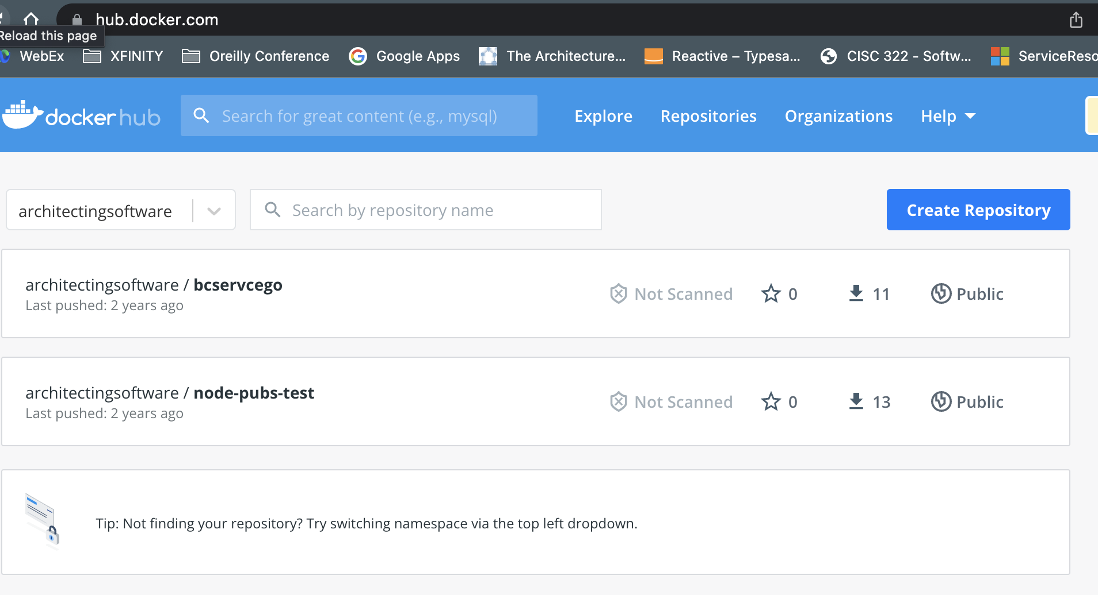
Container Repositories
After containers are created, they are generally pushed to a container repository. These could be public or private
Manage Container Versions
Push Containers on Build
Pull Containers When Needed

Slide 19
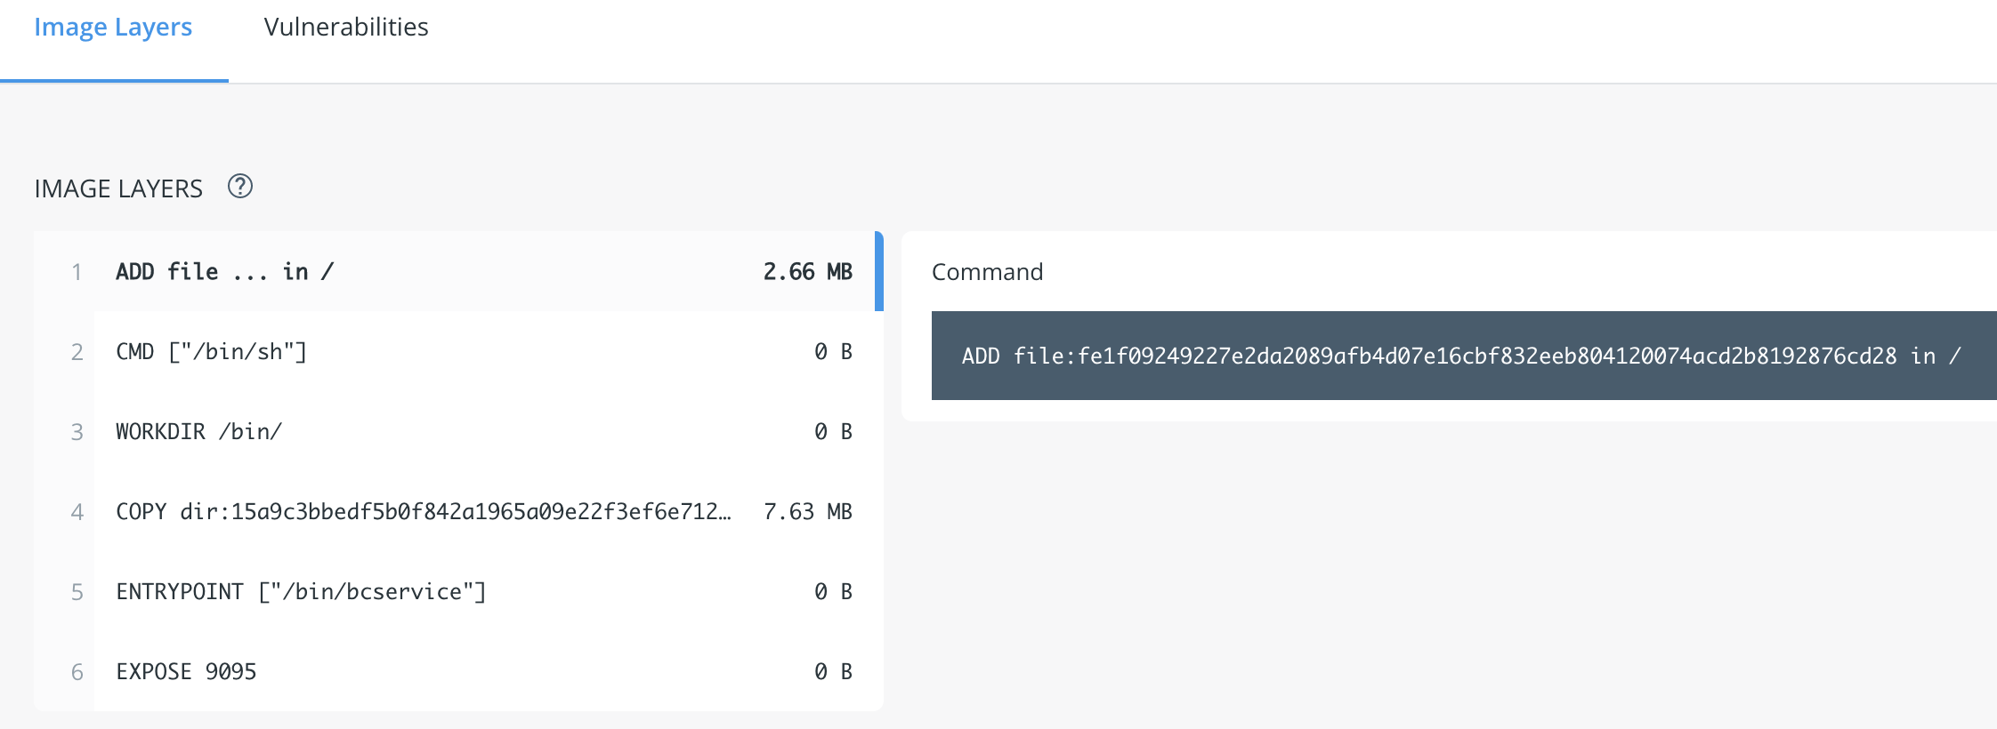
Container Repositories
Container repositories also keep track of the container layers and can do other things like scan for security vulnerabilities

Slide 20
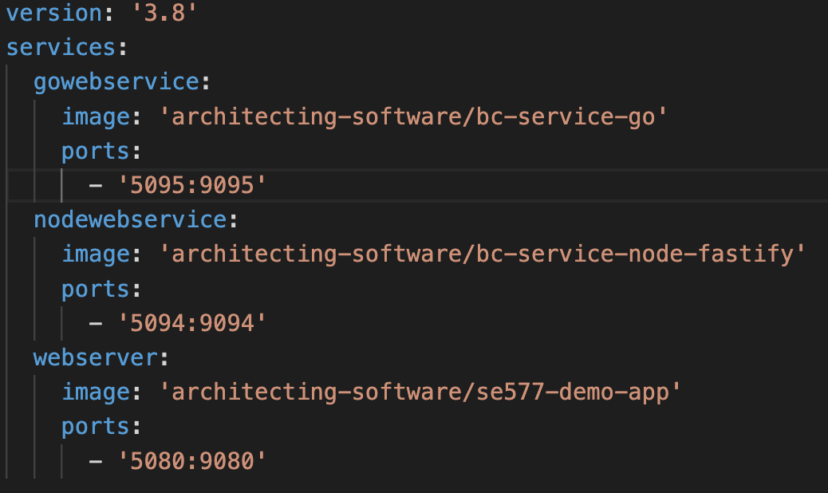
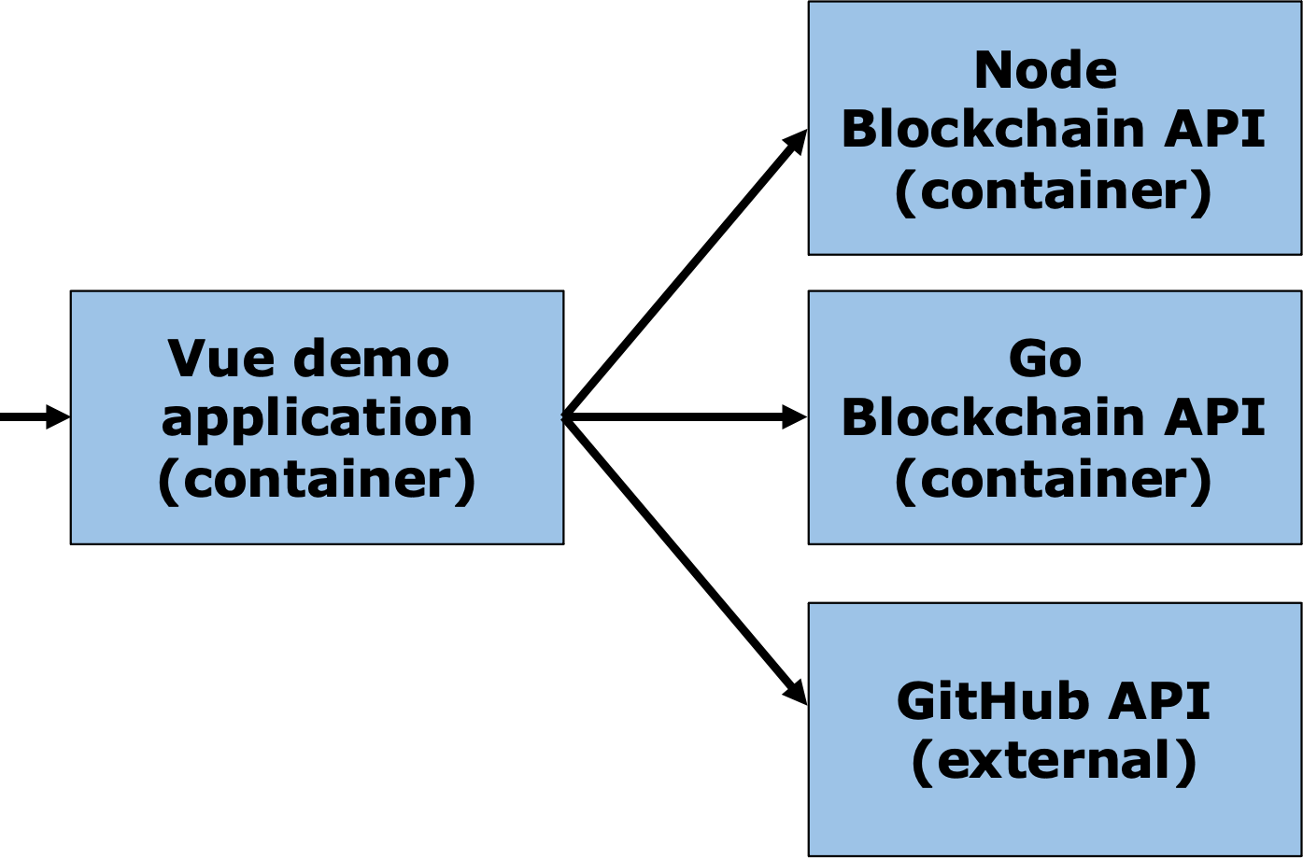
Using Docker-Compose
Generally containers run one process, and are expected to do one thing. Thus we need a way for containers to work together to build useful architectures
Port 5094
Port 5080
:9095
External Port 443 https
Docker compose allows us to bring up collections of containers via docker-compose up, and docker-compose down

Slide 21
Architectural Issues with Docker-Compose
Docker compose does not supervise the running environment
What happens if the process in this container crashes?
Port 5094
Port 5080
What happens if this container is getting slammed with traffic?
:9095
External Port 443 https

Slide 22
Running Containers at Scale In Production
Containers are ephemeral – this is a big deal – every time its run it has the same starting state
Containers can be distributed via container repositories and inherit other benefits like ensuring the proper containers are used, they are secure, etc
But containers alone are not enough:
They need to be “supervised” – are they healthy, have they crashed, do they need to be restarted?
They need to be distributed to prevent against issues when their runtime crashes
They need to be aware of load so they can autoscale up, and autoscale down
They need to be isolated, so only container workloads that interact with each other can interact with each other

Slide 23
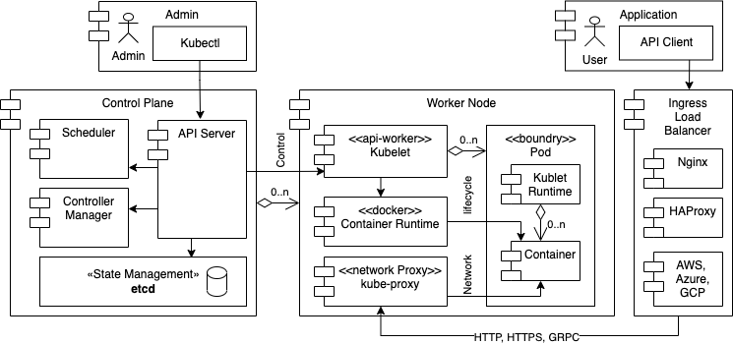
Running Containers at Scale In Production – Kubernetes or k8s

Slide 24
Running Containers at Scale In Production – Kubernetes or k8s
Everything managed via APIs
Control & Data Plane are High Availability
Container Work is Supervised
Target Configuration is Persisted, Tracked and kept up to date
Container Work & Network is Isolated

Slide 25
Running Containers at Scale In Production – Kubernetes or k8s - Pods
Most of the time pods run one container, the kubelet manages the pod runtime
Kubernetes Pod
Namespaces are used to govern what is shared between containers in the “pod” such as IPC, and things across the Kubernetes cluster such as network
Kubernetes Pod
Ip: w.x.y.z
Each k8s pod is given a routable
IP address
Each container in the pod can be reached via a port on that IP address
Kublet Runtime
Kublet Runtime
Container
Container
Container
Container
Container
Container
Container
Container
Container
Container port: xx

Slide 26
Running Containers at Scale In Production – Kubernetes or k8s – Core K8s Objects
Managing Kubernetes can be complex, but you can get by with just a few of the k8s objects
Kubernetes Deployment
Kubernetes Service
Kubernetes Ingress
Kubernetes Replica Set
type ClusterIP
Inbound Ingress Rules
Kubernetes Pod
type NodePort
Routing Rules
Kubernetes Pod
Kubernetes Pod
Kubernetes Pod
type LoadBalancer
Firewall/Security Rules

