Slide 1

A Heuristic Search Approach to Solving the
Software Clustering Problem
Brian S. Mitchell
Software Engineering Research Group
Math & Computer Science Department
Drexel University
Notes:
TODO
Why search versus other techniques? Reread Bill’s ACDC and Koche’s ICSM01 papers.
Thinking Point 1: Goal is to propose an abstract representation of source code. There is no “correct” answer. Use multiple views – each view provides additional insight into the overall architecture.

Slide 2
Outline
Motivation & Background
Search Based Software Clustering (Bunch)
Evaluating Clustering Results
Summary & Future Work

Slide 3
Background
Software clustering simplifies program maintenance and program understanding
Software clustering techniques help developers fix defects (maintenance), or add a features (program understanding) to existing software systems

Slide 4
Understanding the Software Structure
When fixing or extending a software system
  Desirable to change as few of the existing modules/classes as possible
Requires an understanding of the system’s overall structure
Problem 1: The structure is complex and often not
documented for large systems
Problem 2: Ad hoc changes to the source code tend to
deteriorate the system’s structure over time
Notes:
Changing few modules reduces the probability of breaking other things

Slide 5
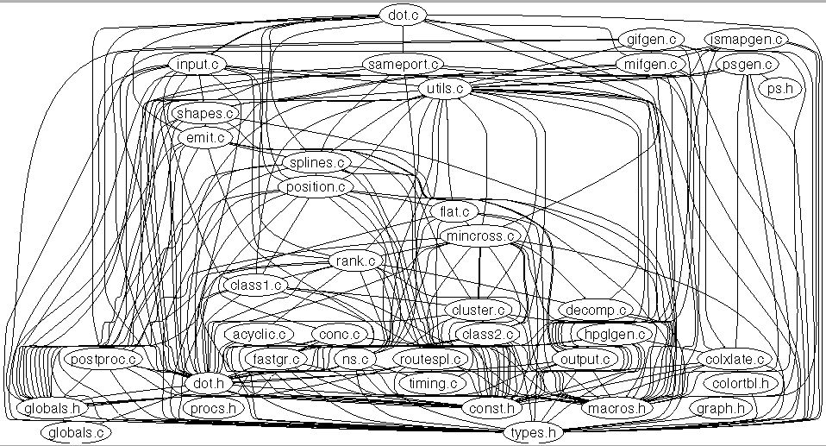
Example: The Structure of the dot System

Slide 6
Example: The Structure of the dot System
The Module Dependency Graph (MDG)
We represent the structure of the system
as a graph, called the MDG
  The nodes are the modules/classes
  The edges are the relations between
  the modules/classes
Notes:
Consistant way to represent the system, independent of the programming language

Slide 7
Example: The Structure of the dot System
Dot is a reasonably small system,
but its structure is complex and
hard to understand…
Notes:
Consistant way to represent the system, independent of the programming language

Slide 8
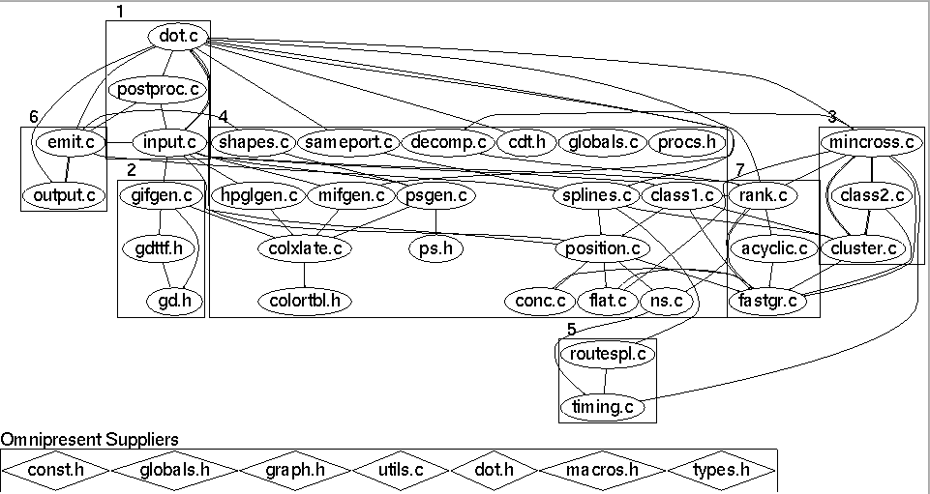
The dot System after Clustering and Filtering
The clustered view
highlights…
Identification of “special” modules
(relations are hidden to improve clarity)
Subsystems that group common features
Modules From the Source Code
Relations Between the Modules

Slide 9
The dot System after Clustering and Filtering
The Partitioned Module Dependency
Graph (MDG)
The partitioned MDG contains clusters
that group related nodes from the MDG.
  The clusters represent the subsystems
  The subsystems highlight high-level
  features or services provided by the
  modules in the cluster.

Slide 10
The dot System after Clustering and Filtering
The clustered view of dot
(its partitioned MDG) is
easier to understand than
the unclustered view…

Slide 11
Clustering Techniques
A variety of techniques for software clustering have been studied by the reverse engineering community:
  Source code component similarity
  (or dissimilarity)
  Concept Analysis
  Subsystem Patterns
  Implementation-Specific Information
Our clustering approach uses search algorithms

Slide 12
Software Clustering
Using Search Algorithms…

Slide 13
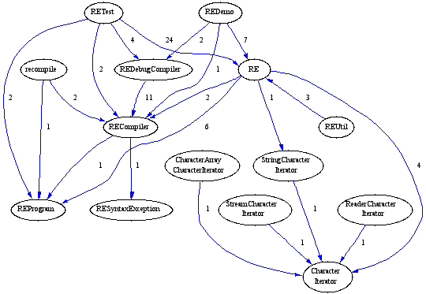
Step 1: Creating the MDG
Example: The MDG for Apache’s
Regular Expression class library
Source Code
void main()
{
printf(“hello”);
}
Source Code
Analysis Tools
Acacia
Chava
The MDG can be generated automatically using source code analysis tools
Nodes are the modules/classes, edges represent source-code relations
Edge weights can be established in many ways, and different MDGs
can be created depending on the types of relations considered
Notes:
Different MDG inputs, produce different partitioned outputs. This is good for understanding different views of the software system.
How to create an MDG is still an open area. Weights, especially. Ex: How do you weight a global variable access versus calling through a public interface. What if subsystem interfaces were available --- high edge weights would be good here, but bad in other circumstances…

Slide 14
Step 1: Creating the MDG
Example: The MDG for Apache’s
Regular Expression class library
Source Code
void main()
{
printf(“hello”);
}
Automatic MDG Generation
We provide scripts on the SERG web
page to create MDGs automatically for
systems developed in C, C++, and
Java.
The MDG eliminates details associated
with particular programming languages
Source Code
Analysis Tools
Acacia
Chava
The MDG can be generated automatically using source code analysis tools
Nodes are the modules/classes, edges represent source-code relations
Edge weights can be established in many ways, and different MDGs
can be created depending on the types of relations considered
Notes:
Can create MDGs manually if needed, or using other tools for languages besides C/C++/Java
The relations may vary also depending on the ways that the relations are defined
The MDG is the input, so how it is created biases the clustering output

Slide 15
Software Clustering with Search Algorithms
SEARCH SPACE
Set of All
MDG Partitions
Software Clustering
Search Algorithms
Source Code
void main()
{
printf(“hello”);
}
bP = null;
while(searching())
{
p = selectNext();
if(p.isBetter(bP))
bP = p;
}
return bP;
M1
M6
M3
M2
M8
M7
Source Code
Analysis Tools
M4
M5
Acacia
Chava
M6
M1
M3
M8
M7
MDG
M2
“GOOD” MDG Partition
M1
M3
M6
M4
M5
M2
M1
M3
M6
M7
M8
Total = 4140 Partitions
M2
M4
M5
M7
M8
M4
M5
Notes:
STEP 1: Create the MDG using source code analysis tools
STEP 2: The MDG defines the search space of all MDG partitions
STEP 3: Search algorithms process the search space

Slide 16
Software Clustering with Search Algorithms
SEARCH SPACE
Set of All
MDG Partitions
Software Clustering
Search Algorithms
Source Code
void main()
{
printf(“hello”);
}
Search Algorithm Requirements
Must be able to compare one partition
to another objectively.
We define the Modularization Quality
(MQ) measurement to meet this goal.
  Given partitions P1 & P2,
  MQ(P1) > MQ(P2) means that
  P1 “is better than” P2
bP = null;
while(searching())
{
p = selectNext();
if(p.isBetter(bP))
bP = p;
}
return bP;
M1
M6
M3
M2
M8
M7
Source Code
Analysis Tools
M4
M5
Acacia
Chava
M6
M1
M3
M8
M7
MDG File
M2
“GOOD” MDG Partition
M1
M3
M6
M4
M5
M2
M1
M3
M6
M7
M8
Total = 4140 Partitions
M2
M4
M5
M7
M8
M4
M5

Slide 17
Problem: There are too many partitions of the MDG…
The number of MDG partitions grows very quickly,
as the number of modules in the system increases…
⎧
1
if
k
=
1
∨
k
=
n
S
=
⎨
n
,
k
⎩
S
+
kS
otherwise
n
−
1
,
k
−
1
n
−
1
,
k
1 = 1
2 = 2
3 = 5
4 = 15
5 = 52
6 = 203
7 = 877
8 = 4140
9 = 21147
10 = 115975
11 = 678570
12 = 4213597
13 = 27644437
14 = 190899322
15 = 1382958545
16 = 10480142147
17 = 82864869804
18 = 682076806159
19 = 5832742205057
20 = 51724158235372
A 15 Module System is about the
limit for performing Exhaustive Analysis

Slide 18
Our Approach to
Automatic Clustering
“Treat automatic clustering as a searching problem”
  Maximize an objective function that formally quantifies of the “quality” of an MDG partition.
  We refer to the value of the objective function as the modularization quality (MQ)
MQ is a Measurement and not a Metric

Slide 19
Edge Types
With respect to each cluster, there are two different kinds of edges:
  μ edges (Intra-Edges) which are edges that start and end within the same cluster
  ε edges (Inter-Edges) which are edges that start and end in different clusters
CLUSTER
Other
Clusters
a
b
c

Slide 20
Our Assumption…
“Well designed software systems are organized into cohesive clusters that are loosely interconnected.”
The MQ measurement design must:
  Increase as the weight of the intra-edges increases
  Decrease as the weight of the inter-edges increases

Slide 21
Not all Partitions are
Created Equal ...
MDG
M1
M4
M2
M3
M5
M6
Good Partition!
Bad Partition!
M1
M4
M1
M4
M2
M5
M2
M5
M3
M3
M6
M6
MQ(Good Partition) > MQ(Bad Partition)
Notes:
Intra-edges/Inter-Edges

Slide 22
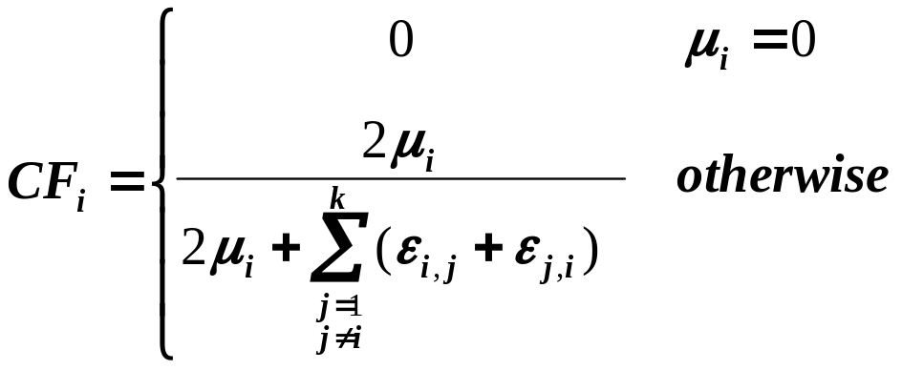
Measuring MQ – Step 1:
The Cluster Factor
The Cluster Factor for cluster i, CF_{i}, is:
CF increases as the
cluster’s cohesiveness
increases
Subsystem 1
Subsystem 2
Subsystem 3
M1
M6
M1
M4
M6
M3
M7
M3
M7
M2
M8
M2
M5
M8
M4
M5
CF₁ = 4/6
CF₂ = 2/5
CF₃ = 6/7

Slide 23
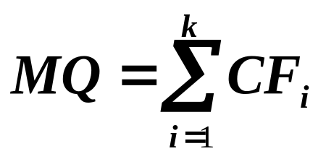
Modularization Quality (MQ):
k represents the number of clusters in the
current partition of the MDG.
Modularization Quality (MQ) is a measurement of the “quality” of a particular MDG partition.

Slide 24
Modularization Quality (MQ):
MQ
We have implemented a family of MQ
functions.
MQ should support MDGs with edge
weights
Faster than older MQ (Basic MQ)
  TurboMQ ≈ O(|V|)
  ITurboMQ ≈ O(1)
ITurboMQ incrementally updates,
instead of recalculates, the CF_{i}
k represents the number of clusters in the
current partition of the MDG.
Modularization Quality (MQ) is a measurement of the “quality” of a particular MDG partition.

Slide 25
The Software Clustering Problem:
Algorithm Objectives
“Find a good partition of the MDG.”
A partition is the decomposition of a set of elements (i.e., all the nodes of the graph) into mutually disjoint clusters.
A good partition is a partition where:
  highly interdependent nodes are grouped in the same clusters
  independent nodes are assigned to separate clusters
The better the partition the higher the MQ

Slide 26
Bunch Genetic Clustering Algorithm (GA)
Favor
Partitions
with Larger
MQ Values
for Crossover
Operation
Generate a Starting Population from the MDG
RANDOM
SELECTION
Iteration Step
Current
Population
Next
Population
P1
P1
P1
P1
P2
Crossover
Operation
P2
Mutation
Operation
P2
P2
P2
P3
P3
P3
P3
Mutate
(Alter)
a Small
Number of
Partitions
RANDOM
SELECTION
Pn
Pn
Pn
Pn
Next Generation
All Generations Processed
Best Partition from Final Population

Slide 27
Bunch Hill Climbing Clustering Algorithm
A neighbor
partition is
created by
altering the
current
partition
slightly.
Generate a Random Decomposition of MDG
Neighbor
Partition
Iteration Step
Current
Partition
Generate
Next
Neighbor
Measure
MQ
Measure MQ
New Best
Neighboring Partition
Compare to Best
Neighboring Partition
Better
Better?
Best Neighboring Partition for Iteration
Convergence
Best Neighboring Partition

Slide 28
Bunch Hill Climbing Clustering Algorithm
A neighbor
partition is
created by
altering the
current
partition
slightly.
Generate a Random Decomposition of MDG
Neighbor
Partition
Iteration Step
Current
Partition
Generate
Next
Neighbor
Measure
MQ
Hill-Climbing Algorithm Features
We have implemented a family of
hill-climbing algorithms
Control the “steepness” of the climb
Simulated Annealing
Population Size
Measure MQ
New Best
Neighboring Partition
Compare to Best
Neighboring Partition
Better
Better?
Best Neighboring Partition for Iteration
Convergence
Best Neighboring Partition

Slide 29
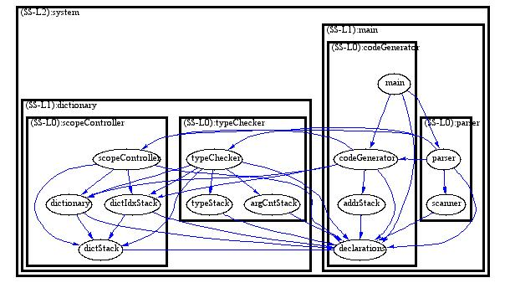
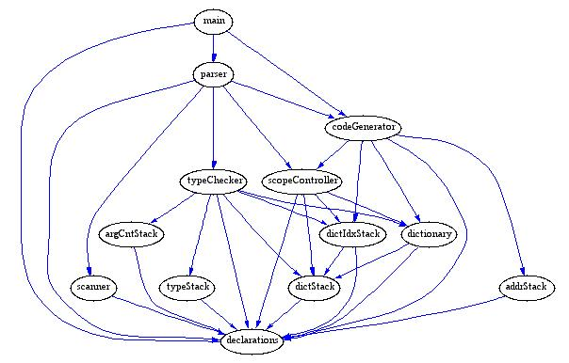
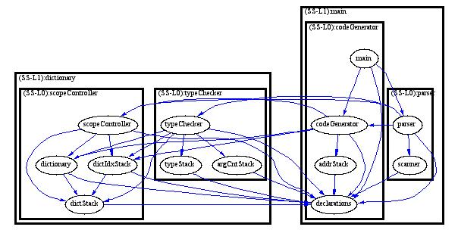
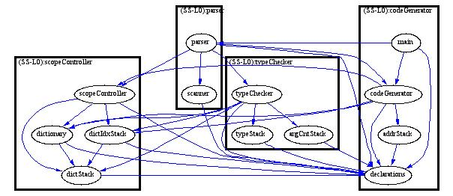
Hierarchical Clustering (1):
Tree View
1.
4.
2. Default
3.

Slide 30
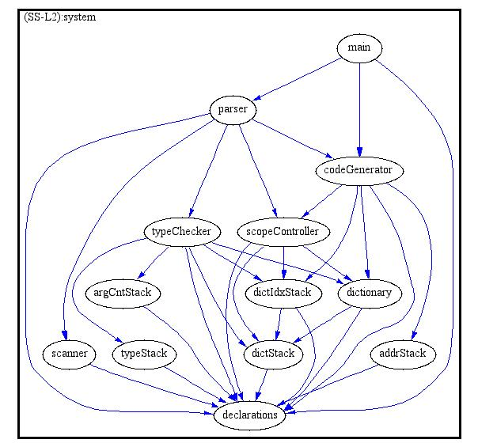
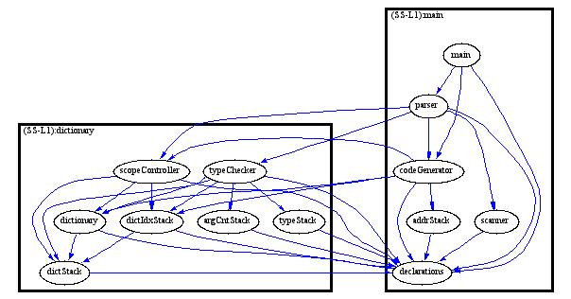
Hierarchical Clustering (2):
Standard View
1.
4.
2. Default
3.

Slide 31
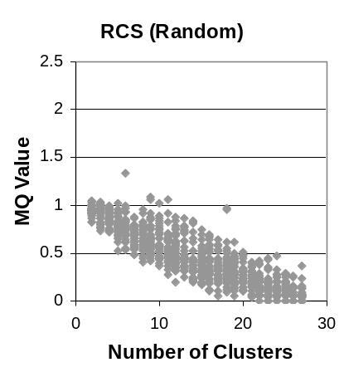
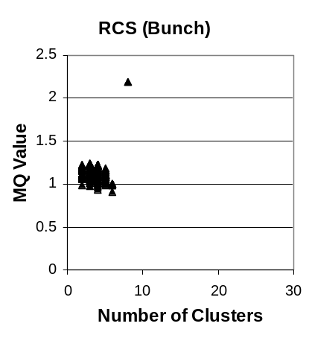
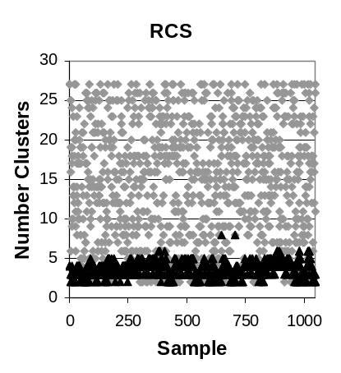
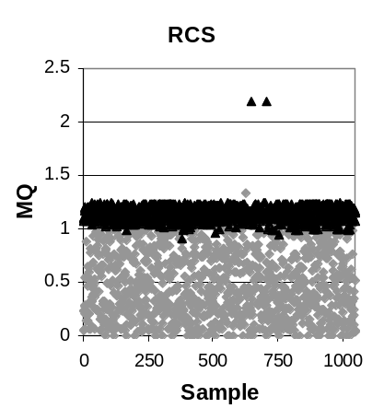
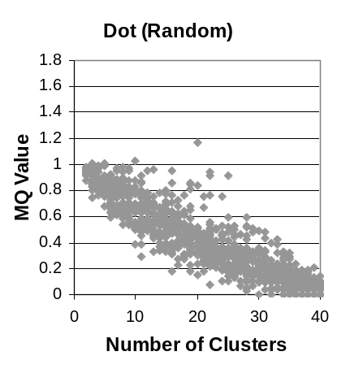
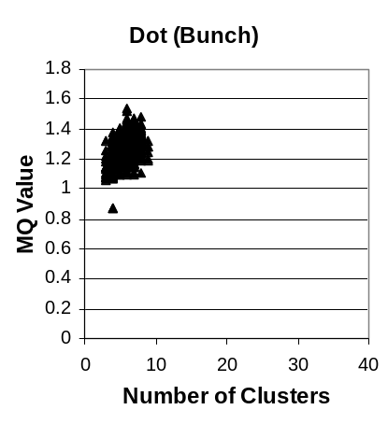
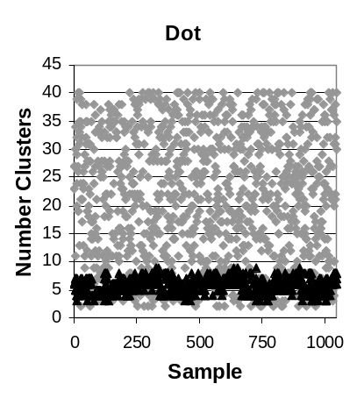
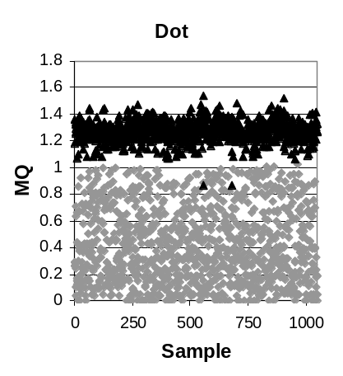
Some Results (1)…
Random
Bunch
RCS
Dot

Slide 32
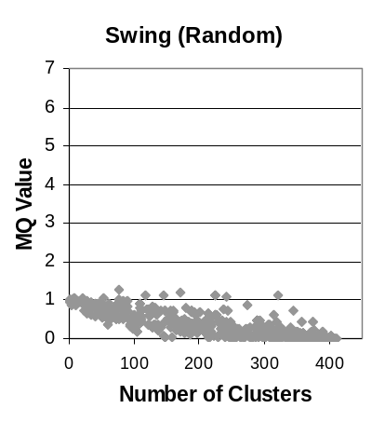
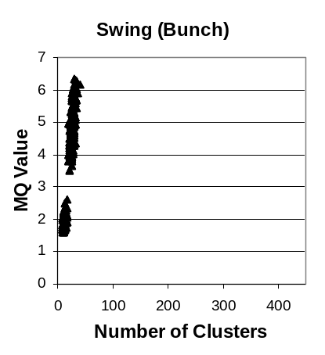
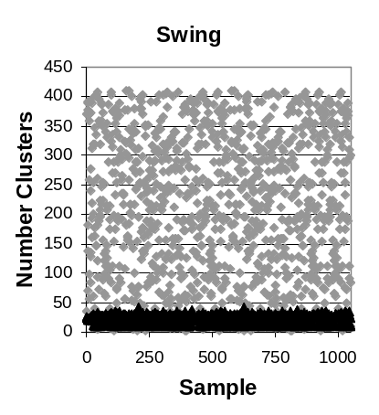
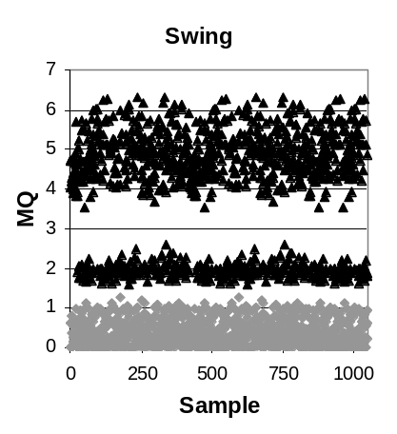
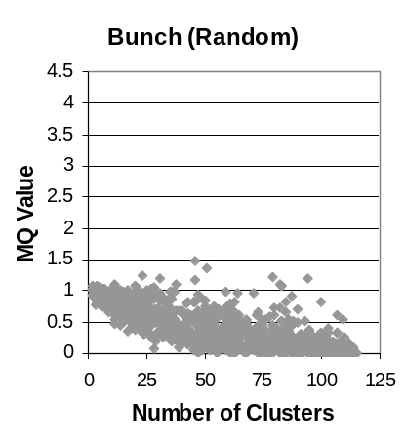
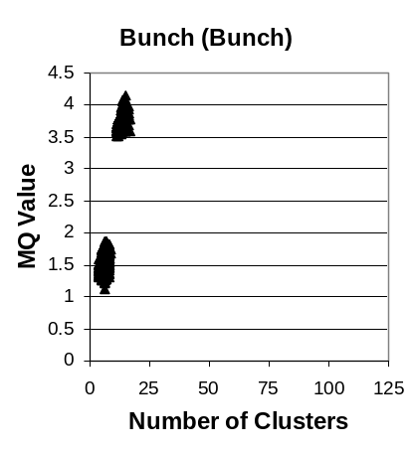
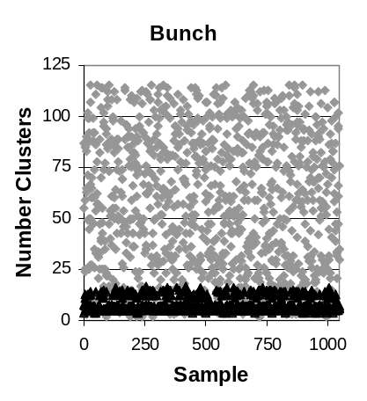
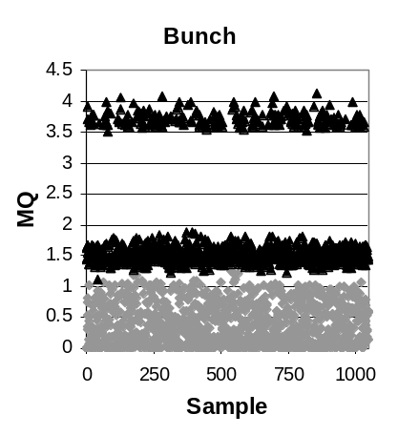
Some Results (2)…
Random
Bunch
Swing
Bunch

Slide 33
Some Results (2)…
Random
Bunch
Observations
As the number of clusters increased
in the random samples, MQ decreased
Bunch converged to a consistent
“family” of solutions, no matter where
the random starting point was generated
Some solutions were multi-modal
Random solutions were consistently
worse than Bunch’s solutions.
Swing
Bunch

Slide 34
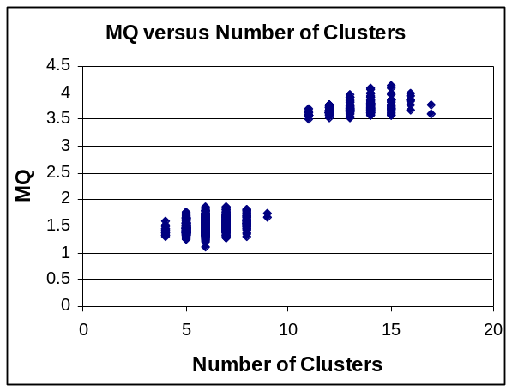
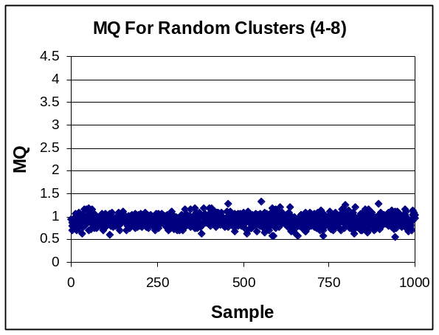
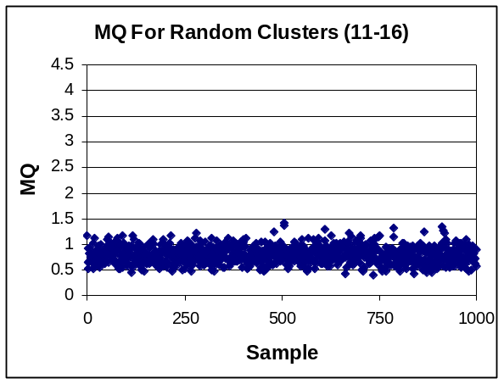
Example - Detailed Results:
Bunch System
The search space
has some inherent
structure, as random
clusters constrained
to the area where
Bunch converged did
not produce better
MQ values.
23%
77%
Notes:
Getting a MQ of 1 is easy --- put everything into one cluster… Random almost never produced anything better (e.g., MQ > 1)

Slide 35
Software Clustering Tools
The Bunch Clustering Tool

Slide 36
The Bunch Clustering Tool
Developed in Java
Provides a GUI and an API
Supports automatic and semi-automatic clustering
Provides source code analysis tools
“Pluggable” clustering algorithms
Bunch was designed to be used
and extended by other researchers

Slide 37
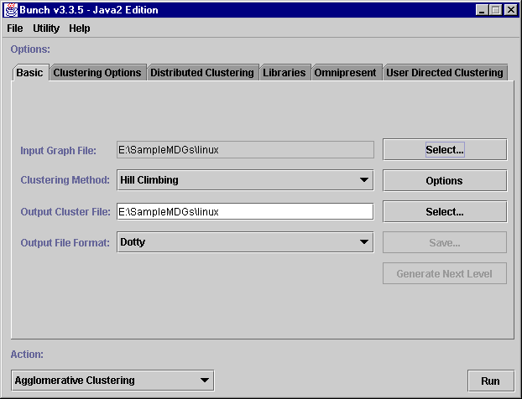
The Bunch Tool:
Automatic Clustering
Other Tools
and Utilities
Clustering
Services
MDG
Clustering
Algorithm
Clustering
Algorithm
Options
Output
Format
START

Slide 38
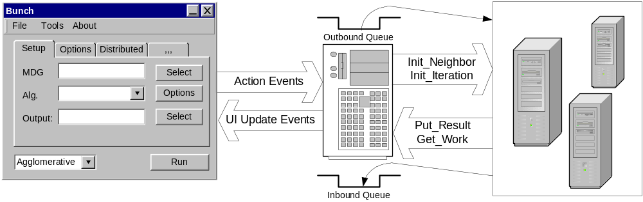
Distributed Clustering
Distributed clustering allows large MDGs to be
clustered faster…
Bunch User
Interface
(BUI)
Bunch Clustering
Service
(BCS)
Neighboring
Servers
(NS)

Slide 39
Distributed Clustering
Distributed clustering allows large MDGs to be
clustered faster…
Distributed Clustering Features
Multiple Clustering Algorithms
Heterogeneous Platforms
Adaptive Load Balancing
Bunch User
Interface
(BUI)
Bunch Clustering
Service
(BCS)
Neighboring
Servers
(NS)

Slide 40
Evaluation

Slide 41
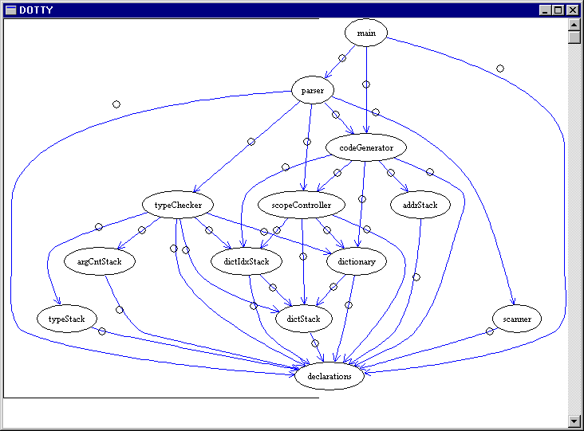
Clustering the Structure of a System (1)
Given the structure of a system…

Slide 42
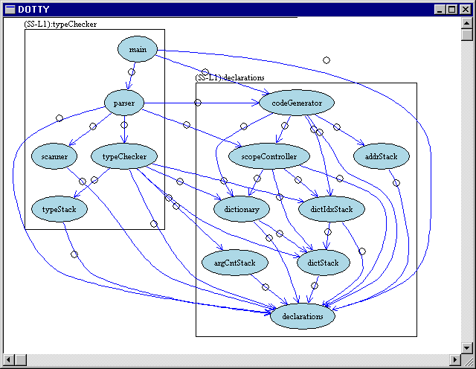
Clustering the Structure of a System (2)
The goal is to partition the system structure graph
into clusters…
The clusters should
represent the
subsystems

Slide 43
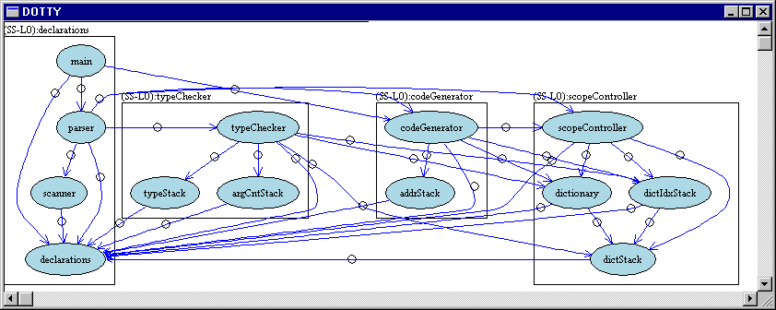
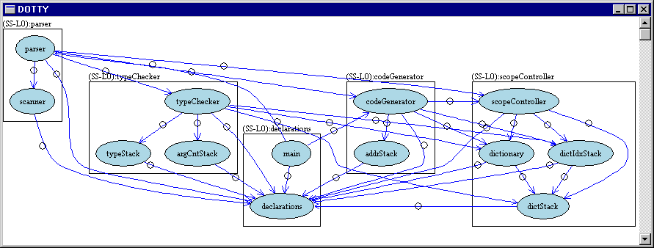
Clustering the Structure of a System (3)
But how do we know that the clustering result is
good?
Notes:
Many ways to partition only a few are good. Exploit commonality is the small set of reasonable solution.

Slide 44
Ways to Evaluate Software Clustering Results…
Given a software clustering result, we can:
Assess it against a mental model
Assess it against a benchmark standard
  Created Manually
  Automatically Generated (CRAFT Tool)
Techniques:
  Subjective Opinions
  Similarity Measurements (MeCl & EdgeSim)

Slide 45
Observation:
Similarity Measurements
An important aspect of evaluation is being able to compare clustering results objectively…
Edges are important for determining the similarity between decompositions
Existing measurements don’t consider edges:
  Precision / Recall (similarity)
  MoJo (distance)
Our idea: Use the edges to determine similarity (MeCl & EdgeSim) [ICSM’01]
  Our similarity measurements are integrated into the Bunch tool

Slide 46
Example: How “Similar” are these Decompositions?
Blue Edges:
Similarity still the same…
M1
M2
M3
M7
P_{A}
Green Edges:
Similarity still the same…
M5
M6
M4
M8
Red Edges:
Not as similar…
M1
M2
M3
M7
Conclusions:
Once we add the red edges the similarity between P_{A} and P_{B} decreases
P_{B}
M4
M5
M6
M8
Notes:
Many ways to partition only a few are good. Exploit commonality is the small set of reasonable solution.
According to MoJo and PR/ still similar...
copy this slide to 12 with the above comments

Slide 47
Example: How “Similar” are these Decompositions?
Blue Edges:
Similarity still the same…
M1
M2
M3
M7
P_{A}
Green Edges:
Similarity still the same…
Similarity Measurements
We created our own similarity
measurements because existing
techniques did not consider the
importance of the relations (edges)
in the subsystem decomposition…
M5
M6
M4
M8
Red Edges:
Not as similar…
M1
M2
M3
M7
Conclusions:
Once we add the red edges the similarity between P_{A} and P_{B} decreases
P_{B}
M4
M5
M6
M8
Notes:
Many ways to partition only a few are good. Exploit commonality is the small set of reasonable solution.
According to MoJo and PR/ still similar...
copy this slide to 12 with the above comments

Slide 48
EdgeSim Example
Common
Edges
MDG
P_{A}
a
b
a
b
k
l
c
f
g
c
f
g
h
d
e
h
d
e
i
j
i
j
P_{B}
k
l
c
e
d
Common
Edge Weight
a
h
i
10
f
=
= 53%
b
k
Total Edge
Weight
19
j
g
l

Slide 49
MeCl Example (A→B)
Intersection of common entities and relations from P_{A} with P_{B}
B₁
Newly Introduced Inter-Edges
A_{1,1}
U
A_{2,1}
U
A₁ B₁
A₂ B₁
A₁
A₂
A₃
a
b
f
g
a
b
k
l
c
P_{A}
c
f
g
h
d
e
i
j
A_{1,2}
A_{2,2}
d
e
h
B₁
B₂
c
e
d
U
U
A₁ B₂
A₂ B₂
a
h
i
j
P_{B}
i
f
b
k
A_{3,2}
k
l
U
A₃ B₂
j
g
l
B₂

Slide 50
MeCl Example (B→A)
Intersection of common entities and relations from P_{B} with P_{A}
A₁
A₂
Newly Introduced Inter-Edges
B_{1,1}
U
B_{1,2}
B₁ A₁
U
B₁ A₂
A₁
A₂
A₃
a
b
f
g
a
b
k
l
c
P_{A}
c
f
g
U
B_{2,1}
B₂ A₁
U
h
B_{2,2}
B₂ A₂
d
e
i
j
d
e
h
B₁
B₂
c
e
d
U
B₂ A₃
a
h
i
j
P_{B}
i
f
b
k
j
B_{2,3}
k
l
g
l
A₃

Slide 51
MeCl Calculation
Inter-Edges Introduced
A₁
A₂
A₃
MeCl(A→B):
({b,e},{e,c},{g,h},{f,h})
MeCl(B→A):
({e,i},{h,j},{b,f},{c,f},{h,e})
a
b
k
l
P_{A}
c
f
g
h
d
e
i
j
B₁
B₂
c
e
d
max_{W}(M_{A→B}, M_{B→A})
MeCl= 1 -
a
Total Edge Weight
h
P_{B}
i
f
b
k
j
5
g
MeCl =
1 -
= 73.7%
l
19

Slide 52
Summary: Similarity Measurement
Evaluation requires the ability to compare clustering results
We created MeCl and EdgeSim to overcome some limitations that we found with other measurements
  The edges are important!
MeCl: Similarity improves as clustering algorithms create larger subsets of overlapping clusters
EdgeSim: Similarity improves as clustering algorithms find common edge-types

Slide 53
Reference Decompositions
A Reference Decomposition, (a.k.a Gold Standard, or Benchmark) is a “good” clustering result
Difficult to create a de facto reference decomposition
Our approach: If no benchmark is available, we create one based on commonalities in various clustering results
If a reference decomposition does not exist, the
goal is to generate one that is “good enough”

Slide 54
The CRAFT Tool: A Reference Decomposition Generator
CRAFT = Clustering Results Analysis Framework and Tools
CRAFT User Interface
CRAFT Application Programming Interface (API)
Clustering
Services
Clustering
Results
Repository
Data
Analysis
Visualization
Services
Clustering
Drivers
Analysis
Tools
Provided Service
User Developed Service

Slide 55
The CRAFT Tool: A Reference Decomposition Generator
CRAFT = Clustering Results Analysis Framework and Tools
CRAFT User Interface
Generating a Reference
Decomposition
CRAFT highlights areas of strong,
weak and marginal agreement
between different clustering
algorithms
CRAFT Application Programming Interface (API)
Clustering
Services
Clustering
Results
Repository
Data
Analysis
Visualization
Services
Clustering
Drivers
Analysis
Tools
Provided Service
User Developed Service

Slide 56
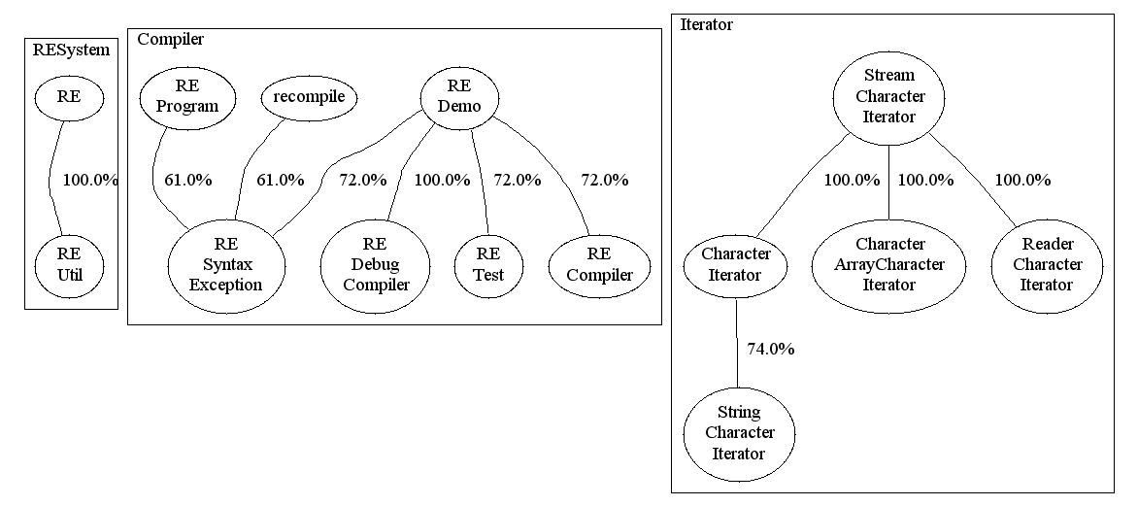
Example: Recovered Reference Decomposition for Apache’s RegExp
CRAFT’s Confidence Analysis
Reference Decomposition Generator

Slide 57
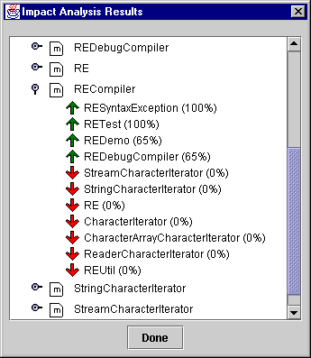
Example: Impact Analysis for for Apache’s RegExp
Impact Analysis
is good for helping
users to understand
the impact associated
with making a
local change…

Slide 58
Summary: Evaluation
Reference decompositions and similarity
measurements are needed to evaluate software clustering results…
Source Code
P: Proposed Solution
R: Reference Solution
void main()
{printf(“hello”);}
M6
M1
M1
M6
M3
M8
M7
M3
New or Updated
Clustering Algorithm
M2
M2
M8
M7
M4
M5
M4
M5
How Similar?
Good: High Similarity
Bad: Low Similarity
Can’t Tell: Moderate Similarity
Compare[Sim(P),Sim(R)]

Slide 59
Conclusions & Future Work

Slide 60
Contributions
Search algorithms that partition the structure of a software system into subsystems
Implementation of algorithms into the Bunch tool that supports clustering large systems (e.g., Linux)
Evaluation techniques including similarity measurements and a reference decomposition generator

Slide 61
Contributions
Impacts of our Research
Our papers are widely referenced by
researchers in the reverse engineering
community.
Our tools are used by software engineering
students, researchers, and industry.
Our tools are commercial quality, and are
designed to be both used and extended
by others.
We are using Bunch services to create
other tools in the SERG lab, including an
online reverse engineering portal.
Search algorithms that partition the structure of a software system into subsystems
Implementation of algorithms into the Bunch tool that supports clustering large systems (e.g., Linux)
Evaluation techniques including similarity measurements and a reference decomposition generator

Slide 62
Research Opportunities
Improved Visualization Services
  Large systems are hard to visualize
Investigate other types of MDG’s
  Example: Data flow, dynamic analysis, distributed systems
Revisit Bunch’s GA design and implementation
  Improve encoding technique
Addressing theoretical questions
  How close is the solution to the “ideal” solution

Slide 63
Publications
“Search Based Reverse Engineering”. (with S. Mancoridis, M. Traverso). Submitted for Publication.
“Using Heuristic Search Techniques to Extract Design Abstractions from Source Code”. (with S. Mancoridis). Proc. of the Genetic and Evolutionary Computation Conference. (GECCO’02), New York, NY, July, 2002.
“Comparing the Decompositions Produced by Software Clustering Algorithms using Similarity Measurements”. (with S. Mancoridis). Proc. of the IEEE International Conference on Software Maintenance (ICSM'01), Florence, Italy, November, 2001.
“CRAFT: A Framework for Evaluating Software Clustering Results in the Absence of Benchmark Decompositions”. (with S. Mancoridis). Proc. of the IEEE Working Conference in Reverse Engineering (WCRE'01), Stuttgart, Germany, October, 2001. (Best Paper Award)
“An Architecture for Distributing the Computation of Software Clustering Algorithms''. (with S. Mancoridis, M.Traverso). Proc. of the IEEE/IFIP Working Conference on Software Architecture (WICSA'01), Amsterdam, Netherlands, August, 2001.
“Bunch: A Clustering Tool for the Recovery and Maintenance of Software System Structures”. (with S. Mancoridis, Y.Chen, E.R.Gansner). Proc. of the IEEE International Conference on Software Maintenance (ICSM'99), Oxford, UK, August, 1999.
“Automatic Clustering of Software Systems using a Genetic Algorithm”. (with D. Doval, S. Mancoridis). Proc. of the IEEE International Conference on Software Tools and Engineering Practice (STEP'99), Pittsburgh, PA, August, 1999.
“Using Automatic Clustering to Produce High-Level System Organizations of Source Code”. (with S. Mancoridis, C.Rorres, Y.Chen, E.R.Gansner). Proc. of the IEEE International Workshop on Program Understanding (IWPC'98), Ischia, Italy, June, 1998.
Papers are
available online

Slide 64
Recognition
Special Thanks To:
  My Advisor: Dr. Spiros Mancoridis
  My Committee: Dr. J. Johnson, Dr. C. Rorres,
  Dr. A. Shokoufandeh, Dr. R. Chen, and
  Dr. L. Perkovic (former member)
  My Sponsors: AT&T Research, Sun Microsystems, DARPA, NSF, US Army
  Bunch Project Contributors: D. Doval,
  M. Traverso, S. Mancoridis
  Dr. E. Gansner & Dr. R. Chen (AT&T Labs -Research) for test data and validation of Bunch’s clustering results.
  The gang at the SERG lab…
Notes:
Emden & Robin

Slide 65






A Heuristic Search Approach to Solving the
Software Clustering Problem
Questions
http://www.mcs.drexel.edu/~bmitchel/research
Notes:
TODO
Why search versus other techniques? Reread Bill’s ACDC and Koche’s ICSM01 papers.
Thinking Point 1: Goal is to propose an abstract representation of source code. There is no “correct” answer. Use multiple views – each view provides additional insight into the overall architecture.

Slide 66
Extra Data

Slide 67
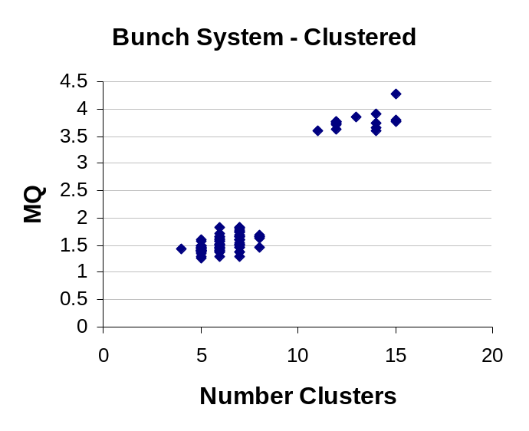
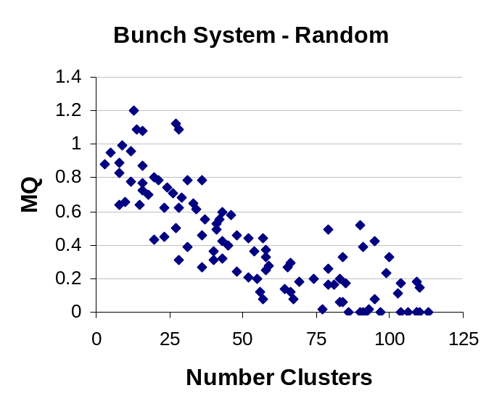
Results: Bunch System
P_{B}
P_{A}
P_{A}
P_{B}
P_{A} versus P_{B}
 | Min | Max | Avg
ES | 59% | 100% | 80%
MC | 80% | 100% | 91%
 | Min | Max | Avg
ES | 73% | 100% | 88%
MC | 89% | 100% | 95%
 | Min | Max | Avg
ES | 63% | 100% | 71%
MC | 69% | 100% | 84%
Sample Size = 100

Slide 68
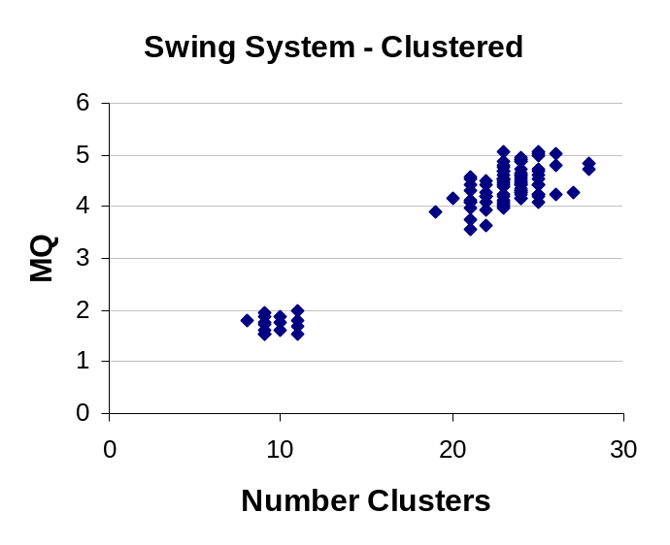
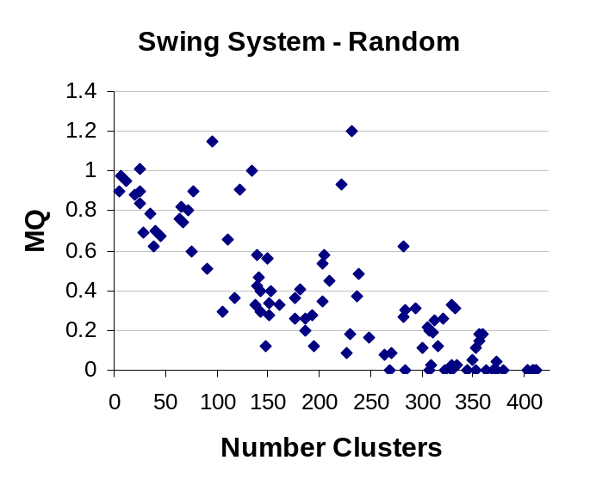
Results: Swing System
P_{B}
P_{A}
P_{A}
P_{B}
P_{A} versus P_{B}
 | Min | Max | Avg
ES | 64% | 100% | 78%
MC | 86% | 100% | 92%
 | Min | Max | Avg
ES | 74% | 100% | 83%
MC | 88% | 100% | 93%
 | Min | Max | Avg
ES | 63% | 86% | 74%
MC | 70% | 91% | 79%
Sample Size = 100

Slide 69
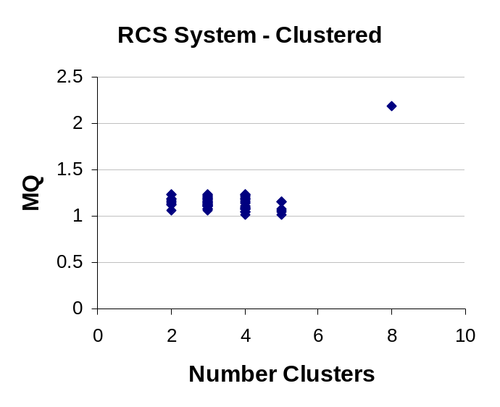
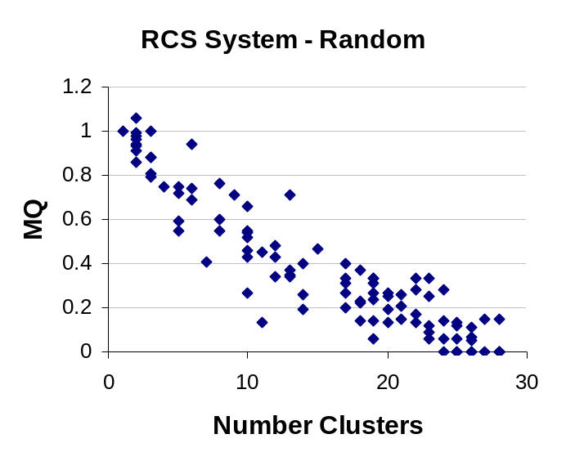
Results: RCS System
P_{A}
P_{A}
Sim_{MIN} versus Sim_{MAX}
 | Min | Max | Avg
ES | 43% | 100% | 81%
MC | 45% | 100% | 88%
 | Sim Value | MaxMQ | Min MQ
ES | 43% | 2.19 | 1.15
MC | 45% | 2.19 | 1.07
Sample Size = 100

Slide 70
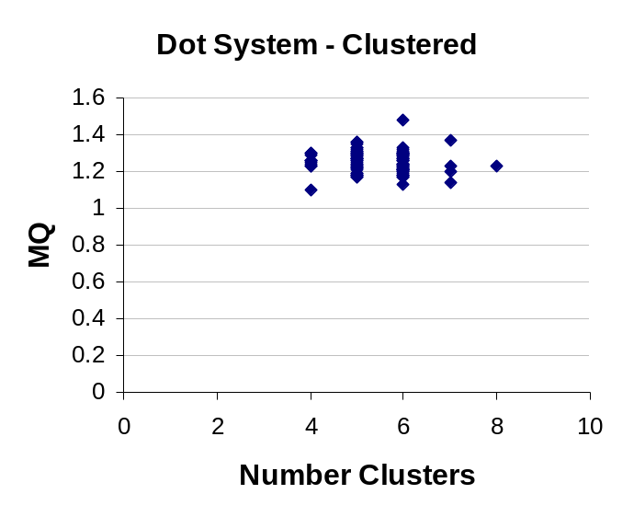
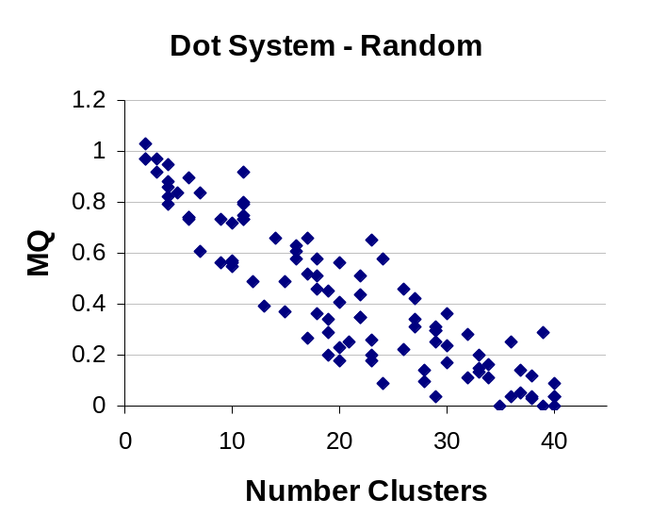
Results: Dot System
P_{A}
P_{A}
 | Min | Max | Avg
ES | 63% | 100% | 81%
MC | 79% | 100% | 88%
Sample Size = 100

