Slide 1

Using Heuristic Search Techniques to Extract Design Abstractions from Source Code
The Genetic and Evolutionary Computation Conference (GECCO'02).
Brian S. Mitchell & Spiros Mancoridis
Math & Computer Science, Drexel University
Notes:
TODO
Why search versus other techniques? Reread Bill’s ACDC and Koche’s ICSM01 papers.
Thinking Point 1: Goal is to propose an abstract representation of source code. There is no “correct” answer. Use multiple views – each view provides additional insight into the overall architecture.

Slide 2
Software Clustering Background
Software clustering simplifies program maintenance and program understanding
Software clustering techniques help developers fix defects (maintenance), or add a features (program understanding) to existing software systems

Slide 3
Understanding the Software Structure
It’s important to understand the software structure when fixing or extending a software system
  Desirable to change as few of the existing modules/classes as possible
Problem 1: The structure is complex and often not
documented for large systems
Problem 2: Ad hoc changes to the source code tend to
deteriorate the system’s structure over time
Notes:
Changing few modules reduces the probability of breaking other things

Slide 4
Clustering Techniques
A variety of techniques for software clustering have been studied by the reverse engineering community:
  Source code component similarity
  (or dissimilarity)
  Concept Analysis
  Subsystem Patterns
  Implementation-Specific Information
Our clustering approach uses search algorithms

Slide 5
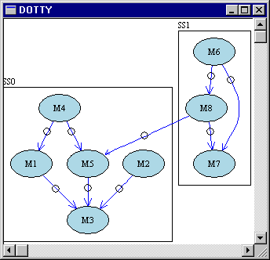
Design Extraction with Bunch
Bunch Clustering
Tool
Visualization Tool
Source Code
void main()
{
printf(“hello”);
}
Bunch GUI
Source Code
Analysis Tools
Clustering
Algorithms
Acacia
Chava
Clustering Tools
Partitioned MDG File
MDG File
Programming
API
M1
M3
M6
M1
M3
M6
M2
M2
M7
M8
M7
M8
M4
M5
M4
M5

Slide 6
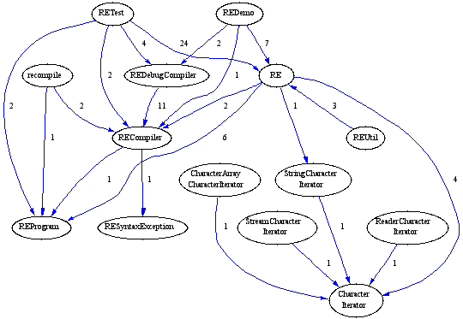
Step 1: Creating the MDG
Example: The MDG for Apache’s
Regular Expression class library
Source Code
void main()
{
printf(“hello”);
}
Source Code
Analysis Tools
Acacia
Chava
The MDG can be generated automatically using source code analysis tools
Nodes are the modules/classes, edges represent source-code relations
Edge weights can be established in many ways, and different MDGs
can be created depending on the types of relations considered
Notes:
Different MDG inputs, produce different partitioned outputs. This is good for understanding different views of the software system.
How to create an MDG is still an open area. Weights, especially. Ex: How do you weight a global variable access versus calling through a public interface. What if subsystem interfaces were available --- high edge weights would be good here, but bad in other circumstances…

Slide 7
Software Clustering with Search Algorithms
SEARCH SPACE
Set of All
MDG Partitions
Software Clustering
Search Algorithms
Source Code
void main()
{
printf(“hello”);
}
bP = null;
while(searching())
{
p = selectNext();
if(p.isBetter(bP))
bP = p;
}
return bP;
M1
M6
M3
M2
M8
M7
Source Code
Analysis Tools
M4
M5
Acacia
Chava
M6
M1
M3
M8
M7
MDG
M2
“GOOD” MDG Partition
M1
M3
M6
M4
M5
M2
M1
M3
M6
M7
M8
Total = 4140 Partitions
M2
M4
M5
M7
M8
M4
M5
Notes:
STEP 1: Create the MDG using source code analysis tools
STEP 2: The MDG defines the search space of all MDG partitions
STEP 3: Search algorithms process the search space

Slide 8
Software Clustering with Search Algorithms
SEARCH SPACE
Set of All
MDG Partitions
Software Clustering
Search Algorithms
Source Code
void main()
{
printf(“hello”);
}
Search Algorithm Requirements
Must be able to compare one partition
to another objectively.
We define the Modularization Quality
(MQ) measurement to meet this goal.
  Given partitions P1 & P2,
  MQ(P1) > MQ(P2) means that
  P1 “is better than” P2
bP = null;
while(searching())
{
p = selectNext();
if(p.isBetter(bP))
bP = p;
}
return bP;
M1
M6
M3
M2
M8
M7
Source Code
Analysis Tools
M4
M5
Acacia
Chava
M6
M1
M3
M8
M7
MDG File
M2
“GOOD” MDG Partition
M1
M3
M6
M4
M5
M2
M1
M3
M6
M7
M8
Total = 4140 Partitions
M2
M4
M5
M7
M8
M4
M5

Slide 9
Problem: There are too many partitions of the MDG…
The number of MDG partitions grows very quickly,
as the number of modules in the system increases…
⎧
1
if
k
=
1
∨
k
=
n
S
=
⎨
n
,
k
⎩
S
+
kS
otherwise
n
−
1
,
k
−
1
n
−
1
,
k
1 = 1
2 = 2
3 = 5
4 = 15
5 = 52
6 = 203
7 = 877
8 = 4140
9 = 21147
10 = 115975
11 = 678570
12 = 4213597
13 = 27644437
14 = 190899322
15 = 1382958545
16 = 10480142147
17 = 82864869804
18 = 682076806159
19 = 5832742205057
20 = 51724158235372
A 15 Module System is about the
limit for performing Exhaustive Analysis

Slide 10
Our Approach to
Automatic Clustering
“Treat automatic clustering as a searching problem”
  Maximize an objective function that formally quantifies of the “quality” of an MDG partition.
  We refer to the value of the objective function as the modularization quality (MQ)

Slide 11
Edge Types
With respect to each cluster, there are two different kinds of edges:
  μ edges (Intra-Edges) which are edges that start and end within the same cluster
  ε edges (Inter-Edges) which are edges that start and end in different clusters
CLUSTER
Other
Clusters
a
b
c

Slide 12
Our Assumption…
“Well designed software systems are organized into cohesive clusters that are loosely interconnected.”
The MQ measurement design must:
  Increase as the weight of the intra-edges increases
  Decrease as the weight of the inter-edges increases

Slide 13
Not all Partitions are
Created Equal ...
MDG
M1
M4
M2
M3
M5
M6
Good Partition!
Bad Partition!
M1
M4
M1
M4
M2
M5
M2
M5
M3
M3
M6
M6
MQ(Good Partition) > MQ(Bad Partition)
Notes:
Intra-edges/Inter-Edges

Slide 14
The Software Clustering Problem:
Algorithm Objectives
“Find a good partition of the MDG.”
A partition is the decomposition of a set of elements (i.e., all the nodes of the graph) into mutually disjoint clusters.
A good partition is a partition where:
  highly interdependent nodes are grouped in the same clusters
  independent nodes are assigned to separate clusters
The better the partition the higher the MQ

Slide 15
Bunch Hill Climbing Clustering Algorithm
A neighbor
partition is
created by
altering the
current
partition
slightly.
Generate a Random Decomposition of MDG
Neighbor
Partition
Iteration Step
Current
Partition
Generate
Next
Neighbor
Measure
MQ
Measure MQ
New Best
Neighboring Partition
Compare to Best
Neighboring Partition
Better
Better?
Best Neighboring Partition for Iteration
Convergence
Best Neighboring Partition

Slide 16
Bunch Genetic Clustering Algorithm (GA)
Favor
Partitions
with Larger
MQ Values
for Crossover
Operation
Generate a Starting Population from the MDG
RANDOM
SELECTION
Iteration Step
Current
Population
Next
Population
P1
P1
P1
P1
P2
Crossover
Operation
P2
Mutation
Operation
P2
P2
P2
P3
P3
P3
P3
Mutate
(Alter)
a Small
Number of
Partitions
RANDOM
SELECTION
Pn
Pn
Pn
Pn
Next Generation
All Generations Processed
Best Partition from Final Population

Slide 17
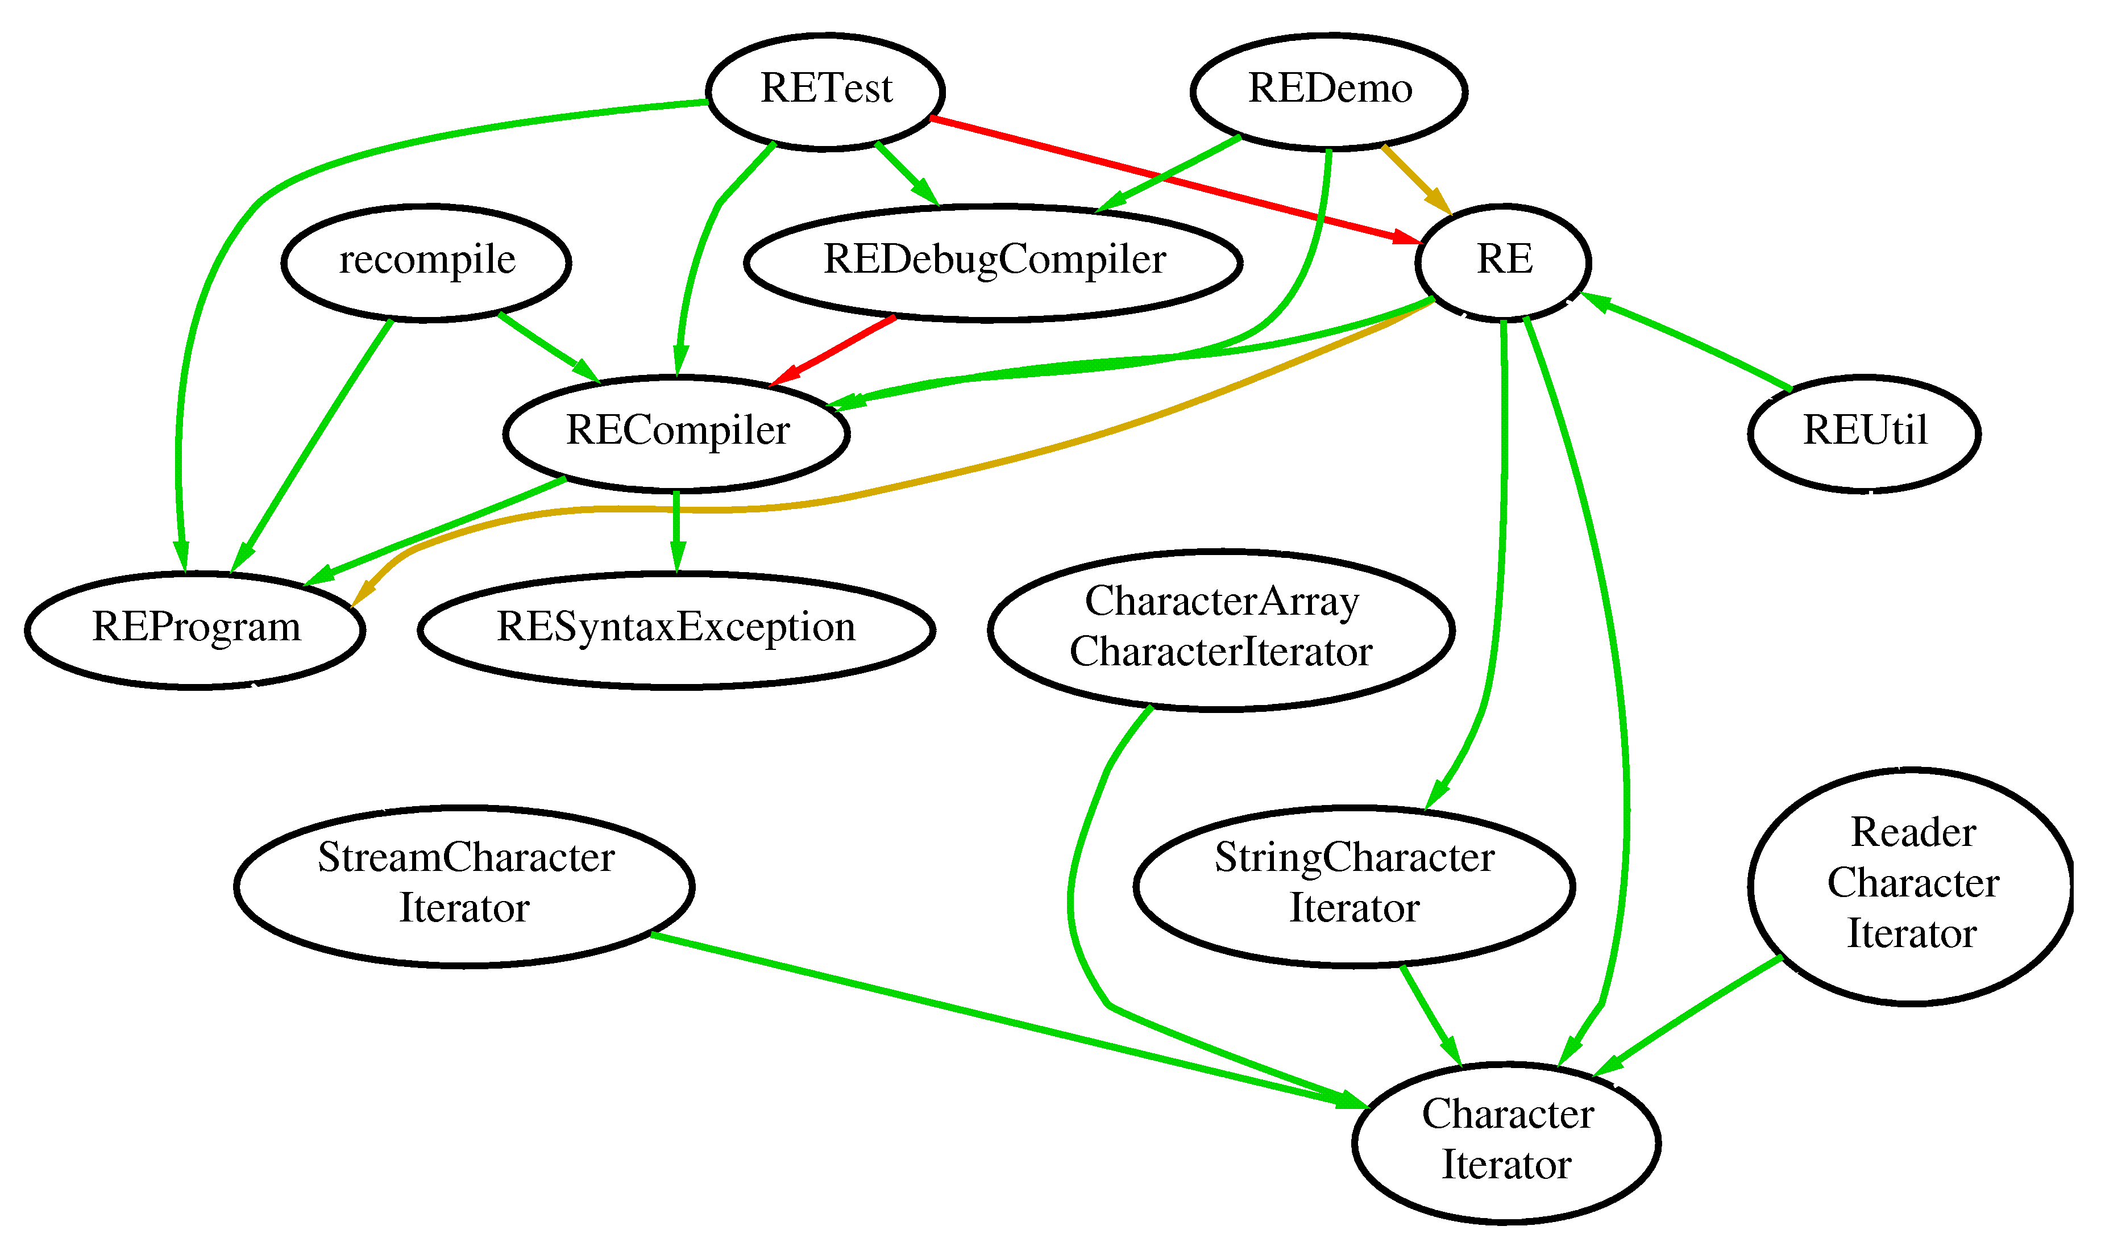
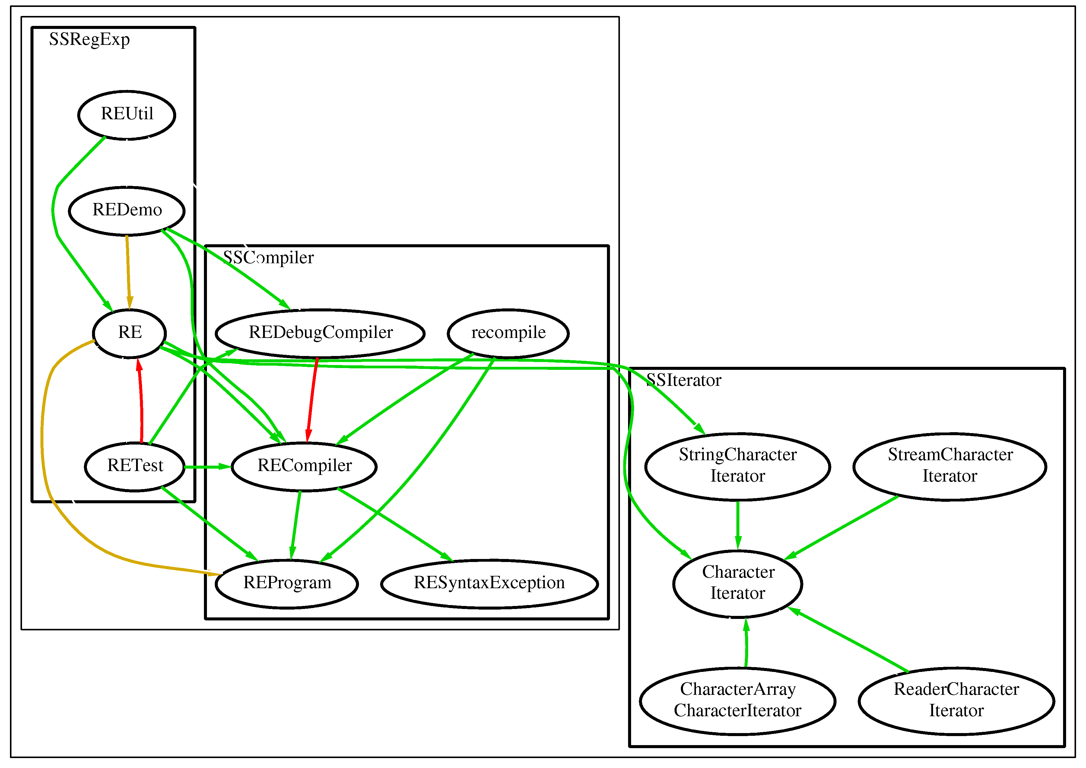
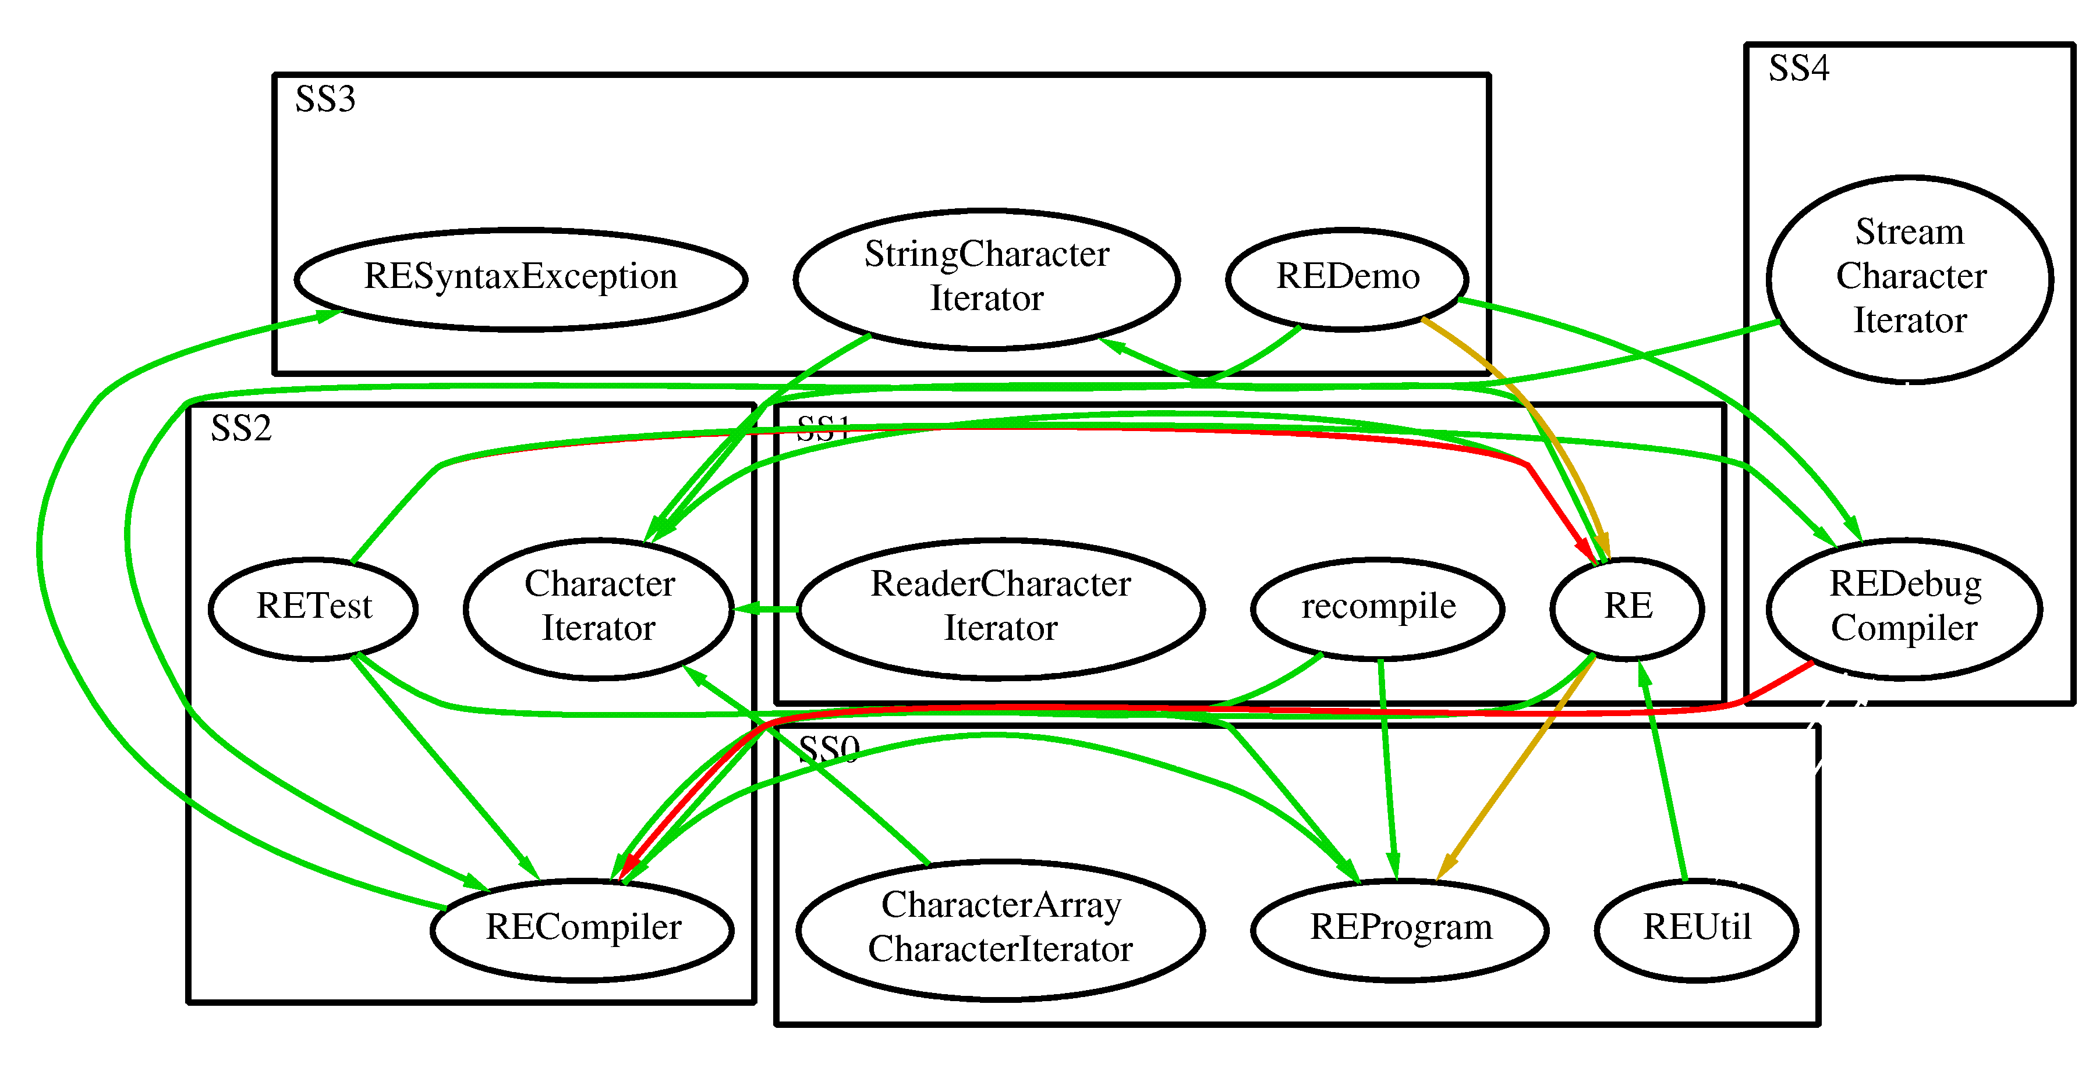
Clustering Example – Apache Regular Expression Library
Bunch Partition
MDG
Random
Partition
< 5 Relations
5-10 Relations
>10 Relations

Slide 18
Bunch Hill Climbing Clustering Algorithm – Extended Features
A neighbor
partition is
created by
altering the
current
partition
slightly.
Generate a Random Decomposition of MDG
Neighbor
Partition
Hill-Climbing
Algorithm
Extended Features
Adjustable Clustering
Threshold
Simulated Annealing
Iteration Step
Current
Partition
Generate
Next
Neighbor
Measure
MQ
Measure MQ
New Best
Neighboring Partition
Compare to Best
Neighboring Partition
Better
Better?
Best Neighboring Partition for Iteration
Convergence
Best Neighboring Partition

Slide 19
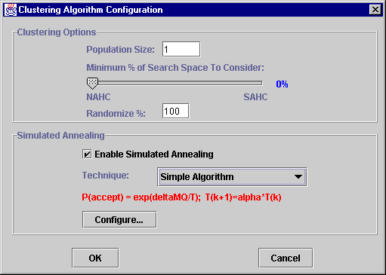
Research Objectives
Investigate if the new hill-climbing clustering features impact:
  The clustering results
  Clustering performance
Goals
  Provide configuration
  guidance to Bunch
  users
  Determine performance
  versus quality tradeoffs
  associated with different Bunch configurations
  Gain intuition into the search space of different systems

Slide 20
Case Study Design
Basic test consisted of 1,050 clustering runs
  50 runs with clustering threshold set to 0%
  Incremented clustering threshold by 5% and repeated the test until clustering threshold reached 100%
Repeated the basic test 3 additional times with simulated annealing altering the initial temperature T(0) and cooling rate α
Examined 5 systems – compiler, ispell, rcs, dot, and swing
We used the Bunch API for the case study

Slide 21
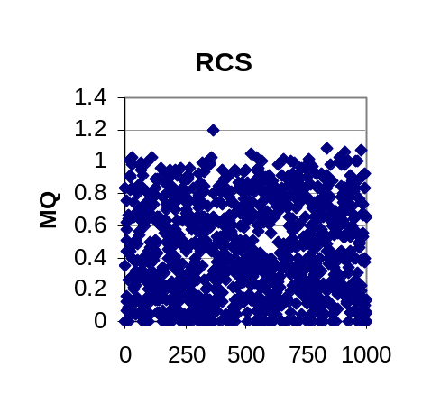
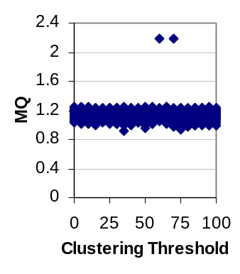
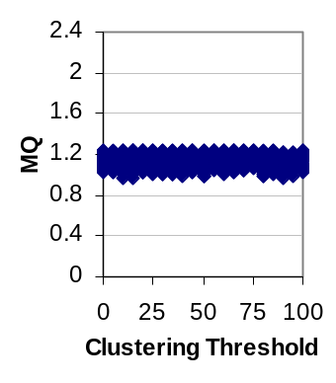
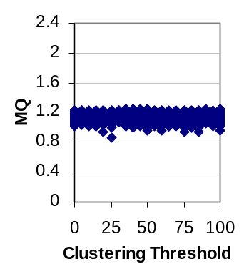
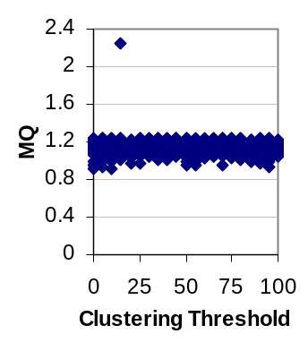
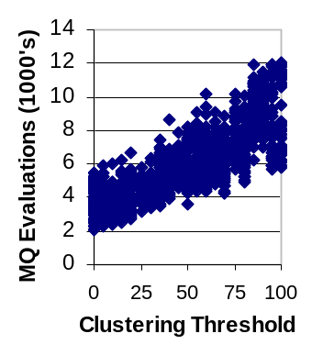
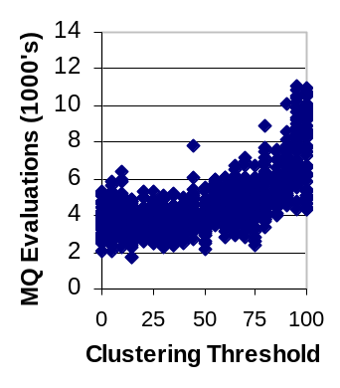
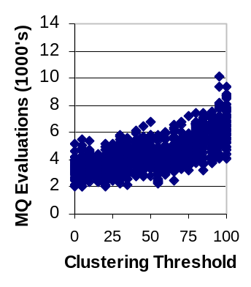
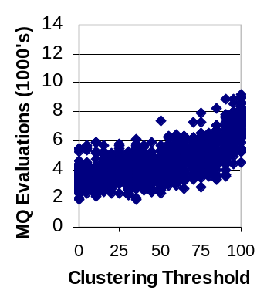
Case Study Results –
RCS
MQ of Random
Partitions
No SA
T(0)=100
α=.99
T(0)=100
α=.90
T(0)=100
α=.80
Clustering Threshold & MQ
Clustering Threshold & MQ Evals.

Slide 22
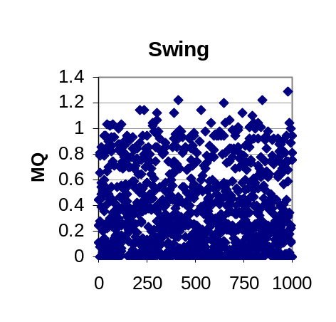
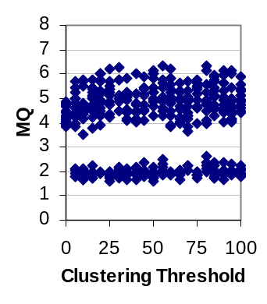
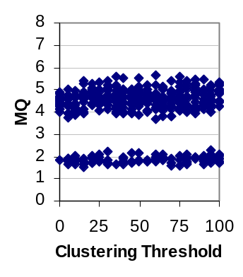
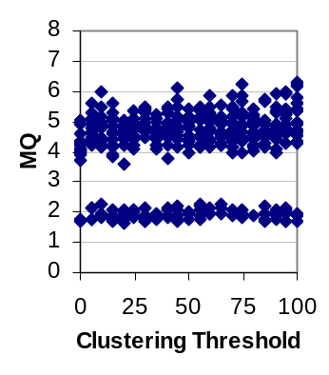

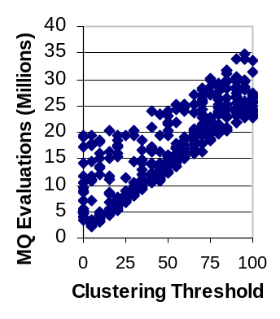
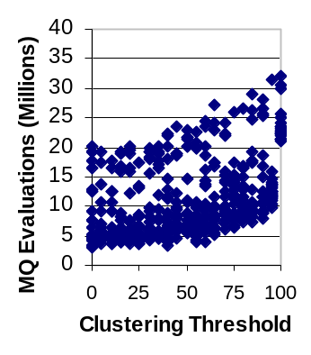
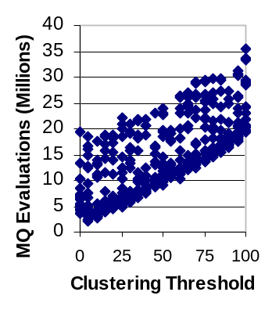
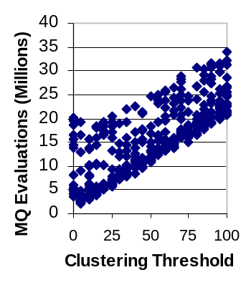
Case Study Results –
Swing
MQ of Random
Partitions
No SA
T(0)=100
α=.99
T(0)=100
α=.90
T(0)=100
α=.80
Clustering Threshold & MQ
Clustering Threshold & MQ Evals.

Slide 23
Case Study Results - Summary
The clustering threshold had an expected and consistent impact on the clustering runtime
The clustering threshold did not appear to have any impact on the quality of the clustering results
The hill-climbing algorithm provides some intuition into the search landscape for the systems studied
The software clustering results always were better than random generated clusters

Slide 24
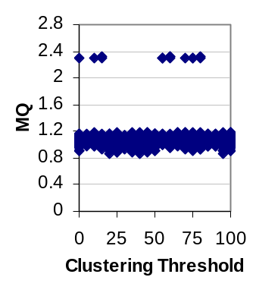
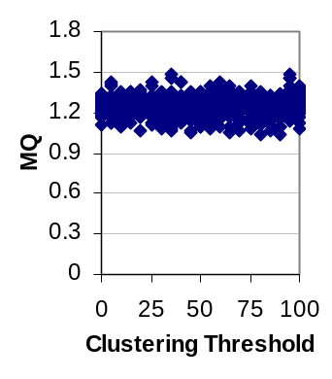
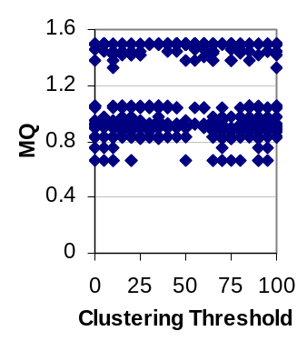
Case Study Results - Summary
Intuition into the search landscape…
ispell
rcs
dot
Rare
Partitions
Systems
That
Converge
To A
Consistent
Neighborhood
Compiler
swing
Multimodal
Search Space

Slide 25
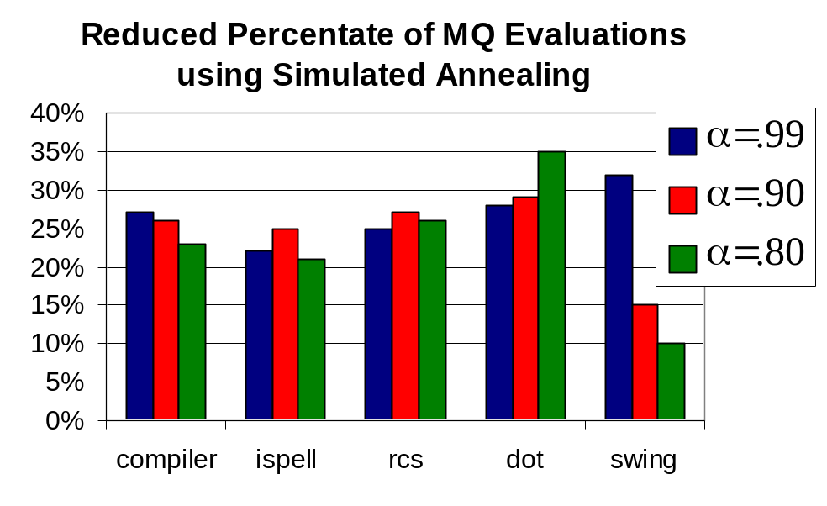
Case Study Results - Summary
Simulated annealing did not have any noticeable impact on the quality of clustering results.
Simulated annealing
did appear to reduce
the overall runtime
needed to cluster
the sample systems.

Slide 26
Concluding Remarks
It was expected that increasing the clustering threshold would impact the runtime or clustering results – neither was found to be true
Simulated annealing did not improve the quality of the clustering results but did decrease the overall clustering runtime
We obtained some intuition into the search landscape of the systems studied

Slide 27

Questions
Special Thanks To:
  AT&T Research
  Sun Microsystems
  DARPA
  NSF
  US Army

