Slide 1

Comparing the Decompositions
Produced by Software Clustering
Algorithms using
Similarity Measurements
2001 IEEE International Conference on Software Maintenance (ICSM'01).
Brian S. Mitchell & Spiros Mancoridis
Math & Computer Science, Drexel University

Slide 2
Motivation
Using module dependencies when determining the similarity between two decompositions
is a good idea…

Slide 3
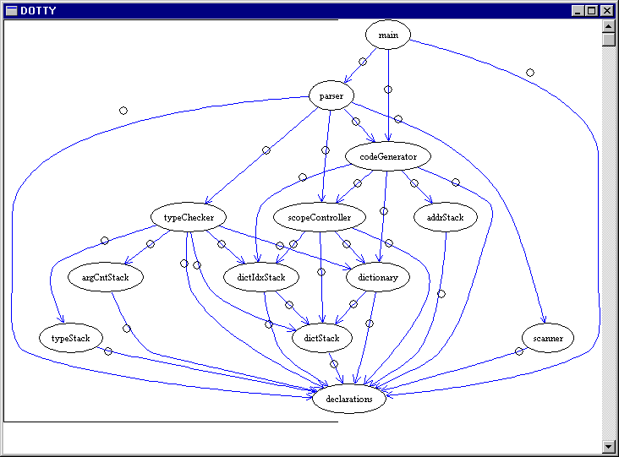
Clustering the Structure of a System (1)
Given the structure of a system…

Slide 4
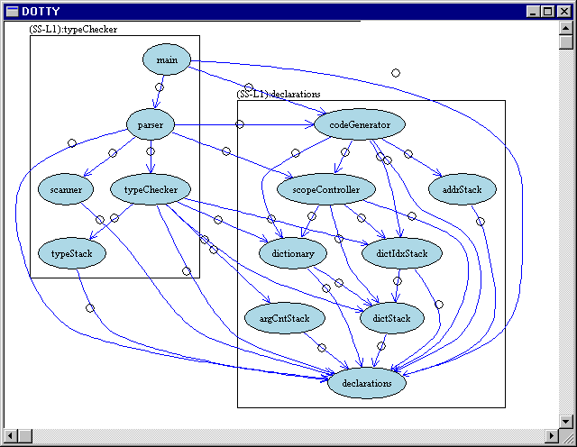
Clustering the Structure of a System (2)
The goal is to partition the system structure graph
into clusters…
The clusters should
represent the
subsystems

Slide 5
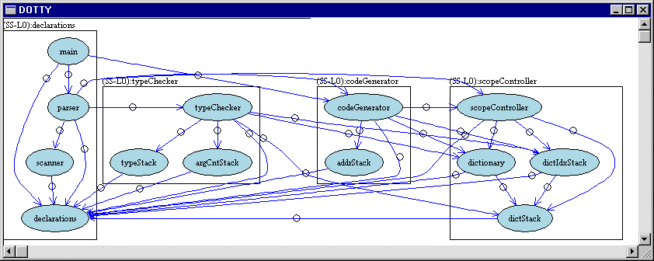
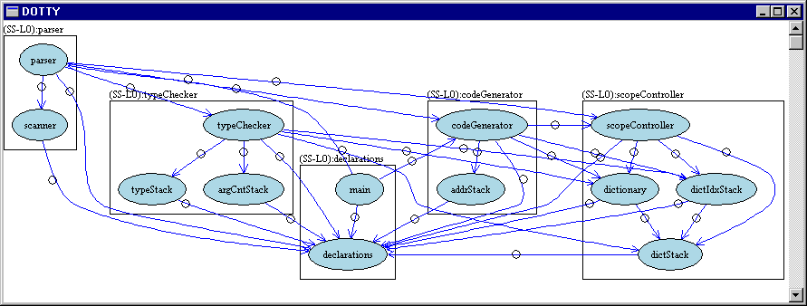
Clustering the Structure of a System (3)
But how do we know that the clustering result is
good?
Notes:
Many ways to partition only a few are good. Exploit commonality is the small set of reasonable solution.

Slide 6
Ways to Evaluate Software Clustering Results…
Given a software clustering result, we can:
Assess it against a mental model
Assess it against a benchmark standard
Techniques:
  Subjective Opinions
  Similarity Measurements

Slide 7
Example: How “Similar” are these Decompositions?
Blue Edges:
Similarity still the same…
M1
M2
M3
M7
P_{A}
Green Edges:
Similarity still the same…
M5
M6
M4
M8
Red Edges:
Not as similar…
M1
M2
M3
M7
Conclusions:
Once we add the red edges the similarity between P_{A} and P_{B} decreases
P_{B}
M4
M5
M6
M8
Notes:
Many ways to partition only a few are good. Exploit commonality is the small set of reasonable solution.
According to MoJo and PR/ still similar...
copy this slide to 12 with the above comments

Slide 8
Observations
Edges are important for determining the similarity between decompositions
Existing measurements don’t consider edges:
  Precision / Recall (similarity)
  MoJo (distance)
Our idea: Use the edges to determine similarity
Notes:
Add Author names for PR and MoJo

Slide 9
Research Objectives
Create new similarity measurements that use dependencies (edges)
  EdgeSim (similarity)
  MeCl (distance)
Evaluate the new similarity measurements against MoJo & Precision/Recall
Use similarity measurements to support evaluation of software clustering results
(see our WCRE’01 paper)

Slide 10
Example: How “Similar” are these Decompositions?
Add
Blue Edges:
PR, MoJo, MeCl & EdgeSim unchanged.
M1
M2
M3
M7
P_{A}
M5
M6
M4
M8
Add
Green Edges:
PR, MoJo, MeCl & EdgeSim unchanged.
M1
M2
M3
M7
P_{B}
Add
Red Edges:
PR, MoJo unchanged. EdgeSim, MeCl reduced.
M4
M5
M6
M8
Notes:
Many ways to partition only a few are good. Exploit commonality is the small set of reasonable solution.
According to MoJo and PR/ still similar...
copy this slide to 12 with the above comments

Slide 11
Definitions
M1
M3
M2
M4
Internal/Intra-Edge: Edge within a cluster
External/Inter-Edge: Edge between two clusters
Notes:
internal and external edges

Slide 12
EdgeSim Example
a
b
k
l
MDG
P_{A}
c
f
g
a
b
h
d
e
i
j
c
f
g
d
e
h
c
e
d
i
j
a
P_{B}
h
k
l
i
f
b
k
j
g
l

Slide 13
EdgeSim Example
MDG
P_{A}
a
b
a
b
k
l
c
f
g
c
f
g
h
d
e
h
d
e
i
j
i
j
P_{B}
k
l
c
e
d
a
h
Step 1:
Find Common Inter- and Intra-Edges
i
f
b
k
j
g
l

Slide 14
EdgeSim Example
MDG
P_{A}
a
b
a
b
k
l
c
f
g
c
f
g
h
d
e
h
d
e
i
j
i
j
P_{B}
k
l
c
e
d
Common
Edge Weight
a
h
i
10
f
=
= 53%
b
k
Total Edge
Weight
19
j
g
l

Slide 15
MeCl Example
a
b
k
l
MDG
P_{A}
c
f
g
a
b
h
d
e
i
j
c
f
g
d
e
h
c
e
d
i
j
a
P_{B}
h
k
l
i
f
b
k
j
g
l

Slide 16
MeCl Example
(A→B)
A₁
A₂
A₃
a
b
k
l
P_{A}
c
f
g
h
d
e
i
j
B₁
B₂
c
e
d
a
h
P_{B}
i
f
b
k
j
g
l

Slide 17
MeCl Example
(A₁ B₁)
U
A_{1,1}
A₁
A₂
A₃
a
b
a
b
k
l
c
P_{A}
c
f
g
h
d
e
i
j
B₁
B₂
c
e
d
a
h
P_{B}
i
f
b
k
j
g
l

Slide 18
MeCl Example
(A₂ B₁)
U
A_{1,1}
A_{2,1}
A₁
A₂
A₃
a
b
f
g
a
b
k
l
c
P_{A}
c
f
g
h
d
e
i
j
B₁
B₂
c
e
d
a
h
P_{B}
i
f
b
k
j
g
l

Slide 19
MeCl Example
(A₁ B₂)
U
A_{1,1}
A_{2,1}
A₁
A₂
A₃
a
b
f
g
a
b
k
l
c
P_{A}
c
f
g
h
d
e
i
j
A_{1,2}
d
e
B₁
B₂
c
e
d
a
h
P_{B}
i
f
b
k
j
g
l

Slide 20
MeCl Example
(A₂ B₂)
U
A_{1,1}
A_{2,1}
A₁
A₂
A₃
a
b
f
g
a
b
k
l
c
P_{A}
c
f
g
h
d
e
i
j
A_{1,2}
A_{2,2}
d
e
h
B₁
B₂
c
e
d
a
h
P_{B}
i
f
b
k
j
g
l

Slide 21
MeCl Example
(A₃ B₂)
U
A_{1,1}
A_{2,1}
A₁
A₂
A₃
a
b
f
g
a
b
k
l
c
P_{A}
c
f
g
h
d
e
i
j
A_{1,2}
A_{2,2}
d
e
h
B₁
B₂
c
e
d
a
h
i
j
P_{B}
i
f
b
k
A_{3,2}
k
l
j
g
l

Slide 22
MeCl Example
(A→B)
B₁
A_{1,1}
A_{2,1}
A₁
A₂
A₃
a
b
f
g
a
b
k
l
c
P_{A}
c
f
g
h
d
e
i
j
A_{1,2}
A_{2,2}
d
e
h
B₁
B₂
c
e
d
a
h
i
j
P_{B}
i
f
b
k
A_{3,2}
k
l
j
g
l
B₂
Notes:
breakdown on A_X,2

Slide 23
MeCl Example (A→B)
B₁
Newly Introduced Inter-Edges
A_{1,1}
A_{2,1}
A₁
A₂
A₃
a
b
f
g
a
b
k
l
c
P_{A}
c
f
g
h
d
e
i
j
A_{1,2}
A_{2,2}
d
e
h
B₁
B₂
c
e
d
a
h
i
j
P_{B}
i
f
b
k
A_{3,2}
k
l
j
g
l
B₂

Slide 24
MeCl Example
(B→A)
B_{1,1}
B_{1,2}
A₁
A₂
A₃
a
b
f
g
a
b
k
l
c
P_{A}
c
f
g
h
B_{2,1}
B_{2,2}
d
e
i
j
d
e
h
B₁
B₂
c
e
d
a
h
i
j
P_{B}
i
f
b
k
j
B_{2,3}
k
l
g
l

Slide 25
MeCl Example
(B→A)
A₁
A₂
B_{1,1}
B_{1,2}
A₁
A₂
A₃
a
b
f
g
a
b
k
l
c
P_{A}
c
f
g
h
B_{2,1}
B_{2,2}
d
e
i
j
d
e
h
B₁
B₂
c
e
d
a
h
i
j
P_{B}
i
f
b
k
j
B_{2,3}
k
l
g
l
A₃

Slide 26
MeCl Example (B→A)
A₁
A₂
Newly Introduced Inter-Edges
B_{1,1}
B_{1,2}
A₁
A₂
A₃
a
b
f
g
a
b
k
l
c
P_{A}
c
f
g
h
B_{2,1}
B_{2,2}
d
e
i
j
d
e
h
B₁
B₂
c
e
d
a
h
i
j
P_{B}
i
f
b
k
j
B_{2,3}
k
l
g
l
A₃

Slide 27
MeCl Calculation
Inter-Edges Introduced
A₁
A₂
A₃
MeCl(A→B):
({b,e},{e,c},{g,h},{f,h})
MeCl(B→A):
({e,i},{h,j},{b,f},{c,f},{h,e})
a
b
k
l
P_{A}
c
f
g
h
d
e
i
j
B₁
B₂
c
e
d
max_{W}(M_{A→B}, M_{B→A})
MeCl= 1 -
a
Total Edge Weight
h
P_{B}
i
f
b
k
j
5
g
MeCl =
1 -
= 73.7%
l
19

Slide 28
Similarity Measurement Recap
M1
M2
M3
M7
M1
M2
M3
M7
A₁:
A₂:
M5
M6
M4
M8
M5
M6
M4
M8
M1
M2
M3
M7
M1
M2
M3
M7
B₁:
M4
B₂:
M4
M5
M6
M8
M5
M6
M8
P₁
P₂
MoJo(P₁) = MoJo(P₂) = 87.5%
PR(P₁) = PR(P₂) = P:84.6%, R:68.7%, AVG_{PR}=76.7%
Conclusion… P1 is equally similar to P2

Slide 29
Similarity Measurement Recap
M1
M2
M3
M7
M1
M2
M3
M7
A₁:
A₂:
M5
M6
M4
M8
M5
M6
M4
M8
M1
M2
M3
M7
M1
M2
M3
M7
B₁:
M4
B₂:
M4
M5
M6
M8
M5
M6
M8
P₁
P₂
EdgeSim(P₁)=77.8% EdgeSim(P₂)=58.3%
MeCl(P₁)=88.9% MeCl(P₂)=66.7%
Conclusion… P1 is more similar than P2

Slide 30
Summary:
EdgeSim & MeCl
EdgeSim:
  Rewards clustering algorithms for preserving the edge types
  Penalizes clustering algorithms for changing the edge types
MeCl:
  Rewards the clustering algorithm for creating cohesive “subclusters”

Slide 31
Special Modules
A₁
A₂
A₃
Omnipresent Modules:
“Strong” Connection to other Modules
a
b
k
l
P_{A}
c
f
g
h
Library Modules:
Always used by other modules, never use other modules
d
e
i
j
B₁
B₂
c
e
d
a
h
Isomorphic Modules:
Modules equally connected to other subsystems
P_{B}
i
f
b
k
j
g
l

Slide 32
Special Modules
A₁
A₂
A₃
Special Treatment of
Special Modules helps to determine the Similarity
a
b
k
l
P_{A}
c
f
g
h
d
k
i
Omnipresent Modules:
Removed
B₁
B₂
Library Modules:
Removed
k
c
d
a
h
P_{B}
i
Isomorphic Modules:
Replicated
f
b
k
g
l
Notes:
OMNIPRESENT,

Slide 33
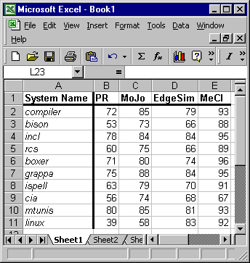
Case Study Overview
Similarity
Evaluation Tool
Similarity Analysis
Source Code
void main()
{
printf(“hello”);
}
Precision/
Recall
MoJo
Clustering
Algorithms
EdgeSim
MeCl
Clustered Result
Average, Variance, etc. based on 100 clustering runs…
(4950 Evaluations)
M1
M3
M6
M2
M7
M8
M4
M5

Slide 34
Case Study Observations
All similarity measurements exhibit consistent behavior for the systems studied
Removal of “special” modules improved all similarity measurements
Treating isomorphic modules specially only improved similarity slightly
EdgeSim and MeCl produced higher and less variable similarity values then Precision/Recall and MoJo
For all systems examined:
If MeCl(S_{A}) < MeCl(S_{B}) then MoJo(S_{A}) < MoJo(S_{B}), PR(S_{A}) < PR(S_{B}), and EdgeSim(S_{A}) < EdgeSim(S_{B})

Slide 35

Questions
Special Thanks To:
  AT&T Research
  Sun Microsystems
  DARPA
  NSF
  US Army

