Slide 1

A Heuristic Approach Towards Solving the Software Clustering Problem
ICSM03
Brian S. Mitchell
bmitchell@drexel.edu / http://www.mcs.drexel.edu/~bmitchel
Department of Computer Science, College of Engineering
Drexel University
Philadelphia, PA, 19104 USA
Notes:
TODO
Why search versus other techniques? Reread Bill’s ACDC and Koche’s ICSM01 papers.
Thinking Point 1: Goal is to propose an abstract representation of source code. There is no “correct” answer. Use multiple views – each view provides additional insight into the overall architecture.

Slide 2
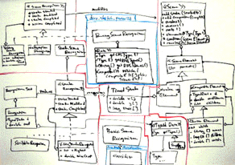

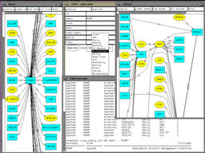

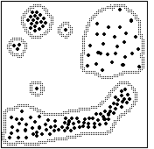
Understanding Large Systems is HARD
(1)
Manual
Analysis is
Tedious and
Error Prone
(2)
Source Code
Analysis Approaches
Create Large
Repositories
Example: RedHat Linux 7.1
(3)
Kernel 1,400 modules, 2.5M LOC
System 350K modules, 30M LOC
Languages: > 19 (including scripting)
Software Clustering
Approaches
Create Abstract
Representations
[http://www.dwheeler.com/sloc]

Slide 3
Software Clustering
Software clustering simplifies program maintenance and program understanding
The abstract views produced by software clustering techniques can be used to help developers fix defects or add features to existing software systems

Slide 4
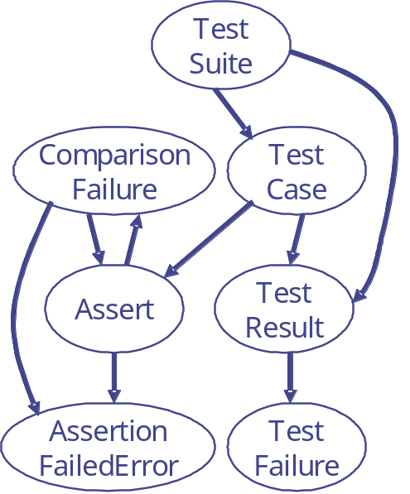
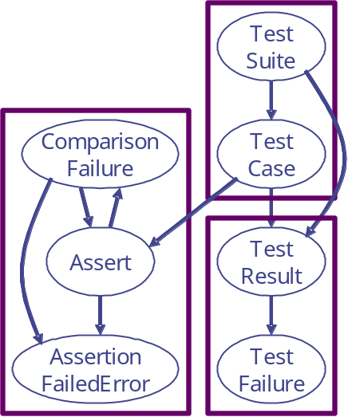

Software Clustering Environments
Requires a
Representation...
…A Clustering
Algorithm…
…A way to
Represent Results…
Bunch
Tool
Other
Tools
…And a way to
Compare Results…
Bunch works by partitioning a software graph
and uses a fitness function called MQ to evaluate the quality of individual partitions
f(x)

Slide 5
Software Clustering Techniques
A variety of techniques for software clustering have been studied by the reverse engineering community:
  Source code component similarity
  (or dissimilarity)
  Concept Analysis
  Subsystem Patterns
  Implementation-Specific Information
My Research Contribution Was Applying Search Techniques to the Software Clustering Problem,
and Improving the State of Practice for
Evaluating Software Clustering Results

Slide 6
Problem: There are too many partitions to search all of them…
The number of partitions (ways to cluster a system)
of a software graph grows very quickly, as the
number of modules in the system increases…
⎧
1
if
k
=
1
∨
k
=
n
S
=
⎨
n
,
k
⎩
S
+
kS
otherwise
n
−
1
,
k
−
1
n
−
1
,
k
1 = 1
2 = 2
3 = 5
4 = 15
5 = 52
6 = 203
7 = 877
8 = 4140
9 = 21147
10 = 115975
11 = 678570
12 = 4213597
13 = 27644437
14 = 190899322
15 = 1382958545
16 = 10480142147
17 = 82864869804
18 = 682076806159
19 = 5832742205057
20 = 51724158235372
A 15 Module System is about the
limit for performing Exhaustive Analysis

Slide 7
Applying Heuristic Search Techniques To The Software Clustering Problem
SEARCH SPACE
Set of All
MDG Partitions
Software Clustering
Search Algorithms
Source Code
void main()
{
printf(“hello”);
}
Hill Climbing
M1
Genetic Algorithm
M6
M3
Simulated
Annealing
M2
M8
M7
Source Code
Analysis Tools
M4
M5
Acacia
Chava
“GOOD” MDG Partition
M6
M1
M3
M8
M7
M1
M3
M6
MDG
M2
M2
M1
M3
M6
M4
M5
M7
M8
M4
M5
M2
M7
M8
Total = 4140 Partitions
Note that a “good” Partition may not be an optimal solution
M4
M5
Notes:
STEP 1: Create the MDG using source code analysis tools
STEP 2: The MDG defines the search space of all MDG partitions
STEP 3: Search algorithms process the search space

Slide 8
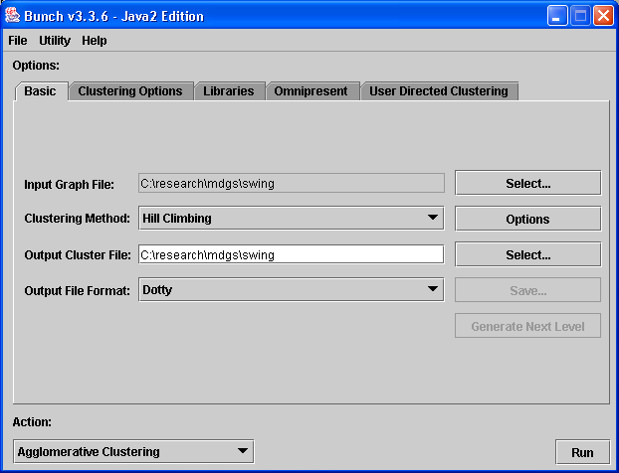
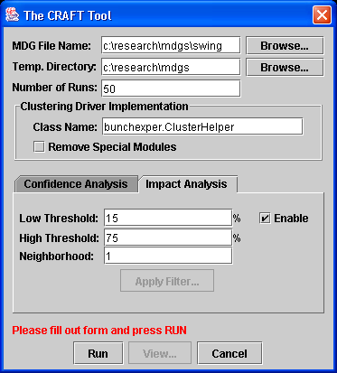
Software Developed as Part of my
Ph.D. Research
Bunch: An Automatic
Clustering Tool
CRAFT: A Reference
Decomposition Generator
Both tools also have a documented API to
support integration into other tools

Slide 9

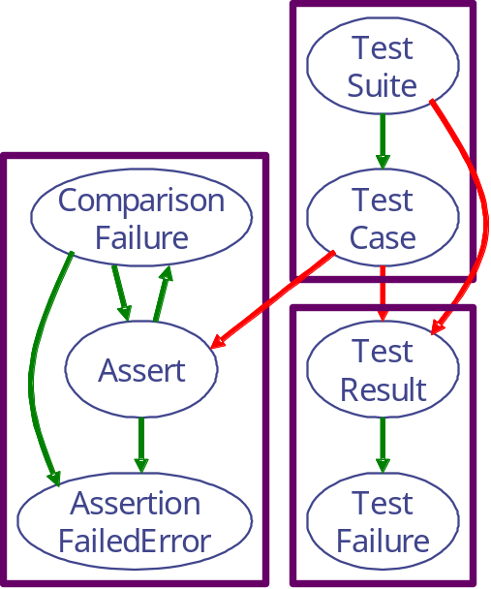
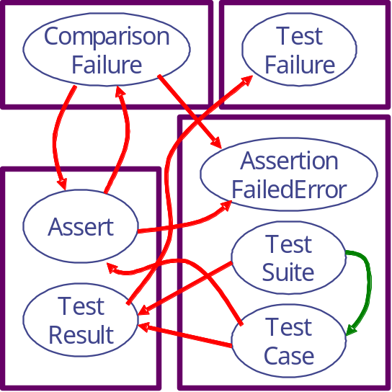
Bunch Example
JUnit is a Unit Testing
Framework for Java
(FrameworkPackage Shown Below)
The Random
Start Point
The MDG
A Solution
CompFailure
TestFailure
TestCase
Assert
TestCase
Assert
TestResult
MQ = 0.2857
MQ = 1.7889
(My Dissertation Discusses Several MQ Measurements)
Notes:
TALKING POINT: Introduce Internal and External Edges

Slide 10
Clustering Large Software Systems Efficiently
Our goal was to cluster large and interesting systems in a reasonable amount of time:
  Linux Kernel: >1,000 modules in ~ 90 seconds
  Swing Framework: > 450 classes in ~ 20 seconds
  Kerberos: > 500 modules in ~35 seconds
  Other Popular Systems Examined: Xerces, Apache HTTP Server, Jigsaw HTTP Server, Mozilla, Ant …
  Overall we examined over 50 reference systems during the course of my Ph.D. research
Since the source code analysis and clustering activities are separated, Bunch can cluster software developed in any programming language.

Slide 11
Research into Evaluating Software Clustering Results
Most software clustering results are evaluated subjectively
For a limited set of well-studied systems a reference is available, but for many systems no benchmark decomposition exists for comparison
  WCRE’01: Paper described the CRAFT system to generate a reasonable reference decomposition by highlighting similarities in a collection of software clustering results
One important aspect of evaluation is being able to compare software clustering results to each other
  ICSM’01: Paper introduced 2 measurements to determine similarity: MeCl and EdgeSim

Slide 12
What’s Been Done Since Completing my Ph.D. Research
Applying a formal Architectural Constraint Language (ISF) to software clustering results to reverse engineer the software architecture of a system
Modeling the Search Landscape to better understand why Bunch produces consistent results given the size of the search space
Integration of Bunch’s software clustering services into the RePortal online reverse engineering portal (http://reportal.cs.drexel.edu)
Support for GXL as both input and output representation into Bunch

Slide 13
Additional Research Opportunities Identified in my Thesis
Improved Visualization Services
Clustering the Dynamic Behavior of Systems
Clustering Distributed and Heterogeneous Systems
Investigating other Heuristics Appropriate for Clustering Software Systems
Investigating other Representations of Systems being Clustered

Slide 14
Summary
Application of search techniques to the software clustering problem
Developed software clustering algorithms and software to cluster large and interesting systems efficiently
Developed software and techniques to improve the state of practice for evaluating software clustering results

Slide 15
Recognition
Special Thanks To:
  My Advisor: Dr. Spiros Mancoridis
  My Committee: Dr. J. Johnson, Dr. C. Rorres,
  Dr. A. Shokoufandeh, Dr. R. Chen, and
  Dr. L. Perkovic (former member)
  My Sponsors: AT&T Research, Sun Microsystems, DARPA, NSF, US Army
  Bunch Project Contributors: D. Doval,
  M. Traverso, S. Mancoridis
  Dr. E. Gansner & Dr. R. Chen (AT&T Labs -Research) for test data and validation of Bunch’s clustering results.
  The gang at the SERG lab…
Notes:
Emden & Robin

Slide 16

Questions / More Information
Reverse Engineering Tools
@ Drexel
Bunch – Software Clustering Tool
CRAFT – Benchmark Generation Tool
RePortal – Online Reverse Engineering Portal
Where to Download & Evaluate

