Slide 1
Operating System Architecture Language WG/RG/CG 1st Meeting
By: Ronaldson Bellande
PhD Student
Founder/CEO/CTO/COO Bellande Technologies Corporation Inc
Founder of Bellande Research Organizations

Slide 2
Meeting Agenda
Data/File Format
Operating System Security
Operating System Permissions
Scripting Language

Slide 3
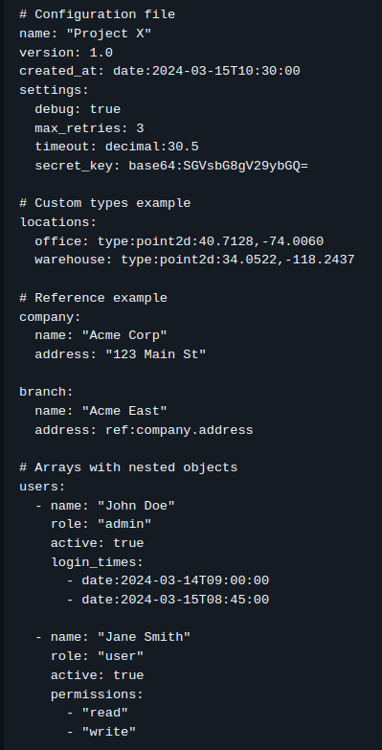
Data/File Format
Bellande File Format has many benefits including; Data Types Support, Structure Features, Data Integrity, Data Processing, Advanced Features, Format Characteristics, Development Features, Export/Import

Slide 4
7. Version Control
a. Change Tracking
b. Version History
c. Author Attribution
d. Modification Timestamps
8. Compression
a. Built-in Huffman
b. Compression
c. Multiple Compression Algorithms
d. Streaming Support
e. Chunk Processing
9. Transformation
a. Custom Type Transformers
b. Data Filters
c. Value Processors
d. Format Converters
Data/File Format
3. Hierarchical Data
a. Nested Objects
b. Arrays/Lists
c. Mixed Nesting
d. Unlimited Depth
4. References
a. Internal References
b. Cross-file References
c. Circular Reference Detection
d. Reference Validation
5. Validation
a. Schema Validation
b. Type Checking
c. Pattern Matching
d. Required Fields
e. Value Ranges
f. Custom Validators
6. Security
a. Built-in Encryption (AES)
b. Custom Encryption Support
c. Checksum Verification
d. Data Integrity Checks
1. Basic Types
a. Strings (with intelligent quoting)
b. Integers
c. Floating point numbers
d. Booleans
e. Null
2. Advanced Types
a. Decimal (high-precision numbers)
b. Dates and Times
c. Binary Data (base64 encoded)
d. File Paths
e. Regular Expressions
f. Complex Numbers
g. Sets
h. URLs
i. Timedeltas
j. Version Numbers
k. Custom Types (user-definable)

Slide 5
Data/File Format
13. Syntax
a. Human-readable
b. Clean Indentation
c. Comment Support
d. Clear Structure
e. Compatibility
14. UTF-8 Support
a. Platform Independent
b. Language Agnostic
c. Extensible Format
15. Performance
a. Streaming Parser
b. Efficient Memory Usage
c. Optimized Processing
d. Large File Support
16. Error Handling
a. Detailed Error Messages
b. Line Number References
c. Error Recovery
d. Validation Reports
17. Debugging
a. Debug Mode
b. Verbose Logging
c. Trace Information
d. Performance Metrics
18. Format Conversion
a. JSON Export/Import
b. YAML Export/Import
c. XML Export/Import
d. CSV Export/Import
e. INI Export/Import
19. Integration
a. Command Line Interface
b. API Support
c. Library Integration
d. Tool Ecosystem
10. Search and Query
a. Path-based Queries
b. Pattern Matching
c. Index Creation
d. Search Optimization
11. Document Operations
a. Merging
b. Diffing
c. Conflict Resolution
d. Patch Generation
12. Metadata Support
a. Document Properties
b. Field Annotations
c. Custom Metadata
d. Tracking Information

Slide 6
Operating System Security
Bellande Operating System has different access levels. Each has a different purpose and different levels of access. OWNER/BELL, ROOT, ADMINISTRATION, GROUP, USER.

Slide 7
Operating System Security
OWNER/BELL (Position 1)
- Value: 7 (rwx)
- Calculation: 4(read) + 2(write) + 1(execute) = 7
- Access:
* All system files and directories
* Core components
* Kernel level access
* Hardware level access
* Can override all permissions
* Complete system control
ROOT (Position 2)
- Value: 7 (rwx)
- Calculation: 4(read) + 2(write) + 1(execute) = 7
- Access:
* System files
* Configuration files
* Installation files
* Startup sequences
* Cannot access core components
* Cannot modify kernel

Slide 8
Operating System Security
ADMINISTRATION (Position 3)
- Value: 5 (r-x)
- Calculation: 4(read) + 0(write) + 1(execute) = 5
- Access:
* Read system configurations
* Execute administrative tasks
* Manage users
* Cannot modify system files
* No core component access
* No kernel modifications
GROUP (Position 4)
- Value: 3 (-wx)
- Calculation: 0(read) + 2(write) + 1(execute) = 3
- Access:
* Modify group files
* Execute group programs
* Share within group
* No read outside group
* No system modifications
* Limited to group scope

Slide 9
Operating System Security
USER (Position 5)
- Value: 1 (--x)
- Calculation: 0(read) + 0(write) + 1(execute) = 1
- Access:
* Execute allowed programs
* Access own directory
* Use basic utilities
* No system modifications
* No file modifications
* No read access outside home

Slide 10
Operating System Permissions
77000 - System Critical Files
Owner: 7 (rwx) = 4+2+1 : Full control
Root: 7 (rwx) = 4+2+1 : Full control
Admin: 0 (---) = 0+0+0 : No access
Group: 0 (---) = 0+0+0 : No access
User: 0 (---) = 0+0+0 : No access
Use: Core system files, kernel components
77530 - Administrative Tools
Owner: 7 (rwx) = 4+2+1 : Full control
Root: 7 (rwx) = 4+2+1 : Full control
Admin: 5 (r-x) = 4+0+1 : Read + Execute
Group: 3 (-wx) = 0+2+1 : Write + Execute
User: 0 (---) = 0+0+0 : No access
Use: System management tools, configuration files

Slide 11
Operating System Permissions
75531 - Standard Applications
Owner: 7 (rwx) = 4+2+1 : Full control
Root: 5 (r-x) = 4+0+1 : Read + Execute
Admin: 5 (r-x) = 4+0+1 : Read + Execute
Group: 3 (-wx) = 0+2+1 : Write + Execute
User: 1 (--x) = 0+0+1 : Execute only
Use: Standard applications, user programs

Slide 12
Scripting Language
Command Execution: Run both built-in and external commands.
Variable Assignment and Expansion: Assign and use variables within scripts or interactive mode.
Control Structures: Implement logic flow using if-else statements, while loops, and for loops.
Functions: Define and call custom functions.
File Operations: Perform basic file I/O operations.
Pipelines: Chain commands together using pipes.
Input/Output Redirection: Redirect command input and output to and from files.
Background Jobs: Run commands in the background.
Environment Variable Handling: Access and modify environment variables.

Slide 13
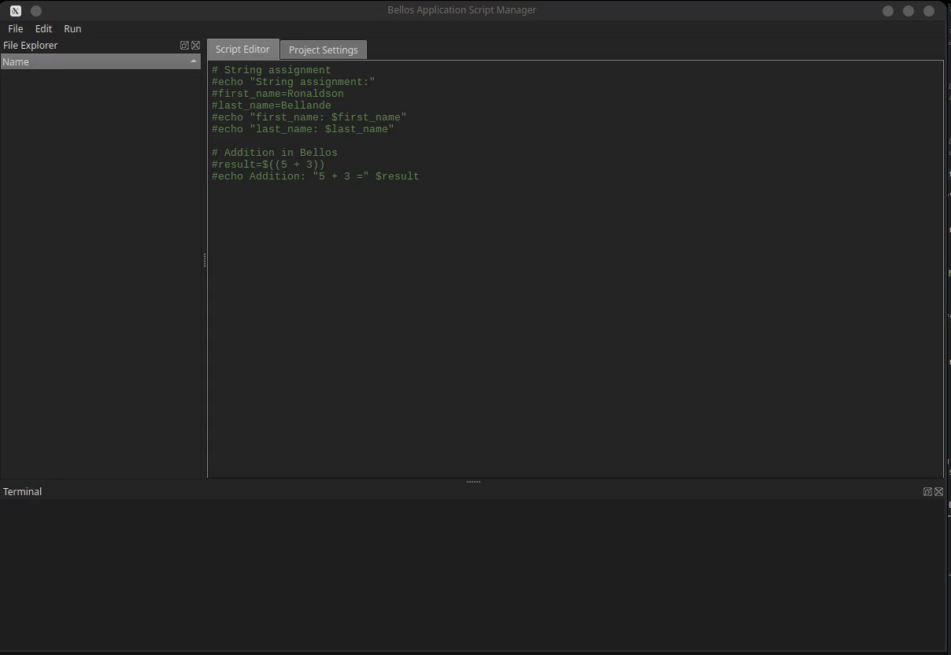
Scripting Language

Slide 14
Collaboration Opportunities & Next Steps & Networking & Resources
Presentation-Notes:https://github.com/Architecture-Mechanism/BAMRI-Operating-System-Architecture-Language-Powerpoint-Notes
GitHub Organization: https://github.com/Architecture-Mechanism
Website: https://bellande-architecture-mechanism-research-innovation-center.org
Discord Group: https://discord.gg/fdkGVKp7wx
Github Profile: https://github.com/RonaldsonBellande

