Slide 1
AUTOMATED TIMETABLE GENERATOR
22B81A05D7

Slide 2
Problem Statement
Manually preparing class timetables in educational institutions is a tedious and error-prone task, especially when handling multiple sections, faculties and subjects.
Traditional scheduling methods often lead to issues like faculty clashes, uneven workload distribution and inefficient utilization of rooms and labs.
Each faculty member may have unique constraints such as availability, subject specialization, and teaching preferences, making manual planning more complex.
There is a growing need for an automated solution that can intelligently generate clash-free, balanced and optimized timetables based on input constraints and availability.

Slide 3
Introduction
The Automated Timetable Generator simplifies and automates the academic scheduling process in educational institutions, addressing common issues in manual scheduling.
It generates section-wise and faculty-wise timetables by considering factors like faculty availability, subject hours, room/lab constraints and ensures no subject repetition per day.
The system also enforces the rule of only one lab per section per day, maintaining academic balance and preventing student fatigue.
Built using Node.js, MongoDB, this solution aims to reduce scheduling conflicts, save administrative time, and enhance overall efficiency.

Slide 4
Literature Survey
Traditional methods rely on manual scheduling using tools like Excel, which are time-consuming, prone to errors and lack real-time adaptability.
Previous systems using Constraint Satisfaction Problems (CSP), and AI techniques offer partial automation but often fail to address institution-specific constraints like lab handling or faculty preferences.
Many existing solutions lack user-friendly interfaces and real-time conflict detection, making them impractical for wide adoption in academic institutions.
This project fills these gaps by introducing a dynamic, web-based timetable generator with smart lab allocation, conflict resolution and faculty availability management.

Slide 5
Architecture and Detailed Design
Uses a modular function structure: allocateSec, allocateLab, reallocate, checkPrev, and more.
Overview:
The system is designed using a modular architecture to ensure flexibility, reusability and maintainability. It consists of four main components:
Frontend Interface
Backend Server (Node.js)
Database (MongoDB)
Timetable Allocation Engine

Slide 6
System Design Components
Frontend (User Interface):
Built using HTML, CSS, and JavaScript.
Provides pages for:
Admin: Add subjects, assign faculty, generate timetables.
Faculty: View their personal timetable.
Students: View section-wise timetables.
Uses fetch API for asynchronous communication with backend.
Backend (Node.js + Express):
Handles business logic and API routing.
Processes incoming requests (POST /allocate, GET /tt/:sectionId, etc.).
Contains key scheduling methods:
allocateSec, allocateLab, reallocate, checkPrev, isSafe.

Slide 7
Database and Scheduling Engine
Database Layer (MongoDB + Mongoose):
Stores:
Section-wise timetables as 2D arrays.
Allocation maps (faculty ID ➝ [row, col]).
Enables persistent storage and retrieval.
Timetable Allocation Engine:
Custom logic to:
Automatically allocate theory and lab sessions.
Avoid faculty clashes and room conflicts.
Ensure one lab per day and no subject repetition.
Follow lab distribution rules based on section type.
Dynamic reallocation logic helps when conflicts are found during generation.

Slide 8
Implementation:
Overview and Setup
Technologies Used:
Frontend: HTML, CSS, JavaScript
Backend: Node.js with Express
Database: MongoDB with Mongoose
Environment: Visual Studio Code, MongoDB Compass/ThunderClient
Initial Setup:
Created a Node.js Express server with REST API endpoints.
Connected MongoDB using Mongoose to manage schema-based data for sections and timetables.
Defined core models such as Section, with fields:
_id: section name (e.g., CSE-A)
timetable: 2D array (5x6) for scheduling
allocationMap: faculty/subject to position mapping

Slide 9
Backend Logic & Core Functions
Subject Allocation Logic:
allocateSec() Handles both lab and theory subject allocation for a section. Ensures 3 periods per theory subject, 1 lab per day, no repetition.
Lab Allocation Logic:
allocateLab() Ensures labs are scheduled in 3 continuous slots, avoiding faculty conflict. Uses row-wise randomization and even/odd section lab distribution.
Conflict Checks:
checkPrev() and checkPrevLabs() Prevents double-booking of faculty across sections at the same time.

Slide 10
Frontend & Data Flow
Frontend Functionality:
sendDataToServer(data) Sends faculty, subject, and section input as JSON to backend API /allocate.
fetchDataFromServer(sectionMap) Retrieves timetable for a section using /tt/:sectionId and renders in HTML table.
fetchTimetable() Gets faculty-wise timetable from /ft/:facultyId.
displayTimetable(data) Dynamically displays timetable in a formatted table on the frontend using JS DOM methods.
Data Flow Summary:
Admin enters input ➝ Data sent to backend.
Backend processes & generates timetable ➝ Stores in MongoDB.
Frontend fetches and displays final output per user role (Admin/Faculty/Student).

Slide 11
Testing procedures and Test cases
1.Testing Types Used:
1. Unit Testing:
Each individual function and method—such as allocateSec, allocateLab, reallocate, and isSafe—was tested in isolation to verify correct logic and return values.
Sample test data for sections and subjects were manually inputted, and output results were validated for expected behavior.
Example:
Inputs: Faculty A, Subject B, Section CSE-A
Expected: Subject B allocated 3 periods across the week without conflict.
Result: Passed
2. Integration Testing
Integration testing was performed to ensure proper communication between the frontend and backend APIs. This included testing POST requests for timetable generation and GET requests for viewing faculty-wise and section-wise timetables.

Slide 12
Tested endpoints:
POST /allocate
GET /tt/:sectionId
GET /ft/:facultyId
Tools Used: Thunder Client, browser console logs
3. Functional Testing
Key features were verified against functional requirements to ensure the application performs as intended:
Add Subject, Generate Timetable , View Section Timetable , View Faculty Timetable, Lab Allocation
All the results are passed.
4. UI/UX Testing
The interface was tested across multiple browsers and screen sizes to ensure consistency and usability. User flows were evaluated for intuitive navigation and responsiveness.
• Browsers tested: Chrome, Firefox, Edge
• Device Viewports: Desktop, Tablet

Slide 13
5. Error Handling and Boundary Testing
The system was tested with edge cases such as:
• Duplicate subject and faculty entries for same section.
The application responded gracefully with alerts, console logs, or error messages without crashing
6. Performance Testing (Basic Level)
Though not formally stress-tested, performance was observed by simulating inputs for 3 - 5 sections, each with multiple subjects and labs. The timetable was generated instantly, with response time <1 second to the local server

Slide 14
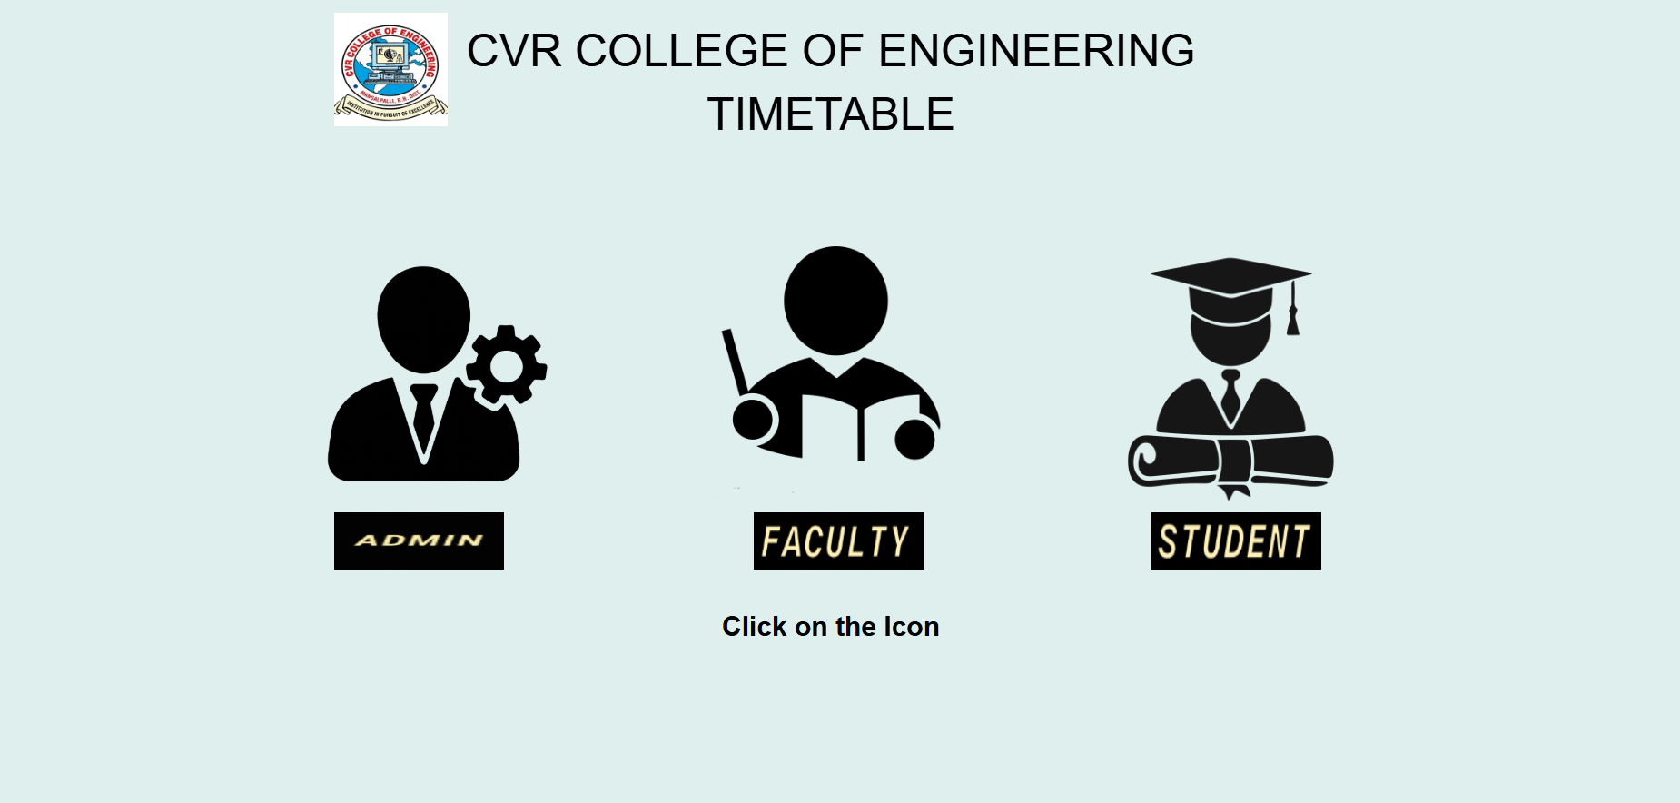
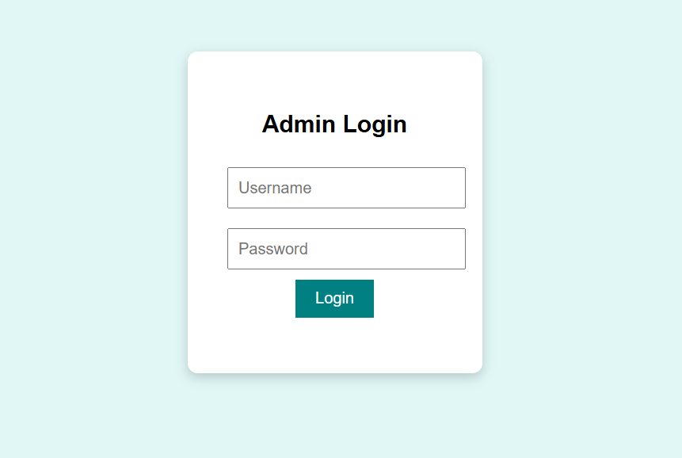
Results

Slide 15
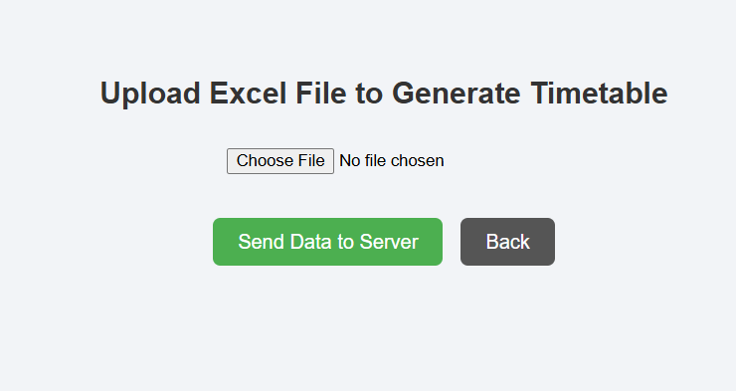
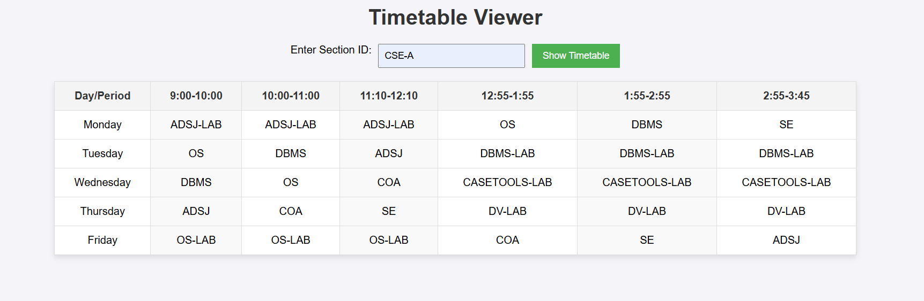

Slide 16
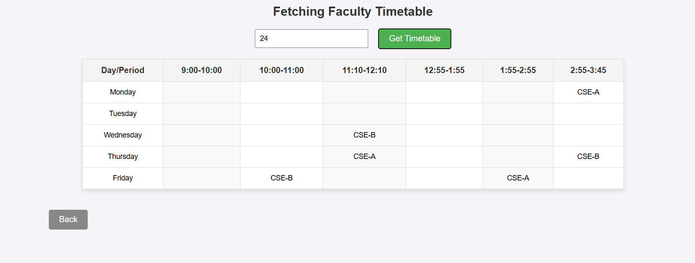

Slide 17
Conclusion and Usability
The Automated Timetable Generator simplifies the complex task of academic scheduling by generating conflict-free, well-structured timetables with minimal manual effort. It ensures no subject repetition in a day and intelligently handles lab sessions with continuous period allocation.
The system offers a user-friendly interface for administrators to manage subject-faculty assignments and generate optimized schedules in a single click. With backend logic built on Node.js and data handling via MongoDB, it ensures efficiency and scalability.
Faculty and students benefit from clear, accessible timetables, reducing confusion and improving daily academic flow. Overall, the system enhances operational productivity and provides a reliable scheduling framework for institutions.

Slide 18
References
We have referred few sites such as:
1.GeeksforGeeks
2.W3Schools
3.StackOverflow
4.https://youtu.be/A01KtJTv1oc?si=WX0ybCfx7ge10zbY
5.https://youtube.com/clip/UgkxDEuG_R5IIqFVCBLPDsilwVGkkhCwL27g?si=axoH6 Buu_n80RppA
6. https://youtu.be/asstH5H223Y?si=Z7GA0oBhEXKWQFqf

