Slide 1




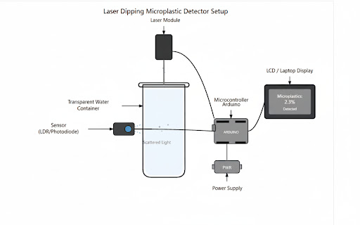

















Team Members
Faculty Mentors
1.25885A6615 - Bollela Tejasri
2. 25885A6616- Bommera Shiva
3. 25885A6618- Pawar Anil
4. 25885A6619- Rampalli Architha
1.Mr. G Krishna Teja,Assistant Professor,ME
2.Ms.Sirisha,Assistant Proffessor,ECE
Community Innovation and Transformation
Department Of Computer Science Engineering (AI & ML)
A8027-TECHNOLOGY ENTREPRENEURSHIP-2K25
Microplastic Detection in Water using Arduino-Based Laser Scattering
Objectives of the Project :
Need Statement :
Product Picture :
Develop a low-cost microplastic detection system using Arduino and optical sensors.
Implement light scattering principles to quantify microplastic concentration in water.
Enable real-time data display through an LCD interface for immediate assessment.
Design a DIY-friendly setup to promote citizen science and environmental awareness
Microplastic pollution is invisible, harmful, and hard to detect with conventional tools.Existing detection methods are expensive and inaccessible to most communities.Our project introduces a low-cost, Arduino-based system using laser scattering.It detects microplastics in real time and displays results on an LCD screen.The setup is DIY-friendly, portable, and ideal for citizen science initiatives.This empowers users to monitor water quality and respond to pollution quickly.
Resources Used :
Community Partner Details :
Solution :
Hardware:
Arduino UNO (Microcontroller),Laser Diode Module (5V)
LDR Sensor Module,Breadboard & Jumper Wires.
Software & Simulation: Arduino IDE
Name: Dhruvansh
Profession: Environmental non-profit NGO
Address: 60,Pragati Resort, Chilkur Balaji Road,
Shankarpalli
Contact details: +918465034598
Real-time concentration display for instant water quality feedback.
Dual-sensor setup enhances detection accuracy and sensitivity.
DIY-friendly design promotes citizen science and accessibility.
Portable system suitable for field testing and rapid deployment.
Reduces reliance on expensive lab equipment and complex analysis.
Supports environmental awareness and early pollution response.
Published or Patented :
SDG’s Covered :
Paper and Patented Applied
Outcomes :
Affordable Microplastic Detection
Real-Time Water Quality Monitoring
Enhanced Environmental Awareness
DIY-Friendly and Portable Design
Accurate Optical Sensing
Empowers Citizen Science
Supports Sustainable Water Management
Cost Analysis :
COMMUNITY PARTNERS
•UNO-R3 – ₹350
•Laser Module – ₹70
•LCD (16×2) – ₹50
•LDR – ₹40
•Jumper Wire – ₹30
Product Execution Video Link :
https://drive.google.com/file/d/1eWBv0yzaJQyocK-8XGe1-mDdTP9fYbIZ/view?usp=sharing

