Slide 1
A Data-Driven Hypothesis Validation
Team Members:- Architha Kattumulla, Sai Suhas Earla

Slide 2
Dataset Overview
2
The dataset captures students’ daily schedules over multiple weeks.
Each entry logs the time, activity, location, social context (who they were with), and mood.
Mood is represented using emojis, such as 😀 for a positive mood.
The data spans all days of the week, from Monday to Sunday.
Activities include sleep, study, meals, socializing, and more.
Social interactions are indicated by whether the student was with someone or alone.
The structure of the data allows analysis of how daily routines relate to mood patterns.
This dataset is suitable for exploring the relationship between social interaction and happiness.

Slide 3
Hypothesis Statement
3
Days with higher social interactions tend to have more positive moods.
Focuses on the connection between the number of social interactions and reported mood levels.
Based on daily records of activities, companions, and mood entries.
Uses data on who students were with during each activity to measure social interaction.
Mood is represented using emoji indicators recorded alongside activities.

Slide 4
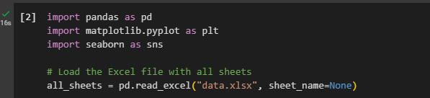
Data Loading
4
Used a dictionary (all_sheets) to load and store each sheet from the Excel file, where sheet names served as keys and individual DataFrames as values. This allowed organized access to weekly data for preprocessing and analysis

Slide 5
Data Preprocessing
5
Data Cleaning:
Dropped unnecessary rows (e.g., titles, empty rows, and duplicates).
Column Renaming:
Standardized column names for consistency:
"Time", "Activity", "Who", "Where", "Mood", and "Extra".

Slide 6
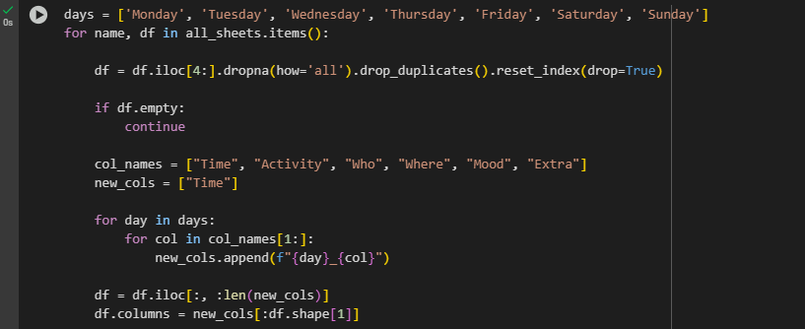
Data Preprocessing Code
6

Slide 7
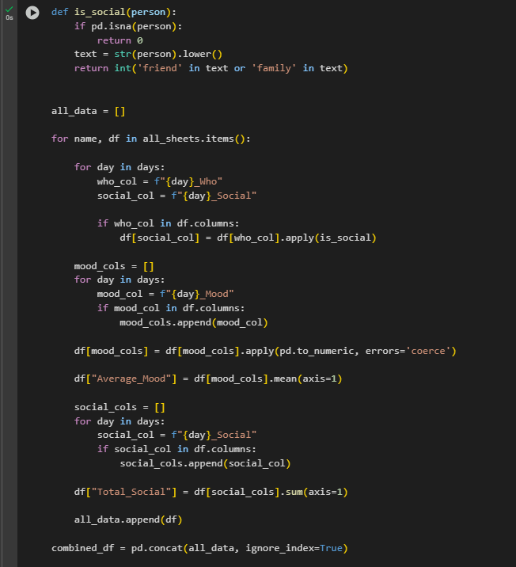
Exploratory Data Analysis (EDA)
7
This code processes data from multiple sheets by:
Using the is_social() function to identify social interactions (friend or family) in the Who column for each day.
Converting mood values to numeric and calculating the average mood (Average_Mood).
Summing social interactions (Total_Social) across the week.
Combining all processed data from the sheets into a single DataFrame.

Slide 8
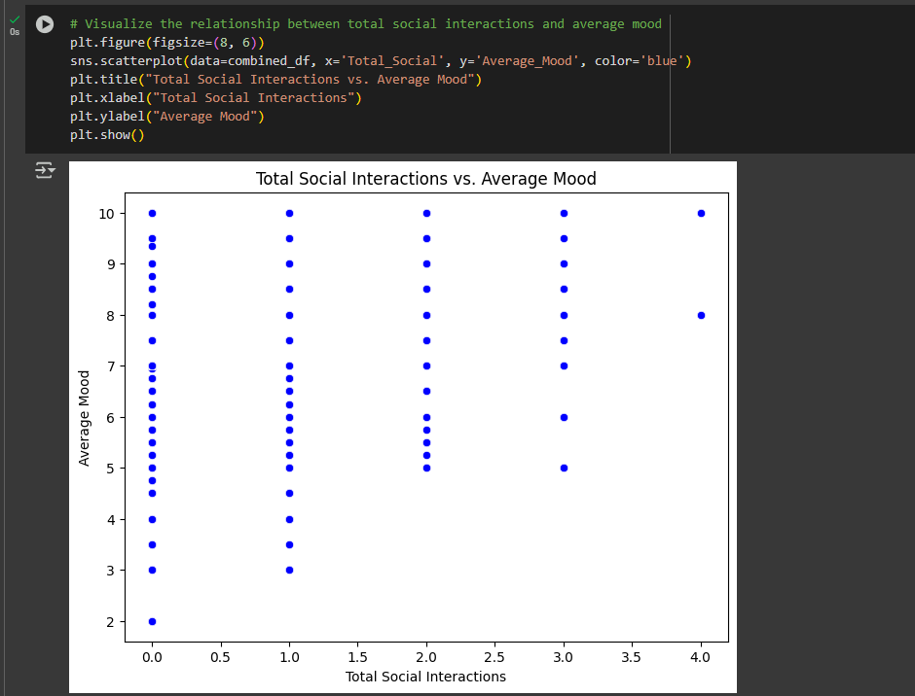
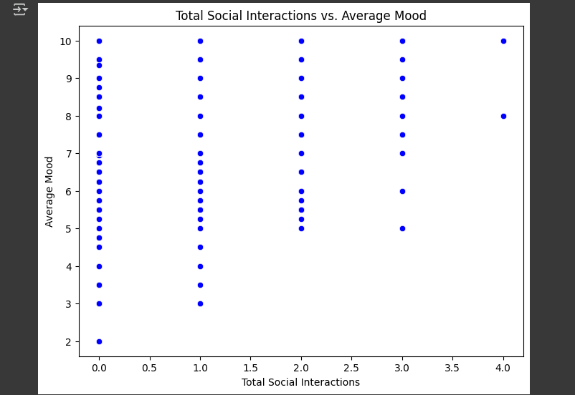
Data Visualization
8
This code creates a scatter plot to visualize the relationship between the total number of social interactions (Total_Social) and the average mood (Average_Mood). It uses seaborn to plot the data, with the x-axis representing social interactions and the y-axis representing mood, and the plot is displayed with appropriate labels and title.

Slide 9
Conclusion
9
Higher social interactions generally correlate with higher mood scores.
.Top mood ratings (8–10) are more common with 2–4 social interactions.
The hypothesis is supported: more social interaction tends to mean better mood.

Slide 10
Contribution
10
Data Preprocessing : Sai Suhas Earla
EDA & Visualization : Architha Kattumulla

