Slide 1
Credit_Data
DS1_L1_C6_S4_HackaThon_Archit

Slide 2
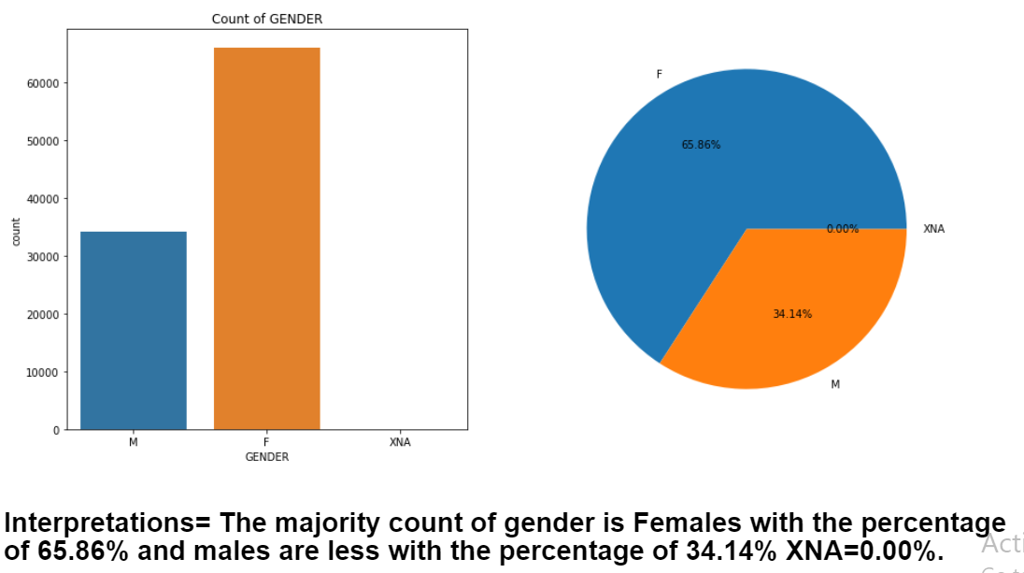
Univariet Category Column=Gender

Slide 3
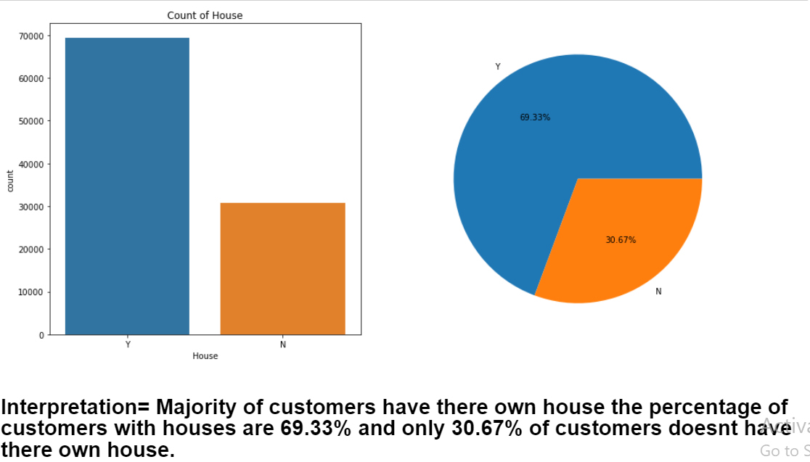
Column=House

Slide 4
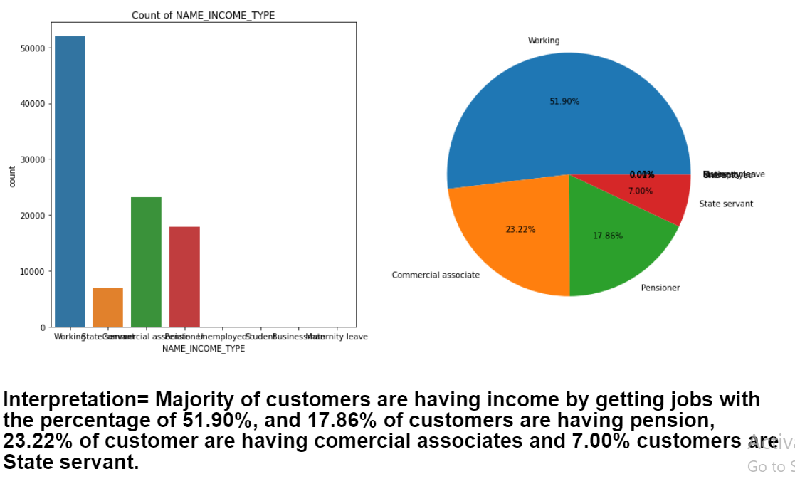
Column=Name_Income_Type

Slide 5
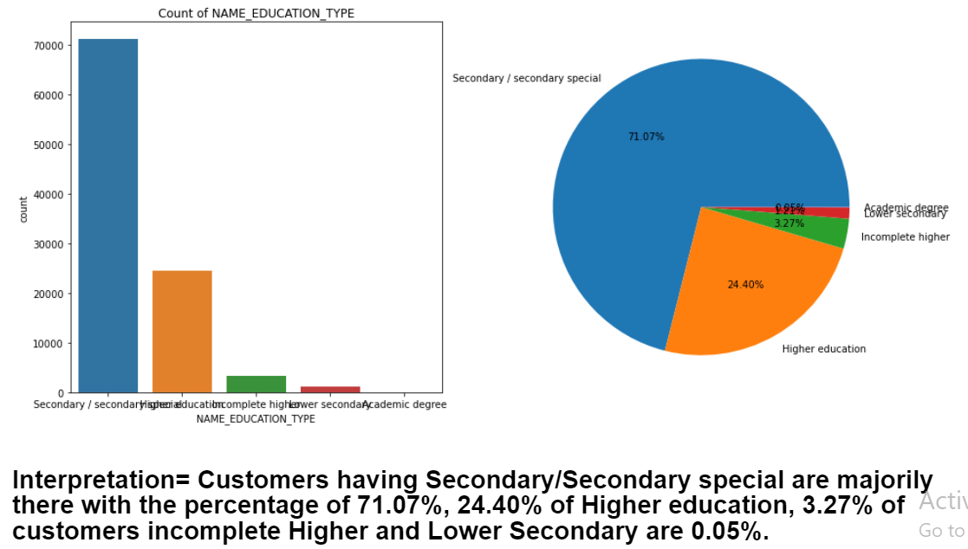
Column=Name_Education_Type

Slide 6
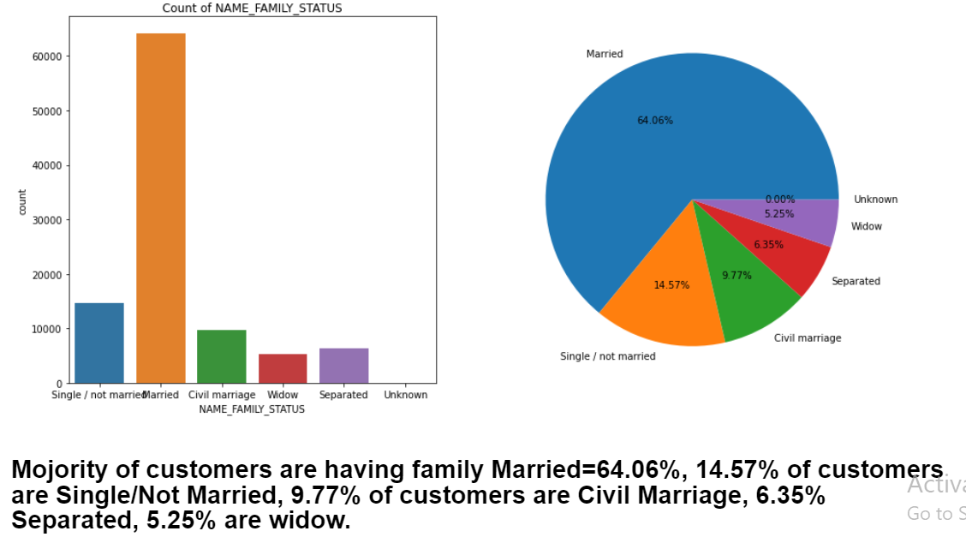
Column=Name_Family_Status

Slide 7
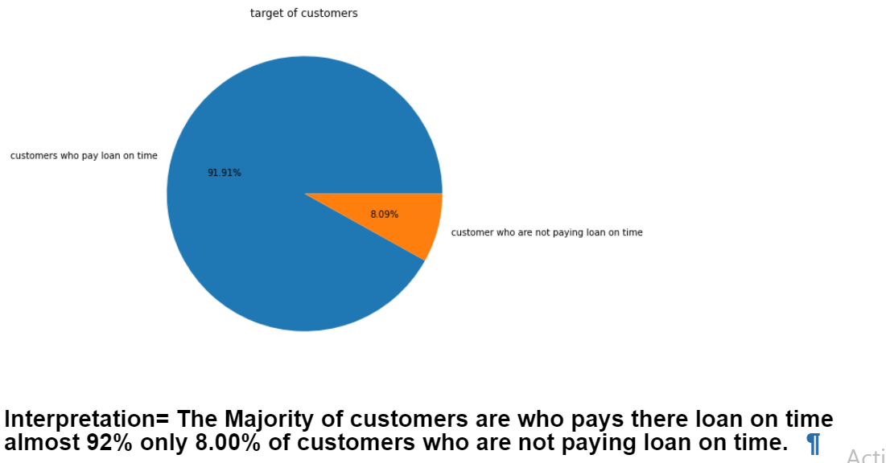
Univariet Numerical Column=Target

Slide 8
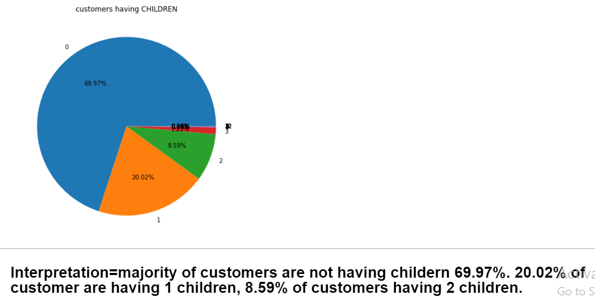
Column=Children

Slide 9
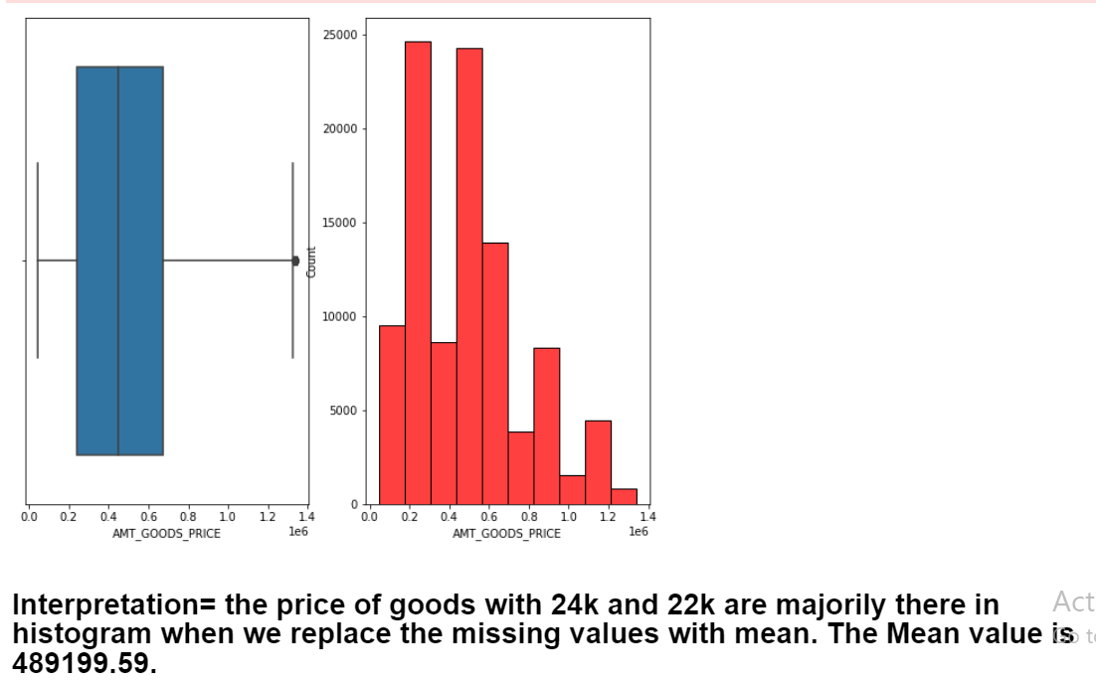
Column=AMT_Goods_Price

Slide 10
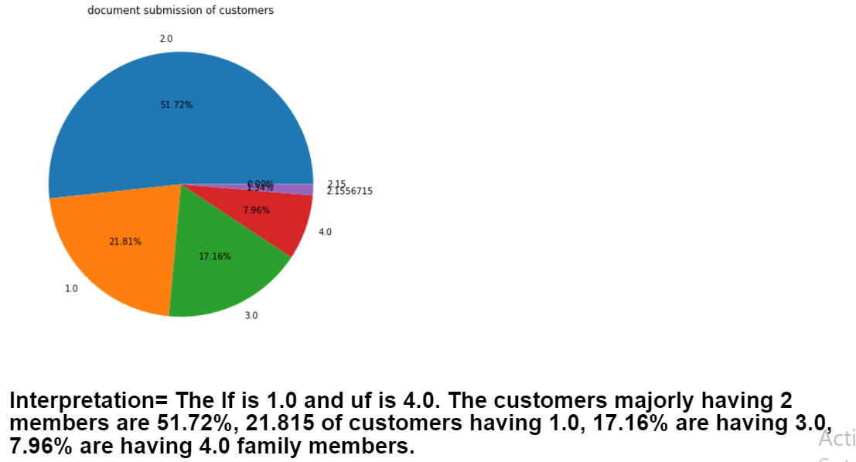
Column=CNT_Fam_Members

Slide 11
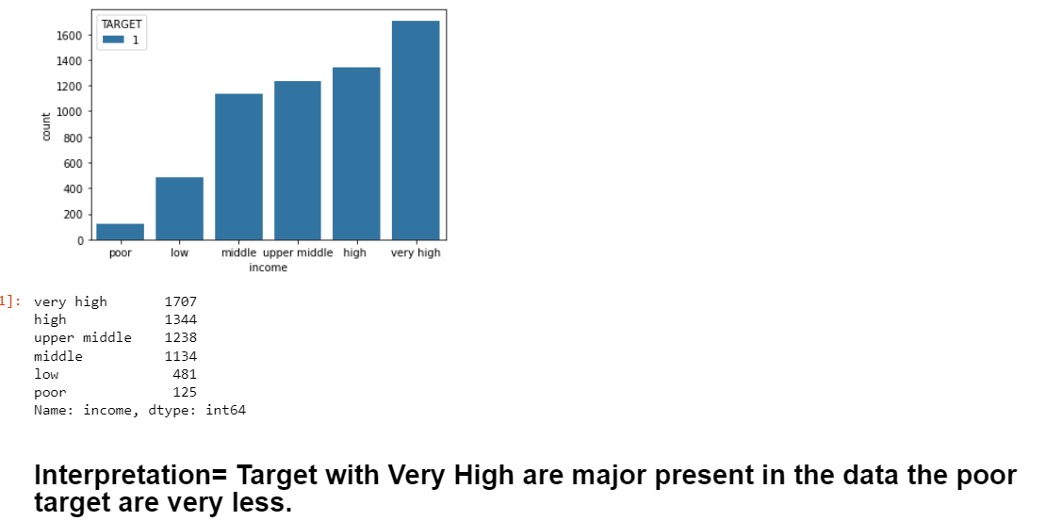
Multivariet Column=AMT_INCOME_TOTAL, TARGET

Slide 12
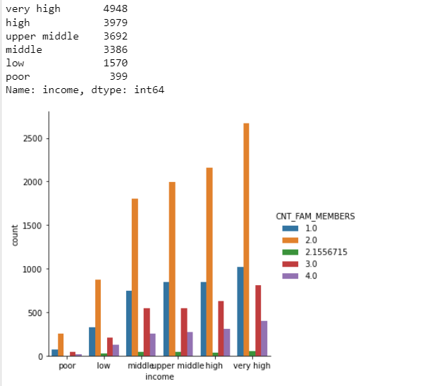
Column=AMT_GOODS_PRICE, CNT_FAM_MEMBERS, income.

Slide 13
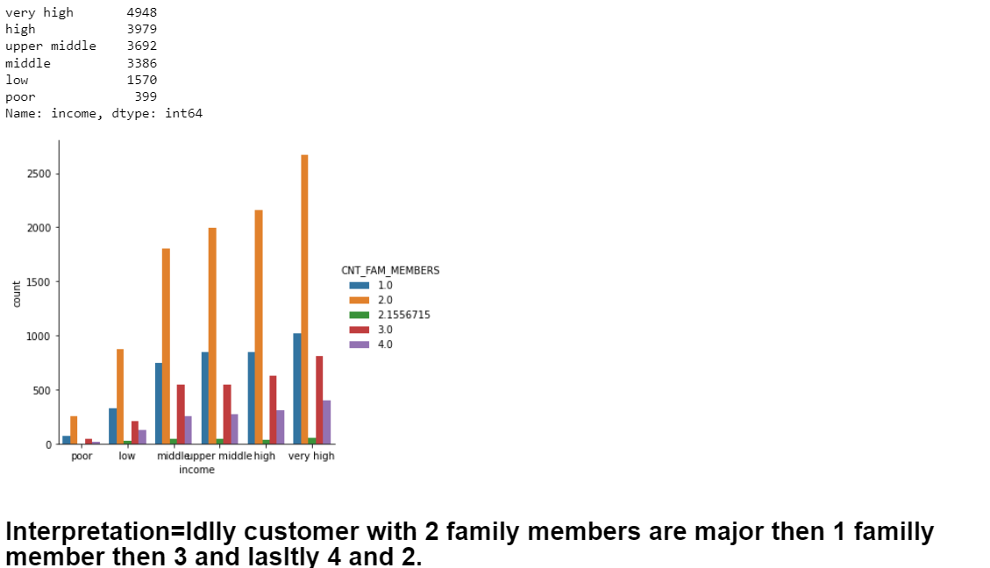
Column=AMT_GOODS_PRICE, CNT_FAM_MEMBERS, AMT_CREDIT

Slide 14
- : CONCLUSION : -
*There are very less customers who are having difficulties to pay there loan.
*The working customers are more then unemployed customers.
*Customer with children are very less.
*Customer are majorily having 2 family members
*There are customers who having there own house are higher then the customer who doesn’t have there own house.
*The Customers that are given the document are higher as compare to who didn’t submitted the documents
- Overall customers who are paying and are capable of paying there loans are in major count and rest all customers are having difficulties to pay there loan.

