Slide 1

BRAINDEAD HACKATHON
Team members
Archit Singh
Anusha Srivastava
Pratyush Kumar
Praneet Rao

Slide 2
Problem Statement 1 : Analyze Placement Data
Challenge Description:
In this challenge, you are supposed to analyze the placement records of the students of a MBA college.
The dataset includes secondary and higher secondary school percentages and specializations. It also contains degree specialization, work experience, and the salary offered to the students. Your main task is to analyze the factors that affect the placement and salary of students.
Analyze the dataset and derive meaningful insights from the data.
Here are some examples that you might consider for your analysis:
What are the factors affecting the placement of a student?
Which degree specializations are in high demand in the industry?
Does mba percentage matter in placement?

Slide 3
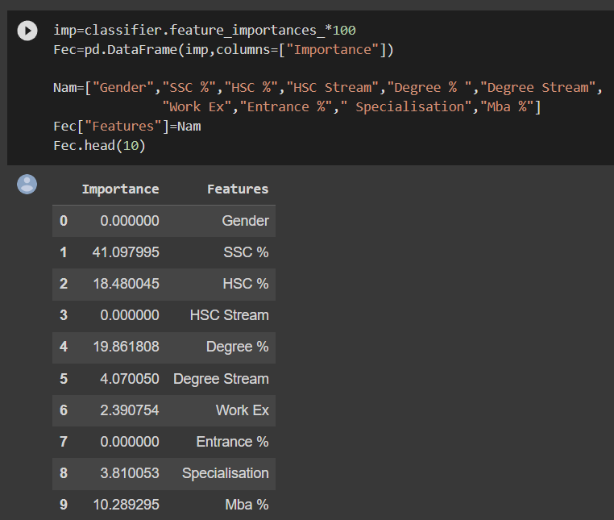
ANALYSIS OF THE FOLLOWING TABLE SHOWS
It shows the importance of various features such as HSC%, SSC% HSC stream. The table shows that SSC% is the most important whereas gender is least important.

Slide 4
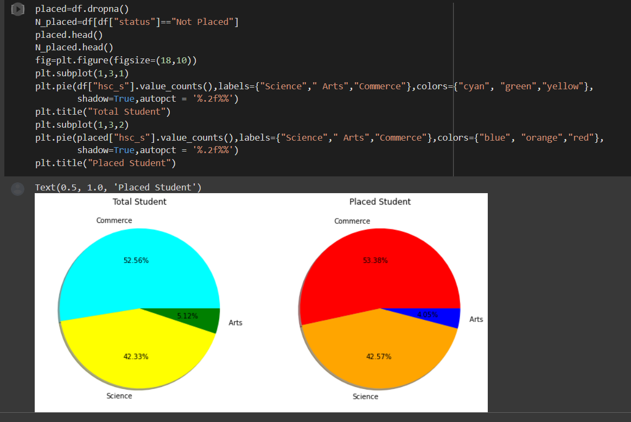
ANALYSIS OF THE FOLLOWING PIE CHART SHOWS
In total students 52.56% are from commerce 42.33 are from science and 5.12% are from art stream.

Slide 5
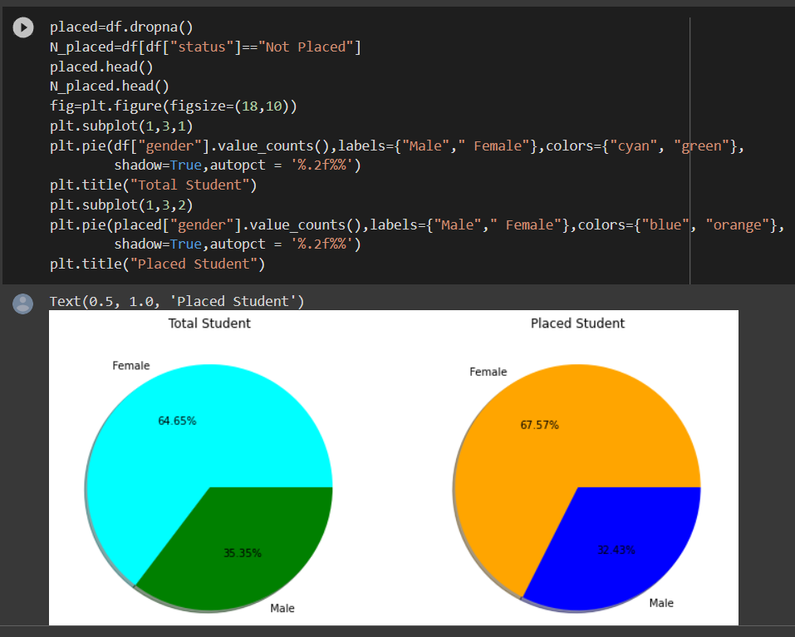
ANALYSIS OF THE FOLLOWING PIE CHART SHOWS
Out of the total number of students 64.65% are female and 35.35% are male.
Among the placed students,67.57% are female and 32.43% are male.

Slide 6
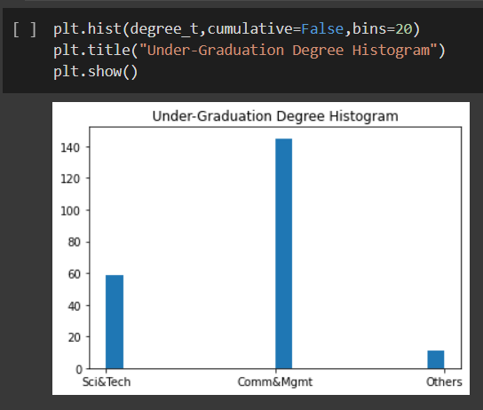
ANALYSIS OF THE FOLLOWING BAR GRAPH SHOWS
60 students are from science and technology degree 140 are from commerce and management while less than 20 from arts stream.

Slide 7
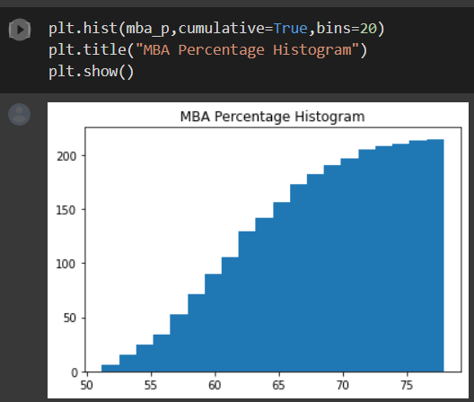
ANALYSIS OF THE FOLLOWING HISTOGRAM SHOWS
This histogram shows that maximum number of students got between 65-75% .

Slide 8
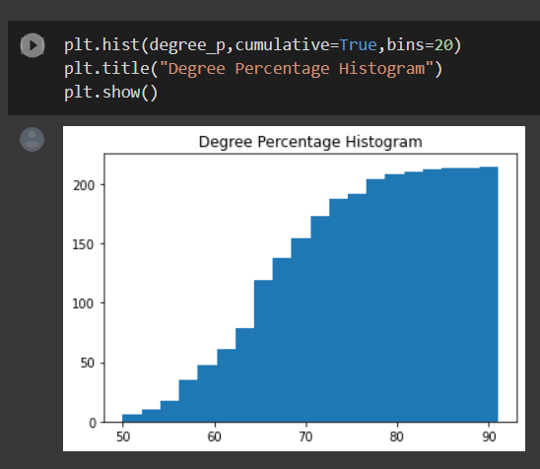
ANALYSIS OF THE FOLLOWING HISTOGRAM SHOWS
This histogram shows that most of the people scored more than 80% in their degree program.

Slide 9
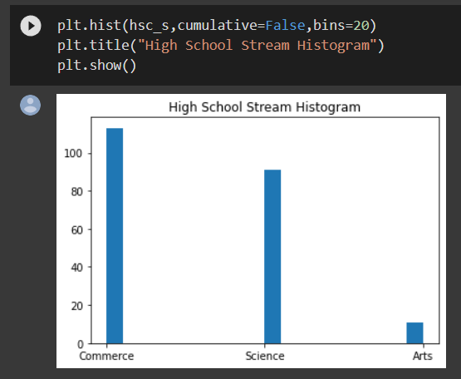
ANALYSIS OF THE FOLLOWING BAR GRAPH SHOWS
The bar graph shows that most of the people are from commerce stream whereas least are from art stream.

Slide 10
Problem Statement 2: Detecting Emotional Sentiment in Cartoons
Challenge Description:
Social media platforms are widely used by individuals and organizations to express emotions, opinions, and ideas. These platforms generate vast amounts of data, which can be analyzed to gain insights into user behavior, preferences, and sentiment. Accurately classifying the sentiment of social media posts can provide valuable insights for businesses, individuals, and organizations to make informed decisions.
To accomplish this task, a customized private cartoon dataset (original images) of social media posts has been provided, which contains labels for each post's emotion category, such as happy, angry, sad, or neutral.
The task is to build and fine-tune a machine-learning model that accurately classifies social media posts into their corresponding emotion categories, using synthetic images.
To achieve this, the following steps are required: ⭐ Generate synthetic images using any image generation techniques (e.g., GAN, Diffusion Models, Autoencoder Decoder) to augment the dataset and increase its size. ⭐ So for example, we use the images in the category of "happy" to synthetically generate similar images. Repeat the same for each category. ⭐ Use the original and synthetic images to build a machine-learning model that accurately classifies social media posts into their corresponding emotion categories. ⭐ Evaluate the performance of the model using appropriate metrics such as accuracy, precision, recall, and F1-score. ⭐ Compare the performance of the model when trained on the original dataset only, the synthetic dataset only, and the combination of both. ⭐ Analyze the results to determine the effectiveness of using synthetic images for improving classification accuracy.

Slide 11
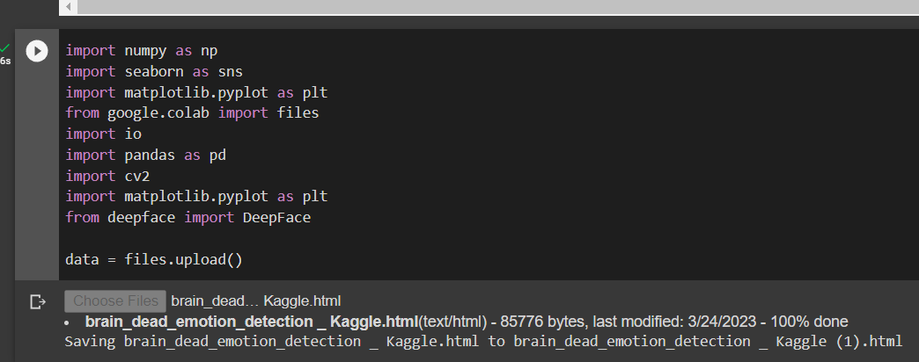
FIRSTLY pip install deepface command is being executed and following libraries are used.
These will help to input data to check our code.

Slide 12
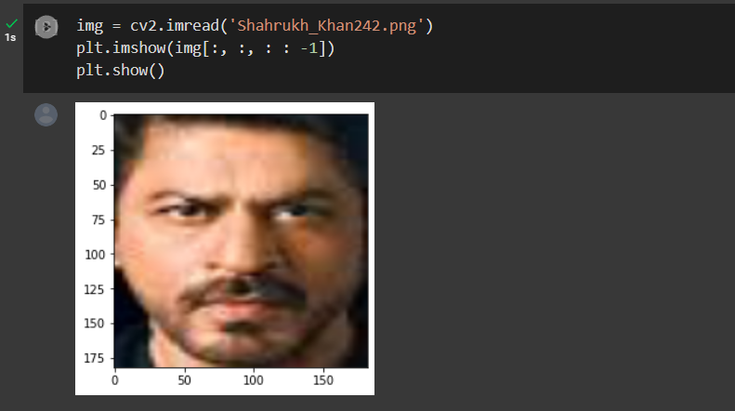
AFTER THE FILE HAS BEEN IMPORTED TO OUR PROGRAM
Select an image and run the next segment of code.

Slide 13
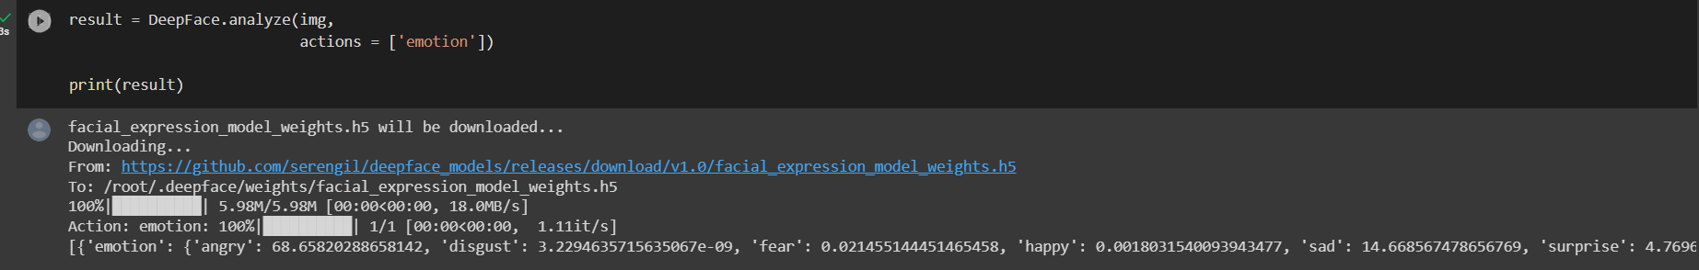
LASTLY CODE WILL TELL THE EMOTIONS TO HUMAN
The code will now understand the facial expressions and will tell about the emotion of the person.

