Slide 1

Swaap: Labs 22
Bobby Hall, Team Lead
Chad Rutherford, iOS
Roberto Banbanaste, Web
Sierra Curtis, Web
Tristan Depew, Web
Corey Gumbs, Web
Erica Ingram, Web
Click Here to View Swaap’s Product Release Canvas L22.1
Notes:
Hello there again, I'm Erica Ingram from the Swaap team in Labs 22. Today, we’re presenting our first release canvas. Here at Swaap, we're about connecting people on the go effortlessly. To that end, we decided our top priority was to rectify an inconsistent user experience. So we decided to complete a lot of functionality updates in this release canvas. The team figured a good way to jump in and get to know the code was to do major user-facing bugs first, or the ones we thought were noticeable by users. Our users aren’t the most tech-savvy user base one could have, so the app being user friendly is very important. We also had a discussion about how fixing bugs would be what happens at the majority of jobs; probably won’t get to do flashy new things as a newbie to a company, so this also influenced our decision to fix bugs first.

Slide 2
Problems Addressed
Inconsistent user experience
Link updating/creation may be confusing for the user, refactor to enhance ease of use (WEB)
Preferred contact shows as “@@swaapApp” if user hasn’t selected one
User isn't warned before they delete a contact (just deletes on click) (iOS & WEB)
Token expiration needs to be fixed (WEB)
Profile picture alignment is off (WEB)
Mobile app and web portal aren't displaying the same information (iOS & WEB)
Changing birthdate on app won't update birthdate on the web portal.
Job title, location, tagline, bio section is not included on the Web Portal
Profile information on Mobile app is left out unless you're editing
Click Here to View Swaap’s Product Release Canvas L22.1
Notes:
So our first release canvas consists of fixing bugs narrowed down from a list we made. Overall, we solved one problem with this release canvas, an inconsistent user experience. First, as a team, we picked through the whole site to find bugs. Once we had what we felt was a full list, we needed to prioritize them in some way. In order to decide what priority to give them, we agreed as a team that user-facing bugs/fixes were the most important and each initialed the ones we thought could be done in one to three weeks.
Next, we sorted the list in order of quantity of people’s initials.
Then we decided as a group to aim for stuff we could turn around in a week to a week and a half, and the first six to eight items on that list became our first release canvas.
What you see here is the final curated list, and I will go over each of these one by one.

Slide 3
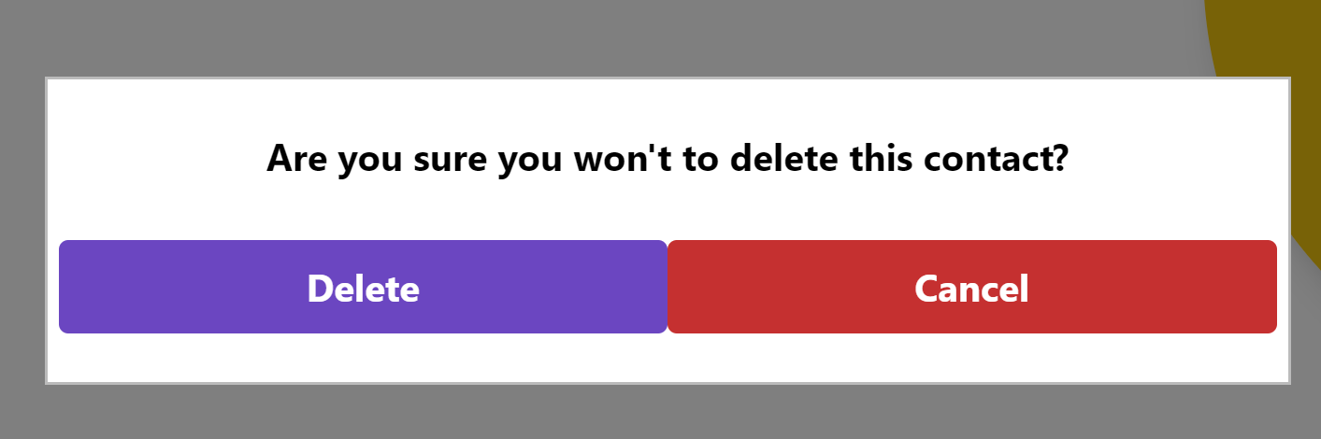
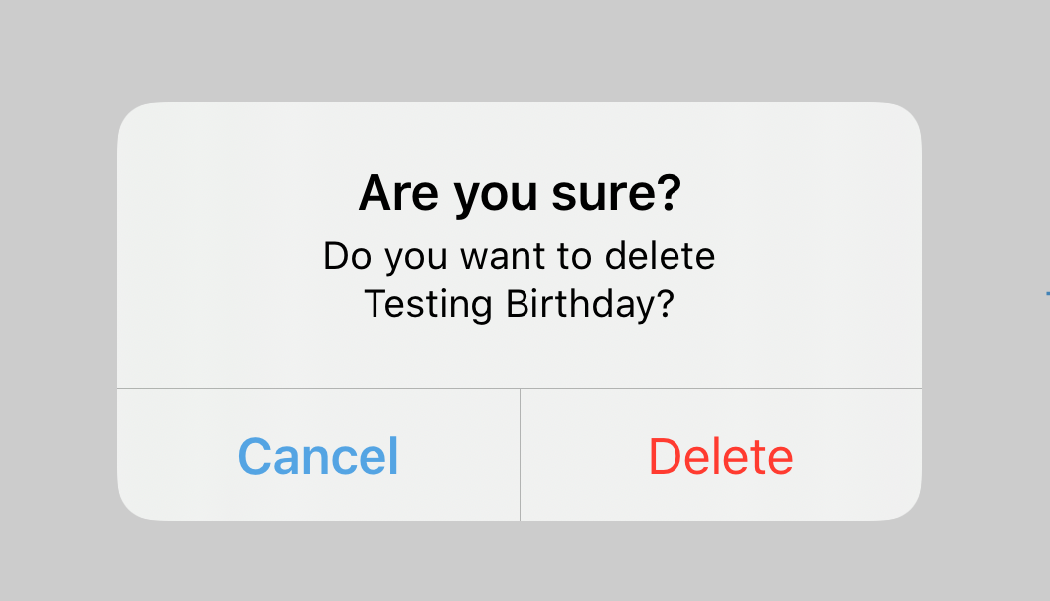
Feature:
Web:
Problem:
Inconsistent User Experience: User isn't warned before they delete a contact
iOS:
Add Prompt before Deleting Contact
Click Here to View Swaap’s Product Release Canvas L22.1
Notes:
Prior to this release, when a user deleted a contact, it didn’t confirm the delete or prompt ‘are you sure’, which we felt was very user unfriendly. What if you didn’t mean to do it? Users make mistakes all the time, especially ones who aren’t tech savvy, and they need to be able to back out of a change like a delete. So now these windows appear before you delete a contact.

Slide 4
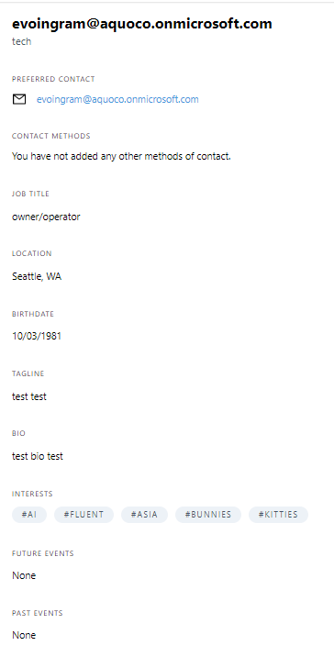
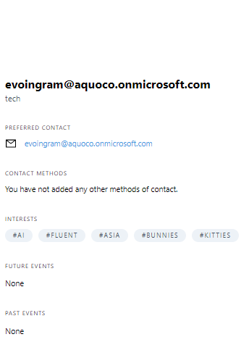
Feature:
Before
Problem:
Inconsistent User Experience: Mobile app and web portal aren't displaying the same information
Edit user profile to render all of user’s information and ensure consistency
After
Click Here to View Swaap’s Product Release Canvas L22.1
Notes:
Another problem we ran into was that the profile page didn’t display all the info a user could potentially enter into Swaap. Things missing from display were the user’s job title, tagline, birthdate, location, and bio, so we added those fields to the profile page.

Slide 5
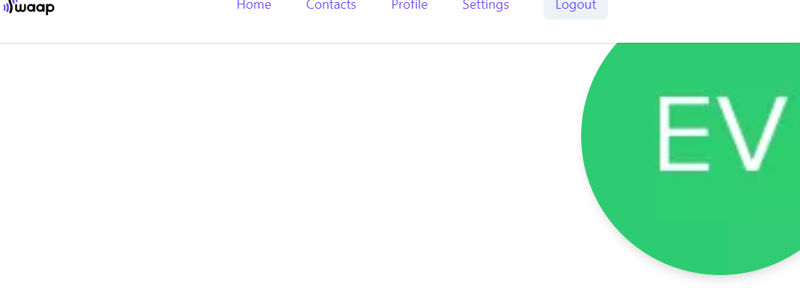
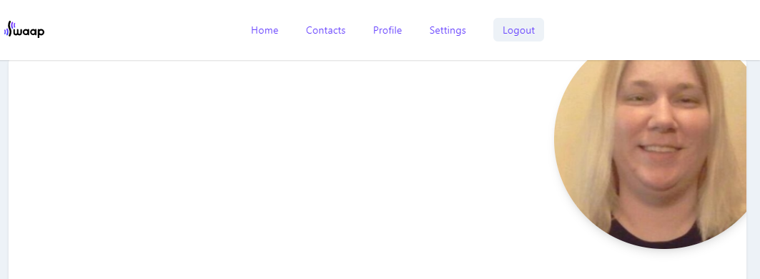
Feature:
Before:
Problem:
Inconsistent User Experience: Profile picture alignment is off
After:
Refactor CSS so home & profile pages match alignment
Click Here to View Swaap’s Product Release Canvas L22.1
Notes:
Our team also noticed alignment of the profile picture on the profile page versus the same picture on the web home page and iOS app were very noticeably different, so we fixed that. It used to go right to the edge, and now it looks like a card, as on the home page.

Slide 6
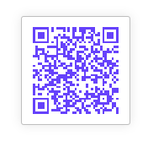
Feature:
Change QR code foreground color
Click Here to View Swaap’s Product Release Canvas L22.1
Notes:
While we were adjusting the profile picture alignment, we found it was very easy to change the color of the QR code that users need in order to swap, so we changed that as well from black to Swaap purple.

Slide 7
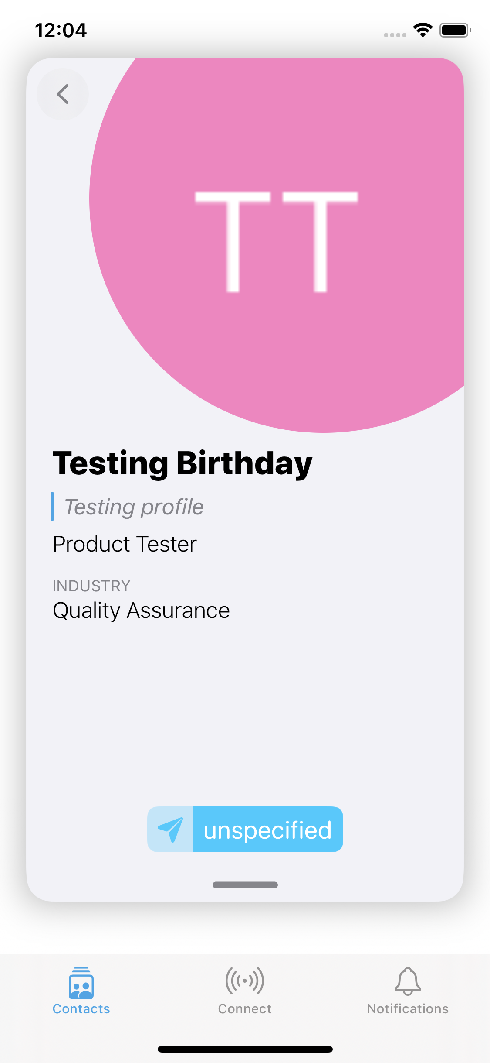
Feature:
Problem:
Inconsistent User Experience: Preferred contact lists “@@swaapApp” if user has not set preferred contact
Remove “@@swaapApp” from preferred contact
Click Here to View Swaap’s Product Release Canvas L22.1
Notes:
This was a problem, so we rectified that by displaying it as you see in the after picture, no ‘@@swaapApp’.

Slide 8
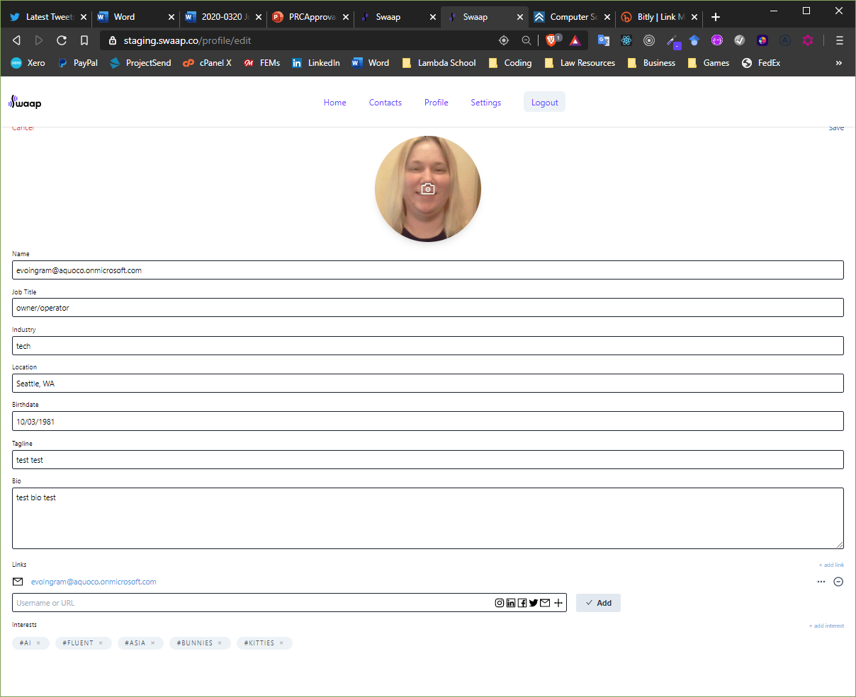
Feature:
Problem:
Inconsistent User Experience: Link updating and creation not user friendly
Add a button to prompt saving of user links
Click Here to View Swaap’s Product Release Canvas L22.1
Notes:
Also, as a team we felt the link update/creation area and process may be confusing for the user, so we redesigned that a little bit. Prior to this change, there was no add button and no plus. So you had to hit the enter key to save, and there was no prompt anywhere for how to save the link once you type it into the box. This is not really a problem for savvy tech users, because most people know you can hit enter in forms, but our users largely won’t be tech savvy, so we added a button to make what the user should do to save the link more obvious and a plus to show the user there’s more to pick from.

Slide 9
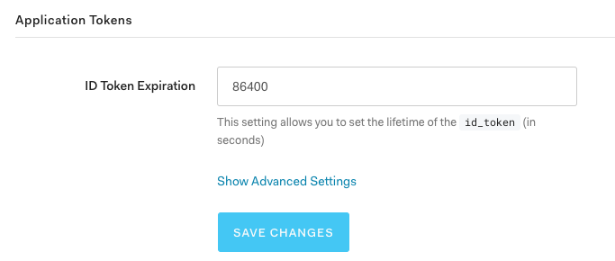
Feature:
Problem:
Inconsistent User Experience: Token expiration too short
Update token expiration time to be longer
Click Here to View Swaap’s Product Release Canvas L22.1
Notes:
The Swaap app used to have a token expiration of one day, and the team felt that was too short. A short token expiration means the user has to log in more frequently, annoying for a lot of people, so we also decided to fix that as well; again, user-facing fixes being the theme here and now the token expiration is one week.

Slide 10
Objectives Supported
Have a positive experience staying in contact with people from conference
Be able to learn about your peers attending an event
Make sharing profile information very fast and easy in person
Click Here to View Swaap’s Product Release Canvas L22.1
Notes:
So those are the features we fixed in this canvas, and several objectives were supported by fixing these features. Why did we select these? Again, this will make the app a lot more polished looking and user friendly in general. There are other fixes and bugs to be made, but these were what we determined were the most user facing and could be done within the time constraints.

Slide 11
Key Results
90% of user-facing bugs resolved
100% less accidental contact deletion
Click Here to View Swaap’s Product Release Canvas L22.1
Notes:
How will we test these features as a successful resolution to the problem of an inconsistent user experience? We use Cypress where appropriate and test the results against the above metrics.

Slide 12
Read Swaap’s full Release Canvas L22.1 at:
https://www.notion.so/Release-L22-1-Update-Functionality-d1fda2ccaec04612916f77642ea1f155
Notes:
The Swaap team hopes you find our work meets your approval requirements to move forward and we’re eager to hear your feedback on this canvas. Thanks for joining us, and have a great day.

