Slide 1

Swaap: Labs 22
Bobby Hall, Team Lead
Chad Rutherford, iOS
Roberto Banbanaste, Web
Sierra Curtis, Web
Tristan Depew, Web
Corey Gumbs, Web
Erica Ingram, Web
Click Here to View Swaap's Product Vision Document
Notes:
Hello there, I'm Erica Ingram from the Swaap team in Labs 22. Welcome to our Product Vision presentation. Here at Swaap, we're about connecting event attendees effortlessly. As you know if you're a regular conference goer, networking at an event most certainly is not effortless.

Slide 2
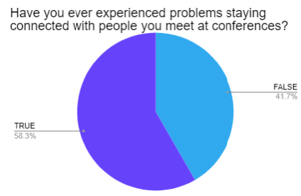
Pain Point: Networking Logistics
Traditional exchanges of business info are not effortless
Carrying around your own business cards
Carrying around a pile of other people’s business cards
Keeping track of everything once you return
Click Here to View Swaap's Product Vision Document
Notes:
According to a survey conducted by our team’s previous UX designer from Labs 18, 58 percent of people surveyed said they experience problems staying connected with people they meet at conferences. The logistics of event networking can be a hassle; having to carry around a pile of your own business cards, carrying around a pile of other people's business cards, and then keeping track of everything once you return.

Slide 3
Solution
Swaap takes the hassle out of networking at conferences, allowing you to effortlessly exchange business info while out & about at your event.
Trade Business Info
Remember When & Where You Met Someone
Make Friends & Contacts
Give Contacts Many Different Ways to Contact You
Click Here to View Swaap's Product Vision Document
Notes:
So what's the solution? Swaap is an app geared towards conference attendees that takes the hassle out of networking at events. You can easily trade business information while at conferences, remember when and where you met someone, make new friends/contacts, and provide numerous ways to contact you in your own profile.

Slide 4
Tech Stack
React
Reach Router
GraphQL
Tailwind CSS
Apollo
Postgres
Prisma
Cypress
Click Here to View Swaap's Product Vision Document
Notes:
The Swaap tech stack includes React, Reach Router, GraphQL, Tailwind CSS, Apollo, Postgres, Prisma, and Cypress for testing. We are discussing switching away from Auth0 to Okta or Amplify but haven't yet decided on a solution.

Slide 5
Team Goals
Update user research
Re-analyze current/new competitors
Identify defects in production
Discuss potential new features
Develop Release Canvases
Click Here to View Swaap's Product Vision Document
Notes:
Now, as you're well aware, we're the most recent additions to the team and so we've hit the ground running by jumping in where the previous team left off. This meant we approached the PVD a little differently than the previous team by updating user research, analyzing current competitors, identifying defects in production, discussion of potential new features, and using all this information to develop release canvases which picked up where the previous team left off.

Slide 6
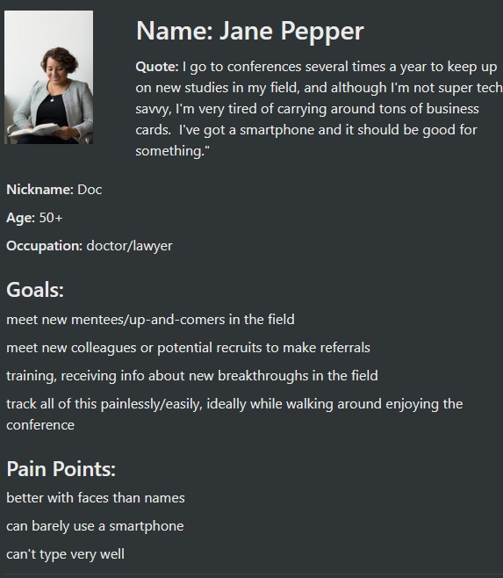
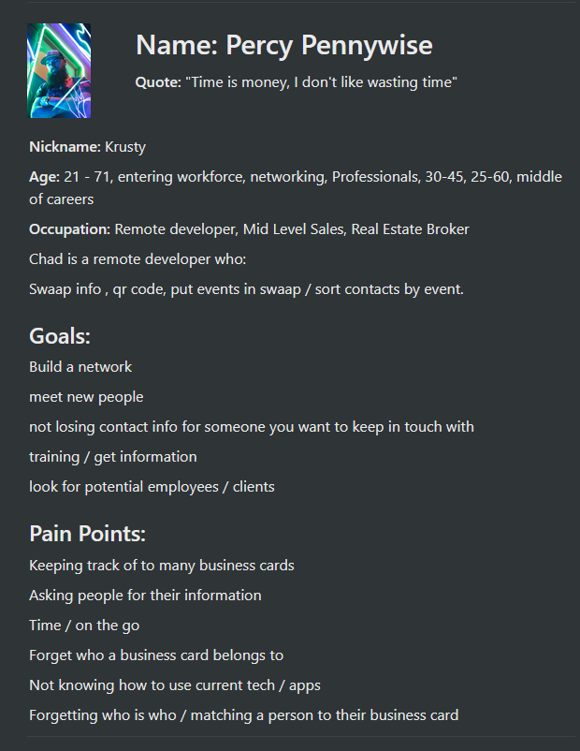
User Research
User Personas:
Click Here to View Swaap's Product Vision Document
Notes:
First, we created a couple of user personas, which you can see here, Percy Pennywise and Jane Pepper. Mr. Pennywise is a 25 to 60 year-old software developer. His pain points include forgetting who is who, matching a business card to a face, not knowing how to use current tech, and having too many business cards to keep track of. Dr. Pepper is a 50+ year-old doctor who goes to several conferences a year to keep up on new breakthroughs in her field, is better with faces than names, and can’t type very well.

Slide 7
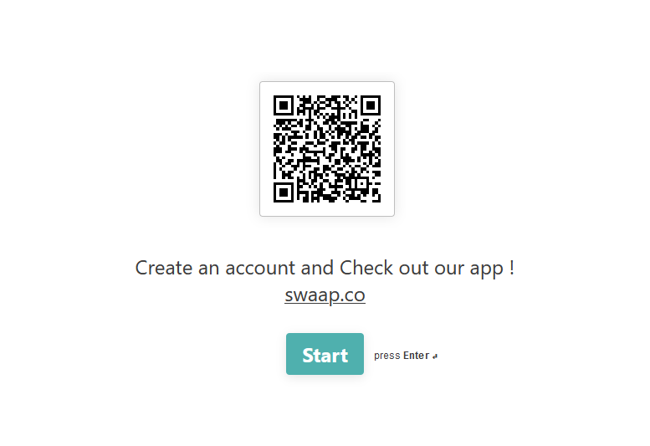
User Research
https://bobbyleonhalljr.typeform.com/to/wVhldA
60+ years old
Retired
Suggestions:
No changes
26-45 years old
Software Developer
Suggestions:
Scan QR code & auto-create connection request
Deciding who has camera & who has QR code clunky
App only saves time if both parties already have app
Click Here to View Swaap's Product Vision Document
Notes:
After creating a couple of user personas, our team made a form with approximately eight to 10 questions, and we each sent it out via our respective social media networks. You can see a screenshot of the form start here on this slide.
To date, we've received two responses. One was from a retired 60+ year old who said the app was perfect and needed no changes whatsoever, and another 26-45 year-old software developer who made several good suggestions, including being able to scan a QR code outside the app, but have it open the app and make the connection request, pointing out how clunky it is deciding who has the QR code and who has the camera, and that this app would only save them time if the person they’re connecting with already has the app.

Slide 8
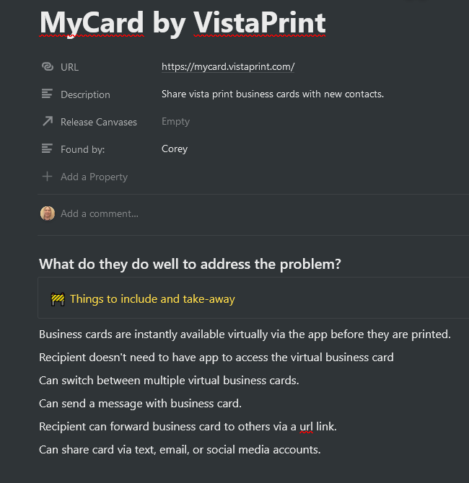
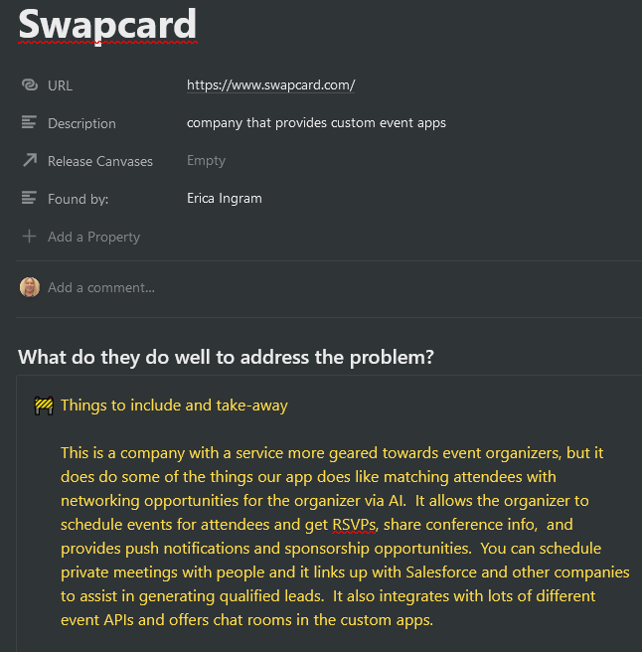
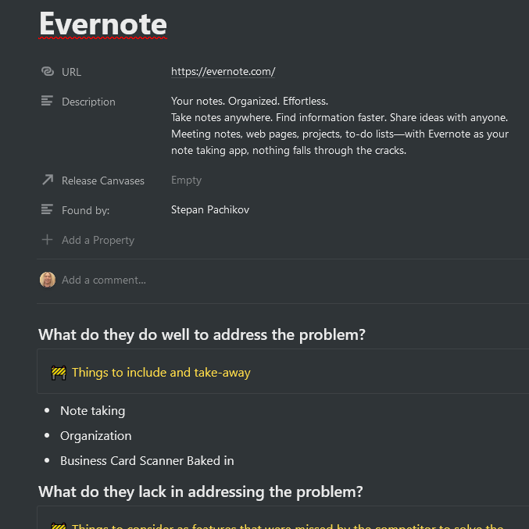
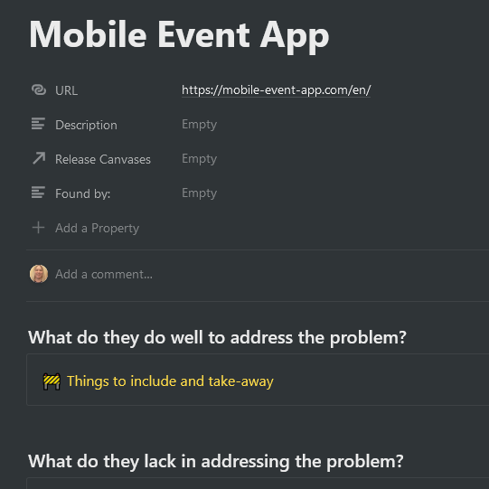
Competitor Analysis
Click Here to View Swaap's Product Vision Document
Notes:
Then we did some research to analyze how others are solving this problem, where we analyzed direct and indirect competitors such as MyCard by VistaPrint, Swapcard, Mobile Event App, Meetup, and Evernote. MyCard allows you to share your VistaPrint business cards with contacts. Both Swapcard and Mobile Event App make custom event apps which include many communication features. Meetup is an event scheduling app. Evernote allows you to easily scan in business cards. There really is no direct competitor, as most have chosen to gear their event apps to the event host or organizer. In addition to analyzing new competitors, we also pulled some of the more solid features from said competitors and put them on the 'future feature concepts to research' page.

Slide 9
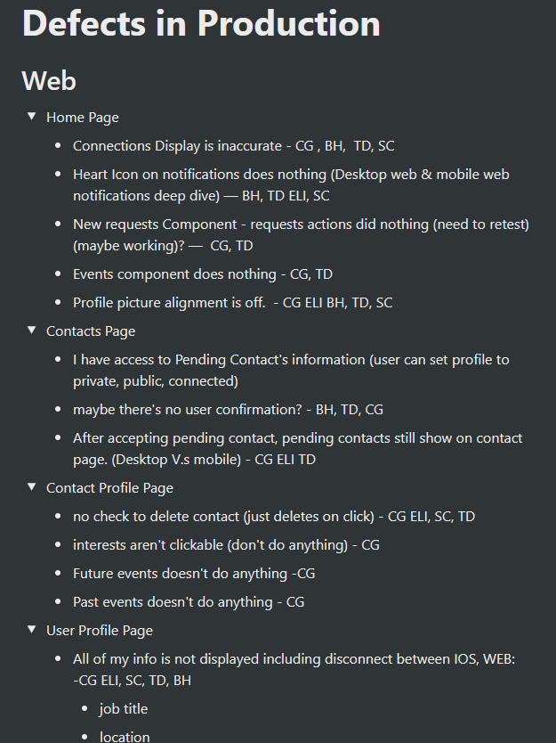
Defects in Production
Click Here to View Swaap's Product Vision Document
Notes:
Then we went through the app to find defects in production, aka bugs to fix. You can see here we found a moderate number of them, although this screenshot is not an all-inclusive list. Then in order to decide what priority we should give them, we each initialed the ones we thought could be done in one to three weeks and eventually condensed it down to what you see on our first release canvas.

Slide 10
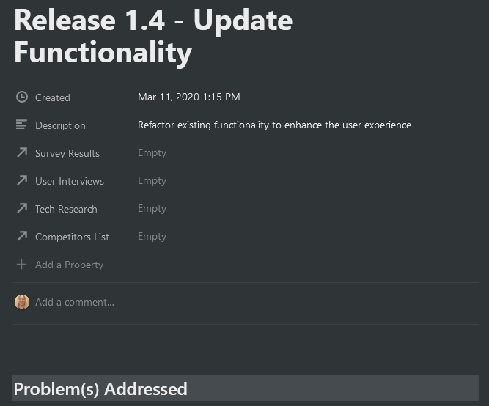
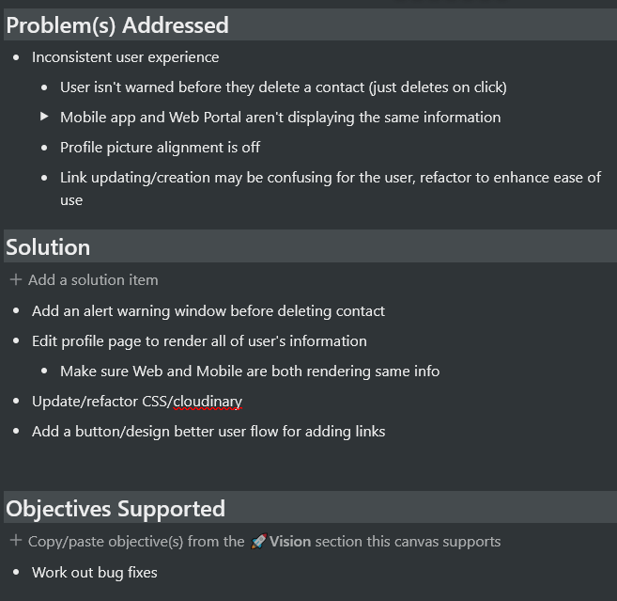
First Release Canvas
Click Here to View Swaap's Product Vision Document
Notes:
This is a screenshot of a portion of our first release canvas, which involves fixing several bugs according to the priority discussed previously. This canvas includes adding a confirmation pop-up before a user deletes a contact, ensuring both the mobile app and web portal display information in a consistent manner, proper alignment of the user’s profile picture, and streamlining how the user handles their personal links, making it easier to navigate modifying them. Our team currently has several other canvases being developed.

Slide 11
Read Swaap’s full Product Vision at:
https://www.notion.so/Swaap-1fa5dafff4964d9d99e07d98dadb8615
Notes:
We here on the Swaap team hope you find our work meets your approval requirements to move forward and we’re eager to get started on the next step. Thanks for joining us, and have a great day.

