Slide 1

Swaap: Labs 22
Bobby Hall, Team Lead
Chad Rutherford, iOS
Roberto Banbanaste, Web
Sierra Curtis, Web
Tristan Depew, Web
Corey Gumbs, Web
Erica Ingram, Web
Click Here to View Swaap’s Product Release Canvas L22.2
Notes:
Hello, I'm Erica Ingram from the Swaap team in Labs 22. Today, we’re presenting our second release canvas, which covers the problem listed here. Our second release canvas solves this problem with a couple of new features.
Based on user research we realized that adding and managing contacts were unclear to the user. This insight helped guide us to make the decision to create a "shareable link" the user can send to anyone, making it easier to share their contact information.
We also decided to help users sort and filter their contacts, and visualize their contacts with a map of where you met that person. We’re adding onboarding screens to the iOS app to show the user how to add and manage contacts.
Lastly, we’re creating a new public route or shareable link that leads to the user’s profile and that user’s QR code. After a user shares a link, they get redirected to an add-user page where the user can, if already a Swaap user, add contact or, if not a Swaap user, sign up/send request to sign up, and access the user’s public contact methods.
Objectives supported include giving a clear understanding of how to create and manage contacts and making sharing profile info very fast and easy.
In terms of key results, those include at least 30% of users interviewed having a clearer understanding of how to create and manage contacts, 60% of users interviewed using the link feature the first time using the app, and that a user can share information with non-Swaap users.

Slide 2
Problems Addressed
Unclear How to Add and Manage Contacts
Users have no way to sort or filter contacts for easy, quick access
Non-Swaap users have no access to your information
Click Here to View Swaap’s Product Release Canvas L22.2
Notes:
So our second release canvas solves this problem with a couple of new features.
Based on user research we realized that adding and managing contacts were unclear to the user.
This insight helped guide us to make the decision to create a "shareable link" the user can send to anyone, making it easier to share their contact information.
We also decided to help users sort, filter, and visualize their contacts with map of where you met that person.

Slide 3
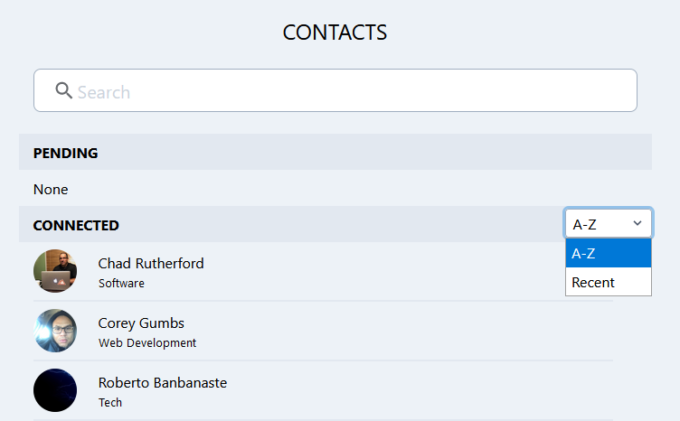
Feature:
Problem:
Unclear how to add and manage contacts
Sort contacts by recent or A to Z
Click Here to View Swaap’s Product Release Canvas L22.1
Notes:
Prior to this release, when a user deleted a contact, it didn’t confirm the delete or prompt ‘are you sure’, which we felt was very user unfriendly. What if you didn’t mean to do it? Users make mistakes all the time, especially ones who aren’t tech savvy, and they need to be able to back out of a change like a delete. So now these windows appear before you delete a contact.

Slide 4
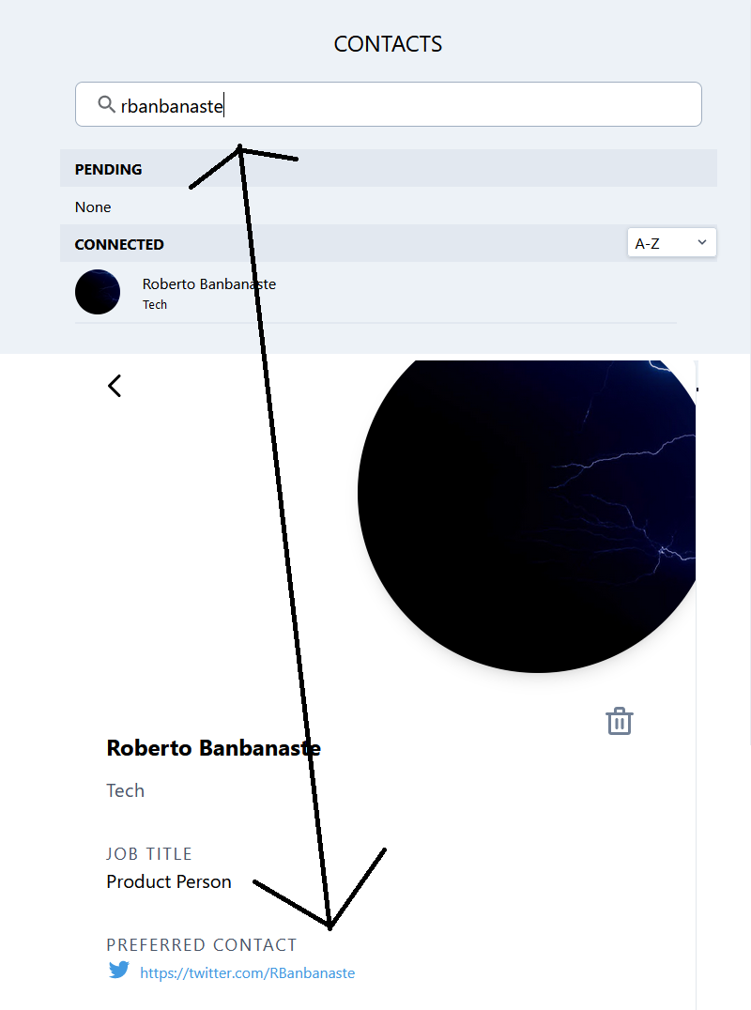
Feature:
Problem:
Unclear how to add and manage contacts
Filter Contacts: Search by Name, Job Title, Tagline, Location, Bio, Any Contact Method
Click Here to View Swaap’s Product Release Canvas L22.2
Notes:
Another problem we ran into was that the profile page didn’t display all the info a user could potentially enter into Swaap. Things missing from display were the user’s job title, tagline, birthdate, location, and bio, so we added those fields to the profile page.

Slide 5
Feature:
Problem:
Unclear how to add and manage contacts
Render map of where you met that person in user’s profile (WEB only; already completed in iOS)
Click Here to View Swaap’s Product Release Canvas L22.2
Notes:
Our team also noticed alignment of the profile picture on the profile page versus the same picture on the web home page and iOS app were very noticeably different, so we fixed that. It used to go right to the edge, and now it looks like a card, as on the home page.

Slide 6
Feature:
User onboarding screens to show user how to add and manage contacts (iOS only)
Click Here to View Swaap’s Product Release Canvas L22.2

Slide 7
Feature:
Problem:
Unclear how to add and manage contacts
Create new public route (shareable link) with user’s profile and include link in QR code
Click Here to View Swaap’s Product Release Canvas L22.2

Slide 8
Objectives Supported
Give a clear understanding of how to create and manage contacts
Make sharing profile information very fast and easy
Click Here to View Swaap’s Product Release Canvas L22.2

Slide 9
Key Results
at least 30% of users interviewed have a clearer understanding of how to create and manage contacts
60% of users interviewed use the link feature the first time using the app
a user can share information with non-swaap users
Click Here to View Swaap’s Product Release Canvas L22.2

Slide 10
Read Swaap’s full Release Canvas L22.2 at:
https://www.notion.so/Release-L22-2-Clarify-Contact-Management-Contact-Page-Refactor-b1367d0988f0468ca347e135e035b6e6

