Slide 1
Learning Goals/Objectives
Be able to read, comprehend, trace, adapt and create Python code that:
Iterates using WHILE loops
Sets Boolean conditions to trigger loops
Uses counters in loop conditions

Slide 2
Boolean Operators - Used in Conditions
== Equal to/The same as
!= Not equal to
> Greater than
>= Greater than or equal to
< Less than
<= Less than or equal to
Notes:
Iteration relies on conditions in the same way that selection does.

Slide 3
Boolean Operators are used to compare TWO pieces of data
data1 boolean operator data2

Slide 4
Iteration
Starts the iteration statement.
Colon - because syntax
while boolean condition:
Do this
This instruction is repeated while the condition is TRUE.
Indented - use the tab key. Your code won’t work if you don’t indent inside the iteration statement.
Notes:
Python often automatically indents for you.
This and the colon are usually the first things to check when debugging/spotting mistakes in student work.

Slide 5
Iteration With While - Flowchart
Condition
Go back to check the condition again
If condition is true
If condition is false
Run if code (indented under the while line)
Notes:
Flowcharts like these often help students visualise the sequence of iteration code.
Question students about how it is possible to get to the black ‘rest of program’ circle. What is the only way to get there?
The final black circle is either end of program (if there is no more code after the selection) or continue to run code that appears further down the program.

Slide 6
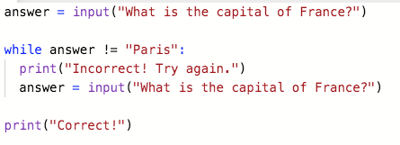
Iteration with while - coding tips
Not part of the loop (comes before ‘while’). Runs before the loop starts.
2. Write the Boolean condition (usually what you DON’T want the user to input).
3. DON’T FORGET THE COLON after the condition.
1. Start with while.
4. Code that is repeated while the condition is true. DON’T FORGET TO INDENT (use the tab key)
Not part of the loop (not indented). Runs after the loop ends.
Notes:
In an example like this (quiz/enter the correct password etc) you want the loop to run until the user enters the correct answer. Set up a condition that loops while the answer IS NOT EQUAL TO the correct one.
Don’t forget to get input again inside the loop, otherwise you will create a never ending (infinite) loop.

Slide 7
Iteration - Tasks Part 2
Task 3
Write a program that stores a secret number in a variable (you decide the number and the name of the variable)
The user has to guess the secret number, the program should loop until they get it right.
Once the user has guessed correctly they get a congratulations message

Slide 8
Iteration With A Counter
counter = 1
while counter < 5
print(“Hello”)
print (“The loop has ended”)
Notes:
Which code is inside the loop? Get students to identify it again- no harm in more practice.
What’s the problem here?
Get students to keep track of the value in the counter variable. It never changes from 1 so we have an infinite loop that keeps printing ‘Hello’ and never ends.
Students could code and run this to further embed the example.
Next slide shows how to fix this.

Slide 9
Iteration With A Counter
counter = 1
while counter < 5
print(“Hello”)
counter +=1
print (“The loop has ended”)
Notes:
The new line adds 1 to the counter every time the loop runs. This means that the counter will eventually reach 5 and break the loop.
Get students to predict how many times the loop will run - it’s 4 - point out that the condition says < (LESS THAN) 5. 5 is not included.
How could we:
Change the operator to include 5? <= 5
Change the number in the condition to include 5 WITHOUT changing the operator? <6
Make the loop run 10 times? Either <11 or <=10

Slide 10
Iteration With A Counter
counter = 1
while counter < 5
print(“The counter is ” + counter)
counter +=1
print (“The loop has ended”)
Add to the counter as the last command inside the loop
Notes:
The counter is often really useful inside the loop. This code just outputs it but you can use it to do maths with. For example, multiplying a number by the counter inside the loop will output a ‘multiplication table’ sequence. This is task 3 in repl 4.2

Slide 11
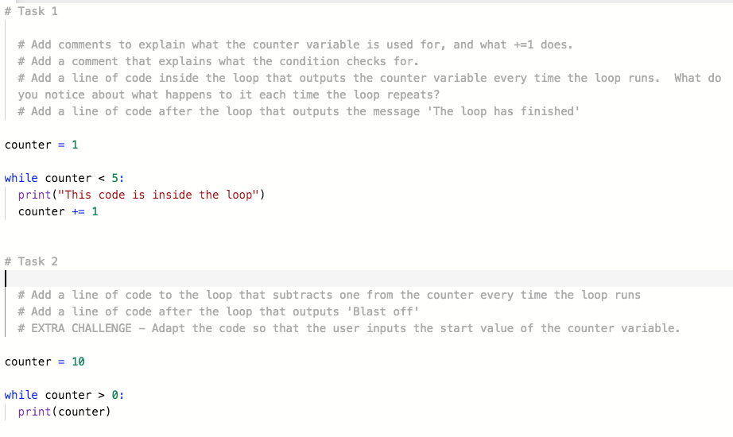
Iteration With A Counter - Tasks Part 1

Slide 12
Iteration With A Counter - Tasks Part 2
Task 3
# Write a program that uses a loop to output the seven times table up to 12 x 7 (HINT - use the counter variable and combine it with what you learned about maths with variables.)
# Output the multiplied number as part of a sentence. Example - '1 times 7 is 7'
# EXTRA CHALLENGE - ask the user to input a number and output the multiplication table for the input.

Slide 13
Homework Challenge - Cubes Cubes Cubes
The cubed number sequence starts: 1, 8, 27, 64, 125.
Write a program that:
Asks the user to input a number.
Display N numbers in the cubed sequence according to user input.

