Slide 1
Learning Goals/Objectives
Be able to read, comprehend, trace, adapt and create Python code that:
Outputs one item from a list
Outputs a whole list
Changes an item in a list
Adds an item to a list
Removes an item from a list

Slide 2
Variable or List?
Variable - stores one piece of data with an identifier.
player1 = Mary
player2 = Sean
player3 = Atif
List - stores more than one piece of data with the same identifier.
players = [“Mary”, “Sean”, “Atif”]
Notes:
Variables only store 1 piece of data using the same identifier. Lists can store many.
You can tell a list because it uses square brackets.

Slide 3
Creating a List - How to Code
1 - Name the list. Use camelCase if it’s more than one word.
players = [“Mary”, “Sean”, “Atif”]
2 - The = symbol assigns data into the array
2 - The = symbol assigns data into the array
3 - All the items in a list are surrounded by square brackets with a comma between each one.
3 - All the items in a list are surrounded by square brackets with a comma between each one.
Notes:
Just like variable assignment, this makes more sense if you read it right to left.

Slide 4
Identifying One Item In A List
0 1 2
players = [“Mary”, “Sean”, “Atif”]
Notes:
Items in a list are indexed, or numbered. Each item has a different number. Indexing starts at 0, which means that Mary in this list is at position 0.

Slide 5
Output From A List

Slide 6
Output One Item From A List
players = [“Mary”, “Sean”, “Atif”]
print(players[2])
3 - Put the index (number) of the item you want to output in square brackets.
1 - Use the print statement.
2 - Put the name of the list inside the normal brackets.
Notes:
We can use the print statement to output an item from a list in a very similar way to outputting a variable.
The new part is adding the square brackets with the index number of the item that we want to output.

Slide 7
Lists and Output
players = [“Mary”, “Sean”, “Atif”, “Steve”, “Lucy”]
print(players[1])
print(players[3])
print(players[5])
print(players[3] + players[4])
Notes:
Use this slide to practice predicting output from a list.
Answers:
Sean
Steve
SteveLucy
Error - out of range. There is no item at position 5 - the array only goes up to position 4 - so this produces an error.

Slide 8
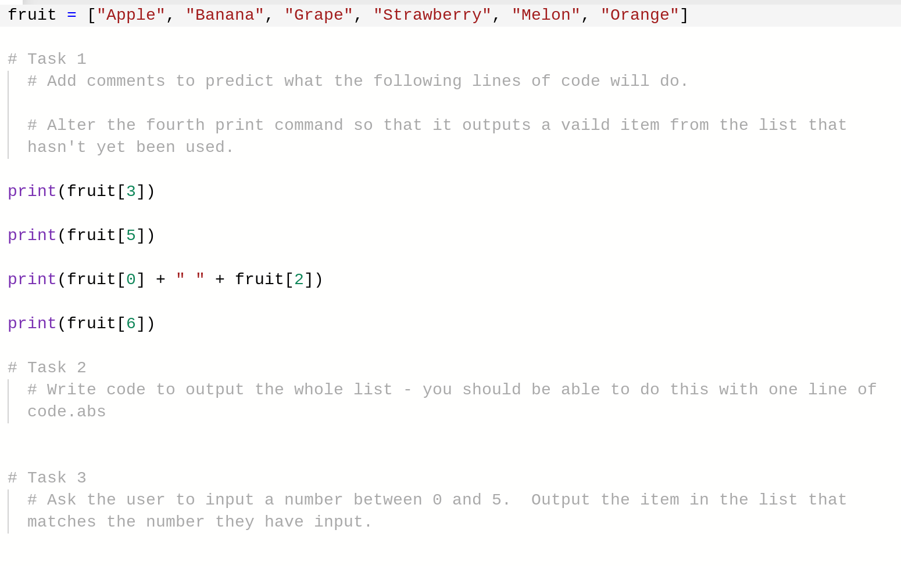
Task - List Output
Notes:
Data in lists can be edited in the same way that data in a variable can.

Slide 9
Change & Edit Items in a List

Slide 10
Change One Item In A List
players = [“Mary”, “Sean”, “Atif”]
players[0] = “Bill”
1 - The item in the list to be replaced
3 - The new data to go into the list.
2 - The = symbol used for assignment.
Notes:
Data in lists can be edited in the same way that data in a variable can.

Slide 11
Lists and Assignment
players = [“Mary”, “Sean”, “Atif”, “Steve”, “Lucy”]
players[1] = “Oliver”
players[4] = “Jane”
players[2] = players[3]
Notes:
Answers
Replace Sean with Oliver
Replace Lucy with Jane
Replace Atif with Steve
Final list looks like:
Mary, Oliver, Steve, Steve, Jane

Slide 12
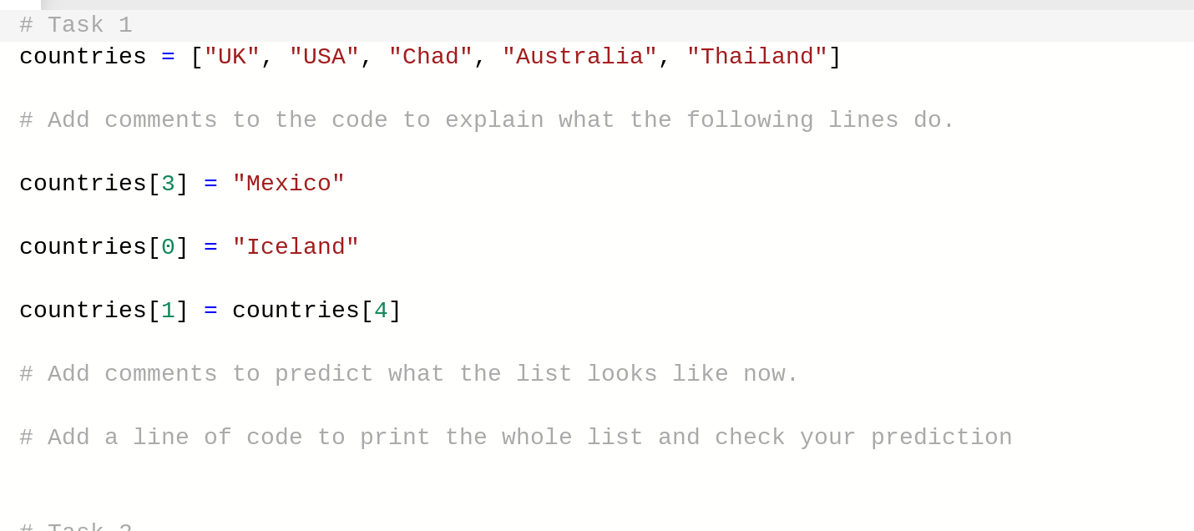
Task - List Assignment 1
Notes:
Data in lists can be edited in the same way that data in a variable can.

Slide 13
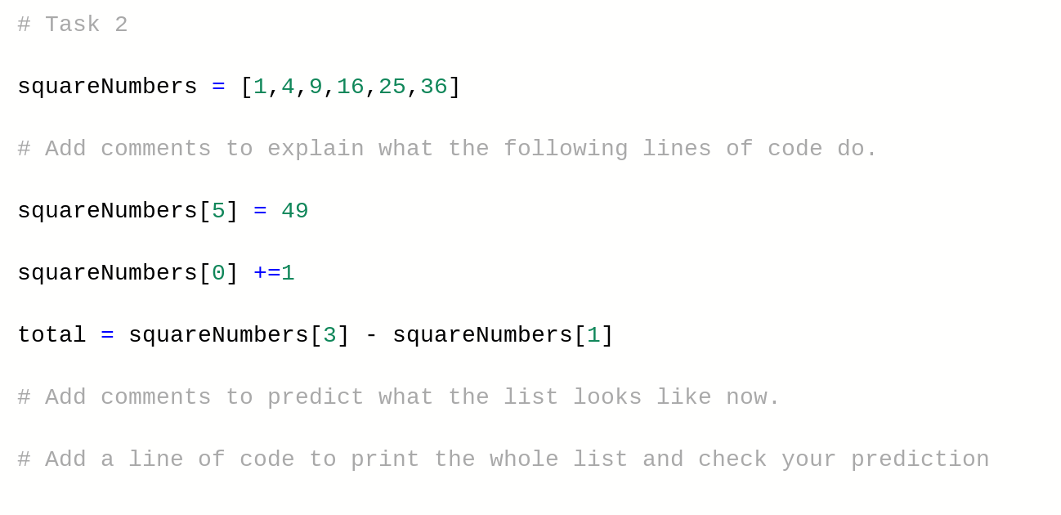
Task - List Assignment 2
Notes:
Data in lists can be edited in the same way that data in a variable can.

Slide 14
Add & Remove Items From A List

Slide 15
Add & Remove From A List
players = [“Mary”, “Sean”, “Atif”, “Steve”, “Lucy”]
players.remove(“Sean”)
players.pop()
players.append(“Dave”)
players.insert(2, “Julia”)
Notes:
The first two lines of code are for adding to a list.
Append - adds the item to the end of the list.
Insert - inserts the item at the position given in the brackets.
The second two lines are for removing items.
Remove - searches through the list and removes the item in brackets.
Pop - removes the last item in the list.

Slide 16
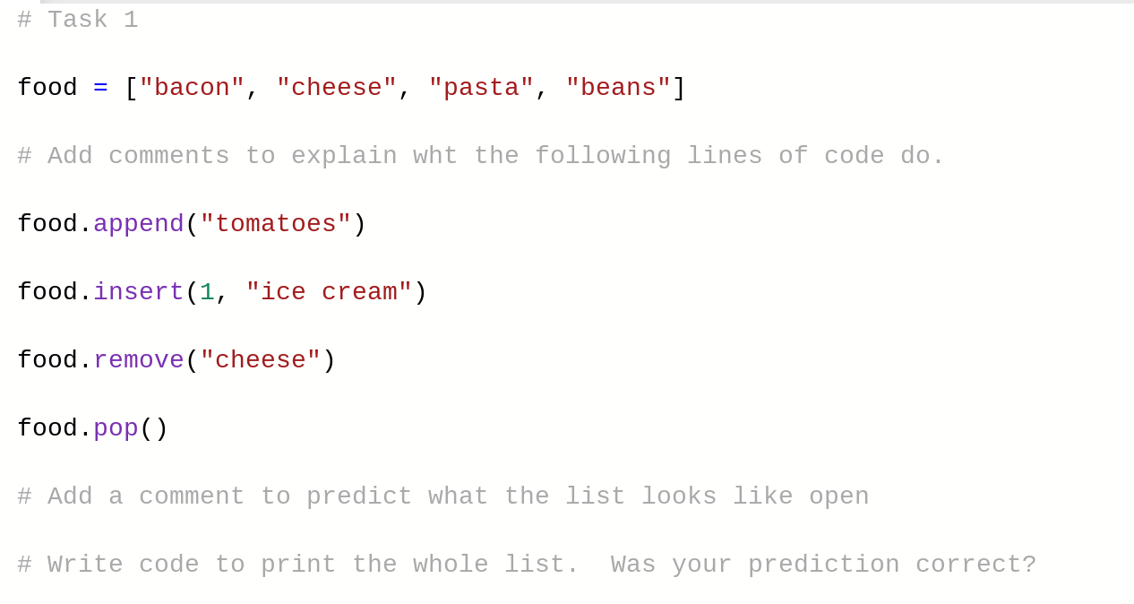
Task - Add & Remove From A List 1
Notes:
In this task students may forget that they have appended ‘tomatoes’ to the list before running the pop code, so they might be confused as to why ‘beans’ is still in the list. This is a good opportunity to remind them that the computer runs the code sequentially. Get them to write down what the list looks like after every line of code is run to make the processes clear.

Slide 17
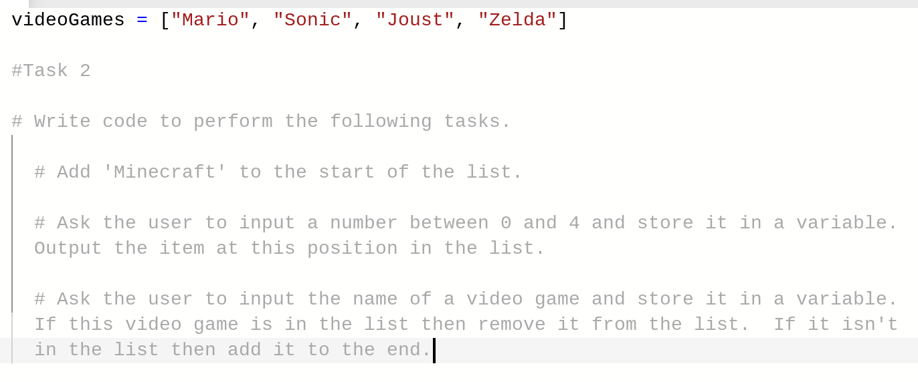
Task - Add & Remove From A List 2
Notes:
The last sub task combines what students have learned about selection with the coding for lists.

Slide 18
Task - Independent Challenge
Create an array called 'names' that stores five names in it (you choose the names).
Ask the user what their name is, store their input in a variable.
Ask the user to enter a number between 0 and 4. Store their input in a variable.
Replace the data at the position that matches the number entered by the user in the names array with their name.
Notes:
Data in lists can be edited in the same way that data in a variable can.

Slide 19
Find An Item In A List

Slide 20
Find An Item In A List
players = [“Mary”, “Sean”, “Atif”, “Steve”, “Lucy”]
if “Atif” in players:
Run this code

Slide 21
Homework Challenge - Beat The Zombie!
Create a list of possible weapons.
In a variable called ‘zombieWeakness’ store the name of one of the weapons from the list.
Output messages telling the user that they have encountered a zombie and should prepare to fight.
Output the list of weapons to the user. Ask if they want to type 1 to use one from the list or 2 to pick their own. If they type 1 then they should input the weapon name - store it to a new variable. If they type 2 they should input the weapon name - add it to the list and save it to a new variable.
If the weapon picked matches the zombieWeakness, output a message telling the user that they have won the fight. Otherwise output a message saying that they have lost.

