Slide 1
Learning Goals/Objectives
Be able to read, comprehend, trace, adapt and create Python code that:
Performs simple maths (addition, subtraction, multiplication, division and integer division) using fixed numbers
Performs simple maths using numbers stored in variables
Converts strings to integers
Gets number input and uses it in calculations

Slide 2
Maths - Operators
2 + 2
Notes:
The operator tells us (and the computer) what calculation to perform.
Where have we seen the + used before. It has a different job depending on how it is being used.

Slide 3
Maths - Operators
addition
subtraction
* multiplication
/ division (with decimal)
// division (integer result)
Notes:
The operator tells us (and the computer) what calculation to perform.
Where have we seen the + used before. It has a different job depending on how it is being used.
Students are usually fine with + and -, they can take a while to adjust to *, / and // if they’ve not come across them before.

Slide 4
Input
Data is collected and sent to the computer
Process
Carrying out instructions.
Output
Presenting the results of processing back to the user
Storage
Saving data that is not in use.
Notes:
Explain that computer operation can be simplified down to this diagram.
Maths happens at the process stage.
We then write code to output the result (you don’t have to, but we will because it helps us test that our code is working properly)

Slide 5
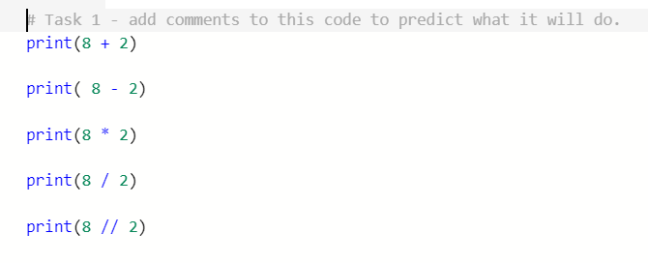
Programming – Operators - Predict & Run
https://repl.it/@MrAColley/21-Maths-part-1
Notes:
Students add comments to predict what the code will do.

Slide 6
Maths With Variables
Assign numbers to your variables.
num1 = 5
num2 = 10
result = num1 + num2
print(result)
Perform the calculation. Assign the result to a NEW VARIABLE.
Don’t forget to output the result
Notes:
Think algebra - use variable names to represent the numbers they store.
Lots of students forget to assign the answer to a new variable. This is a common mistake. Keep a lookout for it.

Slide 7

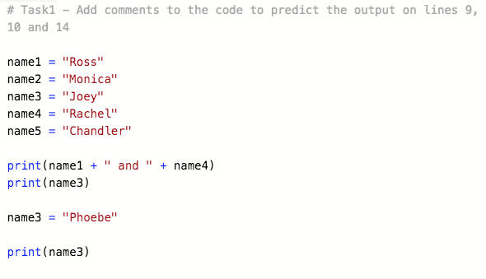
Variables - vary - changing data
“blue”
favColour
Notes:
Remember our envelope?
We can replace or change the data in a variable whilst the program is running.
Let’s go back to strings to see how it works.
What is the difference with the output on line 10 and line 14? They both output the same variable, why do they output different names? - The contents of the name3 variable is changed between the outputs.

Slide 8
Programming – Variable Maths – Modify & Make
score = 0
print(score)
score = 10
print(score)
Notes:
A variable is called a variable because the data in it can change (vary) as the program runs. This is really useful when there are pieces of data that need to change regularly (like your score in a video game). You don’t need to create a new variable every time the score changes, you just change the data in the same variable.
Point out that the computer runs the code line by line in order. What is the output on line 2? What is the output on line 4?

Slide 9
Changing Variables With Maths
score = 0
print(score)
score = score + 1
print(score)
score = 0
print(score)
score = 10
print(score)
score = 0
print(score)
score += 1
print(score)
lives -= 1
Notes:
What if you want to calculate in the same variable?
+= increments
-= decrements
The result is stored back into the original variable. It helps if you read right to left.

Slide 10
Programming – Input & Variables - Integers
Input works with strings. Strings are text.
Computers can’t do maths/logic with text. They have to use numbers.
Whole numbers are called integers (ints for short).
We have to write code to convert our string input to an int before we can do maths with it.

Slide 11
Programming – Input & Variables - Integers
num1 = int(input("Enter a number"))
Tells the computer to convert to an integer.
Tells the computer to convert to an integer.
BRACKETS! Because syntax!
Notes:
Makes more sense if we read right to left. Output ‘enter a number’ -> Get user input -> convert input to an integer -> Store result in the num1 variable.
If students are still having trouble then you can break it down to:
print(“Enter a number”)
num1 = int(input())

Slide 12
Programming – Input & Variables - Integers
print(str(num1)
Tells the computer to convert an integer variable to a string
Notes:
When we output an integer variable we have to convert it back into a string.

Slide 13
Extra Credit Challenges
Perimeter Calc
Create a program that allows the user to enter 2 numbers representing the width and length of a rectangle. The program calculates and displays the perimeter of the rectangle.
Restaurant Tip Calculator
Create a program that allows the user to enter the price of a meal at a restaurant. The program calculates the amount of the tip to be paid at 20%. The tip and total price are then displayed separately.
Volume and Surface Calc
Create a program that allows the user to enter 3 numbers representing the height, width and length of a cuboid. The program calculates and displays the volume and total surface area of the cuboid.

