Slide 1
Learning Goals/Objectives
Be able to read, comprehend, trace, adapt and create Python code that:
Defines a subroutine
Calls a subroutine
Creates a subroutine that uses arguments
Gets user input and use it as an argument in a subroutine
Returns a value from a subroutine

Slide 2
What Is A Subroutine?
A subroutine gives a single name to a set of actions.
You create a subroutine by defining it.
You can use the subroutine at any time in your program by calling it.
1 - Define the subroutine and give it a name.
def say_hi():
print(“Hello there!”)
say_hi()
2 - Add the code that you need to complete the task.
3 - Call the subroutine whenever you need it by typing its name.
Notes:
In all the previous lessons the computer ran code in order one line at a time.
Subroutines let us break up code into small sections that usually carry out one task each.
A subroutine gives a single name to a set of actions.
We usually create subroutines for tasks that our program will need to repeat several times.

Slide 3
Naming Subroutines
Subroutine names do not use camelCase
They use all lower case with underscores between the words.
This helps us tell the difference between subroutines and variables/lists when we are reading the code.
say_hi()
add_one()
get_input()
Notes:
The bottom text box is just examples of some possible subroutine names.

Slide 4
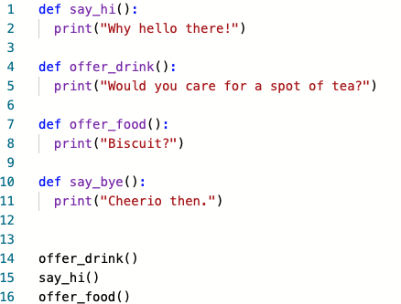
Tracing Subroutines
Subroutines are defined at the top of your program, but they do not run until they are called in the main program
Defining subroutines
Main program
Notes:
Use the python visualiser to paste the code and demonstrate how it runs.
http://pythontutor.com/visualize.html#mode=edit
def say_hi():
print("Why hello there!")
def offer_drink():
print("Would you care for a spot of tea?")
def offer_food():
print("Biscuit?")
def say_bye():
print("Cheerio then.")
offer_drink()
say_hi()
offer_food()

Slide 5
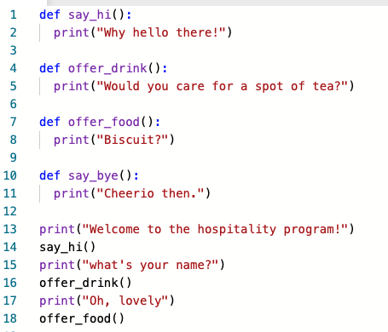
Tracing Subroutines
Write down the line numbers in order that they will execute when the program is run.
Notes:
Solution - 1,4,7,10 (store the subroutine identifiers in memory) 13,14,1,2,15,16,4,5,17,18,10,11
Use the python visualiser to paste the code and demonstrate how it runs.
http://pythontutor.com/visualize.html#mode=edit
def say_hi():
print("Why hello there!")
def offer_drink():
print("Would you care for a spot of tea?")
def offer_food():
print("Biscuit?")
def say_bye():
print("Cheerio then.")
print("Welcome to the hospitality program!")
say_hi()
print("what's your name?")
offer_drink()
print("Oh, lovely")
offer_food()

Slide 6
Subroutines That Return A Value
Notes:
No further examples here, the one on slide 2 and in the repls are more than enough. We are just using the print command inside the subroutines.

Slide 7
Subroutines That Return a Value (Functions)
A subroutine can return (send) some data back to the main program.
When you do this, you should store the returned value in a variable in the main program.
1 - Define the subroutine and give it a name.
2 - Add the code that you need to complete the task.
Def adder():
num1 = 10
num2 = 15
return num1 + num2
outputNum = adder()
print(outputNum)
3 - Call the subroutine in the main program (NOT INDENTED).
Look at how the subroutine is assigned to a variable.
3 - Use return followed by the task that you want to perform

Slide 8
Subroutines That Use Arguments
Notes:
No further examples here, the one on slide 2 and in the repls are more than enough. We are just using the print command inside the subroutines.

Slide 9
Subroutines With Arguments
We can put data into a subroutine. To do this we use arguments.
You can think of arguments like variables used by the subroutine.
1 - The argument name goes in brackets after the subroutine name.
Def add_five(num1):
print(num1 + 5)
add_five(42)
2 - Put the actual data in the brackets when you call the subroutine. This will be put into the num1 argument and used by the subroutine.
Notes:
This subroutine has 1 argument. Subroutines can have several arguments, they are separated by commas in the brackets when the subroutine is defined.
Refer back to the algebra metaphor we have used before. The num1 argument is used to represent the data used by the subroutine (in this case ‘42’).

Slide 10
Subroutines With Arguments
We can get input from users and use that as arguments too.
def add_five(num1):
print(num1 + 5)
userInput = int(input("Enter a number"))
add_five(userInput)
1 - Get the user to input and save it in a variable
2 - Use the variable as the argument. This will put the data from the userInput variable into the num1 argument.

Slide 11
Subroutines With Arguments
We can get input from users and use that as arguments too.
def add_five(num1):
print(num1 + 5)
add_five(int(input("Enter a number")))
Notes:
This slide is optional, it shows how to combine the last two lines to make the program more efficient. It removes the need for the userInput variable. If students have grasped the concept of variables passing data to arguments then show them this to save them time.

Slide 12
Independent Challenge - Calculator
Define four subroutines - add, subtract, multiply, divide that add multiply etc two numbers and return the result. Each should have two integer number arguments.
The user is asked to input two numbers. These numbers will be passed as arguments into one of the subroutines.
The user is asked to input 1 to add, 2 to subtract etc.
If they input 1, call the ‘add’ subroutine, input 2 calls the ‘subtract’ subroutine etc
Output the returned result as part of a sentence.

