Slide 1

Basic Details of the Team and Problem Statement
Ministry/Organization Name/Student Innovation:
University Grants Commission (UGC)
PS Code: VS938
Problem Statement Title: Development of centralized student feedback system, accessible to the HEI, concerned university, and the regulatory body for effective monitoring of teaching-learning in the HEI and to have enhanced learning experience for the learners
Team Name: Technorites
Team Leader Name: Krishna Agarwal
Institute Code: C-25195
Institute Name: Techno India NJR Institute Of Technology
Theme Name: Miscellaneous

Slide 2
IDEA / APPROACH
The main objective behind here is to present a centralized and transparent portal where every individual associated with any educational body can give their feedback which in the future can be helpful to enhance and develop learning experience for learners.
The reports in a graphical format that are generated will be comparable on both state and region-wise basis effectively.
HEIs can keep a check on their institution performances and implementations in the education system. The feedback forms will be accessible to Students, Parents, Alumni, Employer, Faculty.
HEIs can control the flow of feedback, that is, they can separately maintain and create reports according to the participation of stakeholders.
Technology Stack
FRONTEND :
HTML
CSS
BOOTSTRAP
JAVASCRIPT
Google Charts
BACKEND :
PHP
JAVASCRIPT
DATABASE :
MYSQL
SQL WORKBENCH

Slide 3
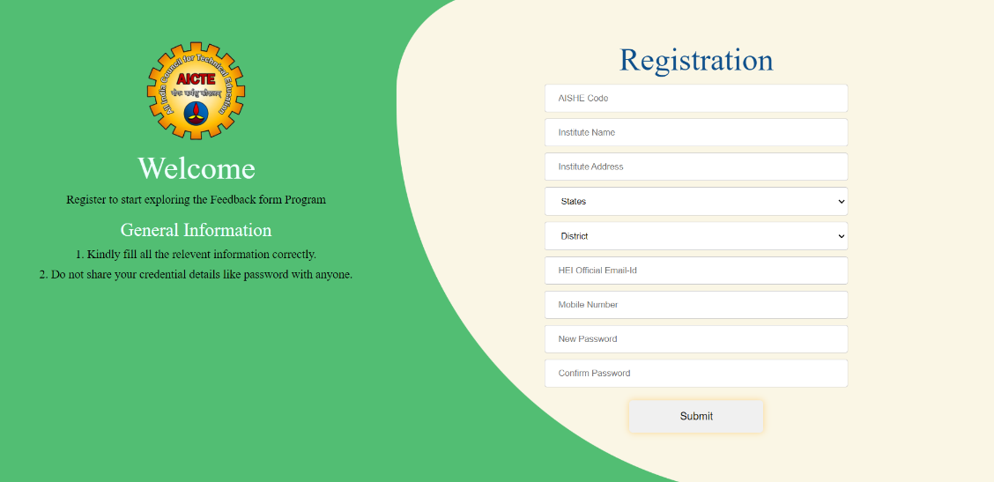
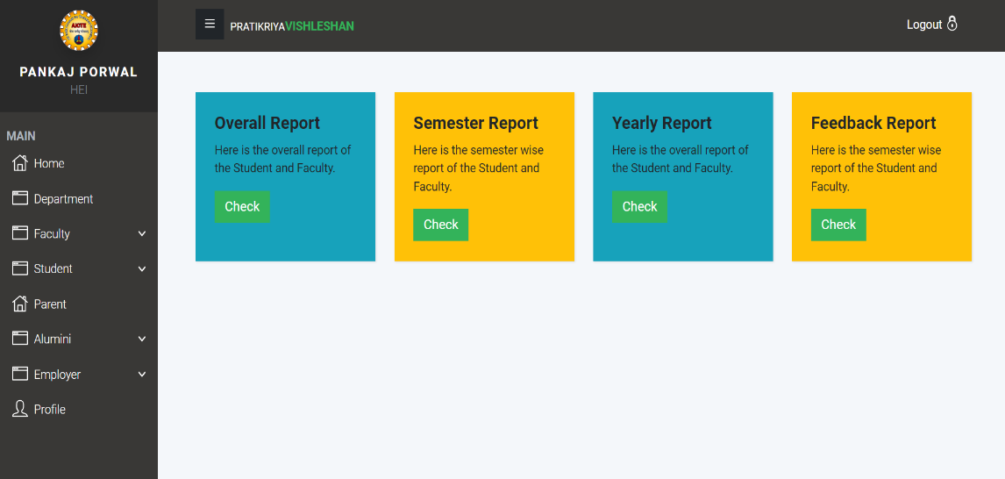
HEIs Features
HEIs can directly register on the Pratikriya Vishleshan portal using necessary details
HEIs can send feedback to the stakeholders Students, Faculty, Alumni, Parents, Employer

Slide 4
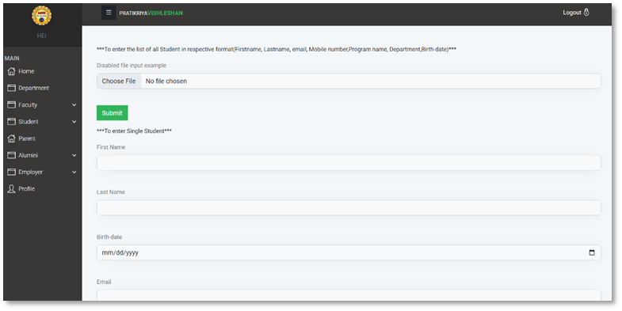
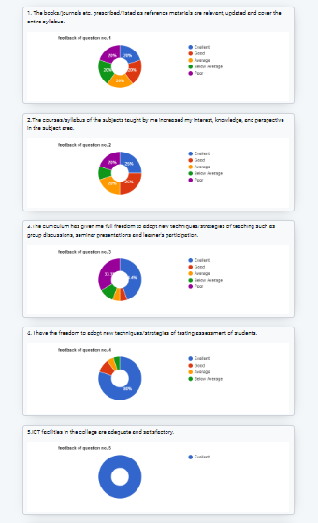
HEIs Features
HEI can upload details of the stakeholders on the portal using CSVs or directly in the portal using forms
HEIs can see results of the issued feedback on the portal and the results will be in form of graph for better analysis.

Slide 5
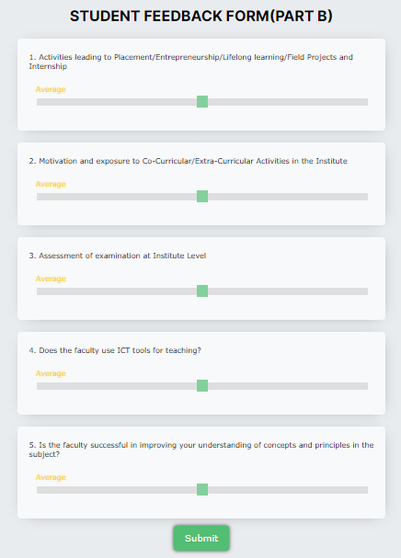
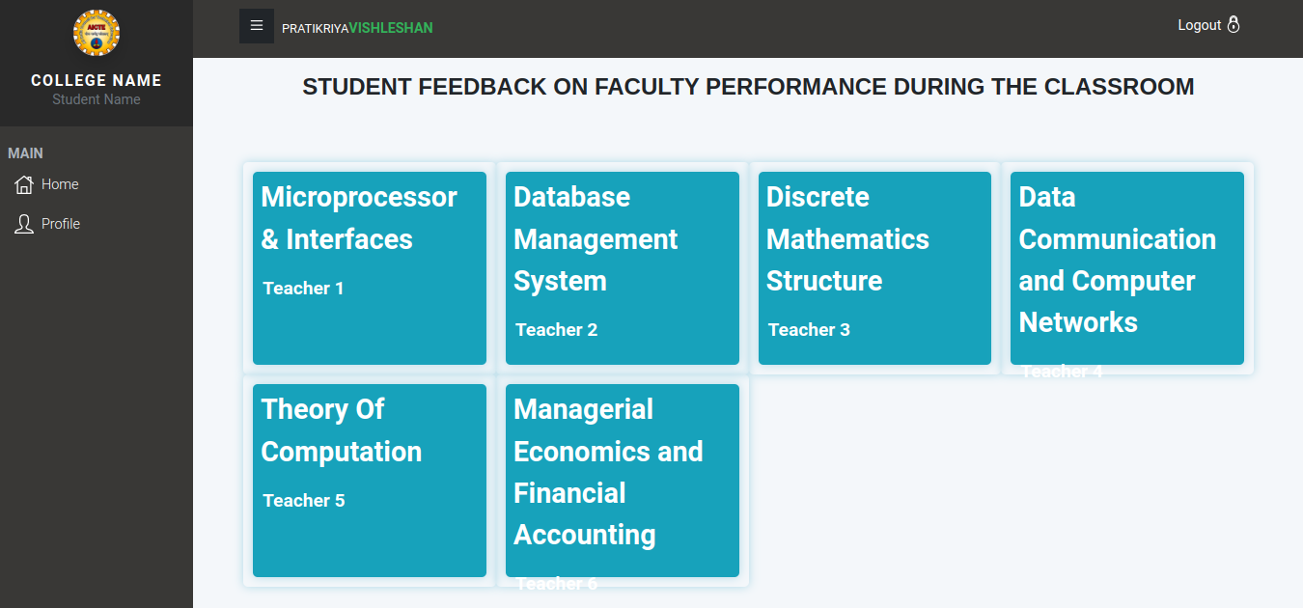
Student/Faculty Features
Students and Faculties can submit feedback forms by directly login in the Pratikriya Vishleshan portal
Sliders are provided in the forms instead of options for better user experience

Slide 6
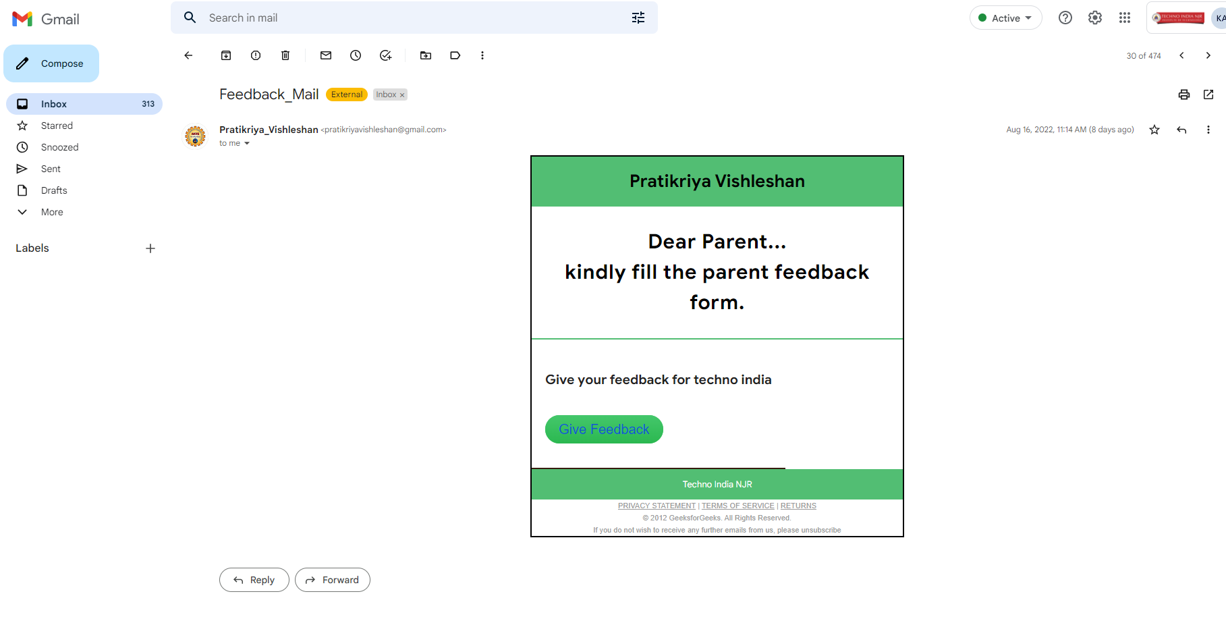
Alumni/Parents/Employer Features
Request to fill the form for Parents, Alumni, Employer will be send to their respective Email-ID, this will make sure that we get maximum participation in the Feedbacks
Sliders are provided in the forms instead of options for better user experience

Slide 7
Future Aspects
Admin/AICTE can also send feedback to all the colleges at Nation/State/Region Wise and can even customize the Questions on the form
One feature is to Take suggestions of the stakeholders and use Artificial Intelligence to analyze the reviews, which helps the university/AICTE to improve Educational System.
Implement a Ranking System to award the Faculties and colleges according to their performance.
Currently, the stakeholders' data is hidden from the HEI and Admin. we can also encrypt the data for more security
HEIs or UGC/AICTE can generate poles on the portal for students and faculties

Slide 8
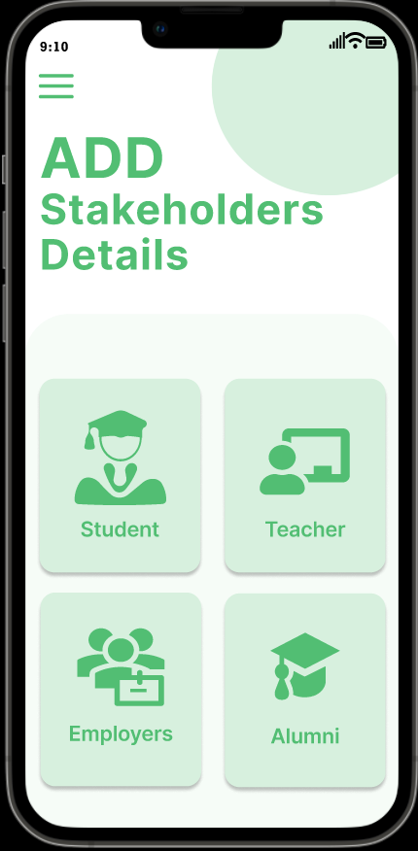
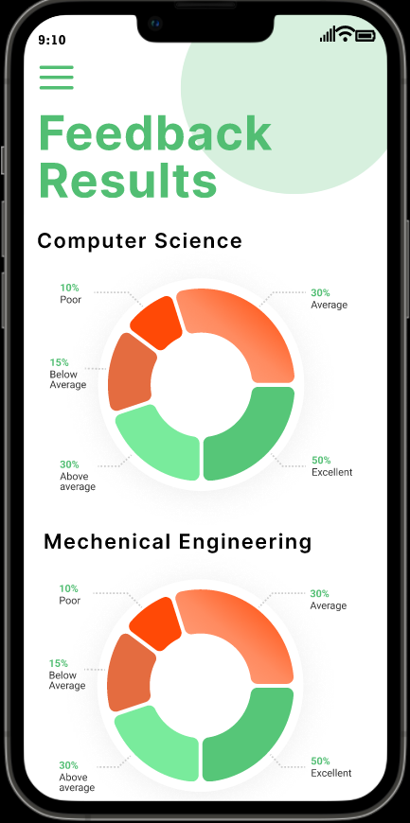
Prototype of App
If the application of the portal can be used very frequently than a mobile application can be of great help
This will increase the interaction with stakeholders
Provides good User Experience

Slide 9
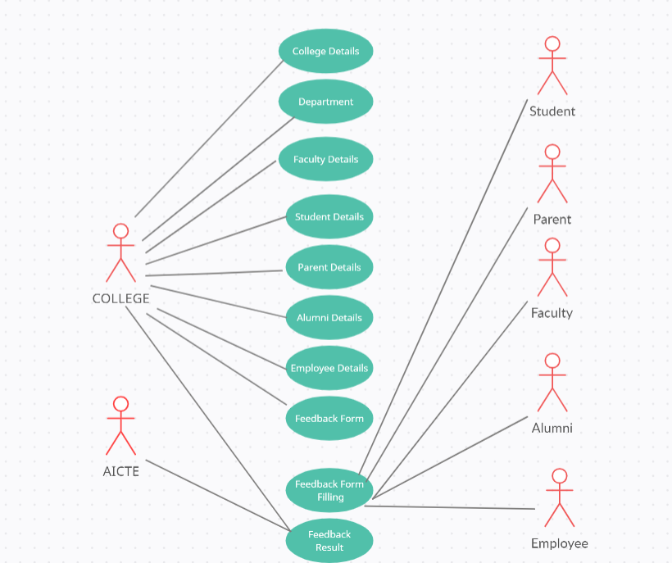
Dependencies
Use Cases
1. HEI (Head of Engineering institution)
2. Student
3. Faculty
4. Parent
5. Alumni
6. Employee
Showstopper
1. Lack of Participation in feedback by stakeholders.
2. Lack of number of feedbacks taken by Colleges.

Slide 10
Team Member Details
Team Leader Name: Krishna Agarwal
Branch: BTech Stream: Computer Science Year : II
Team Member 1 Name: Sunil Kumawat
Branch: BTech Stream: Computer Science Year : II
Team Member 2 Name: Dharmik Patel
Branch: BTech Stream: Computer Science Year : II
Team Member 3 Name: Vineet Agarwal
Branch: BTech Stream: Computer Science Year : II
Team Member 4 Name: Monish Soni
Branch: BTech Stream: Computer Science Year : II
Team Member 5 Name: Syed Nida Ali
Branch: BTech Stream: Computer Science Year : II

