Slide 1
Project: LOCATING
MATH.APP.450
Basic Course on Mathematical Modelling
By-
My Nguyen
Pakhi Rajput
Group: TAU07E

Slide 2
AGENDA
Introduction​
Model
​Results
​Summary​

Slide 3
Introduction
The purpose of this project is to model a situation where we predict the location of a windowless vehicle on a map where each cell is colored either blue, green, red or white. In this problem situation, the vehicle can only move forward, backward, left or right and steering is not allowed. There is no knowledge of the location of the vehicle at the beginning. For each step the vehicle takes, an observation of the color of the current cell is recorded. Another layer of complexity is added when the memory is limited to only 10 steps. Lastly, the probability of getting an incorrect color is given as 0.001. In this report we go through the process of building a probabilistic model based on Bayes’ Theorem to formulate a solution for this Localization problem. Some assumptions and considerations are made at the beginning of the project based on which the solutions is derived. The goal is to provide a practical model and solution keeping in mind the conditions given.

Slide 4
Modelling

Slide 5
ASSUMPTIONS
Based on the available information given by the project, we have made some assumptions:
Each step is taken with the 100% accuracy, meaning that the vehicle is always in the middle of the cells.
The possibility that you will come to the edge of the area does not need to be considered.
You don’t know the orientation of your movement, meaning the direction of your movement doesn’t match the way you view the map.
If there’s one cell that reaches 0.999 probability, we can conclude that the vehicle location is in that cell.

Slide 6
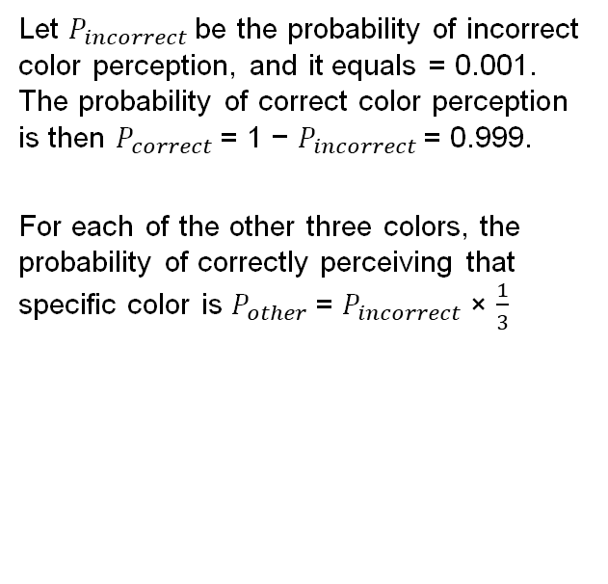
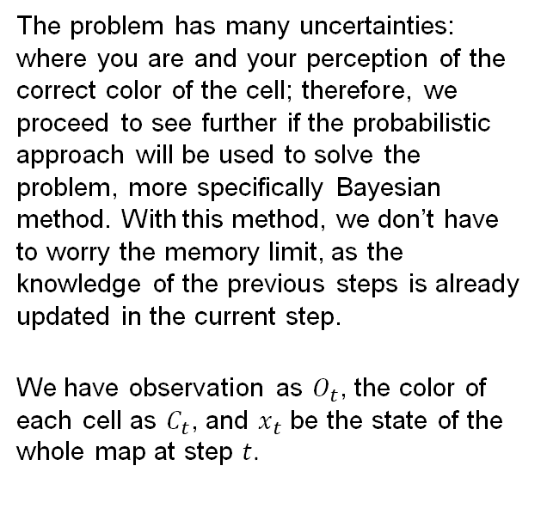
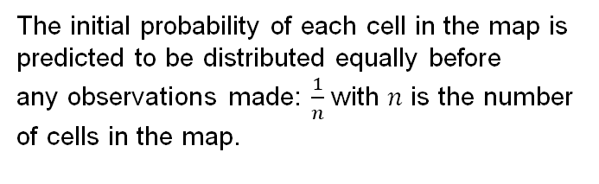
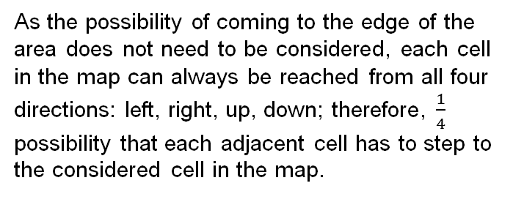
Building the model
The problem has many uncertainties: where you are and your perception of the correct color of the cell; therefore, we proceed to see further if the probabilistic approach will be used to solve the problem, more specifically Bayesian method. With this method, we don’t have to worry the memory limit, as the knowledge of the previous steps is already updated in the current step.
We have observation as $O_{t}$, the color of each cell as $C_{t}$, and $x_{t}$ be the state of the whole map at step $t$.
Color observation model
Let $P_{incorrect}$be the probability of incorrect color perception, and it equals = 0.001. The probability of correct color perception is then $P_{correct}$ = 1 − $P_{incorrect}$= 0.999.
For each of the other three colors, the probability of correctly perceiving that specific color is $P_{other}$ = $P_{incorrect}$ × $\frac{1}{3}$
Motion model
INITIAL DISTRIBUTION
As the possibility of coming to the edge of the area does not need to be considered, each cell in the map can always be reached from all four directions: left, right, up, down; therefore, $\frac{1}{4}$ possibility that each adjacent cell has to step to the considered cell in the map.
The initial probability of each cell in the map is predicted to be distributed equally before any observations made: $\frac{1}{n}$ with $n$ is the number of cells in the map.

Slide 7
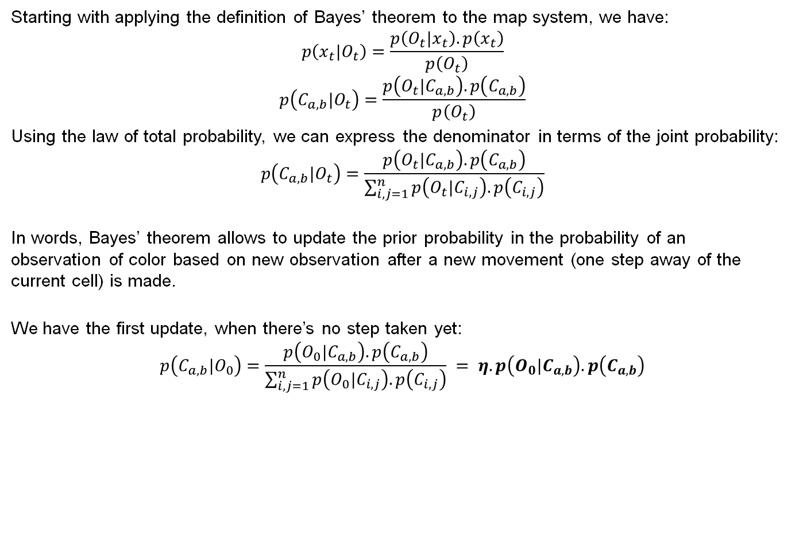
Derivation of the model
Starting with applying the definition of Bayes’ theorem to the map system, we have:
$$p\left(x_{t}|O_{t}\right)=\frac{p\left(O_{t}|x_{t}\right).p\left(x_{t}\right)}{p\left(O_{t}\right)}$$
$$p\left(C_{a, b}|O_{t}\right)=\frac{p\left(O_{t}|C_{a,b}\right).p\left(C_{a,b}\right)}{p\left(O_{t}\right)}$$
Using the law of total probability, we can express the denominator in terms of the joint probability: $$p\left(C_{a, b}|O_{t}\right)=\frac{p\left(O_{t}|C_{a,b}\right).p\left(C_{a,b}\right)}{\sum_{i,j=1}^{n}{p\left(O_{t}|C_{i,j}\right).p\left(C_{i,j}\right)}}$$
In words, Bayes’ theorem allows to update the prior probability in the probability of an observation of color based on new observation after a new movement (one step away of the current cell) is made.
We have the first update, when there’s no step taken yet: $$p\left(C_{a, b}|O_{0}\right)=\frac{p\left(O_{0}|C_{a,b}\right).p\left(C_{a,b}\right)}{\sum_{i,j=1}^{n}{p\left(O_{0}|C_{i,j}\right).p\left(C_{i,j}\right)}} = η.p\left(O_{0}|C_{a,b}\right).p\left(C_{a,b}\right)$$

Slide 8
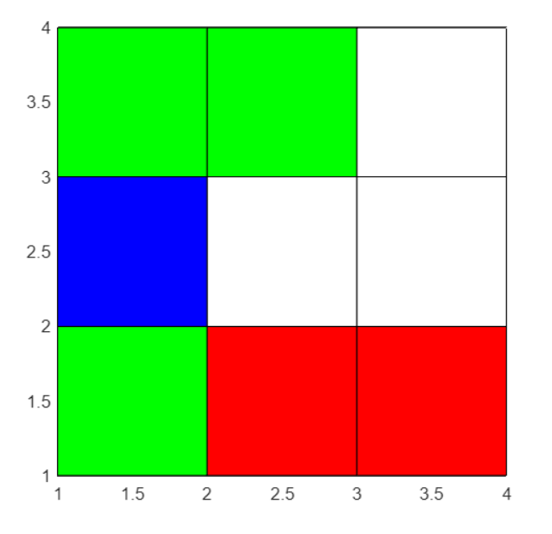
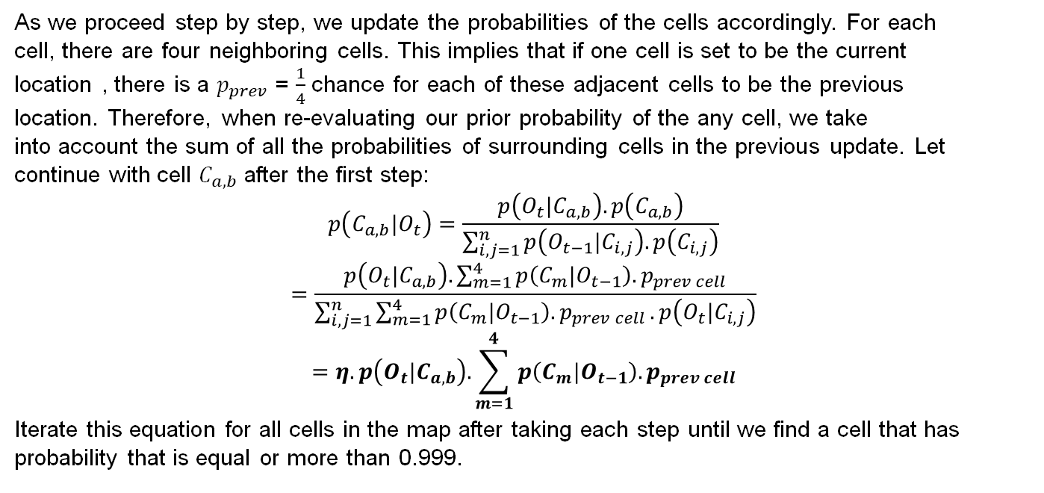
Derivation of the model (CONT.)
As we proceed step by step, we update the probabilities of the cells accordingly. For each cell, there are four neighboring cells. This implies that if one cell is set to be the current location , there is a $p_{prev}$ = $\frac{1}{4}$ chance for each of these adjacent cells to be the previous location. Therefore, when re-evaluating our prior probability of the any cell, we take into account the sum of all the probabilities of surrounding cells in the previous update. Let continue with cell $C_{a,b}$ after the first step:
$$p\left(C_{a, b}|O_{t}\right)=\frac{p\left(O_{t}|C_{a,b}\right).p\left(C_{a,b}\right)}{\sum_{i,j=1}^{n}{p\left(O_{t−1}|C_{i,j}\right).p\left(C_{i,j}\right)}}$$
$$=\frac{p\left(O_{t}|C_{a,b}\right).\sum_{m=1}^{4}{p\left(C_{m}|O_{t−1}\right).p_{prev cell}}}{\sum_{i,j=1}^{n}{\sum_{m=1}^{4}{p\left(C_{m}|O_{t−1}\right).p_{prev cell}}.p\left(O_{t}|C_{i,j}\right)}}$$
$$=η.p\left(O_{t}|C_{a,b}\right).\sum_{m=1}^{4}{p\left(C_{m}|O_{t−1}\right).p_{prev cell}}$$
Iterate this equation for all cells in the map after taking each step until we find a cell that has probability that is equal or more than 0.999.

Slide 9
RESULTS
Our model is robust and is able to give the location with equal or more than 99.99% accuracy, without considering the memory limit or known orientation of the movement.
In real life, our model will need re-modelling to suit the uncertainty of the movement, since each step is also made with imperfect metric. In that case, we can remodel the motion model with, e.g, Gaussian distribution.
Another thing is the edge of the map, as in real life, the map can’t have infinite size. So, we need to modify the iteration formula a bit. Instead of generalization that there are always four neighboring cells, we can have three for side cells, and two for corner cells, which can be easily cooperated in our model in the last equation. With this additional requirement, it helps improve the margin error caused by the four-edge generation in simulation.
As the number of cells increases, the computation load is larger, and therefore, it takes longer to find the location.

Slide 10
SUMMARY
Our model gives an assumption-based solution where we consider a Uniform distribution and apply the Bayes’ Theorem to find the location of the cell. The model is well-defined and has 99.99% accuracy. However, in real-life scenario, we are bound to encounter an edge. The iteration formula will be modified then to take into account the fact that the edge cells will have three neighbouring cells and the corner cells will have two neighbouring cells.
Also, when we have more number of cells., the computation gets slower. In further developments of the project, efforts can be made to eliminate areas of the map that have constantly low probabilities after certain amount of iterations to reduce the computation time.

Slide 11
THANK YOU

