Slide 1

DEPARTMENT OF COMPUTER SCIENCE AND ENGINEERING
Title: XAI-TransMed: Explainable AI Transformer-Based Medical Model for Alzheimer’s Disease Detection and Progression Rate
BATCH ID : 23MPCS-G02
S. No | Roll. No | Student Name
1 | 24885A0544 | D. Archana
2 | 23881A05CA | A. Shashank
3 | 23881A05EM | V. Sai Krishnareddy
Guide Details
Dr. Gagandeep Arora
Associate Professor
Department of CSE

Slide 2
Mini Project Outlines
Introduction
Existing System Vs Proposed
Research Gaps
Problem Statement
Proposed Project Objectives
Proposed Project Outcomes
Software and Hardware Requirements
Architectural Diagram
Proposed Methods and Algorithms
Results
Research Paper (Acceptance Proofs)
Conclusion

Slide 3
Introduction
Alzheimer’s disease is a progressive neurological disorder that affects memory, thinking ability, and daily functioning. Early detection of this disease is very important to improve patient care and treatment outcomes.
With the advancement of Artificial Intelligence, medical imaging techniques like MRI scans can be analyzed more effectively. However, traditional deep learning models such as CNNs mainly focus on local features and lack interpretability, making them less reliable for clinical use.
To address these challenges, our project proposes XAI-TransMed, a transformer-based model that uses Vision Transformers (ViT) to capture global relationships in brain images. The system also integrates clinical data such as age and cognitive scores to improve prediction accuracy.
In addition, Explainable AI techniques are used to provide visual explanations, making the model’s decisions more transparent and trustworthy. This system can classify different stages of Alzheimer’s disease and predict its progression, supporting better clinical decision-making.

Slide 4
Existing System Vs Proposed
Existing System:
Uses traditional Machine Learning and CNN-based models
Focuses mainly on local features in MRI images
Cannot capture global relationships between brain regions
Acts as a “black-box” (no clear explanation of predictions)
Limited use of clinical and demographic data
Lower accuracy in disease progression prediction
Not suitable for real-time clinical decision support
Proposed System (XAI-TransMed):
Uses Vision Transformer (ViT) for advanced feature extraction
Captures global relationships using self-attention mechanism
Integrates multimodal data (MRI + clinical data)
Provides explainability using Grad-CAM and attention maps
Classifies dementia stages and predicts disease progression
Higher accuracy and better performance
Transparent and suitable for clinical applications
DEPARTMENT OF CSE : MINI PROJECT

Slide 5
Research Gaps
Limited Global Feature Learning
Existing CNN-based models focus only on local regions
Fail to capture relationships between different brain regions
Lack of Interpretability
Most models act as black-box systems
Difficult for doctors to understand and trust predictions
Poor Multimodal Integration
Many systems do not effectively combine MRI images with clinical data
Results in reduced prediction accuracy
Inaccurate Disease Progression Prediction
Existing models struggle to predict how the disease evolves over time
CNN models
No transformer-based models.
DEPARTMENT OF CSE : MINI PROJECT

Slide 6
Problem Statement
Alzheimer’s disease is a progressive neurological disorder that severely affects memory, thinking ability, and daily life. Early detection and accurate prediction of disease progression are essential for effective treatment and patient care
However, existing AI-based systems, particularly CNN models, have several limitations. They mainly focus on local features in MRI images and fail to capture global relationships between different brain regions. Additionally, these models act as black-box systems, lacking interpretability, which reduces trust among medical professionals.
Furthermore, many existing approaches do not effectively combine imaging data with clinical information, leading to lower prediction accuracy. They also struggle to accurately predict disease progression over time.
Therefore, there is a need for an advanced, accurate, and explainable system that can effectively analyze both MRI and clinical data, provide reliable predictions, and support real-world clinical decision-making.
DEPARTMENT OF CSE : MINI PROJECT

Slide 7
Proposed Project Objectives
To develop a transformer-based model using Vision Transformer (ViT) for analyzing MRI brain images
To capture global relationships in brain data using self-attention mechanisms
To integrate multimodal data (MRI images + clinical information) for improved accuracy
To classify Alzheimer’s disease into stages: Non-Demented, Very Mild, Mild, and Moderate
To predict disease progression using machine learning techniques like XGBoost and Cox Regression
To implement Explainable AI techniques (Grad-CAM, attention maps) for better interpretability
To evaluate model performance using metrics such as accuracy, precision, recall, and F1-score
DEPARTMENT OF CSE : MINI PROJECT

Slide 8
Proposed Project Outcomes
Accurate detection of Alzheimer’s disease using MRI brain images
Classification of patients into four stages: Non-Demented, Very Mild, Mild, and Moderate Dementia
Reliable prediction of disease progression (MMSE score prediction)
Improved performance through integration of multimodal data (MRI + clinical data)
Generation of visual explanations using Explainable AI (heatmaps, attention maps)
Enhanced transparency and trust in model predictions
A practical system suitable for clinical decision support
DEPARTMENT OF CSE : MINI PROJECT

Slide 9
Software and Hardware Requirements
Software Requirements
Operating System: Windows / Linux / macOS
Programming Language: Python
Deep Learning Frameworks: TensorFlow / PyTorch
Libraries: NumPy, Pandas, Scikit-learn, OpenCV
Machine Learning: XGBoost
Tools: Jupyter Notebook, VS Code, PyCharm
Backend Framework: Flask / Streamlit
Visualization Tools: Matplotlib, Seaborn
Dataset: OASIS MRI Dataset
Hardware Requirements
Processor: Intel Core i5 or above
RAM: Minimum 8 GB (16 GB recommended)
Storage: Minimum 256 GB
GPU: NVIDIA GPU (optional but recommended for faster training)
System Type: 64-bit Operating System
DEPARTMENT OF CSE : MINI PROJECT

Slide 10
Architectural Diagram
The proposed system, XAI-TransMed, follows a structured pipeline for Alzheimer’s disease detection and progression prediction.
Input Layer Users upload MRI brain images along with clinical data such as age, MMSE score, and other parameters.
Preprocessing The MRI images are resized, normalized, and cleaned to remove noise for better analysis.
Feature Extraction (ViT) A Vision Transformer (ViT) extracts important features from MRI images by capturing global relationships using self-attention.
Multimodal Integration Extracted image features are combined with clinical data to improve prediction accuracy.
Classification Module The system classifies the patient into dementia stages: Non-Demented, Very Mild, Mild, or Moderate.
Progression Prediction Machine learning models like XGBoost and Cox Regression predict disease progression (MMSE score).
Explainable AI (XAI) Attention maps and Grad-CAM generate heatmaps to highlight important brain regions influencing predictions.
Output Layer The system displays the predicted class, probabilities, progression score, and visual explanations.
DEPARTMENT OF CSE : MINI PROJECT

Slide 11
PROPOSED METHOD AND ALGORITHMS
Method:
MRI images and clinical data are taken as input
Images are preprocessed (resizing, normalization)
Vision Transformer (ViT) extracts global features
Image features are combined with clinical data
Model classifies dementia stages
XGBoost predicts disease progression (MMSE score)
Explainable AI generates heatmaps for interpretation
Algorithms:
Vision Transformer (ViT): captures global relationships in MRI images
XGBoost: predicts disease progression using clinical + image features
Classification Model: identifies dementia stages
Grad-CAM / Attention: provides visual explanations (heatmaps)
DEPARTMENT OF CSE : MINI PROJECT
DEPARTMENT OF CSE : MINI PROJECT

Slide 12
Results
The proposed XAI-TransMed model achieved very high classification accuracy of 98.6% on the OASIS dataset
🔹 Successfully classified Alzheimer’s disease into four stages: Non-Demented, Very Mild, Mild, and Moderate Dementia
🔹 Achieved strong performance with high precision, recall, and F1-score across all classes
🔹 XGBoost model showed best performance for disease progression prediction with MAE of 2.48 for MMSE score
🔹 Explainable AI generated attention heatmaps highlighting important brain regions
🔹 Fast computation: prediction time is less than 1 second, suitable for real-time clinical use
🔹 Overall system is accurate, interpretable, and reliable for clinical decision support
DEPARTMENT OF CSE : MINI PROJECT

Slide 13
Research Paper (Acceptance Proof)
Research Paper Details
Title:
XAI-TransMed: Explainable AI Transformer-Based Medical Model for Alzheimer’s Disease Detection and Progression Rate
Authors:
D. Archana, A. Shashank, V. Sai Krishnareddy
Affiliation:
Dept. of CSE, Vardhaman College of Engineering, Hyderabad, India
DEPARTMENT OF CSE : MINI PROJECT
DEPARTMENT OF CSE : MINI PROJECT

Slide 14
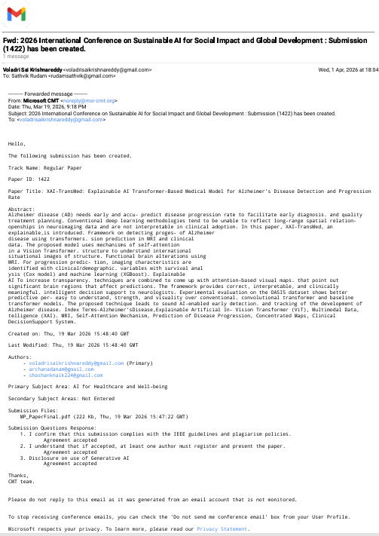
Research Paper (Acceptance Proof)

Slide 15
Conclusion
Use larger and more diverse datasets for better generalization
Improve progression prediction using advanced temporal models
Extend system for real-time clinical deployment
Enhance explainability with more advanced XAI techniques
Integrate additional medical data like PET scans or genetic data
Proposed XAI-TransMed improves Alzheimer’s detection using Vision Transformer
Achieves high accuracy and reliable stage classification
Multimodal data enhances prediction performance
Explainable AI provides transparency through heatmaps
Suitable for real-world clinical decision support
Conclusion
Future Scope
DEPARTMENT OF CSE : MINI PROJECT

Slide 16
Thank You
DEPARTMENT OF CSE : MINI PROJECT

