Slide 1
Unit-5 Leading and communication
Concept and qualities of leadership. Transformational and transactional leadership,
Leadership styles: autocratic, democratic, and participate.
Concept of managerial ethics.
Motivation: concepts, importance, and techniques.
Communication: meaning, process, and networks. Types of communication, barriers to effective communication

Slide 2
Concept of Leadership
Leadership is the art of influencing other’s behavior and performance.
Leadership is the ability of an individual or a group of individuals to influence and guide followers or other members of an organization.
It is ability to persuade(convince) subordinates to make them work willingly to achieve desired goal.
Manager must have leadership quality to stimulate and inspire his subordinates to do works according to his instruction.

Slide 3
Nature/features of leadership
Influence the behavior of others: Leadership is an ability of an individual to influence the behavior of other employees in the organization to achieve a common purpose or goal so that they are willingly co-operating with each other for the fulfillment of the same.
Inter-personal process: It is an interpersonal process between the leader and the followers. The relationship between the leader and the followers decides how efficiently and effectively the targets of the organization would be met.
Attainment of common organizational goals: The purpose of leadership is to guide the people in an organization to work towards the attainment of common organizational goals. The leader brings the people and their efforts together to achieve common goals.
Continuous process: Leadership is a continuous process. A leader has to guide his employees every time and also monitor them in order to make sure that their efforts are going in the same direction and that they are not deviating from their goals.
Group process: It is a group process that involves two or more people together interacting with each other. A leader cannot lead without the followers.
Dependent on the situation: It is situation bound as it all depends upon tackling the situations present. Thus, there is no single best style of leadership.

Slide 4
Qualities of leadership
A. Personal qualities
Physical fitness/attractive personality
Self Confidence
Intelligence
maturity
vision and foresight
human character/discipline
Optimistic
Sense of responsibility
Flexible attitude
Desire to excel (do better than other)

Slide 5
B. Managerial qualities
Technical knowledge
Moderate state of mind(on decision making)
Organizing ability
Motivation and communication skills
Human relation expert
Wider perspective(wide vision)
Self confidence
Ability to judgement

Slide 6
Leadership style
A. Autocratic Leadership style
Also called authoritarian or dictatorial style
The leader believes in centralized power and expects all decisions from him without consultation with subordinates.
They may use fear, threat, authority and prestige inherent in their organizational position.
They are power loving and promote their own goals.

Slide 7
Characteristics
Allows little or no input from group members
Requires leaders to make almost all of the decisions
Provides leaders with the ability to dictate work methods and processes
Leaves group feeling like they aren't trusted with decisions or important tasks
Tends to create highly structured and very rigid environments
Discourages creativity and out-of-the box thinking
Establishes rules and tends to be clearly outlined and communicated

Slide 8
Advantages
Quick decision
Provide strong motivation
Frequent implementation
Strict discipline
Works well in emergency situation
Conscious in profit and cost

Slide 9
Disadvantages
Negative motivation style
Decrease organizational efficiency
Lack of creativity
Instability
Causes employee frustration
Provide little opportunity for employee growth and advancement
Results in grievance, slowdowns, and high turnover

Slide 10
B . Democratic leadership style
It is type of leadership, also known as participative or consultative leadership style.
The leader believes in decentralization of power and invites subordinates in decision making process.
The leaders rely(depends) more on rewards than on punishment.
It is suitable where subordinates are educated, trained, matured and intelligent.

Slide 11
Features
Believes in sharing authority and responsibility
Delegates authority and builds commitment
Manages through goals, not controls
Displays trust in the work force
Creates a positive work climate
Informs employees about work conditions and change
Seeks feedback on ideas
Stresses on effective human relation practices

Slide 12
Advantages
Better decision
Better satisfaction of employees
Increase productivity
Promotion improved morale
Encourages the development of subordinates
Two way communication
Enhances workers creativity

Slide 13
Disadvantages
Delay in decision making
Inefficient and incompetent employees
Absence of discipline
Provides only general guidelines to subordinates
May cause inconsistent decisions
May result in confusion and lack of control
Reduces accountability

Slide 14
C. Laissez-fair or free rain leadership style
Also called ‘country club supervision’
The leader avoid power and responsibility
Leader grants authority and responsibility to a group
The role of leader is to provide advice and directions as requested by the subordinates
Subordinates enjoy high degree of freedom in decision making
It is suitable for highly trained, knowledgeable, motivated, goal directed, independent, capable of self direction and professional staff.

Slide 15
Features
Believes in liberally sharing responsibility
Gives employees total freedom
Delegates all decisions
Relies on worker self motivation
Displays extensive trust in the work force
Creates a relaxed working climate
Motivates through freedom and flexibility
Communicates via broad goals, providing minimum amount of direction
Does not strictly enforce policies and procedures

Slide 16
Advantages
Enhance workers creativity
Develops worker in initiative
Result in employee ownership
Increase employees’ motivation
Boost up employees’ morale and job satisfaction
Provide maximum possible scope for development of subordinates
Full utilization of subordinates’ qualities.

Slide 17
Disadvantages
Avoidance of management
Ignores leader’s contributions
Lead inadequate direction
Can result in confusion
Viewed an no caring leadership style
Lack of accountability
Limited scope

Slide 18
d. Paternalistic style
The leader assumes a fatherly role
The leader works to guide, protect and keep followers who work together as a member of a family
E. Situational style
It is based on reality
There is no any particular leadership style as such, applicable to all situations
The leader should change himself from one style to the other or adopt a mix of various styles.

Slide 19
Concept of managerial ethics
Managerial ethics is a set of principles and rules directed by upper management that define what is right and what is wrong in an organization. It is the guideline that helps direct a lower manager's decisions in the scope of his or her job when a conflict of values is presented.
Managers make ethical decisions every day, so they need to act according to the principles set by the organization to make sure they're doing the right thing.
According to Decenzo and Robbins “Ethics commonly refers to a set of rules or principles that defined right and wrong conduct.”
According to Webster’s Dictionary, “Ethics is defined as the discipline dealing with what is good and bad with moral duty and obligation.”

Slide 20
Motivation
The term "motivation" describes why a person does something. It is the driving force behind human actions. Motivation is the process that initiates, guides, and maintains goal-oriented behaviors. For instance, motivation is what helps you lose extra weight, or pushes you to get that promotion at work.
Motivation is the art of inspiring and encouraging subordinates to do work in an effective way so that both organizational and individual goals can be achieved.
According to W. G. Scot, “Motivation means a process of stimulating people to action to accomplish the desired goals.”

Slide 21
Nature/ Features of Motivation
Phycological process
Continuous process
Complex and unpredictable
Influence the behavior
Concentrated on whole individual
Positive or negative
Goal directed

Slide 22
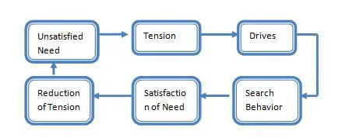
Process of motivation

Slide 23
Unsatisfied need. Motivation process begins when there is an unsatisfied need in a human being.
Tension. The presence of unsatisfied need gives him tension.
Drive. This tension creates an urge of drive in the human being an he starts looking for various alternatives to satisfy the drive.
Search Behavior. After searching for alternatives the human being starts behaving according to chosen option.
Satisfied need. After behaving in a particular manner for a long time then he evaluates that whether the need is satisfied or not.
Reduction of tension. After fulfilling the need the human being gets satisfied and his tension gets reduced.

Slide 24
Importance of motivation
Goal achievement
Higher efficiency
Minimizes disputes and strikes
Low employee absenteeism and turnover
Acceptance of organizational changes
Effective utilization of resources
Industrial peace
Better image and goodwill
Lead to profitable operation
Basis of coordination
Minimizes supervision cost

Slide 25
Techniques of motivation
Financial incentives
Reward and promotion
Participation
Delegation of authority
Job security
Job enlargement: more task of same level
Job enrichment: vertical expansion of job
Job rotation
Quality of work life: favorable working environment
competition

Slide 26
Theories of motivation
Maslow’s need hierarchy theory
Herzberg’s two factor theory
Douglas McGregor’s theory X and Y

Slide 27
1. Maslow’s Theory of Hierarchical Needs
Abraham Maslow postulated that a person will be motivated when all his needs are fulfilled. People do not work for security or money, but they work to contribute and to use their skills. He demonstrated this by creating a pyramid to show how people are motivated and mentioned that ONE CANNOT ASCEND TO THE NEXT LEVEL UNLESS LOWER-LEVEL NEEDS ARE FULFILLED. The lowest level needs in the pyramid are basic needs and unless these lower-level needs are satisfied people do not look at working toward satisfying the upper-level needs.

Slide 28
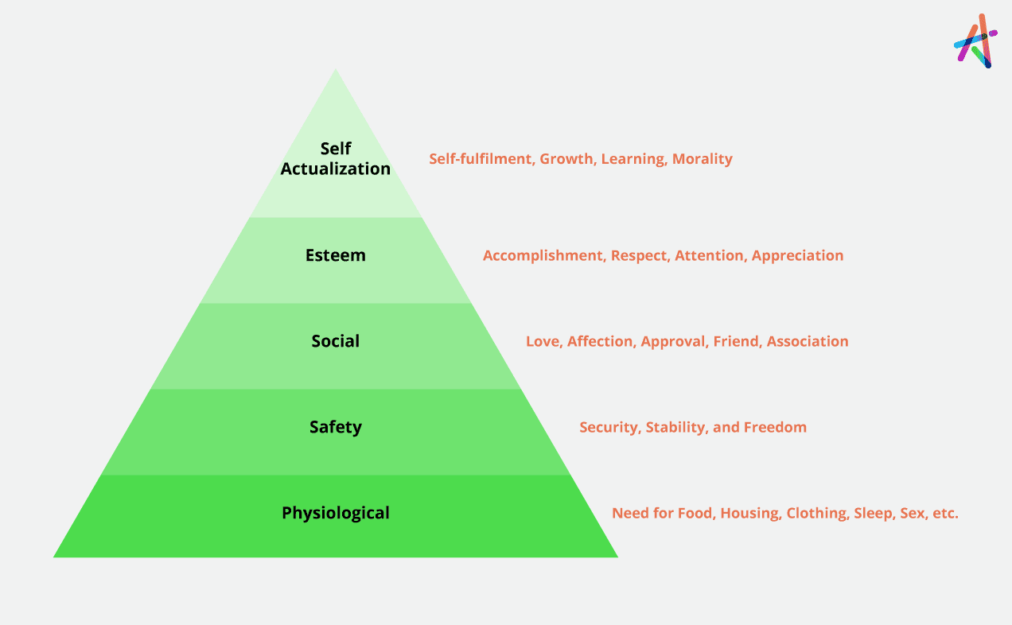

Slide 29
Below is the hierarchy of needs:
Physiological needs: are basic needs for survival such as air, sleep, food, water, clothing, sex, and shelter.
Safety needs: Protection from threats, deprivation, and other dangers (e.g., health, secure employment, and property)
Social (belongingness and love) needs: The need for association, affiliation, friendship, and so on.
Self-esteem needs: The need for respect and recognition.
Self-actualization needs: The opportunity for personal development, learning, and fun/creative/challenging work. Self-actualization is the highest-level need to which a human being can aspire.

Slide 30
Theory X and Y : Douglas McGregor
In 1960, an American social psychologist, developed theory X (negative), and theory Y (positive) suggesting two aspects of human behavior at work.
According to him, theory Y is a set of optimistic assumption about human nature and theory X is a set of pessimistic assumption about the workers.

Slide 31
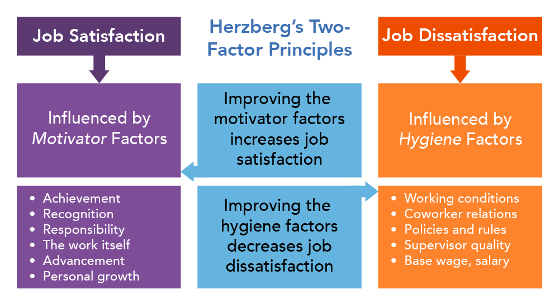

Slide 32
#1 Hygiene Factors
n Herzberg two factor theory, hygiene factors are also known as dissatisfiers or maintenance factors. These are external to the job itself. The presence of these factors does not motivate employees but the absence of it causes dissatisfaction. When these factors are adequate, people will not be dissatisfied but they either be satisfied. Hygiene factors include:

Slide 33
Company Policy and Administration
Supervision
Relationship with Supervisor
Working Conditions
Salary
Relationship with Peers
Personal Life
Relationship with Subordinates
Job Security
Status
Security, etc.

Slide 34
These factors are necessary to maintain a minimum level of need satisfaction. They bring employees to zero levels of motivation from the negative direction. Therefore, Herzberg felt that managers have to focus on hygiene or maintenance factors. If they do not focus on these factors, the desired behaviors will not be obtained from the employees.

Slide 35
#2 Motivating Factors
In Herzberg two factor theory, motivating factors are also known as motivators, satisfiers, or job content factors. These factors are job-centered and relate directly to the job itself. The presence of motivating factors causes a high level of motivation and job satisfaction, whereas their absence does not cause high dissatisfaction. Motivating factors include:
Achievement
Recognition
Advancement
Work Itself
Personal Growth
Responsibility

Slide 36
Theory X and Y : Douglas McGregor
In 1960, an American social psychologist, developed theory X (negative), and theory Y (positive) suggesting two aspects of human behavior at work.
According to him, theory Y is a set of optimistic assumption about human nature and theory X is a set of pessimistic assumption about the workers.

Slide 37
Theory X
According to this theory, people want to avoid work as much as possible.
The general assumptions of theory X are:
Employees inherently dislike work and avoid
responsibilities.
People tend to resist change
The authoritarian leadership style is appropriate
Work motivation comes through financial incentives
People prefer to be lead by others rather than lead others.
People must be corrected, controlled or threatened with punishment to achieve desired goals.

Slide 38
Theory Y
According to this theory, people are inherently happy to work.
The general assumptions of theory Y are:
People like to work as natural as play or rest.
People are committed to the objectives and exercise self control, and direction.
They are all consequences of experience.
People always tend to be creative to solve organizational problems.
Management has given to develop the intellectual potentialities of people.
All employees are given equal chance to develop their skills.

Slide 39
Communication
“Communication is the process of passing information and understanding from one person to another.” -Keith Davis
Communication is all about getting information from one party to another. According to Merriam-Webster Dictionary.
It is the exchange of facts, opinions, ideas, suggestions and other information.
It is a continuous process and basis of managerial function
Managers provide information of instruction, guidance and suggestions to the subordinates to implement plans and policies.

Slide 40
Nature/Features
Minimum two person
Two way process
Pervasive(broadly) function
Complete and rational process
Continuous function
Oral or written
Formal or informal
Basis of action and coordination
Understanding

Slide 41
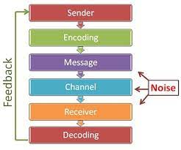
Process of communication

Slide 42
Sender: The sender or the communicator is the person who initiates the conversation and has conceptualized the idea that he intends to convey it to others.
Encoding: The sender begins with the encoding process wherein he uses certain words or non-verbal methods such as symbols, signs, body gestures, etc. to translate the information into a message. The sender’s knowledge, skills, perception, background, competencies, etc. has a great impact on the success of the message.
Message: Once the encoding is finished, the sender gets the message that he intends to convey. The message can be written, oral, symbolic or non-verbal such as body gestures, silence, sighs, sounds, etc. or any other signal that triggers the response of a receiver.
Communication Channel: The Sender chooses the medium through which he wants to convey his message to the recipient. The choice of medium depends on the interpersonal relationships between the sender and the receiver and also on the urgency of the message being sent. Oral, virtual, written, sound, gesture, etc. are some of the commonly used communication mediums.

Slide 43
Receiver: The receiver is the person for whom the message is intended or targeted. He tries to comprehend it in the best possible manner such that the communication objective is attained. The degree to which the receiver decodes the message depends on his knowledge of the subject matter, experience, trust and relationship with the sender.
Decoding: Here, the receiver interprets the sender’s message and tries to understand it in the best possible manner. An effective communication occurs only if the receiver understands the message in exactly the same way as it was intended by the sender.
Feedback: The Feedback is the final step of the process that ensures the receiver has received the message and interpreted it correctly as it was intended by the sender. It increases the effectiveness of the communication as it permits the sender to know the efficacy of his message. The response of the receiver can be verbal or non-verbal.
Note: The Noise shows the barriers in communications. There are chances when the message sent by the sender is not received by the recipient.

Slide 44
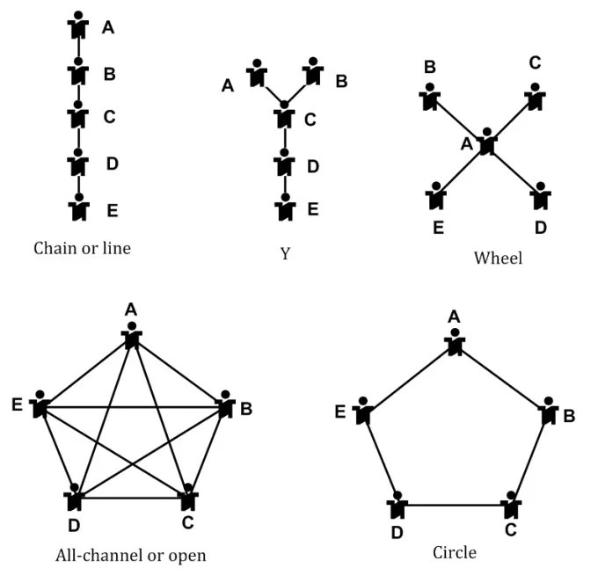
Networks/Structure of communication

Slide 45
Communication structure of organization
Communication network refer to a combination of sender and receiver in their role of transmission of message. Communication networks make the communication interesting, quicken the flow of information, and increases the effectiveness of communication. Depending upon the nature of message, urgency, organizational culture and size of the organization, different communication networks can be used. Basically there are five types of communication networks as follows:

Slide 46
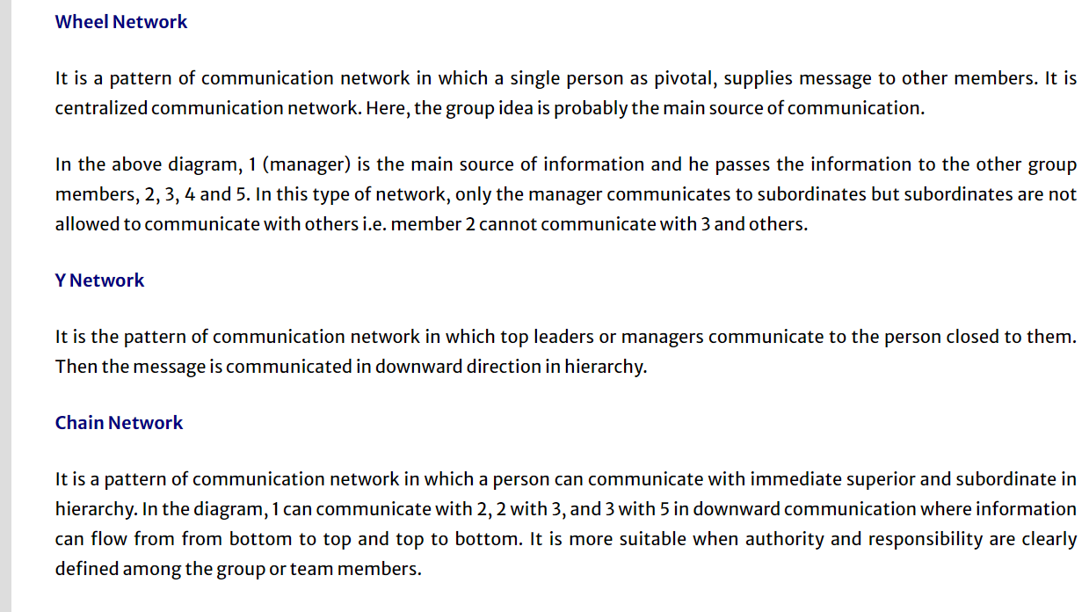

Slide 47
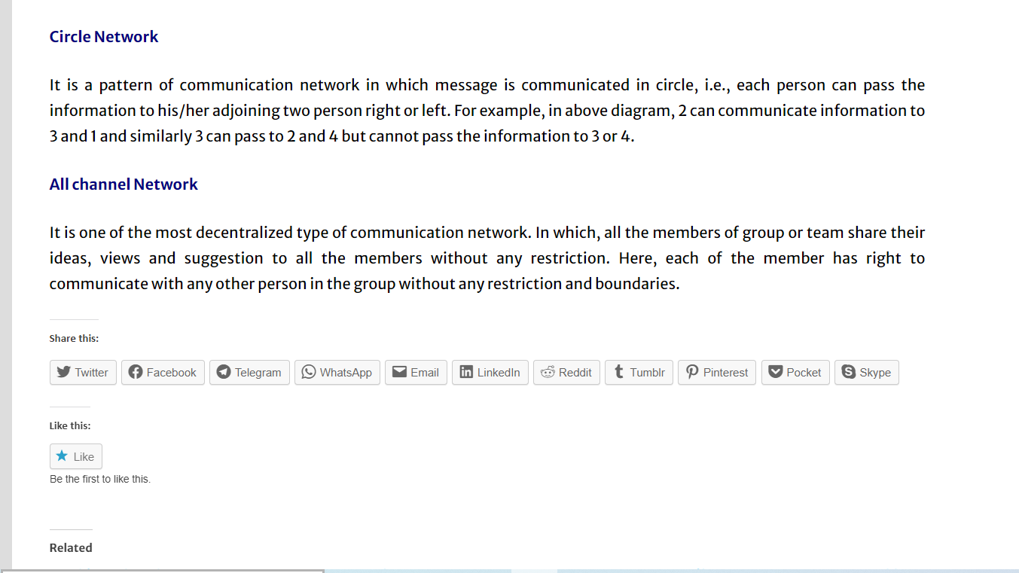

Slide 48
Types of communication
Formal and informal communication.
Upward and downward communication.
personal and group communication.
Oral and written communication.
Specific and mass communication.

Slide 49
Barriers of effective communication
There are many barriers in communication which may creates problems in its effectiveness.
Physical barriers
Internal structure of the organization and layout of machines and equipment creates physical barriers in communication.
Physical distance
Office design
Hierarchy structure
Noise

Slide 50
b. Psychological barriers
The human perception, incapability, negative thinking of top level manager creates.
Distrust of communication
Superiority complex
Individual perception
Premature evaluation
No attention
Lack of interest
Screening of information

Slide 51
c. Organizational barriers
It is formed within the organization through organizational system, rules, policy and belief.
Organizational policy
Organizational rules and regulations
Lengthy scalar chain
One way communication system
Lack of confidence in subordinates
Poor planning
Complex structure
Poor timing

Slide 52
d. Semantic(meaningful) barriers
The use of difficult, vague, and insensitive language by the sender creates semantic barriers.
Harsh(poor) language
Vague(unclear) language
Misleading translation
Technical language
Badly expressed message
Faulty translation
Complex sentences

Slide 53
e. Technological barriers
It is created due to defect in technology used and information overload
Mechanical barriers
Loss of transmission
Information overload
Insufficient period allowed
Unfamiliar technology
Cyber crime

