Slide 1
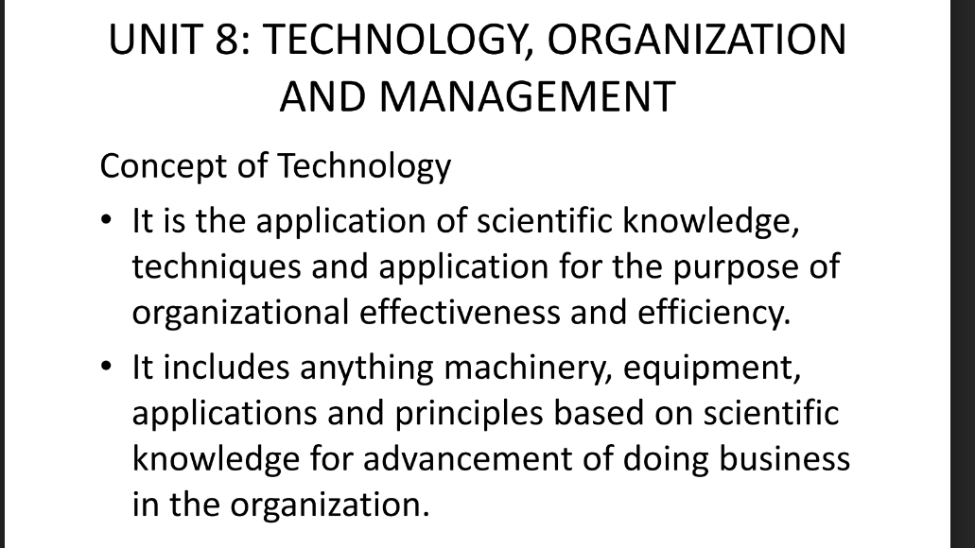

Slide 2

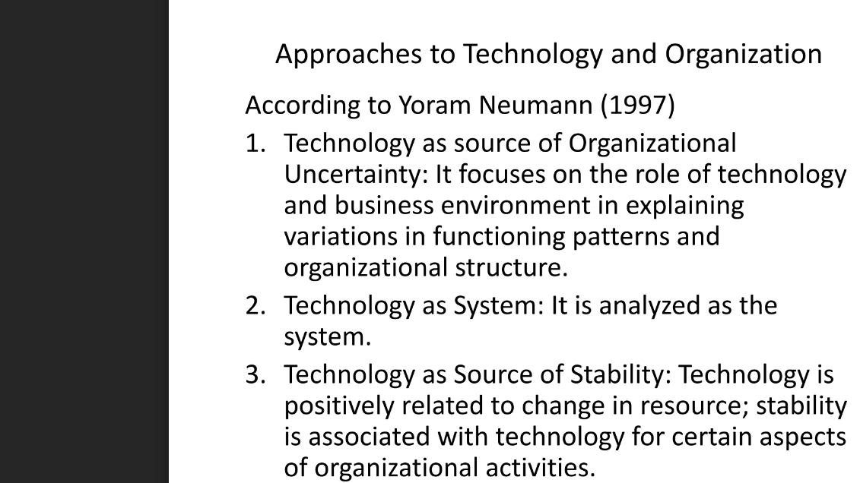

Slide 3
Social Networking
Social networking is the use of internet-based social media platforms to get and stay connected with friends, family, or peers.
Three of the most popular social networking sites in the U.S. include Facebook, Instagram, and Twitter.
Marketers use social networking to increase brand recognition and encourage brand loyalty.
Social media can help connect people with businesses for various needs.

Slide 4
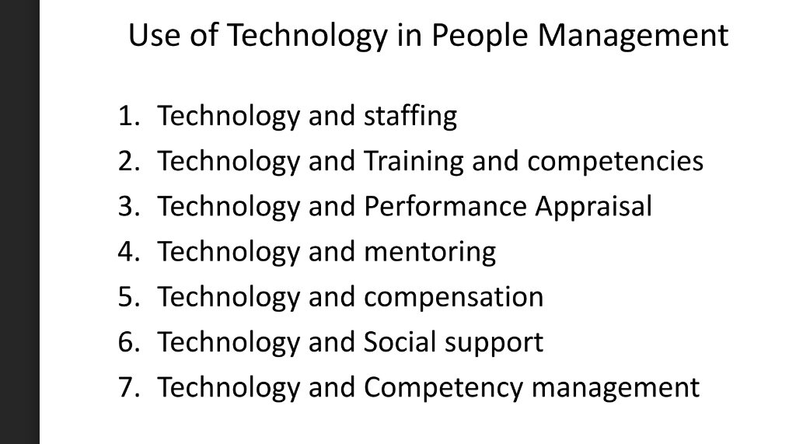

Slide 6
Thank you!

