Slide 1
Angular 101: Angular from Start to Finish
Nick Hodges
nick@nickhodges.com
http://anglesandtypes.io
@nickhodges

Slide 2
About Me
Former Naval Intelligence Officer
Software Development Manger at Gateway Ticketing Systems
We are hiring!
Long-time Delphi Developer, Former Delphi Product Manager
Author of three Delphi books (Ask me about self-publishing….)
Extensive Conference Speaking Experience
Self-taught Angular Developer

Slide 3

Prerequisites
You have to know nothing about Angular beyond “it’s some kind of web framework….”

Slide 4
Pre-requisites
The latest version of Git
Google: ‘git’
https://git-scm.com/downloads
Visual Studio Code
Google: ‘visual studio code’
https://code.visualstudio.com/Download
Node.js
Google: ‘node.js’
https://nodejs.org/en/download/

Slide 5
Agenda
History & Information
TypeScript
Get Installed
Run down a basic application with CLI
Build a ToDo Application
Conclusions

Slide 6

History of Angular Framework
Started out as AngularJS
20% Project at Google started by Miško Hevery and Adam Abrons
Completely re-written as Angular 2
Current version is 7.0
Backed by Google
https://angular.io/
https://www.madewithangular.com/

Slide 7
Angular Topics
Components
Modules
Data-binding
@Input and @Output
Services and HTTP
Routing
Material Design

Slide 8
Hello TypeScript
TypeScript is a JavaScript that adds classes (OOP)
All JavaScript is TypeScript
Transpiles (compiles) to JavaScript
Open source project run by Anders Hejlsberg and Microsoft
Hosted on (surprise!) GitHub
Purpose is to:
Make large scale JavaScript applications manageable and maintainable
Provide tooling and ease of development around code

Slide 9
Important TypeScript Constructs
Modules
Classes
Decorators
Interfaces

Slide 10
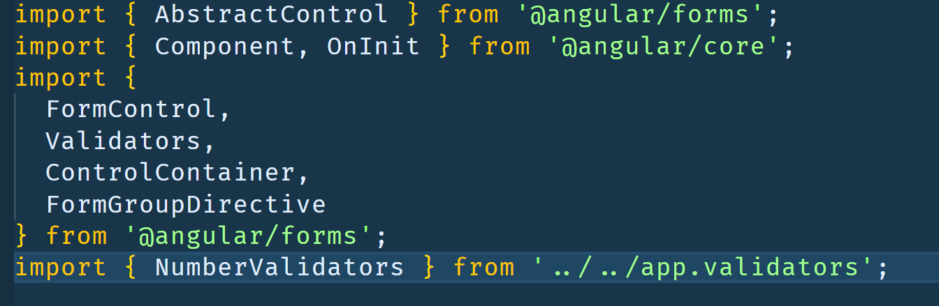
Modules
Modules hold code and only expose explicitly exported code to the outside world
Code from a Module must be explicitly imported
Any file containing a top-level import or export is considered a module.

Slide 11
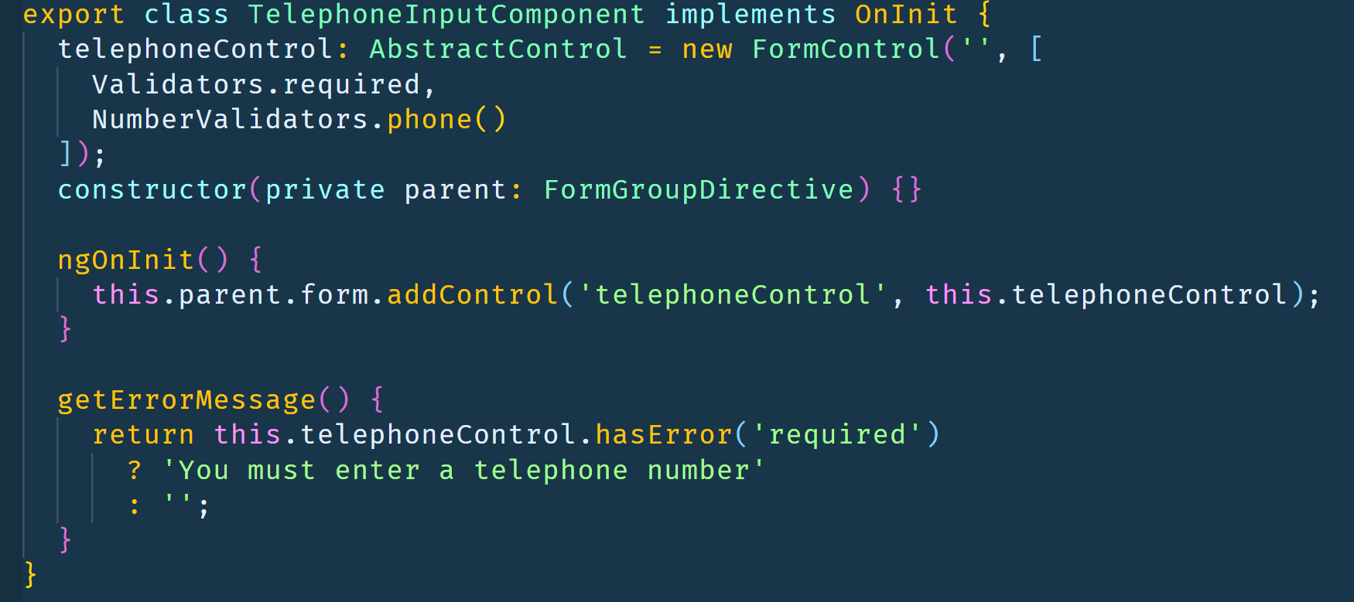
Classes
Provide Encapsulation, Inheritance, Polymorphism
Can implement Interfaces

Slide 12
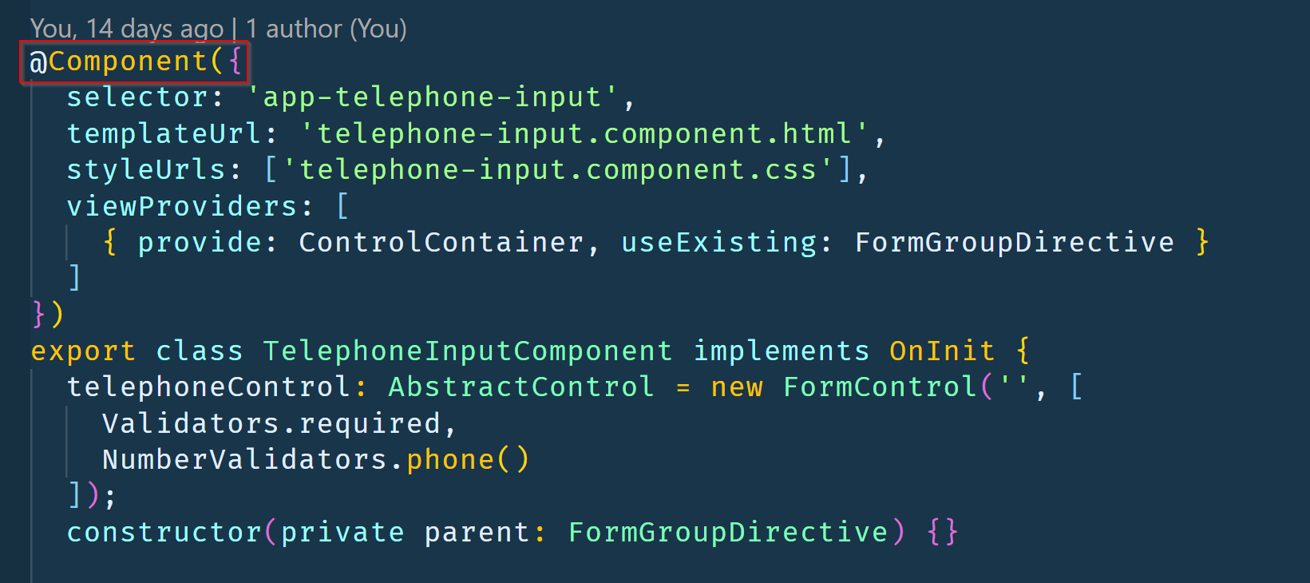
Decorators
Meta-data to provide information about a given class
In Angular, used to define components

Slide 13
Interfaces
Define the “shape” of a class
No associated Javascript code
Purely a TypeScript construct to enforce code functionality
interface ClockInterface {
currentTime: Date;
}
class Clock implements ClockInterface { currentTime: Date;
constructor(h: number, m: number) {}
}

Slide 14
Install json-server
npm install –g json-server
Get a full fake REST API with zero coding in less than 30 seconds (seriously)
Created for front-end developers who need a quick back-end for prototyping and mocking.

Slide 15
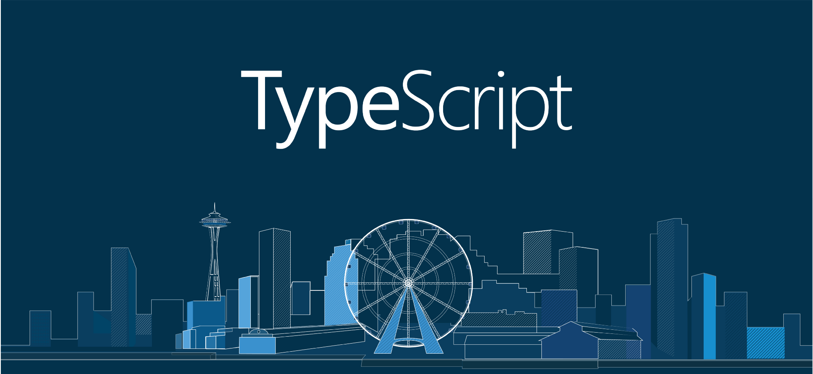
Install TypeScript
npm install -g typescript

Slide 16

Install Angular
npm install -g angular

Slide 17
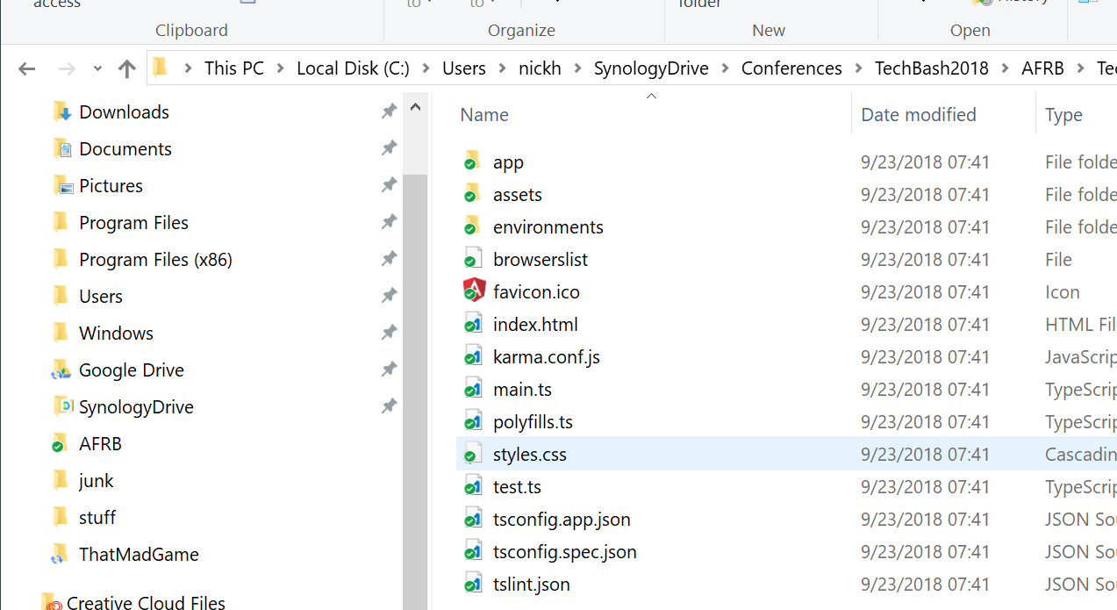
Install Angular CLI
npm install -g @angular/cli
Angular Command Line Interface
Good for starting and scaling applications

Slide 18
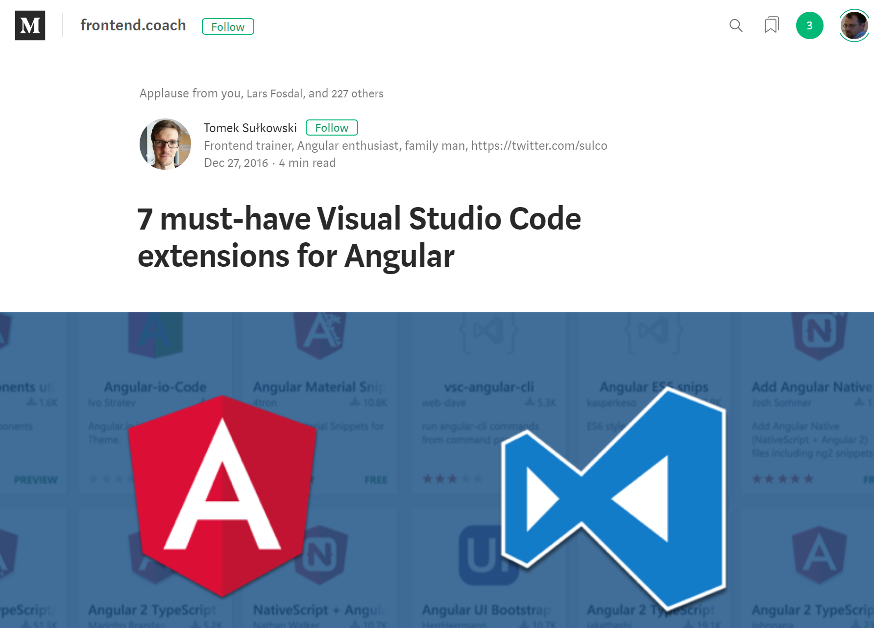
Angular Extensions for VS Code
http://bit.ly/NGExtensions

Slide 19
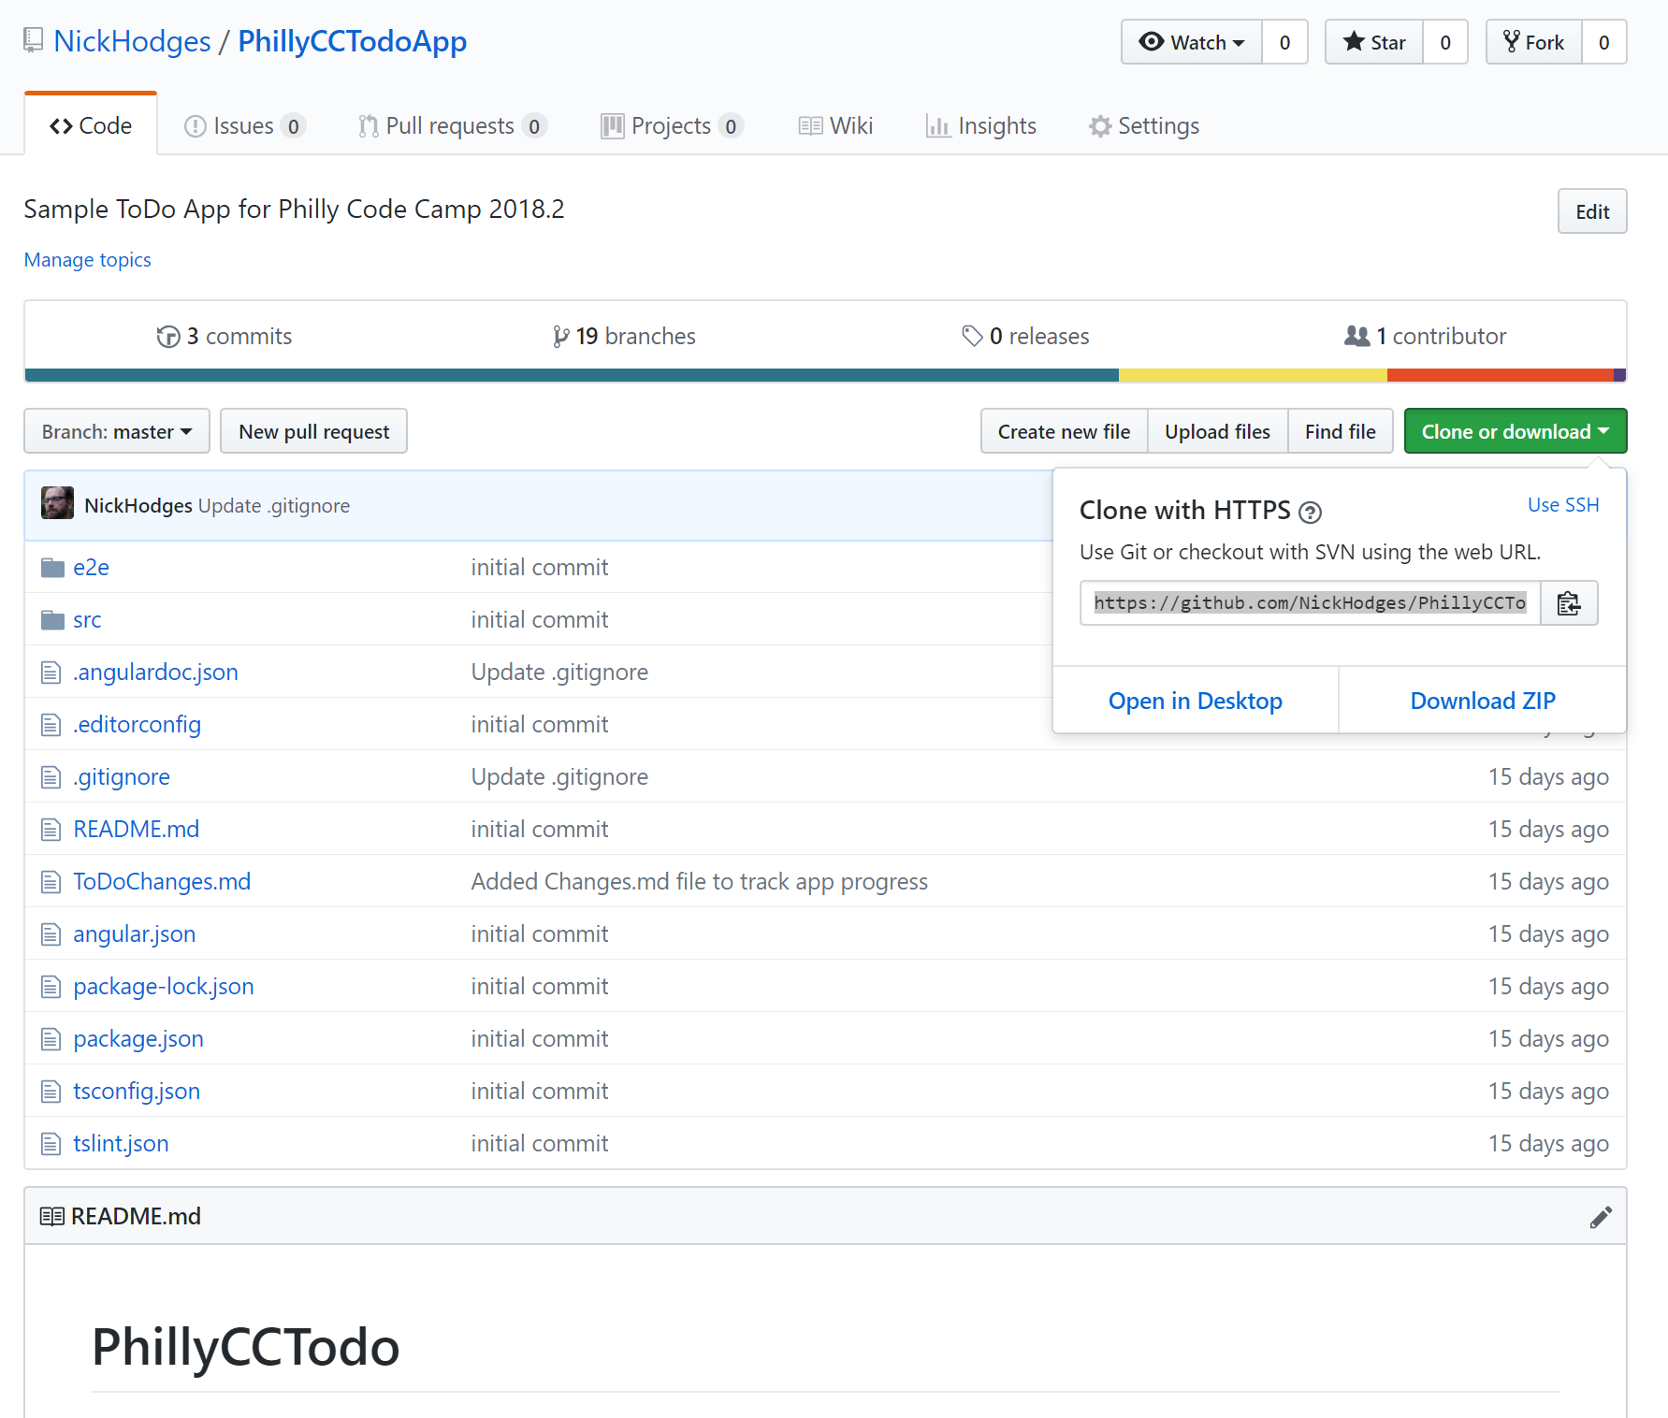
Install Todo Application Code
git clone https://github.com/NickHodges/PhillyCCTodoApp.git

Slide 20
A Look at a Basic Angular Application

Slide 21
Let’s Build a ToDo App in Angular

Slide 22
Resources
Main Page: http://angular.io
Official Docs: https://angular.io/docs
Project on Github: https://github.com/angular
My Blog: http://www.anglesandtypes.io
Best VS Code Plugins:
http://bit.ly/VSCAngular
http://bit.ly/NGExtensions

Slide 23
Questions
Nick Hodges
nick@nickhodges.com
http://anglesandtypes.io
@nickhodges

