Slide 1
Scuola di Ingegneria Industriale e dell'Informazione
Corso di Laurea Magistrale in Ingegneria Informatica
Anno Accademico 2013 - 2014
Avoiding CRUD operations lock-in in NoSQL databases: extension of the CPIM library
Candidato: Fabio Arcidiacono (799001)
Relatore: Prof.ssa Elisabetta Di Nitto
Correlatore: Ing. Marco Scavuzzo

Slide 2
Data management systems
RDBMS
NoSQL
Well structured data
Vertical scaling
ACID transactions
Relational model
SQL
Non-structured data
Horizontal scaling
BASE properties
Various data models
Proprietary API
Notes:
sharding

Slide 3
NoSQL Common language approaches
Meta-model
Apache MetaModel
SOS platform
SQLification
Apache Phoenix
UnQL
Native support
ORM
Kundera
PlayORM
Spring-data
Apache Gora

Slide 4
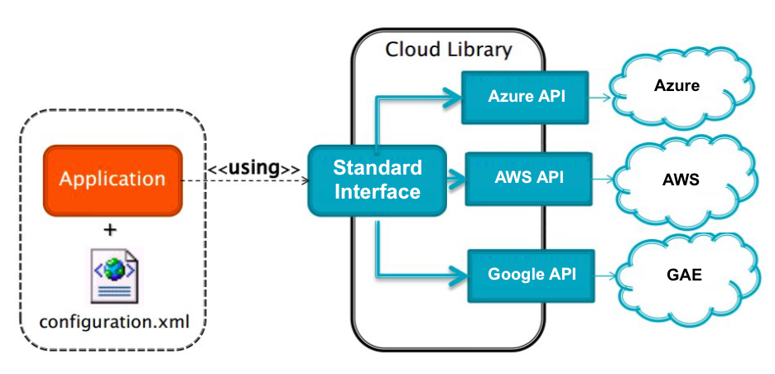
Cloud Platform Independent Model
Abstract application logic from the specific PaaS Provider to overcome the vendor lock-in
Many supported services:
Blob
NoSQL
Memcache
Queue
Mail
SQL
Notes:
Astrazione per servizi allo scopo di evitare lock-in
Dire servizi

Slide 5
Work objectives
Integrate Kundera in the CPIM library
Contribute to the open source project Kudera
Integrate the migration and synchronization system Hegira
Evaluation

Slide 6
Work objectives
Integrate Kundera in the CPIM library
Contribute to the open source project Kudera
Integrate the migration and synchronization system Hegira
Evaluation

Slide 7
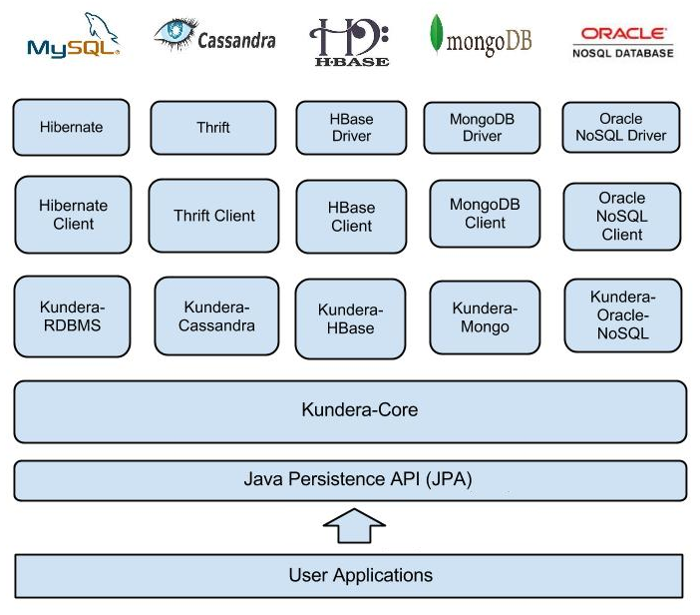
Kundera
A JPA 2.1 compliant ORM Library for NoSQL databases
Notes:
No DaaS
Translate to SQL intercepted operations
JPQL queries (DELETE and UPDATE)
ORM operation (through EntityManager interface)

Slide 8
Why Kundera
Open source
Developed with extensibility as primary goal
Ployglot persistency
In the field since 2010 with an active community
Already used in production
Support to many different NoSQL databases

Slide 9
Original CPIM NoSQL service implementation
Many JPA providers
Duplicated code
No complete code portability
Choice of the NoSQL database strictly bounded to the cloud provider (e.g. App Engine → Datastore)
Limited NoSQL databases support

Slide 10
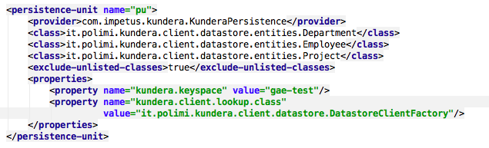
Kundera integration
Single persistence provider
NoSQL support inherited by Kundera
Easier Configuration through standard persistence.xml

Slide 11
Work objectives
Integrate Kundera in the CPIM library
Contribute to the open source project Kudera
Integrate the migration and synchronization system Hegira
Evaluation

Slide 12
Contributions to Kundera
Paradigm shift
support for DaaS
Bug fix Kundera deploy on PaaS
Two newly developed clients
Azure Tables¹
GAE Datastore²
1: https://github.com/deib-polimi/kundera-azure-table 2: https://github.com/deib-polimi/kundera-gae-datastore

Slide 13

Developed clients
GAE Datastore | Azure Tables
No ancestor path support | Full suport to partition key and row key
Key(table, id) | partitionKey_rowKey
GAE Datastore | Azure Tables
No ancestor path support | Partition key bounded to table name
columnFamily_key | columnFamily_key
master
migration
Notes:
Garantire consistenza in lettura -> primitive
Ancestor path ->
Usare data model più possibile
Restringo ma interoperability

Slide 14
Work objectives
Integrate Kundera in the CPIM library
Contribute to the open source project Kudera
Integrate the migration and synchronization system Hegira
Evaluation

Slide 15
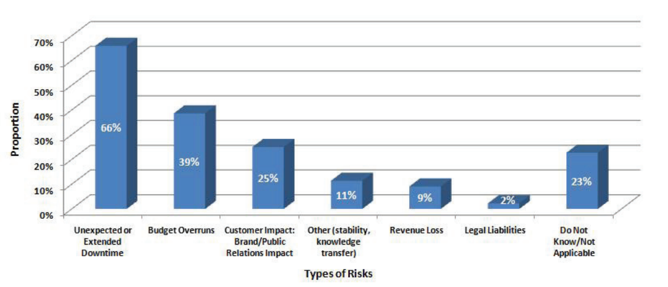
Data migration
move application to another cloud provider
move data to a database that better fit requirements
load balancing, system expansion, failure recovery, costs, etc.
modern computer systems are expected to be up continuously
data synchronization between the two involved systems

Slide 16
Hegira support
Intercept transparently user operations (DMQ)
Translate operations to SQL statements
Send them to the Hegira commit-log

Slide 17
Work objectives
Integrate Kundera in the CPIM library
Contribute to the open source project Kudera
Integrate the migration and synchronization system Hegira
Evaluation

Slide 18

Cloud Serving Benchmark
Framework for evaluating the performance of different NoSQL databases
Workload
100.000 entities
Load phase
(write)
produces
Write operation report
Transaction phase (read)
produces
Read
operation report
Compare Kundera client w.r.t. the use of low-level API for the same operations
Development of new adapter for operations through Kundera
Development of new adapter for operations through the low-level API

Slide 19
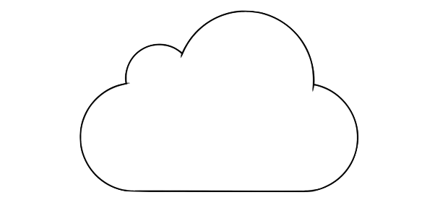
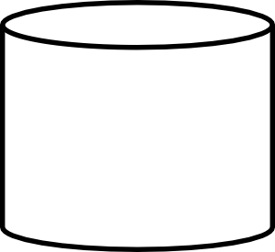


Environment setup
4 core 7 GB RAM
YCSB +
YCSB adapters
+ Kundera Azure Tables client
Azure Tables
4 core 3.6 GB RAM
YCSB +
YCSB adapters
+ Kundera GAE Datastore client
Datastore

Slide 20
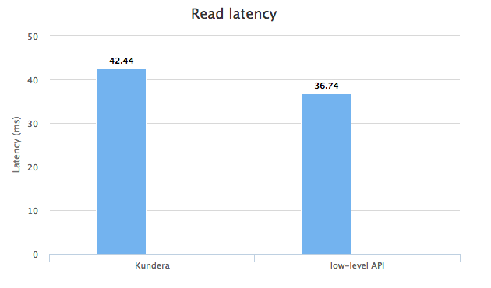
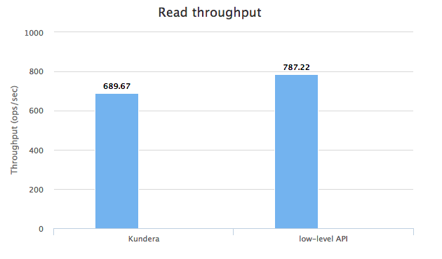
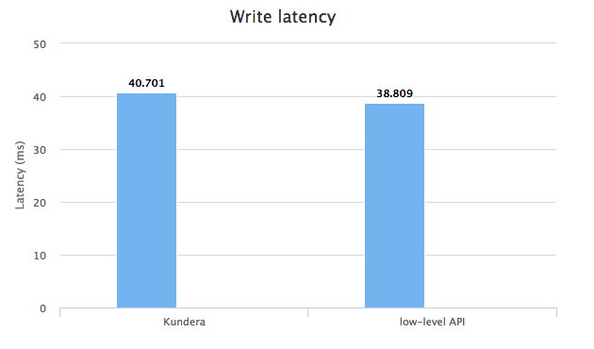
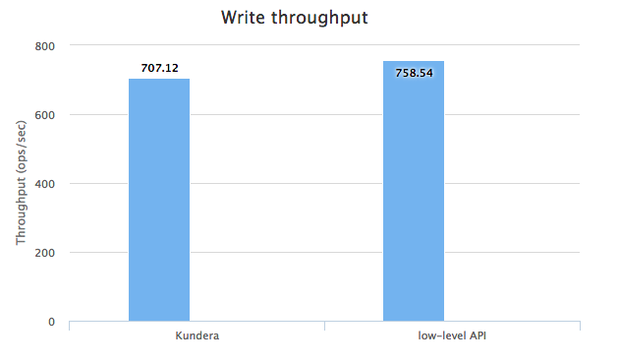
Results - Azure Tables

Slide 21
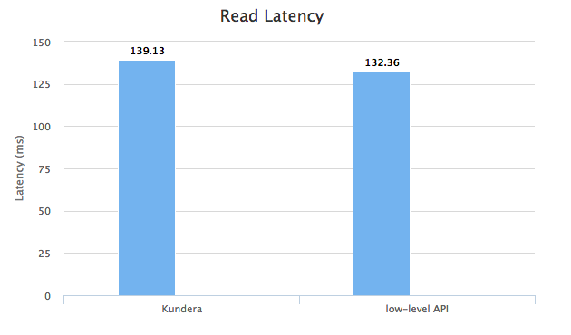
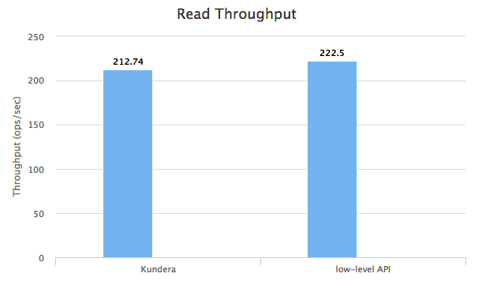
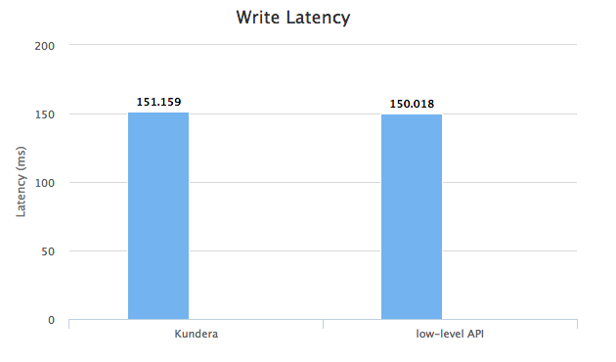
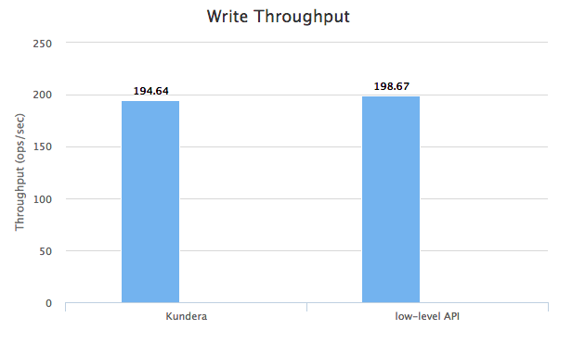
Results - GAE Datastore

Slide 22
Results comparison
Azure Tables Kunedra overhead w.r.t low-level API
Read latency | Read throughput | Write latency | Write throughput
13,43 % | 12,39 % | 4,75 % | 6,78 %
Google Datastore Kunedra overhead w.r.t low-level API
Read latency | Read throughput | Write latency | Write throughput
4,36 % | 4,39 % | 0,76 % | 2,03 %

Slide 23
Conclusions
Contributions:
Integration of Kundera in CPIM library
New Kundera clients to support Google Datastore and Azure Tables
Hegira integration in the CPIM library
Future work:
Compare developed client performance with the ones of the other client developed by Kundera team

Slide 24
THANK YOU

