Slide 1
Scuola di Ingegneria Industriale e dell'Informazione
Corso di Laurea Magistrale in Ingegneria Informatica
Anno Accademico 2013 - 2014
Avoiding CRUD operations lock-in in NoSQL databases: extension of the CPIM library
Candidato: Fabio Arcidiacono (799001)
Relatore: Prof.ssa Elisabetta Di Nitto
Correlatore: Ing. Marco Scavuzzo

Slide 2
Data management systems
RDBMS
NoSQL
Well structured data
Relational model
Vertical scaling
ACID transactions
SQL
Non-structured data
Various data models
Horizontal scaling
BASE properties
Proprietary API
Notes:
Sharding
Atomicity, Consistency, Isolation, Durability
Basically Available, Soft state, Eventual consistency

Slide 3
NoSQL Common language approaches
Meta-model
Apache MetaModel
SOS platform
SQLification
Apache Phoenix
UnQL
Native support
ORM
Kundera
PlayORM
Spring-data
Apache Gora

Slide 4
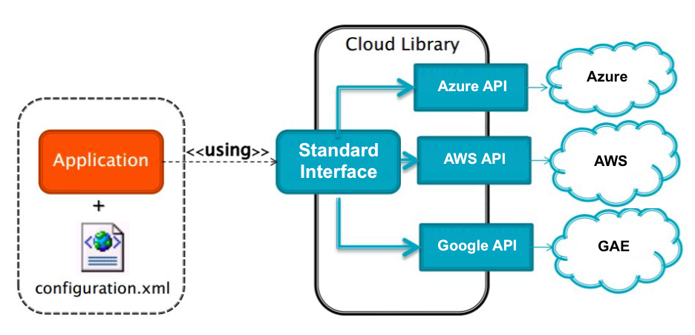
Cloud Platform Independent Model
Abstract application logic from the specific PaaS Provider to overcome the vendor lock-in
Many supported services:
Blob
NoSQL
Memcache
Queue
Mail
SQL
Notes:
Astrazione per servizi allo scopo di evitare lock-in
Dire servizi

Slide 5
Work objectives
Integrate Kundera in the CPIM library
Contribute to the open source project Kundera
Integrate the migration and synchronization system Hegira
Evaluation

Slide 6
Work objectives
Integrate Kundera in the CPIM library
Contribute to the open source project Kundera
Integrate the migration and synchronization system Hegira
Evaluation

Slide 7
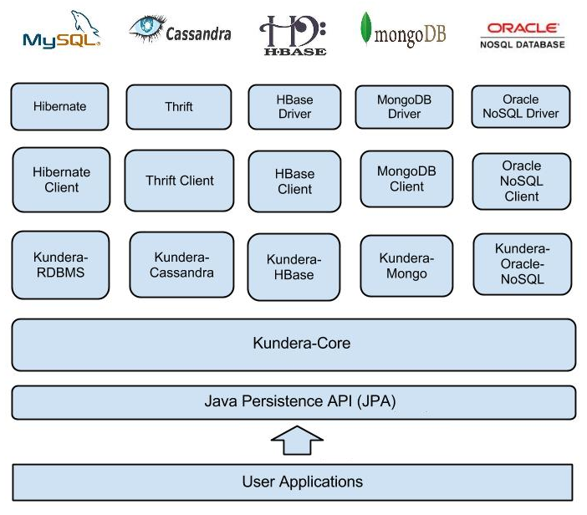
Kundera
A JPA 2.1 ORM Library for NoSQL databases
ORM operation (through EntityManager interface)
JPQL queries (DELETE and UPDATE)
On-premises databases:
Cassandra
HBase
MongoDB
Oracle NoSQL
Redis
Neo4j
Couchdb
Elastic Search
MySQL
Notes:
No DaaS

Slide 8
Why Kundera
Open source
Developed with extensibility as primary goal
Support to many different NoSQL databases
Polyglot persistency
In the field since 2010 with an active community
Already used in production

Slide 9
Original CPIM NoSQL service implementation
Many JPA providers
Duplicated code
No complete code portability
Choice of the NoSQL database strictly bounded to the cloud provider (e.g. App Engine → Datastore)
Limited NoSQL databases support
Azure EntityManager
jpa4Azure
Azure EntityManagerFactory
CloudEntityManagerFactory
AWS EntityManager
SimpleJPA
CloudEntityManager
AWS EntityManagerFactory
GAE EntityManager
Google JPA
GAE EntityManagerFactory

Slide 10
Kundera integration
Single persistence provider
Complete code portability
NoSQL support inherited by Kundera
Easier Configuration through standard persistence.xml
CloudEntityManagerFactory
Kundera
CloudEntityManager

Slide 11
Work objectives
Integrate Kundera in the CPIM library
Contribute to the open source project Kundera
Integrate the migration and synchronization system Hegira
Evaluation

Slide 12
Contributions to Kundera
Paradigm shift
Off-premises databases → DaaS solutions
Bug fix Kundera deploy on PaaS
two newly developed clients
Azure Tables¹
GAE Datastore²
1: https://github.com/deib-polimi/kundera-azure-table 2: https://github.com/deib-polimi/kundera-gae-datastore

Slide 13

Developed clients
master
Exploit consistency mechanisms as much as possible
GAE Datastore
→ no Ancestor Path support
Azure Tables
→ manage partition key and row key
migration
Limited support to consistency mechanisms but achieve interoperability
GAE Datastore
→ no Ancestor Path support
Azure Tables
→ fix partition key to table name
Notes:
Garantire consistenza in lettura -> primitive
Ancestor path ->
Usare data model più possibile
Restringo ma interoperability

Slide 14
Work objectives
Integrate Kundera in the CPIM library
Contribute to the open source project Kundera
Integrate the migration and synchronization system Hegira
Evaluation

Slide 15
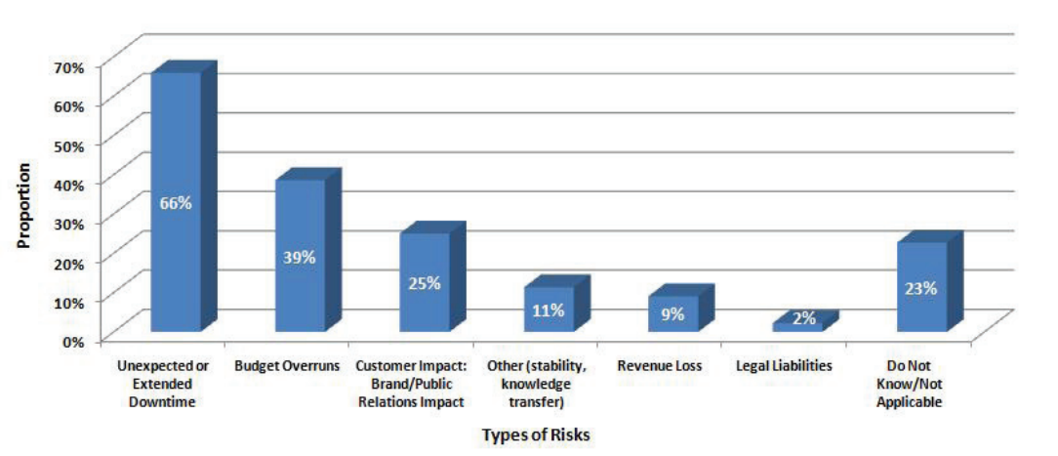
Data migration
move application to another cloud provider
move data to a database that better fit requirements
load balancing, system expansion, failure recovery, costs, etc.
modern computer systems are expected to be up continuously
data synchronization between the two involved systems

Slide 16
Hegira support
Intercept transparently user operations (DMQ)
Translate operations to SQL statements
Send them to the Hegira commit-log

Slide 17
Work objectives
Integrate Kundera in the CPIM library
Contribute to the open source project Kundera
Integrate the migration and synchronization system Hegira
Evaluation

Slide 18

Cloud Serving Benchmark
Framework for evaluating the performance of different NoSQL databases
Workload
100.000 entities
Load phase
(write)
produces
Write operation report
Transaction phase (read)
produces
Read
operation report
Compare Kundera client w.r.t. the use of low-level API for the same operations
Development of new adapter for operations through Kundera
Development of new adapter for operations through the low-level API

Slide 19
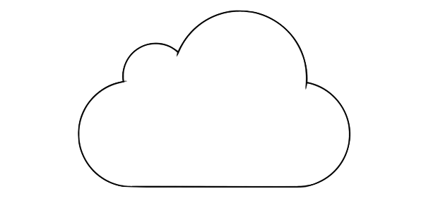
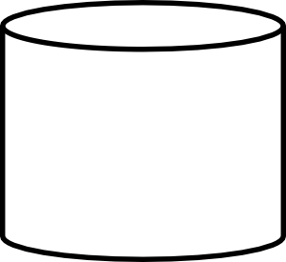


Environment setup
4 core 7 GB RAM
YCSB +
YCSB adapters
+ Kundera Azure Tables client
Azure Tables
4 core 3.6 GB RAM
YCSB +
YCSB adapters
+ Kundera GAE Datastore client
Datastore

Slide 20
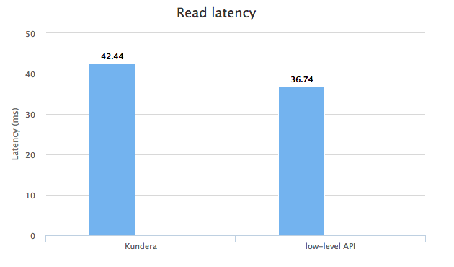
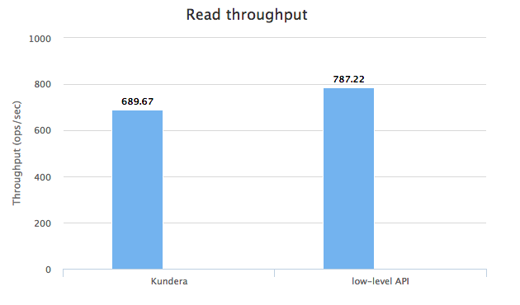
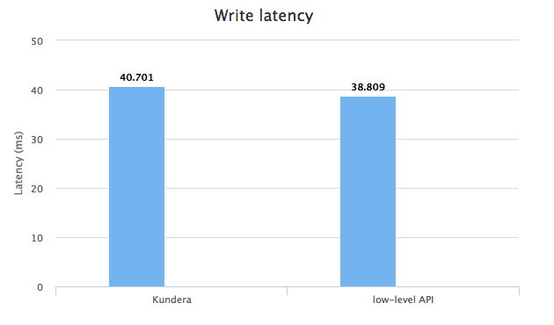
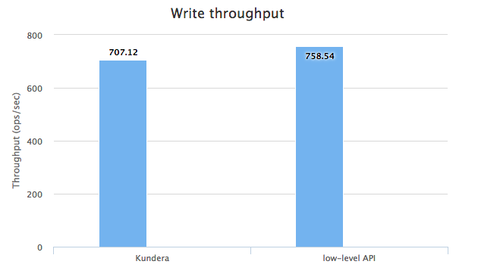
Results - Azure Tables

Slide 21
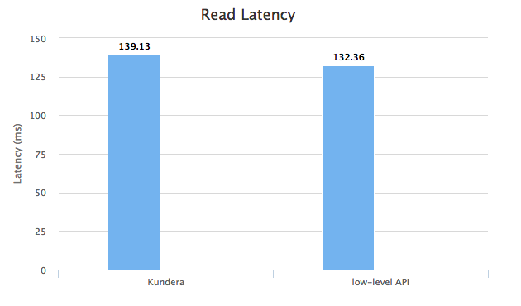
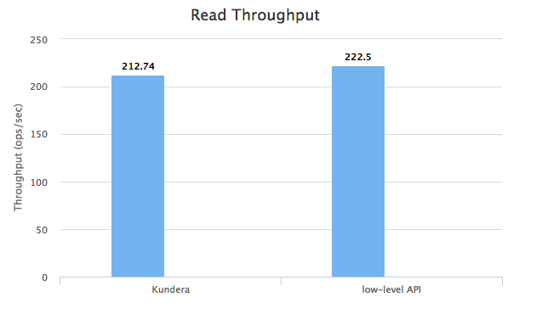
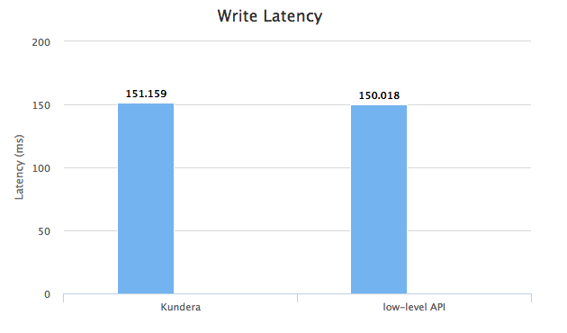
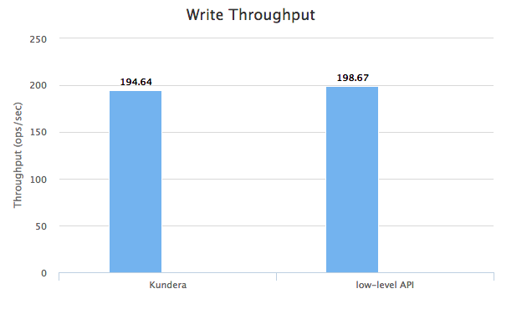
Results - GAE Datastore

Slide 22
Results comparison
Azure Tables Kunedra overhead w.r.t low-level API
Read latency | Read throughput | Write latency | Write throughput
13,43 % | 12,39 % | 4,75 % | 6,78 %
Google Datastore Kundera overhead w.r.t low-level API
Read latency | Read throughput | Write latency | Write throughput
4,36 % | 4,39 % | 0,76 % | 2,03 %

Slide 23
Conclusions
Contributions:
Integration of Kundera in CPIM library
New Kundera clients to support Google Datastore and Azure Tables
Hegira integration in the CPIM library
Future work:
Compare developed client performance with the ones of the other client developed by Kundera team

Slide 24
THANK YOU

