Slide 1

“La Sapienza” University of Rome
Faculty of information engineering, information technology and statistics
Department of informatics, automation and control engineering "ANTONIO RUBERTI"
Degree program: Artificial Intelligence and Robotics
Subject: Elective on AI – Reasoning Agents
Presentation
Imitation Learning over Heterogeneous Agents with Restraining Bolts
Students: ARCINIEGAS, Andrés (1836521)
OREL, Egor (1836231)
MAKINWA, Sayo (1858908)
IMBAJOA, David (1922212)
Professor: Giuseppe de Giacomo, PhD.
Rome, 2020

Slide 2
Outline
Original paper
Problem definition
Restraining Bolts
Imitation Learning
Proposed solution
Case studies:
Breakout
Sapientino
Minecraft
Additional examples
TODO

Slide 3

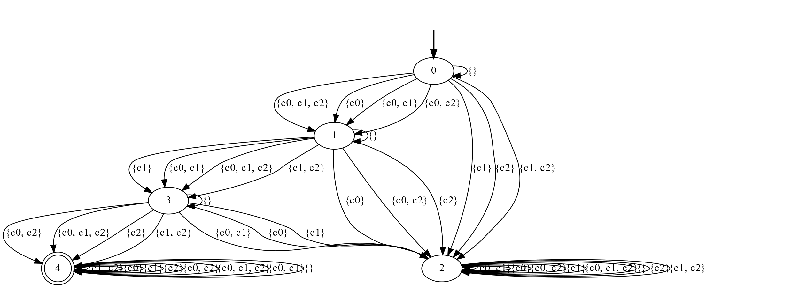
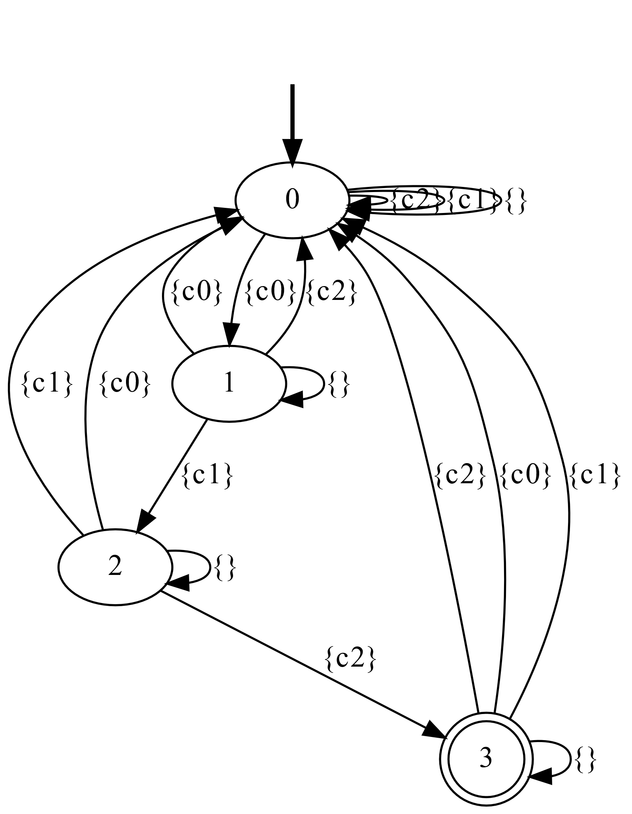
BREAKOUT - Diagrams
True automaton
Learned automaton

Slide 4
BREAKOUT - Diagrams
True automaton
Learned automaton
Formula string
< (!c0 & !c1 & !c2) * ; c0 ;
(!c0 & !c1 & !c2) * ; c1 ;
(!c0 & !c1 & !c2) * ; c2 >tt
Formula
<(((!(c1) & !(c0) & !(c2)))* ; c0 ; ((!(c1) & !(c0) & !(c2)))* ; c1 ; ((!(c1) & !(c0) & !(c2)))* ; c2)>(tt)
Labels
{'c0', 'c1', 'c2'}

Slide 5
BREAKOUT – traces and DFA
TRACES are the performed actions.
Formula string
< (!c0 & !c1 & !c2) * ; c0 ; (!c0 & !c1 & !c2) * ; c1 ; (!c0 & !c1 & !c2)*;c2 >tt
POSITIVE TRACES
c0;c1;c2
c0;c1;c2
c0;c1;c2
c0;c1;c2
c0;c1;c2
c0;c1;c2
c0;c1;c2
c0;c1;c2
c0;c1;c2
c0;c1;c2
c0;c1;c2
c0;c1;c2
c0;c1;c2
c0;c1;c2
c0;c1;c2
c0;c1;c2
c0;c1;c2
NEGATIVE TRACES
c1;c0;c2
c1;c2
c1;c2
c0;c2;c1
c2;c1
c1;c2;c0
c2;c1
c1;c2;c0
c2;c1;c0
c2;c1
c1;c0
c1;c0
c0;c2;c1
c2;c1;c0
c2;c1;c0
c2;c0
{'_states': frozenset({'0', '1', '2', '3'}),
'_alphabet': frozenset({{}, {c1}, {c0}, {c2}}),
'_initial_state': '0',
'_accepting_states': frozenset({'3'}),
'_transition_function’:
{'2': {{c2}: '3', {c0}: '0', {c1}: '0', {}: '2'},
'0': {{c2}: '0', {c0}: '1', {c1}: '0', {}: '0'},
'3': {{c2}: '0', {c0}: '0', {c1}: '0', {}: '3'},
'1': {{c2}: '0', {c0}: '0', {c1}: '2', {}: '1'}},
'_idx_to_state': ['2', '3', '1', '0'],
'_state_to_idx': {'2': 0, '3': 1, '1': 2, '0': 3},
'_idx_to_symbol': [{c1}, {}, {c0}, {c2}],
'_symbol_to_idx': {{c1}: 0, {}: 1, {c0}: 2, {c2}: 3},
'_idx_transition_function': {0: {3: 1, 2: 3, 0: 3, 1: 0},
1: {3: 3, 2: 3, 0: 3, 1: 1},
2: {3: 3, 2: 3, 0: 0, 1: 2},
3: {3: 3, 2: 2, 0: 3, 1: 3}},
'_idx_delta_by_state': {0: {(0, 3), (1, 0), (2, 3), (3, 1)},
1: {(0, 3), (1, 1), (2, 3), (3, 3)},
2: {(0, 0), (1, 2), (2, 3), (3, 3)},
3: {(0, 3), (1, 3), (2, 2), (3, 3)}},
'_idx_initial_state': 3,
'_idx_accepting_states': frozenset({1})}
From traces, the DFA is generated:

Slide 6
BREAKOUT – traces and DFA
{'_states': frozenset({'0', '1', '2', '3'}),
'_alphabet': frozenset({{}, {c1}, {c0}, {c2}}),
Alphabet = Sigma = Set of possible actions
'_initial_state': '0',
'_accepting_states': frozenset({'3’}), # Goal state
'_transition_function’:
{'2': {{c2}: '3', {c0}: '0', {c1}: '0', {}: '2'},
'0': {{c2}: '0', {c0}: '1', {c1}: '0', {}: '0'},
'3': {{c2}: '0', {c0}: '0', {c1}: '0', {}: '3'},
'1': {{c2}: '0', {c0}: '0', {c1}: '2', {}: '1’}},
# This define the edges of the graph
'_idx_to_state': ['2', '3', '1', '0'],
'_state_to_idx': {'2': 0, '3': 1, '1': 2, '0': 3},
'_idx_to_symbol': [{c1}, {}, {c0}, {c2}],
'_symbol_to_idx': {{c1}: 0, {}: 1, {c0}: 2, {c2}: 3},
'_idx_transition_function': {0: {3: 1, 2: 3, 0: 3, 1: 0},
1: {3: 3, 2: 3, 0: 3, 1: 1},
2: {3: 3, 2: 3, 0: 0, 1: 2},
3: {3: 3, 2: 2, 0: 3, 1: 3}},
'_idx_delta_by_state': {0: {(0, 3), (1, 0), (2, 3), (3, 1)},
1: {(0, 3), (1, 1), (2, 3), (3, 3)},
2: {(0, 0), (1, 2), (2, 3), (3, 3)},
3: {(0, 3), (1, 3), (2, 2), (3, 3)}},
'_idx_initial_state': 3,
'_idx_accepting_states': frozenset({1})}
From traces, the DFA is generated:
POSITIVE TRACES
c0;c1;c2
c0;c1;c2
c0;c1;c2
c0;c1;c2
c0;c1;c2
c0;c1;c2
NEGATIVE TRACES
c1;c0;c2
c1;c2
c1;c2
c0;c2;c1
c2;c1
c1;c2;c0

Slide 7
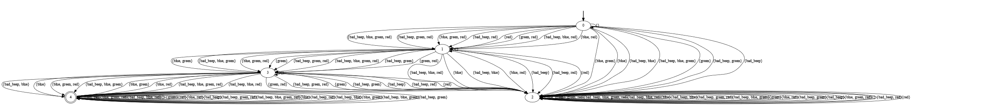
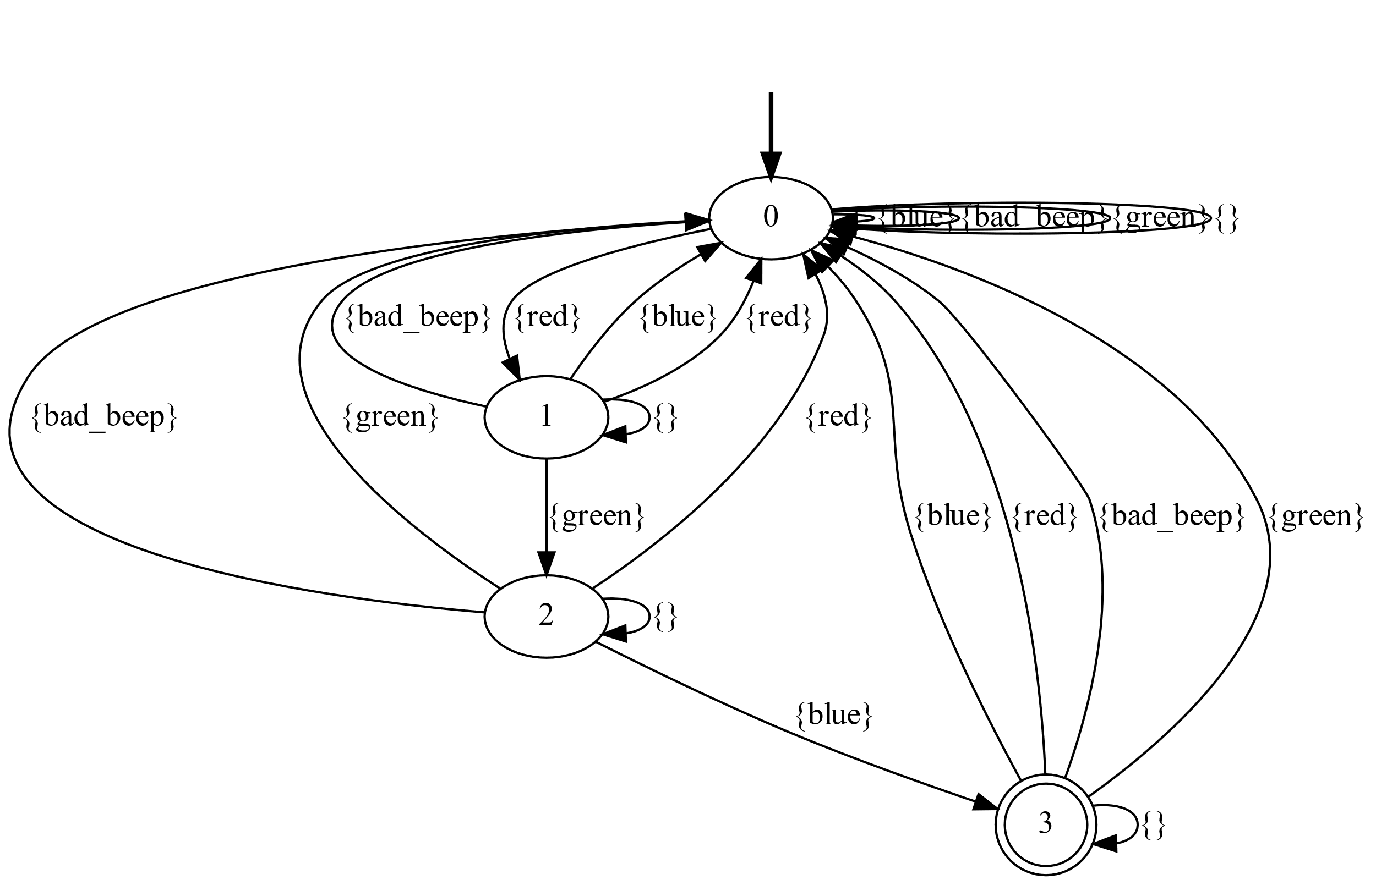
Sapientino - Diagrams
True automaton
Learned automaton

Slide 8
SAPIENTINO - Diagrams
Learned automaton
Formula:
<(!bad_beep & !red & !green & !blue)*;red;
(!bad_beep & !red & !green & !blue)*;green;
(!bad_beep & !red & !green & !blue)*;blue>tt
{'_states': frozenset({'0', '1', '2', '3'}),
'_alphabet': frozenset({{}, {blue}, {red}, {bad_beep}, {green}}),
'_initial_state': '0',
'_accepting_states': frozenset({'3'}),
'_transition_function’:
{'1': {{blue}: '0', {red}: '0', {bad_beep}: '0’, {green}: '2', {}: '1'},
'0': {{blue}: '0', {red}: '1', {bad_beep}: '0', {green}: '0', {}: '0'},
'2': {{blue}: '3', {red}: '0', {bad_beep}: '0', {green}: '0', {}: '2'},
'3': {{blue}: '0', {red}: '0', {bad_beep}: '0', {green}: '0', {}: '3'}},
'_idx_to_state': ['0', '2', '3', '1'],
'_state_to_idx': {'0': 0, '2': 1, '3': 2, '1': 3},
'_idx_to_symbol': [{blue}, {}, {red}, {bad_beep}, {green}],
'_symbol_to_idx': {{blue}: 0, {}: 1, {red}: 2, {bad_beep}: 3, {green}: 4},
'_idx_transition_function’:
{0: {0: 0, 2: 3, 3: 0, 4: 0, 1: 0},
1: {0: 2, 2: 0, 3: 0, 4: 0, 1: 1},
2: {0: 0, 2: 0, 3: 0, 4: 0, 1: 2},
3: {0: 0, 2: 0, 3: 0, 4: 1, 1: 3}},
'_idx_delta_by_state’:
{0: {(0, 0), (1, 0), (2, 3), (3, 0), (4, 0)},
1: {(0, 2), (1, 1), (2, 0), (3, 0), (4, 0)},
2: {(0, 0), (1, 2), (2, 0), (3, 0), (4, 0)},
3: {(0, 0), (1, 3), (2, 0), (3, 0), (4, 1)}},
'_idx_initial_state': 0,
'_idx_accepting_states': frozenset({2})}
POSITIVE TRACES
red;green;blue
red;green;blue
red;green;blue
red;green;blue
red;green;blue
red;green;blue
red;green;blue
red;green;blue
red;green;blue
red;green;blue
NEGATIVE TRACES
bad_beep
green
bad_beep
bad_beep
bad_beep
bad_beep
bad_beep
red;red
bad_beep
red;red
From traces, the DFA is generated:

Slide 9
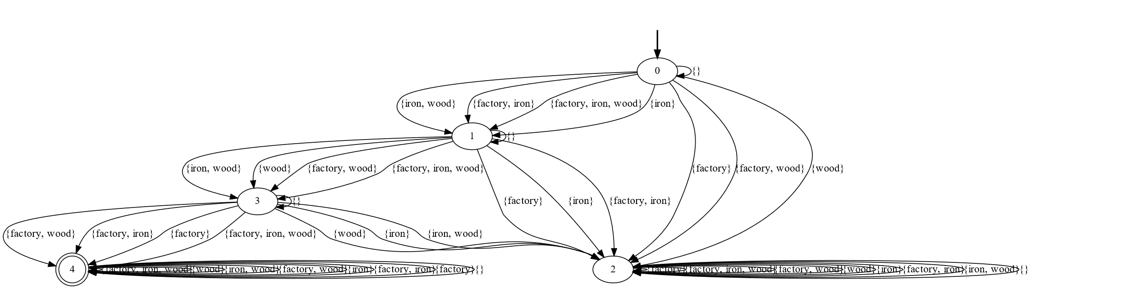
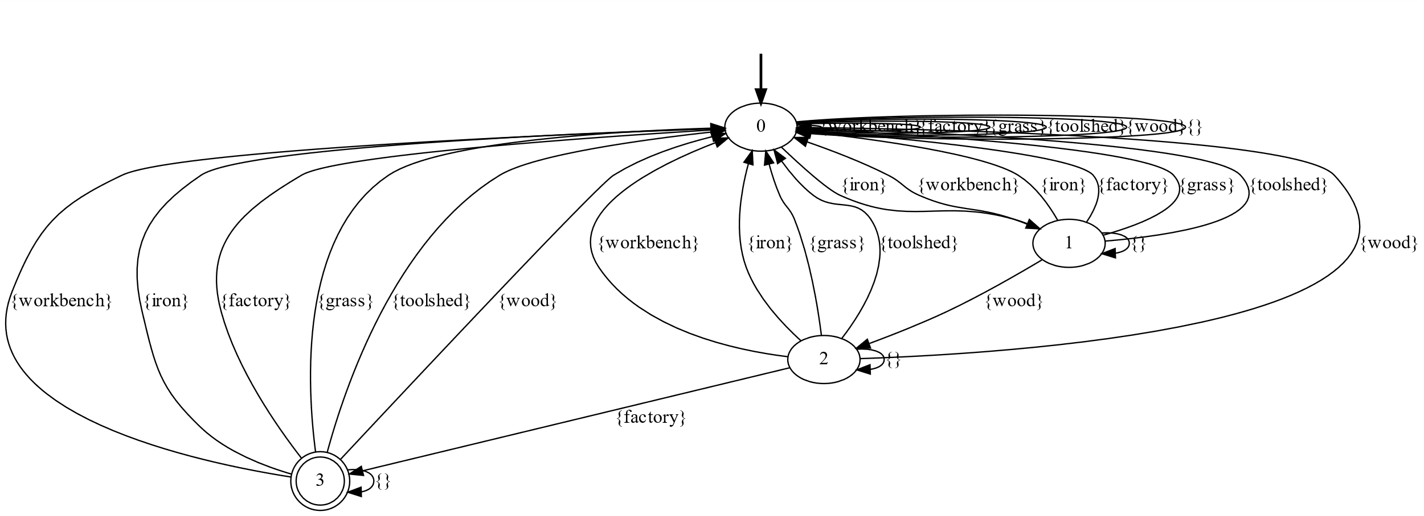
Minecraft - Diagrams
True automaton
Learned automaton

Slide 10
Minecraft – DFA Generation
FORMULA:
<(!iron & !factory & !wood)*;iron;
(!iron & !factory & !wood)*;wood;
(!iron & !factory & !wood)*;factory>tt
From traces, the DFA is generated:
POSITIVE TRACES
iron;wood;factory
iron;wood;factory
iron;wood;factory
iron;wood;factory
iron;wood;factory
iron;wood;factory
iron;wood;factory
iron;wood;factory
iron;wood;factory
iron;wood;factory
iron;wood;factory
iron;wood;factory
iron;wood;factory
iron;wood;factory
iron;wood;factory
NEGATIVE TRACES
iron;wood;wood
toolshed
workbench
factory
workbench
iron;iron
iron;toolshed
grass
wood
toolshed
grass
wood
toolshed
wood
iron;wood;grass
{'_states': frozenset({'0', '1', '2', '3'}),
'_alphabet': frozenset({{}, {iron}, {factory}, {toolshed}, {workbench}, {wood}, {grass}}),
'_initial_state': '0',
'_accepting_states': frozenset({'3'}),
'_transition_function': {'1': {{grass}: '0', {wood}: '2', {iron}: '0', {factory}: '0', {workbench}: '0', {toolshed}: '0’, {}: '1’},
'0': {{grass}: '0', {wood}: '0', {iron}: '1', {factory}: '0', {workbench}: ‘0', {toolshed}: '0', {}: '0’},
'2': {{grass}: '0', {wood}: '0', {iron}: '0', {factory}: '3', {workbench}: '0', {toolshed}: '0', {}: '2’},
'3': {{grass}: '0', {wood}: '0', {iron}: '0', {factory}: '0', {workbench}: '0', {toolshed}: '0', {}: '3'}},
'_idx_to_state': ['3', '1', '0', '2'],
'_state_to_idx': {'3': 0, '1': 1, '0': 2, '2': 3},
'_idx_to_symbol': [{}, {iron}, {factory}, {toolshed}, {workbench}, {wood}, {grass}],
'_symbol_to_idx': {{}: 0, {iron}: 1, {factory}: 2, {toolshed}: 3, {workbench}: 4, {wood}: 5, {grass}: 6},
'_idx_transition_function’:
{0: {6: 2, 5: 2, 1: 2, 2: 2, 4: 2, 3: 2, 0: 0},
1: {6: 2, 5: 3, 1: 2, 2: 2, 4: 2, 3: 2, 0: 1},
2: {6: 2, 5: 2, 1: 1, 2: 2, 4: 2, 3: 2, 0: 2},
3: {6: 2, 5: 2, 1: 2, 2: 0, 4: 2, 3: 2, 0: 3}},
'_idx_delta_by_state’:
{0: {(0, 0), (1, 2), (2, 2), (3, 2), (4, 2), (5, 2), (6, 2)},
1: {(0, 1), (1, 2), (2, 2), (3, 2), (4, 2), (5, 3), (6, 2)},
2: {(0, 2), (1, 1), (2, 2), (3, 2), (4, 2), (5, 2), (6, 2)},
3: {(0, 3), (1, 2), (2, 0), (3, 2), (4, 2), (5, 2), (6, 2)}},
'_idx_initial_state': 2,
'_idx_accepting_states': frozenset({0})}

Slide 11
Comparison
INITIAL FORMULA (Expert input)
(They are basically the same formula, with different names)
BREAKOUT:
<(!c0 & !c1 & !c2)*;c0;
(!c0 & !c1 & !c2)*;c1;
(!c0 & !c1 & !c2)*;c2 >tt
SAPIENTINO
<(!bad_beep & !red & !green & !blue)*;red;
(!bad_beep & !red & !green & !blue)*;green;
(!bad_beep & !red & !green & !blue)*;blue>tt
MINECRAFT:
<(!iron & !factory & !wood)*;iron;
(!iron & !factory & !wood)*;wood;
(!iron & !factory & !wood)*;factory>tt

Slide 12
Output diagram – learned automaton
BREAKOUT:
SAPIENTINO:
MINECRAFT:

