Slide 1
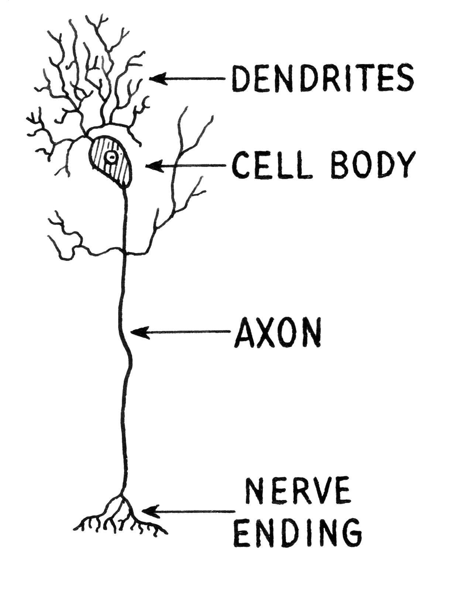
NEURON
wikimedia commons: http://commons.wikimedia.org/wiki/File:Dendrite_(PSF).png

Slide 2
Cajal – Pyramidal Neuron

Slide 3
Cajal – Purkinje Cell

Slide 4
Action Potential
Hodgkin, A.L., and Huxley, A.F. (1939).
Action potentials recorded from inside a nerve fiber
Nature, 144:710

Slide 5
Voltage dynamics
The voltage inside the cell lower than outside, this is called the membrane potential, between -70mV and -55mV.
Inputs from other cells change the voltage, inhibitory cells decrease it, excitatory cells increase it.
If the voltage exceeds a threshold the neuron sends out a spike.

Slide 6
A retinal ganglion cell spiking
https://www.youtube.com/watch?v=KE952yueVLA

Slide 7
Synapse
http://upload.wikimedia.org/wikipedia/commons/b/b2/SynapseIllustration2.png

Slide 8
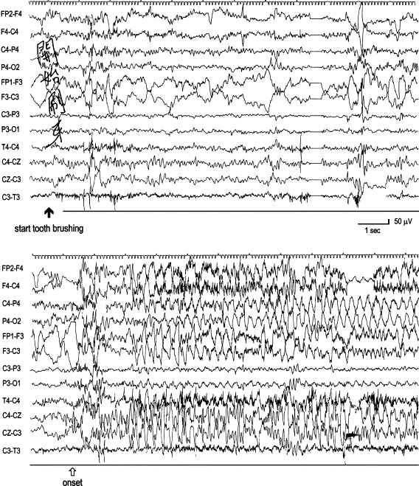
EEG
Chuang et al. 2004. Tooth-brushing epilepsy with ictal orgasms

Slide 9
fMRI
From wikipedia

Slide 10
In vivo electrophysiology
From: http://neuroscience.cornell.edu/faculty.html

Slide 11
In vitro electrophysiology – patch clamping
From: https://en.wikipedia.org/wiki/Patch_clamp

Slide 12
Calcium imaging – Zebra fish
q40dtdkZUN4
https://www.youtube.com/watch?v=q40dtdkZUN4

Slide 13
Optogenetics
From: http://web.stanford.edu/group/dlab/optogenetics/

Slide 14
A brain
https://upload.wikimedia.org/wikipedia/commons/4/49/Human_brain_NIH.jpg

Slide 15
Sagital view
https://commons.wikimedia.org/wiki/File:Brain_bulbar_region.PNG

Slide 16
Cerebellar ataxia.
https://en.wikipedia.org/wiki/File:Thomas-fig68,69-p127.png

Slide 17
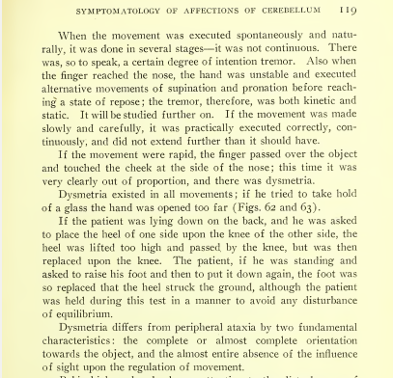
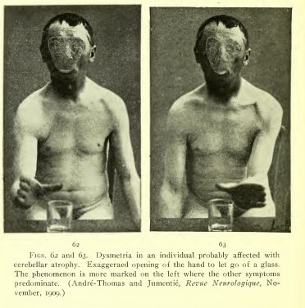
Cerebellar dysmetria.
From Thomas: Cerebellar Functions (1912)

Slide 18
Thalamus
https://en.wikipedia.org/wiki/File:Brain_chrischan_thalamus.jpg

Slide 19
Thalamus - routing
http://faculty.clintoncc.suny.edu/faculty/michael.gregory/default.htm
http://creativecommons.org/licenses/by-nc-sa/3.0/deed.en_US

Slide 20
Hippocampus
https://commons.wikimedia.org/wiki/File:Hippocampus_small.gif

Slide 21
H.M. - Henry Molaison
Scoville, W. B., & Milner, B. (1957).
Loss of recent memory after bilateral hippocampal lesions.
Journal of neurology, neurosurgery, and psychiatry, 20(1), 11.

Slide 22
Clive Wearing
https://www.youtube.com/watch?v=Vwigmktix2Y

Slide 23
Amygdala
http://en.wikipedia.org/Amygdala

Slide 24
Drawing by S.M.
Adolphs, R., Tranel, D., Damasio, H., & Damasio, A. R. (1995).
Fear and the human amygdala.
The Journal of neuroscience, 15(9), 5879-5891.

Slide 25
Basal Ganglia
https://en.wikipedia.org/wiki/File:Basal_Ganglia_and_Related_Structures.svg

Slide 26
Basal ganglia – decides between cortical areas competing for motor control.
https://en.wikipedia.org/wiki/File:Basal-ganglia-classic.png

Slide 27
Parkinsonian gait
http://en.wikipedia.org/wiki/Parkinson's_disease

Slide 28
Macaque cortex
https://en.wikipedia.org/wiki/File:Brainmaps-macaque-hippocampus.jpg

Slide 29
Layers of the neocortex
Gray's anatomy

Slide 30
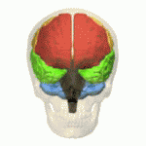
Lobes of the cortex
Orange – Frontal Lobe, Yellow – Parietal Lobe
Green – Temporal Lobe, Pink – Occipital Lobe
https://en.wikipedia.org/wiki/File:Four_lobes_animation_small2.gif

Slide 31
Tan / Hodor
https://www.youtube.com/watch?v=h5X6Qn9hQHk

Slide 32
Broca and Wernicke areas
https://en.wikipedia.org/wiki/File:BrocasAreaSmall.png

Slide 33
Secondary zone of left temporal region
A.R. Luria (1973) The working brain, an introduction to neuropsychology. p140

Slide 34
Andreas Vesalius' sketch of the visual pathway from 1543.
https://en.wikipedia.org/wiki/File:1543,Vesalius%27Fabrica,VisualSystem,V1.jpg

Slide 35
Somatomotor and somatosensory cortex
https://en.wikipedia.org/wiki/File:Cerebrum_lobes.svg

Slide 36
The motor homunculus
http://commons.wikimedia.org/wiki/File:Homunculus.PNG

Slide 37
The sensory homunculus
http://commons.wikimedia.org/wiki/File:Homunculus.jpg

Slide 38
Brodmann areas
https://en.wikipedia.org/wiki/Brodmann_area

Slide 39
Names of brain areas.
Names often reflect shape not function Abbreviations are often used – see the list on the website.
https://en.wikipedia.org/wiki/File:Hippocampus_and_seahorse_cropped.JPG

