Slide 1
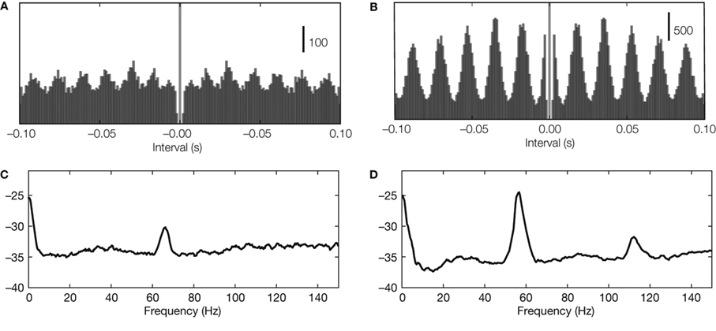
Autocorrelograms
Detecting neural oscillations. (A,B) Oscillations in autocorrelations in two example recordings
(spike trains recorded from LGN in cat) with oscillation score 10 and 29,
respectively. (C,D) Oscillations in spectral power (same spike trains as used for panel A).
From Exploring the function of neural oscillations in early sensory system, Koepsell, Wang,
Hirsch and Sommer (2010) Front. Neurosci. 3:00010

Slide 2
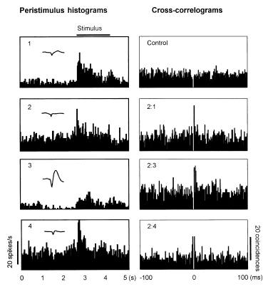
Peristimulus & cross correlogram
Peristimulus time histograms (left) and cross-correlograms (right) for neurons recorded from inferior temporal cortex for monkeys performing prompted memory tasks.
From Recognition memory: neuronal substrate of the judgment of prior occurrence. Brown and Xiang. (1997) Prog. In Neurobiology 55:149

Slide 3
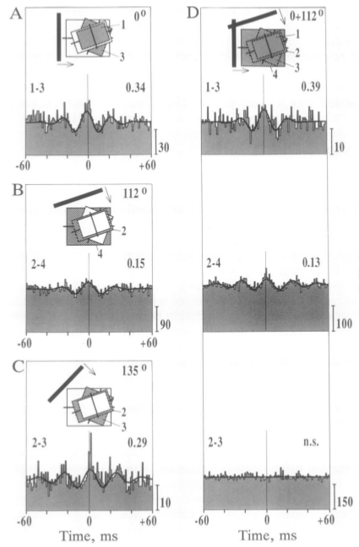
Cross correlograms
Cross correlograms for neurons in V1 in cat showing synchronous activity.
From Direct physiological evidence for scene segmentation by temporal coding Engel, Koenig and Singer. (1991) PNAS 88:9126

Slide 4
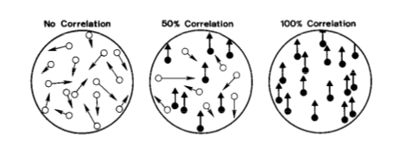
Moving dot task
From The analysis of visual motion: a comparison of neuronal and psychophysical performance Britten, Shalden, Newsome and Movshon (1992) J. Neuroscience 12:4745

Slide 5
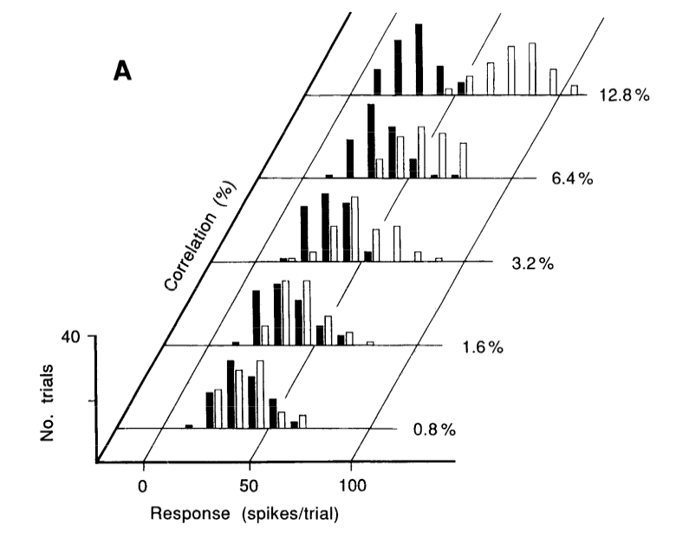
Neuronal responses
From The analysis of visual motion: a comparison of neuronal and psychophysical performance Britten, Shalden, Newsome and Movshon (1992) J. Neuroscience 12:4745

Slide 6
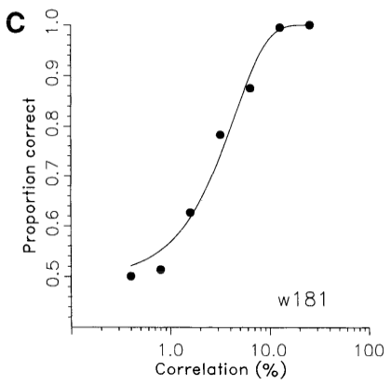
Performance – real and ideal
From The analysis of visual motion: a comparison of neuronal and psychophysical performance Britten, Shalden, Newsome and Movshon (1992) J. Neuroscience 12:4745

