Slide 4
Computer science is no
more the study of
computers than
astronomy is the
study of telescopes.

Slide 7
Tan / Hodor
https://www.youtube.com/watch?v=h5X6Qn9hQHk

Slide 8
Broca and Wernicke areas
https://en.wikipedia.org/wiki/File:BrocasAreaSmall.png

Slide 9
Secondary zone of left temporal region
A.R. Luria (1973) The working brain, an introduction to neuropsychology. p140

Slide 10
H.M. - Henry Molaison
Scoville, W. B., & Milner, B. (1957).
Loss of recent memory after bilateral hippocampal lesions.
Journal of neurology, neurosurgery, and psychiatry, 20(1), 11.

Slide 11
Clive Wearing
https://www.youtube.com/watch?v=Vwigmktix2Y

Slide 12
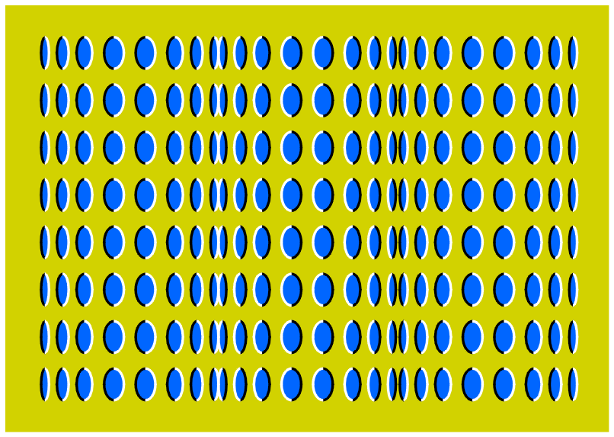

Slide 13
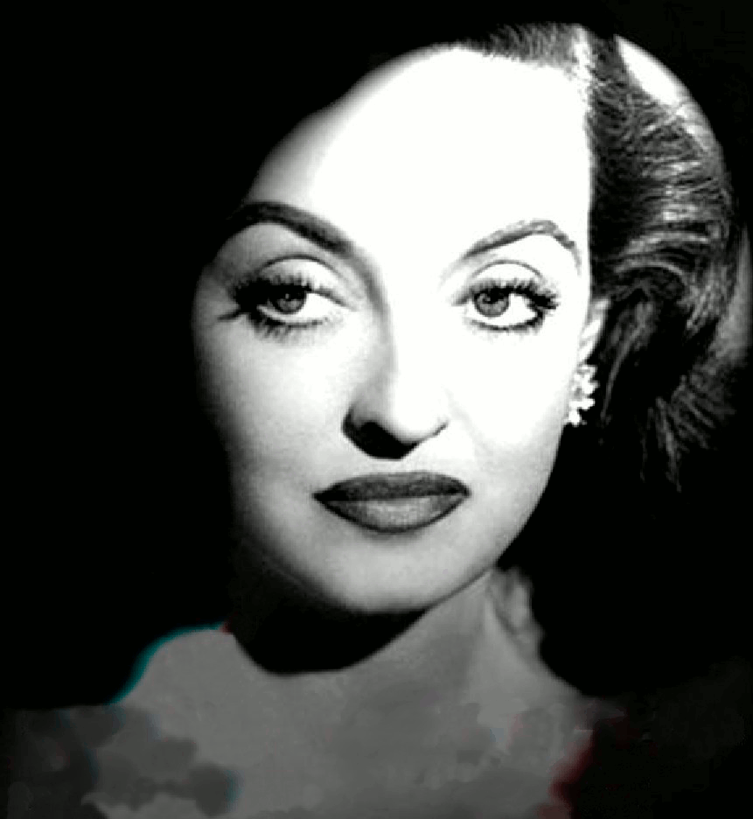

Slide 15
statue in the Bankfield museum
wikipedia.org

Slide 16
Kaniza triangle

Slide 17
cafe wall illusion
wikipedia.org

Slide 18
Benzold effect
discovermagazine.com

Slide 19
Benzold effect - ruined
discovermagazine.com

Slide 20
Lilac chaser
wikipedia.org

Slide 21
Thatcher illusion
blogs.scientificamerican.com

Slide 23
From “Cutting the Stone” by Hieronymous Bosch.

