Slide 1
OpenNutri AI / Algorithm Master Defense
Main midterm claim
Midterm exposition deck | Retrieval, ranking, bilingual search, and feedback reuse
OpenNutri already operates as a closed loop linking search, filtering, PDF acquisition, annotation, and feedback reuse.
Role framing
Retrieval design across multiple scientific sources
Ranking logic before PDF acquisition
EN/TR language split and Turkish-source support
Feedback reuse from annotation outcomes
This deck explains that loop from the AI / algorithm side, then goes deeper into the implementation details likely to matter in the defense.
OpenNutri | AI / algorithm master deck
EN 01

Slide 2
Why this layer exists
The algorithmic problem is not merely collecting papers; it is deciding which papers deserve download and expert time.
01
02
03
Distributed literature
High acquisition cost
Turkish visibility gap
Relevant food-composition papers are spread across Europe PMC, OpenAlex, Semantic Scholar, DergiPark, and local open-access paths. A single-source strategy misses too much.
Blindly downloading every candidate PDF is expensive, noisy, and wasteful. The system needs ranking before acquisition, not only after download.
Turkish studies are underrepresented in standard international food-data systems. Retrieval therefore needs explicit EN/TR separation and Turkish-source support.
Goal of the AI layer: maximize useful paper flow to the annotator while preserving recall and avoiding unnecessary PDF work.
OpenNutri | AI / algorithm master deck
EN 02

Slide 3
What OpenNutri is at midterm
For the AI role, the important point is that the project is one connected loop rather than a separate scraper, backend, and UI.
Search sources
Search gate
Metadata filter
PDF intake
Expert annotation
Feedback update
What it is
What it is not
A human-in-the-loop scientific paper discovery system
A shared data contract between crawler, storage, and annotation
A feedback-driven retrieval system that changes later runs
Not a one-shot scraper that downloads everything
Not only a database schema or only a labeling UI
Not yet a fully automatic extraction engine
OpenNutri | AI / algorithm master deck
EN 03

Slide 4
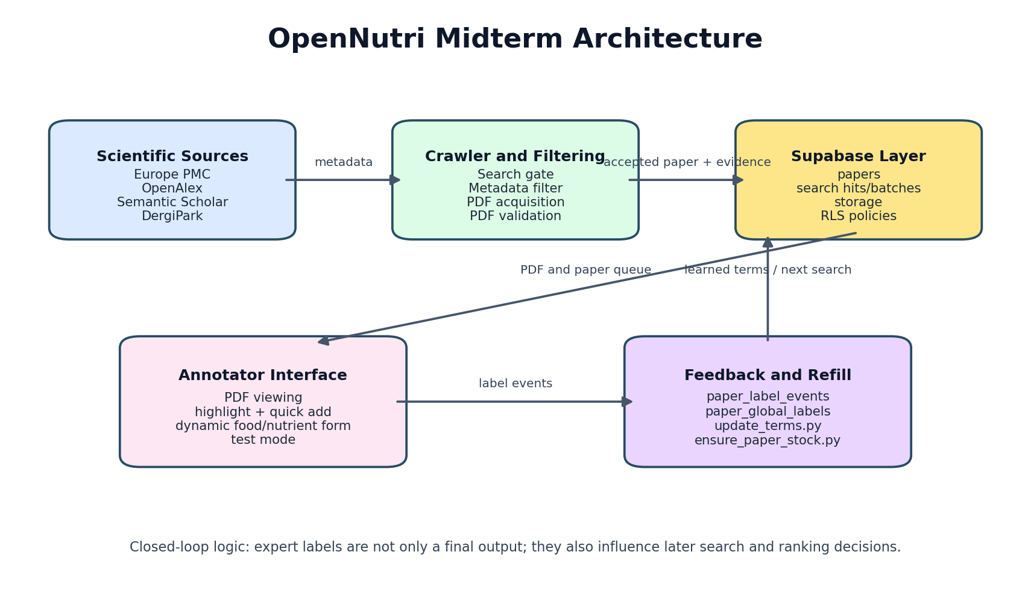
End-to-end architecture
The architecture already links discovery, storage, annotation, and later feedback reuse. This is the system map for the rest of the presentation.
How to read this figure
Search sources produce metadata candidates.
The crawler decides which candidates deserve acquisition.
Accepted papers move into Supabase storage and paper records.
The annotator creates structured food-item and nutrient evidence.
Label events and global labels later feed the next retrieval cycle.
Main defense point: the AI layer is connected to real user decisions, not isolated from the product.
OpenNutri | AI / algorithm master deck
EN 04

Slide 5
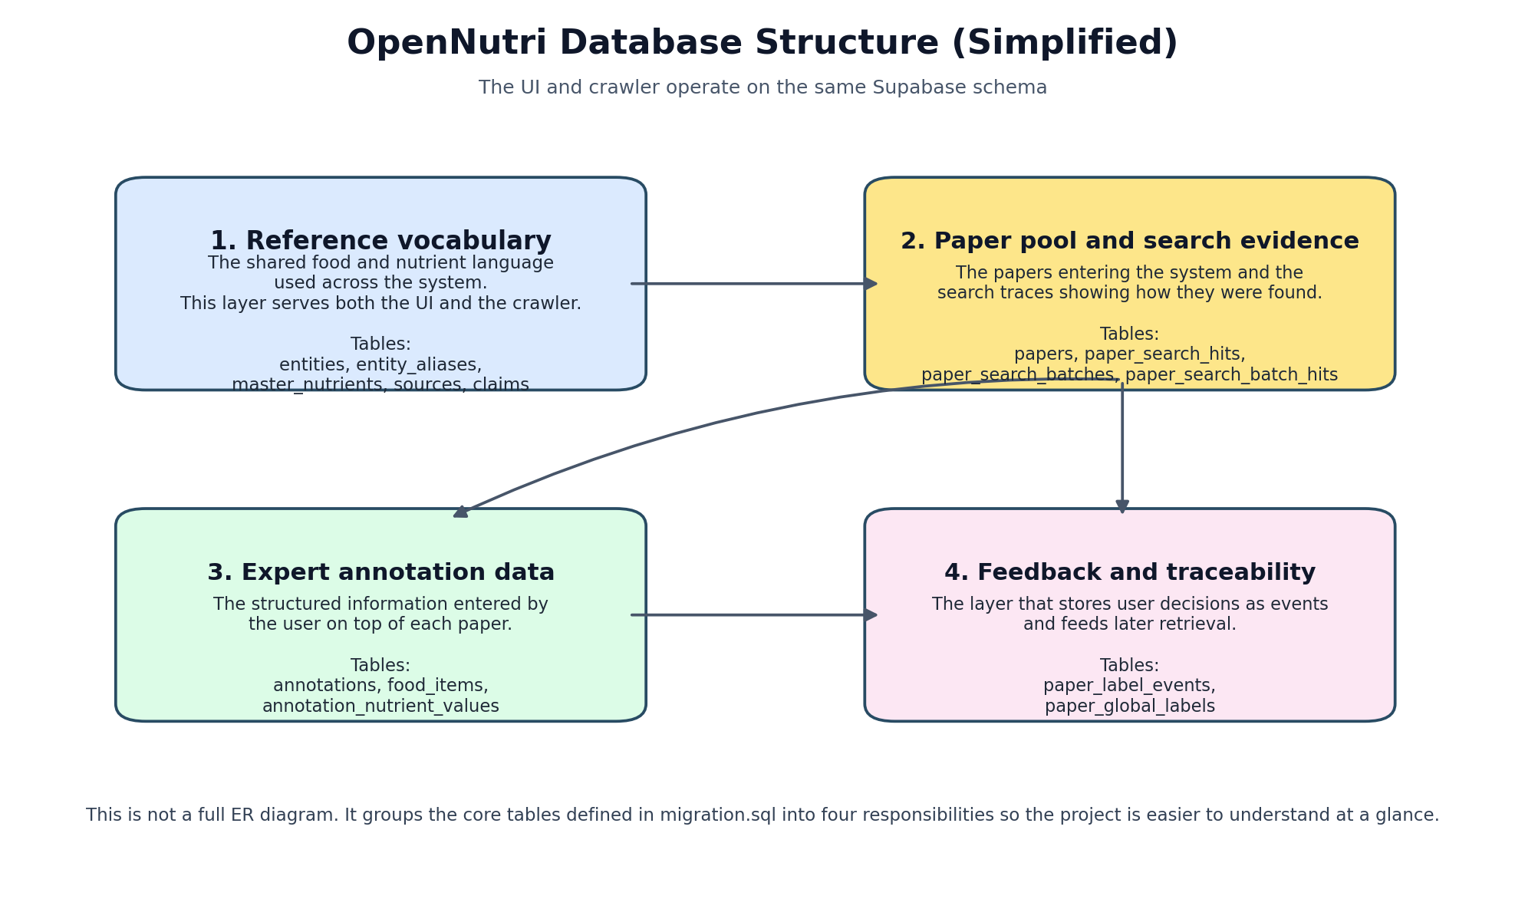
Shared data model relevant to AI
The retrieval layer depends on papers, search evidence, user events, and a shared vocabulary.
Reference vocabulary: entities, aliases, and master nutrients are reused by both retrieval and annotation.
Paper intake: papers store accepted PDF-level records available to the UI.
Search evidence: paper_search_hits, paper_search_batches, and paper_search_batch_hits preserve why a paper entered the system.
Feedback evidence: paper_label_events, paper_global_labels, and search_sessions preserve user behavior for later ranking updates.
Important distinction: raw search evidence is stored separately from accepted paper records.
OpenNutri | AI / algorithm master deck
EN 05

Slide 6
Search layer and language split
The crawler is multi-source by design, and it treats English and Turkish as different retrieval environments rather than one merged pool.
Europe PMC
OpenAlex
Semantic Scholar
DergiPark
Main open-access biomedical surface; strongest default bias for English.
Broad metadata coverage used in both languages.
Additional discovery path and duplicate-aware evidence.
Essential Turkish source; highest static bias in Turkish.
EN
TR
Default bias favors Europe PMC, then OpenAlex.
English composition frames and phrase pools stay language-scoped.
Default bias favors DergiPark, then OpenAlex and Semantic Scholar.
Separate anchors, phrases, and feedback scores keep Turkish behavior language-scoped.
OpenNutri | AI / algorithm master deck
EN 06

Slide 7
Query construction
The crawler does not rely on a fixed query list. It mixes base composition queries, learned query phrases, and a rotating concept pool.
Base queries
Concept pool
Phrase pool
Learned query
Source task
Start with language-specific base composition templates.
Interleave food terms and nutrient terms in one concept pool.
Reorder concepts using concept_scores learned from previous outcomes.
Mix core phrases with a small exploration slice from the longer phrase pool.
Exact implementation choices
Exploration rate for extra phrases: 2 percent of the phrase pool.
Separate cursors are preserved per language.
Nutrient learned queries add unit framing such as mg/100g or g/100g.
Queries are normalized and deduplicated before search-task expansion.
OpenNutri | AI / algorithm master deck
EN 07

Slide 8
Search-task prioritization
After query construction, each query is expanded into source-specific search tasks and ranked before execution.
Priority score
Static source bias by language
priority_score = pair_score + batch_score
EN: Europe PMC +0.35 OpenAlex +0.15 Semantic Scholar +0.05 DergiPark -0.15 TR: DergiPark +0.35 OpenAlex +0.20 Semantic Scholar +0.10 Europe PMC -0.30
pair_score = learned pair feedback + 0.15 x source_prior + static source bias
batch_score comes from historical performance of the exact batch key
Tasks are sorted descending and truncated to the run budget
This is how the system turns language strategy into execution order.
OpenNutri | AI / algorithm master deck
EN 08

Slide 9
Search gate
The search gate is a cheap first-pass metadata screen. It rejects weak candidates before the heavier metadata filter and acquisition stages.
Positive signals
Penalties and pass rule
First anchor/composition phrase hit (+0.90)
First food term hit (+0.35)
First nutrient term hit (+0.35)
Unit pattern such as mg/100g or g/100g (+0.70)
Food + nutrient combo bonus (+0.45)
Missing metadata -> immediate reject with score -2.0
Missing abstract penalty: -1.30 or -0.45
Strong negative signals penalized up to -2.5
Soft negatives penalized up to -1.5
Health-outcome terms penalized up to -1.6
Pass threshold: score >= -0.35
OpenNutri | AI / algorithm master deck
EN 09

Slide 10
Metadata filter
The metadata filter is the stronger additive decision layer. It combines lexical cues, source priors, embeddings, and feedback terms before PDF acquisition.
Core evidence
Learned and semantic evidence
Composition phrase +1.35
Unit pattern +1.25
Food hit +0.65 and nutrient hit +0.65
Food + nutrient combo +0.75
Missing abstract penalty -1.10 or -0.35
Health-outcome penalty capped at -2.0
Source prior from historical positive/negative balance, clamped to +/-0.9
Embedding similarity adds +1.45 if similarity crosses the language threshold
An extra +0.75 is added when embedding similarity is above threshold
Feedback n-gram score is summed and clamped to +/-6.0
Accept threshold: score >= 1.75
OpenNutri | AI / algorithm master deck
EN 10

Slide 11
Embedding layer
Embeddings are a semantic support layer inside metadata scoring, not a standalone classifier.
English model
Turkish / multilingual model
Shared rule
all-MiniLM-L6-v2 threshold = 0.45
paraphrase-multilingual-MiniLM-L12-v2 threshold = 0.42
Trim metadata text to 1800 characters before encoding.
How the score is produced
Why this design
Load anchor phrases from feedback config; fall back to seeded anchors if needed.
Encode the candidate title + abstract in the language-specific model.
Compute normalized similarity against all anchors and keep the maximum match.
Anchors keep the semantic target narrow: composition-oriented rather than general nutrition.
Two models keep EN and TR scoring language-aware.
This layer recovers semantically relevant phrasing that exact keywords may miss.
OpenNutri | AI / algorithm master deck
EN 11

Slide 12
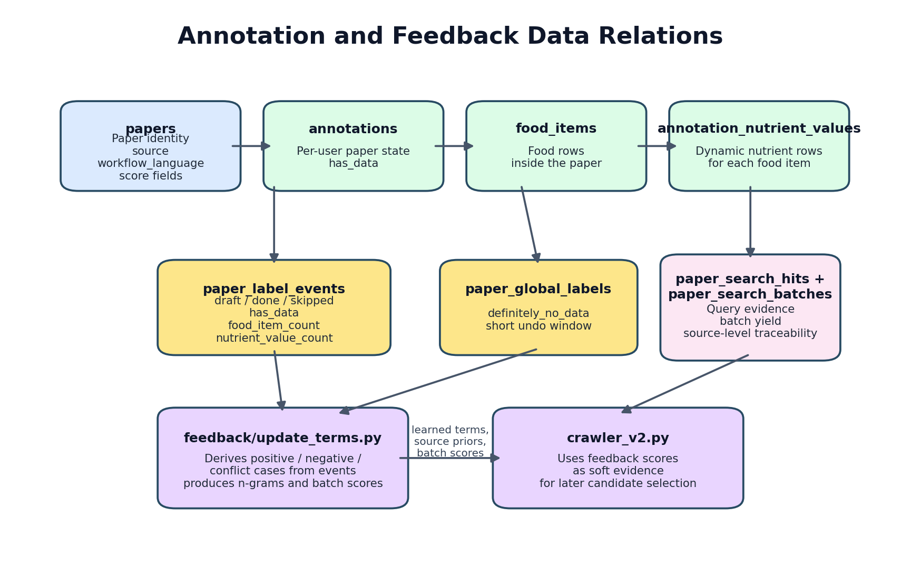
Feedback labels and training sets
The learning loop is based on the latest visible state of each annotator, not on raw event totals.
Positive paper: latest draft or done state with has_data = true, food-item count > 0, and nutrient-value count > 0.
Negative paper: a global definitely-no-data label or at least two unique skip users.
Conflict paper: both positive and negative evidence; excluded from learning.
Processing is language-scoped after label construction.
Important: the feedback loop is implemented, but it is batch-updated rather than online.
OpenNutri | AI / algorithm master deck
EN 12

Slide 13
What feedback changes in later runs
The loop is already active. Feedback is not only stored; it is exported into a new config and consumed by the next crawler run.
Annotation outcomes
Feedback export
latest.json
Crawler startup
Later search behavior
query_phrases
anchor_phrases
weighted_terms
concept_scores
pair_scores, batch_scores, source_priors
Later runs search different phrases in different orders.
Concept ordering changes which foods or nutrients are combined first.
Source-query combinations with better yield move up the queue.
OpenNutri | AI / algorithm master deck
EN 13

Slide 14
Operational closure
The refill script is what turns the algorithmic pieces into a working operational loop when the annotator queue runs low.
Check EN/TR deficits
Refresh feedback terms
Refresh DergiPark index
Run crawler v2
Upload accepted PDFs
The system can react when paper stock falls below target.
Feedback refresh is part of the refill cycle by default.
DergiPark refresh keeps the Turkish pool renewable.
The strongest sentence here is: “The current system is operational, not only experimental: it can refresh feedback, search new papers, and push accepted PDFs back into the annotator pipeline.”
OpenNutri | AI / algorithm master deck
EN 14

Slide 15
AI-relevant UI interaction
The frontend is not only data entry. It captures structured evidence that the retrieval layer can later learn from.
PDF highlight and click resolution
Quick-add popover and structured save
Autocomplete ranking and telemetry
Nutrient names are matched with boundary-aware regex patterns, wrapped in marks, and opened through direct-target, elementsFromPoint, or caret-based fallback when PDF.js text layers behave irregularly.
A clicked nutrient opens a popover near the highlight, captures value and unit, and adds a structured nutrient row into the current food-item form.
Food and nutrient searches use custom ranking rules, and search_sessions record typed queries, shown options, selected options, and abandon cases.
OpenNutri | AI / algorithm master deck
EN 15

Slide 16
Current state and scope boundary
This slide is for staying technically strong without overclaiming.
Implemented now
Not claimed at midterm
Multi-source search across Europe PMC, OpenAlex, Semantic Scholar, and DergiPark
Search gate plus stronger metadata filter before acquisition
Dual-model embedding support inside metadata scoring
Batch-updated feedback loop that changes later runs
Operational refill loop tied to paper stock
No trained classifier for query ranking yet
No LLM-based search-term ranking
No fully automatic extraction pipeline in the current loop
Document segmentation and extraction are deferred to the second semester
OpenNutri | AI / algorithm master deck
EN 16

Slide 17
Defense takeaway
If you had to compress the whole AI story into a few claims, these are the ones worth defending strongly.
Claim 1
Claim 2
Claim 3
The system performs staged filtering before acquisition. This is the main reason expert time is not wasted on every retrieved paper.
English and Turkish are separate retrieval pools. This is a real technical decision, not only a presentation detail, and DergiPark is part of that strategy.
The feedback loop is implemented now. It updates phrases, weighted terms, and source/query priorities for later runs.
If challenged, come back to these three claims and then answer with one concrete implementation detail.
OpenNutri | AI / algorithm master deck
EN 17

Slide 18
Appendix: implementation detail and Q&A
The next slides are designed for long committee questions.
Appendix: implementation detail and Q&A
The appendix goes deeper into schema slices, exact thresholds, feedback rules, UI internals, and safe answers for common committee questions.
OpenNutri | AI / algorithm master deck
EN 18

Slide 19
Appendix A. Sources and language strategy
This is the detailed justification for using multiple sources and for not merging EN and TR into one ranking pool.
Europe PMC provides open-access biomedical coverage and is the strongest English default surface.
OpenAlex broadens metadata coverage and supports both languages when PMC coverage is weak.
Semantic Scholar adds another discovery path and duplicate-aware evidence.
DergiPark is the essential Turkish source and justifies the language-specific Turkish workflow.
Different source visibility
Different term surfaces and composition phrasing
Different source priors and static biases
Different anchor and query-phrase pools
OpenNutri | AI / algorithm master deck
EN 19

Slide 20
Appendix B. Exact weights and thresholds
These are the implemented constants for the two main ranking stages.
Search gate
Metadata filter
composition phrase +0.90 food term +0.35 nutrient term +0.35 unit pattern +0.70 food + nutrient combo +0.45 missing metadata -2.00 reject missing abstract -1.30 or -0.45 strong negatives up to -2.50 soft negatives up to -1.50 health terms up to -1.60 pass if score >= -0.35
composition phrase +1.35 unit pattern +1.25 food hit +0.65 nutrient hit +0.65 food + nutrient combo +0.75 embedding above threshold +1.45 embedding positive bonus +0.75 source prior clamp +/-0.90 feedback term clamp +/-2.50 feedback score clamp +/-6.00 accept if score >= 1.75
OpenNutri | AI / algorithm master deck
EN 20

Slide 21
Appendix C. Feedback scoring detail
This slide combines exact label rules with the term-ranking logic used by the feedback updater.
Positive = latest draft/done with has_data = true and real structured rows
Negative = global definitely-no-data or at least two unique skips
Conflict = both positive and negative evidence, excluded from learning
n-grams are extracted separately from titles and title+abstract text
positive, negative, and background document frequencies are compared with log-odds style scoring
query_phrases default max = 64, anchor_phrases default max = 16
weighted_terms carries the full scored-term payload into later metadata scoring
query_rank = 1.75*title_good + 0.75*title_net + 0.35*ta_net - max(0, title_bad) anchor_rank = 1.25*title_good + 1.0*ta_good + 0.5*title_net + 0.25*ta_net - max(0, title_bad)
OpenNutri | AI / algorithm master deck
EN 21

Slide 22
Appendix D. Pair, batch, and concept feedback
The feedback exporter learns more than phrases: it also learns which source-query combinations and concept terms produce better outcomes.
Pair feedback
Batch feedback
Concept feedback
Group search hits by source + template_id + source_term. Score = novel_positive_count / retrieved. Also derive source_priors as log((positive + 1) / (negative + 1)).
Group by batch_key over paper_search_batches and paper_search_batch_hits. Score = positive_count / retrieved.
Group by source_term. Score = (positive_count - negative_count) / retrieved. This later reorders the concept pool.
OpenNutri | AI / algorithm master deck
EN 22

Slide 23
Appendix E. Acquisition and validation
Even after metadata acceptance, papers still need a robust PDF path and a full-text validation step before becoming accepted records.
dedupe
metadata accept
PDF fetch
pdftotext validation
manifest + upload
Try OA XML and direct PDF links first.
Use package extraction or HTML-discovered links when direct links fail.
Use curl / fallback paths for unstable source behavior.
Extract full text with pdftotext.
Check for composition framing, table/method evidence, nutrient-unit signals, and food markers.
Reject candidates that still fail full-text usefulness checks.
OpenNutri | AI / algorithm master deck
EN 23

Slide 24
Appendix F. UI internals relevant to AI
These details matter when the committee asks how human interaction is turned into structured signals.
PDF highlight
Click resolution
Autocomplete and telemetry
Build boundary-aware nutrient regex patterns, scan PDF.js text spans after render, wrap matches in mark tags, and resolve overlaps so shorter nutrient names do not break longer ones.
Try the direct event target first, then fall back to elementsFromPoint, then to caretPositionFromPoint or caretRangeFromPoint because PDF.js text layers do not behave like normal HTML.
Food and nutrient autocomplete use custom ranking rules, and search_sessions logs typed queries, shown options, selected options, status, and timestamps.
OpenNutri | AI / algorithm master deck
EN 24

Slide 25
Appendix G. Audited sample run summary
This slide intentionally separates stage counts from recorded acquisition outcomes so the sample run is not misread as a strict funnel.
Stage counts (TR live run 2026-03-30)
Recorded acquisition outcomes
Raw hits
142
PDF fetch failed
32
Passed search gate
137
PDF validation failed
31
Passed metadata filter
78
Accepted
3
No terminal result in manifest
12
These counts come from the manifest summary and are valid as stage counts up to metadata_pass.
Important audit note: 78 metadata-pass candidates exist, but only 66 have recorded terminal results in this manifest. Therefore this sample must not be presented as a strict funnel.
OpenNutri | AI / algorithm master deck
EN 25

Slide 26
Appendix H. Likely questions and safe answers
These are the short answers to return to under pressure.
Q: Is the feedback loop implemented? A: Yes. It is batch-updated, not online, and it already changes later crawler runs. Q: Do you use an LLM to rank search terms? A: No. Search-term ranking is feedback-driven statistical scoring, not LLM ranking. Q: Did you train a model for query ranking? A: Not yet. The current system learns through feedback statistics and embeddings, not a trained classifier.
Q: Why not download everything? A: Because metadata filtering is much cheaper and protects expert time. Q: Why separate English and Turkish? A: Because source coverage, terminology, and source priors differ. Q: Why not only embeddings? A: Domain cues like units, composition phrases, and food/nutrient combinations are too valuable to ignore.
OpenNutri | AI / algorithm master deck
EN 26

