Slide 1
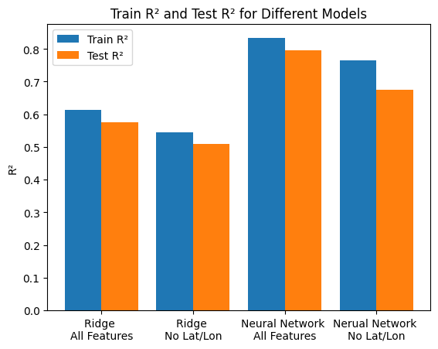
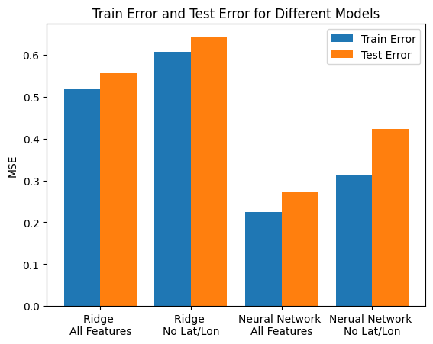
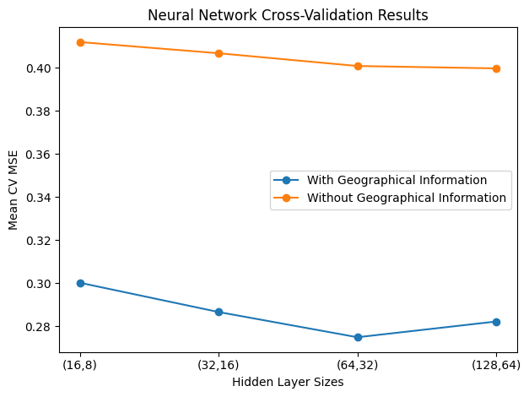
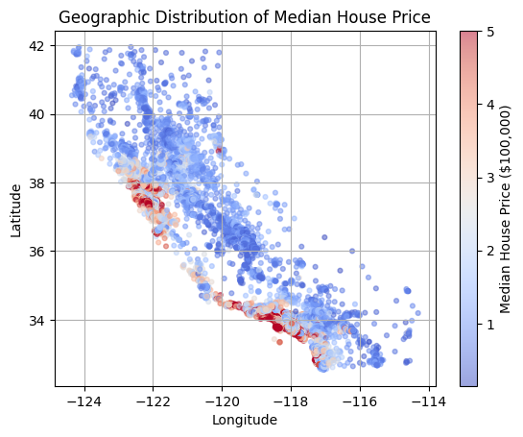
Predicting California Housing Values with Ridge Regression and PyTorch Neural Networks
Project Question: Can a PyTorch neural network improve California median house value prediction compared with Ridge Regression, and how important are geographic features such as latitude and longitude for predictive performance?
Dataset
• California Housing Dataset from scikit-learn • 20,640 census block groups • 8 features: income, house age, rooms, bedrooms, population, occupancy, latitude, longitude • Target: median house value in $100,000 units
Cross-validation and Model Selection
• Ridge: 5-fold CV over α = [0.01, 0.1, 1, 10, 100]
• Best α: 0.01 with geo, 10 without geo
• Ridge CV MSE was nearly flat across α values
• NN: 5-fold CV over hidden sizes:
(16,8), (32,16), (64,32), (128,64)
• Best NN: (64,32) with geo, (128,64) without geo
Model Comparison Results
Best Test Results:
• Best model: NN with all features • Test MSE = 0.2686 • Test R² = 0.7950 • Ridge baseline: MSE = 0.5559, R² = 0.6126
Machine Learning Methods
• Ridge Regression baseline
• Two-layer PyTorch neural network
• Both models trained with and without latitude/longitude
Conclusions
• Best model: NN with all features
• Removing latitude/longitude reduced performance
• Geographic features are important for housing prediction
Future Work
• Compare with tree-based models
• Tune more NN hyperparameters

