Slide 1

DIPARTIMENTO DI INGEGNERIA ELETTRICA E TECNOLOGIE DELL’INFORMAZIONE
SCUOLA POLITECNICA E DELLE SCIENZE DI BASE
CONTROL SYSTEMS OF AUTONOMOUS GROUND VEHICLES
Design of Autonomous Vehicles Control under Variable Speed Limit (VLS) system
Candidato: Ciro Arena P38/53
Ch.mo Prof.re: Stefania Santini
Anno Accademico 2022/23

Slide 2
OUTLINE
Simulink model
Open loop analysis
ADAS designing
Feedback Linearization control law
ACC with PID
Results
ACC with MPC
Results
Driving Scenario
Validation with Automated Driving Toolbox
Results
Robustness to uncertaintes parameters
1/12

Slide 3
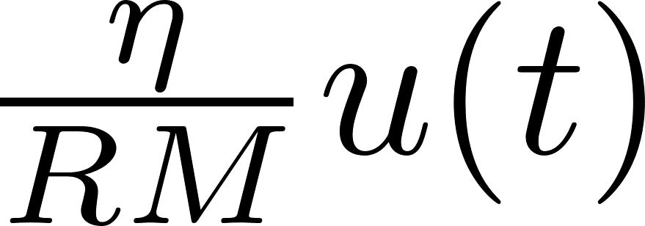

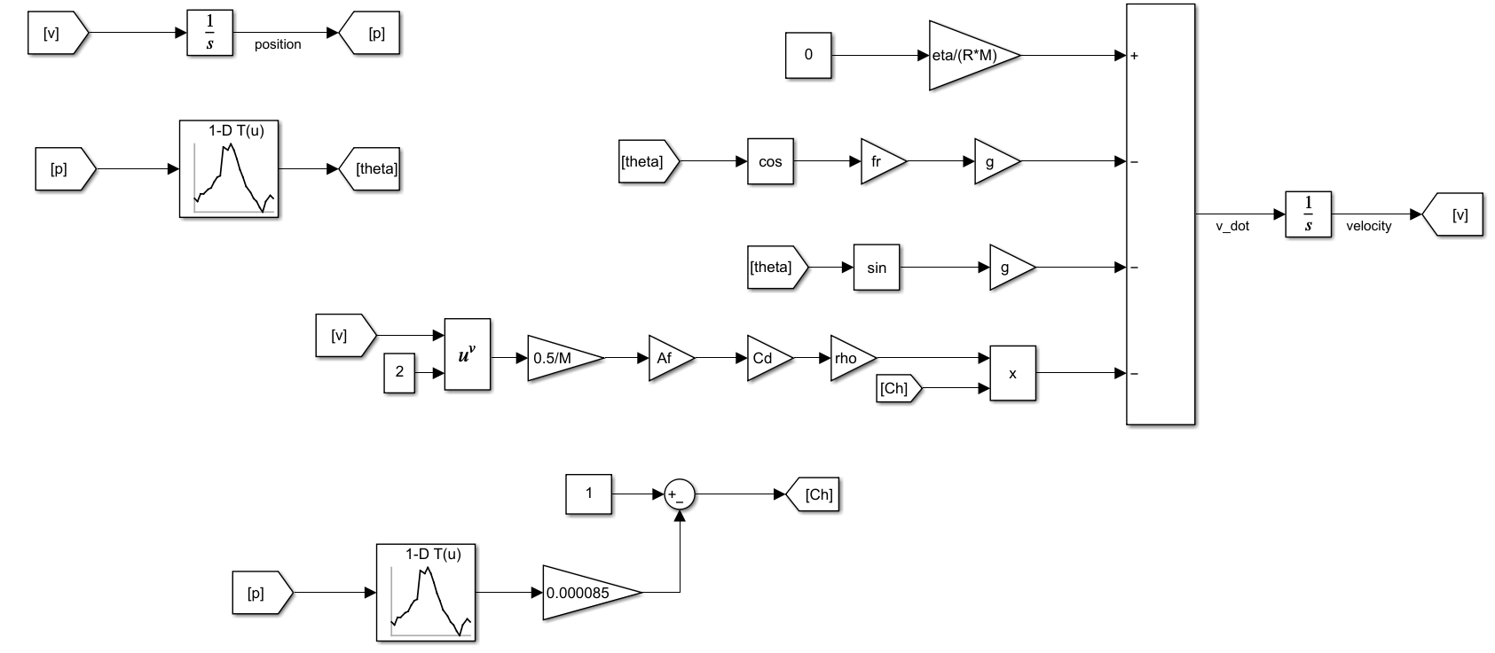



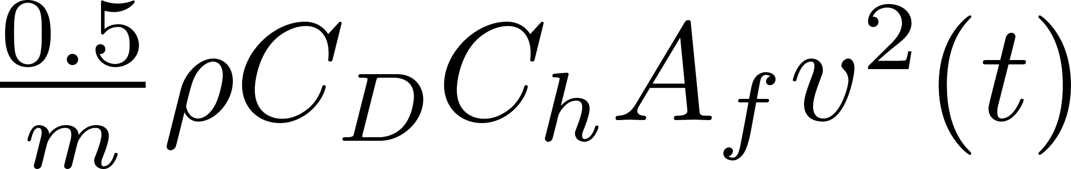
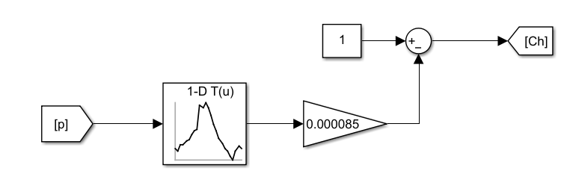

Simulink model
2/12

Slide 4
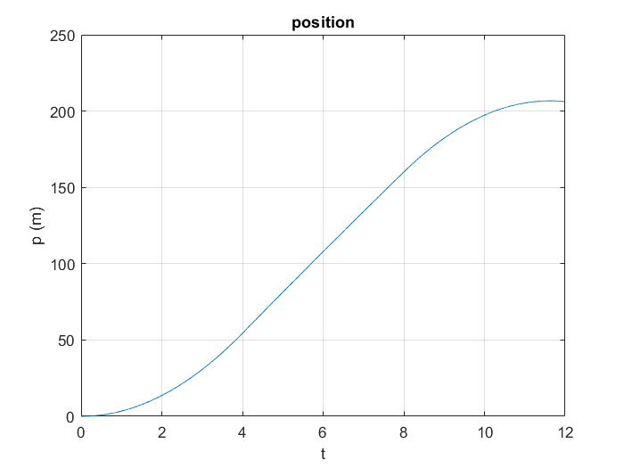
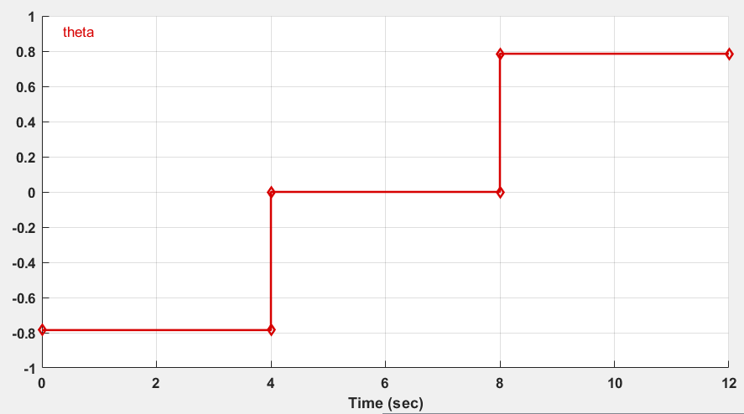
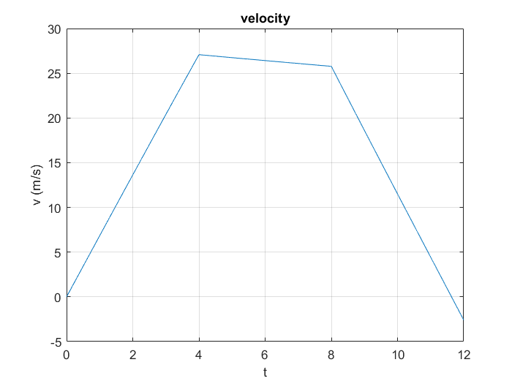
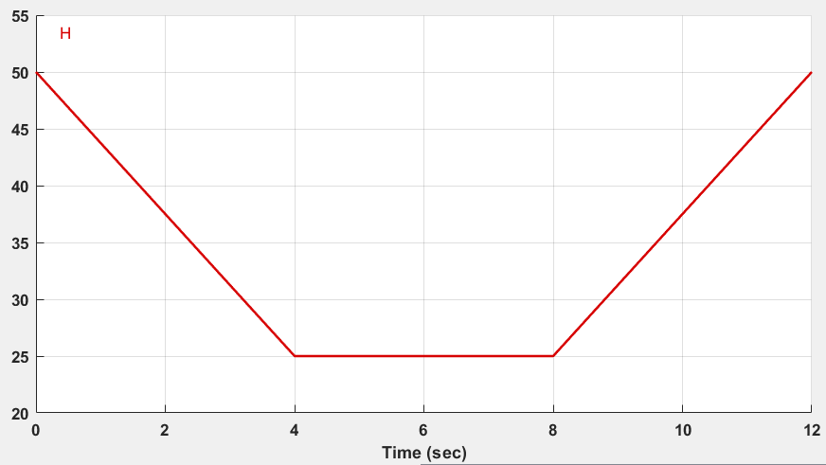
Open loop analysis (1)
Zero input and zero initial condition

Slide 5
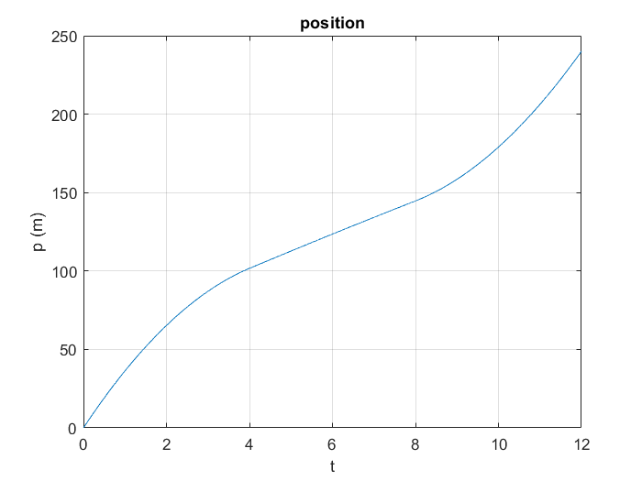

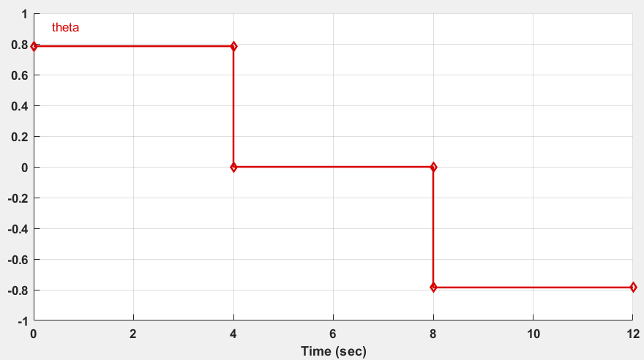
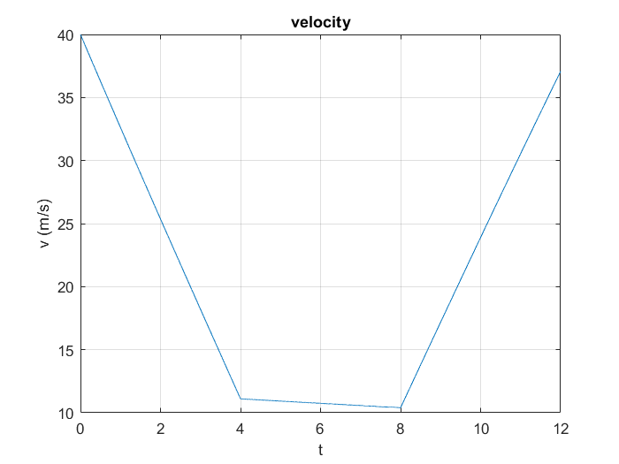
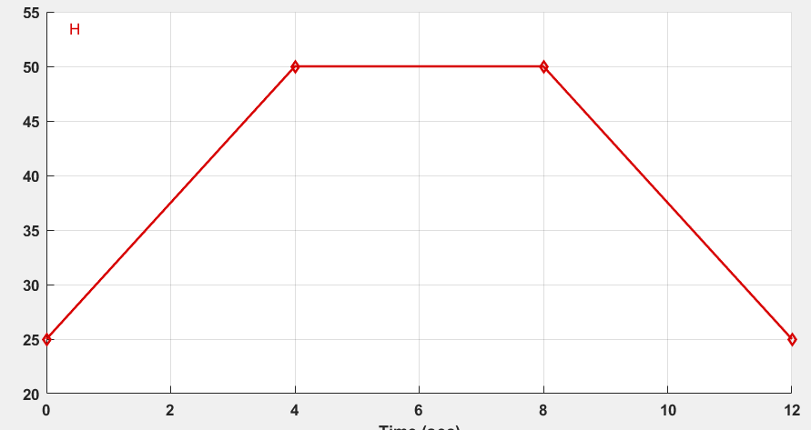
Open loop analysis (2)
Zero input and initial condition

Slide 6

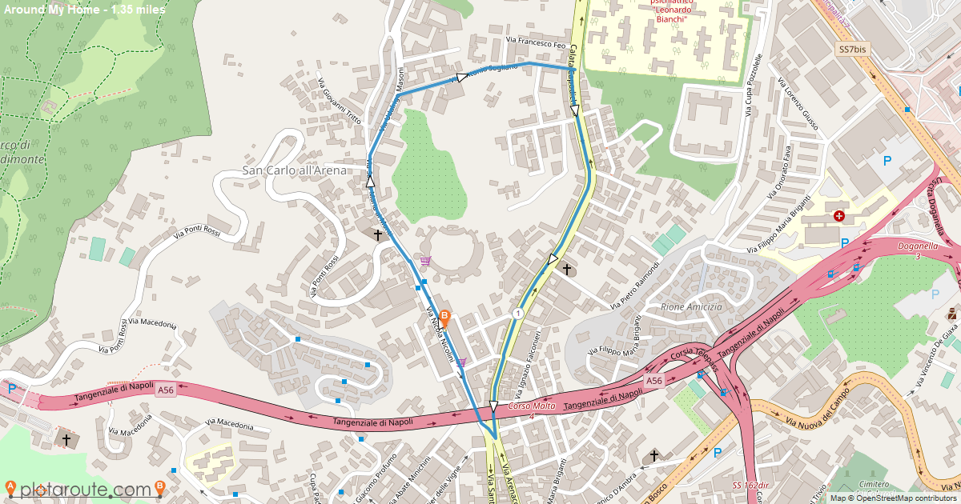
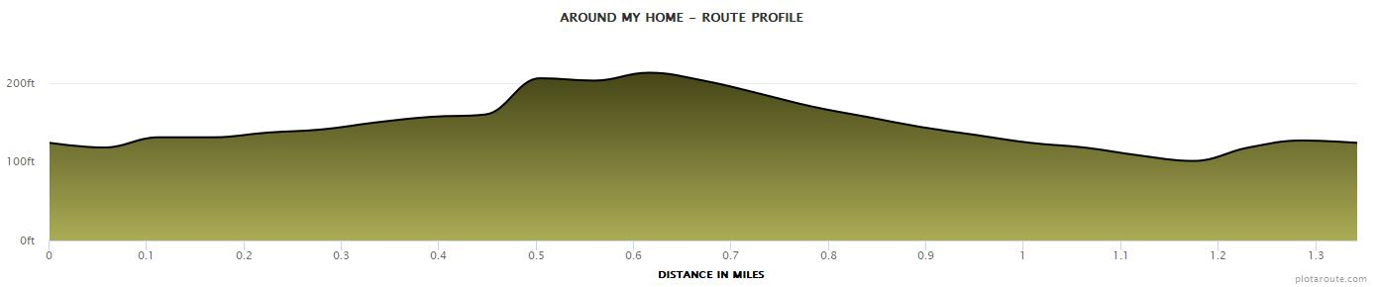
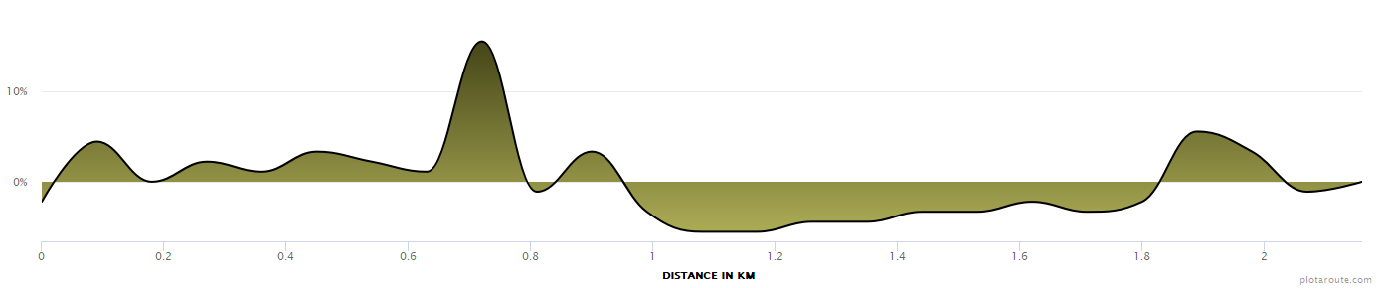


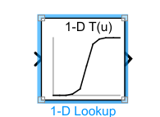

Open loop analysis (3)
https://www.plotaroute.com/route/2157148
readmatrix()

Slide 7
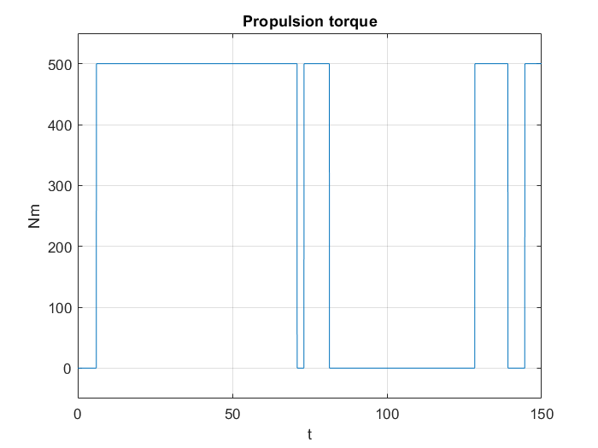
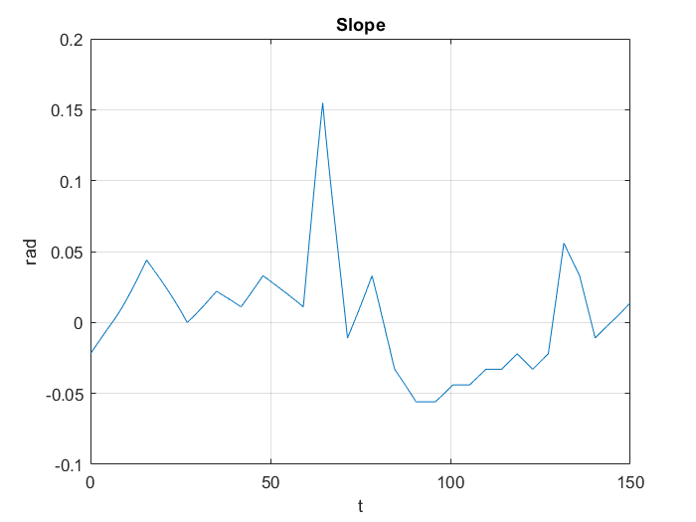
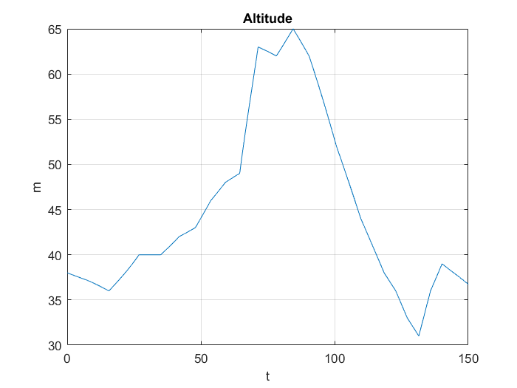
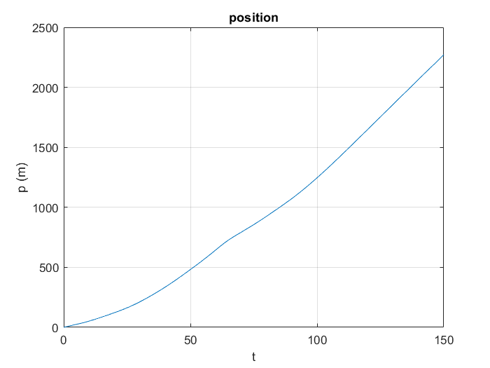
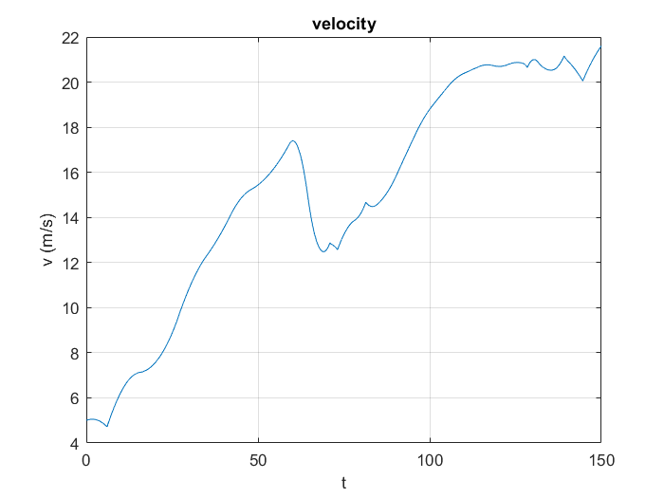
Open loop analysis (4)

Slide 8
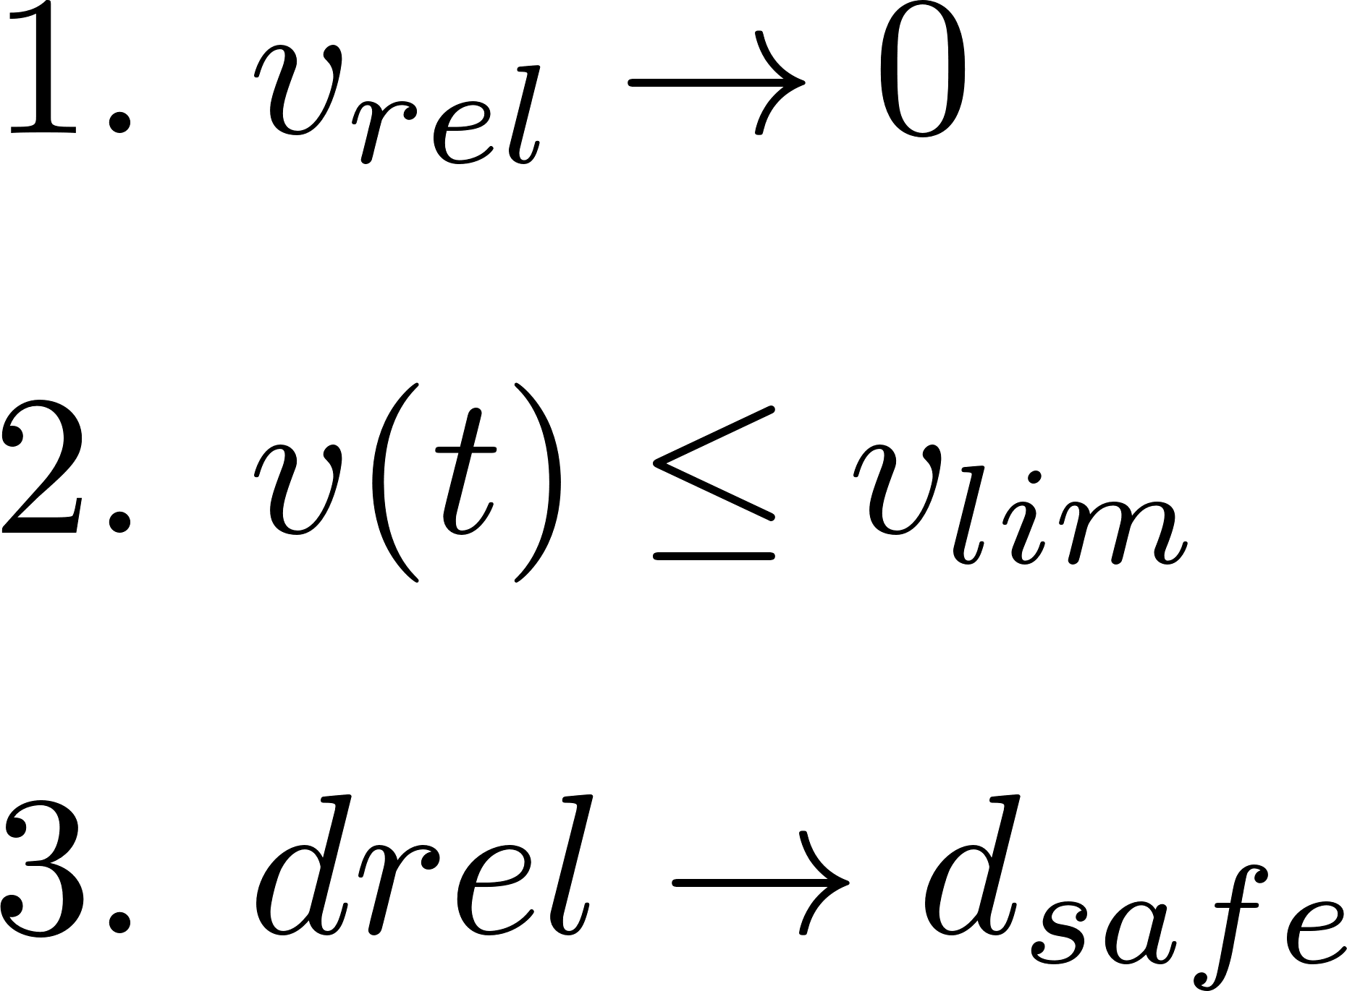


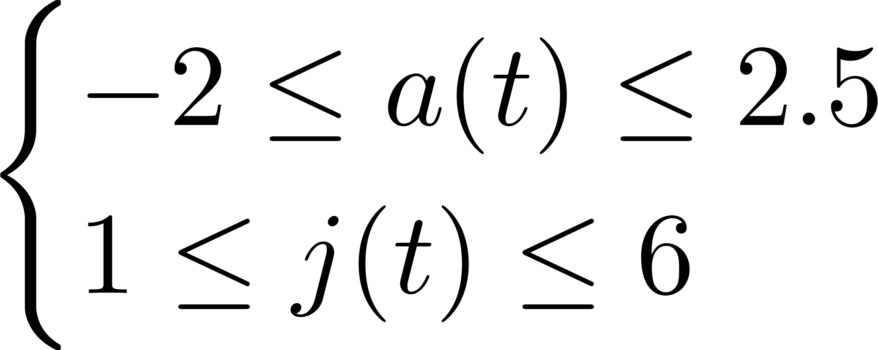

ADAS Designing
The aim is to design an ADAS system in a such a way that
PID
ACC
MPC
Limit velocity:
Constraints: Driving Comfort

Slide 9

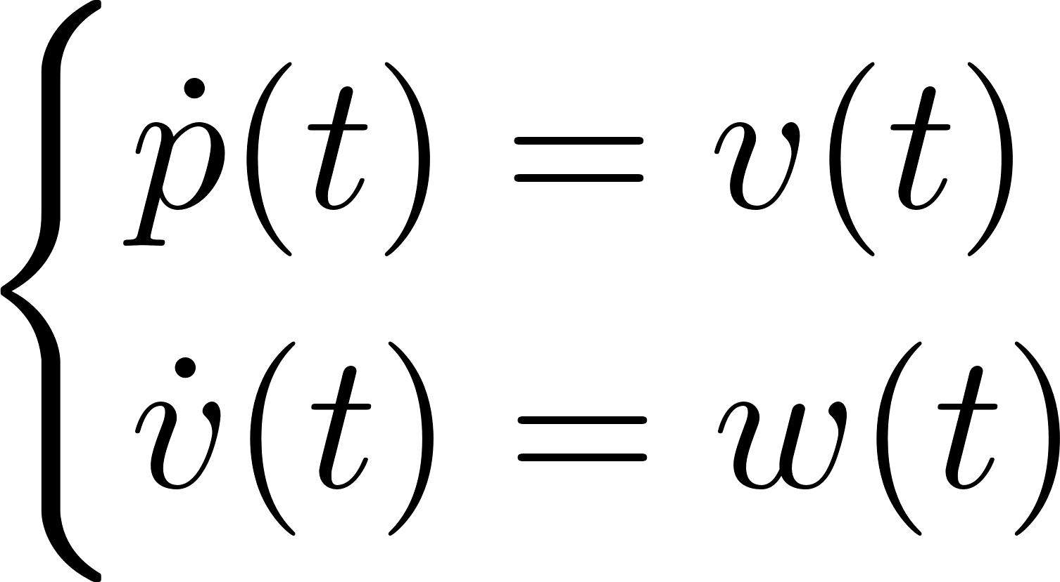
ADAS Designing: Feedback Linearization
NONLINEAR MODEL
CONTROL LAW
LINEARIZED MODEL

Slide 10
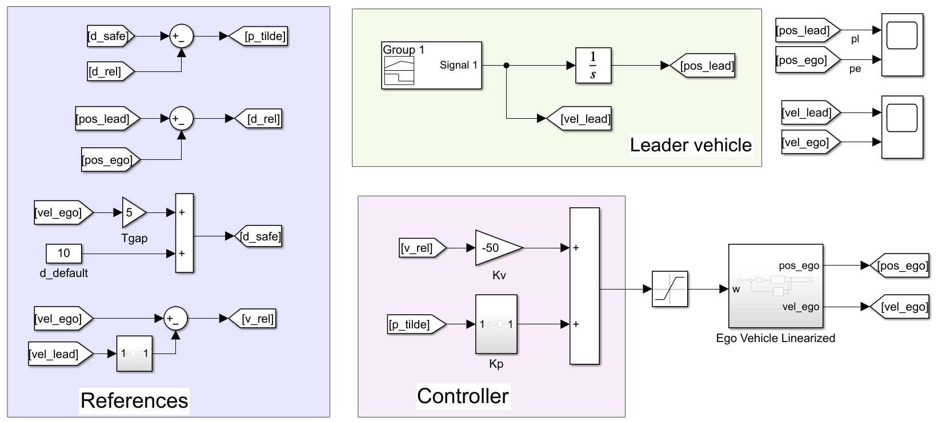
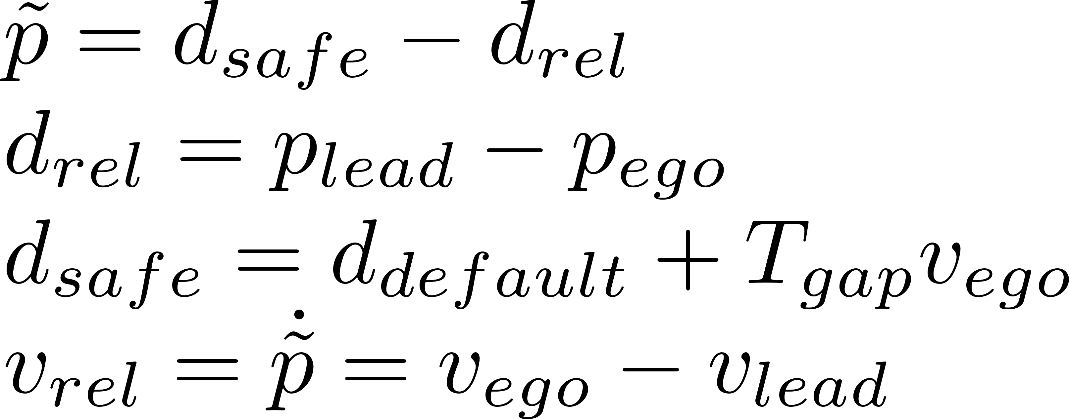
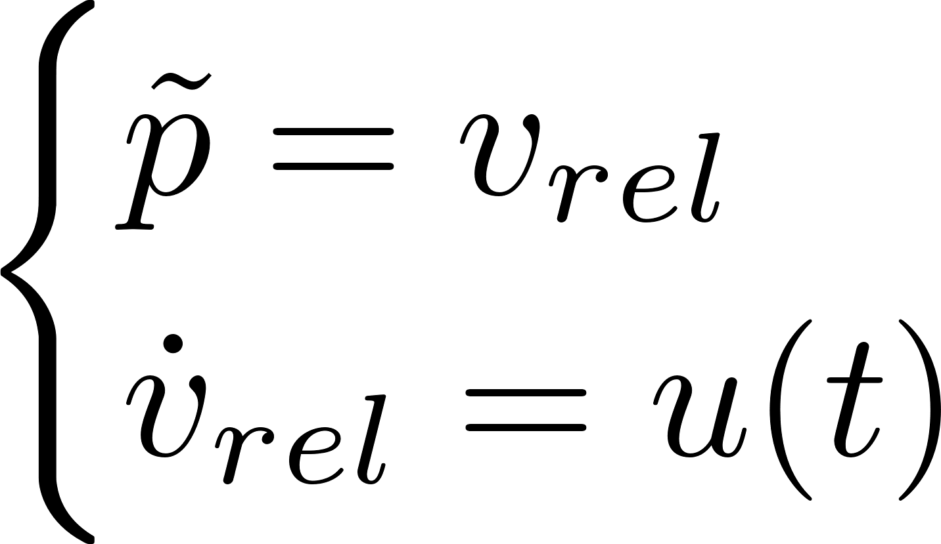
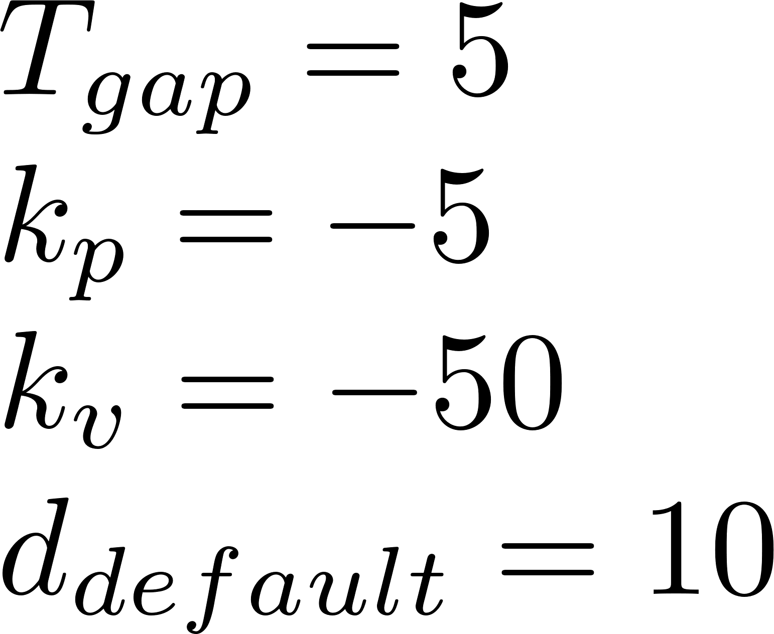
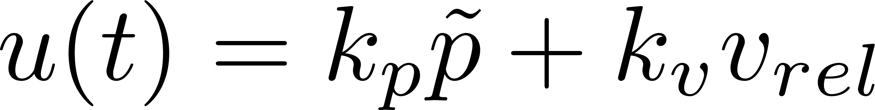
ADAS Designing: ACC with PID

Slide 11
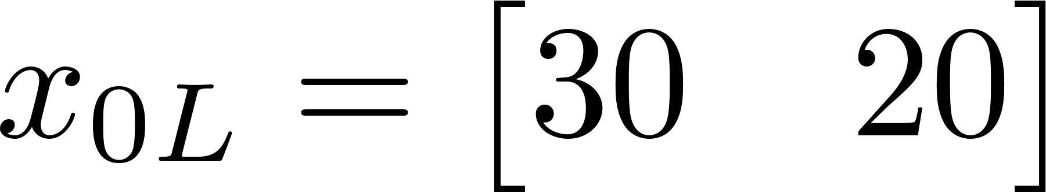
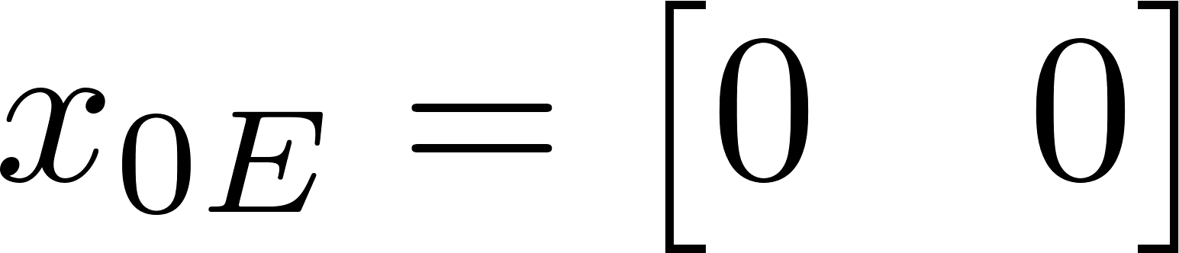
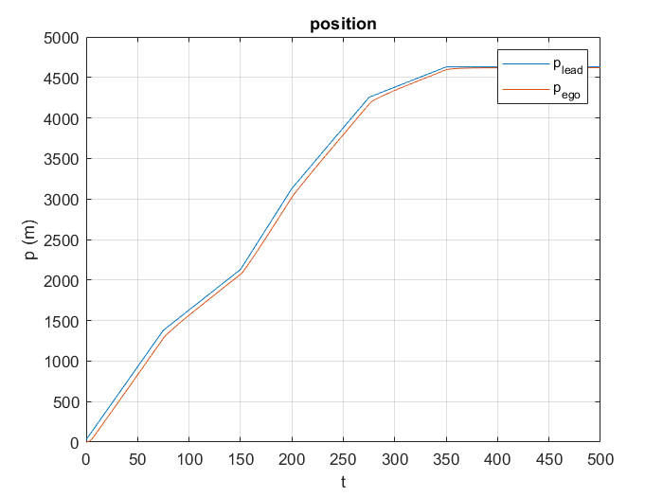
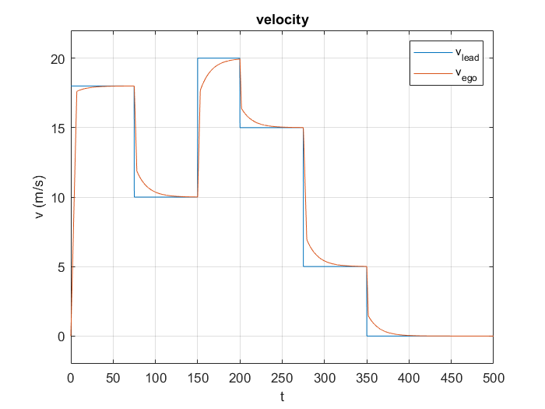
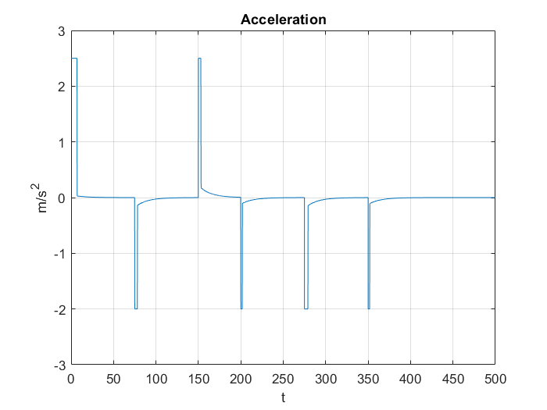
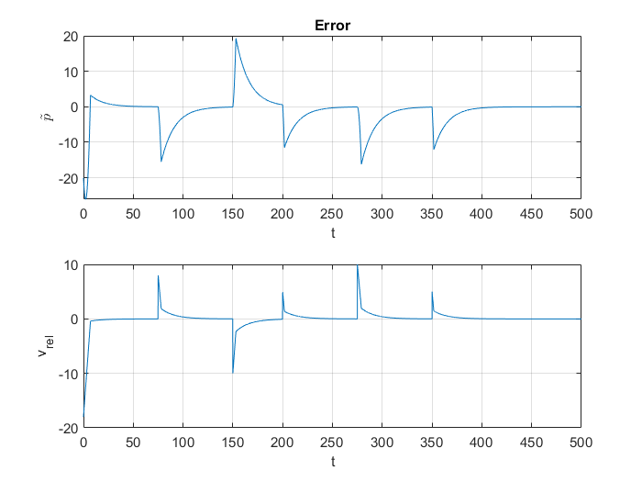
Results

Slide 12
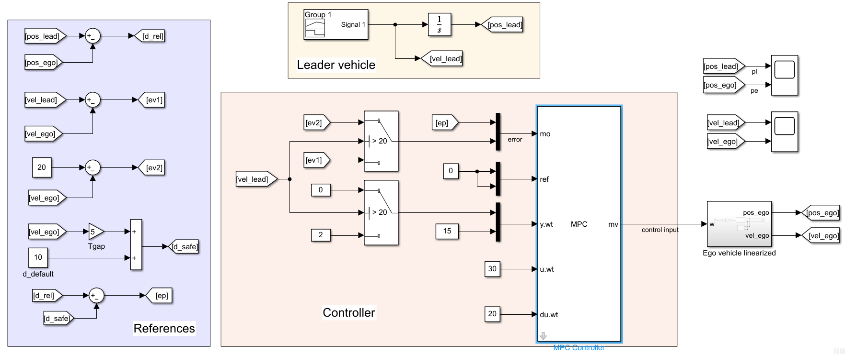
ADAS Designing: ACC with MPC

Slide 13
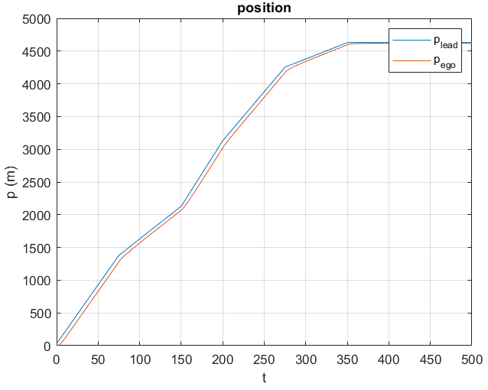
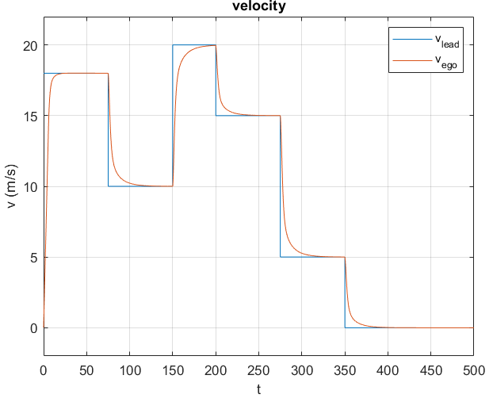
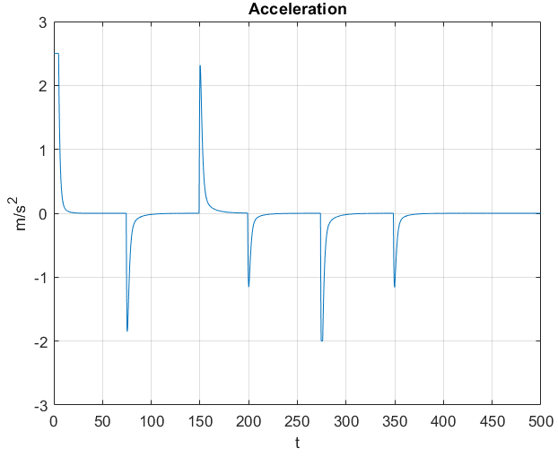
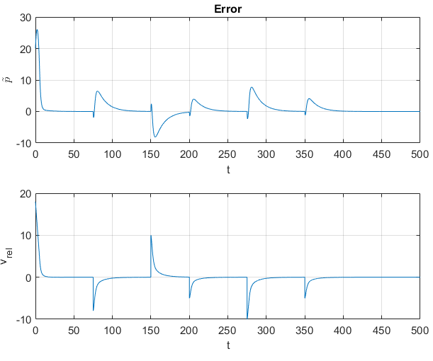
Results

Slide 14
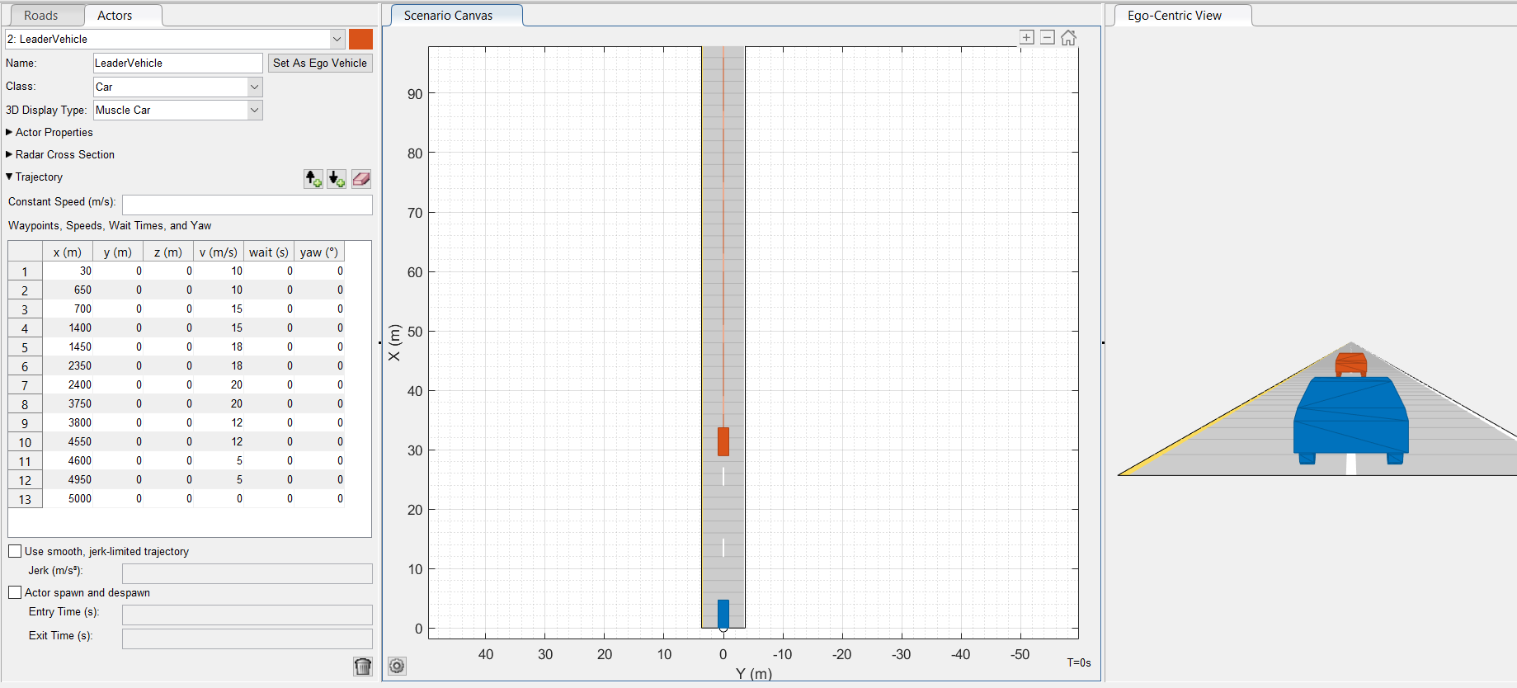
Driving Scenario
Leader Vehicle
RSU
Ego Vehicle

Slide 15
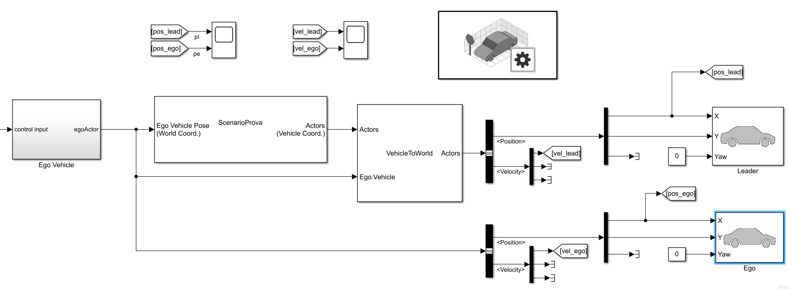
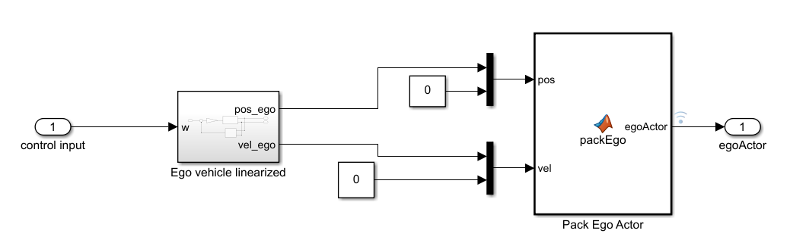
ADAS Designing: Feedback Linearization

