Slide 1

DIPARTIMENTO DI INGEGNERIA ELETTRICA E TECNOLOGIE DELL’INFORMAZIONE
SCUOLA POLITECNICA E DELLE SCIENZE DI BASE
CONTROL SYSTEMS OF AUTONOMOUS GROUND VEHICLES
Design of Autonomous Vehicles Control under Variable Speed Limit (VLS) system
Candidato: Ciro Arena P38/53
Ch.mo Prof.re: Stefania Santini
Anno Accademico 2022/23

Slide 2
OUTLINE
Simulink model
Open loop analysis
ADAS designing
Feedback Linearization control law
ACC with PID
Results
ACC with MPC: 1º case
Results
ACC with MPC: 2º case
Results
Driving Scenario
Test with Automated Driving Toolbox
Results
Robustness to parameters uncertainty
Linear MPC on nonlinear model
Conclusion and future developments
1/20

Slide 3
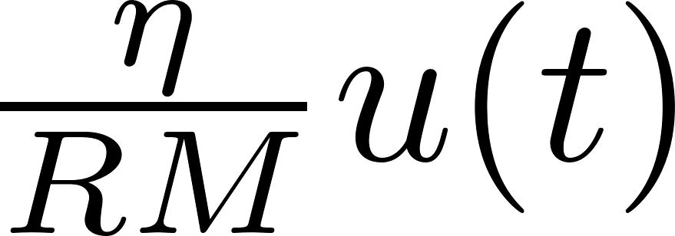

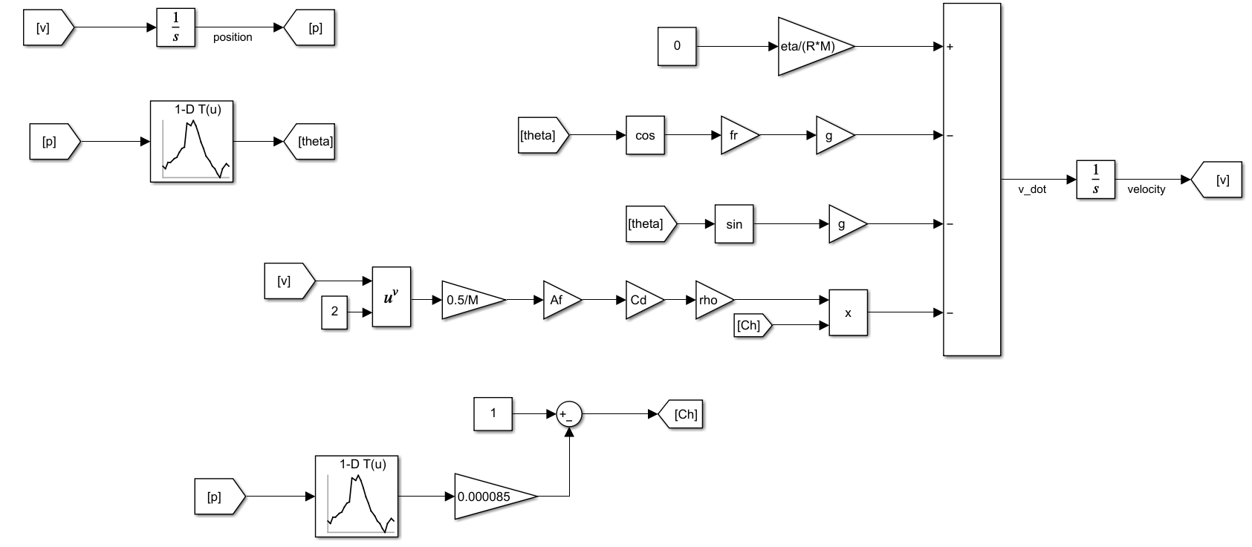



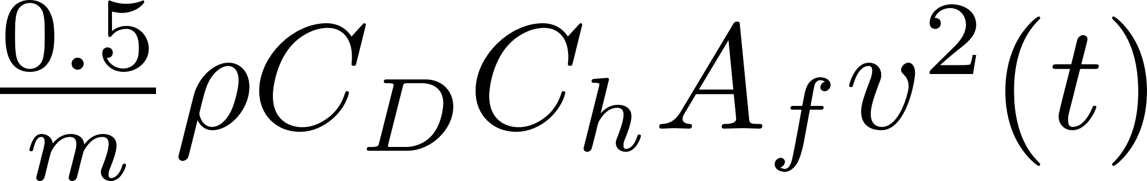
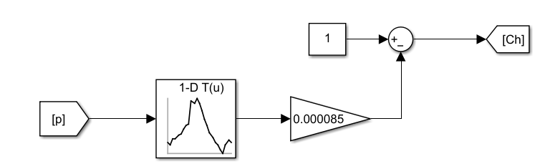

Simulink model
2/20

Slide 4
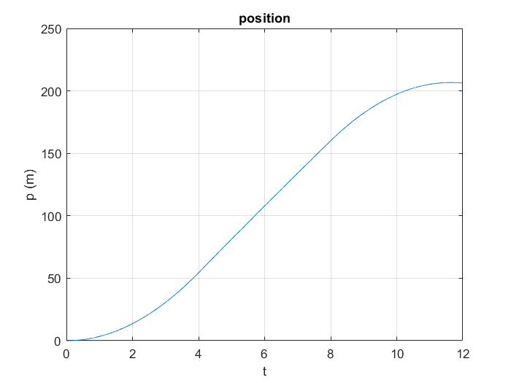
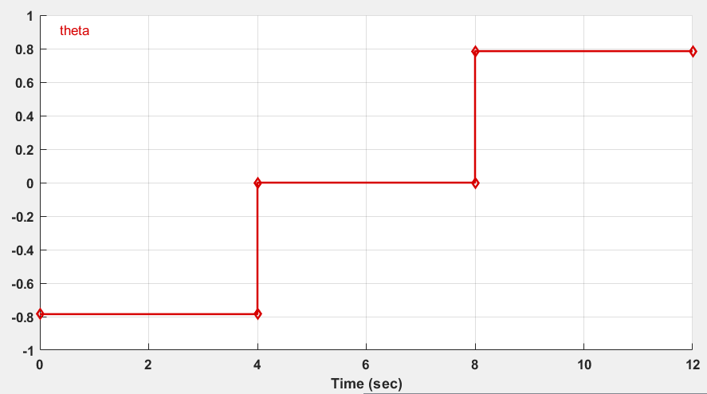
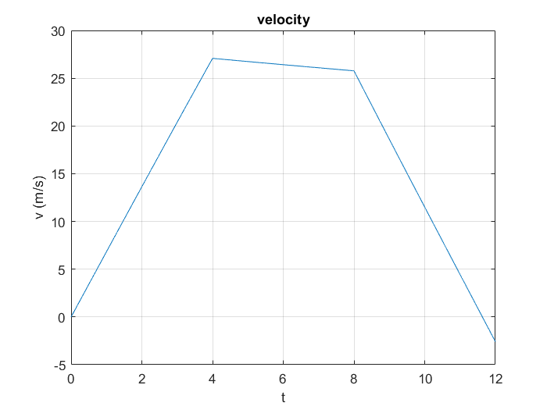
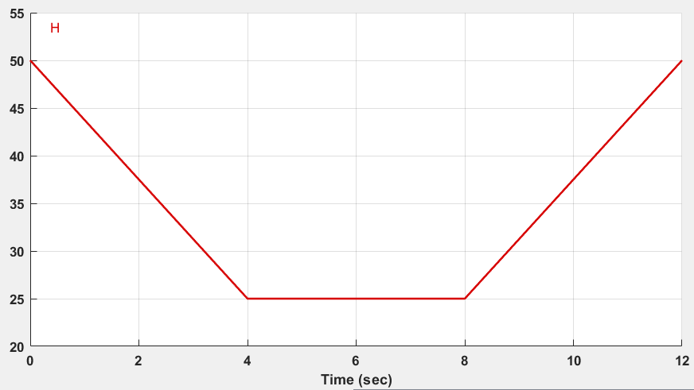
Open loop analysis (1)
Zero input and zero initial condition
3/20

Slide 5
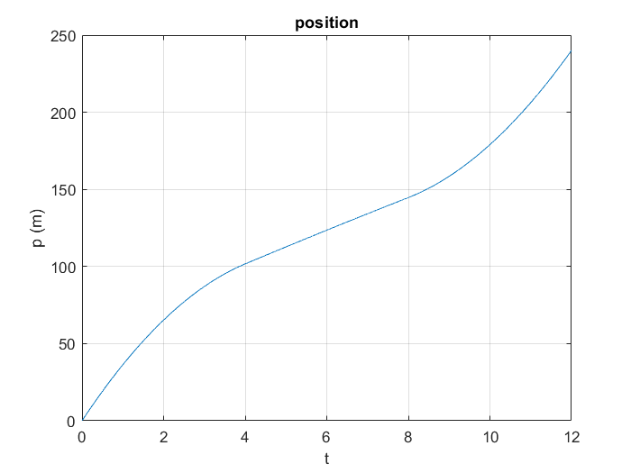

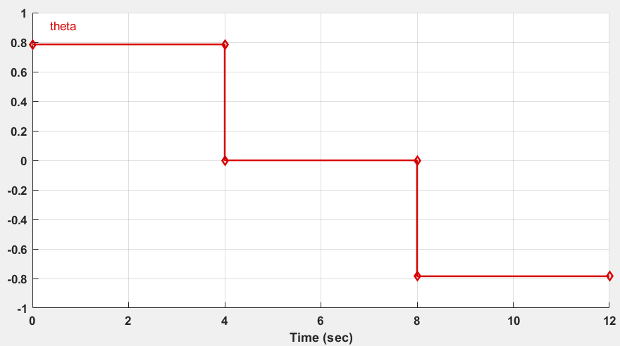
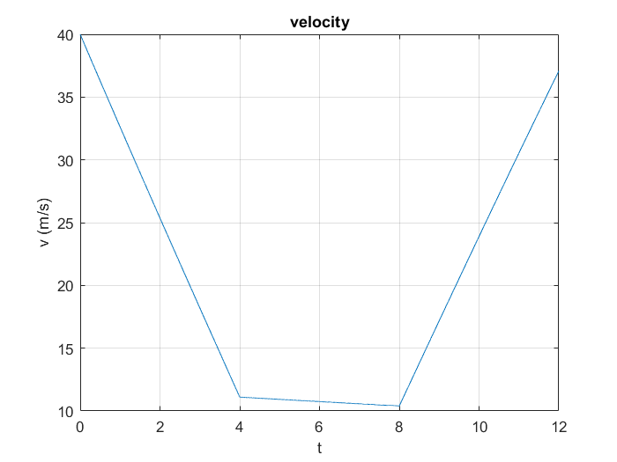
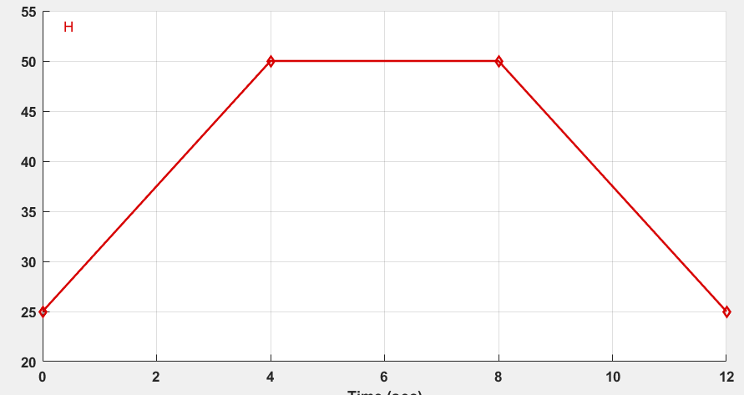
Open loop analysis (2)
Zero input and initial condition
4/20

Slide 6

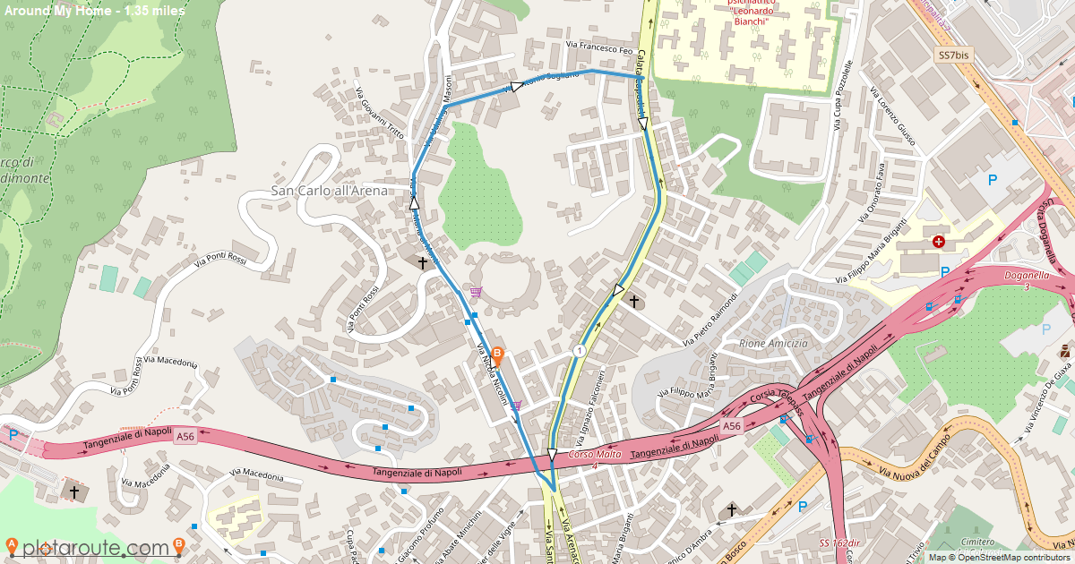
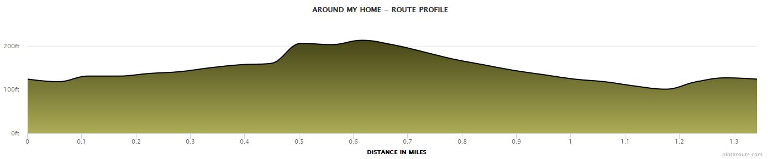
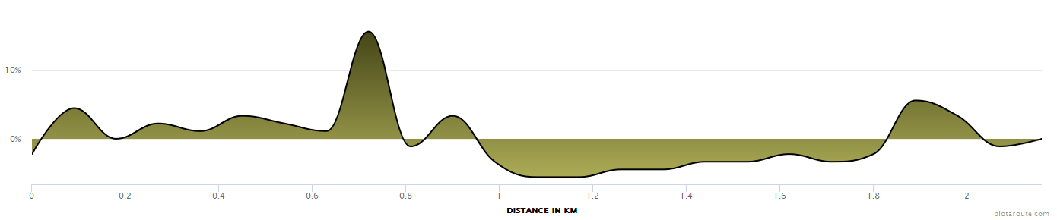

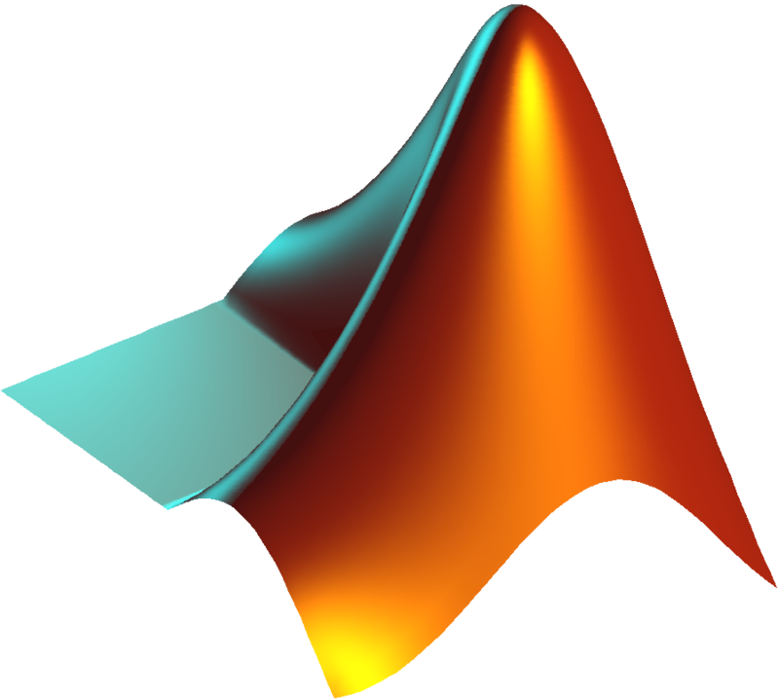
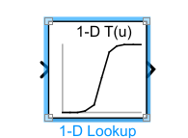

Open loop analysis (3)
https://www.plotaroute.com/route/2157148
readmatrix()
5/20

Slide 7
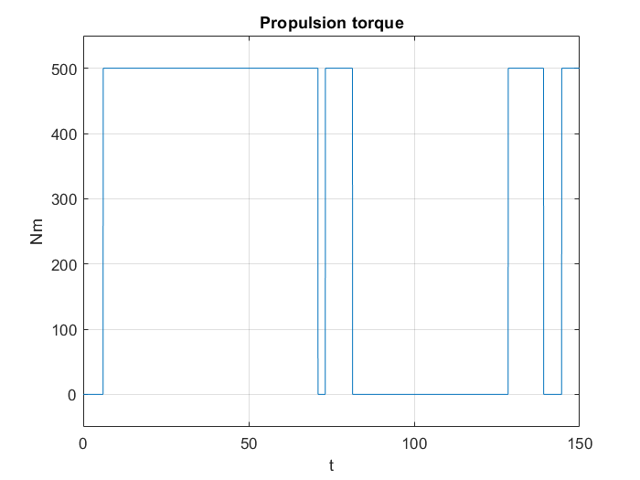
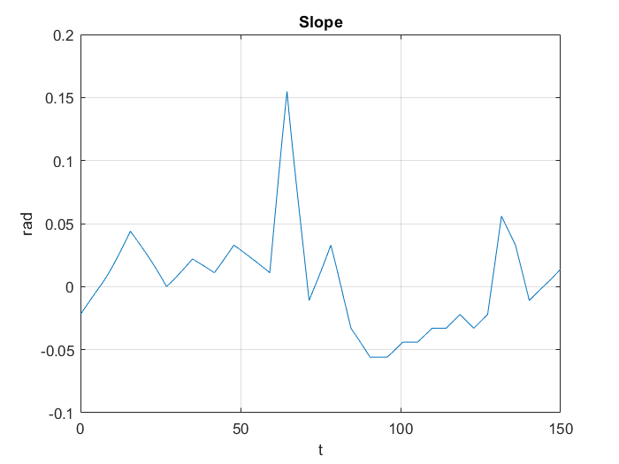
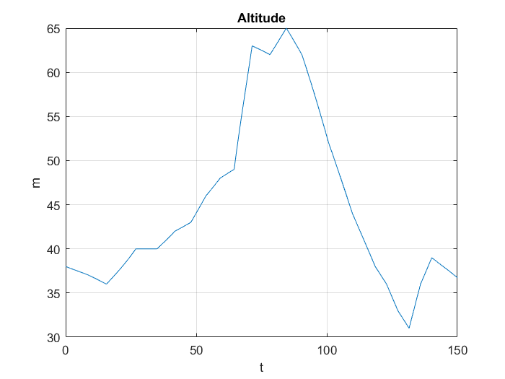
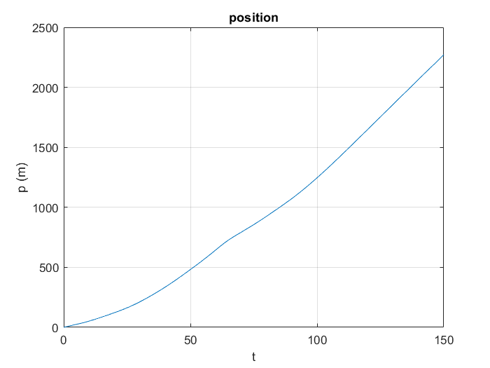
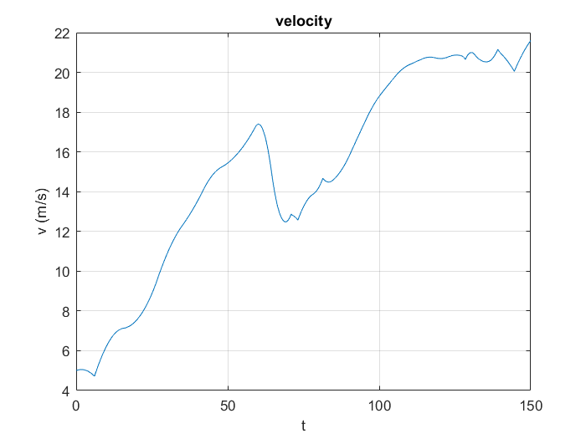
Open loop analysis (4)
6/20

Slide 8
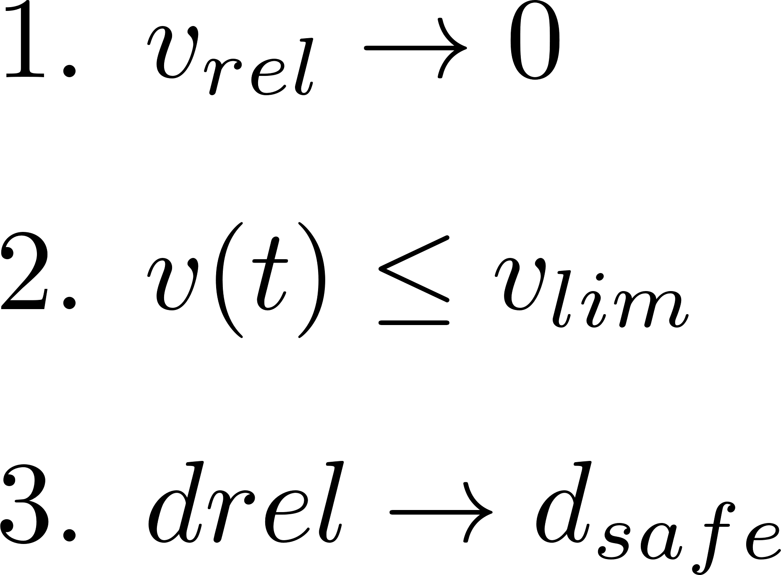

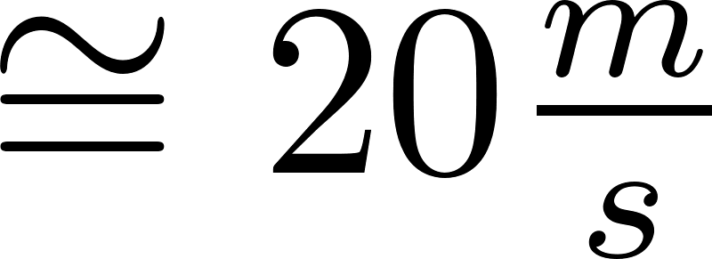
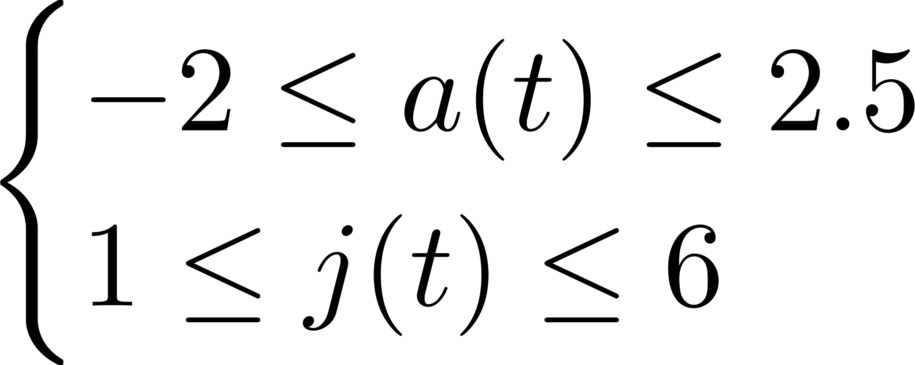

ADAS Designing
The aim is to design an ADAS system in a such a way that
PID
ACC
MPC
Limit velocity:
Constraints: Driving Comfort
7/20

Slide 9

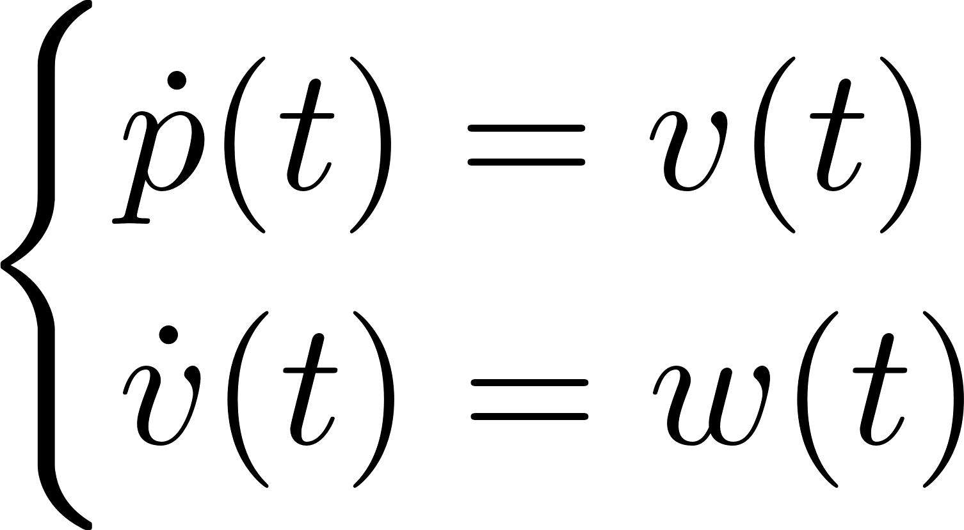
Feedback Linearization
NONLINEAR MODEL
CONTROL LAW
LINEARIZED MODEL
8/20

Slide 10
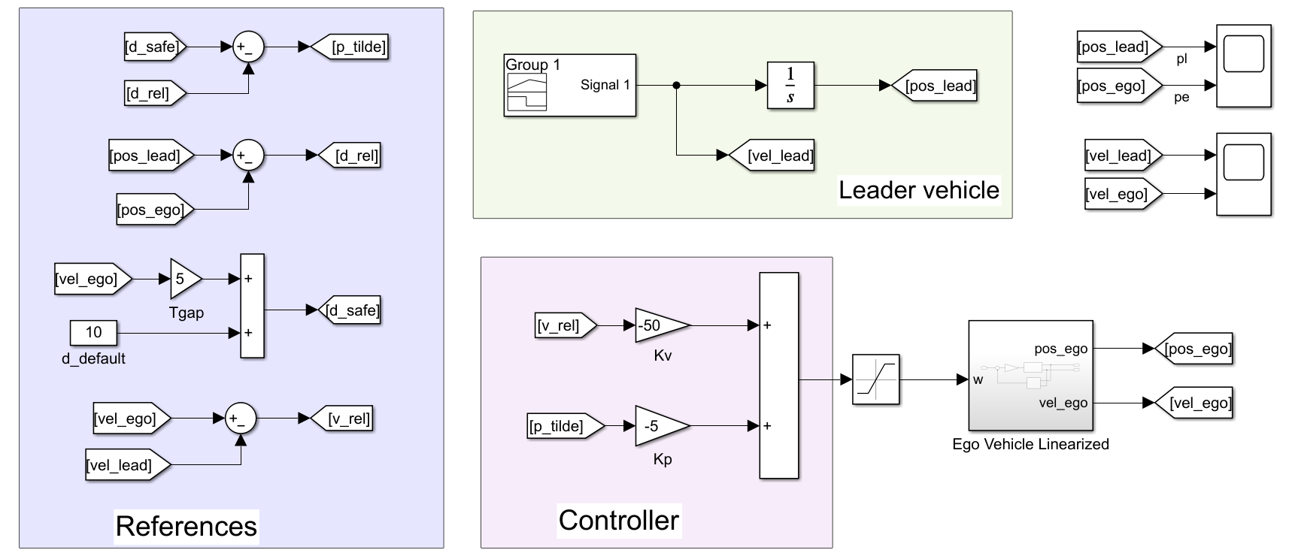
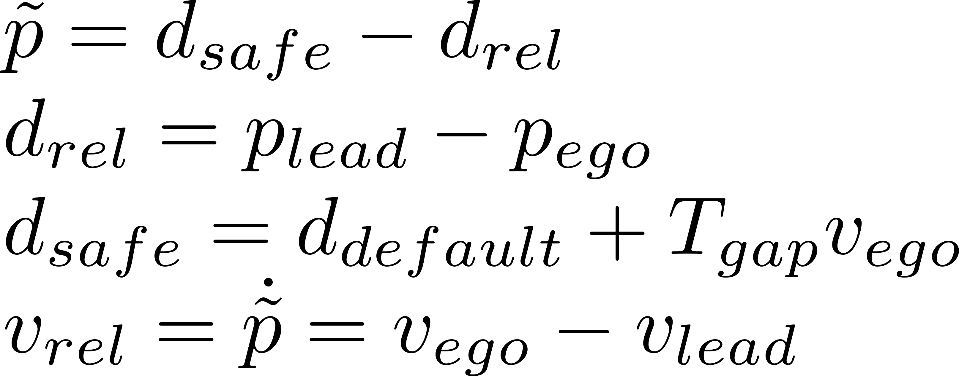
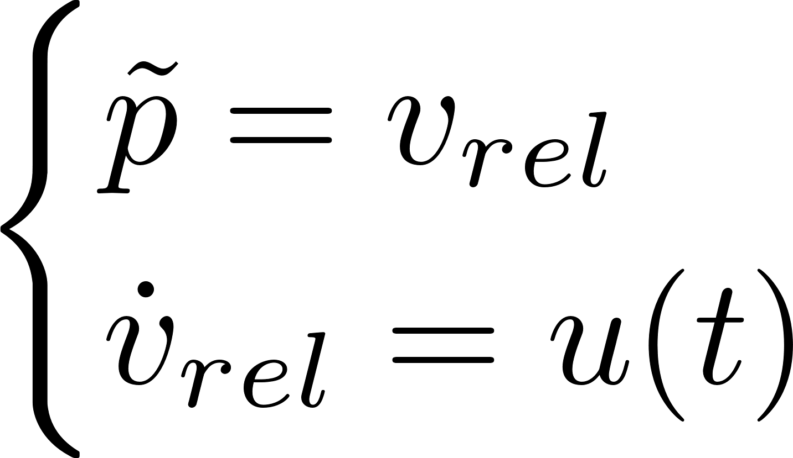
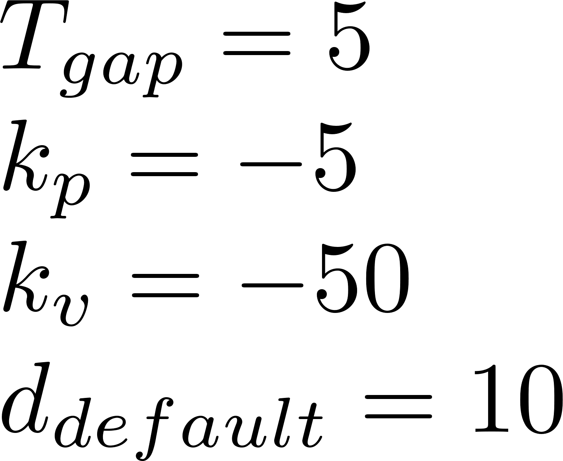
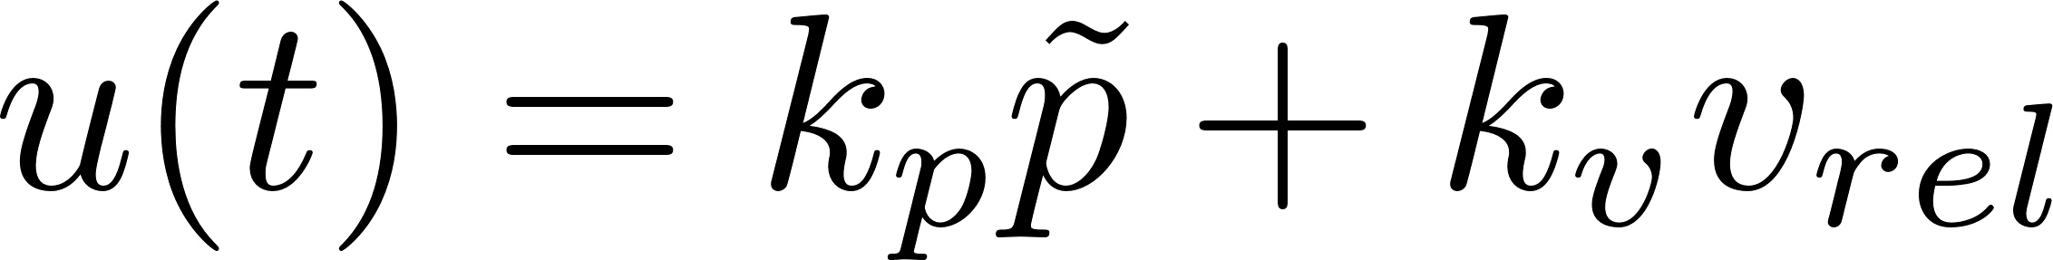
ACC with PID
9/20

Slide 11
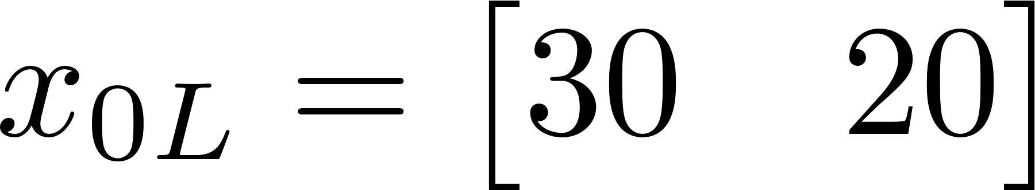

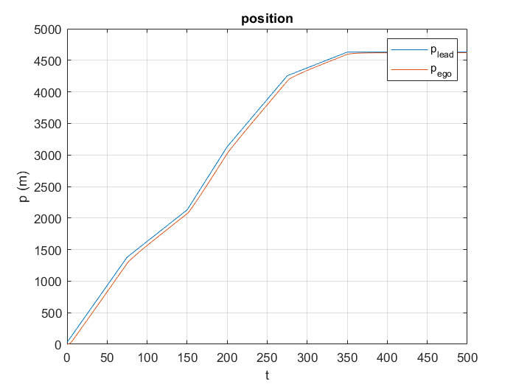
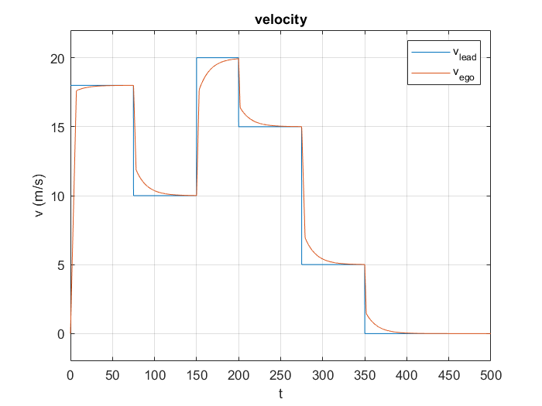
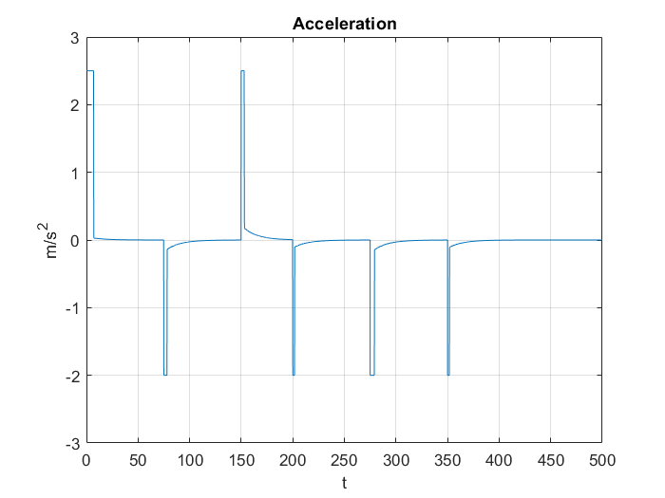
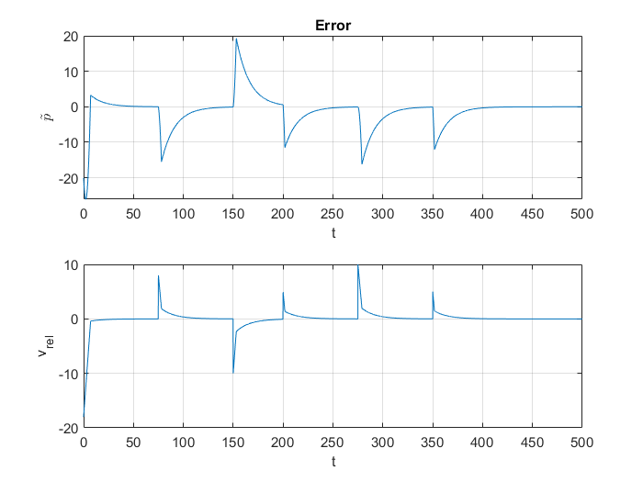
Results
10/20

Slide 12
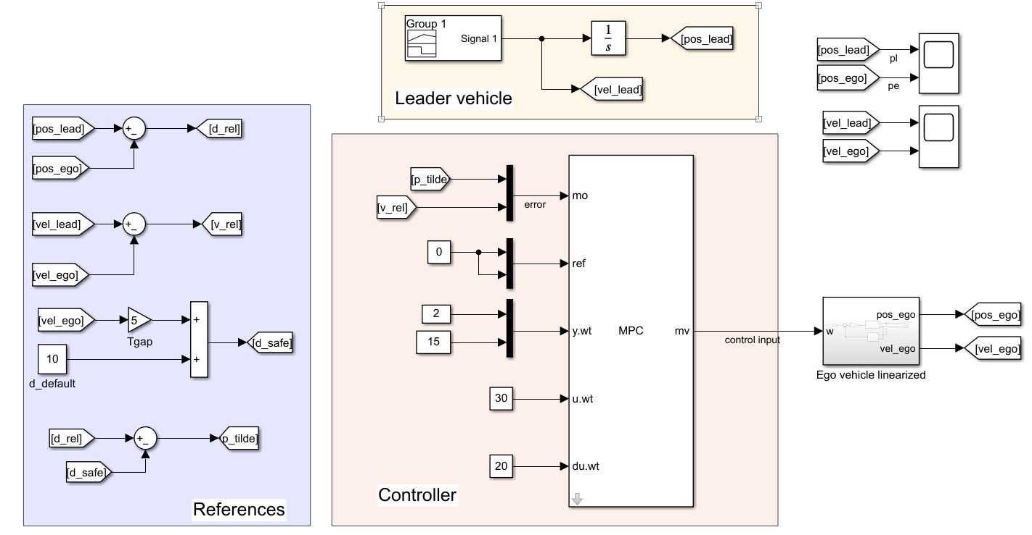



ACC with MPC: 1º case
11/20

Slide 13
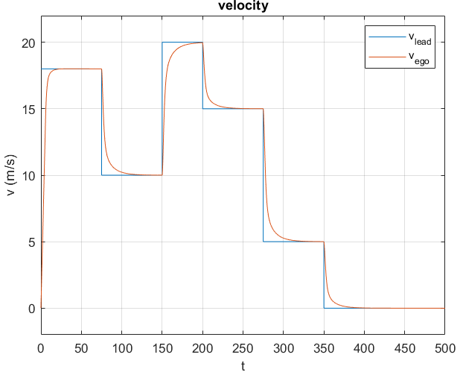
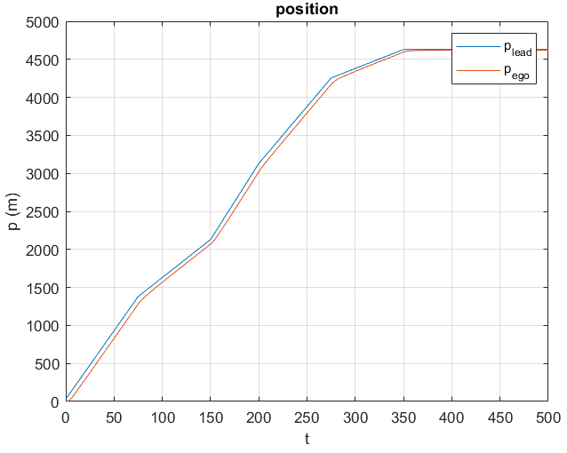
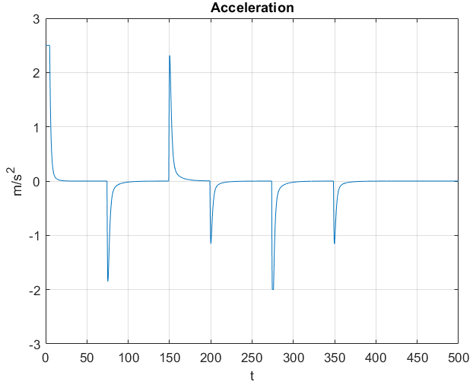
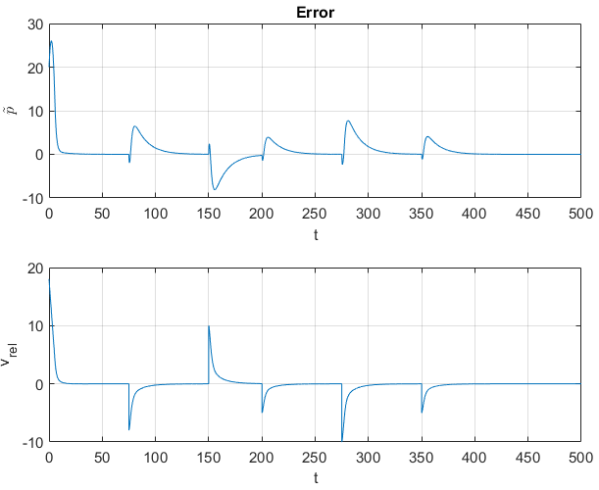
Results
12/20

Slide 14
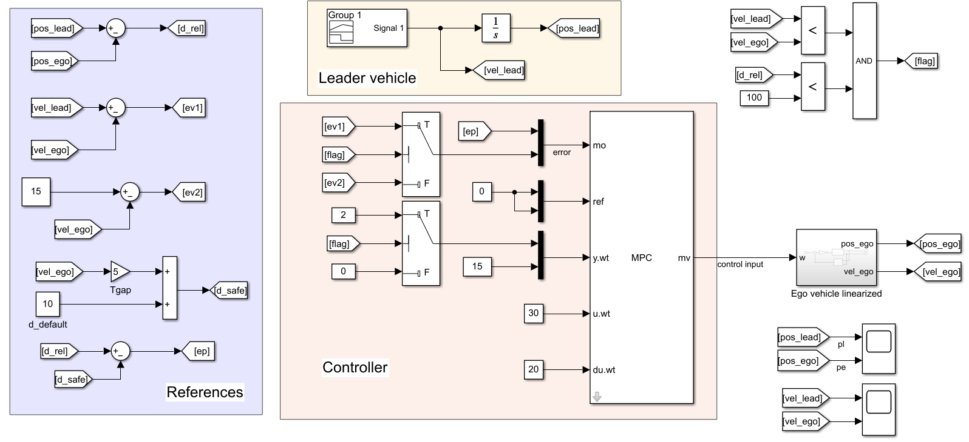
ACC with MPC: 2º case
13/20

Slide 15
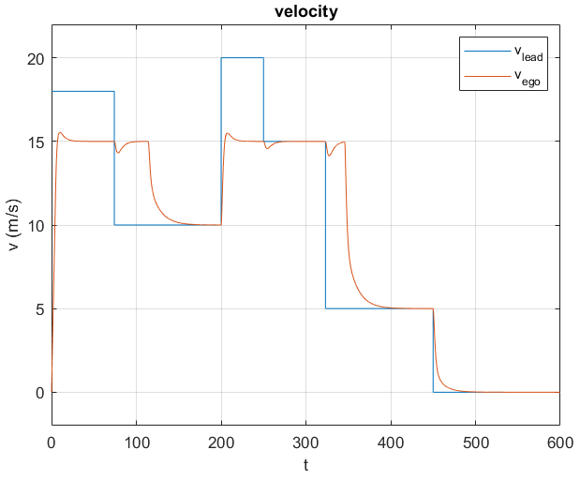
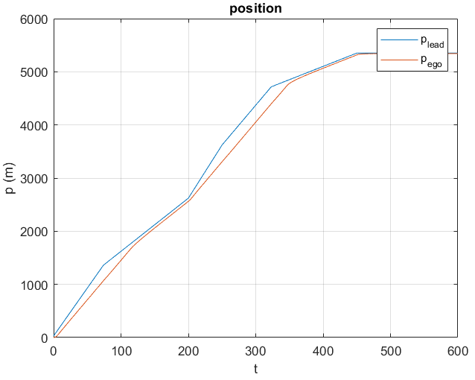
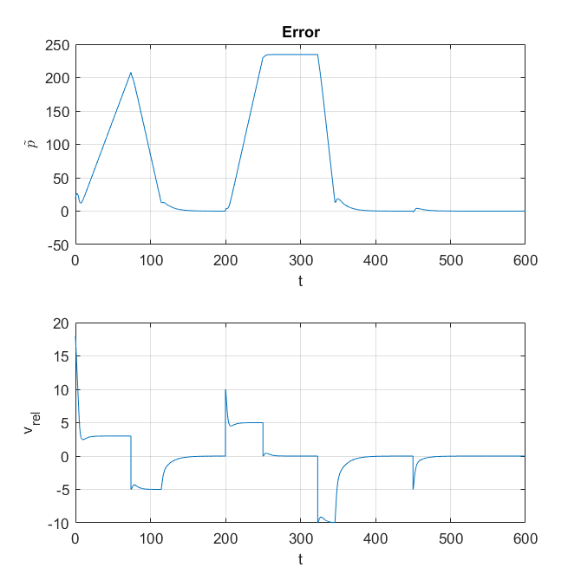
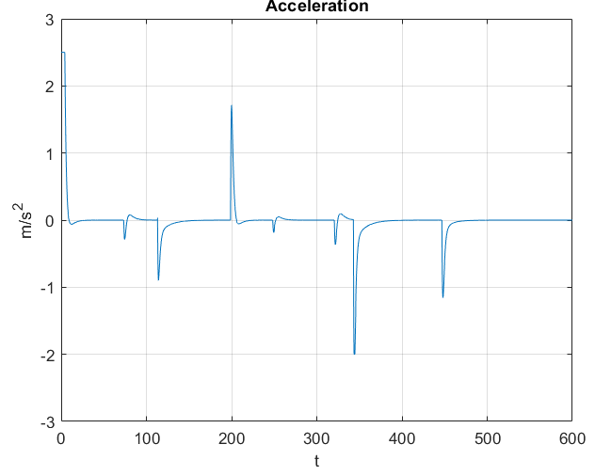
Results
14/20

Slide 16
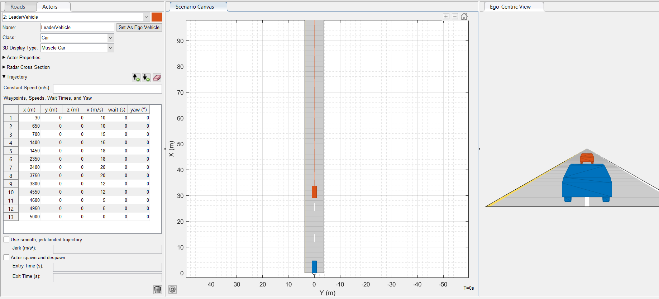
Driving Scenario
Leader Vehicle
RSU
Ego Vehicle
15/20

Slide 17
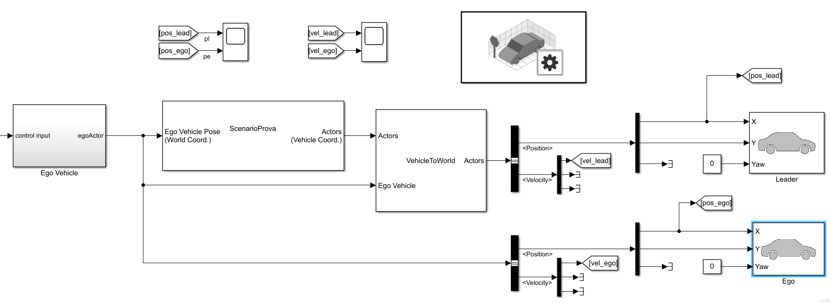
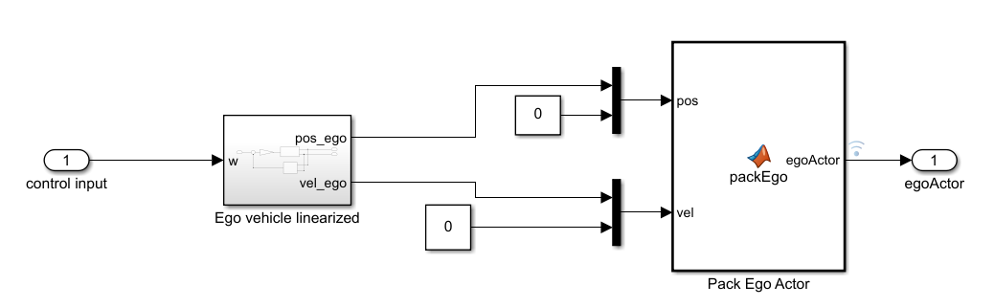
Test with Automated Driving Toolbox
16/20

Slide 18
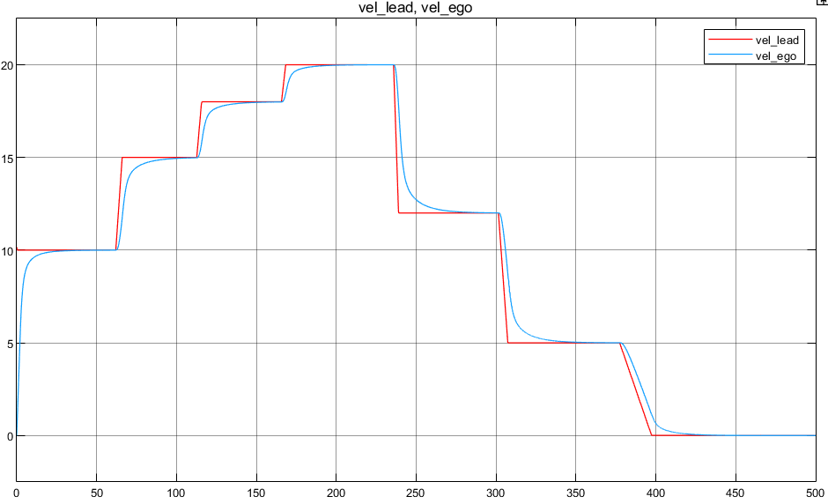



Results
17/20

Slide 19

Robustness to uncertainty parameters
18/20

Slide 20




Linear MPC on nonlinear model
19/20

Slide 21
Conclusion and future developments
First of all we have carried on an open loop analysis of the nonlinear model of the ego vehicle
Then we have done a closed loop analysis specifying control requirements and designing different control strategies and considering different cases
After that we’ve validated such controllers exploiting Automated Driving Toolbox, so considering the leader vehicle provided from such toolbox
Finally we have led an analysis about robustness to parameters uncertainty on the controller designed
As future development, an idea could be designing an adaptive model predictive controller because of variation of some parameters, and nonlinear model predictive controller.
20/20

