Slide 1

DIPARTIMENTO DI INGEGNERIA ELETTRICA E TECNOLOGIE DELL’INFORMAZIONE
SCUOLA POLITECNICA E DELLE SCIENZE DI BASE
CONTROL SYSTEMS OF AUTONOMOUS GROUND VEHICLES
Design of Autonomous Vehicles Control under Variable Speed Limit (VLS) system
Candidato: Ciro Arena P38/53
Ch.mo Prof.re: Stefania Santini
Anno Accademico 2022/23

Slide 2
OUTLINE
Simulink model
Open loop analysis
ADAS designing
Feedback Linearization control law
ACC with PID
Results
ACC with MPC
Results
Driving Scenario
1/12

Slide 3
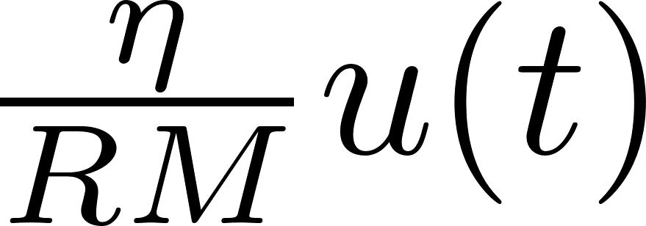

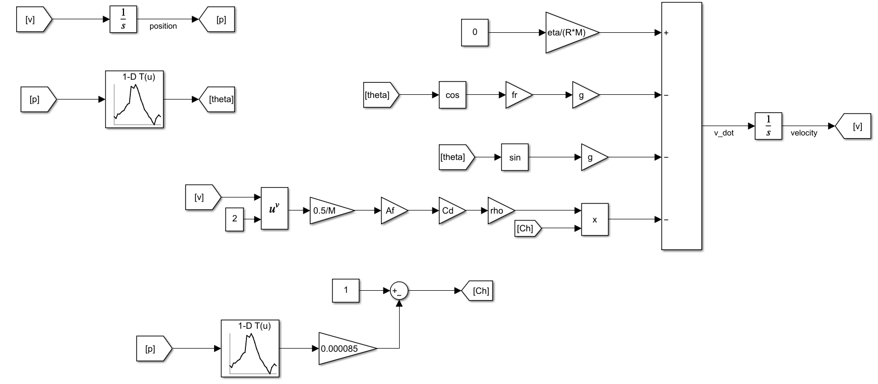



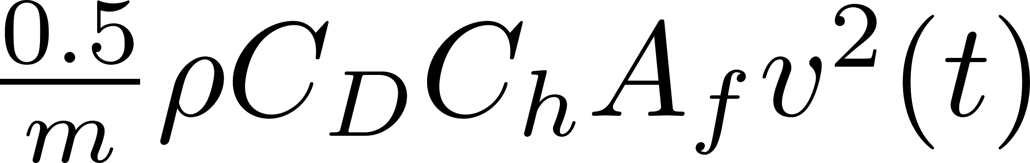
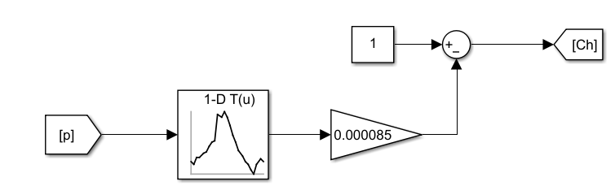

Simulink model
2/12

Slide 4
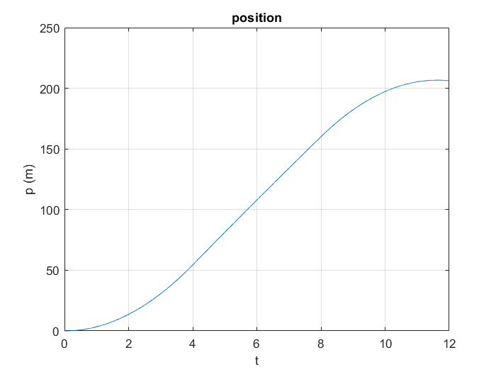
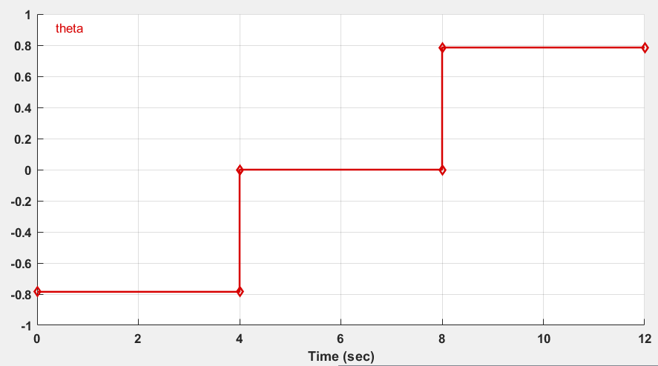
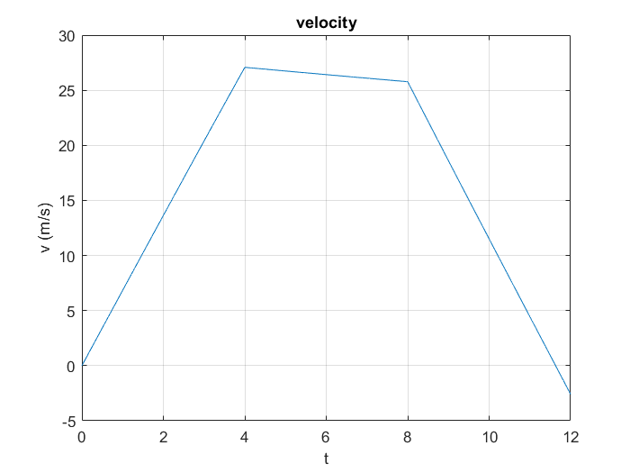
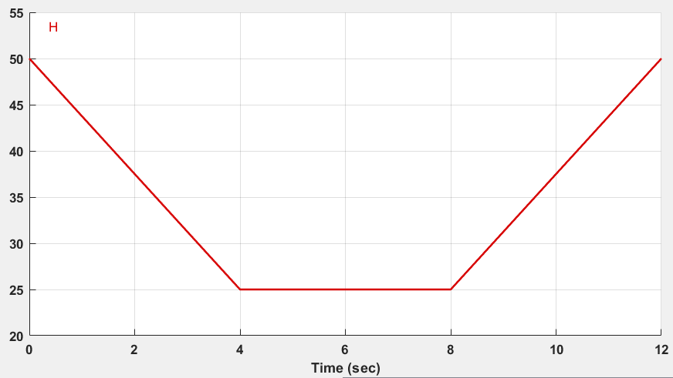
Open loop analysis (1)
Zero input and zero initial condition

Slide 5
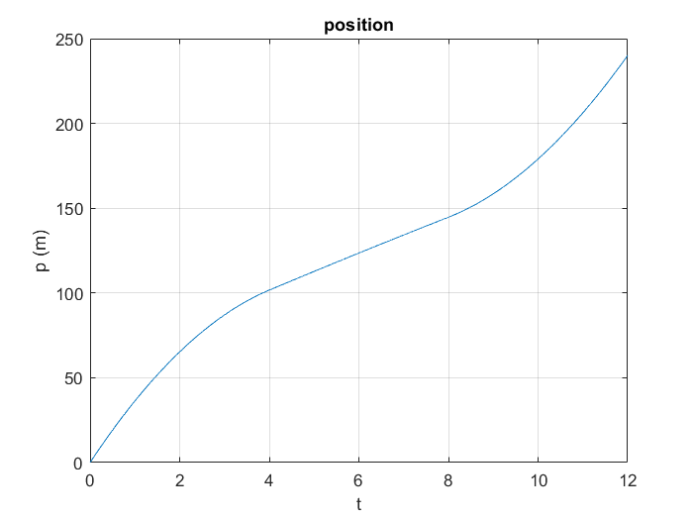

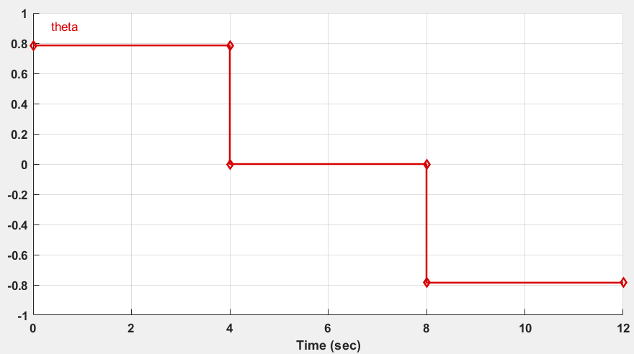
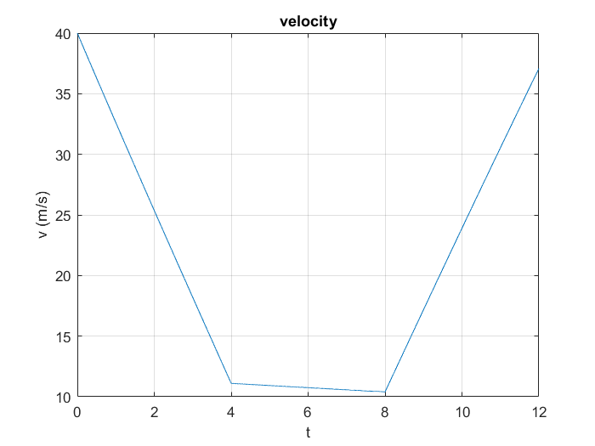
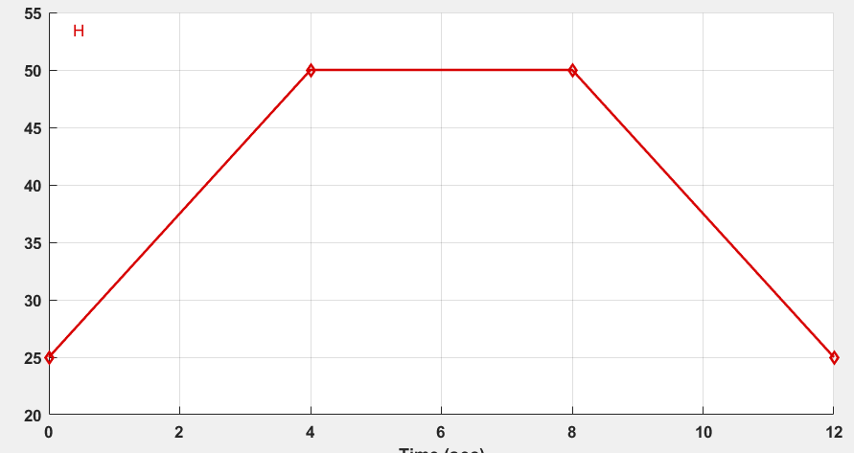
Open loop analysis (2)
Zero input and initial condition

Slide 6

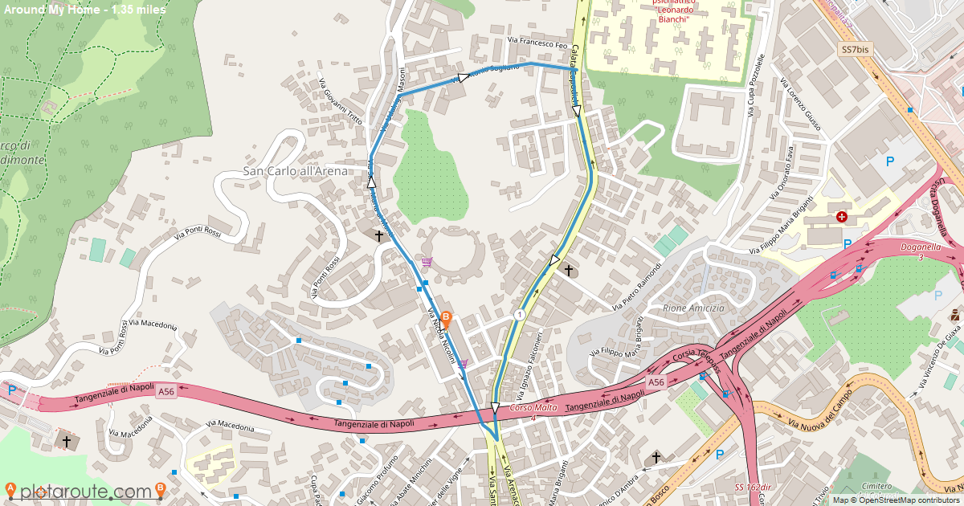
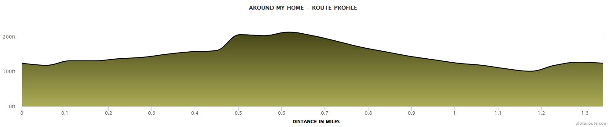
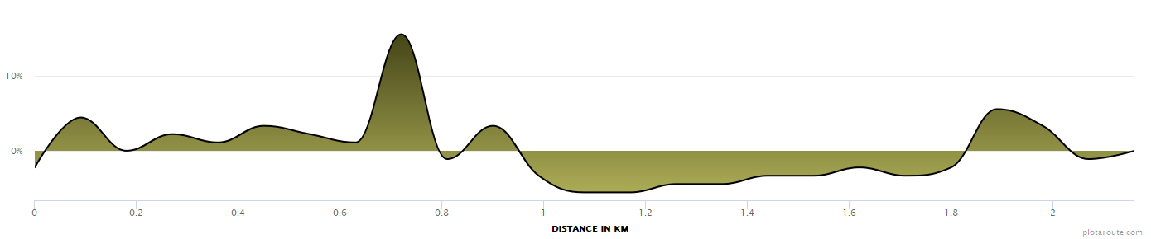


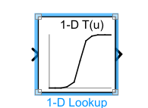

Open loop analysis (3)
https://www.plotaroute.com/route/2157148
readmatrix()

Slide 7
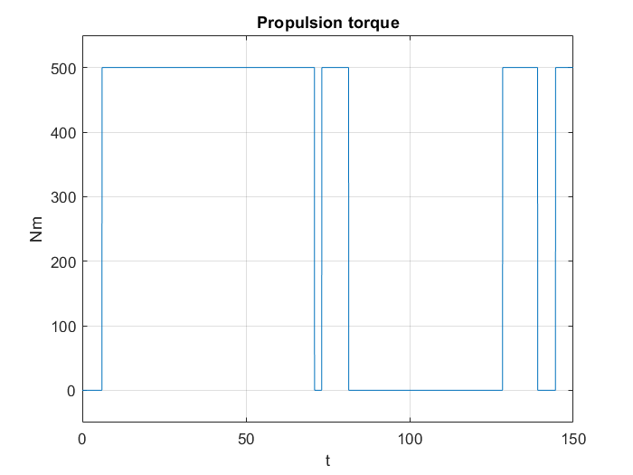
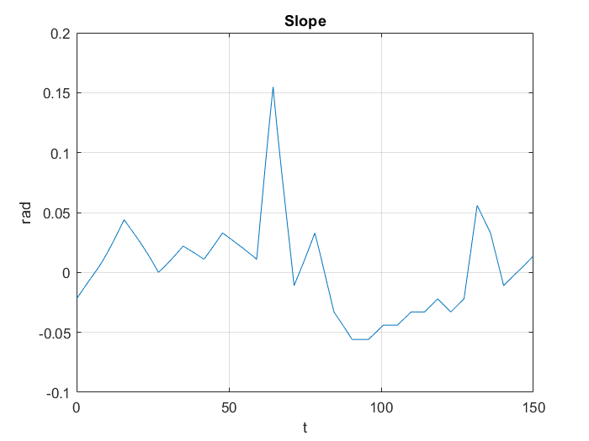
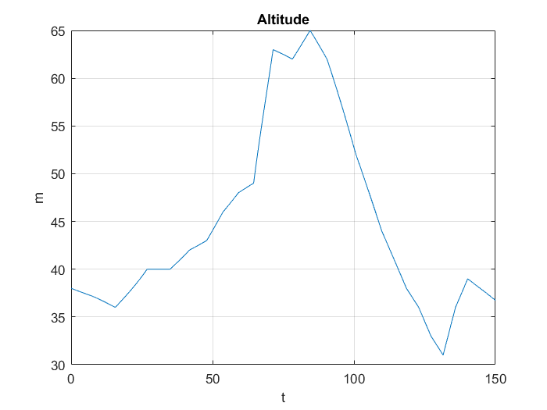
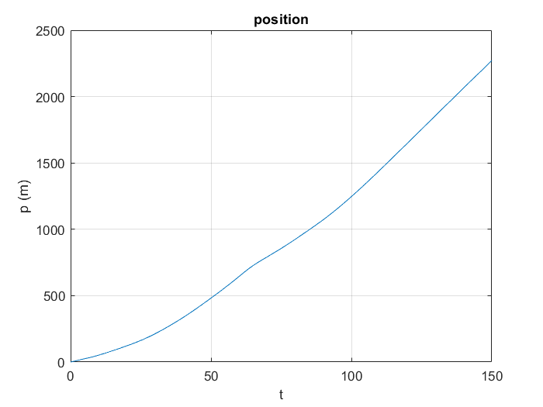
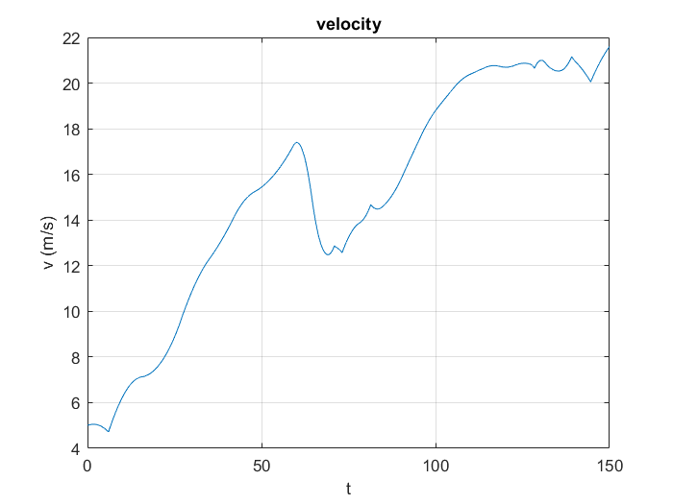
Open loop analysis (4)

Slide 8
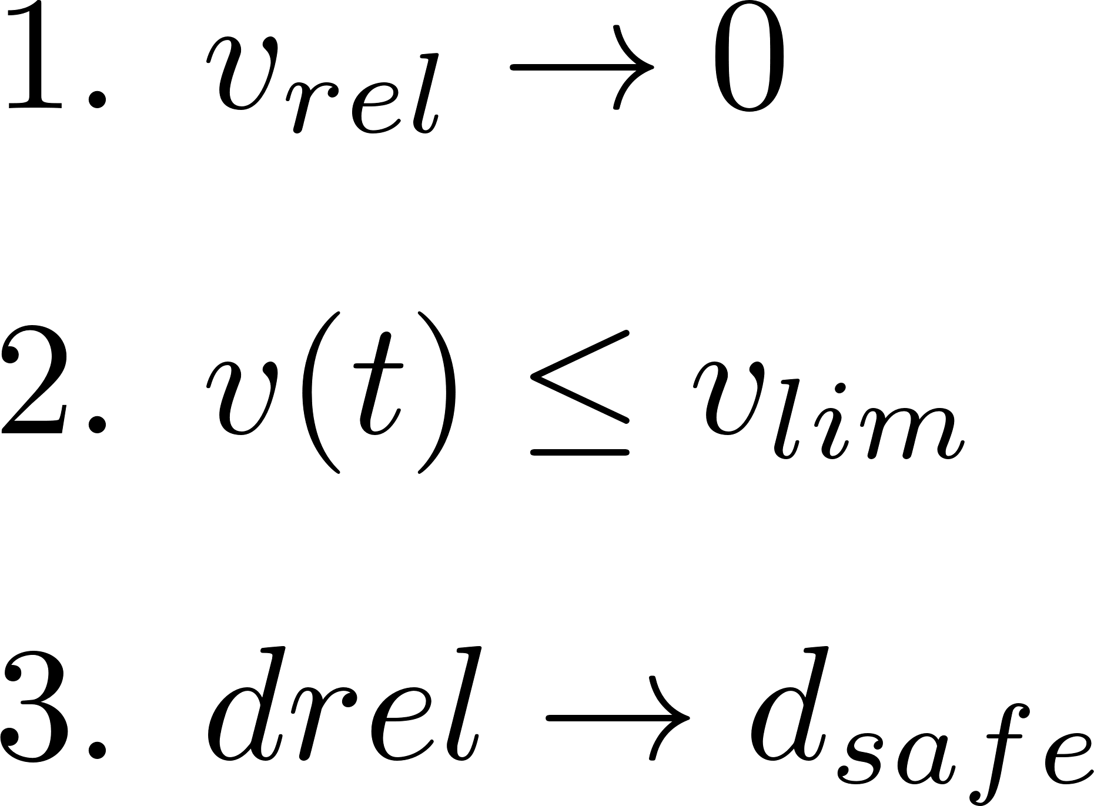


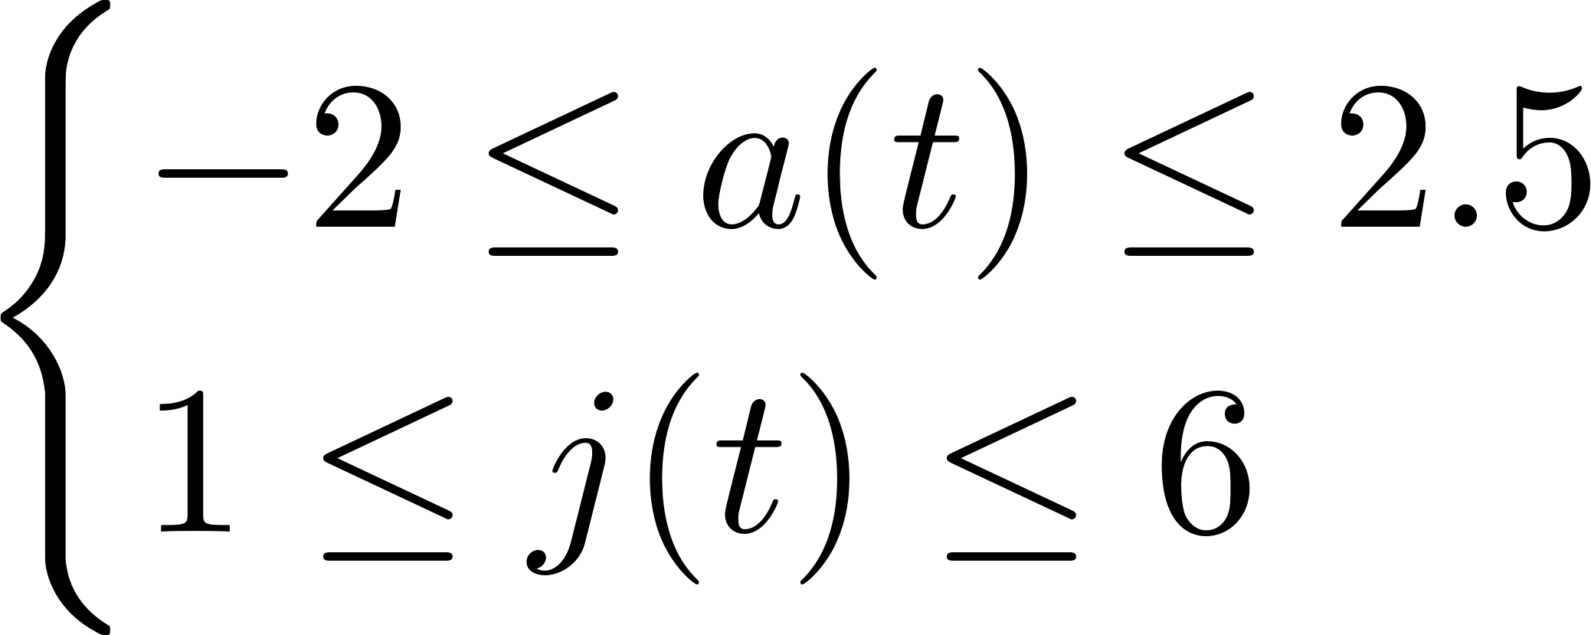

ADAS Designing
The aim is to design an ADAS system in a such a way that
PID
ACC
MPC
Limit velocity:
Constraints: Driving Comfort

Slide 9

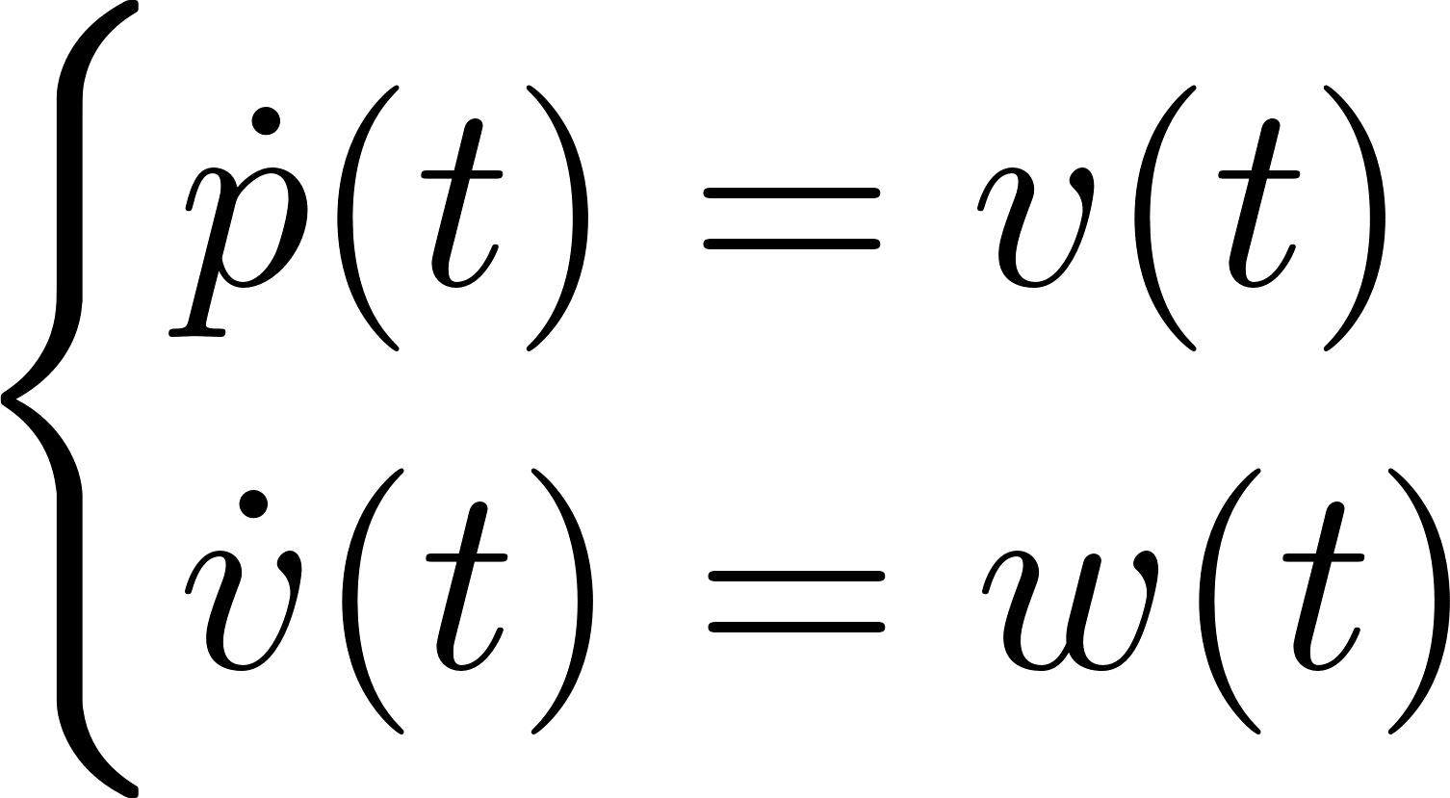
ADAS Designing: Feedback Linearization
NONLINEAR MODEL
CONTROL LAW
LINEARIZED MODEL

Slide 10
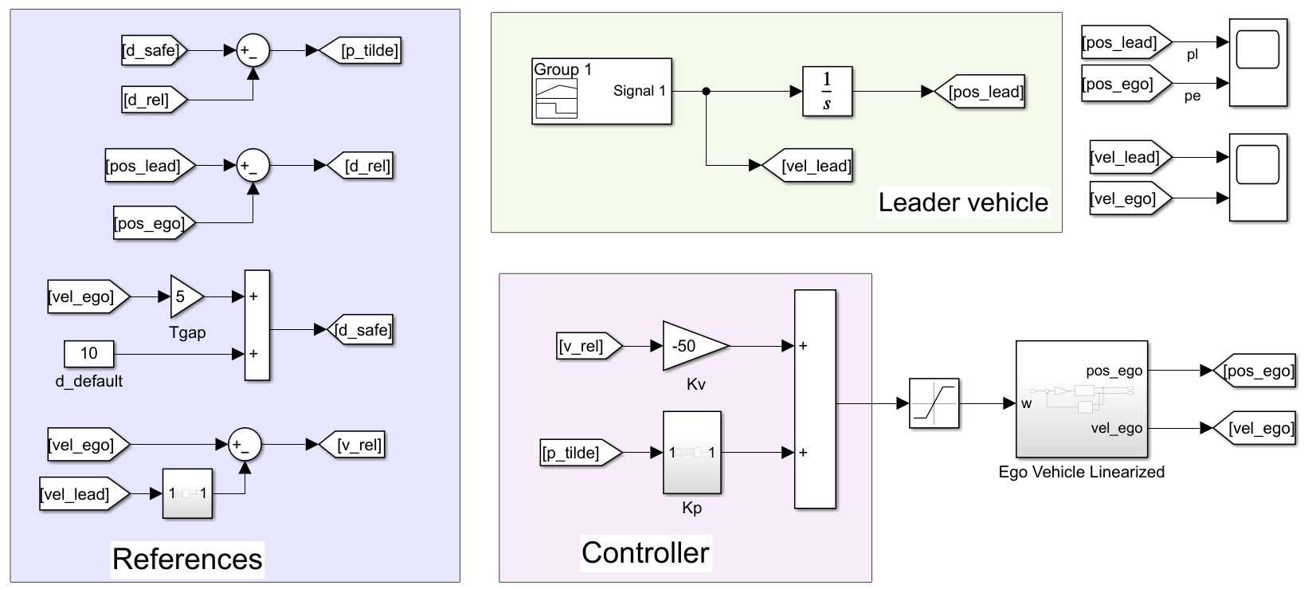
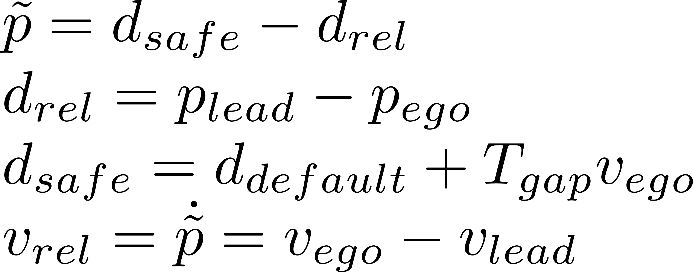
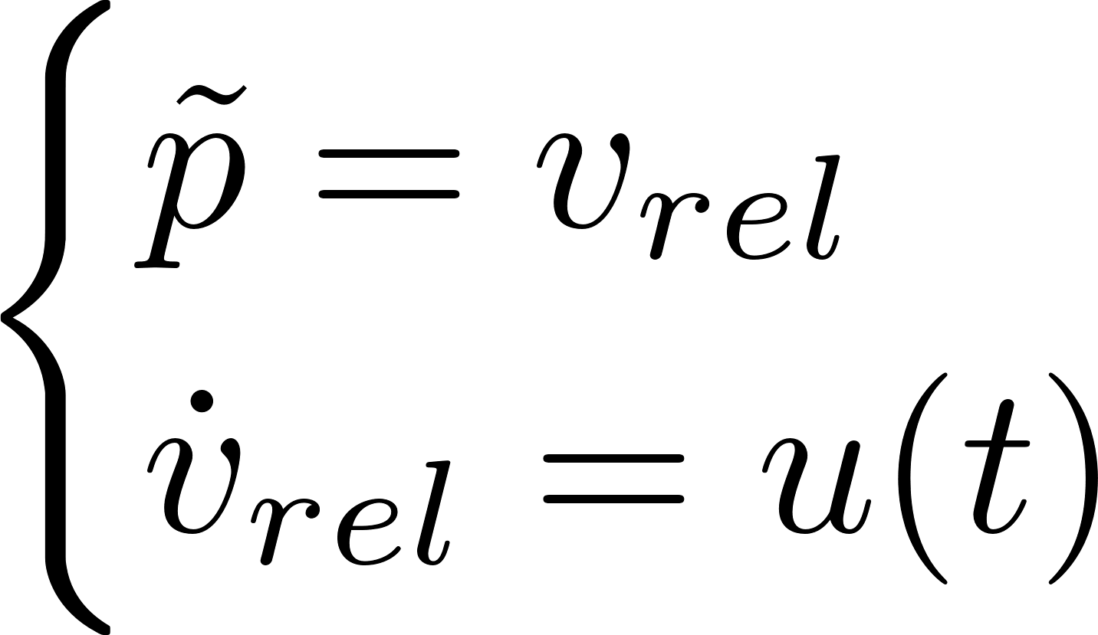
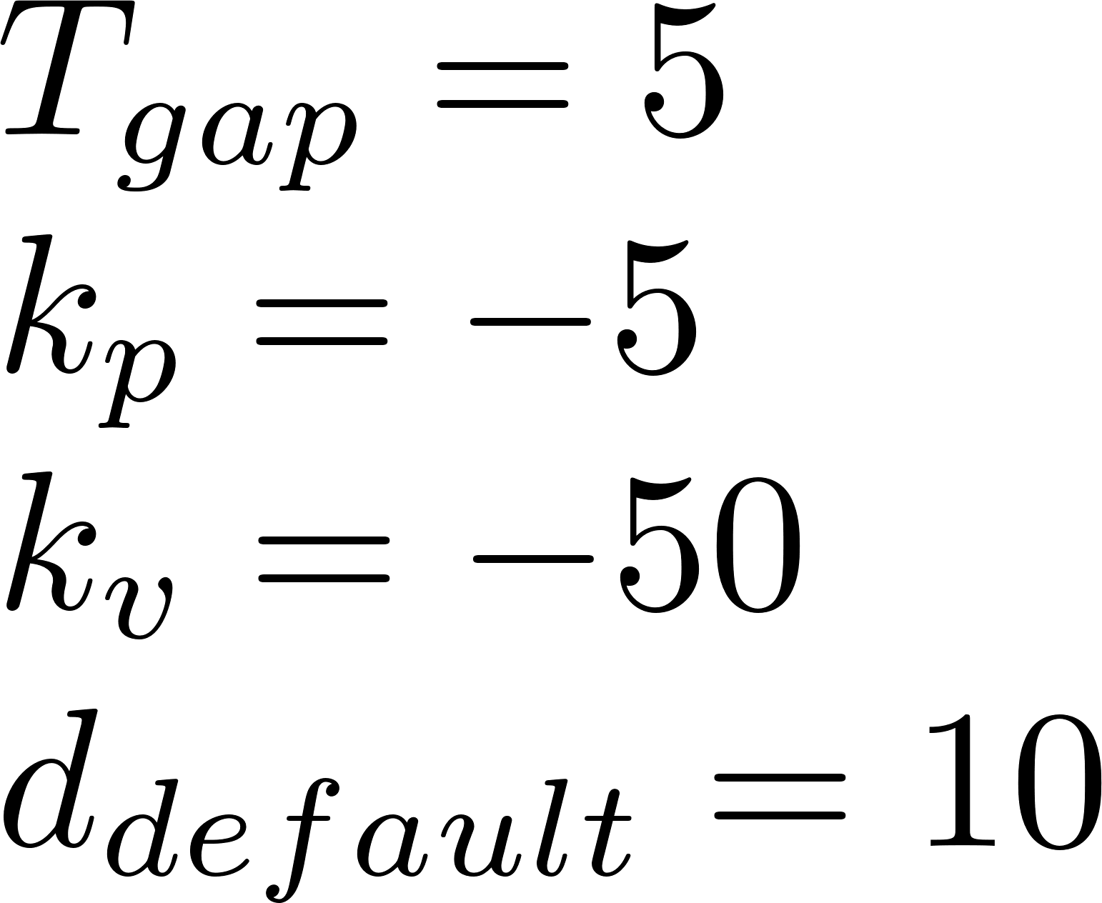
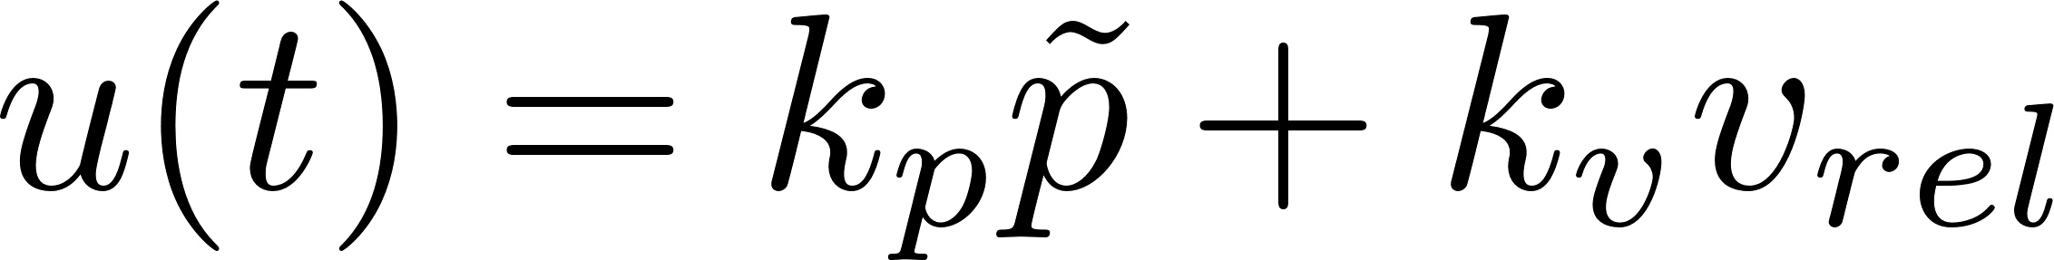
ADAS Designing: ACC with PID

Slide 11
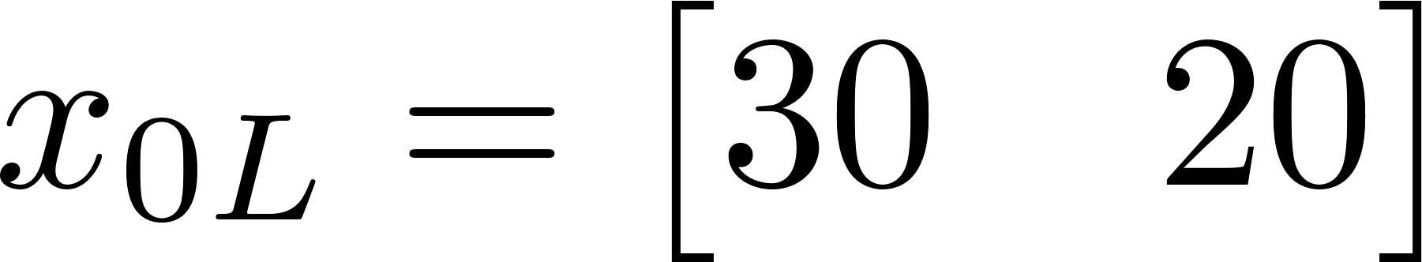
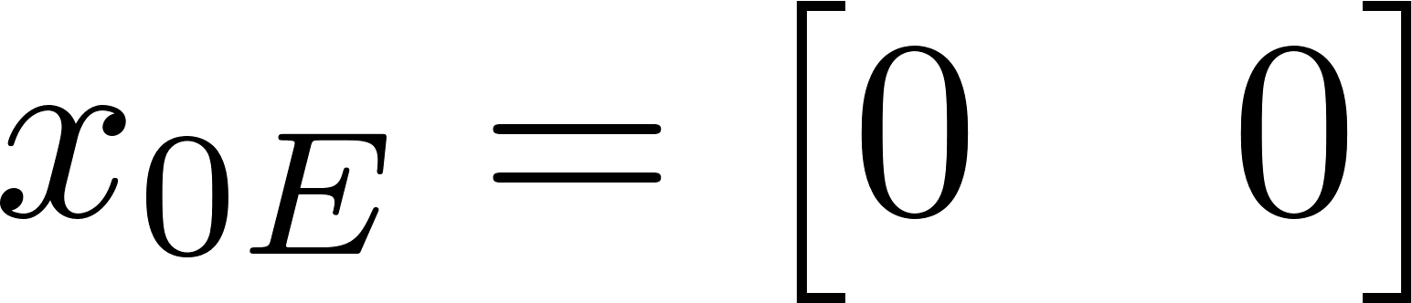
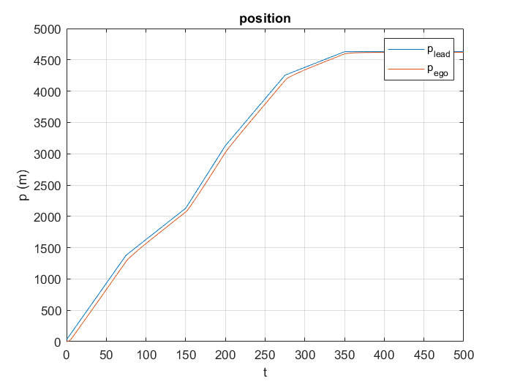
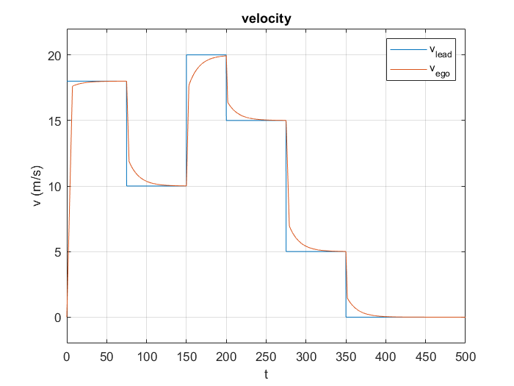
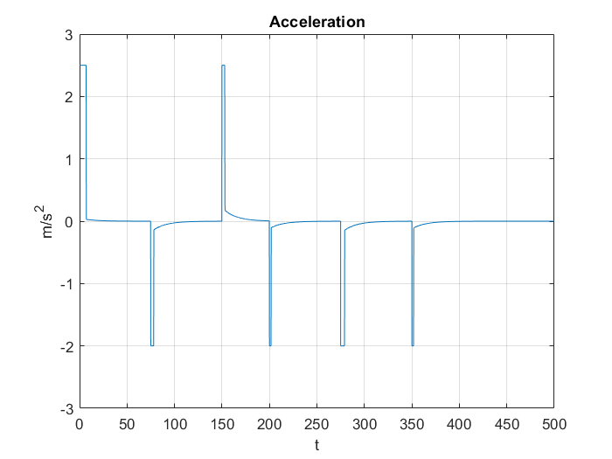
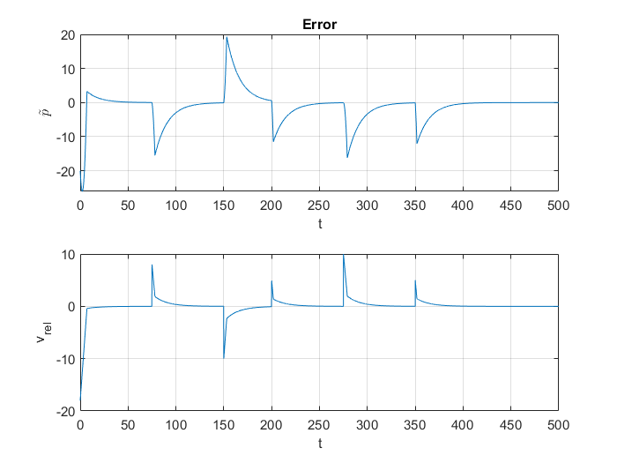
Results

Slide 12
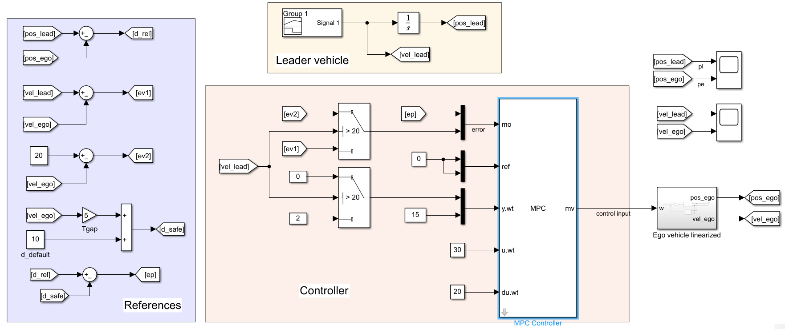
ADAS Designing: ACC with MPC

Slide 13
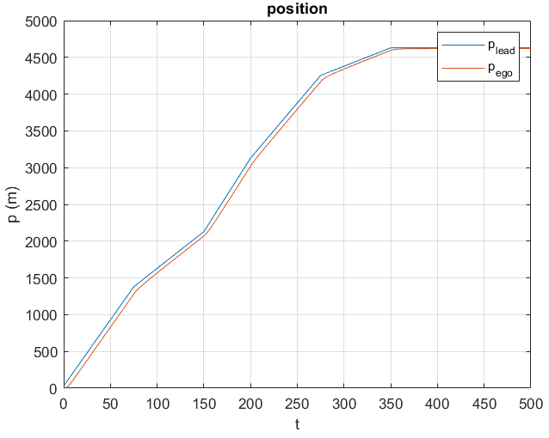
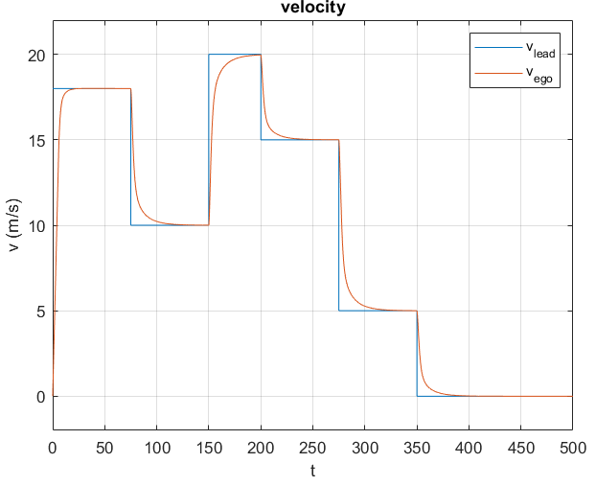
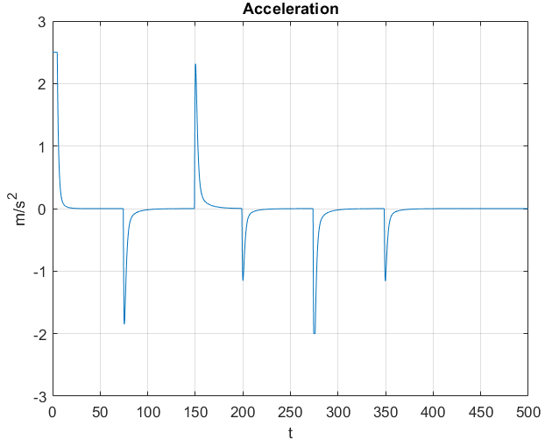
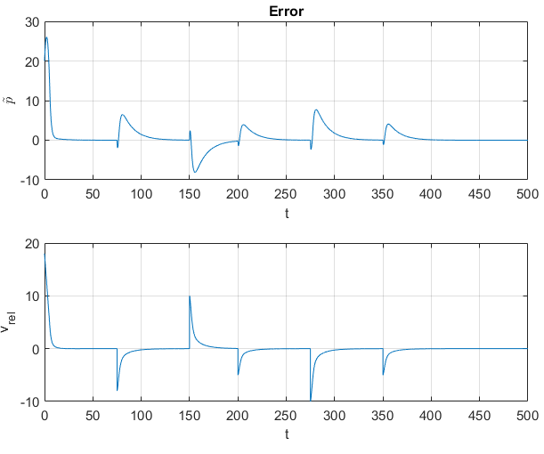
Results

Slide 14
Driving Scenario

