Slide 1

Evaluation of HTTP/3 for Media Streaming
Philip Nys | Open Distributed Systems | Workshop 1 | May 23rd 2023

Slide 2
Overview
Problem Statement
HTTP/3 – What is new?
Comparision TCP vs QUIC
Potential Solution / Concept
Next Steps
References

Slide 3
Problem Statement
Media Streaming makes up the majority of all Internet traffic
In 2017: 72% ^{[1]}
HTTP/3 aims to reduce latency, head of line (HOL) blocking and improve the user experience
Better stream multiplexing
Faster verification handshake ^{[2]}
Notes:
In 2017 about 72% of all internet traffic was was used up by media streaming and HTTP/3 aims to improve several things.
- reduce latency, by speeding up the initial handshake
- reduce head of line blocking, through better stream multiplexing
- improve the user experience in general

Slide 4
HTTP/3 – What is new?
Standardization of QUIC as version 3 of HTTP
QUIC made by Google
Relies on UDP + TLS
Error correction through retransmission
Allows bidirectional communitcation
Utilizes streams
Supports multiple streams through multiplexing
Uses WebTransport client-side, similar to WebSockets
Notes:
At the core of HTTP/3 is QUIC, a internet connection protocol designed by Google about 10 years.
In comparsion to previous HTTP Version 1.1 and 2, which use the well established Transmission Control Protocol TCP, QUIC uses the User Datagram Protocol UDP, always with TLS encryption.
One improvement QUIC introduces over the usually unreliable UDP, is error detection and correction by retransmitting faulty packages.
Additionally HTTP/3 communicate over streams, which allows not only bidrectional communication, but also allows the server to push data to the client, as well as maintaining several streams at the same time.
On the client side HTTP/3 uses WebTransport to establish connections to servers. WebTransport is a similar API to WebSockets.

Slide 5
Comparision TCP vs QUIC
TCP + TLS | QUIC ( UDP + TLS )
Slower handshake before receiving data | Faster handshake before receiving data
Client bears computational load | Computational load offloaded to server
Client polls data through requests | Data can be sent on uni-/bidirectional streams
Encryption is optional (HTTPS used by 82.7%) | Always encrypted (HTTPS)
Notes:
Comparing TCP and QUIC:
Biggest selling point: QUIC has a much faster handshake than TCP, achieves that by exchanging the TLS keys and supported protocols in the same opening message rather than one after the other, more on that on the next slide
Furthermore since QUIC allows the server to push data to client instead of the client always having to request data, QUIC allows the computational to be offloaded to a server rather than the client having to do all of it.
This has multiple advantages:
- enables lower end devices to perform more effitient
- reduces required bandwidth by essentially eliminated any message from client to server -> client establishes WebTransport and server starts push data
As alluded before the client no longer needs to send request every segment by itself rather the segments are pushed by the server to the client.
Finally QUIC mandates encryption through TLS, while it‘s optional with TCP there are over 80% of all websites using HTTPS.

Slide 6
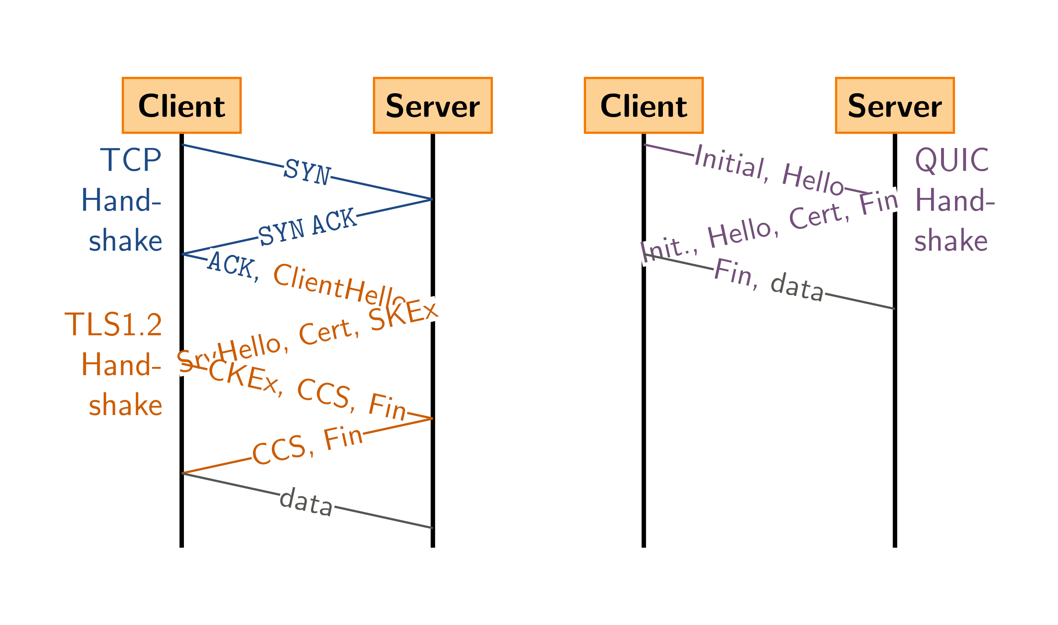
Comparision TCP vs QUIC
Handshakes
TCP + TLS
QUIC
https://commons.wikimedia.org/wiki/File:Tcp-vs-quic-handshake.svg#/media/File:Tcp-vs-quic-handshake.svg
Notes:
Describe image….

Slide 7
Potential Solution / Concept
There have been 3 standards proposed:
RUSH by Facebook ^{[3]}
WARP by Twitch ^{[4]}
QUICR by Cisco ^{[5]}
Notes:
In context of this project we‘ll be taking a look at three standard propositions.
These consist of
- RUSH designed by Facebook with live video streaming as intended use case.
- WARP made by Twitch with low latency live streaming in mind.
- QUICR by Cisco being intended as universal delivery protocol intended for wide range of applications, including ultra low latency interactions, like video conferencing and multiplayer video games.

Slide 8
Next Steps
Our goal is to evaluate these propositions and potenially make adjustments to them.
Setting up RUSH, WARP, QUICR
Evaluating the performance in their current state
Possibly make adjustments and evaluate again
Compile results and final report
Notes:
Our goal is to evaluate the previously mentioned protocols and if needed make adjustments to them.
We will start by setting up RUSH, WARP and QUIC.
Followed by evaluating their performance in the current state they are in.
Then if needed we will be making adjustments to them and evaluate again.
Finally compile a project report with our findings.

Slide 9
References
[1] M. Nguyen, D. Lorenzi, F. Tashtarian, H. Hellwagner and C. Timmerer, "DoFP+: An HTTP/3-Based Adaptive Bitrate Approach Using Retransmission Techniques," in IEEE Access, vol. 10, pp. 109565-109579, 2022, doi: 10.1109/ACCESS.2022.3214827.
[2] Divyashri Bhat, Rajvardhan Deshmukh, and Michael Zink. 2018. Improving QoE of ABR Streaming Sessions through QUIC Retransmissions. In Proceedings of the 26th ACM international conference on Multimedia (MM '18). Association for Computing Machinery, New York, NY, USA, 1616–1624. DOI:https://doi.org/10.1145/3240508.3240664
[3] https://github.com/facebookexperimental/webcodecs-capture-play
[4] https://github.com/kixelated/warp
[5] https://github.com/Quicr/qmedia
[6] https://w3techs.com/technologies/details/ce-httpsdefault
Thank you for listening! Any questions?

