Slide 1
Camera response understanding
Spectrograph

Slide 2
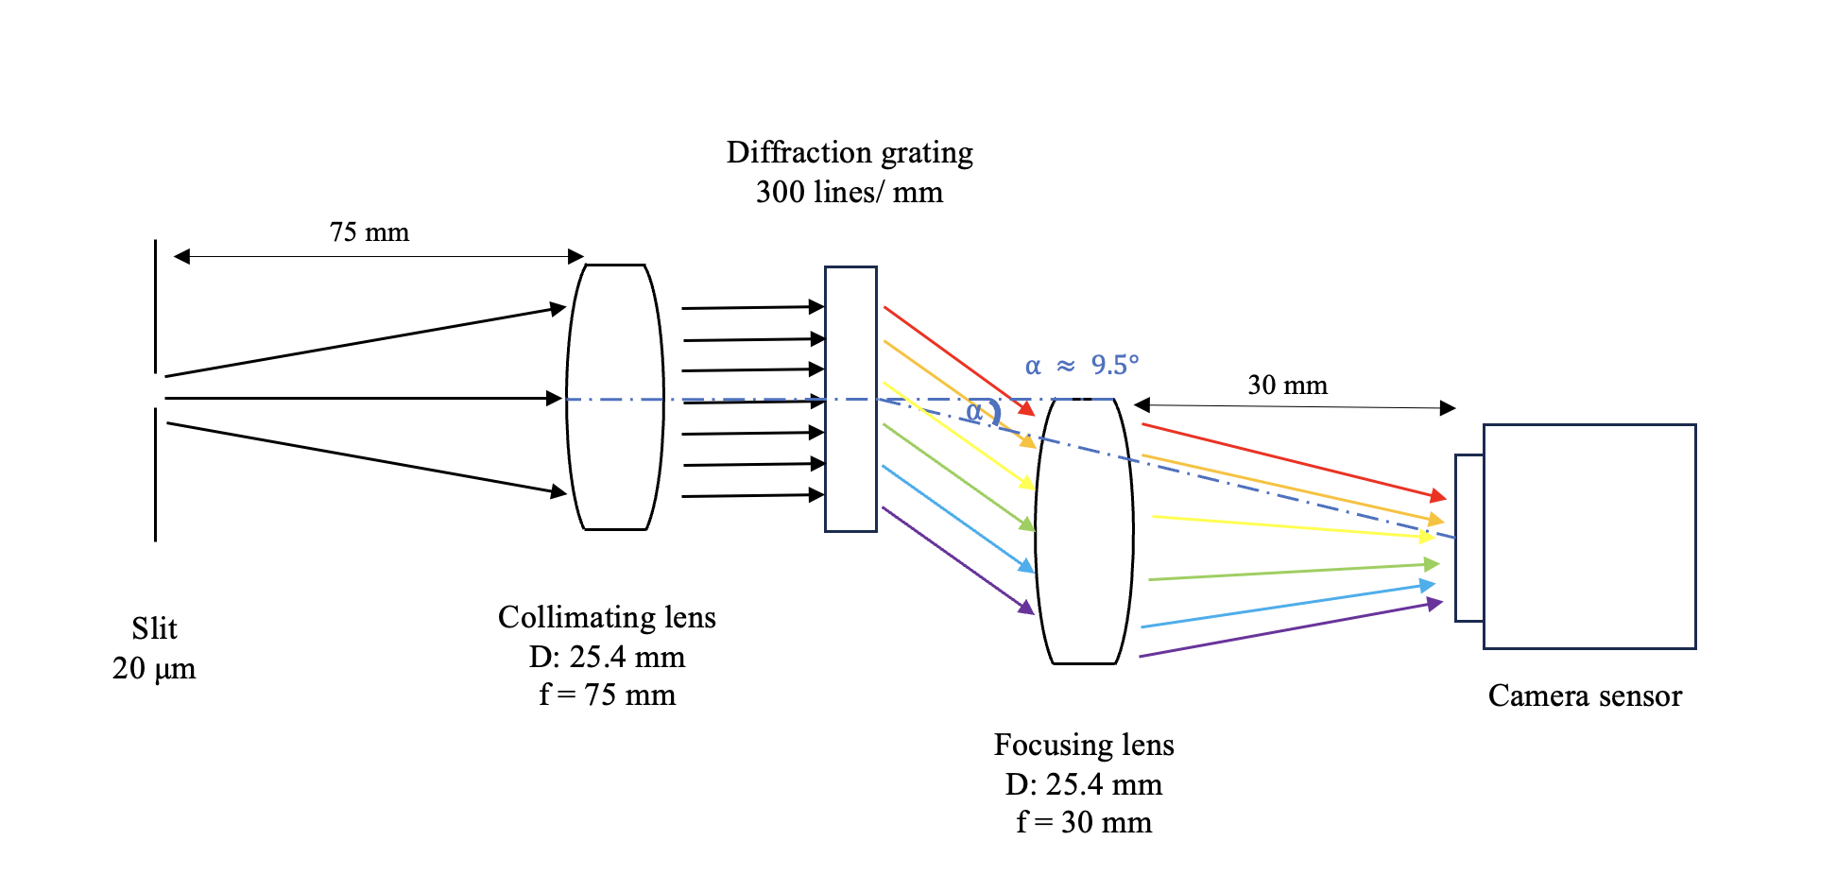
Experimental setup

Slide 3
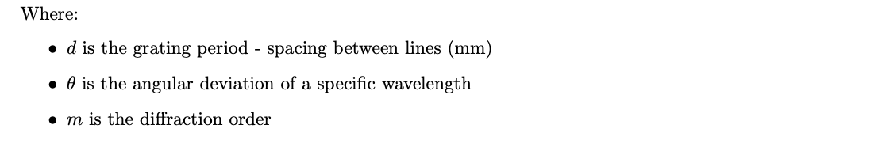

Grating equation
$$d\sin{θ}=m λ$$

Slide 4

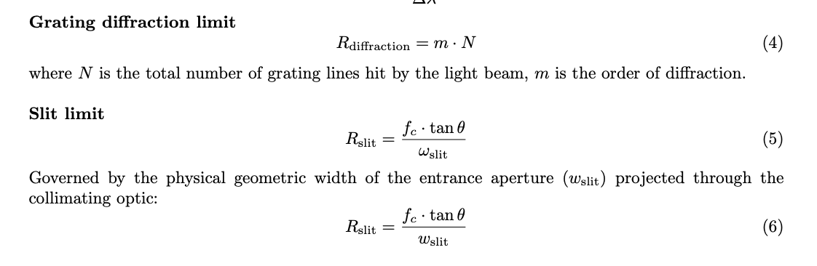
Resolving power
The capacity of an instrument to resolve two points which are close together

Slide 5
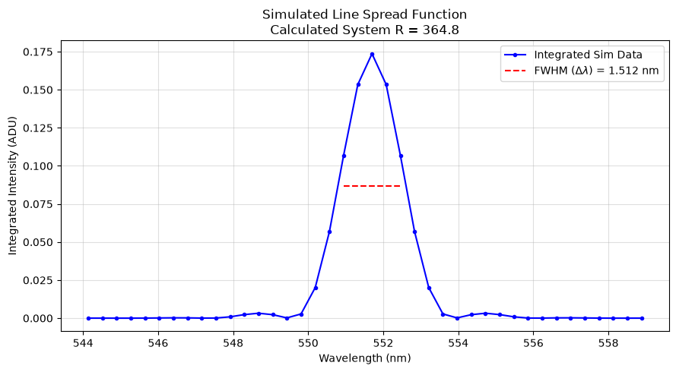
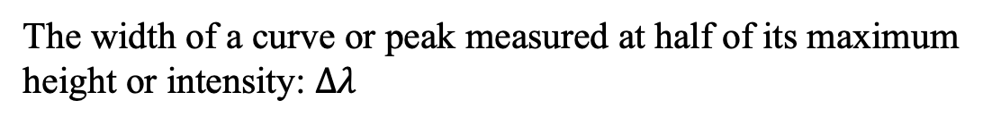
FWHM (full width at half-maximum)
The width of a curve or peak measured at half of its maximum height or intensity: $∆λ$

Slide 6

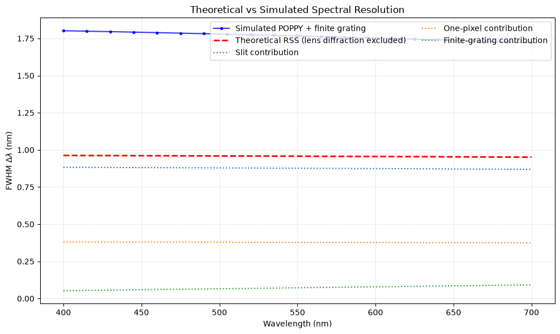
Net resolution of optical system:
Convolving different independent distributions, assuming the final shape to be a Gaussian distribution:

